Slide 1

16 Memory
Peter H. Chen

Slide 2
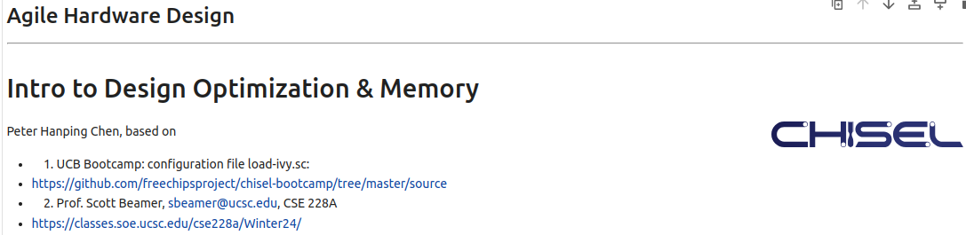
16 Memory
https://www.youtube.com/watch?v=GIW1GxIfwAU&list=PLfrN7RIcMe6g2LBRJLTHTdhyj5s8ag0Rg&index=16
Network (0:00-0:01/57:23)
We used UCB bootcamp configuration file (load_ivy.sc)
source/load-ivy.sc (https://github.com/freechipsproject/chisel-bootcamp)

Slide 3
16 Memory
https://www.youtube.com/watch?v=GIW1GxIfwAU&list=PLfrN7RIcMe6g2LBRJLTHTdhyj5s8ag0Rg&index=16
Network (0:02-0:45/57:23)
We discuss Network (Crossbar, Ring Network, Torus Network) Design.
Topics:
1. Setup: jupyter notebook, select scala, and run cells.

Slide 4
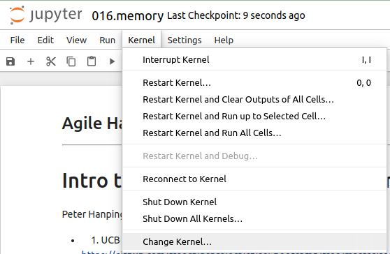
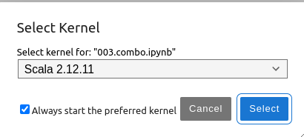
16 Memory
https://www.youtube.com/watch?v=GIW1GxIfwAU&list=PLfrN7RIcMe6g2LBRJLTHTdhyj5s8ag0Rg&index=16
Network (0:03-1:08/57:23)
We discuss Chisel Collection.
> jupyter notebook 016.network.ipynb > Kernel > Change Kernel … > Select Scala2.21.22
> Run All Cells

Slide 5
16.1 Plan

Slide 6
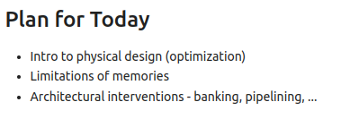
16.1 Plan
https://www.youtube.com/watch?v=GIW1GxIfwAU&list=PLfrN7RIcMe6g2LBRJLTHTdhyj5s8ag0Rg&index=16
Plan (1:09-1:25/57:23)
Today, we talk
1. Physical design optimization.
2. Memory limitation
3. Architectural intervention.

Slide 7
16.2 Why Optimize Physical Design?

Slide 8
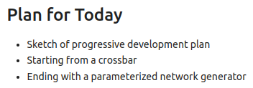
16.2 Why Optimize Physical Design?
https://www.youtube.com/watch?v=GIW1GxIfwAU&list=PLfrN7RIcMe6g2LBRJLTHTdhyj5s8ag0Rg&index=16
Why Optimize Physical Design? (1:26-2:10/57:23)
Today, we talk about Network.

Slide 9
End

