Slide 1

1 Scale to Verilog
Peter H. Chen

Slide 2
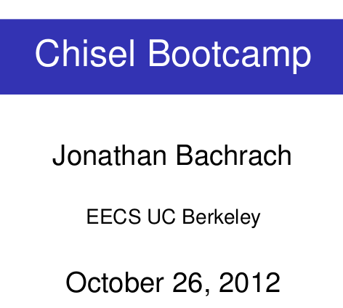
1 Scala to Verilog
https://www.youtube.com/watch?v=OPhFfNLcVsI&list=PLlu0CT-JnSasfpk8tq1ZDiE2G0AK1BhOg&index=2
Scala to Verilog (0:00-2:57/1:05:46)
Chisel is a set of tools developed by UC Berkeley with Scala and produce Verilog: Chisel constructs the hardware primitives with the Scala. Designers write complex and parameters for circuits and use Chisel to produce synthesizable Verilog.
This Bootcamp material is provided by Jonathan Bachrach who is a faculty of UC Berkeley.
UC Berkeley started to work on Chisel since 4-5 years ago (2010-2011).
Related notes:
https://aspire.eecs.berkeley.edu/chisel-archive/bootcamp-20121026.pdf

Slide 3
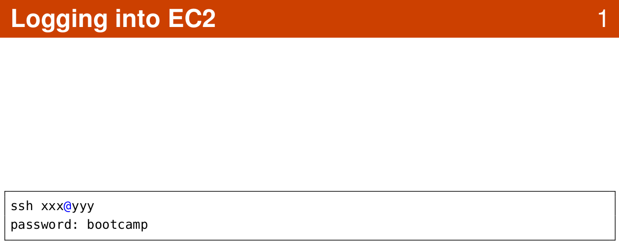
1 Chisel Bootcamp
https://www.youtube.com/watch?v=OPhFfNLcVsI&list=PLlu0CT-JnSasfpk8tq1ZDiE2G0AK1BhOg&index=2
Logging into EC2 (0:00-2:57/1:05:46)

Slide 4
1.1 User Screen

Slide 5
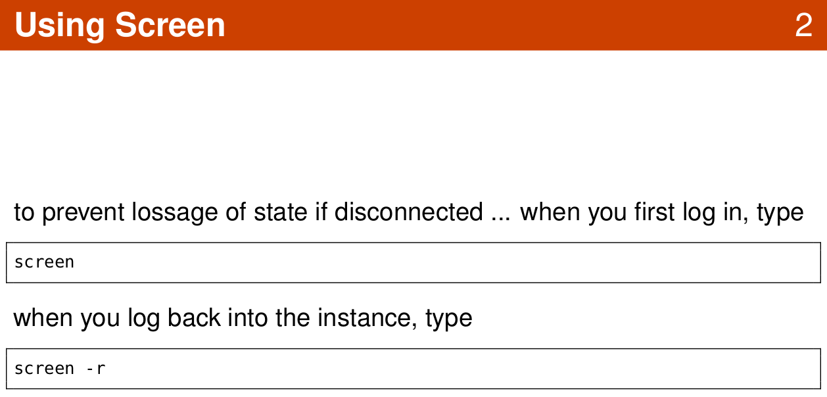
1.1 User Screen
https://www.youtube.com/watch?v=OPhFfNLcVsI&list=PLlu0CT-JnSasfpk8tq1ZDiE2G0AK1BhOg&index=2
Logging into EC2 (2:58-7:58/1:05:46)

Slide 6
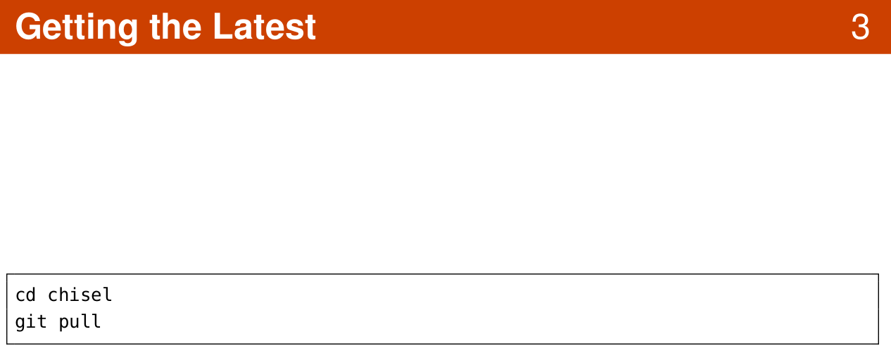
1.1 User Screen
https://www.youtube.com/watch?v=OPhFfNLcVsI&list=PLlu0CT-JnSasfpk8tq1ZDiE2G0AK1BhOg&index=2
Logging into EC2 (2:58-7:58/1:05:46)

Slide 7
1.2 Scala Programming

Slide 8
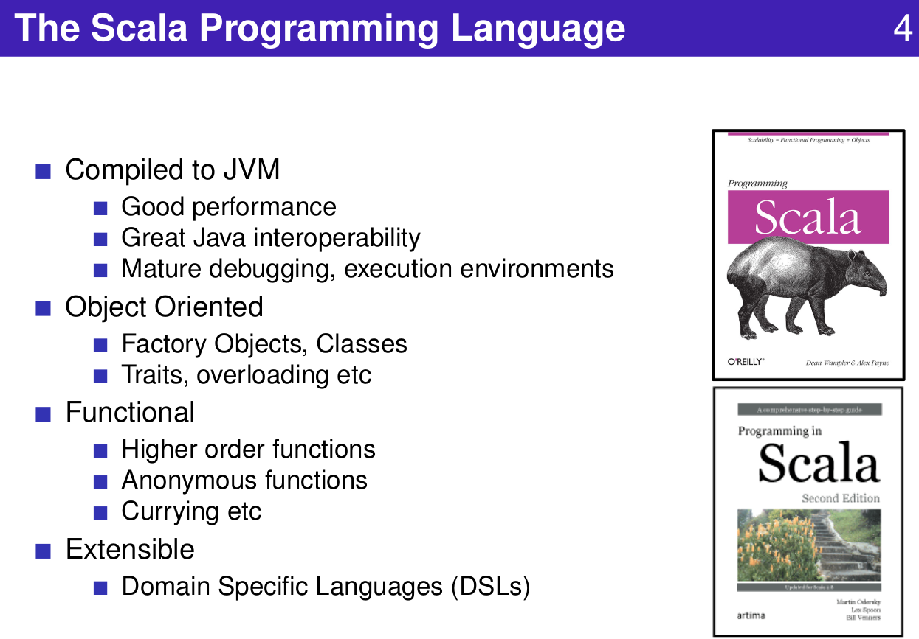
1.2 Scala Programming
https://www.youtube.com/watch?v=OPhFfNLcVsI&list=PLlu0CT-JnSasfpk8tq1ZDiE2G0AK1BhOg&index=2
Scala Programming (7:59-8:49/1:05:46)

Slide 9
End

