Slide 1

1.11 Define Function

Slide 2
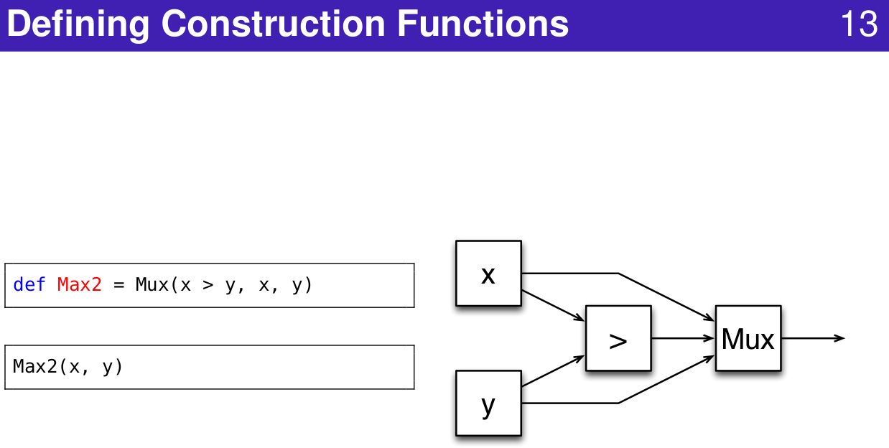
1.11 Define Function
https://www.youtube.com/watch?v=OPhFfNLcVsI&list=PLlu0CT-JnSasfpk8tq1ZDiE2G0AK1BhOg&index=2
Define Construct Function (20:44-21:03/1:05:46)

Slide 3
1.12 Functional Construction

Slide 4
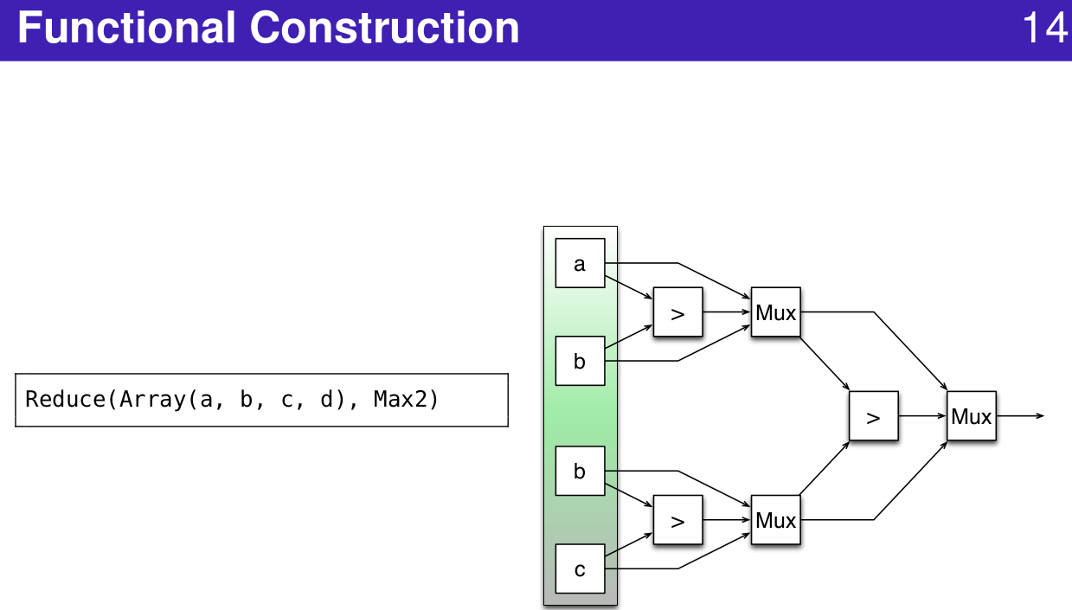
1.12 Functional Construction
https://www.youtube.com/watch?v=OPhFfNLcVsI&list=PLlu0CT-JnSasfpk8tq1ZDiE2G0AK1BhOg&index=2
Functional Construction (21:04-23:22/1:05:46)

Slide 5
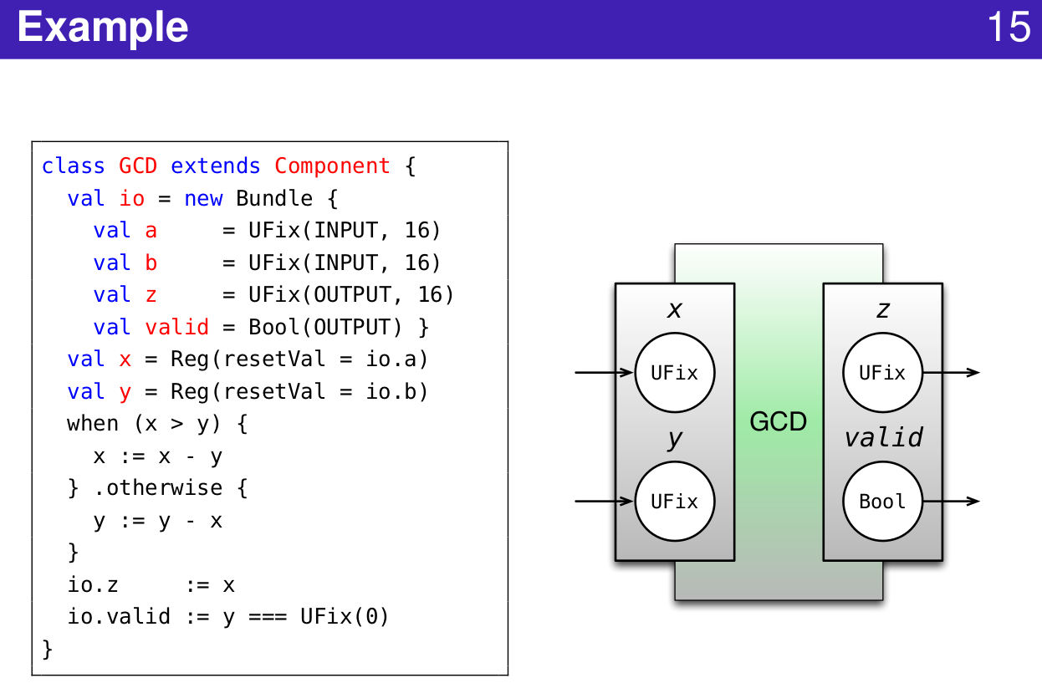
1.12 Functional Construction
https://www.youtube.com/watch?v=OPhFfNLcVsI&list=PLlu0CT-JnSasfpk8tq1ZDiE2G0AK1BhOg&index=2
Functional Construction Example (21:04-23:22/1:05:46)

Slide 6
1.13 Data Type

Slide 7
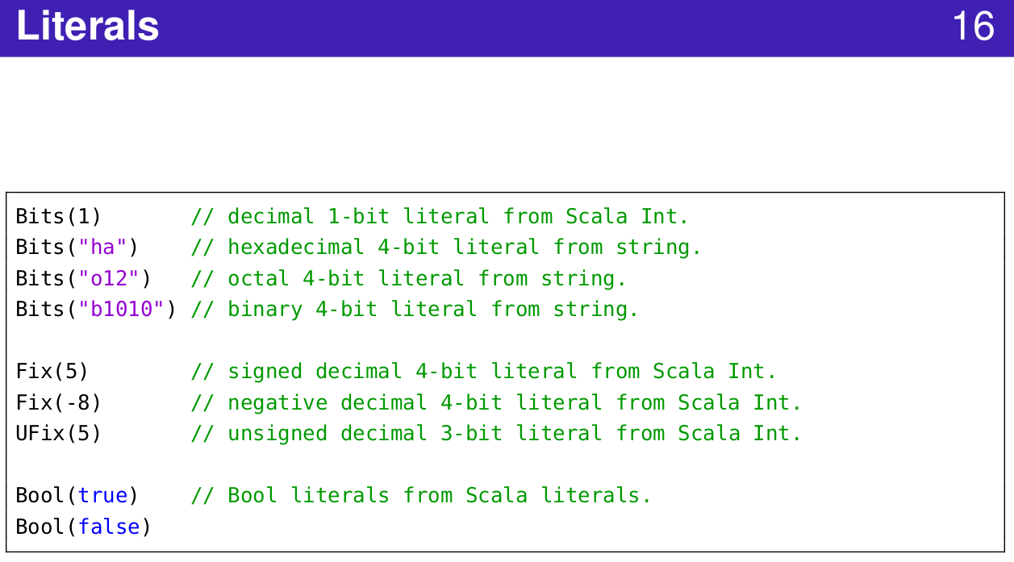
1.13 Data Type
https://www.youtube.com/watch?v=OPhFfNLcVsI&list=PLlu0CT-JnSasfpk8tq1ZDiE2G0AK1BhOg&index=2
Literals (21:04-23:22/1:05:46)

Slide 8
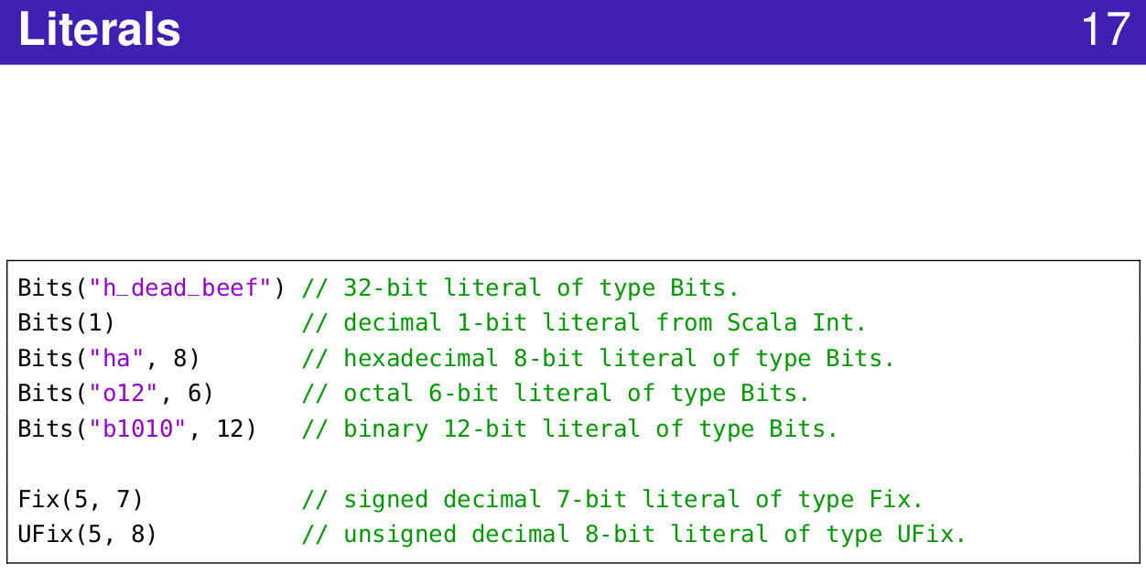
1.13 Data Type
https://www.youtube.com/watch?v=OPhFfNLcVsI&list=PLlu0CT-JnSasfpk8tq1ZDiE2G0AK1BhOg&index=2
Literals (21:04-23:22/1:05:46)

Slide 9
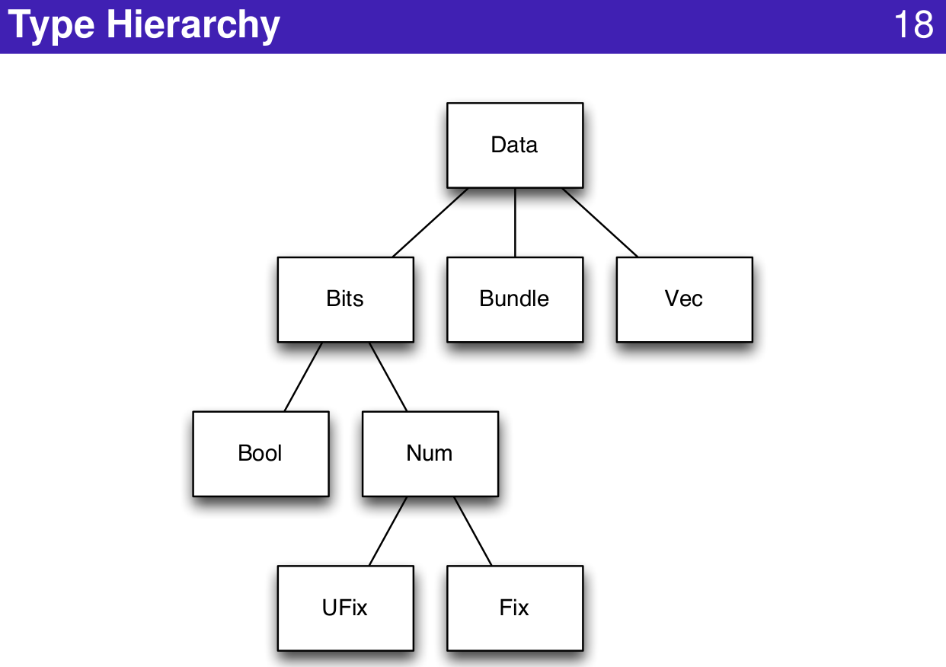
1.13 Data Type
https://www.youtube.com/watch?v=OPhFfNLcVsI&list=PLlu0CT-JnSasfpk8tq1ZDiE2G0AK1BhOg&index=2
Type Hierarchy (21:04-23:22/1:05:46)

Slide 10
1.14 Combinational Circuit

Slide 11
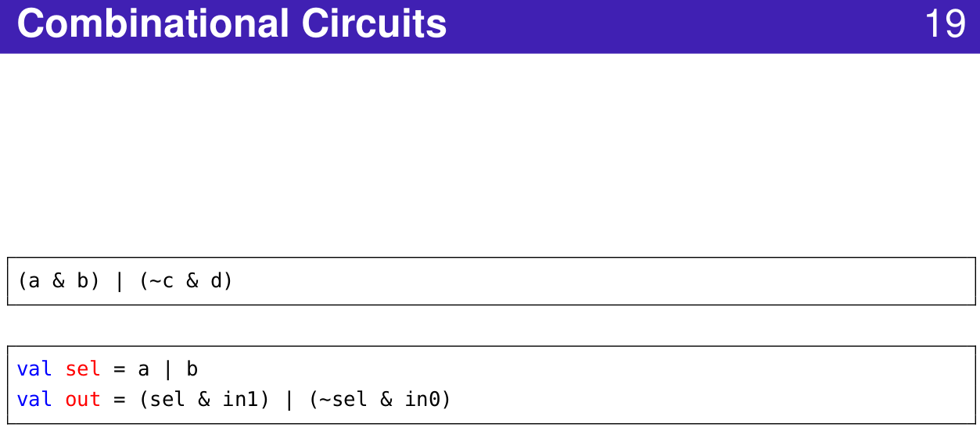
1.14 Combinational Circuit
https://www.youtube.com/watch?v=OPhFfNLcVsI&list=PLlu0CT-JnSasfpk8tq1ZDiE2G0AK1BhOg&index=2
Combinational Circuit (21:04-23:22/1:05:46)

Slide 12
1.15 Graph

Slide 13
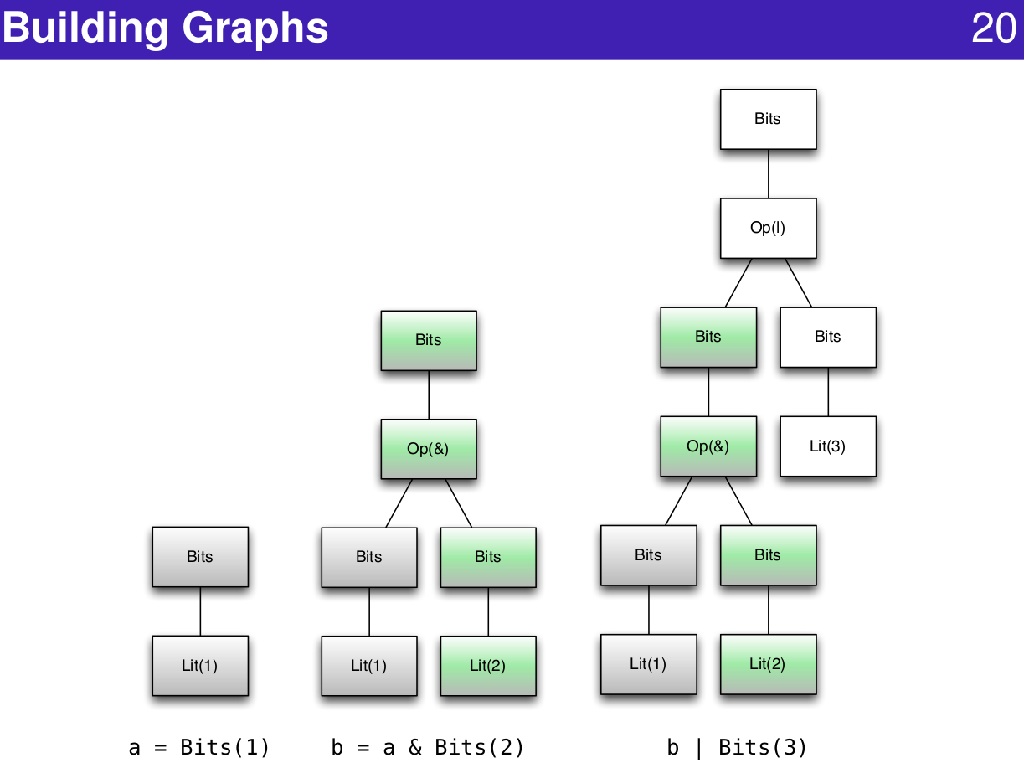
1.15 Graph
https://www.youtube.com/watch?v=OPhFfNLcVsI&list=PLlu0CT-JnSasfpk8tq1ZDiE2G0AK1BhOg&index=2
Building Graph (21:04-23:22/1:05:46)

Slide 14
1.16 Operator

Slide 15
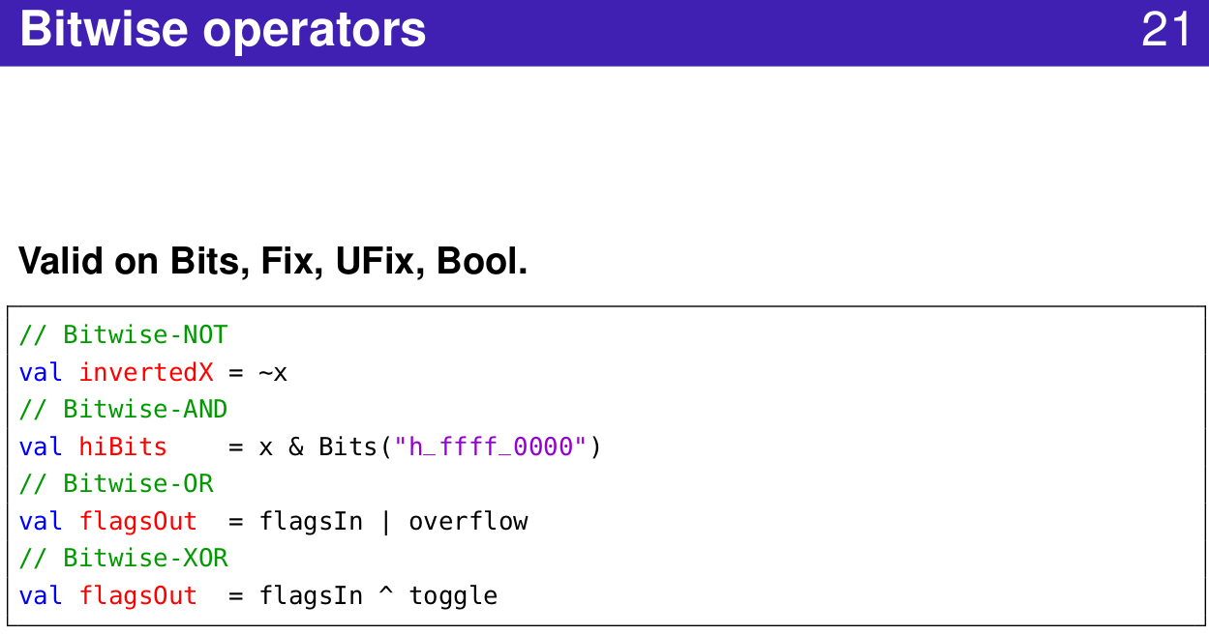
1.16 Operator
https://www.youtube.com/watch?v=OPhFfNLcVsI&list=PLlu0CT-JnSasfpk8tq1ZDiE2G0AK1BhOg&index=2
Bitwise Operator (21:04-23:22/1:05:46)

Slide 16
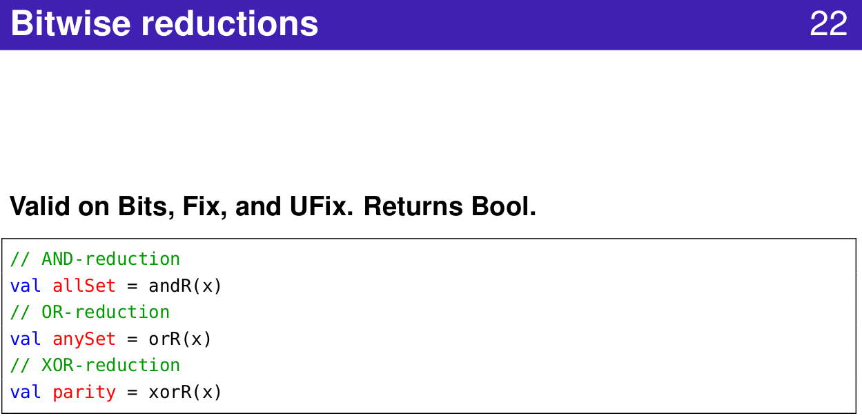
1.16 Operator
https://www.youtube.com/watch?v=OPhFfNLcVsI&list=PLlu0CT-JnSasfpk8tq1ZDiE2G0AK1BhOg&index=2
Bitwise Reduction (21:04-23:22/1:05:46)

Slide 17
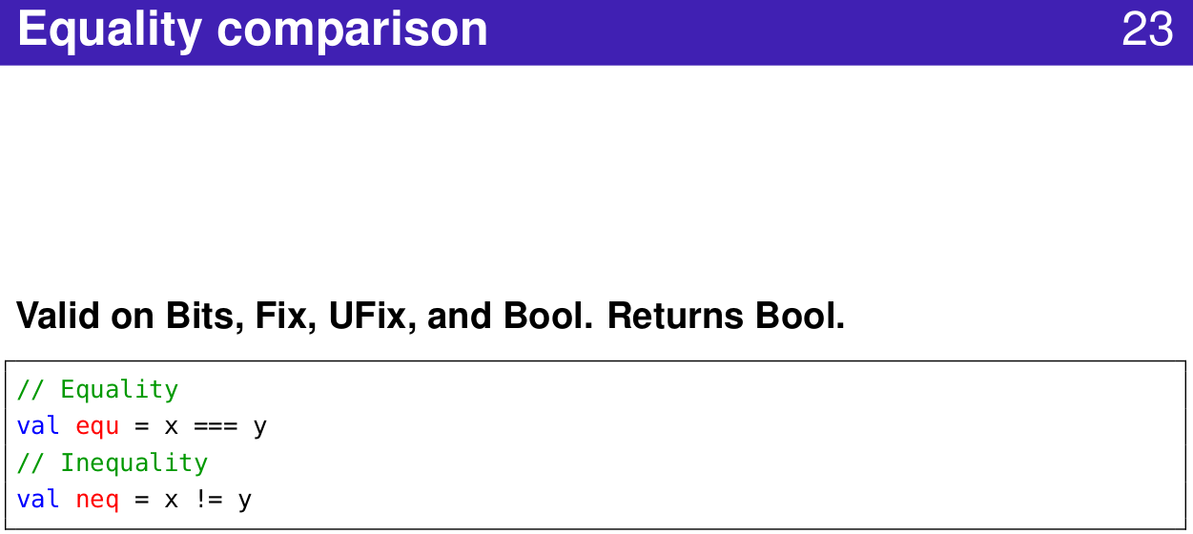
1.16 Operator
https://www.youtube.com/watch?v=OPhFfNLcVsI&list=PLlu0CT-JnSasfpk8tq1ZDiE2G0AK1BhOg&index=2
Equality Comparison (21:04-23:22/1:05:46)

Slide 18
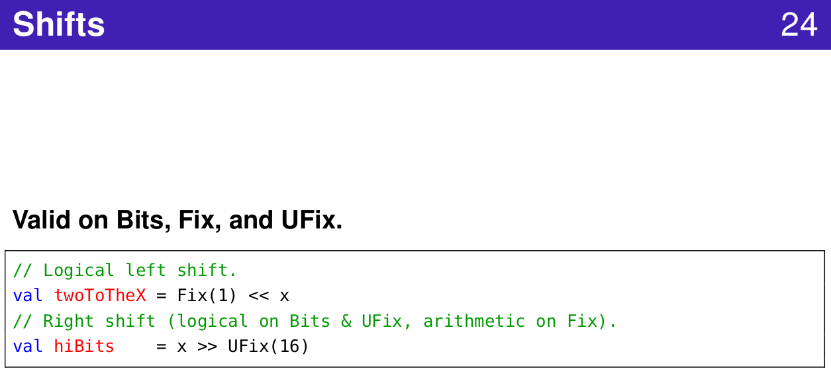
1.16 Operator
https://www.youtube.com/watch?v=OPhFfNLcVsI&list=PLlu0CT-JnSasfpk8tq1ZDiE2G0AK1BhOg&index=2
Shift (21:04-23:22/1:05:46)

Slide 19
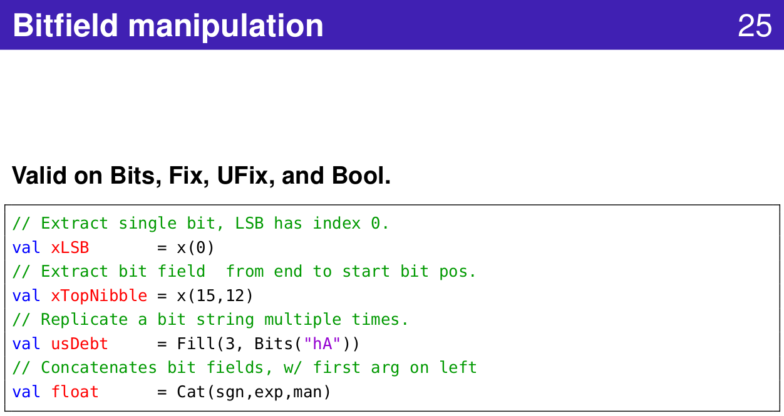
1.16 Operator
https://www.youtube.com/watch?v=OPhFfNLcVsI&list=PLlu0CT-JnSasfpk8tq1ZDiE2G0AK1BhOg&index=2
Bitfield (21:04-23:22/1:05:46)

Slide 20
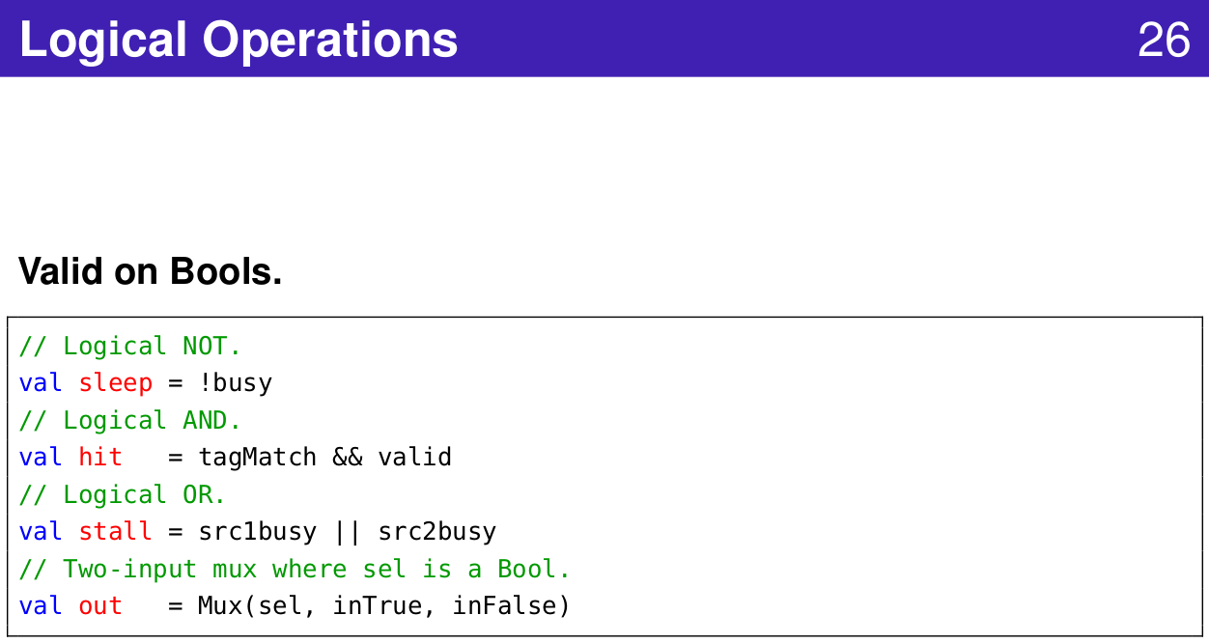
1.16 Operator
https://www.youtube.com/watch?v=OPhFfNLcVsI&list=PLlu0CT-JnSasfpk8tq1ZDiE2G0AK1BhOg&index=2
Logical Operation (21:04-23:22/1:05:46)

Slide 21
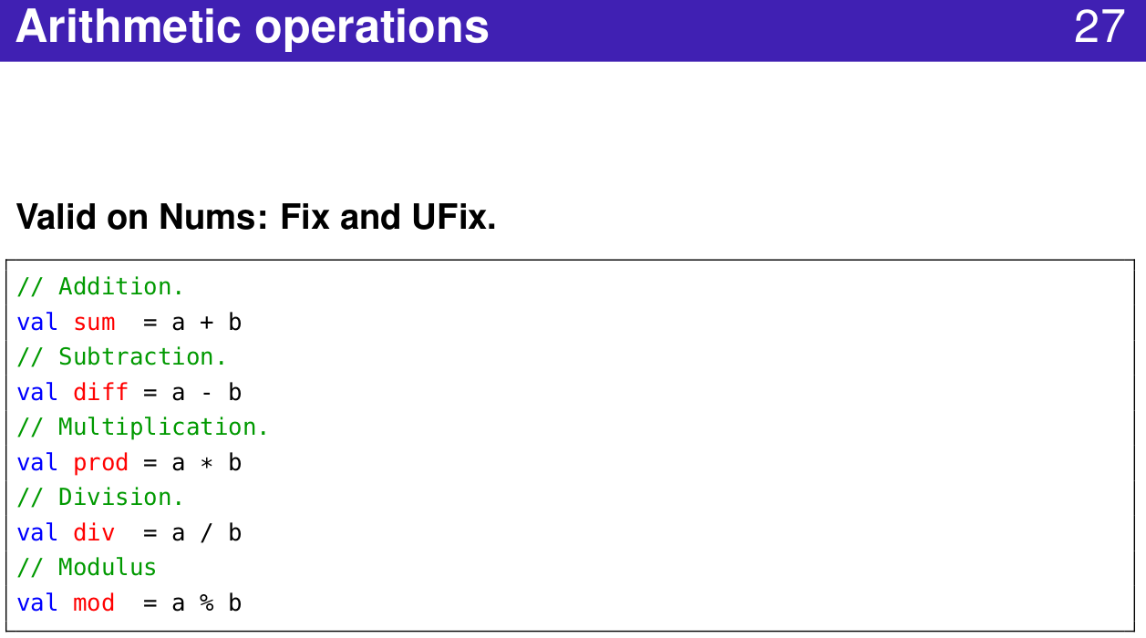
1.16 Operator
https://www.youtube.com/watch?v=OPhFfNLcVsI&list=PLlu0CT-JnSasfpk8tq1ZDiE2G0AK1BhOg&index=2
Arithmetic Operation (21:04-23:22/1:05:46)

Slide 22
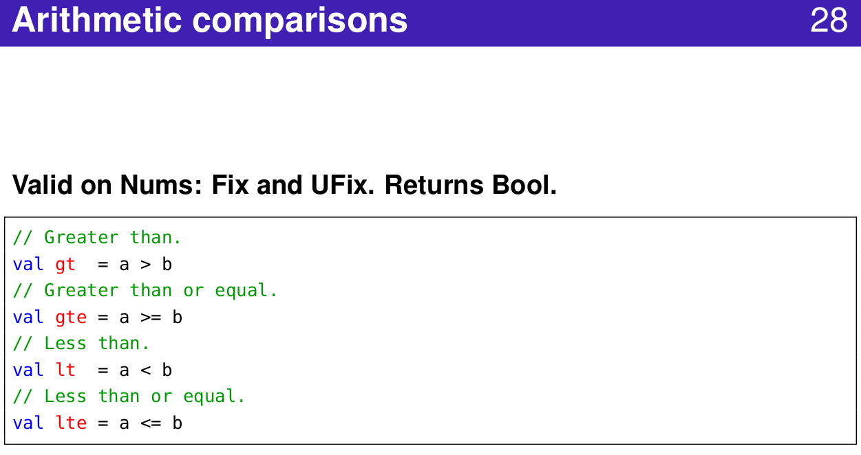
1.16 Operator
https://www.youtube.com/watch?v=OPhFfNLcVsI&list=PLlu0CT-JnSasfpk8tq1ZDiE2G0AK1BhOg&index=2
Arithmetic Operation (21:04-23:22/1:05:46)

Slide 23
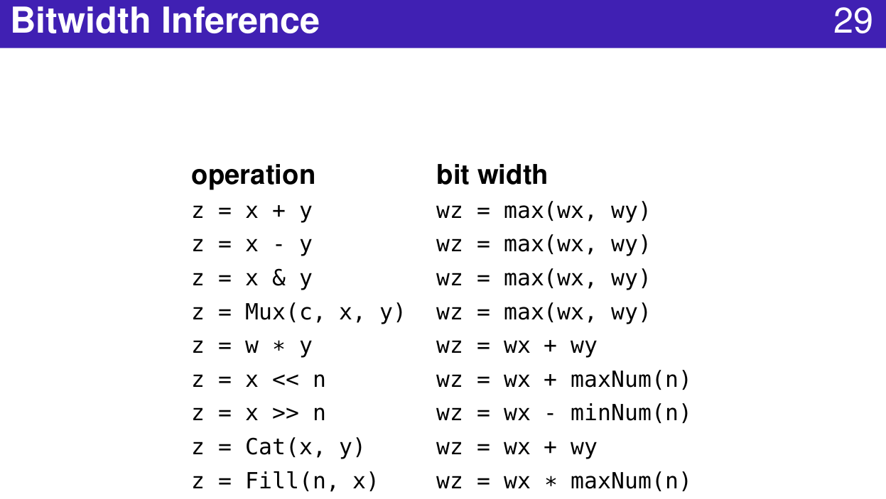
1.16 Operator
https://www.youtube.com/watch?v=OPhFfNLcVsI&list=PLlu0CT-JnSasfpk8tq1ZDiE2G0AK1BhOg&index=2
Bitwidth Inference (21:04-23:22/1:05:46)

Slide 24
1.17 Node Class

Slide 25
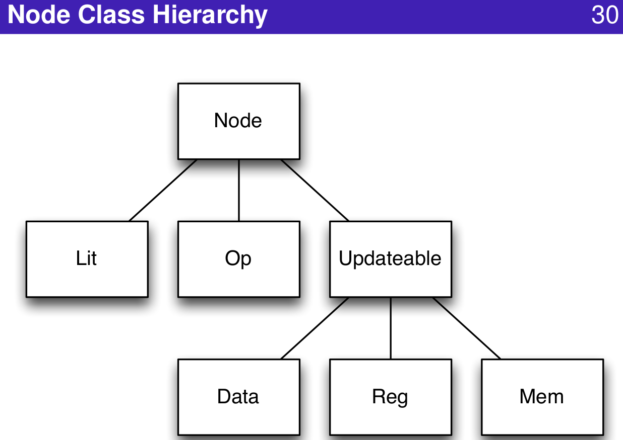
1.17 Node Class
https://www.youtube.com/watch?v=OPhFfNLcVsI&list=PLlu0CT-JnSasfpk8tq1ZDiE2G0AK1BhOg&index=2
Node Class Hierarchy (21:04-23:22/1:05:46)

Slide 26
1.18 Chisel Repository

Slide 27
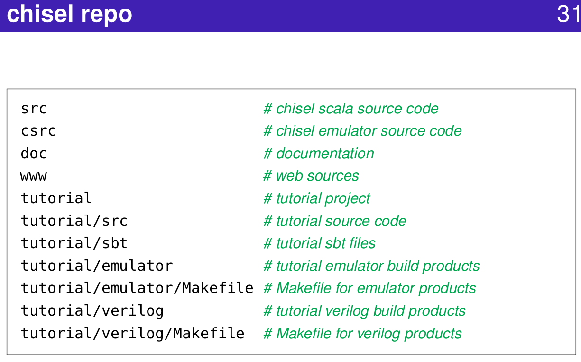
1.18 Chisel Repository
https://www.youtube.com/watch?v=OPhFfNLcVsI&list=PLlu0CT-JnSasfpk8tq1ZDiE2G0AK1BhOg&index=2
Chisel Repo (20:44-21:03/1:05:46)
Repo: Repository (Storage)

Slide 28
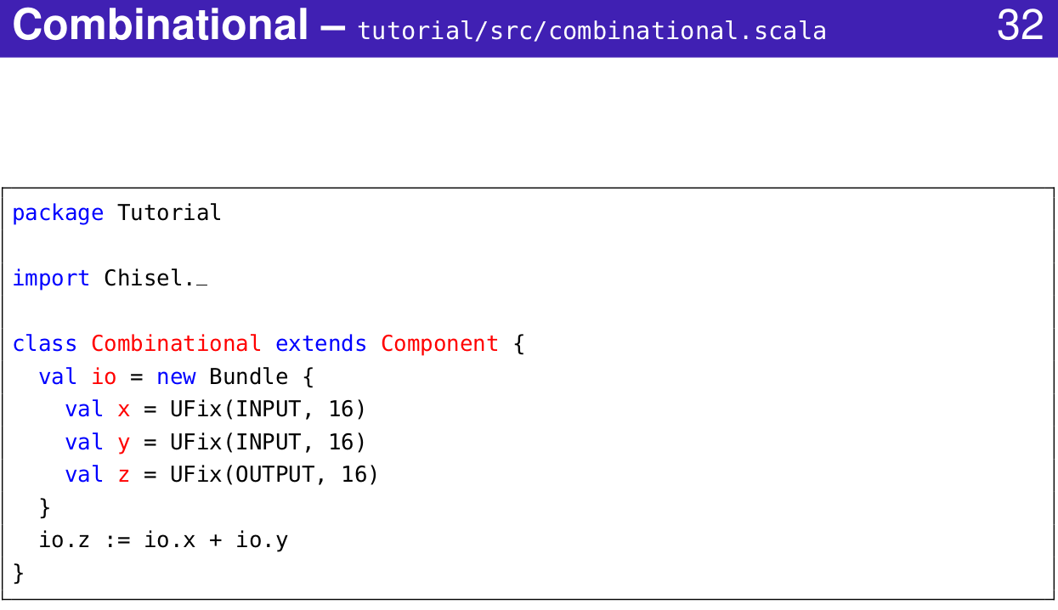
1.18 Chisel Repository
https://www.youtube.com/watch?v=OPhFfNLcVsI&list=PLlu0CT-JnSasfpk8tq1ZDiE2G0AK1BhOg&index=2
Combinational (20:44-21:03/1:05:46)

Slide 29
1.19 Chisel Compiler

Slide 30
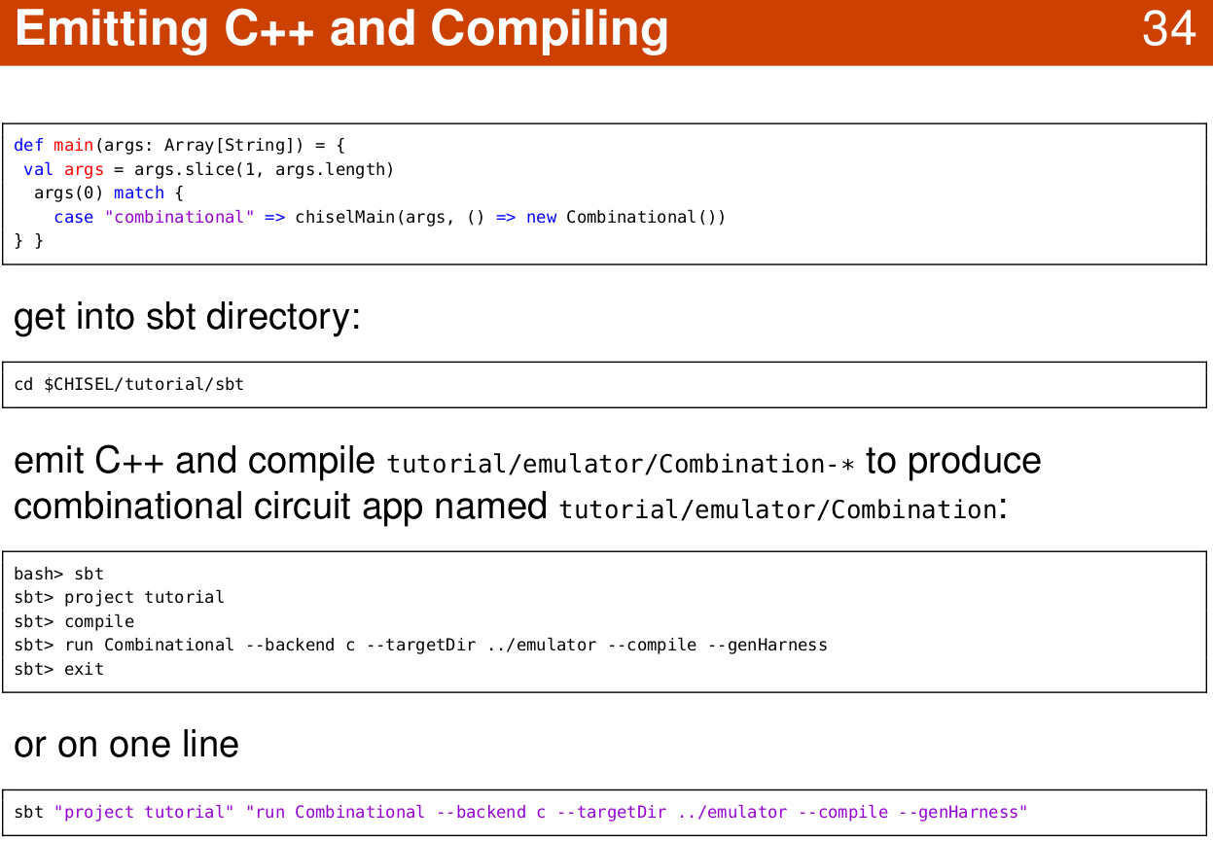
1.19 Chisel Compiler
https://www.youtube.com/watch?v=OPhFfNLcVsI&list=PLlu0CT-JnSasfpk8tq1ZDiE2G0AK1BhOg&index=2
C++ (20:44-21:03/1:05:46)
Emit (发射)

Slide 31
1.20 Chisel Main Program

Slide 32
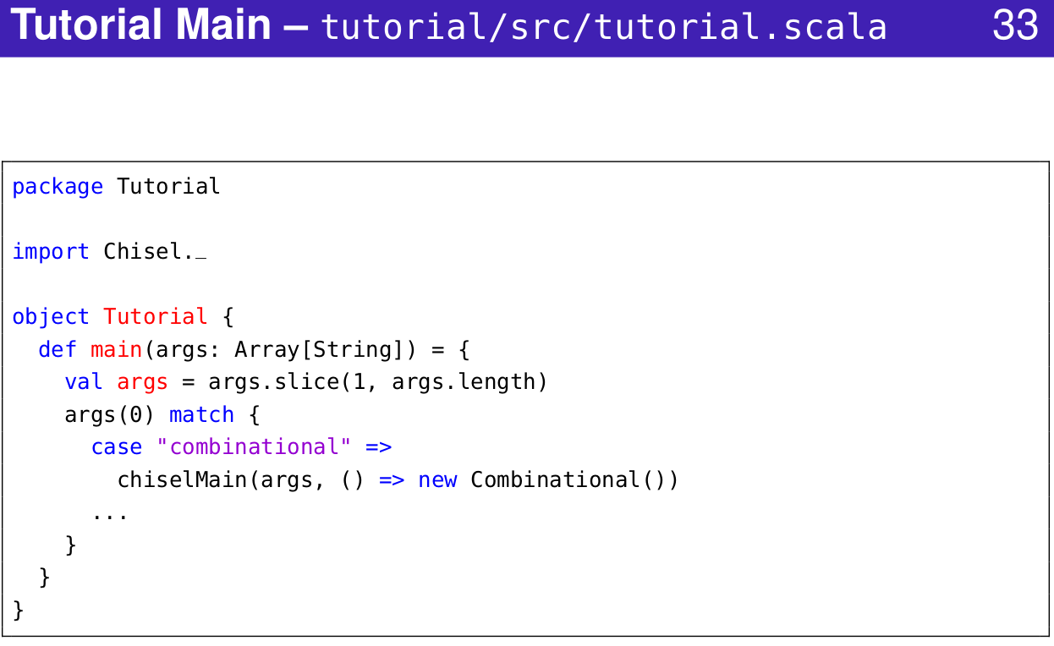
1.20 Chisel Main Program
https://www.youtube.com/watch?v=OPhFfNLcVsI&list=PLlu0CT-JnSasfpk8tq1ZDiE2G0AK1BhOg&index=2
Scala Main Program (20:44-21:03/1:05:46)

Slide 33
End

