Slide 1

1.21 Chisel Flow

Slide 2
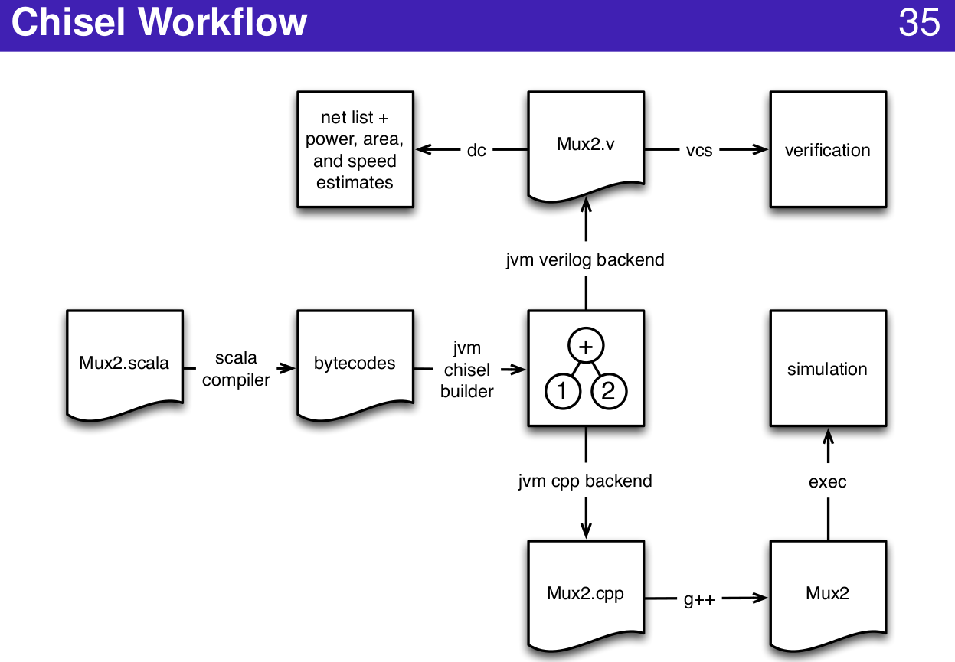
1.21 Chisel Flow
https://www.youtube.com/watch?v=OPhFfNLcVsI&list=PLlu0CT-JnSasfpk8tq1ZDiE2G0AK1BhOg&index=2
Chisel Workflow (20:44-21:03/1:05:46)

Slide 3
1.22 Tester

Slide 4
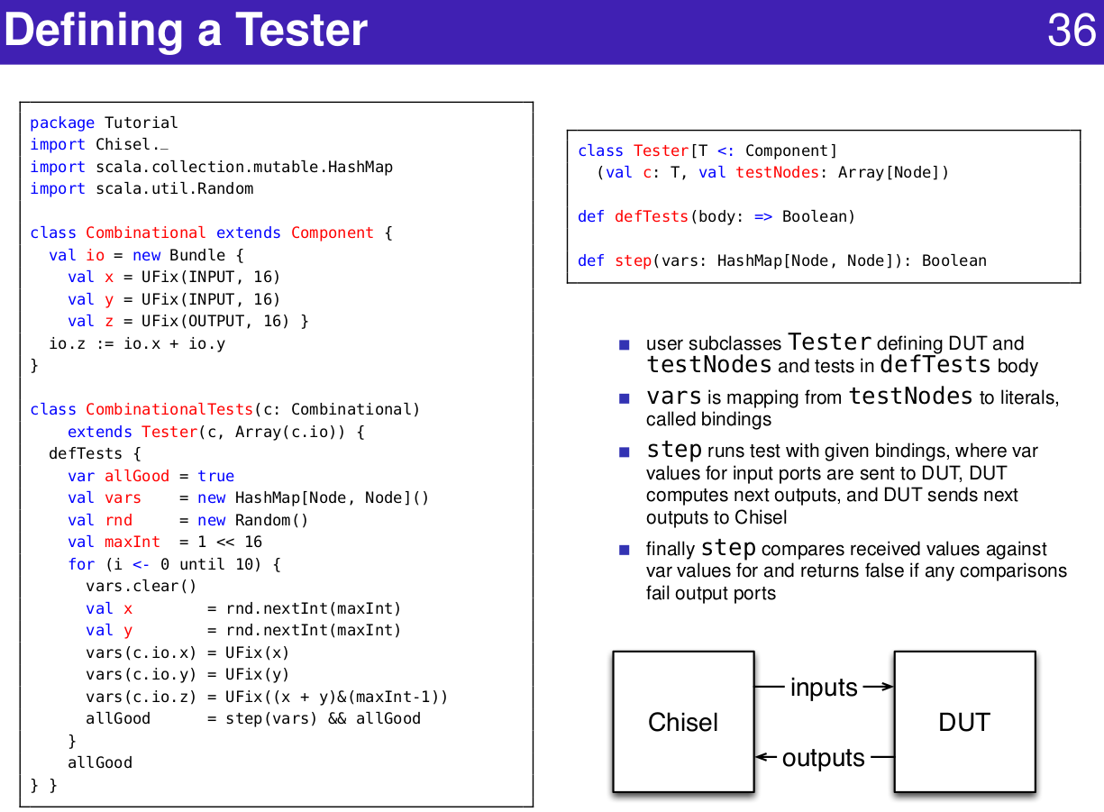
1.22 Tester
https://www.youtube.com/watch?v=OPhFfNLcVsI&list=PLlu0CT-JnSasfpk8tq1ZDiE2G0AK1BhOg&index=2
Tester (20:44-21:03/1:05:46)

Slide 5
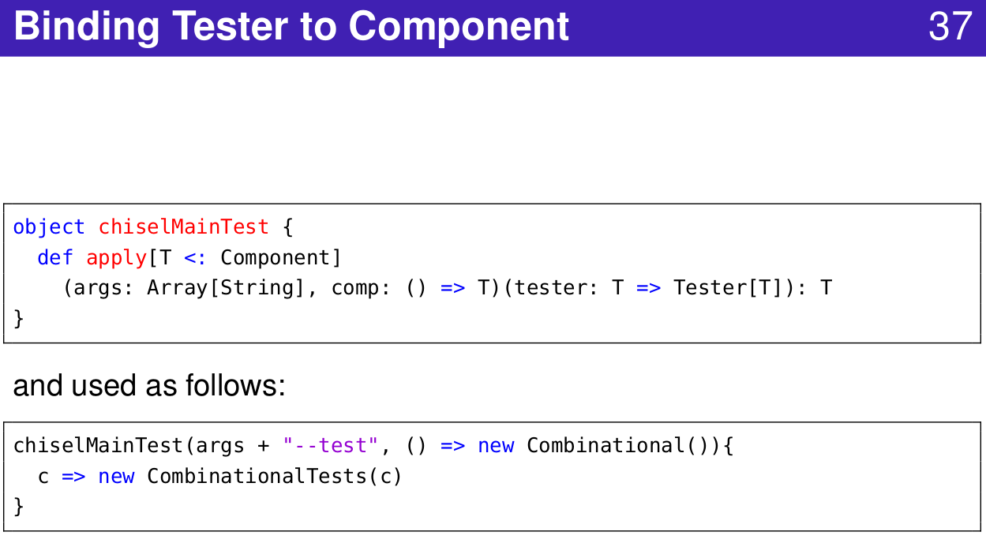
1.22 Tester
https://www.youtube.com/watch?v=OPhFfNLcVsI&list=PLlu0CT-JnSasfpk8tq1ZDiE2G0AK1BhOg&index=2
Bind Tester to Component (20:44-21:03/1:05:46)

Slide 6
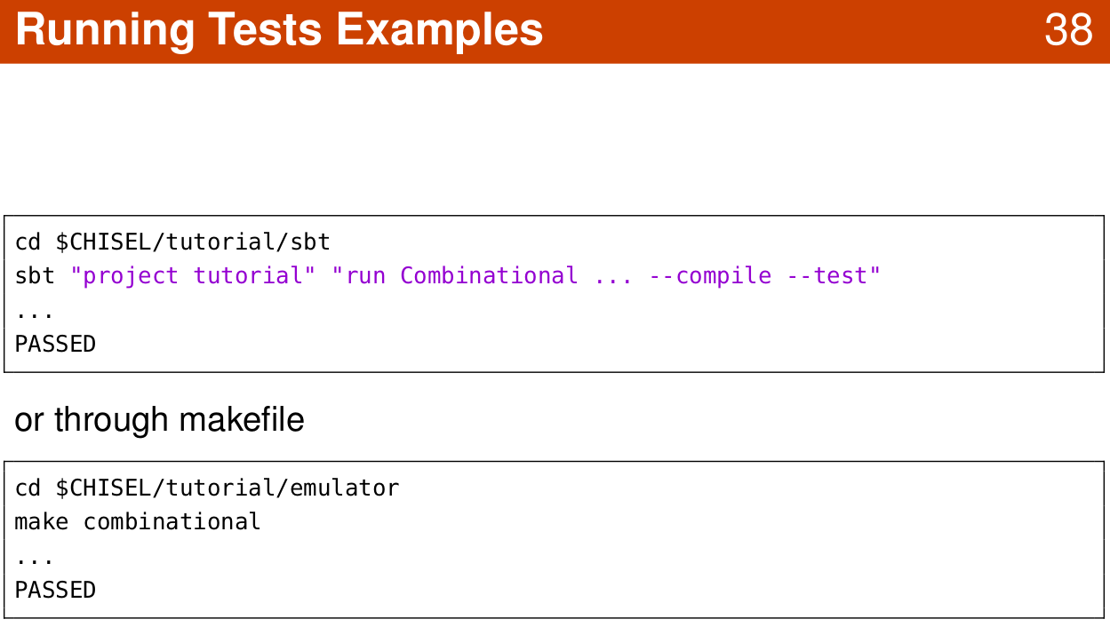
1.22 Tester
https://www.youtube.com/watch?v=OPhFfNLcVsI&list=PLlu0CT-JnSasfpk8tq1ZDiE2G0AK1BhOg&index=2
Run Test (20:44-21:03/1:05:46)

Slide 7
1.23 Function Abstraction

Slide 8
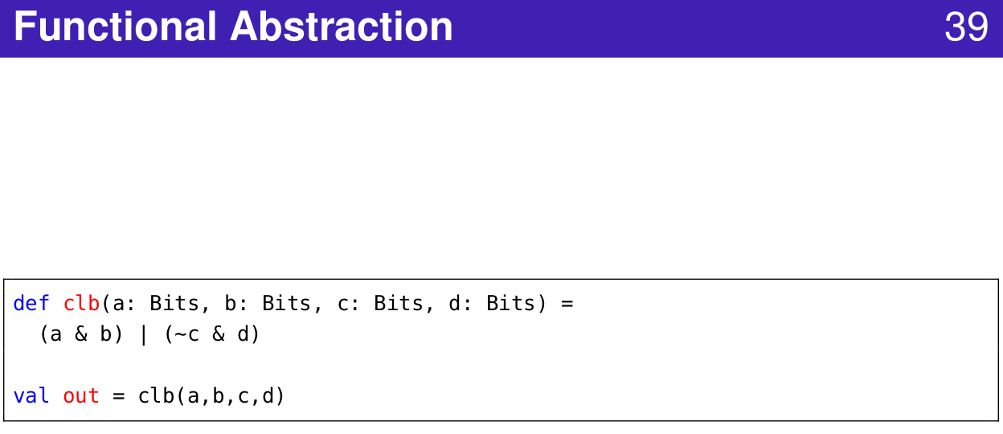
1.23 Function Abstraction
https://www.youtube.com/watch?v=OPhFfNLcVsI&list=PLlu0CT-JnSasfpk8tq1ZDiE2G0AK1BhOg&index=2
Functional Abstraction (20:44-21:03/1:05:46)

Slide 9
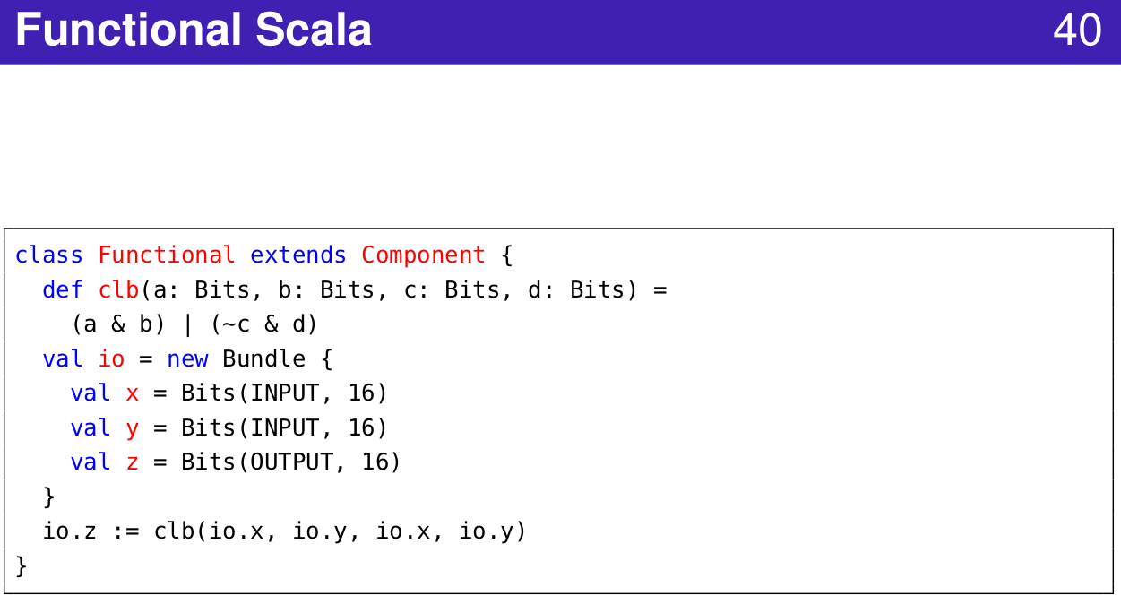
1.23 Function Abstraction
https://www.youtube.com/watch?v=OPhFfNLcVsI&list=PLlu0CT-JnSasfpk8tq1ZDiE2G0AK1BhOg&index=2
Functional Scala (20:44-21:03/1:05:46)

Slide 10
1.24 Bundle

Slide 11
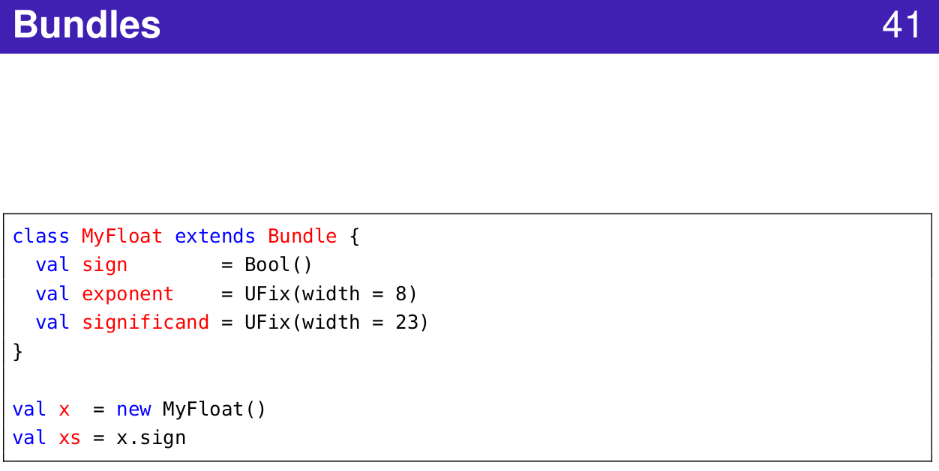
1.24 Bundle
https://www.youtube.com/watch?v=OPhFfNLcVsI&list=PLlu0CT-JnSasfpk8tq1ZDiE2G0AK1BhOg&index=2
Bundle (20:44-21:03/1:05:46)

Slide 12
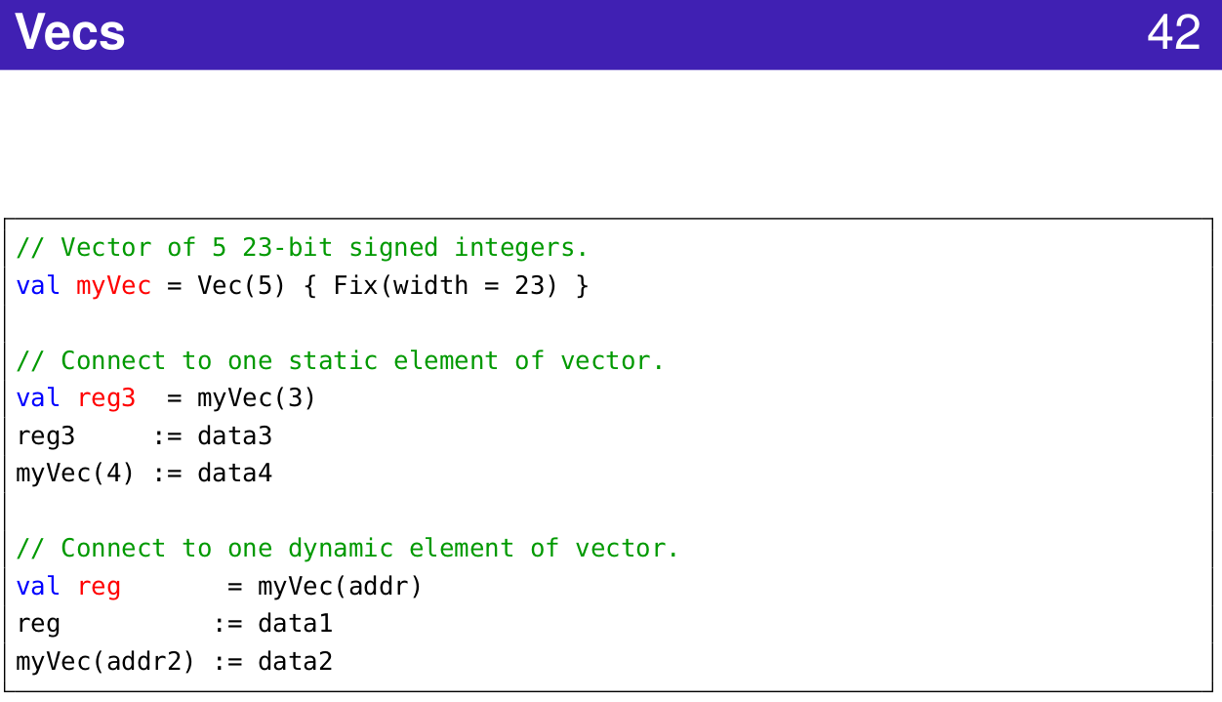
1.24 Bundle
https://www.youtube.com/watch?v=OPhFfNLcVsI&list=PLlu0CT-JnSasfpk8tq1ZDiE2G0AK1BhOg&index=2
Vector (20:44-21:03/1:05:46)

Slide 13
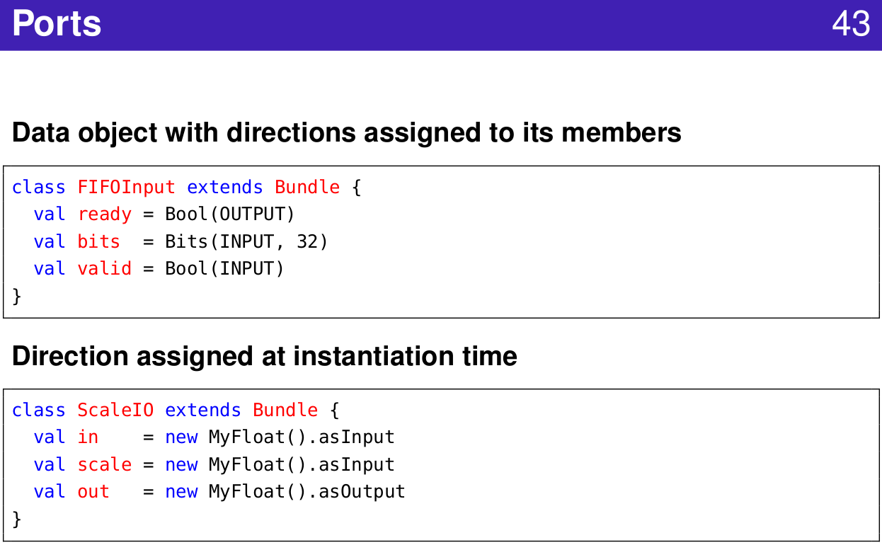
1.24 Bundle
https://www.youtube.com/watch?v=OPhFfNLcVsI&list=PLlu0CT-JnSasfpk8tq1ZDiE2G0AK1BhOg&index=2
Port (20:44-21:03/1:05:46)

Slide 14
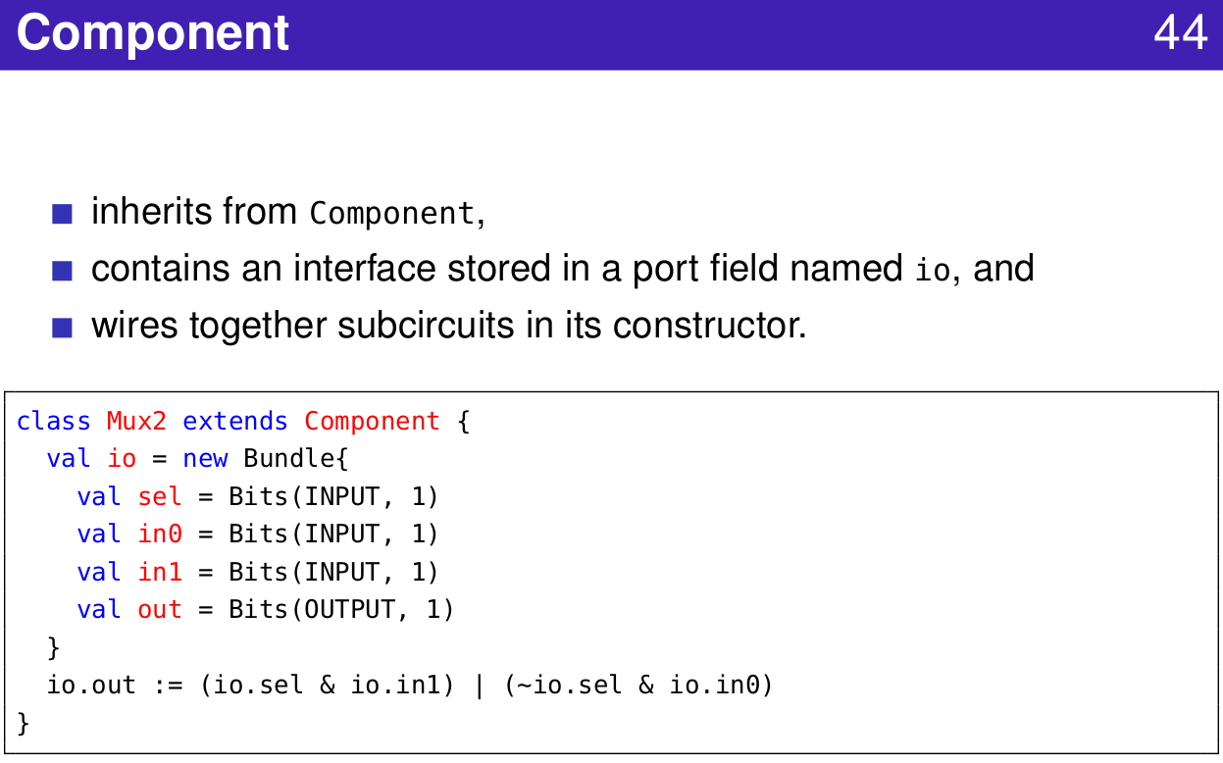
1.24 Bundle
https://www.youtube.com/watch?v=OPhFfNLcVsI&list=PLlu0CT-JnSasfpk8tq1ZDiE2G0AK1BhOg&index=2
Component (20:44-21:03/1:05:46)

Slide 15
1.25 Chisel Command Line

Slide 16
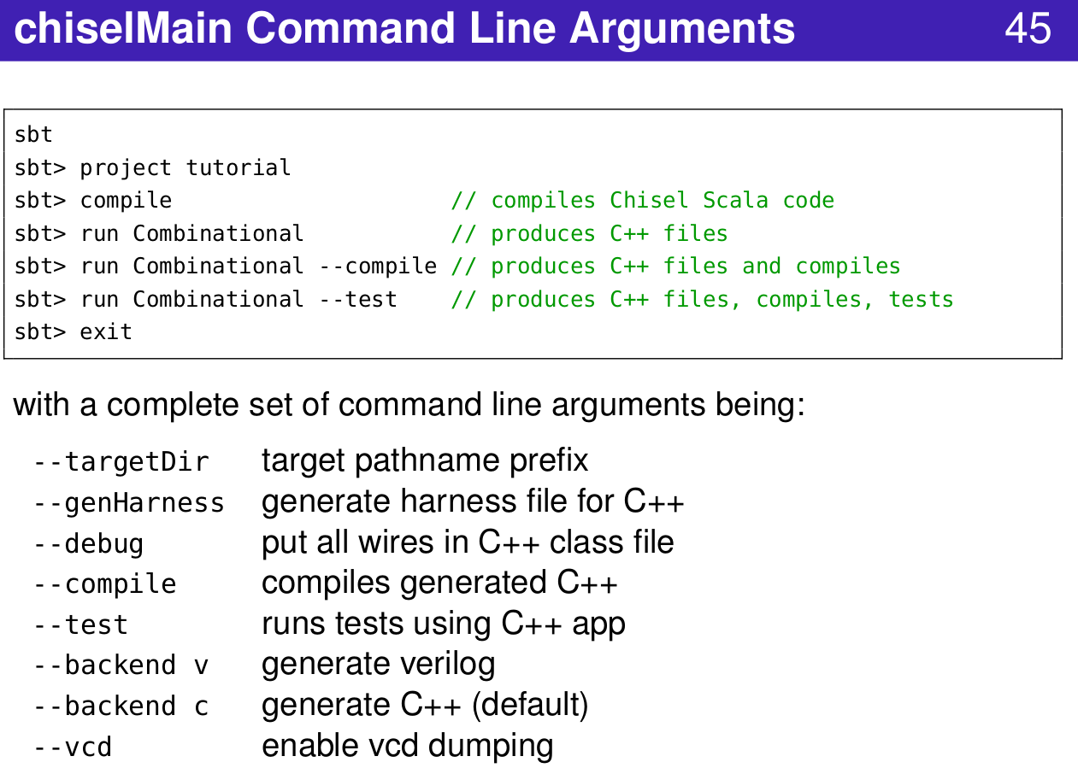
1.25 Chisel Command Line
https://www.youtube.com/watch?v=OPhFfNLcVsI&list=PLlu0CT-JnSasfpk8tq1ZDiE2G0AK1BhOg&index=2
Chisel Command Line Argument (20:44-21:03/1:05:46)

Slide 17
1.26 Create Verilog

Slide 18
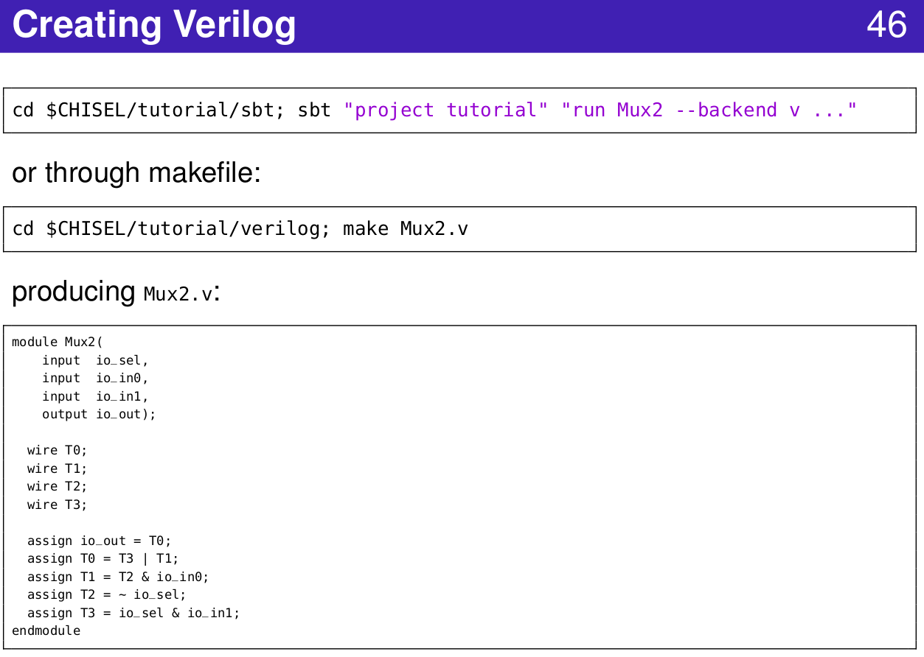
1.26 Create Verilog
https://www.youtube.com/watch?v=OPhFfNLcVsI&list=PLlu0CT-JnSasfpk8tq1ZDiE2G0AK1BhOg&index=2
Create Verilog (24:59-30:54/1:05:46)

Slide 19
1.27 VCD

Slide 20
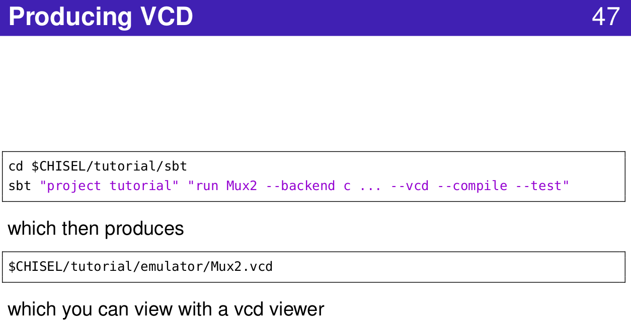
1.27 VCD
https://www.youtube.com/watch?v=OPhFfNLcVsI&list=PLlu0CT-JnSasfpk8tq1ZDiE2G0AK1BhOg&index=2
VCD (20:44-21:03/1:05:46)
VCD (Value Change Dump) from Verilog Simulation

Slide 21
1.28 Component

Slide 22
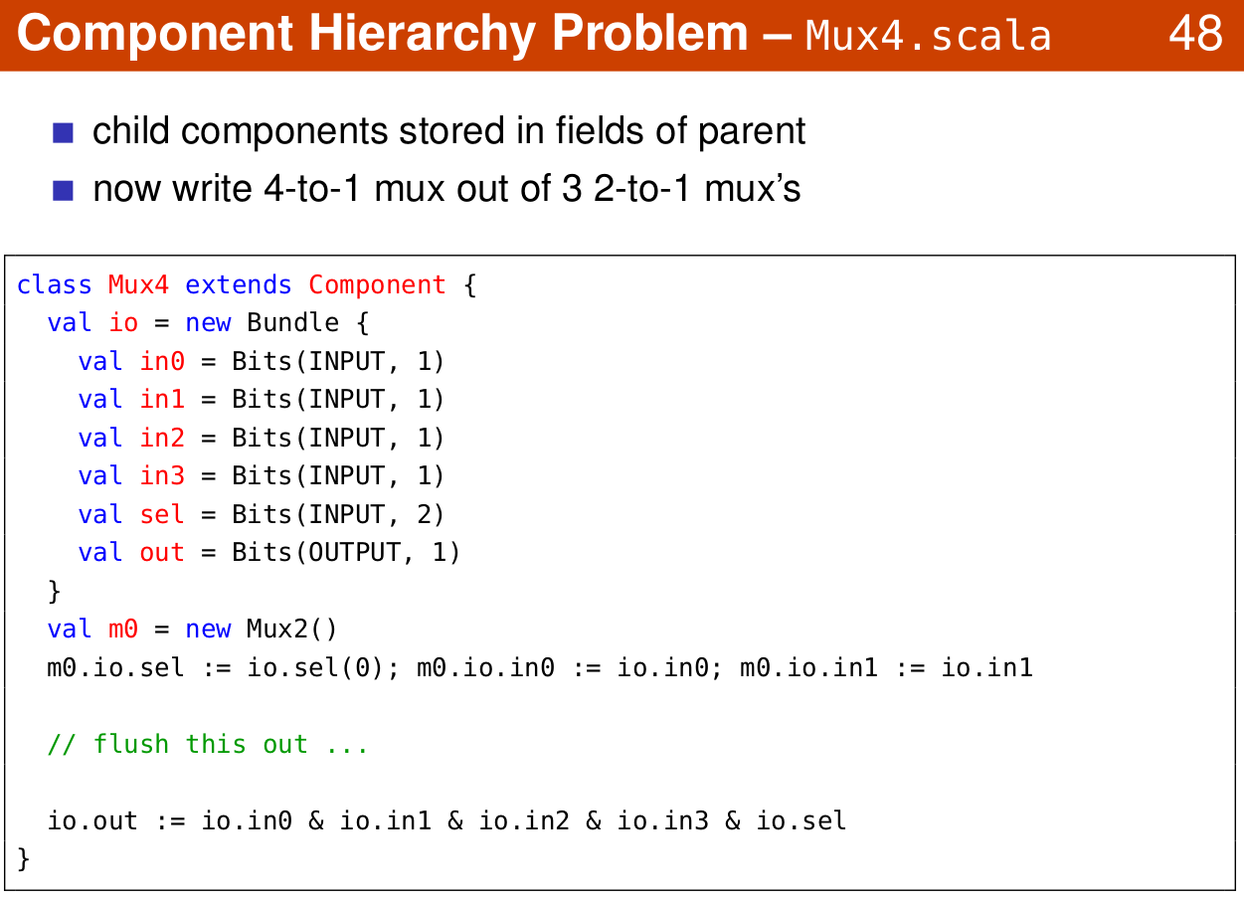
1.28 Component
https://www.youtube.com/watch?v=OPhFfNLcVsI&list=PLlu0CT-JnSasfpk8tq1ZDiE2G0AK1BhOg&index=2
Component Hierarchy (24:59-30:54/1:05:46)

Slide 23
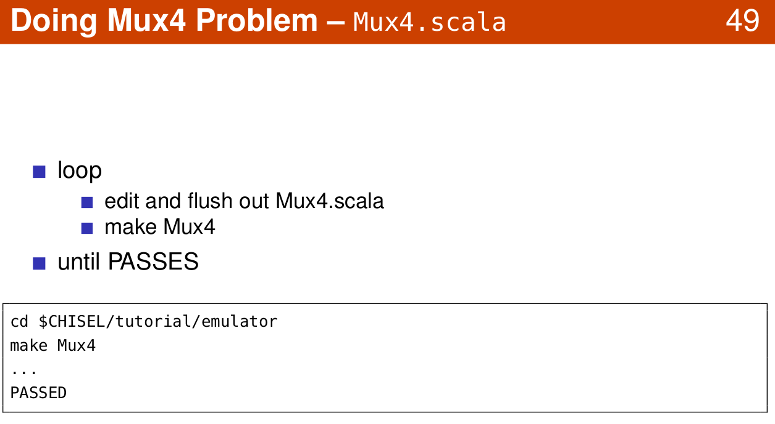
1.28 Component
https://www.youtube.com/watch?v=OPhFfNLcVsI&list=PLlu0CT-JnSasfpk8tq1ZDiE2G0AK1BhOg&index=2
Mux4 (24:59-30:54/1:05:46)
Mux4: Multiplexer with 4 inputs.

Slide 24
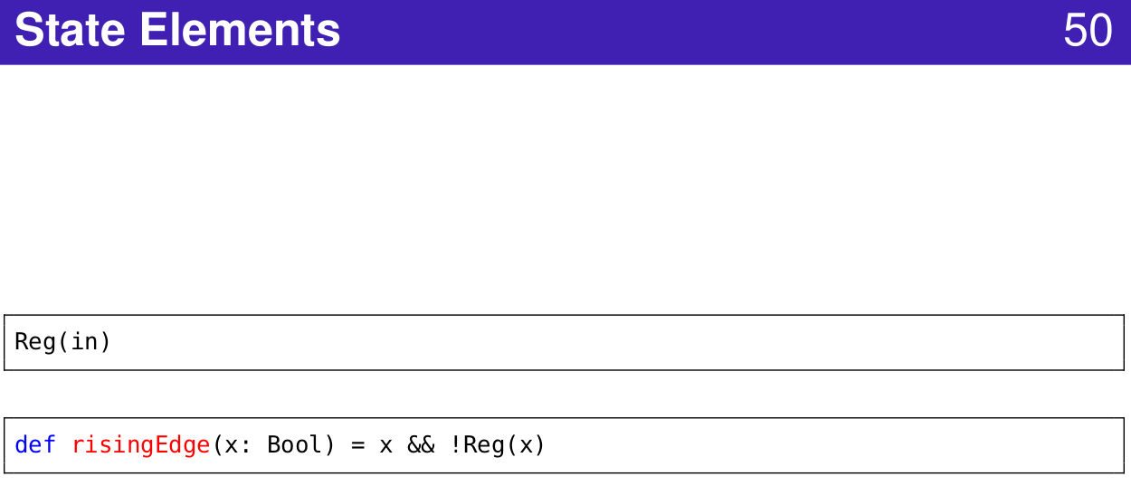
1.28 Component
https://www.youtube.com/watch?v=OPhFfNLcVsI&list=PLlu0CT-JnSasfpk8tq1ZDiE2G0AK1BhOg&index=2
State Element (24:59-30:54/1:05:46)

Slide 25
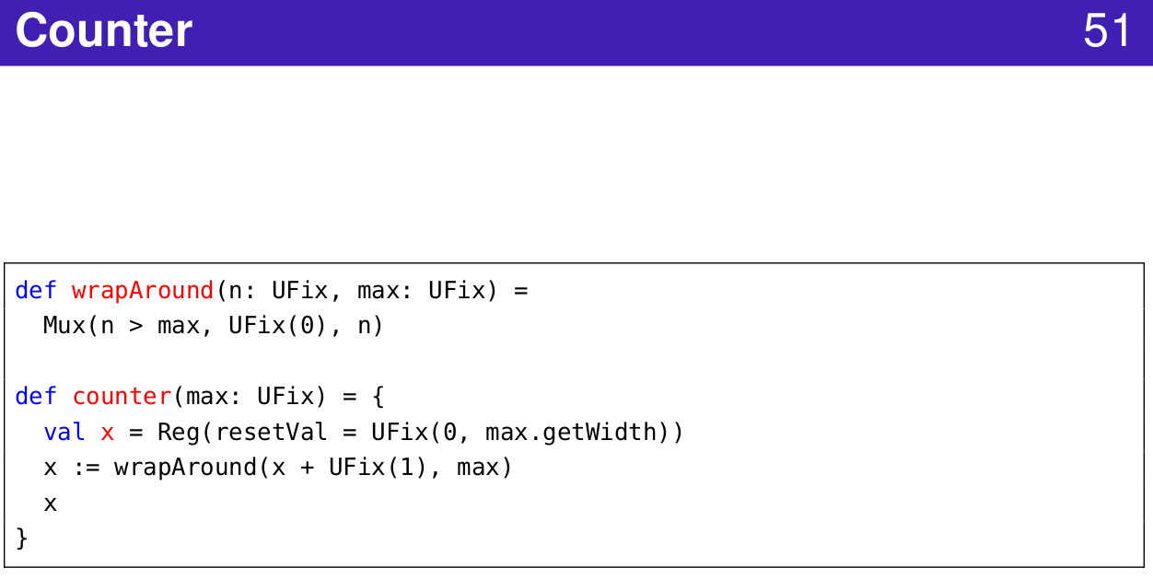
1.28 Component
https://www.youtube.com/watch?v=OPhFfNLcVsI&list=PLlu0CT-JnSasfpk8tq1ZDiE2G0AK1BhOg&index=2
Counter (24:59-30:54/1:05:46)

Slide 26
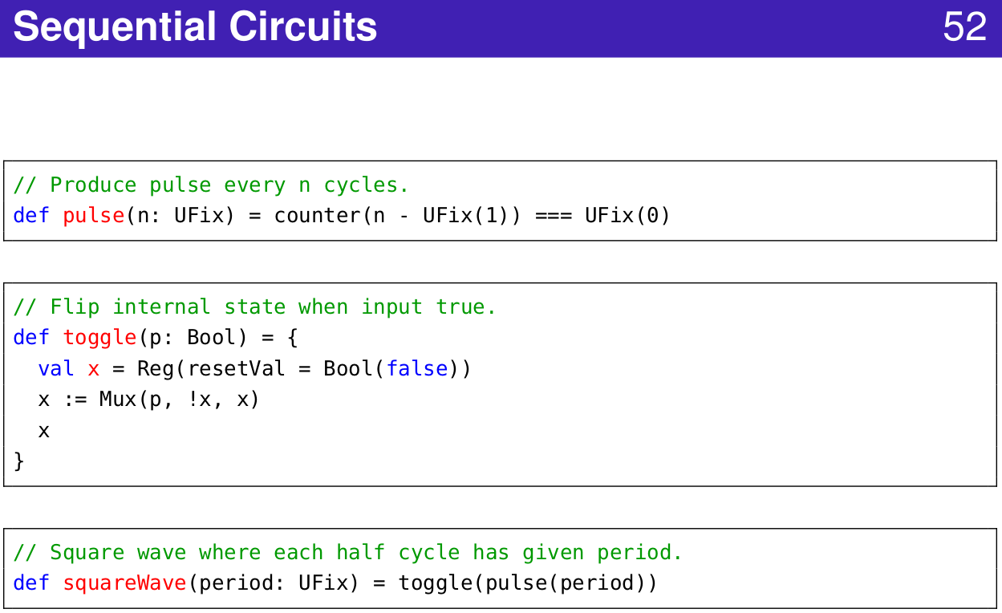
1.28 Component
https://www.youtube.com/watch?v=OPhFfNLcVsI&list=PLlu0CT-JnSasfpk8tq1ZDiE2G0AK1BhOg&index=2
Sequential Circuit (24:59-30:54/1:05:46)

Slide 27
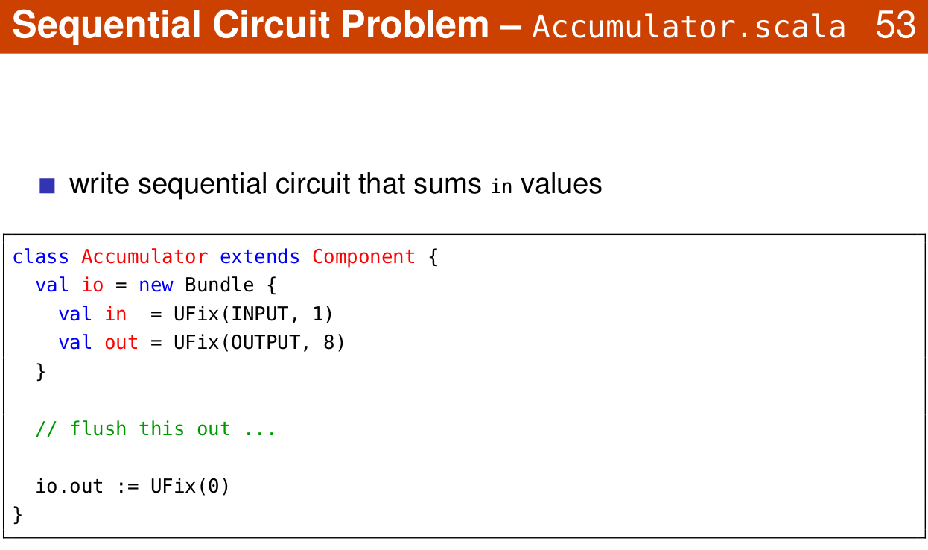
1.28 Component
https://www.youtube.com/watch?v=OPhFfNLcVsI&list=PLlu0CT-JnSasfpk8tq1ZDiE2G0AK1BhOg&index=2
Sequential Circuit: Accumulator (24:59-30:54/1:05:46)

Slide 28
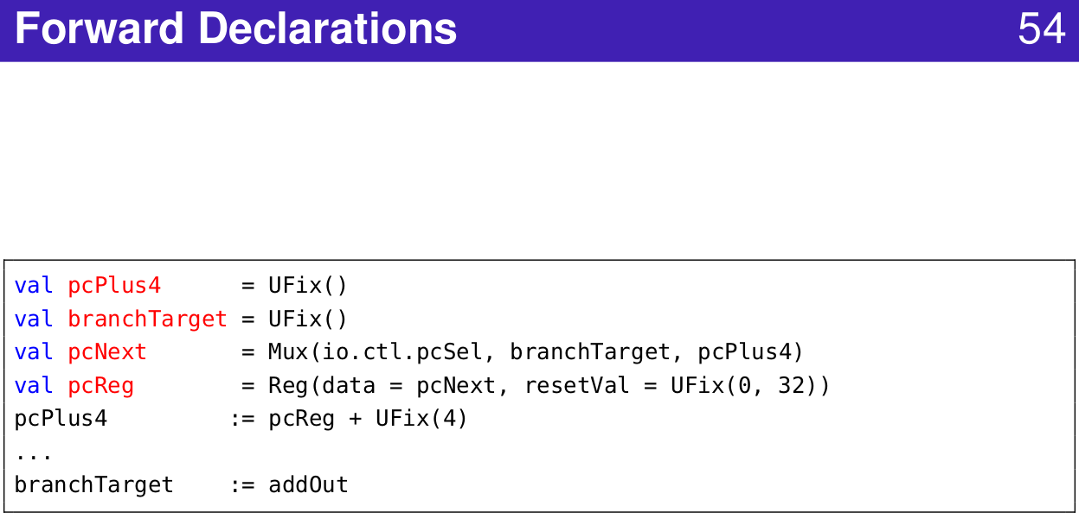
1.28 Component
https://www.youtube.com/watch?v=OPhFfNLcVsI&list=PLlu0CT-JnSasfpk8tq1ZDiE2G0AK1BhOg&index=2
Forward Declaration (24:59-30:54/1:05:46)

Slide 29
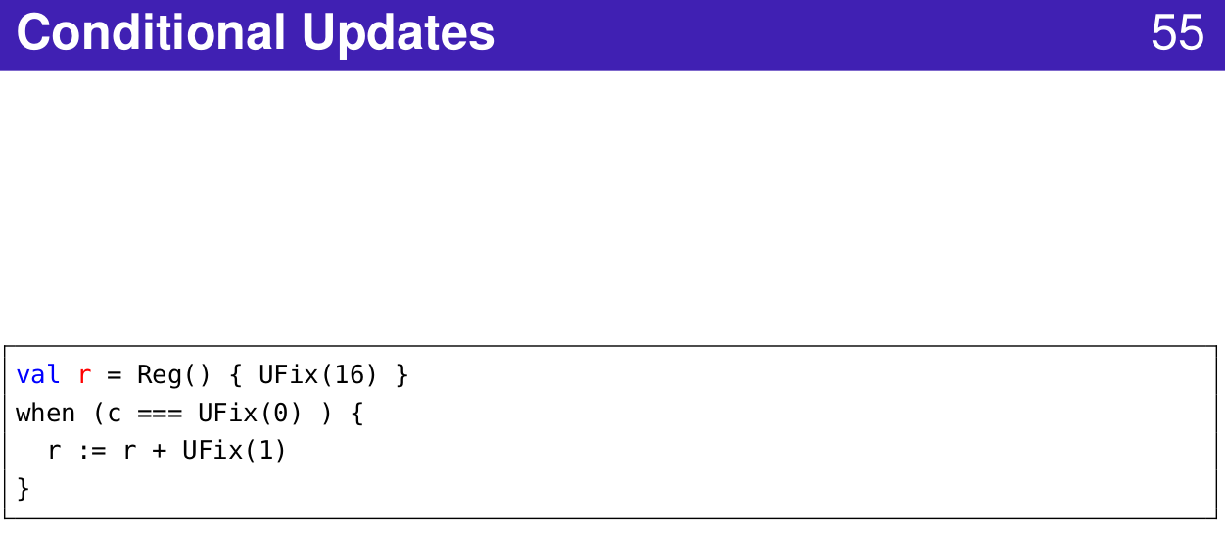
1.28 Component
https://www.youtube.com/watch?v=OPhFfNLcVsI&list=PLlu0CT-JnSasfpk8tq1ZDiE2G0AK1BhOg&index=2
Conditional Update (24:59-30:54/1:05:46)

Slide 30
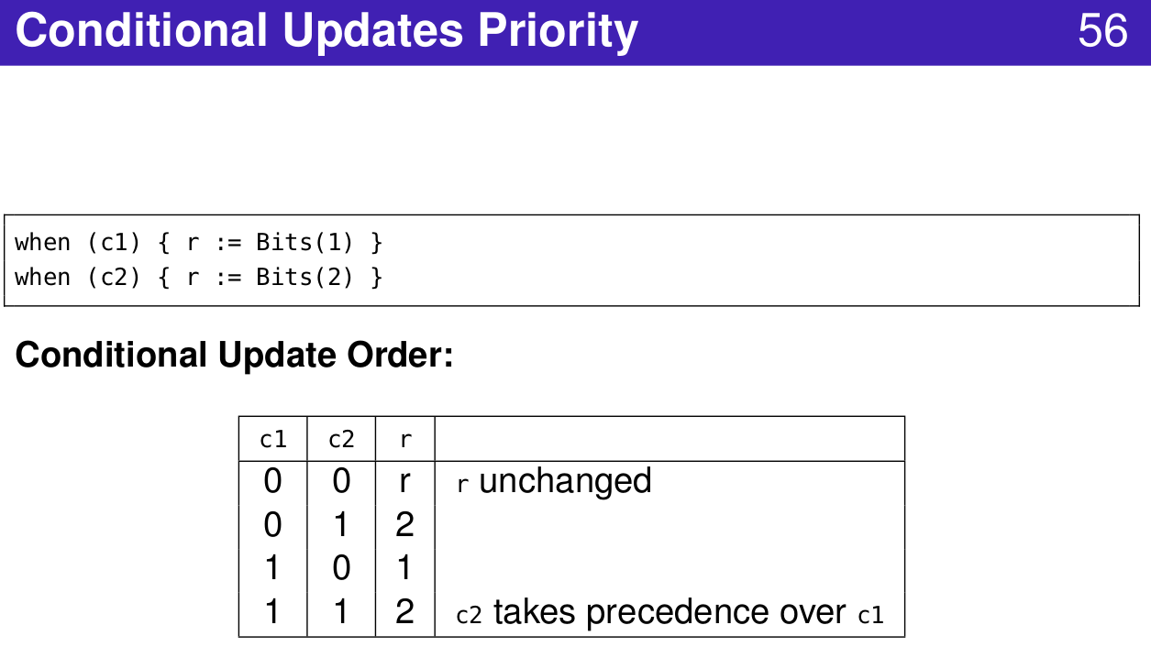
1.28 Component
https://www.youtube.com/watch?v=OPhFfNLcVsI&list=PLlu0CT-JnSasfpk8tq1ZDiE2G0AK1BhOg&index=2
Conditional Update Priority (24:59-30:54/1:05:46)

Slide 31
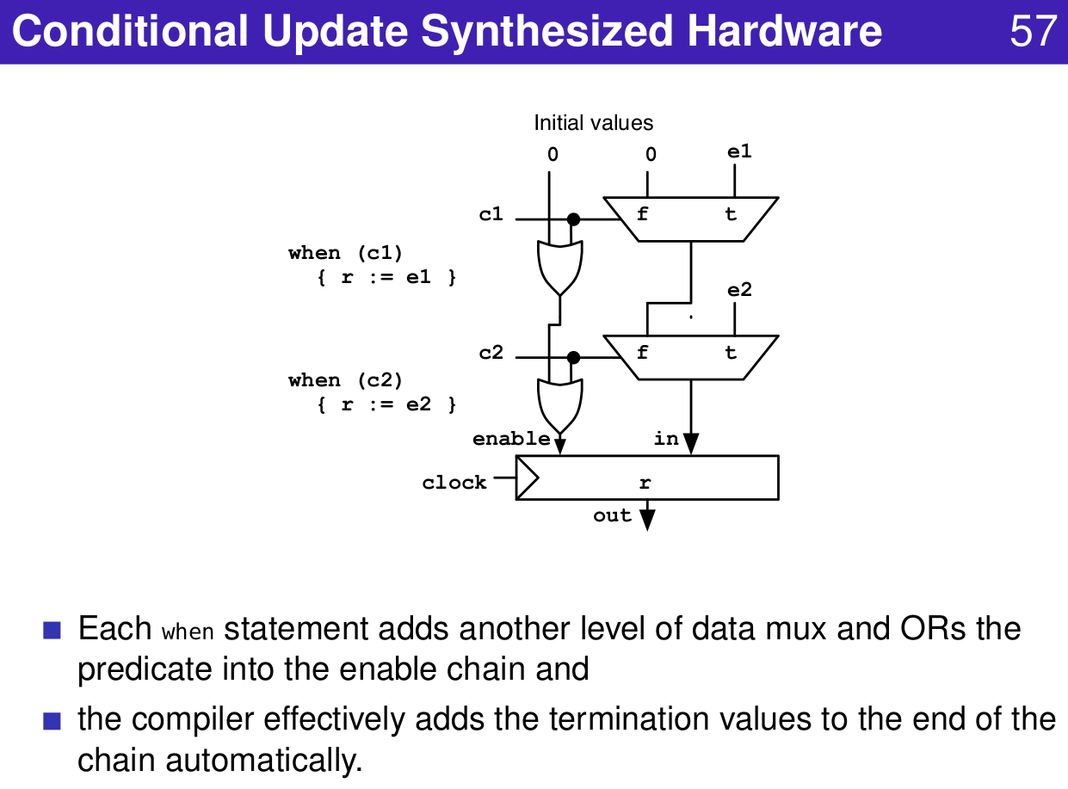
1.28 Component
https://www.youtube.com/watch?v=OPhFfNLcVsI&list=PLlu0CT-JnSasfpk8tq1ZDiE2G0AK1BhOg&index=2
Conditional Update Synthesized Hardware (24:59-30:54/1:05:46)

Slide 32
1.28 Component
https://www.youtube.com/watch?v=OPhFfNLcVsI&list=PLlu0CT-JnSasfpk8tq1ZDiE2G0AK1BhOg&index=2
Conditional Update Priority (20:44-21:03/1:05:46)

Slide 33
1.28 Component
https://www.youtube.com/watch?v=OPhFfNLcVsI&list=PLlu0CT-JnSasfpk8tq1ZDiE2G0AK1BhOg&index=2
Conditional Update Synthesized Hardware (20:44-21:03/1:05:46)

Slide 34
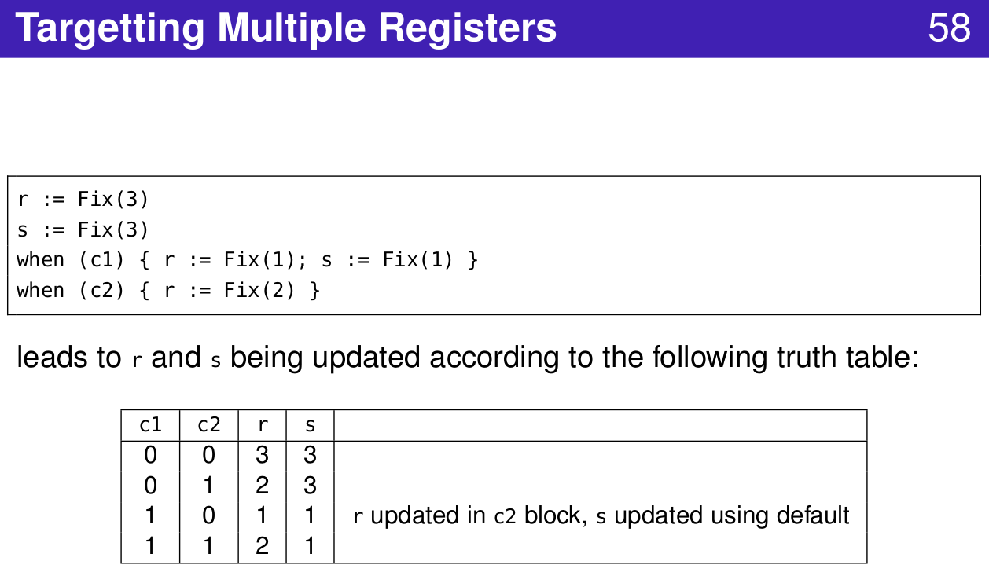
1.28 Component
https://www.youtube.com/watch?v=OPhFfNLcVsI&list=PLlu0CT-JnSasfpk8tq1ZDiE2G0AK1BhOg&index=2
Multiple Registers (20:44-21:03/1:05:46)

Slide 35
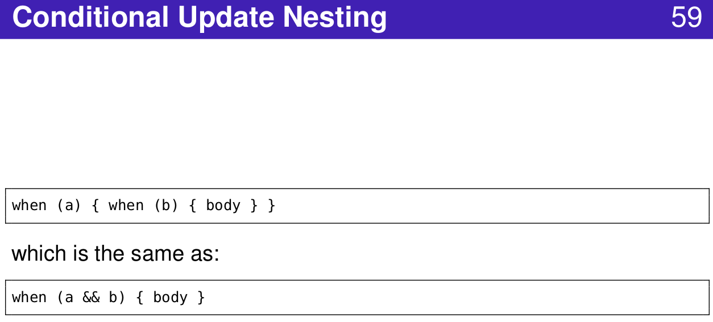
1.28 Component
https://www.youtube.com/watch?v=OPhFfNLcVsI&list=PLlu0CT-JnSasfpk8tq1ZDiE2G0AK1BhOg&index=2
Conditional Update Nesting (20:44-21:03/1:05:46)

Slide 36
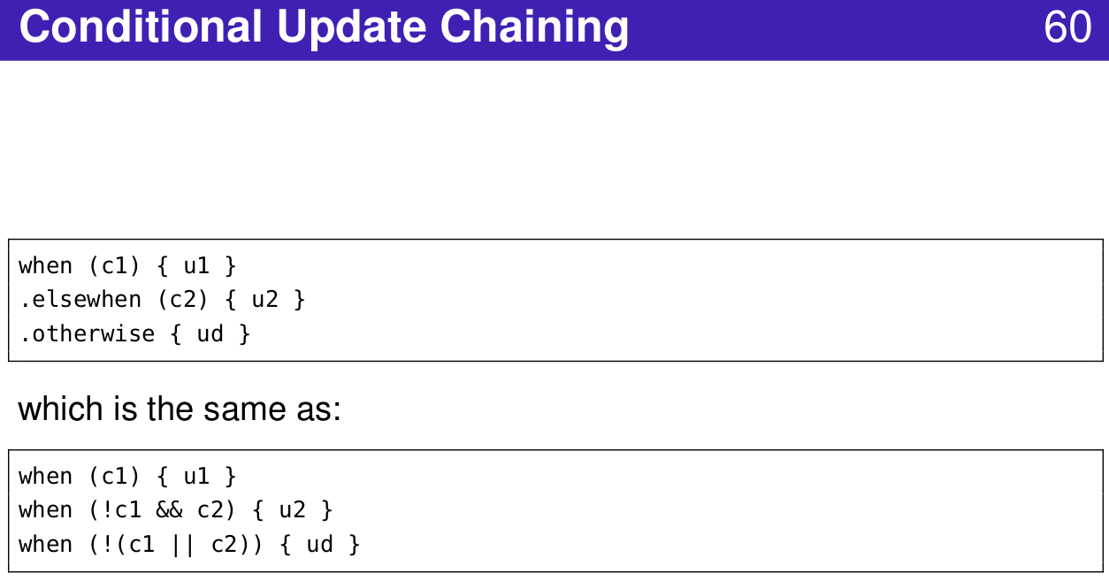
1.28 Component
https://www.youtube.com/watch?v=OPhFfNLcVsI&list=PLlu0CT-JnSasfpk8tq1ZDiE2G0AK1BhOg&index=2
Conditional Update Chaining (20:44-21:03/1:05:46)

Slide 37
1.29 FSM

Slide 38
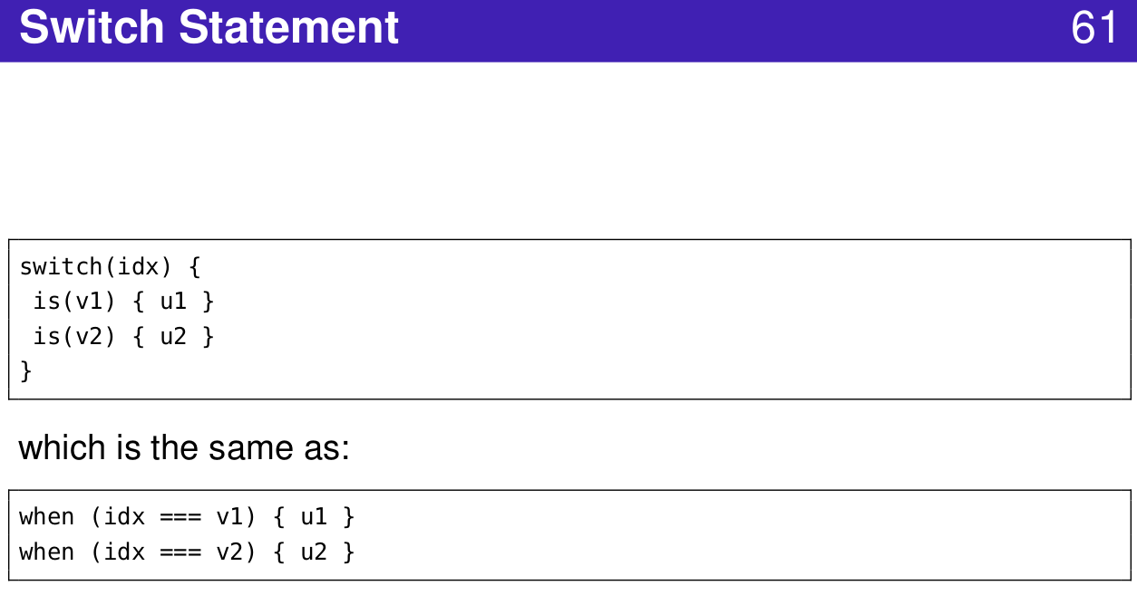
1.29 FSM
https://www.youtube.com/watch?v=OPhFfNLcVsI&list=PLlu0CT-JnSasfpk8tq1ZDiE2G0AK1BhOg&index=2
Switch Statement (20:44-21:03/1:05:46)

Slide 39
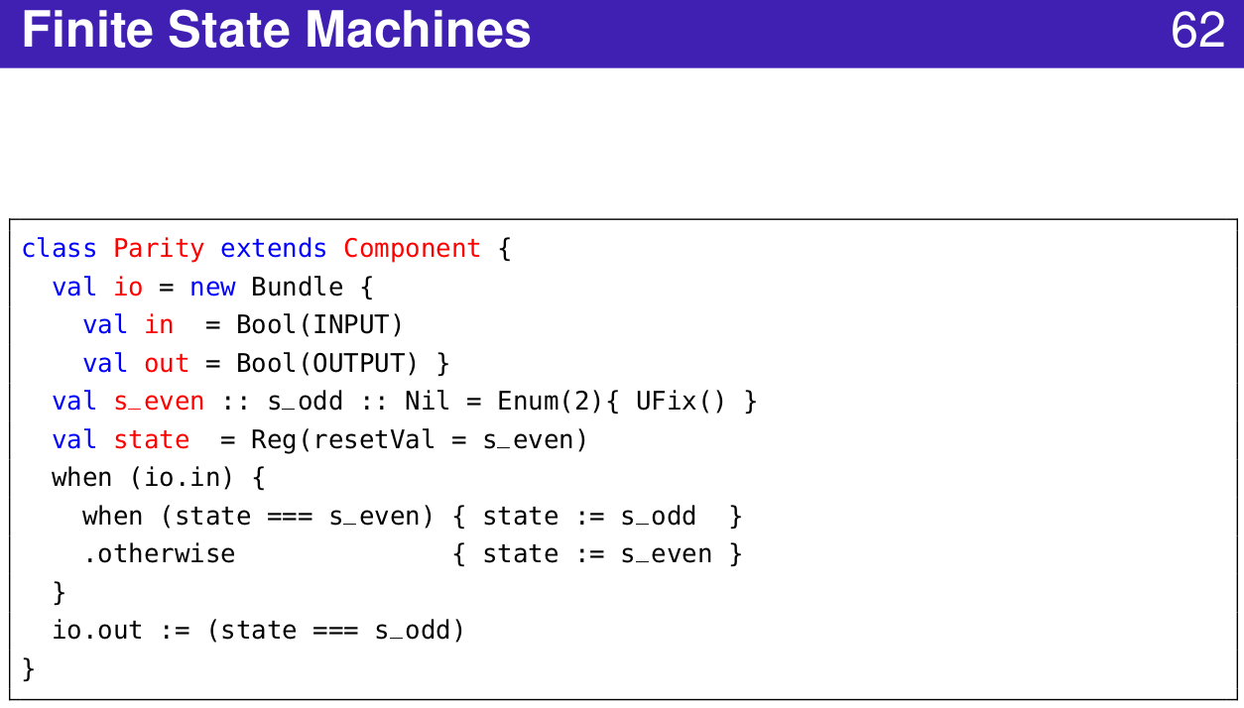
1.29 FSM
https://www.youtube.com/watch?v=OPhFfNLcVsI&list=PLlu0CT-JnSasfpk8tq1ZDiE2G0AK1BhOg&index=2
Finite State Machine (20:44-21:03/1:05:46)

Slide 40
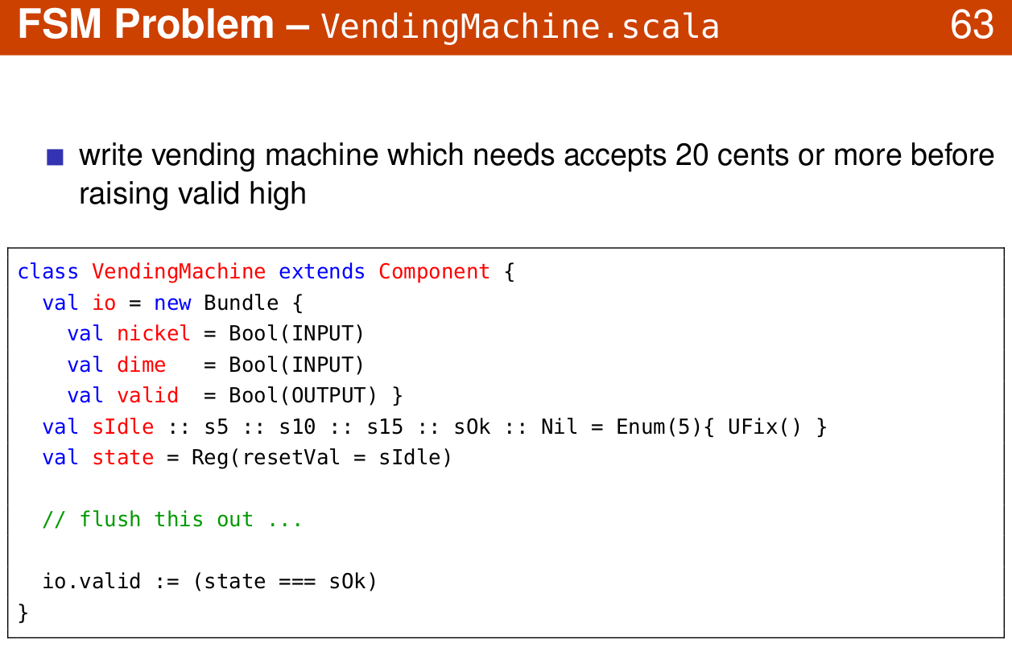
1.29 FSM
https://www.youtube.com/watch?v=OPhFfNLcVsI&list=PLlu0CT-JnSasfpk8tq1ZDiE2G0AK1BhOg&index=2
FSM: Vending Machine (20:44-21:03/1:05:46)

Slide 41
1.30 ROM

Slide 42
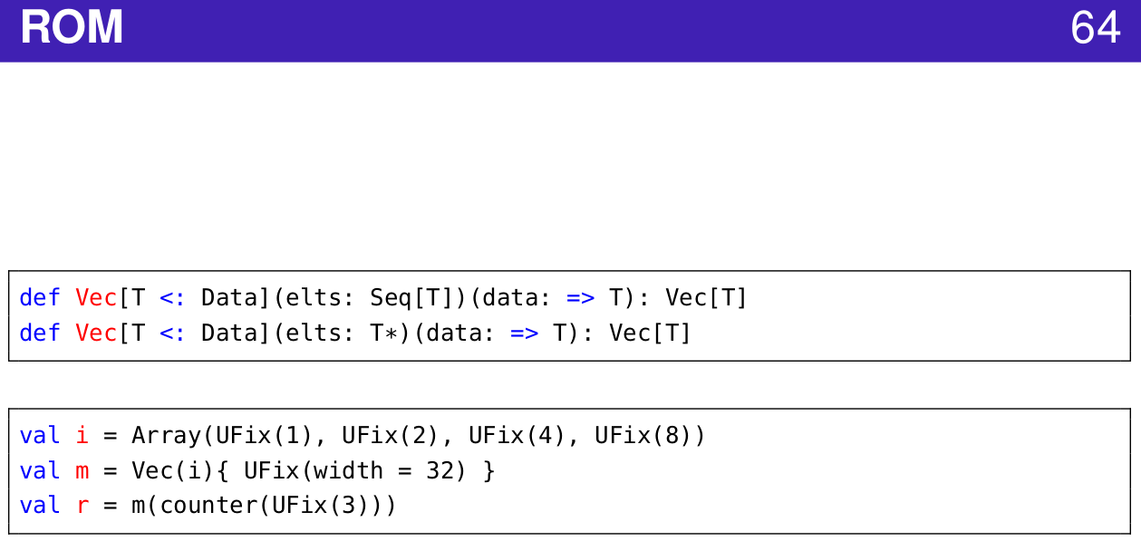
1.30 ROM
https://www.youtube.com/watch?v=OPhFfNLcVsI&list=PLlu0CT-JnSasfpk8tq1ZDiE2G0AK1BhOg&index=2
ROM (20:44-21:03/1:05:46)

Slide 43
End

