Slide 1

1.31 Look Up Table

Slide 2
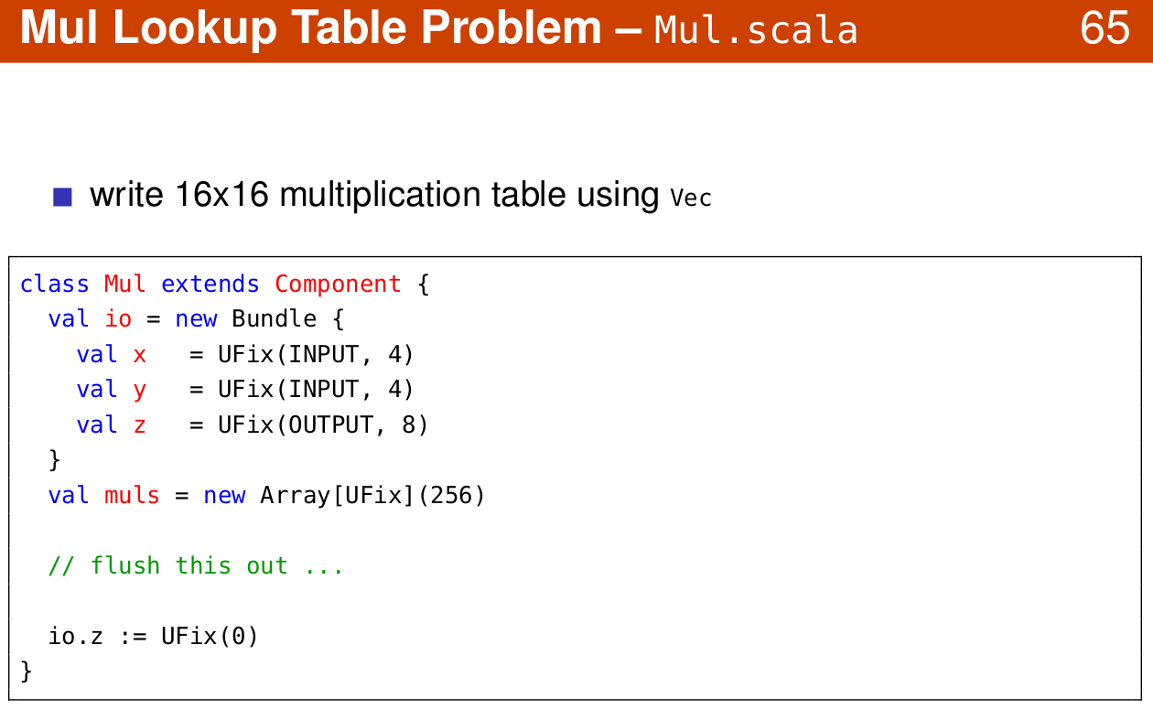
1.31 Look Up Table
https://www.youtube.com/watch?v=OPhFfNLcVsI&list=PLlu0CT-JnSasfpk8tq1ZDiE2G0AK1BhOg&index=2
Lookup Table (20:44-21:03/1:05:46)

Slide 3
1.32 Register File

Slide 4
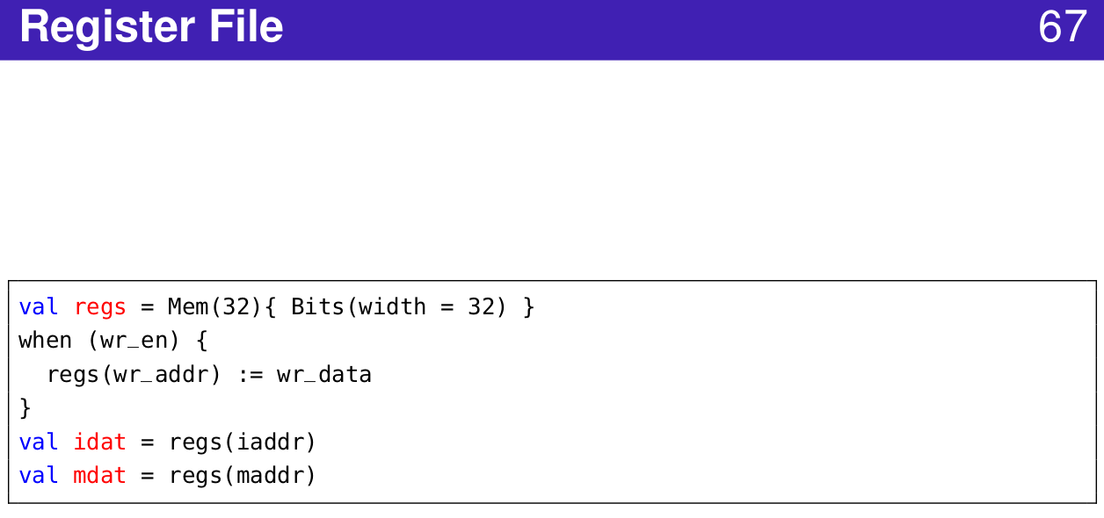
1.32 Register File
https://www.youtube.com/watch?v=OPhFfNLcVsI&list=PLlu0CT-JnSasfpk8tq1ZDiE2G0AK1BhOg&index=2
Register File (20:44-21:03/1:05:46)

Slide 5
1.33 Memory

Slide 6
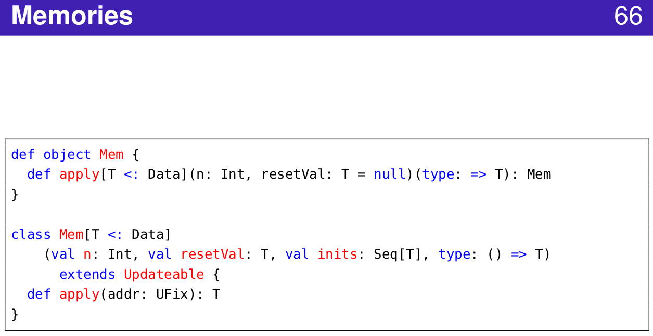
1.33 Memory
https://www.youtube.com/watch?v=OPhFfNLcVsI&list=PLlu0CT-JnSasfpk8tq1ZDiE2G0AK1BhOg&index=2
Memory (20:44-21:03/1:05:46)

Slide 7
1.34 Table

Slide 8
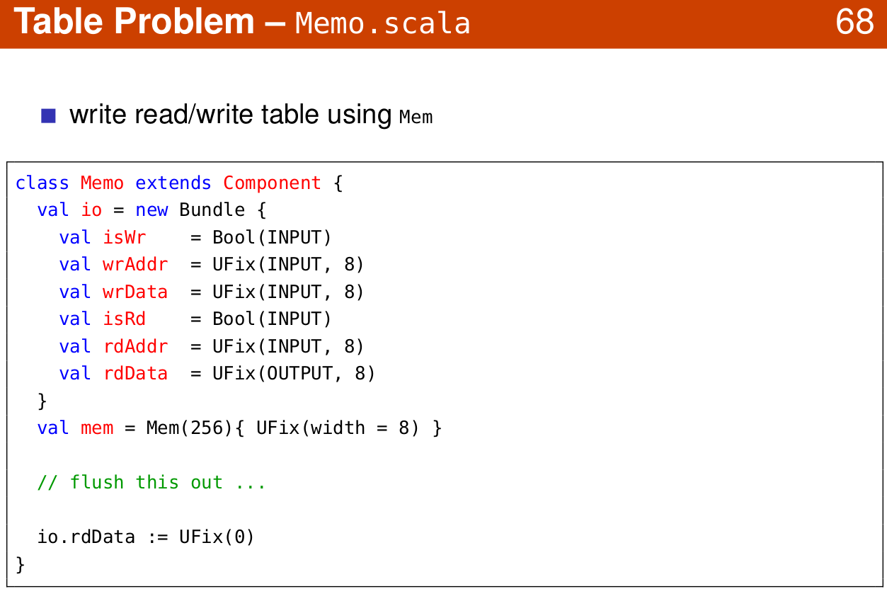
1.34 Table
https://www.youtube.com/watch?v=OPhFfNLcVsI&list=PLlu0CT-JnSasfpk8tq1ZDiE2G0AK1BhOg&index=2
Table (20:44-21:03/1:05:46)

Slide 9
1.35 Port

Slide 10
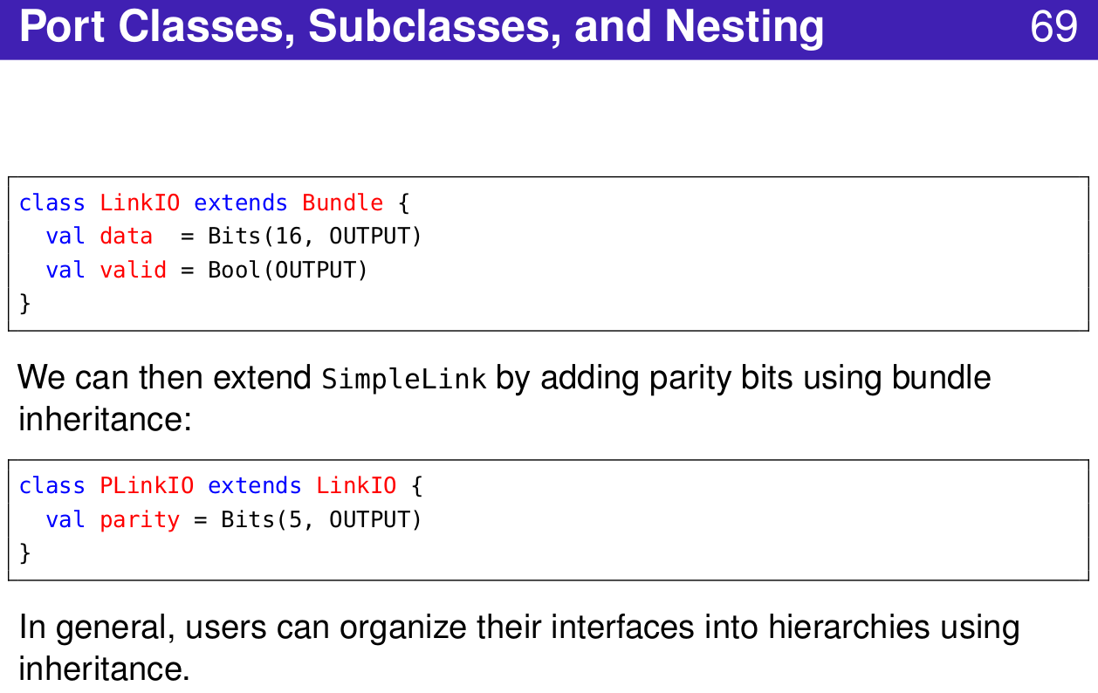
1.35 Port
https://www.youtube.com/watch?v=OPhFfNLcVsI&list=PLlu0CT-JnSasfpk8tq1ZDiE2G0AK1BhOg&index=2
Port Class (20:44-21:03/1:05:46)

Slide 11
1.36 Filter

Slide 12
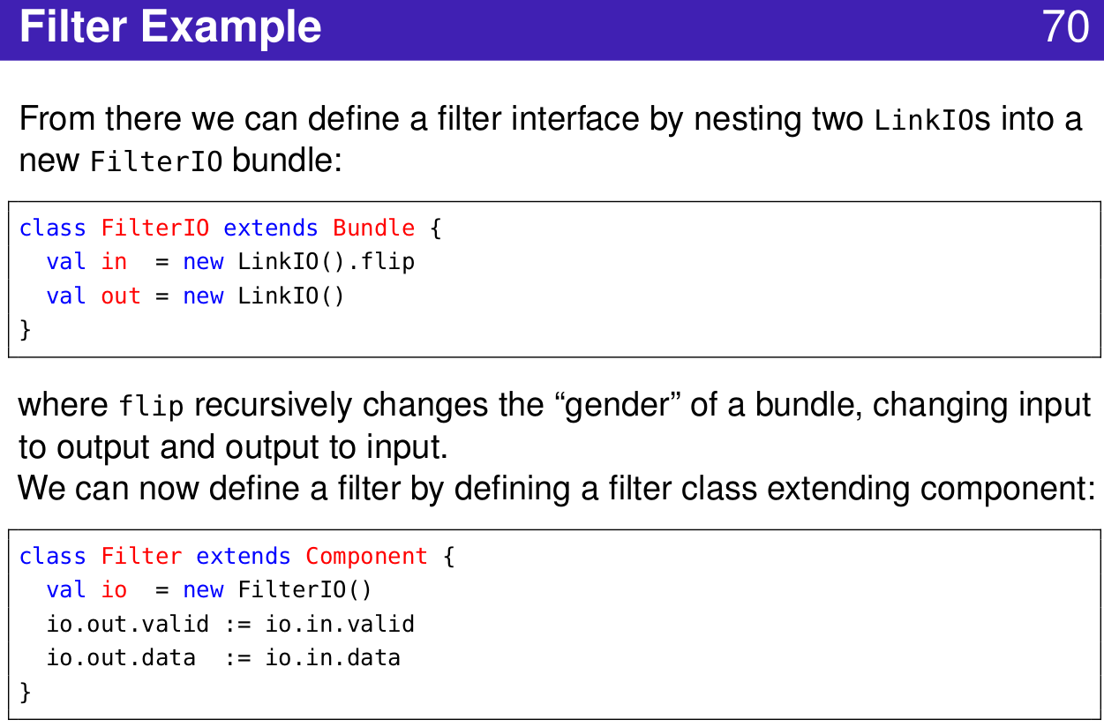
1.36 Filter
https://www.youtube.com/watch?v=OPhFfNLcVsI&list=PLlu0CT-JnSasfpk8tq1ZDiE2G0AK1BhOg&index=2
Filter (20:44-21:03/1:05:46)

Slide 13
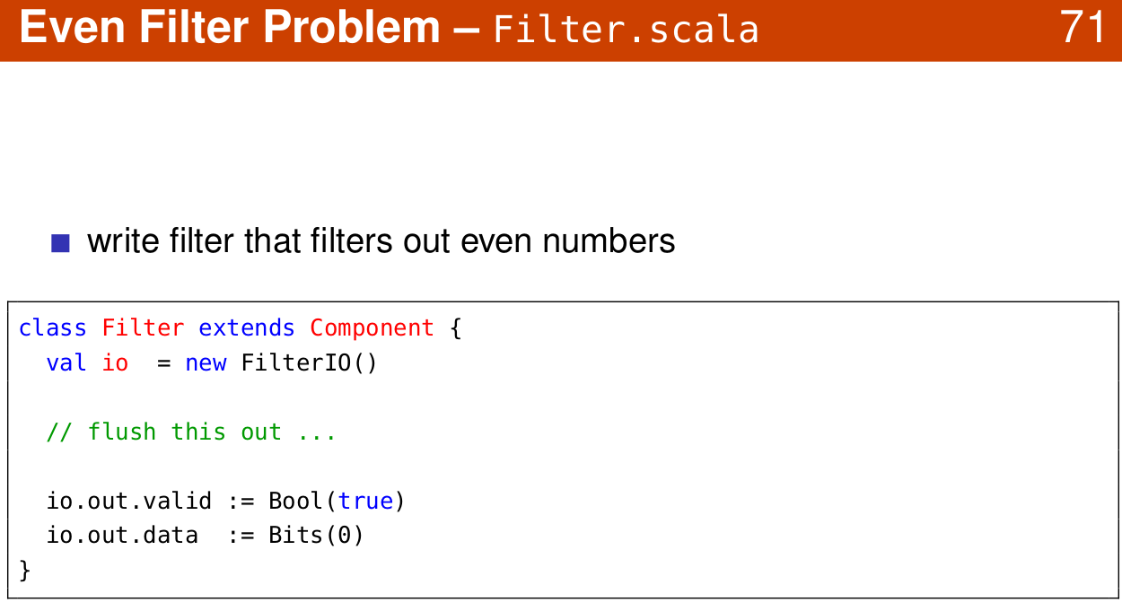
1.36 Filter
https://www.youtube.com/watch?v=OPhFfNLcVsI&list=PLlu0CT-JnSasfpk8tq1ZDiE2G0AK1BhOg&index=2
Filter (20:44-21:03/1:05:46)

Slide 14
1.37 Decoupled Circuit

Slide 15
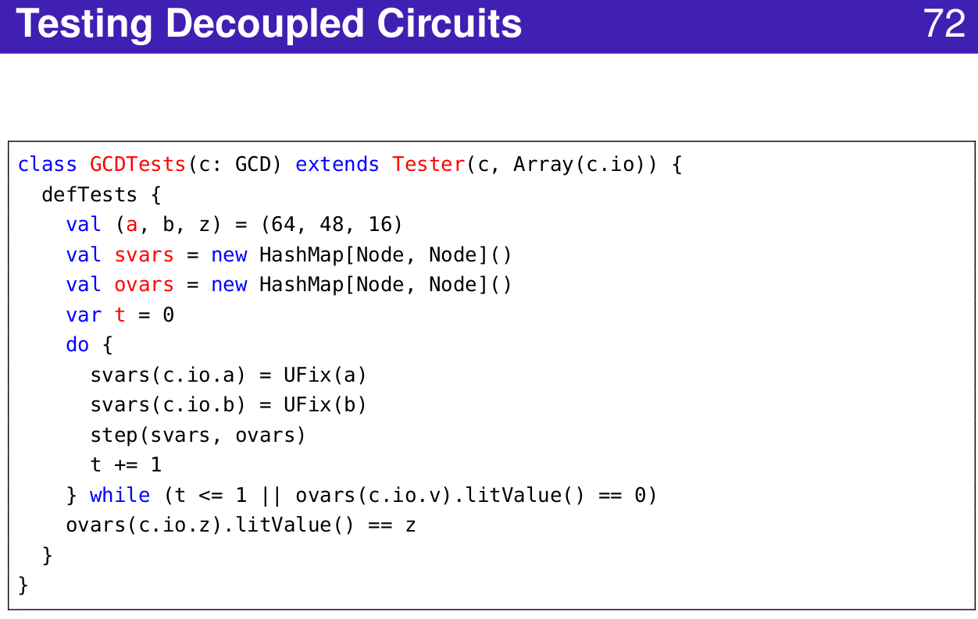
1.37 Decoupled Circuit
https://www.youtube.com/watch?v=OPhFfNLcVsI&list=PLlu0CT-JnSasfpk8tq1ZDiE2G0AK1BhOg&index=2
Decoupled Circuit (20:44-21:03/1:05:46)

Slide 16
1.38 Bundle Vector

Slide 17
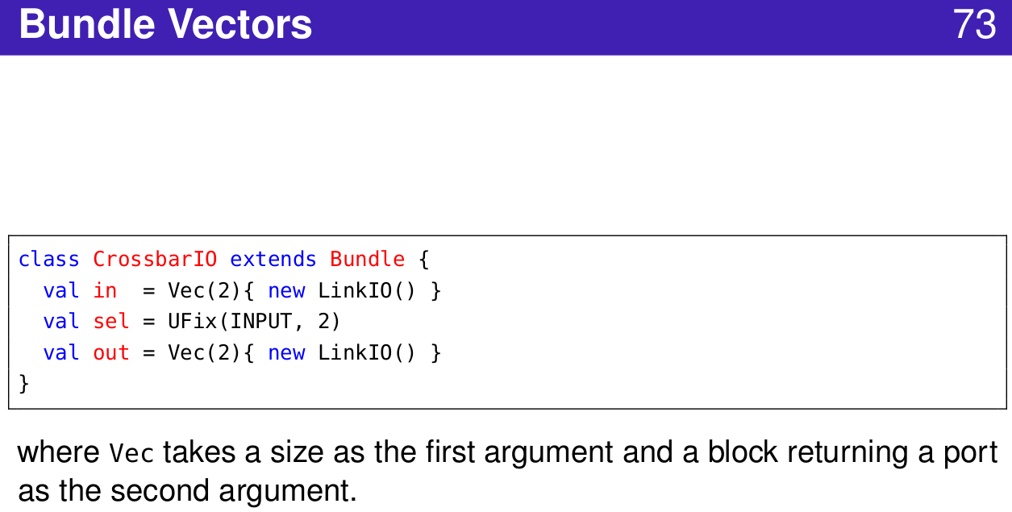
1.38 Bundle Vector
https://www.youtube.com/watch?v=OPhFfNLcVsI&list=PLlu0CT-JnSasfpk8tq1ZDiE2G0AK1BhOg&index=2
Bundle Vector (20:44-21:03/1:05:46)

Slide 18
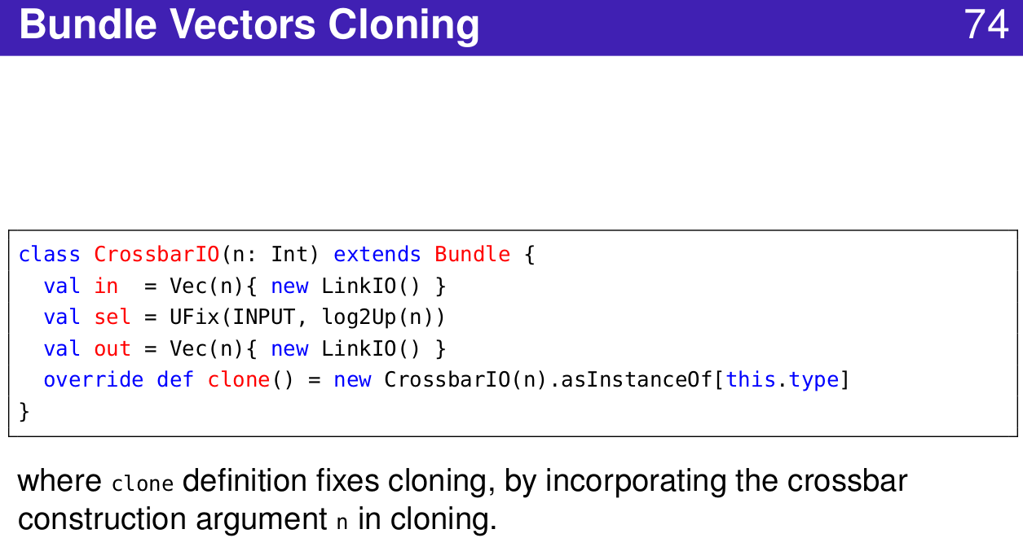
1.38 Bundle Vector
https://www.youtube.com/watch?v=OPhFfNLcVsI&list=PLlu0CT-JnSasfpk8tq1ZDiE2G0AK1BhOg&index=2
Bundle Vector Clone (20:44-21:03/1:05:46)

Slide 19
1.39 Bulk

Slide 20
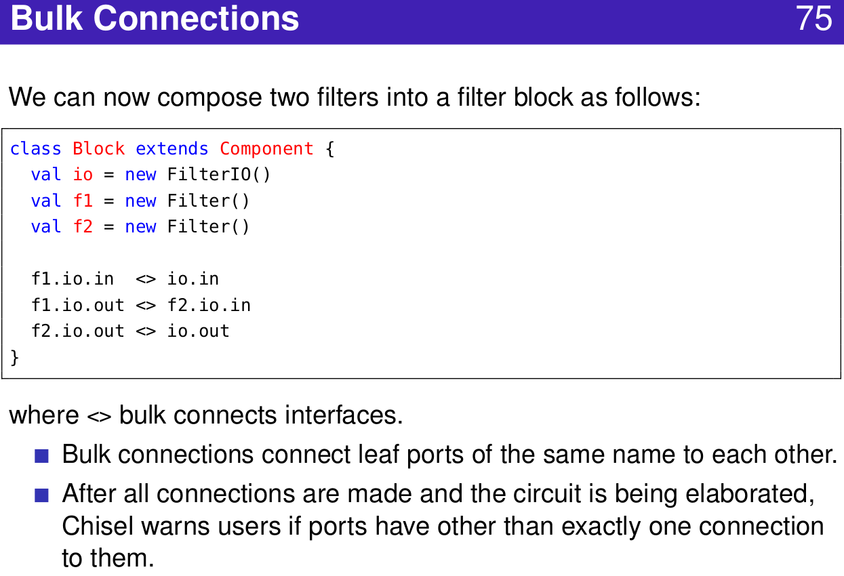
1.39 Bulk
https://www.youtube.com/watch?v=OPhFfNLcVsI&list=PLlu0CT-JnSasfpk8tq1ZDiE2G0AK1BhOg&index=2
Bulk Connection (20:44-21:03/1:05:46)

Slide 21
1.40 Parameterize Function

Slide 22
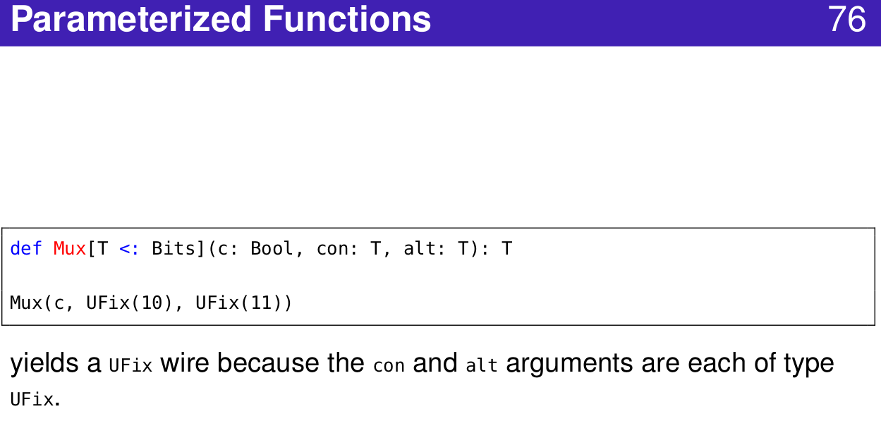
1.40 Parameterize Function
https://www.youtube.com/watch?v=OPhFfNLcVsI&list=PLlu0CT-JnSasfpk8tq1ZDiE2G0AK1BhOg&index=2
Parameterized Function (20:44-21:03/1:05:46)

Slide 23
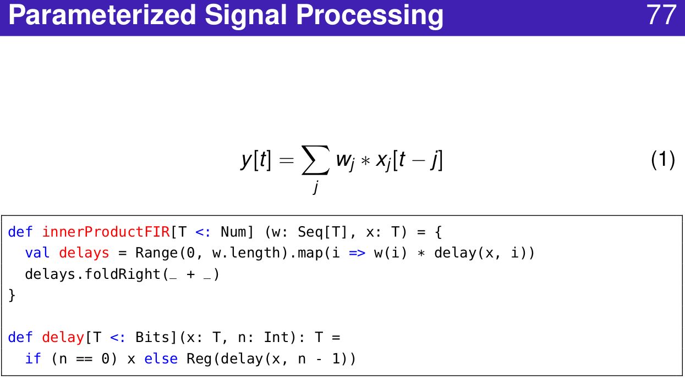
1.40 Parameterize Function
https://www.youtube.com/watch?v=OPhFfNLcVsI&list=PLlu0CT-JnSasfpk8tq1ZDiE2G0AK1BhOg&index=2
Parameterized Signal Processing (20:44-21:03/1:05:46)

Slide 24
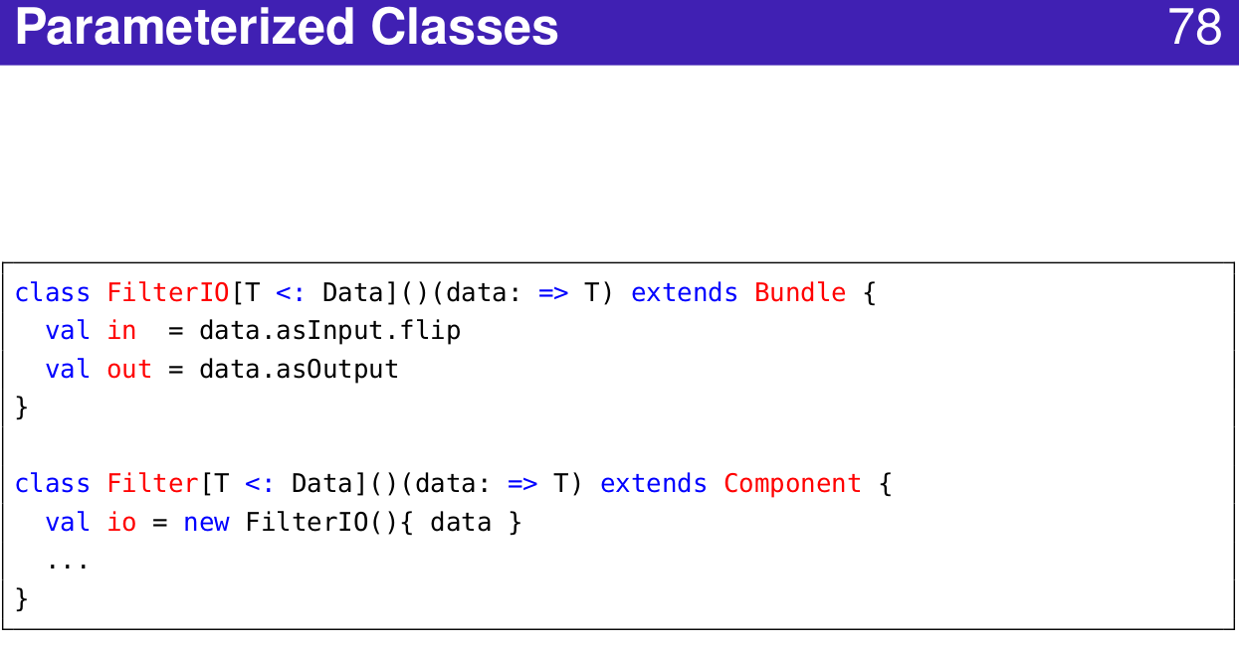
1.40 Parameterize Function
https://www.youtube.com/watch?v=OPhFfNLcVsI&list=PLlu0CT-JnSasfpk8tq1ZDiE2G0AK1BhOg&index=2
Parameterized Class (20:44-21:03/1:05:46)

Slide 25
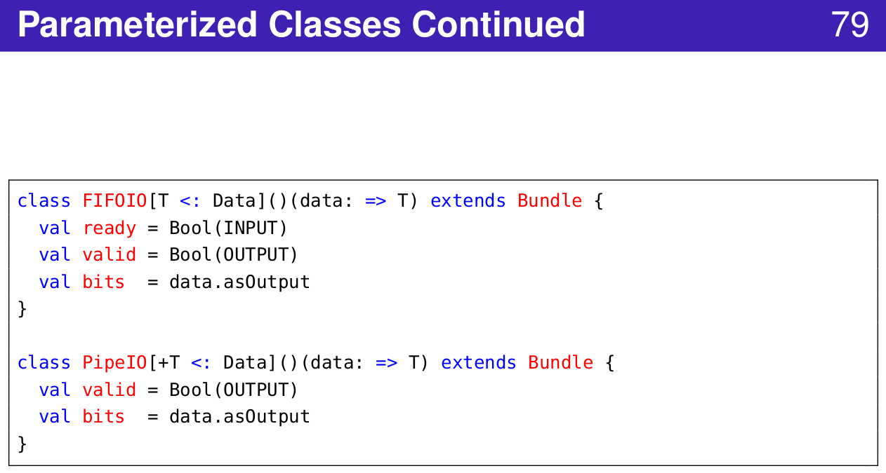
1.40 Parameterize Function
https://www.youtube.com/watch?v=OPhFfNLcVsI&list=PLlu0CT-JnSasfpk8tq1ZDiE2G0AK1BhOg&index=2
Parameterized Class (20:44-21:03/1:05:46)

Slide 26
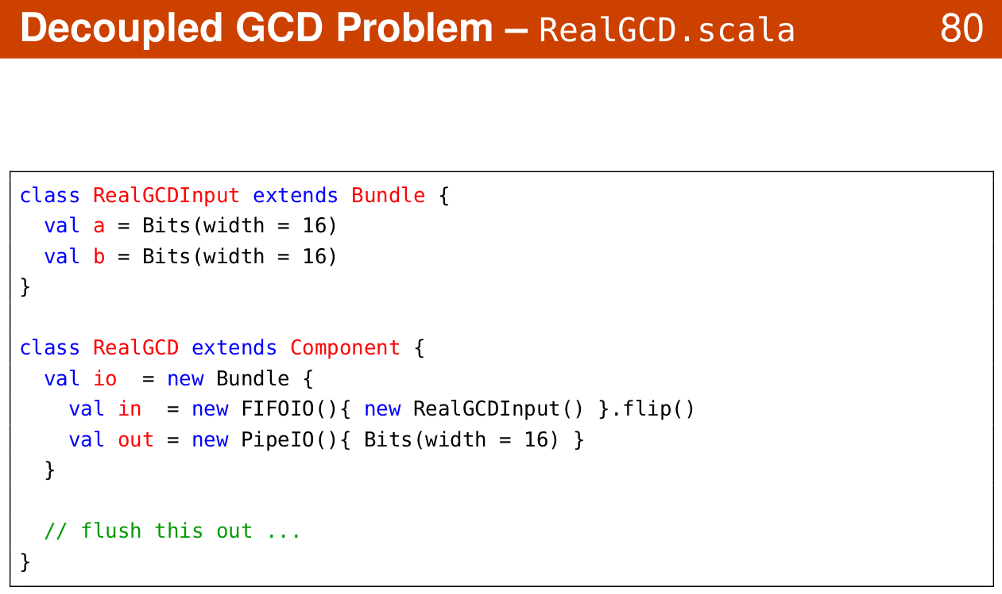
1.40 Parameterize Function
https://www.youtube.com/watch?v=OPhFfNLcVsI&list=PLlu0CT-JnSasfpk8tq1ZDiE2G0AK1BhOg&index=2
Decoupled GCD (20:44-21:03/1:05:46)

Slide 27
1.41 FIFO IO

Slide 28
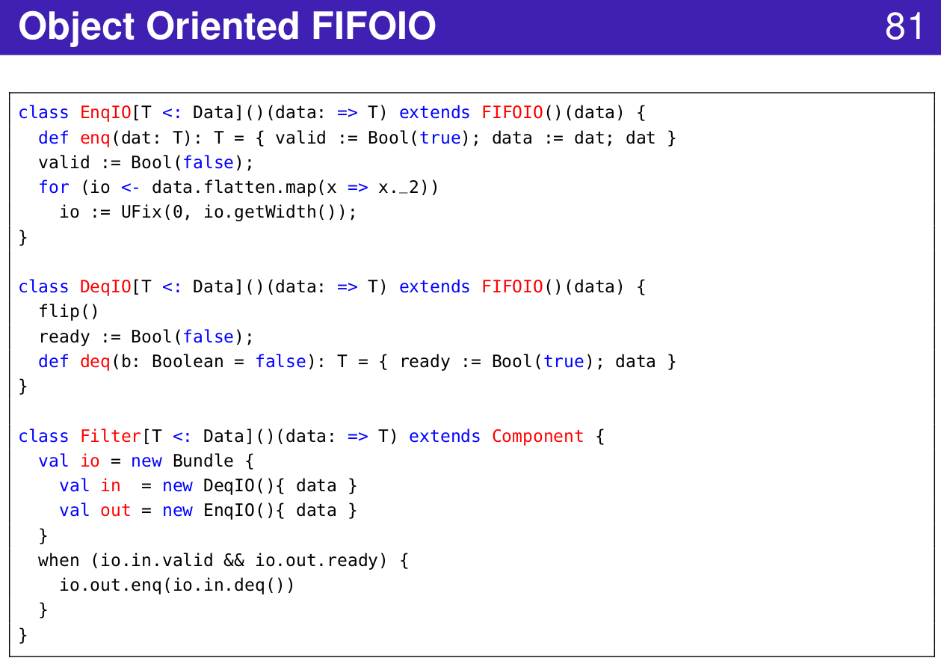
1.41 FIFO IO
https://www.youtube.com/watch?v=OPhFfNLcVsI&list=PLlu0CT-JnSasfpk8tq1ZDiE2G0AK1BhOg&index=2
FIFO IO (20:44-21:03/1:05:46)

Slide 29
1.42 Router

Slide 30
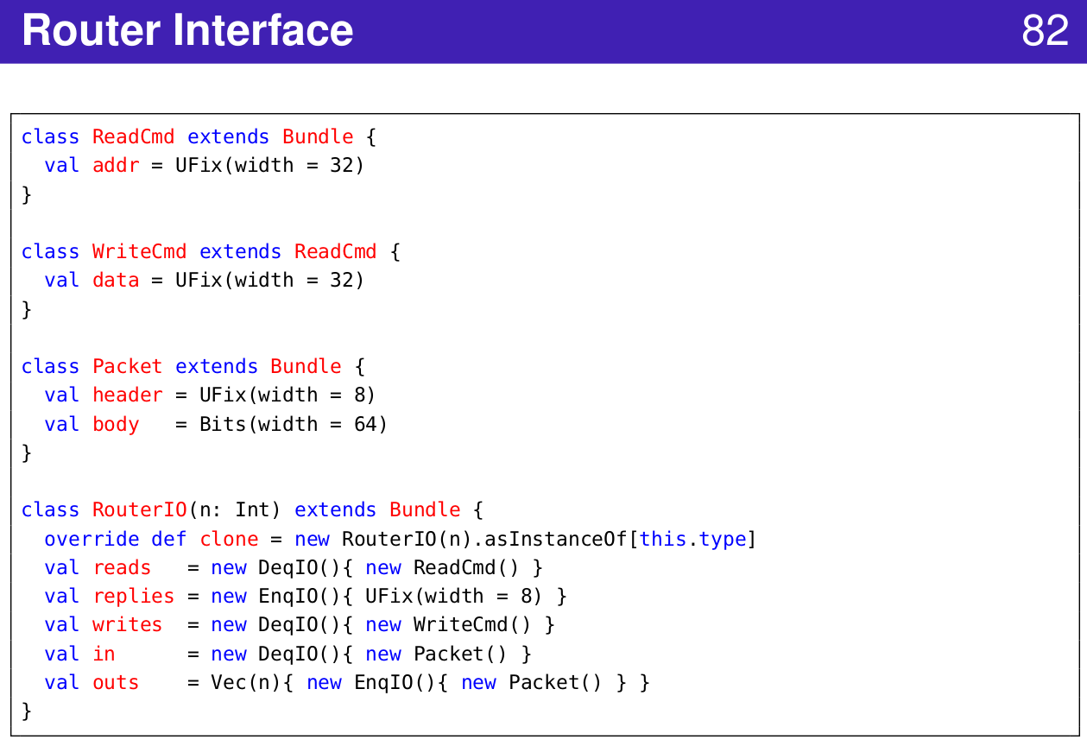
1.42 Router
https://www.youtube.com/watch?v=OPhFfNLcVsI&list=PLlu0CT-JnSasfpk8tq1ZDiE2G0AK1BhOg&index=2
Router Interface (20:44-21:03/1:05:46)

Slide 31
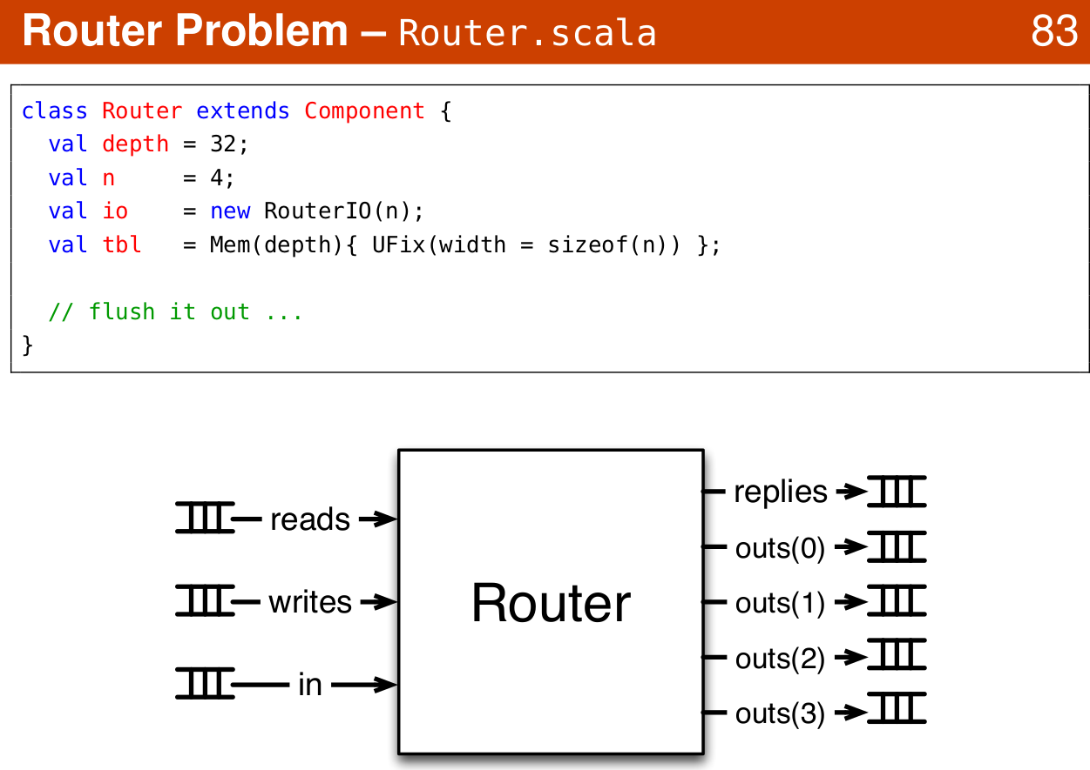
1.42 Router
https://www.youtube.com/watch?v=OPhFfNLcVsI&list=PLlu0CT-JnSasfpk8tq1ZDiE2G0AK1BhOg&index=2
Router Example (20:44-21:03/1:05:46)

Slide 32
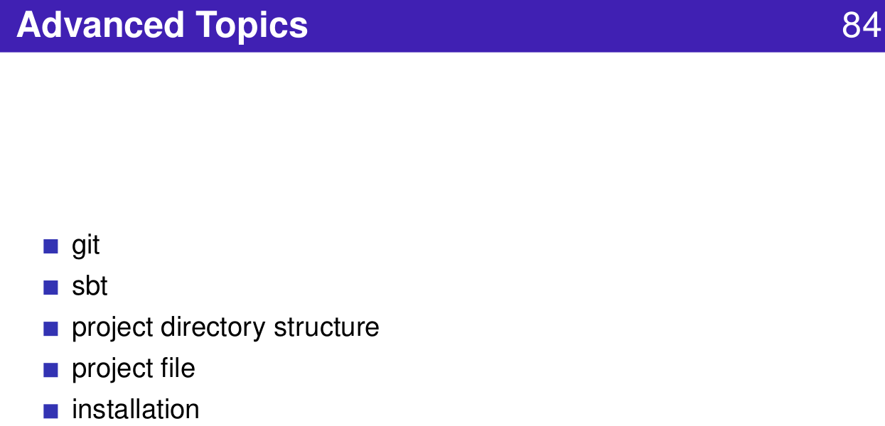
1.11 Define Construct Function
https://www.youtube.com/watch?v=OPhFfNLcVsI&list=PLlu0CT-JnSasfpk8tq1ZDiE2G0AK1BhOg&index=2
Advanced Topics (20:44-21:03/1:05:46)

Slide 33
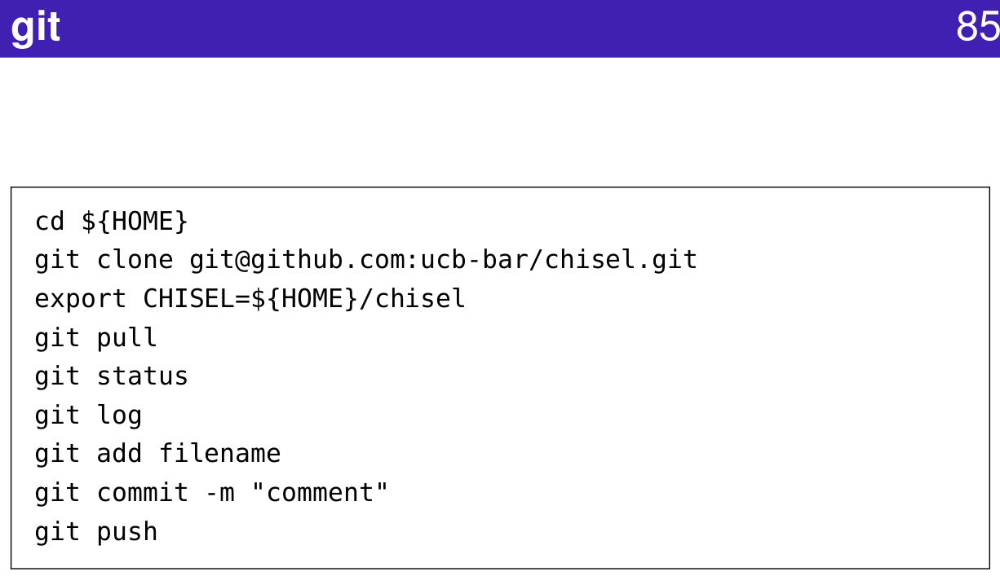
1.11 Define Construct Function
https://www.youtube.com/watch?v=OPhFfNLcVsI&list=PLlu0CT-JnSasfpk8tq1ZDiE2G0AK1BhOg&index=2
GIT (20:44-21:03/1:05:46)

Slide 34
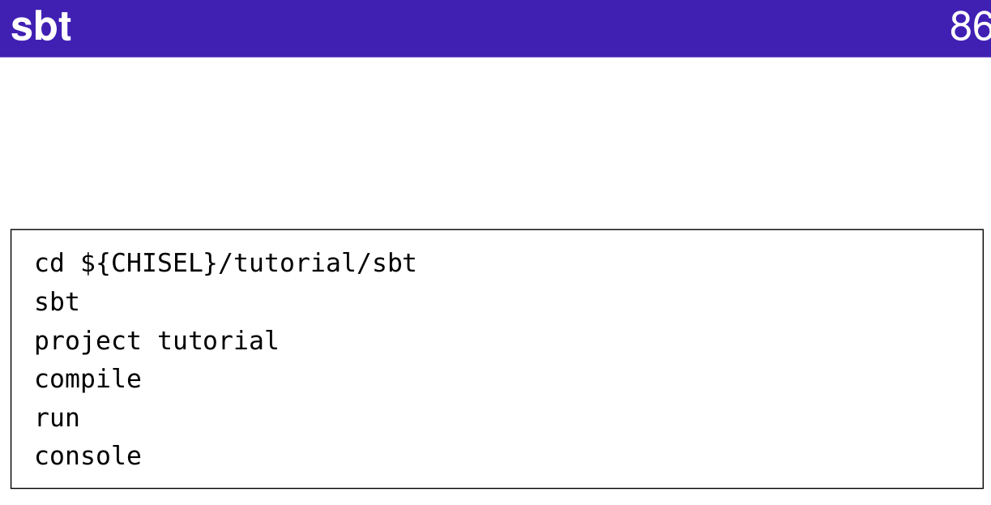
1.11 Define Construct Function
https://www.youtube.com/watch?v=OPhFfNLcVsI&list=PLlu0CT-JnSasfpk8tq1ZDiE2G0AK1BhOg&index=2
SBT (20:44-21:03/1:05:46)
SBT (Scala Build Tool)

Slide 35
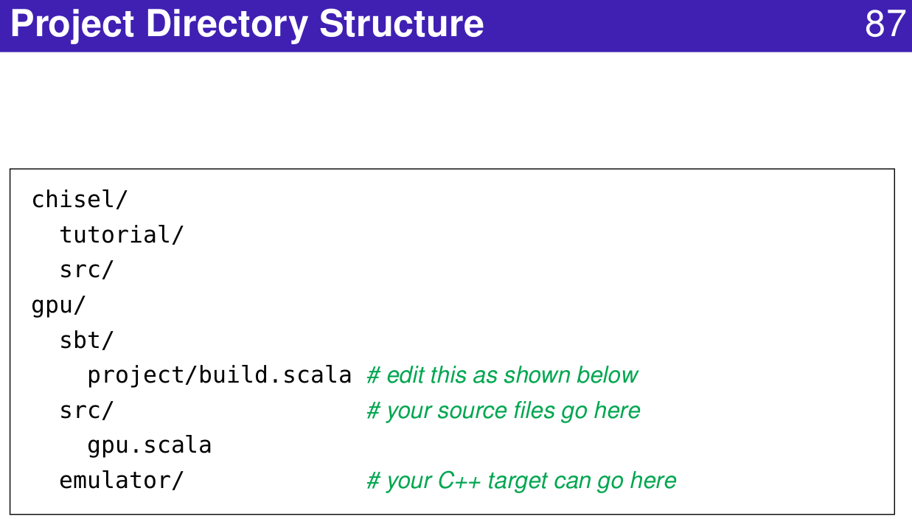
1.11 Define Construct Function
https://www.youtube.com/watch?v=OPhFfNLcVsI&list=PLlu0CT-JnSasfpk8tq1ZDiE2G0AK1BhOg&index=2
Project Directory Structure (20:44-21:03/1:05:46)

Slide 36
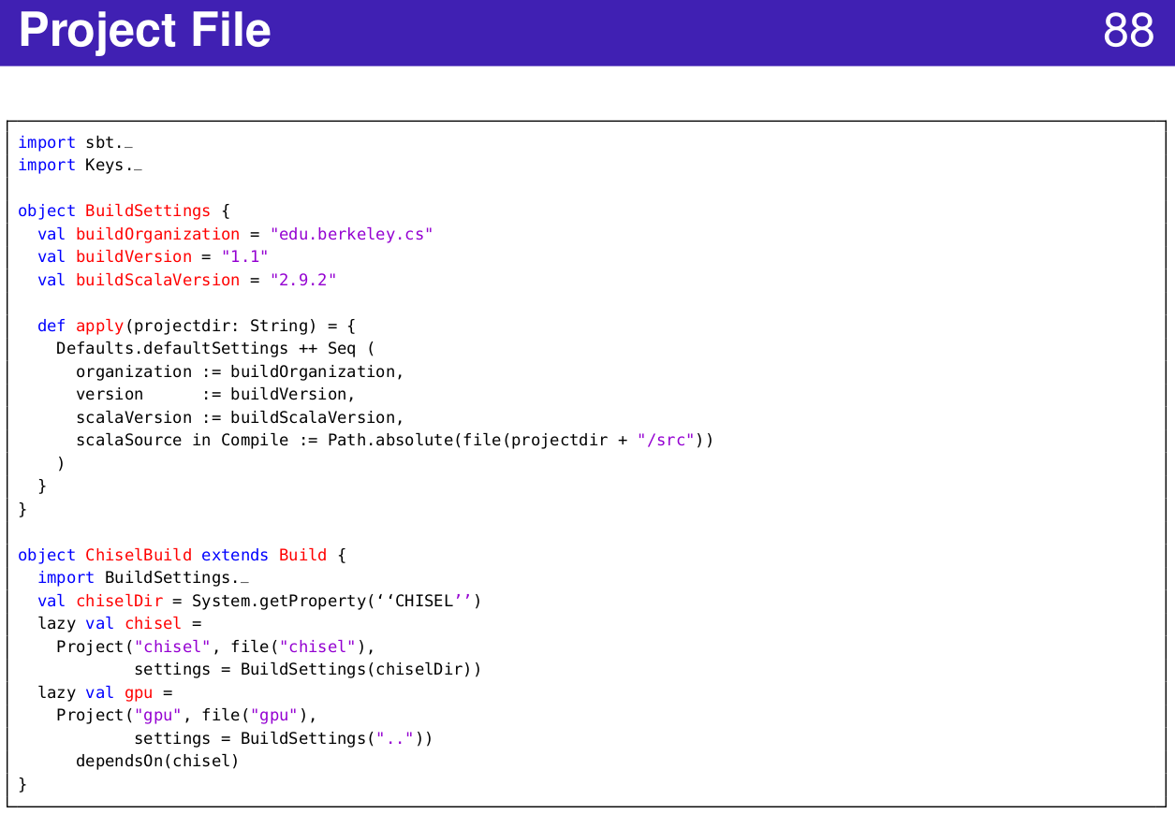
1.11 Define Construct Function
https://www.youtube.com/watch?v=OPhFfNLcVsI&list=PLlu0CT-JnSasfpk8tq1ZDiE2G0AK1BhOg&index=2
Project File (20:44-21:03/1:05:46)

Slide 37
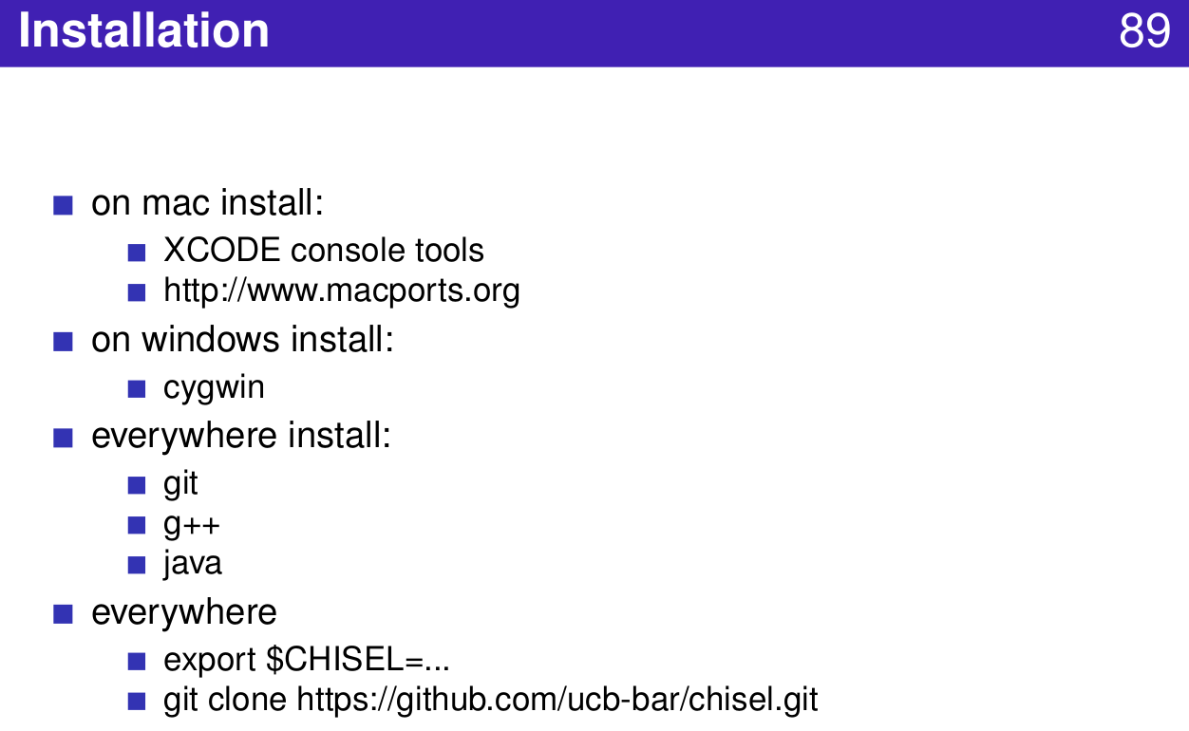
1.11 Define Construct Function
https://www.youtube.com/watch?v=OPhFfNLcVsI&list=PLlu0CT-JnSasfpk8tq1ZDiE2G0AK1BhOg&index=2
Installation (20:44-21:03/1:05:46)

Slide 38
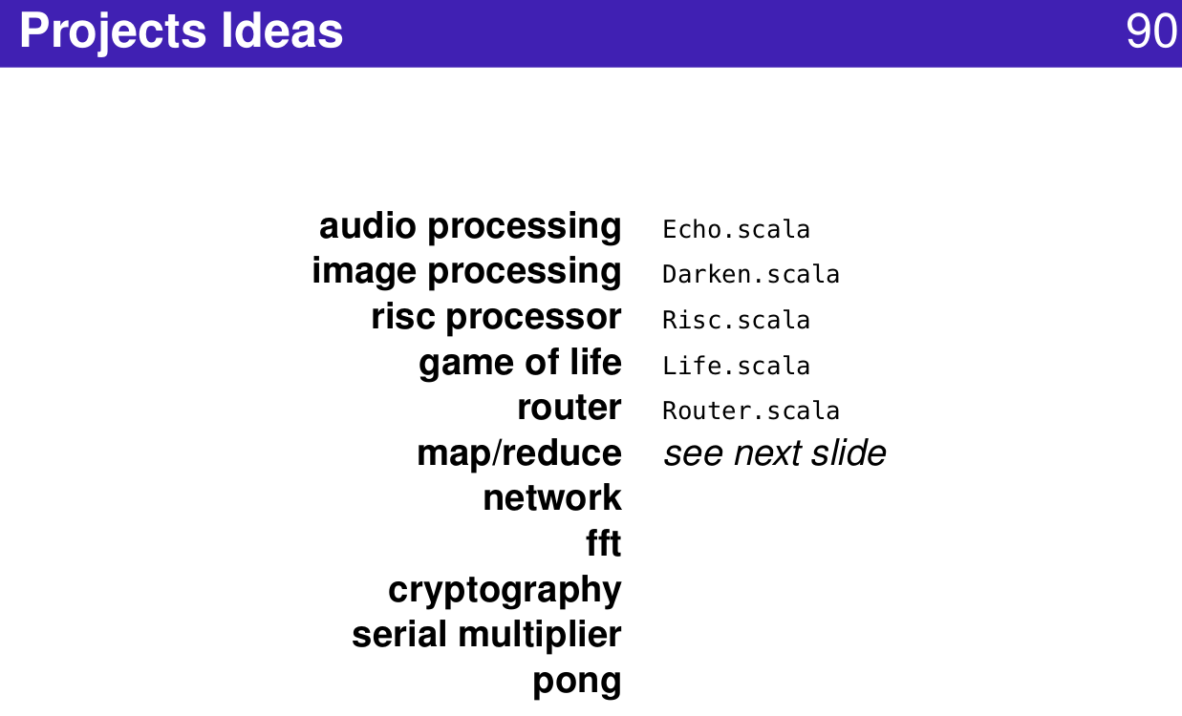
1.11 Define Construct Function
https://www.youtube.com/watch?v=OPhFfNLcVsI&list=PLlu0CT-JnSasfpk8tq1ZDiE2G0AK1BhOg&index=2
Projects (20:44-21:03/1:05:46)

Slide 39
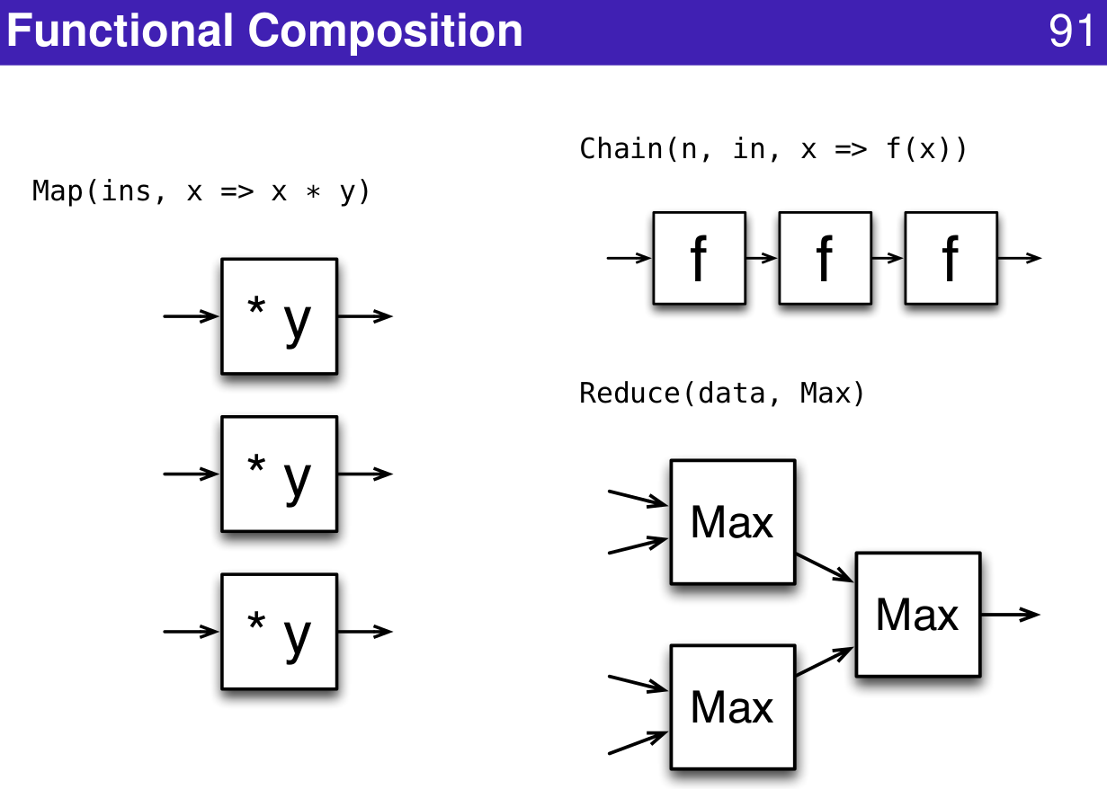
1.11 Define Construct Function
https://www.youtube.com/watch?v=OPhFfNLcVsI&list=PLlu0CT-JnSasfpk8tq1ZDiE2G0AK1BhOg&index=2
Functional Composition (20:44-21:03/1:05:46)

Slide 40
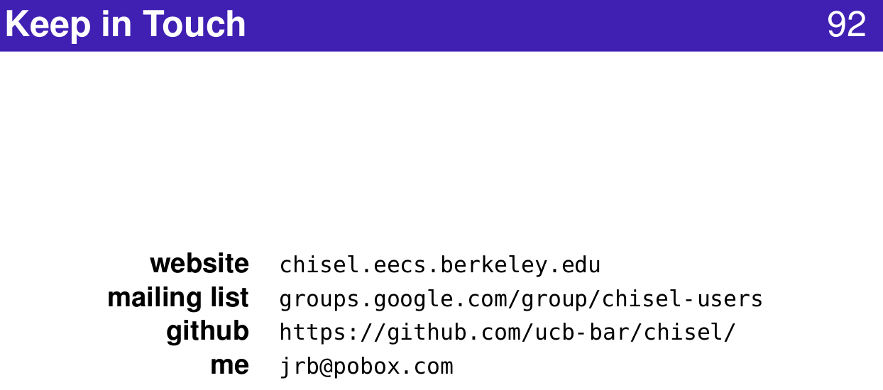
1.11 Define Construct Function
https://www.youtube.com/watch?v=OPhFfNLcVsI&list=PLlu0CT-JnSasfpk8tq1ZDiE2G0AK1BhOg&index=2
Community (20:44-21:03/1:05:46)

Slide 41
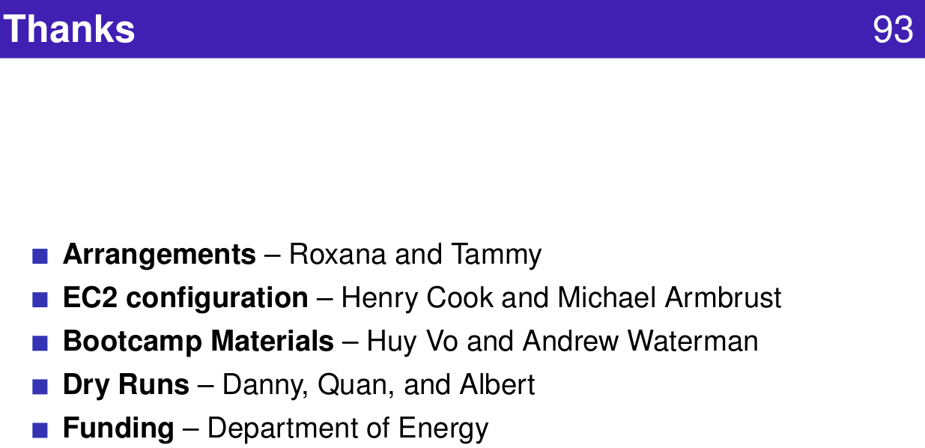
1.11 Define Construct Function
https://www.youtube.com/watch?v=OPhFfNLcVsI&list=PLlu0CT-JnSasfpk8tq1ZDiE2G0AK1BhOg&index=2
Funding (20:44-21:03/1:05:46)

Slide 42
End

