Slide 1

1.41 FIFO IO

Slide 2
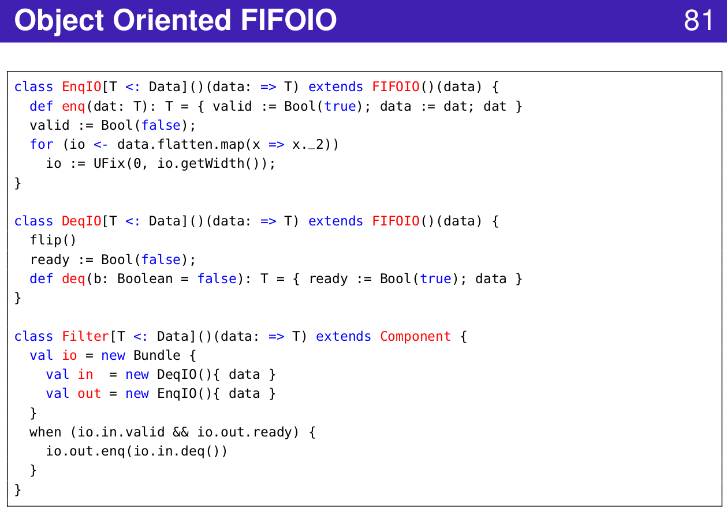
1.41 FIFO IO
https://www.youtube.com/watch?v=OPhFfNLcVsI&list=PLlu0CT-JnSasfpk8tq1ZDiE2G0AK1BhOg&index=2
FIFO IO (20:44-21:03/1:05:46)

Slide 3
1.42 Router

Slide 4
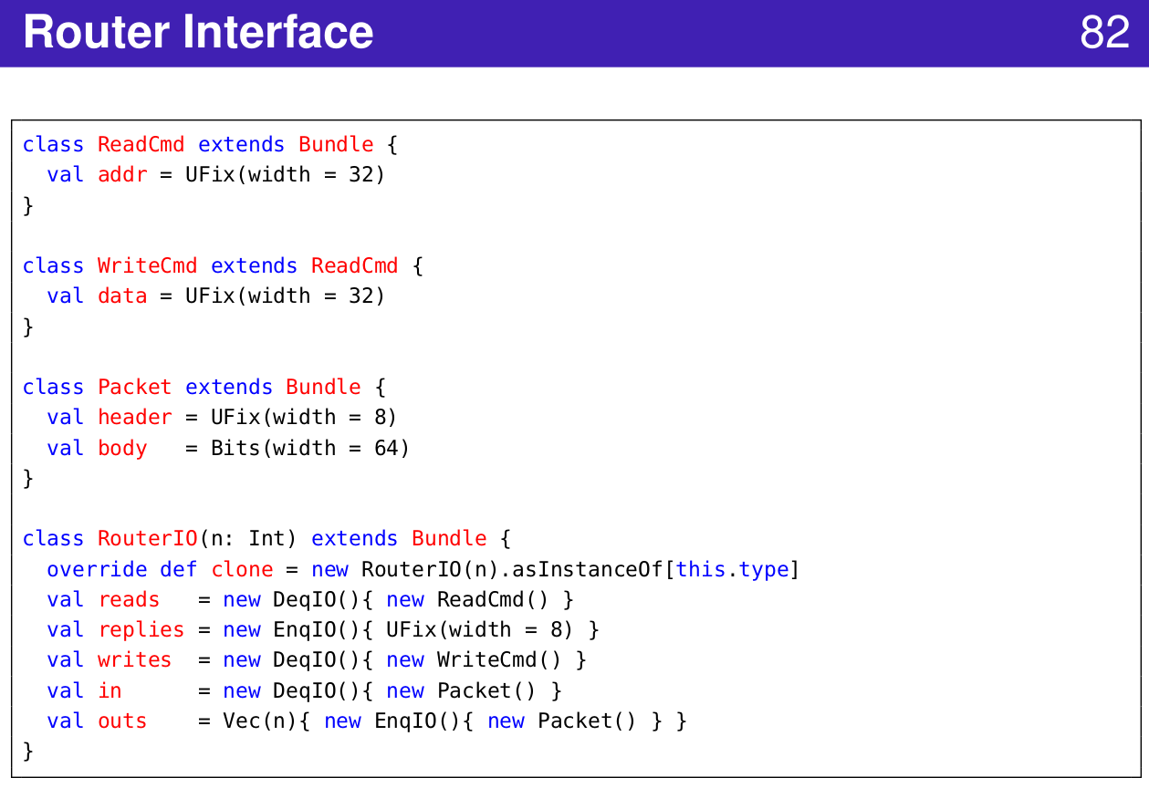
1.42 Router
https://www.youtube.com/watch?v=OPhFfNLcVsI&list=PLlu0CT-JnSasfpk8tq1ZDiE2G0AK1BhOg&index=2
Router Interface (20:44-21:03/1:05:46)

Slide 5
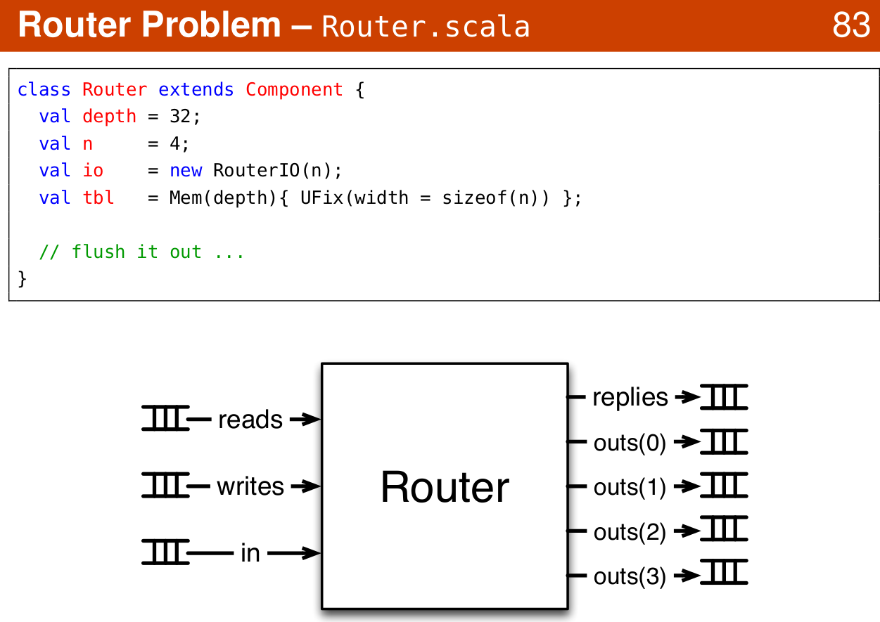
1.42 Router
https://www.youtube.com/watch?v=OPhFfNLcVsI&list=PLlu0CT-JnSasfpk8tq1ZDiE2G0AK1BhOg&index=2
Router Example (20:44-21:03/1:05:46)

Slide 6
1.43 Advanced Topics

Slide 7
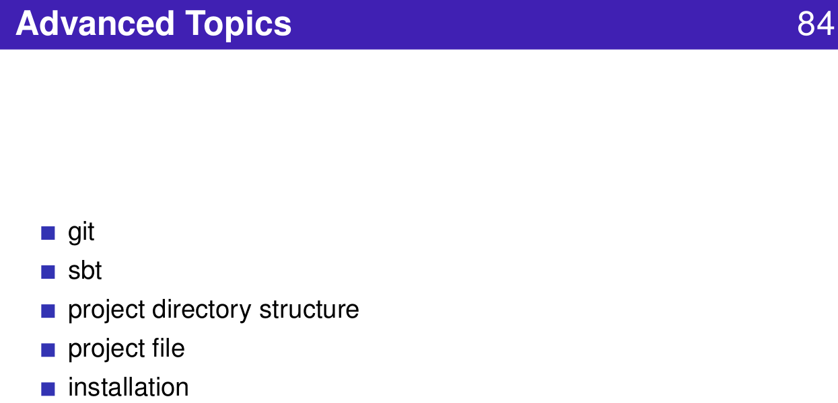
1.43 Advanced Topics
https://www.youtube.com/watch?v=OPhFfNLcVsI&list=PLlu0CT-JnSasfpk8tq1ZDiE2G0AK1BhOg&index=2
Advanced Topics (20:44-21:03/1:05:46)

Slide 8
1.44 GIT

Slide 9
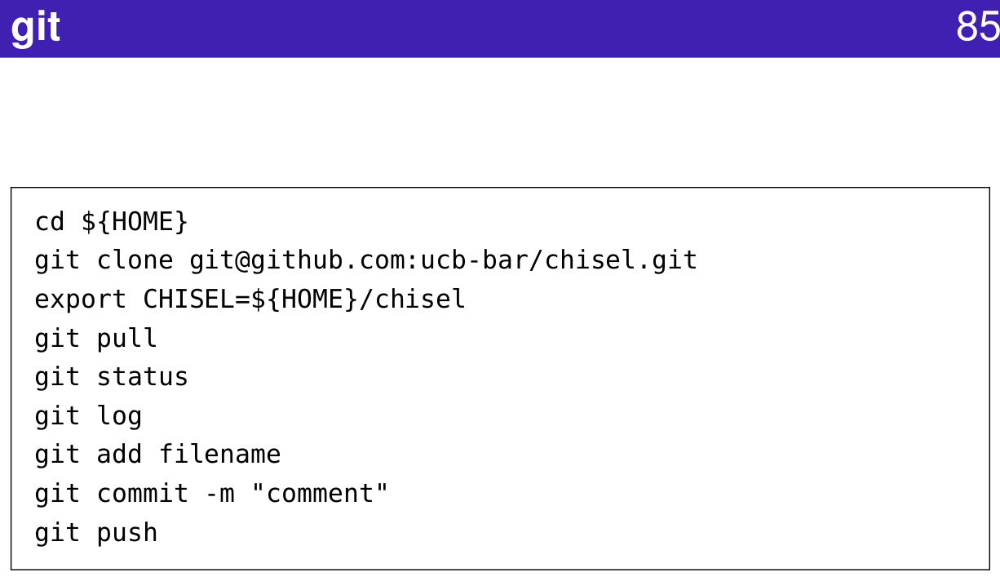
1.44 GIT
https://www.youtube.com/watch?v=OPhFfNLcVsI&list=PLlu0CT-JnSasfpk8tq1ZDiE2G0AK1BhOg&index=2
GIT (20:44-21:03/1:05:46)

Slide 10
1.45 SBT

Slide 11
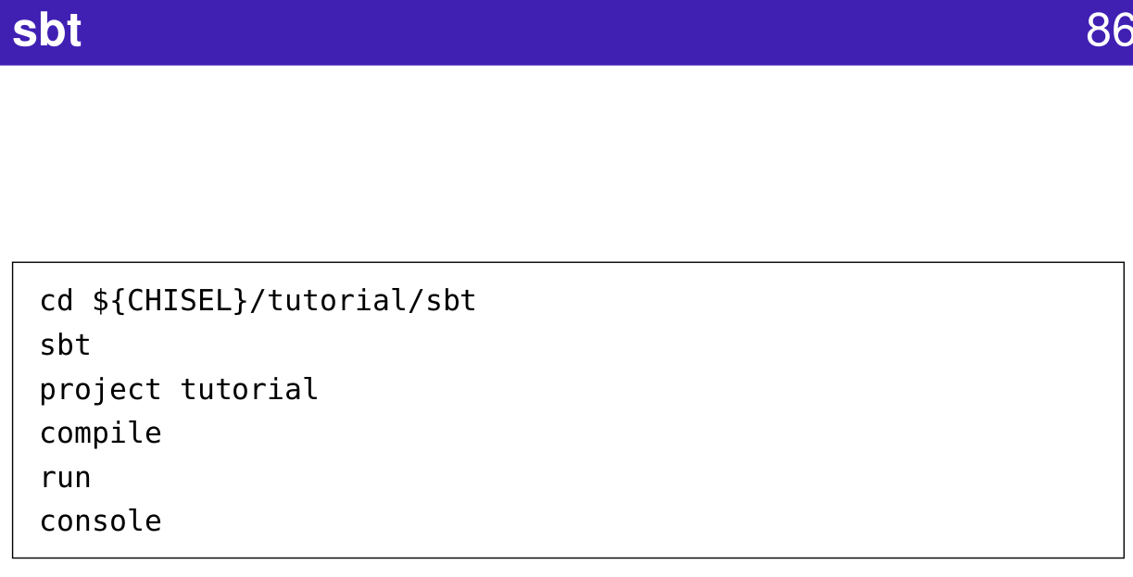
1.45 SBT
https://www.youtube.com/watch?v=OPhFfNLcVsI&list=PLlu0CT-JnSasfpk8tq1ZDiE2G0AK1BhOg&index=2
SBT (20:44-21:03/1:05:46)
SBT (Scala Build Tool)

Slide 12
1.46 Chisel Directory Structure

Slide 13
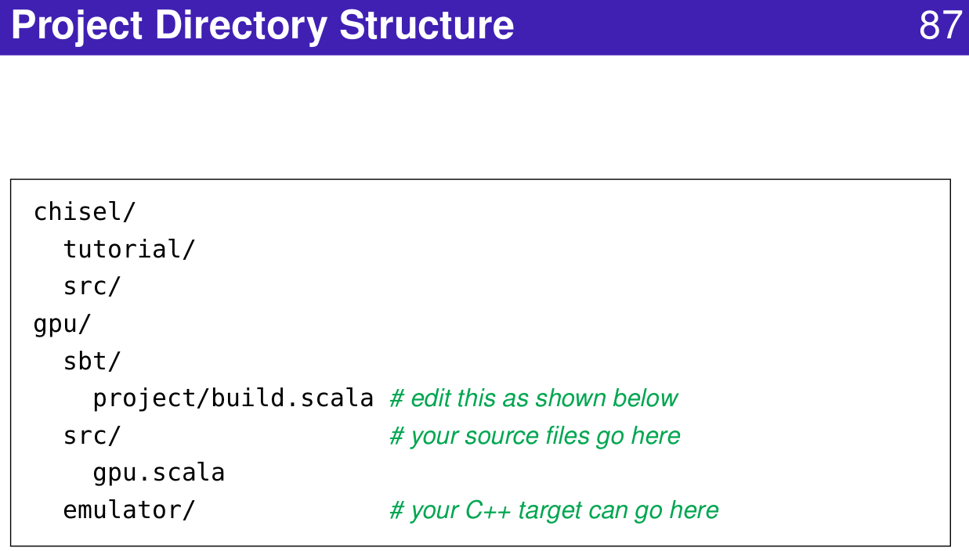
1.46 Chisel Directory Structure
https://www.youtube.com/watch?v=OPhFfNLcVsI&list=PLlu0CT-JnSasfpk8tq1ZDiE2G0AK1BhOg&index=2
Project Directory Structure (20:44-21:03/1:05:46)

Slide 14
1.47 Chisel Project File

Slide 15
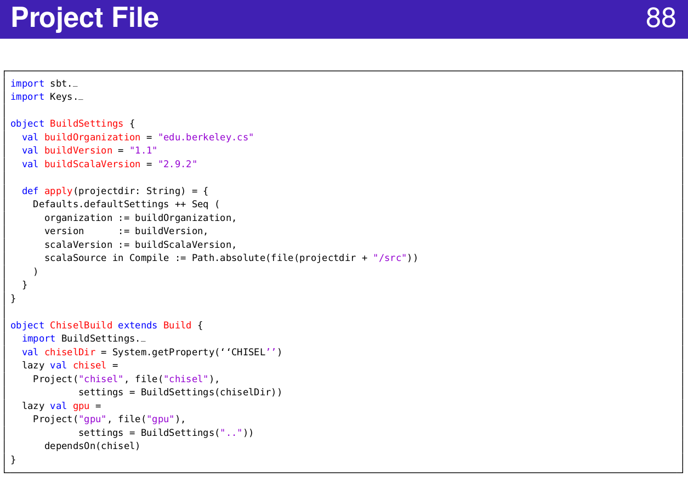
1.47 Chisel Project File
https://www.youtube.com/watch?v=OPhFfNLcVsI&list=PLlu0CT-JnSasfpk8tq1ZDiE2G0AK1BhOg&index=2
Project File (20:44-21:03/1:05:46)

Slide 16
1.48 Chisel Installation

Slide 17
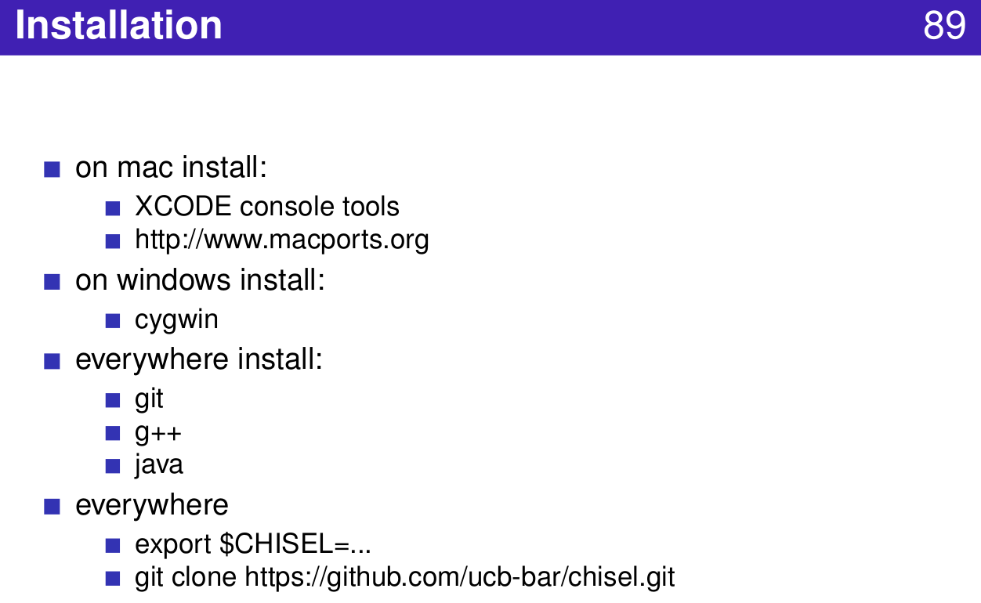
1.48 Chisel Installation
https://www.youtube.com/watch?v=OPhFfNLcVsI&list=PLlu0CT-JnSasfpk8tq1ZDiE2G0AK1BhOg&index=2
Installation (20:44-21:03/1:05:46)

Slide 18
1.49 Chisel Project

Slide 19
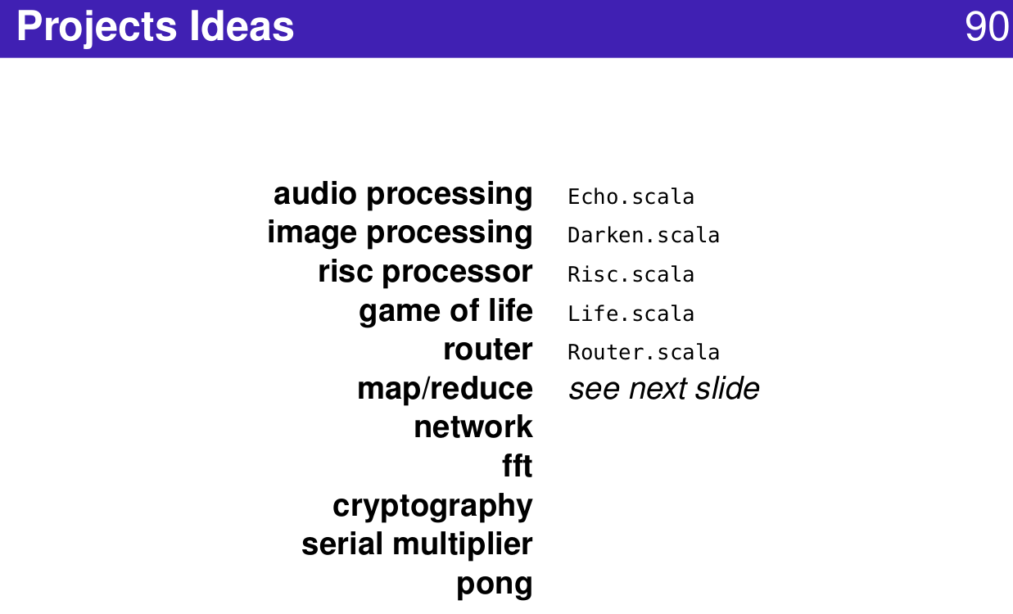
1.49 Chisel Project
https://www.youtube.com/watch?v=OPhFfNLcVsI&list=PLlu0CT-JnSasfpk8tq1ZDiE2G0AK1BhOg&index=2
Projects (20:44-21:03/1:05:46)

Slide 20
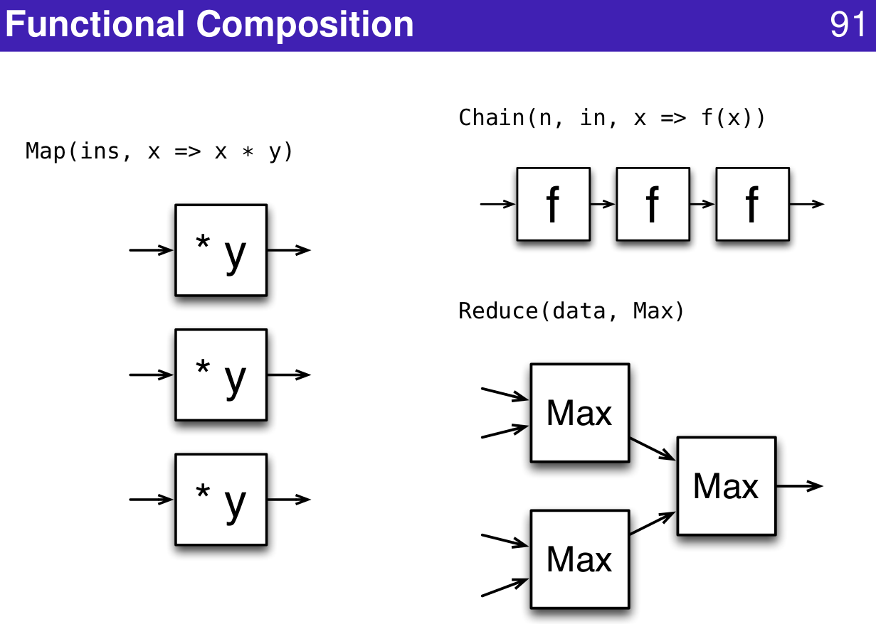
1.49 Chisel Project
https://www.youtube.com/watch?v=OPhFfNLcVsI&list=PLlu0CT-JnSasfpk8tq1ZDiE2G0AK1BhOg&index=2
Functional Composition (20:44-21:03/1:05:46)

Slide 21
1.50 Chisel Community

Slide 22
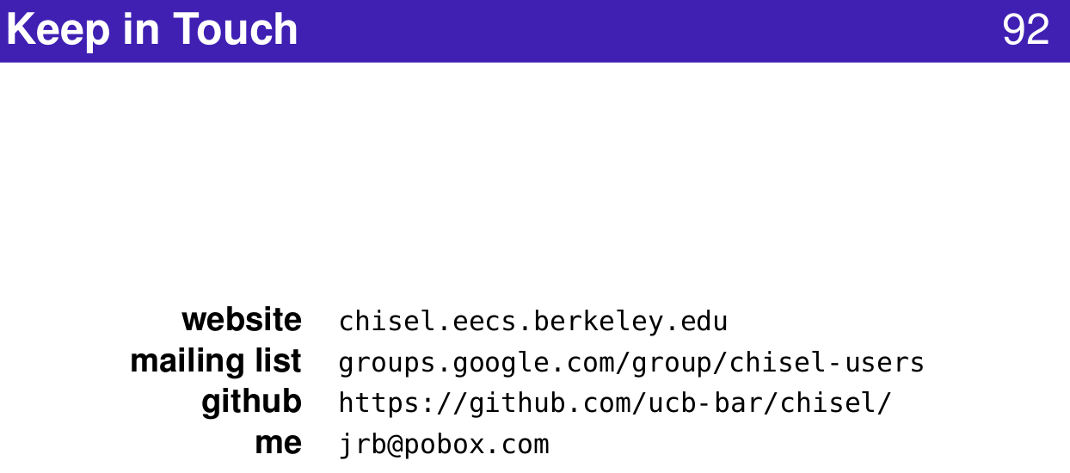
1.50 Chisel Community
https://www.youtube.com/watch?v=OPhFfNLcVsI&list=PLlu0CT-JnSasfpk8tq1ZDiE2G0AK1BhOg&index=2
Community (20:44-21:03/1:05:46)

Slide 23
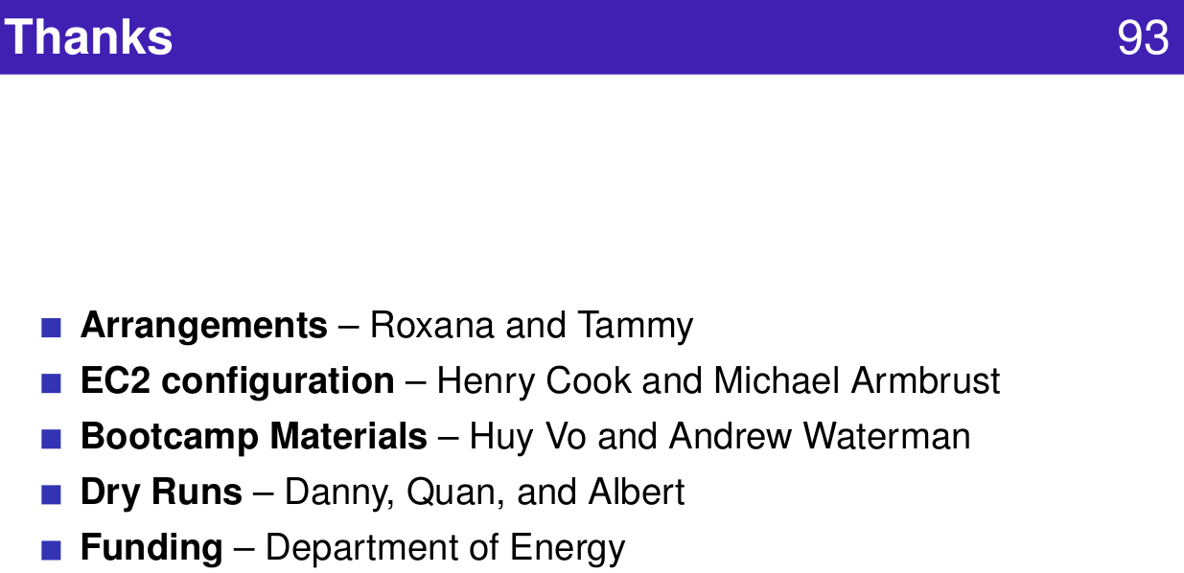
1.50 Chisel Community
https://www.youtube.com/watch?v=OPhFfNLcVsI&list=PLlu0CT-JnSasfpk8tq1ZDiE2G0AK1BhOg&index=2
Funding (20:44-21:03/1:05:46)

Slide 24
End

