Slide 1

7 Memory
Peter H. Chen

Slide 2
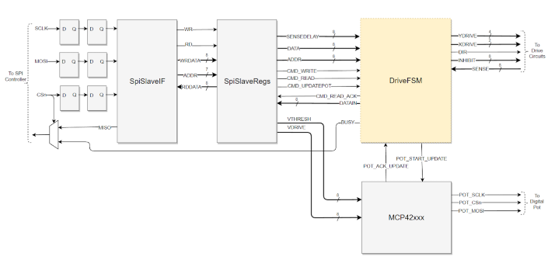
7 Memory
https://github.com/ucb-bar/chisel-tutorial?tab=readme-ov-file
Memory
Memory block.
https://jeffmcbride.net/core-memory/array/

Slide 3
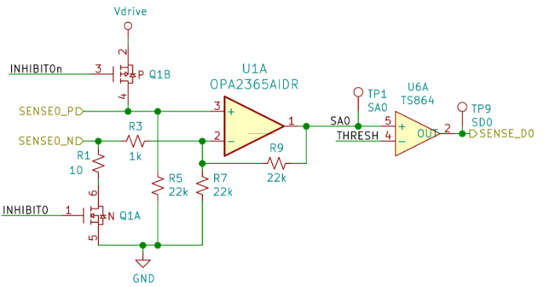
7 Memory
https://github.com/ucb-bar/chisel-tutorial?tab=readme-ov-file
Memory
Memory Schematic
https://jeffmcbride.net/core-memory/array/

Slide 4
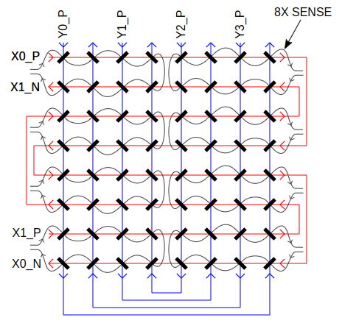
7 Memory
https://github.com/ucb-bar/chisel-tutorial?tab=readme-ov-file
Memory
Memory Cell.
https://jeffmcbride.net/core-memory/array/

Slide 5
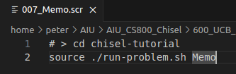
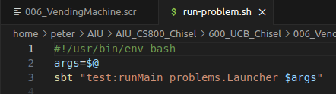
7 Memory
https://github.com/ucb-bar/chisel-tutorial?tab=readme-ov-file
Memory
1. > source ./run-problem.sh Memo
2. run-problem.sh
> args = $@
> sbt “test:runMain problems.Launcher $args

Slide 6
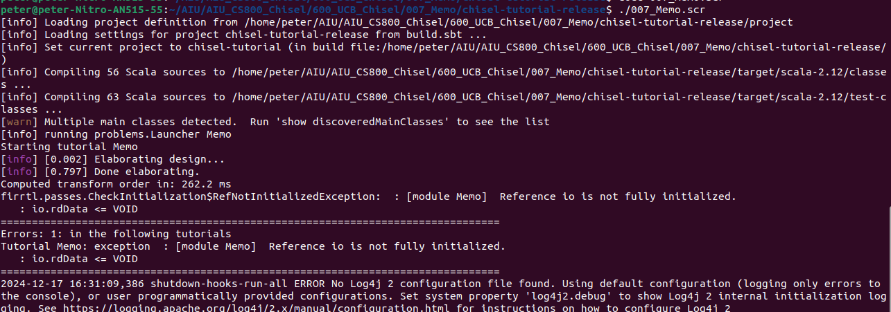
7 Memory
https://github.com/ucb-bar/chisel-tutorial?tab=readme-ov-file
Memory
Test result.
There are some errors. We will discuss more later on.

Slide 7
End

