Slide 1

2.6 Test
Peter H. Chen

Slide 2
2.6 Test
https://github.com/freechipsproject/chisel-bootcamp
Test
We discuss chisel test framework, i.e., ChiselTest.
1. suitable for both unit tests and system integration tests
2. designed for composable abstractions and layering
3. highly usable, encouraging unit tests by making it as easy, painless (avoiding boilerplate and other nonsense), and useful as possible to write them
ChiselTest planned:
1. target multiple backends and simulators (possibly requiring a link to Scala, if the testvector is not static, or using a limited test constructing API subset, when synthesizing to FPGA)
2. will be included in base chisel3, to avoid packaging and dependency nightmares

Slide 3
2.6 Test
https://github.com/freechipsproject/chisel-bootcamp
Test
Topic:
1. Setup: > jupyter notebook, scala interpreter, run
2. Basic functions of tester: poke(...), peek(...), expect(...), step(...), and test (...).
3. PassthroughGenerator Tester Example: Simple PassthroughGenerator with basic test functions.
4. Explain the difference of old iotesters (version 1) and new ChiselTest (version 2).
5. Decoupled/Flipped Interface: Convert the abstract class into concrete class. Decoupled for Output IO and Flipped for Input IO.
6. Method enqueueNow() and expectDequeueNow(): for one element added/remove from queue.
7. Method enqueueSeq() and expectDequeueSeq(): for sequence of elements add/remove from queue.
8. Method fork() and Join (): for multi-processing.
9. GCD Input/Output: Implement example
10. Decoupled GCD Abstract Input/Output Example
11. GCD Test()

Slide 4
2.6.1 Setup

Slide 5
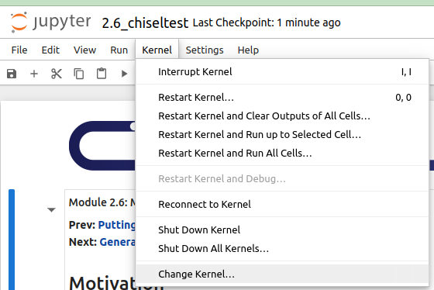
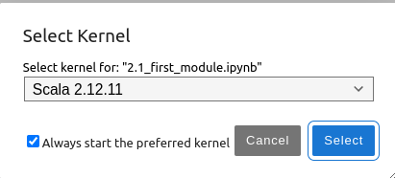
2.6.1 Setup
https://github.com/freechipsproject/chisel-bootcamp
Setup
1. Change folder to chisel-bootcamp. If you want to work on your working space, copy image folder and source folder to your working directory.
> cd chisel-bootcamp
2. Start Jupyter notebook
> jupyter notebook 2.6_chiseltest.ipynb
3. Select the scala interpreter: > Kernel > Change Kernel… >Scala 2.12.11
3

Slide 6
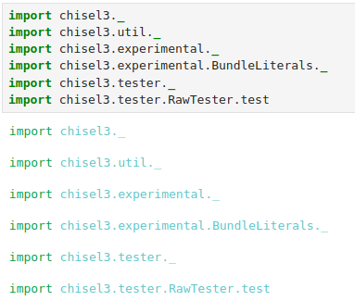
2.6.1 Setup
https://github.com/freechipsproject/chisel-bootcamp
Setup
1. Scala uses maven to setup path to with for source folder for Scala Libraries and get Scala Property.
2. import chisel3 library, utility, tester harness (horse controller), and test interface function.
3. The import chisel3.tester.RawTester.test brings in version of test (…).

Slide 7
2.6.2 Basic Functions of Tester

Slide 8
2.6.2 Basic Functions of Tester
https://github.com/freechipsproject/chisel-bootcamp
Basic Functions Tester
1. UCB (University of California, Berkeley) develops Chisel (Constructing Hardware in Scala Embedded Language) hardware design and iotesters for hardware test.
2. Iotesters are available on GitHub and Maven Central.
3. The Iotesters project is part of the freechipsproject organization.
4. The Iotesters project is licensed under Apache 2.0.
5. Chisel is a hardware construction language that supports advanced hardware design.
6. Chisel uses parameterized generators and domain-specific hardware languages.
7. Below is summary of old style iotesters and New ChiselTest.
8. The basic functions of tester are: poke(...), peek(...), expect(...), step(...), and test (...).
 | Old style iotesters | New ChiselTest
Poke (...) | poke(c.in.in1,. 6) | c.io.in1.poke(6.U)
Peek (...) | peek(c.io.out1) | c.io.out1.peek()
Expect (...) | expect(c.io.out1, 6) | c.io.out1.expect(6.U)
Step (...) | step(1) | c.io.clock.step(1)
Test (...) | Driver.execute(...) { c => | test(...) { c =>

Slide 9
2.6.3 PassthroughGenerator Example

Slide 10
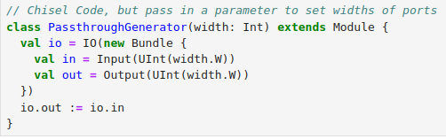
2.6.3 PassthroughGenerator Example
https://github.com/freechipsproject/chisel-bootcamp
PassthroughGenerator Example
Look at Chisel Code of PassthroughGenerator Tester.

Slide 11
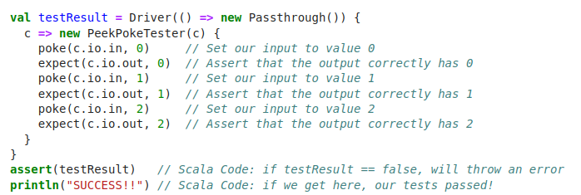
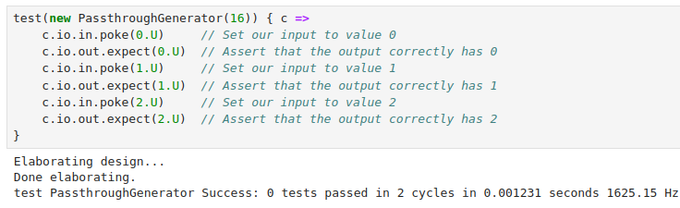
2.6.3 PassthroughGenerator Example
https://github.com/freechipsproject/chisel-bootcamp
PassthroughGenerator Example
Old style iotesters code:
New Chisel Test code:

Slide 12
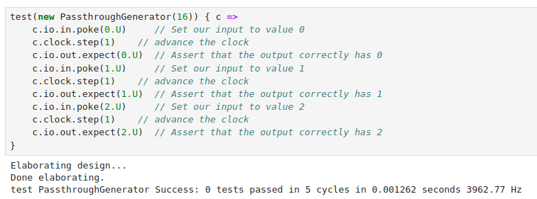
2.6.3 PassthroughGenerator Example
https://github.com/freechipsproject/chisel-bootcamp
PassthroughGenerator Example
Old style iotesters code:
Add Step for Chisel Test code:

Slide 13
2.6.4 Old iotesters vs. New ChiselTest

Slide 14
2.6.4 Old iotesters vs. New ChiselTest
https://github.com/freechipsproject/chisel-bootcamp
Old iotesters vs. New ChiselTest
1. ChiselTest's test method requires less code.
2. The PeekPokeTester is now built into the process.
3. The poke and expect methods are now part of each individual io element.
4. The poke and expect methods of io element make better checking of types.
5. The peek and step operations are also now methods on io elements.
6. The values of poked and expected are Chisel literals.
7. They are simple but provides stronger checking in more advanced and interesting examples.
8. They are enhanced with coming improvements in the ability to specify Bundle literals.
Old iotesters
New ChiselTest

Slide 15
2.6.5 Decoupled Interface

Slide 16
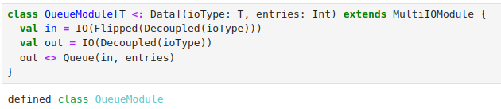
2.6.5 Decoupled Interface
https://github.com/freechipsproject/chisel-bootcamp
Decoupled Interface
1. In this section, we will look at Decoupled interfaces.
2. Question: What is Decoupled (…) Interface in Chisel?
Ans: Decoupled(...) creates a producer / output ready-valid interface (i.e. bits is an output).
3. Question: What is Flipped (Decoupled (…)) in Chisel?
Ans: Flipped is a method. Flipped(Decoupled(...)) creates a consumer / input ready-valid interface (i.e. bits is an input).
4. Decoupled takes a chisel data type make data ready and valid signals.
5. Below is a class QueueModule Example for Decoupled (…) and Flipped(Decoupled(…)).
6. Here, the QueueModule passes through data with ioType.
6. Here, we also have an entries state elements inside the QueueModule. The code take the entries and put into the Queue (in, entries)
7. Below “<:” means an abstract type member is defined (e.g., class Data), so that concrete implementations of that context must define that type.

Slide 17
2.6.6 enqueueNow and expectDequeueNow

Slide 18
2.6.6 enqueueNow and expectDequeueNow
https://github.com/freechipsproject/chisel-bootcamp
enqueueNow and expectDequeueNow
1. enqueueNow () is a method for add one element from a decouple input interface.
2. expectDequeueNow() is a method to remove one element from a dequeue output interface.
Method | Description
enqueueNow | Add (enqueue) one element to a Decoupled input interface
expectDequeueNow | Removes (dequeues) one element from a Decoupled output interface

Slide 19
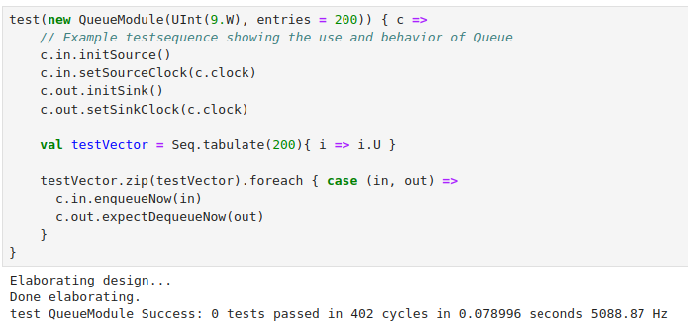
2.6.6 enqueueNow and expectDequeueNow
https://github.com/freechipsproject/chisel-bootcamp
enqueueNow and expectDequeueNow
We need initSource (), setSourceClock (), initSink(), setSinkClock(), etc. to ensure that the ready and valid fields are all initialized correctly at the beginning of the test.

Slide 20
2.6.7 enqueueSeq and expectDequeueSeq

Slide 21
2.6.7 enqueueSeq and expectDequeueSeq
https://github.com/freechipsproject/chisel-bootcamp
enqueueSeq and expectDequeueSeq
1. enqueueSeq () is a method for continues to add (enqueue) elements from the Seq to a Decoupled input interface, one at a time, until the sequence is exhausted
2. expectDequeueNow() is a method to remove (dequeue) elements from a Decoupled output interface, one at a time, and compares each one to the next element of the Seq.
Method | Description
enqueueSeq | Continues to add (enqueue) elements from the Seq to a Decoupled input interface, one at a time, until the sequence is exhausted
expectDequeueSeq | Removes (dequeues) elements from a Decoupled output interface, one at a time, and compares each one to the next element of the Seq

Slide 22
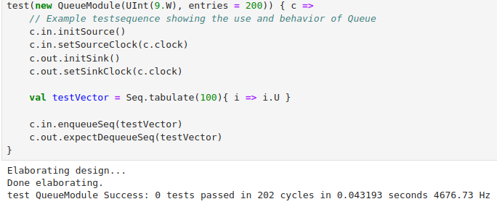
2.6.7 enqueueSeq and expectDequeueSeq
https://github.com/freechipsproject/chisel-bootcamp
enqueueSeq and expectDequeueSeq
1. The example below works fine but, as written, the enqueueSeq must finish before the expectDequeueSeq can begin.
2. This example would fail if the testVector's size is made larger than the queue depth, because the queue would fill up and not be able to complete the enqueueSeq.
3. Try it yourself to see what the failure looks like. In the next section we will show to construct this type of test properly.
Note:
1. The methods enqueueNow (), enqueueSeq (), expectDequeueNow (), and expectDequeueSeq () are simple in ChiselTest.
2. We use these methods from the ChiselTest primitives to build the test.
3. Fore more details, please check TestAdapters.scala (https://github.com/ucb-bar/chiseltest/blob/d199c5908828d0be5245f55fce8a872b2afb314e/src/main/scala/chisel3/tester/TestAdapters.scala)

Slide 23
2.6.8 Fork and Join

Slide 24
2.6.8 Fork and Join
https://github.com/freechipsproject/chisel-bootcamp
Fork and Join
Method | Description
fork | launches a concurrent code block, additional forks can be run concurrently to this one via the .fork appended to end of the code block of the preceding fork (it means the fork that comes before the current one in a sequence.)
Join | re-unites multiple related forks back into the calling thread

Slide 25
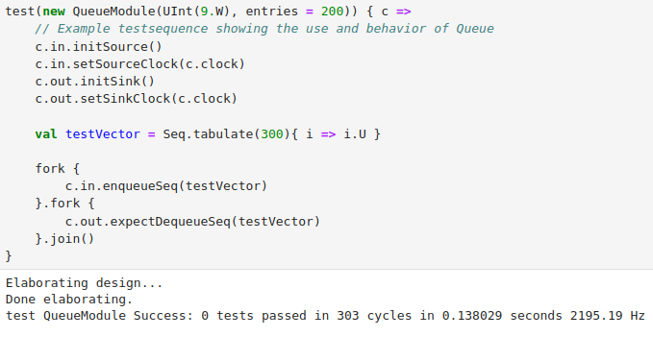
2.6.8 Fork and Join
https://github.com/freechipsproject/chisel-bootcamp
Fork and Join
1. Below example, two forks are chained together, and then joined.
2. In the first, fork block the enqueueSeq will continue to add elements until exhausted.
3. In the The second fork block will expectDequeueSeq on each cycle when data is available.
Note:
1. The threads created by fork are run in a deterministic order, largely according to their order as specified in code.
2. Certain bug-prone operations that depend on other threads are forbidden with runtime checks.

Slide 26
2.6.9 GCD Input/Output

Slide 27
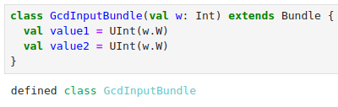
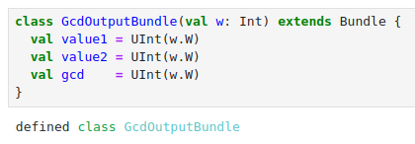
2.6.9 GCD Input/Output
https://github.com/freechipsproject/chisel-bootcamp
GCD Input/Output
For the rest of sections, we implement GCD (Greatest Common Denominator) test with fork and join.
1. Below, we define two abstract (No solid code inside, only abstract) classes: class GcdInputBundle and class GcdOutputBundle.
2. First, we define abstract class GcdInputBoundle for Input with inherited Bundle.
3. Next, we define abstract class GcdOutputBundle for Output with inherited Bundle class.
2
3

Slide 28
2.6.10 Decoupled GCD Abstract Input/Output

Slide 29
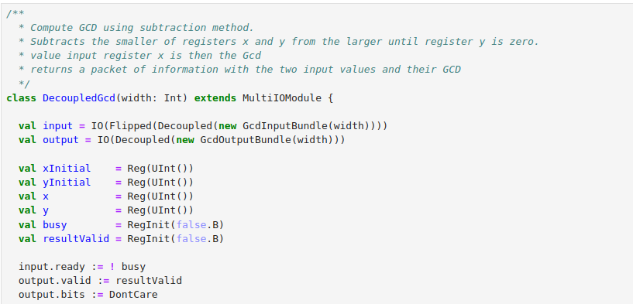
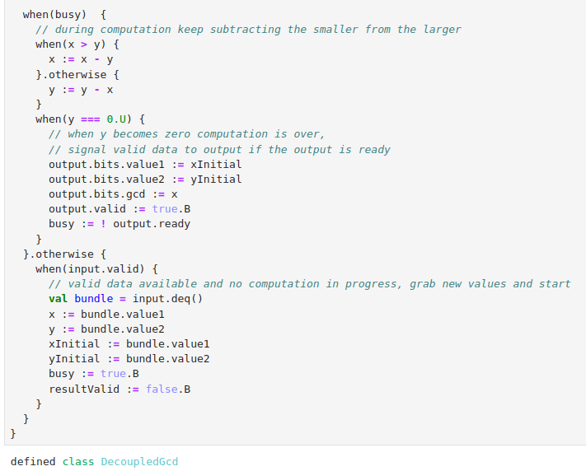
2.6.10 Decoupled GCD Abstract Input/Output
https://github.com/freechipsproject/chisel-bootcamp
Decoupled GCD Abstract Input/Output
Below, we decoupled the Abstract Input class and Output class.
1. We decoupled ready and a valid signal to the input and output Bundle.
2. Then, we use Flipped wrapper takes the Decoupled GcdInputBundle which by default is created as an output and converts each field to the opposite direction (recursively).
3. The data elements of the bundled arguments to Decoupled are placed in the top level field bits.

Slide 30
2.6.11 GCD Test

Slide 31
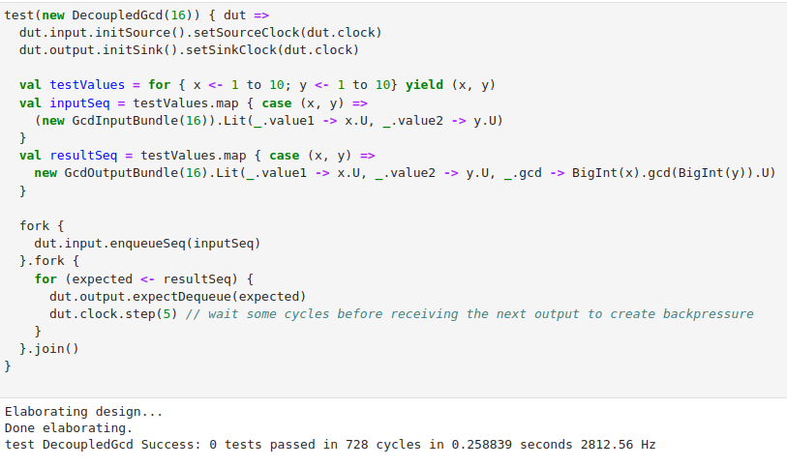
2.6.11 GCD Test
https://github.com/freechipsproject/chisel-bootcamp
GCD Test
1. The GCD test are same as the earlier Queue tests. We only need to take care the defined data field in the abstract class.
2. But there are more on the computation take multiple cycles. The input enqueue process is blocked as each GCD is computed.
3. We use lambda function map() to calculate the inputSeq and resultSeq.

Slide 32
2.6.11 GCD Test
https://github.com/freechipsproject/chisel-bootcamp
GCD Test
1. Here, Bundle has .Lit Method to bind the input into the abstract variables (value1 and value2) defined in the abstract Input and Output class :
> new GcdInputBundle(16).Lit(_.value1 -> x.U, _.value2 -> y.U)
2. GcdInputBundle defined above has two fields value1 and value2.
3. We create a bundle literal by first creating a bundle then calling its .Lit method.
4. The method takes a variable argument list of key/value pairs, where the key (e.g. _.value) is the field name and the value (e.g. x.U) is a chisel hardware literal, the Scala Int x is converted into a Chisel UInt literal.
5. The _. in front of the field name is necessary to bind the name value to the bundle internals.

Slide 33
End

