Slide 1

3 Combinational Logic
Peter H. Chen

Slide 2
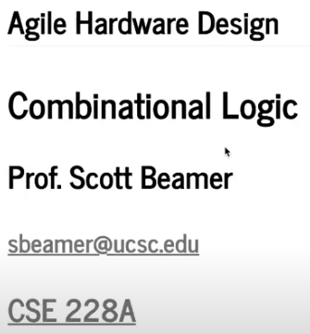
3 Combinational Logic
https://www.youtube.com/watch?v=BpJ21q-reFU&list=PLfrN7RIcMe6g2LBRJLTHTdhyj5s8ag0Rg&index=3
Hello Chisel (0:00-0:34/1:03:50)
We discuss Chisel Combinational Logic.
Topics:
1. Setup:

Slide 3
3.1 Plan

Slide 4
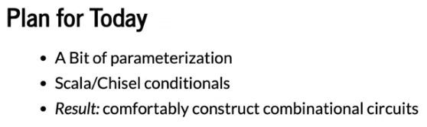
3.1 Plan
https://www.youtube.com/watch?v=BpJ21q-reFU&list=PLfrN7RIcMe6g2LBRJLTHTdhyj5s8ag0Rg&index=3
Plan (0:36-1:25/1:03:50)

Slide 5
3.2 Import Chisel Library

Slide 6
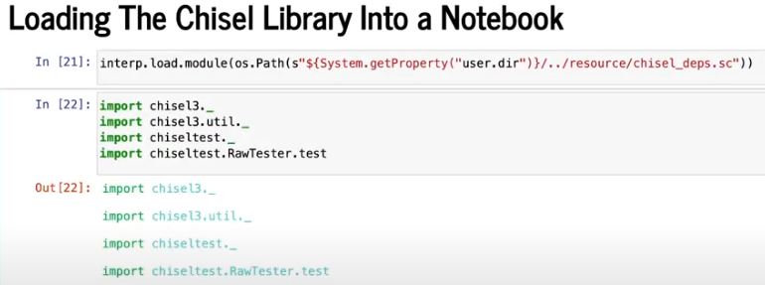
3.2 Import Chisel Library
https://www.youtube.com/watch?v=BpJ21q-reFU&list=PLfrN7RIcMe6g2LBRJLTHTdhyj5s8ag0Rg&index=3
Import Chisel Library (1:26-1:29/1:03:50)

Slide 7
3.3 Chisel Mux

Slide 8
3.3 Chisel Mux
https://www.youtube.com/watch?v=BpJ21q-reFU&list=PLfrN7RIcMe6g2LBRJLTHTdhyj5s8ag0Rg&index=3
Chisel Mux (1:30-2:26/1:03:50)

Slide 9
End

