Slide 1

10 Introduction to Functional Programming
Peter H. Chen

Slide 2
10 Introduction to Functional Programming
https://www.youtube.com/watch?v=VBR-KovOmiw&list=PLfrN7RIcMe6g2LBRJLTHTdhyj5s8ag0Rg&index=10
Introduction to Functional Programming (0:00-0:24/1:04:03)
Note: by Peter Hanping Chen
1. Why do I modify?
I cannot use configuration file (chisel_deps.sc) from Prof. Scott Beamer which have error in dependencies on my Ubuntu OS.
2. Instead, I used UCB bootcamp configuration file (load_ivy.sc) below.
Since load-ivy.sc is not 100% compatible in dependencies as chisel.deps.sc, I made some modification to make them work.
3. source/load-ivy.sc (https://github.com/freechipsproject/chisel-bootcamp)

Slide 3
10 Introduction to Functional Programming
https://www.youtube.com/watch?v=VBR-KovOmiw&list=PLfrN7RIcMe6g2LBRJLTHTdhyj5s8ag0Rg&index=10
Introduction to Functional Programming (0:21-0:25/1:04:03)
We discuss how to write the Chisel Testbench.
Topics:
1. Setup: jupyter notebook, select scala, and run cells.
2.

Slide 4
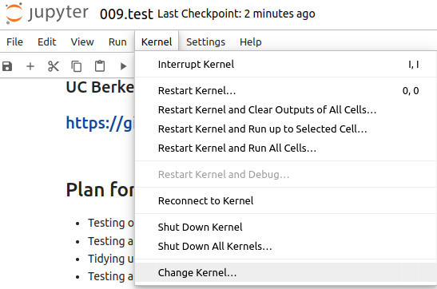
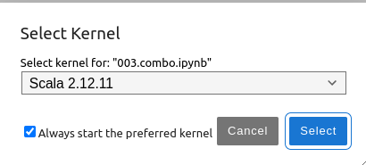
10 Introduction to Functional Programming
https://www.youtube.com/watch?v=VBR-KovOmiw&list=PLfrN7RIcMe6g2LBRJLTHTdhyj5s8ag0Rg&index=10
Introduction to Functional Programming (0:26-0:50/1:04:03)
We discuss Chisel Collection.
> jupyter notebook 006.combo.ipynb > Kernel > Change Kernel … > Select Scala2.21.22
> Run All Cells

Slide 5
10.1 Plan

Slide 6
10.1 Plan
https://www.youtube.com/watch?v=VBR-KovOmiw&list=PLfrN7RIcMe6g2LBRJLTHTdhyj5s8ag0Rg&index=10
Plan (0:51-0:53/1:04:03)

Slide 7
10.2 Import Chisel Library

Slide 8
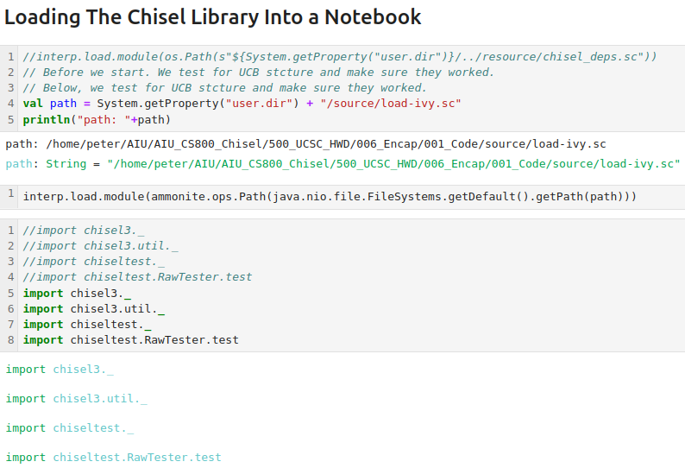
10.2 Import Chisel Library
https://www.youtube.com/watch?v=VBR-KovOmiw&list=PLfrN7RIcMe6g2LBRJLTHTdhyj5s8ag0Rg&index=10
Import Chisel Library (0:54-0:55/1:04:03)

Slide 9
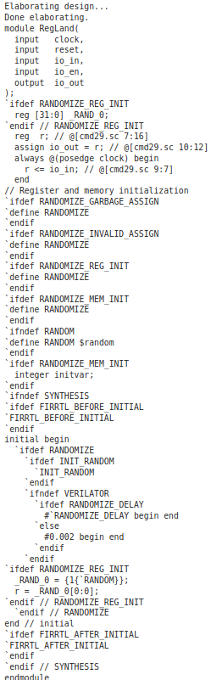
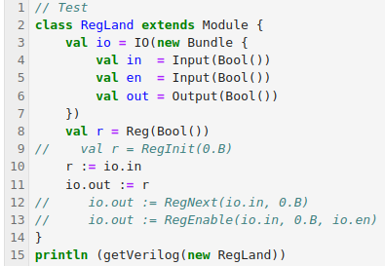
10.2 Import Chisel Library
https://www.youtube.com/watch?v=VBR-KovOmiw&list=PLfrN7RIcMe6g2LBRJLTHTdhyj5s8ag0Rg&index=10
Import Chisel Library (0:56-0:58/1:04:03)
Test

Slide 10
10.3 Why Test?

Slide 11
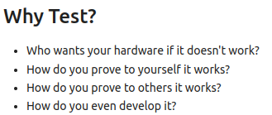
10.3 Why Test?
https://www.youtube.com/watch?v=VBR-KovOmiw&list=PLfrN7RIcMe6g2LBRJLTHTdhyj5s8ag0Rg&index=10
Why Test? (0:59-3:05/1:04:03)
Who wants your hardware if it doesn't work?
  Both hardware and software need to be worked.
How do you prove to yourself it works?
How do you prove to others it works?
How do you even develop it?
  Test helped developer

Slide 12
End

