Slide 1

13 Queue
Peter H. Chen

Slide 2
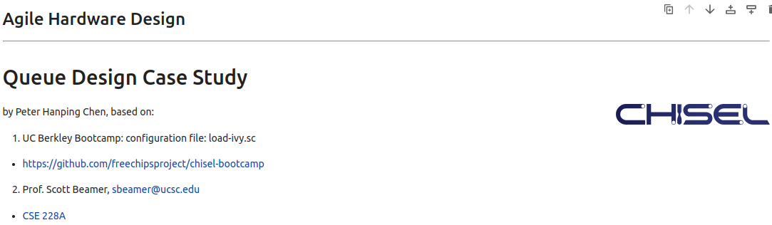
13 Queue
https://www.youtube.com/watch?v=5K9tWlv7d1A&list=PLfrN7RIcMe6g2LBRJLTHTdhyj5s8ag0Rg&index=13
Queue (0:00-0:01/56:05)
We used UCB bootcamp configuration file (load_ivy.sc)
source/load-ivy.sc (https://github.com/freechipsproject/chisel-bootcamp)

Slide 3
13 Queue
https://www.youtube.com/watch?v=5K9tWlv7d1A&list=PLfrN7RIcMe6g2LBRJLTHTdhyj5s8ag0Rg&index=13
Queue (0:02-0:03/56:05)
We will use Chisel Library for Queue Design.
Topics:
1. Setup: jupyter notebook, select scala, and run cells.
2

Slide 4
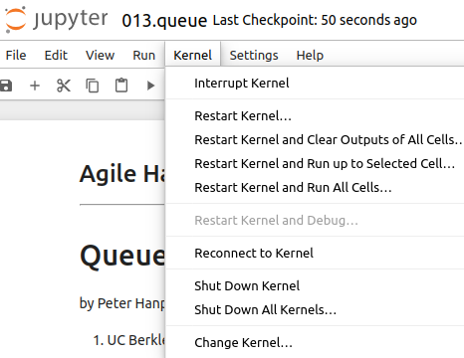
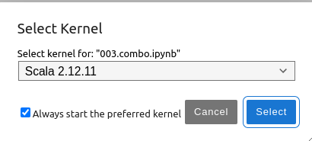
13 Queue
https://www.youtube.com/watch?v=5K9tWlv7d1A&list=PLfrN7RIcMe6g2LBRJLTHTdhyj5s8ag0Rg&index=13
Queue (0:03-1:20/56:05)
We discuss Chisel Collection.
> jupyter notebook 013.queue.ipynb > Kernel > Change Kernel … > Select Scala2.21.22
> Run All Cells

Slide 5
13.1 Plan

Slide 6
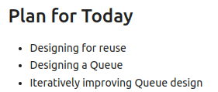
13.1 Plan
https://www.youtube.com/watch?v=5K9tWlv7d1A&list=PLfrN7RIcMe6g2LBRJLTHTdhyj5s8ag0Rg&index=13
Plan (1:21-1:30/56:05)
Today, we talk about Queue.

Slide 7
13.2 Import Chisel Library

Slide 8
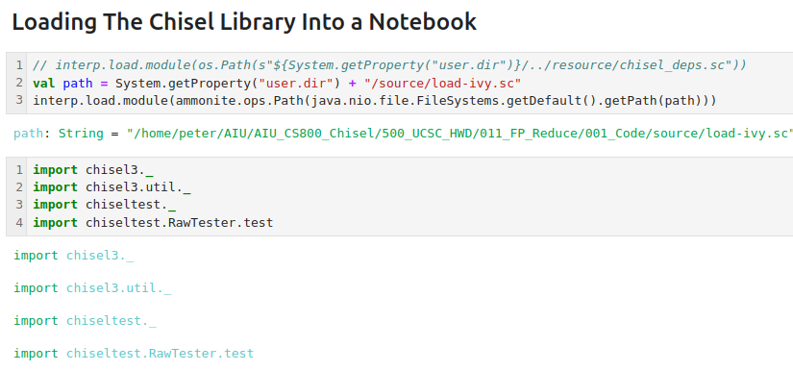
13.2 Import Chisel Library
https://www.youtube.com/watch?v=5K9tWlv7d1A&list=PLfrN7RIcMe6g2LBRJLTHTdhyj5s8ag0Rg&index=13
Import Chisel Library (1:31-2:00/56:05)

Slide 9
13.3 Goal for Reuse

Slide 10
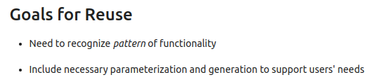
13.3 Goal for Reuse
https://www.youtube.com/watch?v=5K9tWlv7d1A&list=PLfrN7RIcMe6g2LBRJLTHTdhyj5s8ag0Rg&index=13
Goal for Reuse (2:01-2:19/56:05)
1. Group the functionality.
2. Use parameters to generate the Verilog.

Slide 11
13.4 Progressive Design

Slide 12
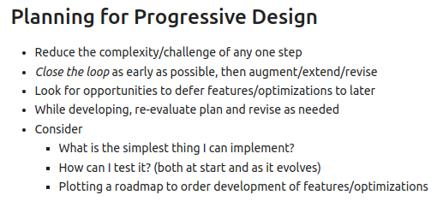
13.4 Progressive Design
https://www.youtube.com/watch?v=5K9tWlv7d1A&list=PLfrN7RIcMe6g2LBRJLTHTdhyj5s8ag0Rg&index=13
Progressive Design (2:20-5:55/56:05)
We make plan for progressive design.

Slide 13
13.5 Queue Design

Slide 14
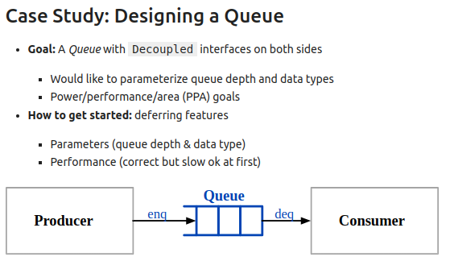
13.5 Queue Design
https://www.youtube.com/watch?v=5K9tWlv7d1A&list=PLfrN7RIcMe6g2LBRJLTHTdhyj5s8ag0Rg&index=13
Queue Design (2:20-5:05/56:05)
We
1. decouple/separate the Queue from our hardware design system.
2. generally use the Chisel Library to generate the Verilog code.
3. enqueue input data for Queue and
4. dequeue the output data from Queue.
5. want to see the performance of the Queue.
6. How to use Chisel Library to generate the Verilog hardware code?
7. We want to input the few parameters, verify the performance, optimize the design,

Slide 15
13.6 First Queue Design

Slide 16
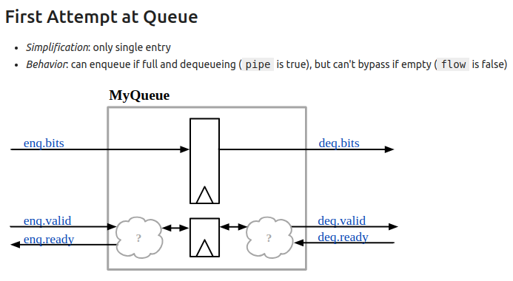
13.6 First Queue Design
https://www.youtube.com/watch?v=5K9tWlv7d1A&list=PLfrN7RIcMe6g2LBRJLTHTdhyj5s8ag0Rg&index=13
First Queue Design (5:06-6:38/56:05)
1. Inputs: enq.bits, enq.valid, enq.ready.
2. Outputs: deq.bits, deq.valid, deq.ready.
Pipe is true: we can do enqueue if full and if dequeue if pipe is true. We cannot dequeue if pipe empty.

Slide 17
13.7 V0: Queue

Slide 18
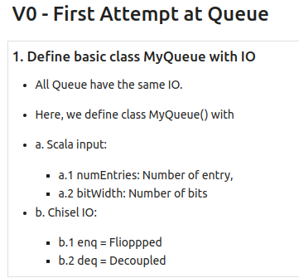
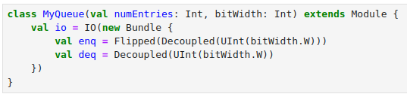
13.7 V0: Queue
https://www.youtube.com/watch?v=5K9tWlv7d1A&list=PLfrN7RIcMe6g2LBRJLTHTdhyj5s8ag0Rg&index=13
V0 Queue (6:39-7:25/56:05)
All Queue have the same IO.
1. We define class MyQueue with IO: enq = Flipped() and deq = Decoupled ()
2. Input: numEntries (Number of Entry) and bitWidth (number fo bits).
We will access MyQueue later on. Here, we define class MyQueueV0 inherited from class MyQueue.

Slide 19
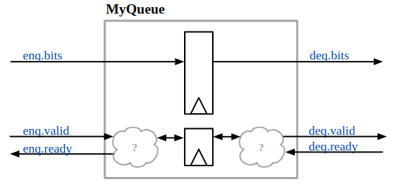
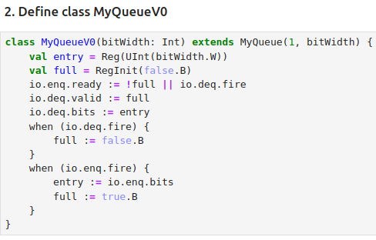
13.7 V0: Queue
https://www.youtube.com/watch?v=5K9tWlv7d1A&list=PLfrN7RIcMe6g2LBRJLTHTdhyj5s8ag0Rg&index=13
V0 Queue (7:26-10:00/56:05)
Define MyQueueV0:
1. get entry (number of bits)
2. get flag
3. ser enq, valid, bits
4. when deq is fire
5. when enq is fire

Slide 20
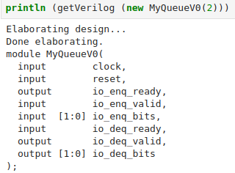
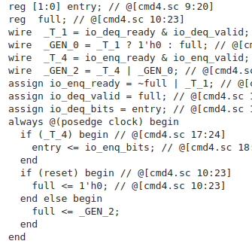
13.7 V0: Queue
https://www.youtube.com/watch?v=5K9tWlv7d1A&list=PLfrN7RIcMe6g2LBRJLTHTdhyj5s8ag0Rg&index=13
V0 Queue (10:01-11:20/56:05)
Generate Verilog

Slide 21
13.8 Test Queue

Slide 22
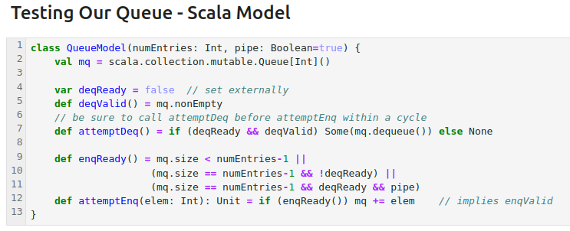
13.8 Test Queue
https://www.youtube.com/watch?v=5K9tWlv7d1A&list=PLfrN7RIcMe6g2LBRJLTHTdhyj5s8ag0Rg&index=13
QueueModel (11:21-11:25/56:05)
Scala Queue Model define three methods: attemptDeq(), enqReady(), attemptEnq().

Slide 23
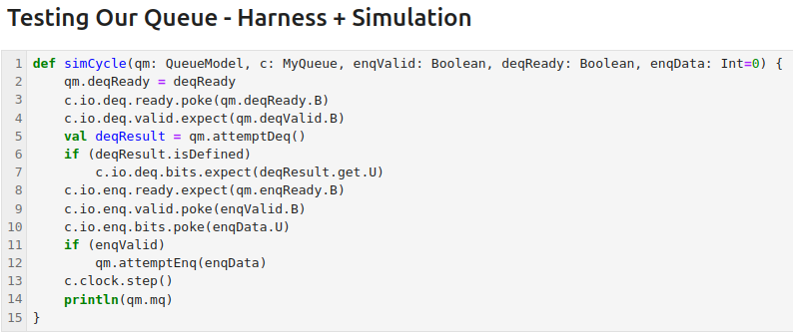
13.8 Test Queue
https://www.youtube.com/watch?v=5K9tWlv7d1A&list=PLfrN7RIcMe6g2LBRJLTHTdhyj5s8ag0Rg&index=13
SimCycle (11:26-11:50/56:05)
The harness is very similar to we discussed in 009_Test. Not exactly the same but very close.
Below, we define the test hardness simCylce () which is used to test the Queue Model.
1. Poke ready, expect valid
2. Make attemptDeq(), expect deq bits.
3. Get enq ready, enq valid
4. Poke enq bits.
5. Make attemptEnq
6. Move next time step.

Slide 24
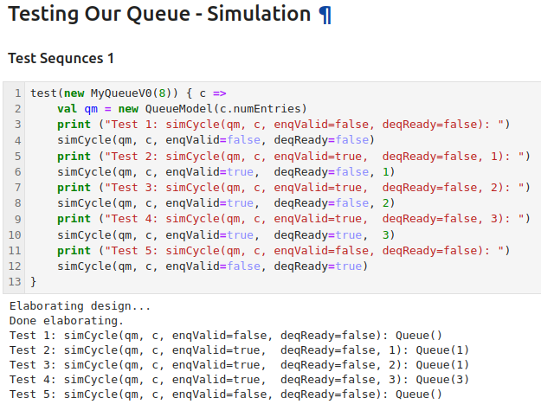
13.8 Test Queue
https://www.youtube.com/watch?v=5K9tWlv7d1A&list=PLfrN7RIcMe6g2LBRJLTHTdhyj5s8ag0Rg&index=13
Test Sequence 1 (11:41-12:00/56:05)
Test Queue
1. Empty Queue.
2. enq (1)
3. enq (2)
4. enq (3)
5. enq ()

Slide 25
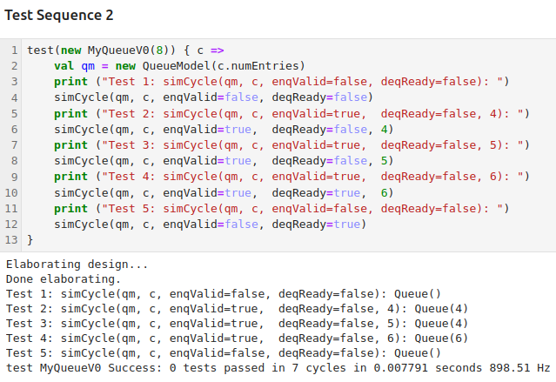
13.8 Test Queue
https://www.youtube.com/watch?v=5K9tWlv7d1A&list=PLfrN7RIcMe6g2LBRJLTHTdhyj5s8ag0Rg&index=13
Test Sequence 2 (12:01-12:57/56:05)
Test Queue
1. Empty Queue.
2. enq (4)
3. enq (5)
4. enq (6)
5. enq ()

Slide 26
13.9 Assess MyQueue V0

Slide 27
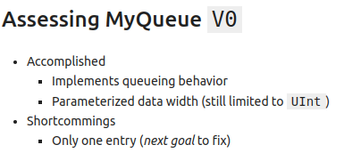
13.9 Assess MyQueue V0
https://www.youtube.com/watch?v=5K9tWlv7d1A&list=PLfrN7RIcMe6g2LBRJLTHTdhyj5s8ag0Rg&index=13
Assess MyQueue V0 (12:57-13:30/56:05)

Slide 28
End

