Slide 1

13.11 Schematic Diagram
Peter H. Chen

Slide 2
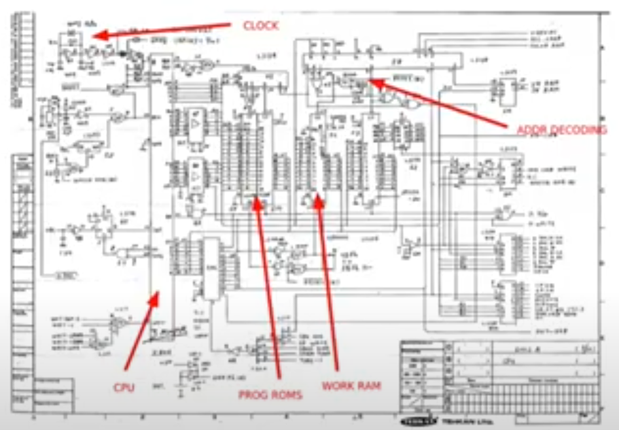
13.11 Schematic Diagram
https://www.youtube.com/watch?v=Wst8IoYRWKo&list=PLlu0CT-JnSasfpk8tq1ZDiE2G0AK1BhOg&index=13
Schematic Diagram (9:35-10:03/40:19)
FPGA board comes with a Schematic Diagram.
The schematic diagram shows the elements of circuit, different wires, signals, and interconnections of the components. We can fit them together in the different parts, like CPI, Memory, etc.
How do we convert a bitstream to put onto an FPGA?

Slide 3
13.12 HDL

Slide 4
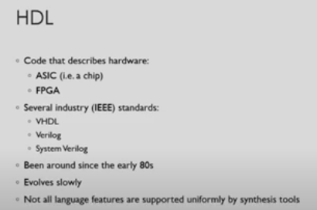
13.12 HDL
https://www.youtube.com/watch?v=Wst8IoYRWKo&list=PLlu0CT-JnSasfpk8tq1ZDiE2G0AK1BhOg&index=13
HDL (10:04-11:04/40:19)
1. How do we stream to the FPGA board?
We need to write the HDL (Hardware Description Language).
The HDL describes how the FPGA or custom chip work. We send the bitstream off to a factory to be manufactured. We use HDL to describe how the circuit of the device.
2. There are few industry standards: VHDL, Verilog, and System Verilog.
3. These languages are around since 1980s. System Verilog come out a bit later.
4. These languages are industry standard for manufactures. They involve quite slow.
5. We don’t see modern features added very often. Not all languages features are supported. Since they are used in all the different manufactures, so even though their standards are not implemented 100% across all different synthesis tools.

Slide 5
13.13 VHDL

Slide 6
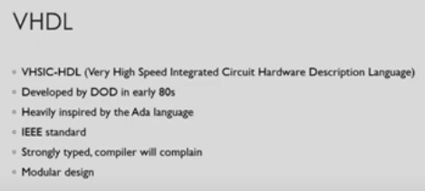
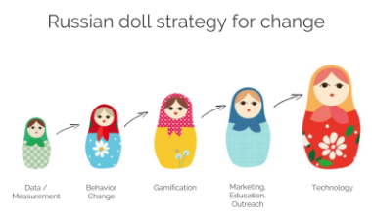

13.13 VHDL
https://www.youtube.com/watch?v=Wst8IoYRWKo&list=PLlu0CT-JnSasfpk8tq1ZDiE2G0AK1BhOg&index=13
VHDL (11:05-11:51/40:19)
1. VHSIC-HDL (Very High Speed Integrated Circuit Hardware Description Language): High speed IC HDL.
2. This language is defined by Department of Defense in 1980s.
3. It is inspired by the Ada Programming Language.
4. VHDL is an IEEE standard.
5. VHDL is a strongly typed language. The compiler will compliant if your types do not match up between the modules.
6. VHDL circuits are used in hierarchical modular design. It is similar to Russian Doll design which contains top level design and many layers of changes with the involved technology.

Slide 7
13.14 Verilog and System Verilog

Slide 8
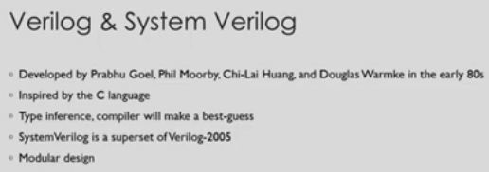
13.14 Verilog and System Verilog
https://www.youtube.com/watch?v=Wst8IoYRWKo&list=PLlu0CT-JnSasfpk8tq1ZDiE2G0AK1BhOg&index=13
Verilog and System Verilog (11:52-12:47/40:19)
1. Verilog and System Verilog is another HDL (Hardware Description Language). Verilog is developed by a bunch of academics back in early 1980s.
2. Verilog is inspired by C Programming Language.
3. Verilog is type inference so that compiler need to make a best guess what kind of doing and what kind of sending signals around our design. These will need to correct if you do not carefully define the data. Somethimes, the compiler will mess up the guess of data type.
4. System Verilog is superset of Verilog. System Verilog add the extension of system level synthesis and modular testing.
5.System Verilog is used in hierarchical modular design for describing circuit.

Slide 9
13.15 VHDL Example

Slide 10

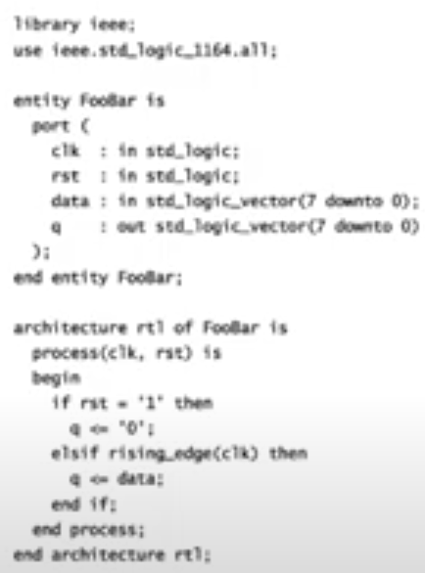
13.15 VHDL Example
https://www.youtube.com/watch?v=Wst8IoYRWKo&list=PLlu0CT-JnSasfpk8tq1ZDiE2G0AK1BhOg&index=13
VHDL Example (12:48-14:50/40:19)
1. This VHDL code generated by the Chisel.
2. We need to import the libraries at the top.
> library ieee;
> use ieee.std_logic_1164.all;
3. We then define the module with keyword entity and module name Foollar.
4. In the module, we describe the inputs (in) and outputs (out). These inputs and outputs are called ports. Here, we have clock, reset, data as input and q as output.
5. We have data bus which is are 8 bits wide (from bit 7 to bit 0) and call std_logic_vector module.
6. We have output port 8 bits wide q.
7. Then, we have the architecture which actually describes the behavior of this module.
8. Within the block, we have process (clock, reset) which we define the sensitivity list. Anytime those signals changes, we re-evaluate what is happening inside the block.
9. Inside the block, we have define process module which re-evaluate the rst (reset) signal.

Slide 11
13.16 Verilog Example

Slide 12

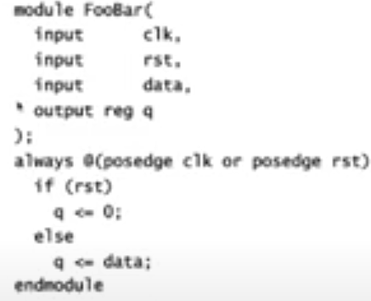
13.16 Verilog Example
https://www.youtube.com/watch?v=Wst8IoYRWKo&list=PLlu0CT-JnSasfpk8tq1ZDiE2G0AK1BhOg&index=13
Verilog Example (14:51-15:35/40:19)
1. Here, Verilog module called Foollar.
2. We have the input and output port.
3. The output port is a register.
4. > always @()
Define the clock edge.
5. Every time clock edge happened, the output q is set/reset.
6. How to define bus in Verilog?
> input wire [7:0]data
> output reg [7:0]q

Slide 13
13.17 Chisel Example

Slide 14

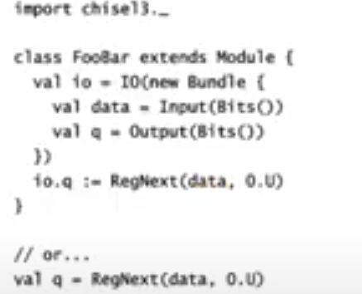
13.17 Chisel Example
https://www.youtube.com/watch?v=Wst8IoYRWKo&list=PLlu0CT-JnSasfpk8tq1ZDiE2G0AK1BhOg&index=13
Chisel Example (15:36-17:31/40:19)
Here, we have Chisel code,
1. We import the chisel3 standard library.
2. Chisel is a domain specific language. Chisel is built inside of Scala. If you use Scala language, then Chisel is easy for you.
3. We build modules based on Scala type system. We define classes extend from Chisel superclass Module.
4. We define
> io = IO (new Bundle {...} )
5. We have the bus for data and q.
> data = Input()
> q = Output ()
These are vector of signals are carried together.
6. The register use the register function call RegNext(data, 0.U). This means on the clock tick, we are going to latch that value into the register. The second parameter 0.U are use for initialization when the circuit starts up value of that register,
7. Below one line statement:
> q = RegNext (data, 0.U)
We assign the output. This one line is same as Class FooBar.
Chisel implicitly does all the clock at each clock reset.

Slide 15
13.18 What is Chisel?

Slide 16

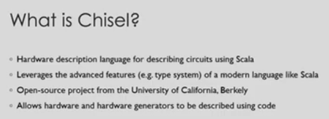
13.18 What is Chisel?
https://www.youtube.com/watch?v=Wst8IoYRWKo&list=PLlu0CT-JnSasfpk8tq1ZDiE2G0AK1BhOg&index=13
What is Chisel? (17:32-18:43/40:19)
There is a Chisel Introduction:
1. HDL (Hardware Description Language) for describing circuits using Scala.
2. Chisel leverages the advanced system features of a modern language like Scala. The type system as we saw before,
3. Chisel is an open-source project from the University of California, Berkeley. Chisel is been there around 2012.
4. Chisel allows hardware and hardware generators to be described using code. Hardware is very obvious but a hardware generator generates the circuit from the description.

Slide 17
13.19 Who Is Using Chisel?

Slide 18
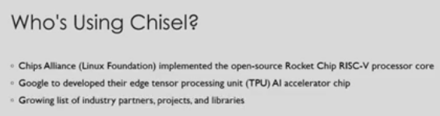
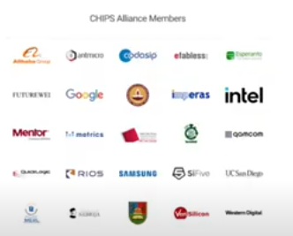
13.19 Who Is Using Chisel?
https://www.youtube.com/watch?v=Wst8IoYRWKo&list=PLlu0CT-JnSasfpk8tq1ZDiE2G0AK1BhOg&index=13
Who Is Using Chisel? (18:44-19:43/40:19)
1. Chips Alliance 9Linux Foundation) implemented RISCV processor core using chisel.
The processor core is called Rocket Chip.
2. Google has used Chisel to develop edge TPU (Tensor Processor Unit). TPU is used in Artificial Intelligence Accelerator chip. They turned this Rocket Chip into a physical chip.
3. There is a growing list of industry partners and libraries out there.

Slide 19
13.20 Why is Chisel Interesting?

Slide 20
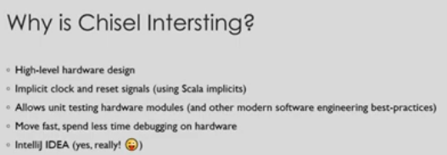
13.20 Why is Chisel Interesting?
https://www.youtube.com/watch?v=Wst8IoYRWKo&list=PLlu0CT-JnSasfpk8tq1ZDiE2G0AK1BhOg&index=13
Who Is Using Chisel? (18:44-21:52/40:19)
1. High Level Hardware Design: If you are software engineer, you don’t coding and assembly all day unless you write software for microcontroller. Chisel is high level language to design the hardware.
2. We have implicit clock ans reset signals using Scala implicit.
3. Chisel has unit test for hardware modules based on Scala. We have used all Scala testing libraries which based on software engineer practices.
4. Easy to debug for hardware. Easier for FPGA bitstream.
5. GUI code tools.

Slide 21
End

