Slide 1

20 Chisel Grab Bag
Peter H. Chen

Slide 2
20 Chisel Grab Bag
https://www.youtube.com/watch?v=EOMMpYBo8To&list=PLfrN7RIcMe6g2LBRJLTHTdhyj5s8ag0Rg&index=22
Chisel Grab Bag (0:00-0:05/1:05:51)
We discuss Chisel Grab Bag for Hardware Design.
Topics:
1. DVFS (Dynamic Voltage Frequency Scaling): We can use Chisel for Verilog Simulation or Aladdin,/Gem5 Architectural Simulator (Chip Statistics)
2. Static Power and Dynamic Power
3. DSE (Design Space Exploration): We can use Hypermapper from Stanford University or OpenTuner
4. PAT Pareto Frontier of CPU/Memory/GPU
5. PT Pareto Frontier of Core Design

Slide 3
20 Chisel Grab Bag
https://www.youtube.com/watch?v=EOMMpYBo8To&list=PLfrN7RIcMe6g2LBRJLTHTdhyj5s8ag0Rg&index=22
Chisel Grab Bag(0:06-0:30/1:05:51)
We discuss the Chisel Grab Bag based on:
1. Gem5-Aladdin by UC Berkeley:
  Integrate Simulator of Gem5, Intel Based CPU, and GPU (Accelerator) for PAT (Power/Area/Timing)
  Note: Gem5-Aladdin uses HP toolkit for Power/Area Simulator.
  https://github.com/harvard-acc/gem5-aladdin
2. DSE (Design Space Exploration)
  2.1 by Stanford University: Black-box optimizer by Bayesian Optimization
  https://github.com/luinardi/hypermapper
  2.2 by OpenTuner
  https://opentuner.org/
3. Prof. Scott Beamer, sbeamer@ucsc.edu, CSE 228A
  https://classes.soe.ucsc.edu/cse228a/Winter24/

Slide 4
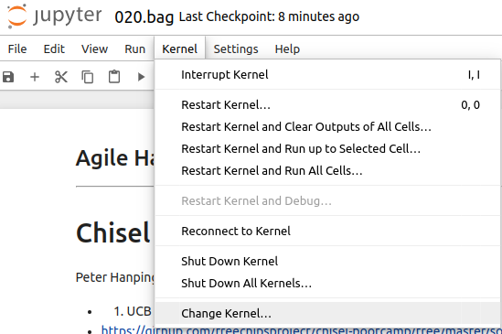
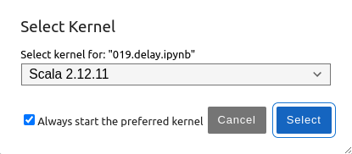
20 Chisel Grab Bag
https://www.youtube.com/watch?v=EOMMpYBo8To&list=PLfrN7RIcMe6g2LBRJLTHTdhyj5s8ag0Rg&index=22
Chisel Grab Bag (0:31-0:42/1:05:51)
Setup Scala 2.12.11:
> jupyter notebook 020.bag.ipynb
Kernel > Change Kernel ,,, > Select Scala 2.12.11
Run > Run All Cells

Slide 5
18.1 Plan

Slide 6
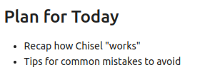
18.1 Plan
https://www.youtube.com/watch?v=EOMMpYBo8To&list=PLfrN7RIcMe6g2LBRJLTHTdhyj5s8ag0Rg&index=22
Plan (0:43-0:54/1:05:51)
Today, we talk about Chisel Grab Bag.
1. How Chisel work
2. Avoid Common Mistake

Slide 7
18.2 Import Chisel Library

Slide 8
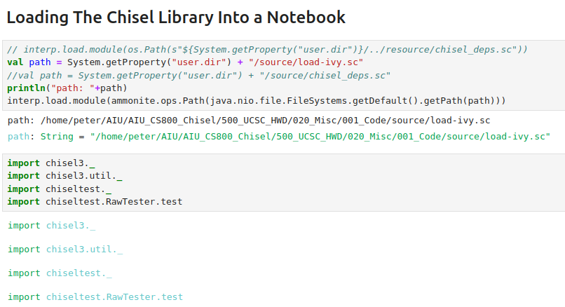
18.2 Import Chisel Library
https://www.youtube.com/watch?v=EOMMpYBo8To&list=PLfrN7RIcMe6g2LBRJLTHTdhyj5s8ag0Rg&index=22
Import Chisel Library (0:43-0:54/1:05:51)

Slide 9
End

