Slide 1

3.3 Higher Order Function
Peter H. Chen

Slide 2
3.3 Higher Order Function
https://github.com/freechipsproject/chisel-bootcamp
Higher Order Function
We discuss Chisel Operation of HOF (Higher Order Function), i.e., anonymous function, map, and reduce, to do the convolution.
1.

Slide 3
3.3.1 Setup

Slide 4
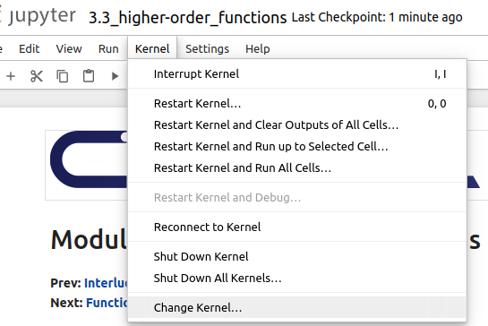
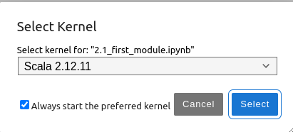
3.3.1 Setup
https://github.com/freechipsproject/chisel-bootcamp
Setup
1. Change folder to chisel-bootcamp. If you want to work on your working space, copy image folder and source folder to your working directory.
> cd chisel-bootcamp
2. Start Jupyter notebook
> jupyter notebook 3.3_higher-order_funcitons.ipynb
3. Select the scala interpreter: > Kernel > Change Kernel… >Scala 2.12.11
3

Slide 5
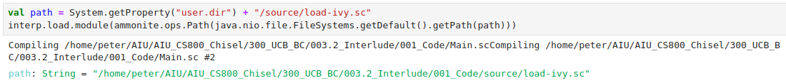
3.3.1 Setup
https://github.com/freechipsproject/chisel-bootcamp
Setup
1. Scala uses maven to setup path to with for source folder for Scala Libraries and get Scala Property.

Slide 6
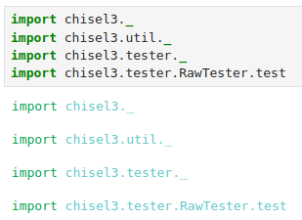
3.3.1 Setup
https://github.com/freechipsproject/chisel-bootcamp
Setup
1. import chisel3 library, utility, tester harness (horse controller), and test interface function.

Slide 7
3.3.2 Two FIR Filters

Slide 8
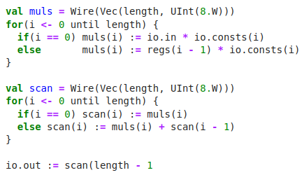
3.3.2 Two FIR Filters
https://github.com/freechipsproject/chisel-bootcamp
Two FIR Filters
1. Below code does the Convolution.
2. We multiply each element of io.in with the corresponding element of io.consts.
3. Then,we store the results in muls.
4. Then, the elements in muls are accumulated into scan, with
  a. scan(0) = muls(0),
  b. scan(1) = scan(0) + muls(1) = muls(0) + muls(1), and in general
  c. scan(n) = scan(n-1) + muls(n) = muls(0) + ... + muls(n-1) + muls(n).
5. The last element in scan (equal to the sum of all muls) is assigned to io.out.

Slide 9
3.3.2 Two FIR Filters
https://github.com/freechipsproject/chisel-bootcamp
Zip, Map, and Reduce Explanation
1. We can use convolution operation and re-write the above codes into one line:
> io.out := (taps zip io.consts).map { case (a, b) => a * b }.reduce(_ + _)
2. This above statement explained as below.
3. Assume taps is the list of all samples, with taps(0) = io.in, taps(1) = regs(0), etc.
4. In the statement “(taps zip io.consts)”, the zip takes two lists: taps and io.consts, and combines them into one list.
5. In taps and io.consts list, each element is a tuple of the elements at the inputs at the corresponding position.
6. The zip value would be a list [] which contains tuples (tuple 0) (tuple 1), …, (tuple n) as below:
> [(taps(0), io.consts(0)), (taps(1), io.consts(1)), ..., (taps(n), io.consts(n))].
7. The above code statement is equal to: (taps.zip(io.consts)).
8. The statement “.map { case (a, b) => a * b }” applies the anonymous function (takes a tuple of two elements returns their product) to the elements of the list, and returns the result.
9. In this case, the result is
> [taps(0) * io.consts(0), taps(1) * io.consts(1), ..., taps(n) * io.consts(n)].
10. The statement “.reduce(_ + _)” is the addition of elements of the list. The statement takes two arguments: the first is the current accumulation, and the second is the list element (in the first iteration, it just adds the first two elements). These are given by the two underscores in the parentheses.
11. The result would then be, assuming left-to-right traversal, (((muls(0) + muls(1)) + muls(2)) + ...) + muls(n), with the result of deeper-nested parentheses evaluated first. This is the output of the convolution.

Slide 10
3.3.3 Function as Argument

Slide 11
3.3.3 Function as Argument
https://github.com/freechipsproject/chisel-bootcamp
Function as Argument
1.

Slide 12
End

