Slide 1

11 Solution
Peter H. Chen

Slide 2
11 Solution
https://github.com/ucb-bar/chisel-tutorial?tab=readme-ov-file
Solution
Below 18 tests: “./run-solution.sh all”. We compare the result of solution.
1. Mux4: 4 input multiplexer
2. Accumulator
3. DynamicMemorySearch: This module Dynamic Allocate the memory and do sequential search of 'data'.
4. MaxN: Pick the maximum number of n input data.
5. VecShiftRegisterSimple: Simple shift register with four 8-bit stages.
6. Max2: Max2 implement with Multiplexer with 2 inputs.
7. VendingMachineSwitch: Use “Switch” statement to implement the Vending Machine.
8. Mul: Multiplication
9. LFSR16 (Linear-Feedback Fibonacci Sift Register 16 bits): LFSR16 generates a pseudo-random bit sequence
10. VecShiftRegisterParam: Parameterized simple shift register.
11. RealGCD: GCD (Greatest Common Divisor of two numbers) Circuit.
12. VendingMachine: Implement Vending machine using 'when' statements.
13. Mux2: Multiplexer with 2 inputs
14. Memo: Memory Controller.
15. VecShiftRegisterParam: Parameterized simple shift register.
16. Counter: Counter increase by the amt (amount) and en (enable).
17. SingleEvenFilter: Identify SingleFilter (input is Single decimal digit) and EvenFilter (input is Even number)
18. Adder: Add two numbers.

Slide 3
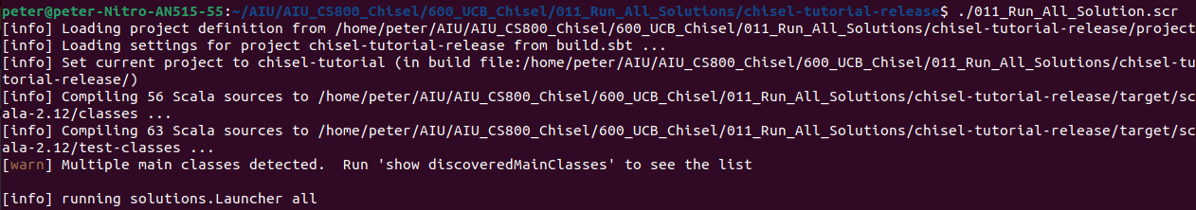
11 Solution
https://github.com/ucb-bar/chisel-tutorial?tab=readme-ov-file
Solution
Below 17 tests with SBT automatic command “./run-solution.sh all”:

Slide 4
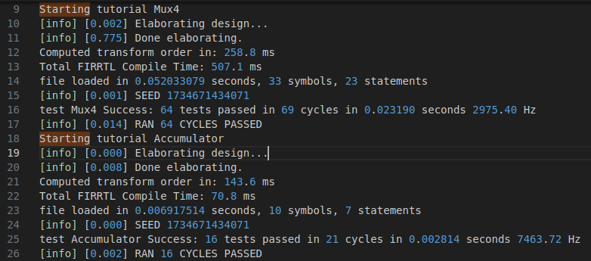
11 Solution
https://github.com/ucb-bar/chisel-tutorial?tab=readme-ov-file
Solution
1. Mux4: 4 input multiplexer
2. Accumulator

Slide 5
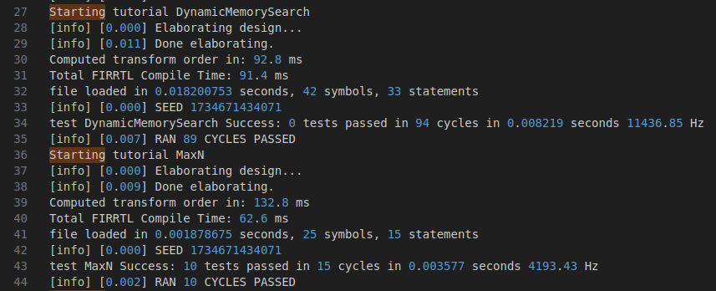
11 Solution
https://github.com/ucb-bar/chisel-tutorial?tab=readme-ov-file
Solution
3. DynamicMemorySearch: This module Dynamic Allocate the memory and do sequential search of 'data'.
4. MaxN: Pick the maximum number of n input data.

Slide 6
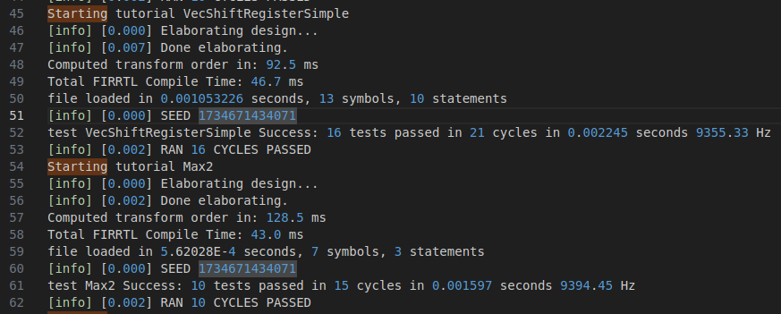
11 Solution
https://github.com/ucb-bar/chisel-tutorial?tab=readme-ov-file
Solution
5. VecShiftRegisterSimple: Simple shift register with four 8-bit stages.
6. Max2: Max2 implement with Multiplexer with 2 inputs.

Slide 7
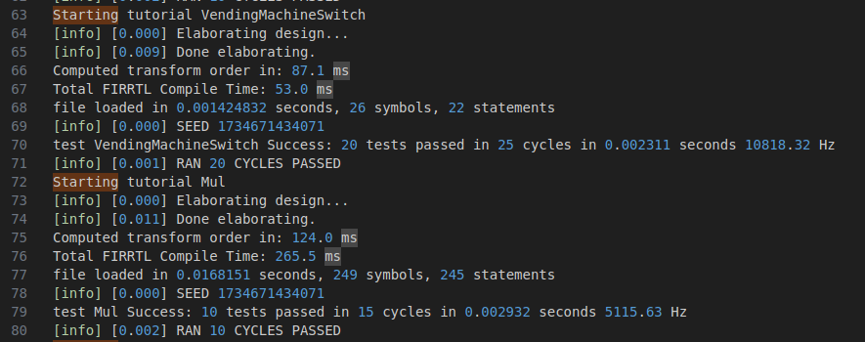
11 Solution
https://github.com/ucb-bar/chisel-tutorial?tab=readme-ov-file
Solution
7. VendingMachineSwitch: Use “Switch” statement to implement the Vending Machine.
8. Mul: Multiplication

Slide 8
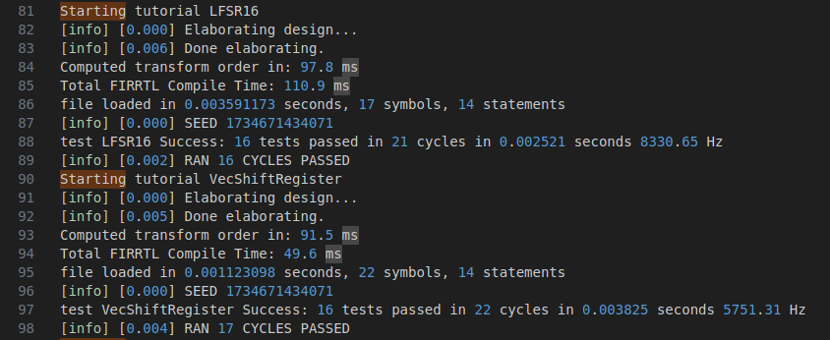
11 Solution
https://github.com/ucb-bar/chisel-tutorial?tab=readme-ov-file
Solution
9. LFSR16 (Linear-Feedback Fibonacci Sift Register 16 bits): LFSR16 generates a pseudo-random bit sequence.
10. VecShiftRegisterParam: Parameterized simple shift register.

Slide 9
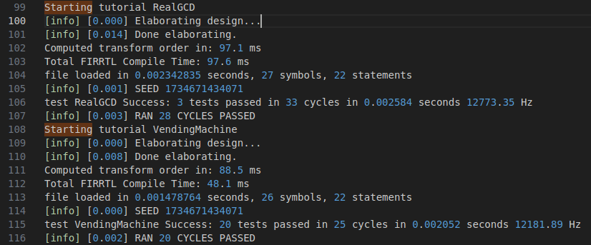
11 Solution
https://github.com/ucb-bar/chisel-tutorial?tab=readme-ov-file
Solution
11. RealGCD: GCD (Greatest Common Divisor of two numbers) Circuit.
12. VendingMachine: Implement Vending machine using 'when' statements.

Slide 10
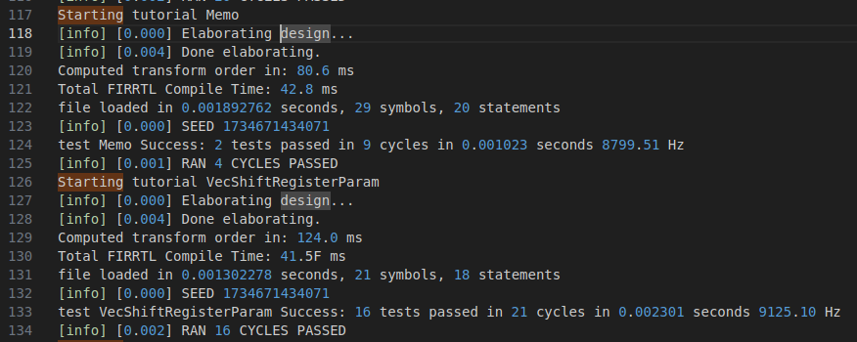
11 Solution
https://github.com/ucb-bar/chisel-tutorial?tab=readme-ov-file
Solution
13. Memo: Memory Controller.
14. VecShiftRegisterParam: Parameterized simple shift register.

Slide 11
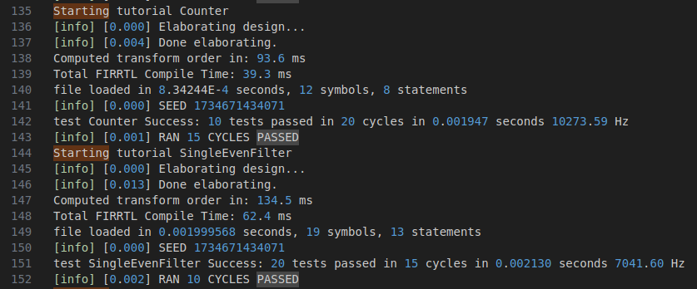
11 Solution
https://github.com/ucb-bar/chisel-tutorial?tab=readme-ov-file
Solution
15. Counter: Counter increase by the amt (amount) and en (enable).
16. SingleEvenFilter: Identify SingleFilter (input is Single decimal digit) and EvenFilter (input is Even number)

Slide 12
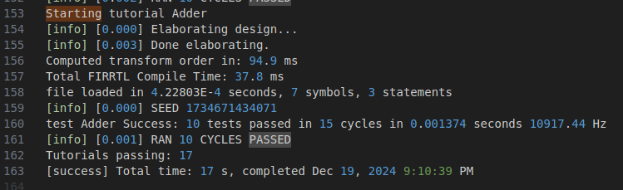
11 Solution
https://github.com/ucb-bar/chisel-tutorial?tab=readme-ov-file
Solution
17. Adder: Add two numbers.

Slide 13
End

