Slide 1

1.1 McPAT
Peter H. Chen

Slide 2
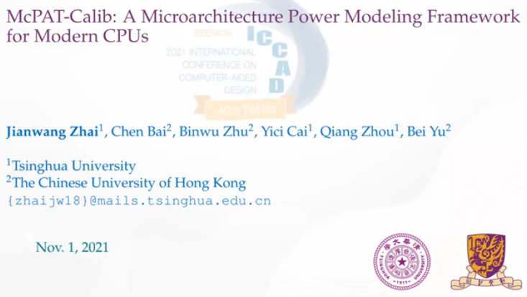
1.1 McPAT
https://www.youtube.com/watch?v=Lwt2YxlFutA
McPAT (0:00-0:29/21:59)
McPAT (Multi-core Power, Area, Timing), 2021
Jianwang Zhai from Tsinghua University. talks about the McPAT-Calib, A Micro architecture Power Modeling Framework for Modern CPUs.
This paper presents the CPU design and Power Modeling.

Slide 3
1.2 Topic

Slide 4
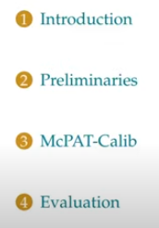
1.2 Topic
https://www.youtube.com/watch?v=L2e-55iSA_8&list=PLfrN7RIcMe6g2LBRJLTHTdhyj5s8ag0Rg&index=1
Topic (0:30-0:52/21:59)
1. Introduction: Background
2. Preliminaries: Preliminary risk and problem for mission
3. McPAT-Calib: details of McPAT-Calib
4. Evaluation: Show evaluation result.
5. Conclusion

Slide 5
1.3 CPU Design and Power Modeling

Slide 6
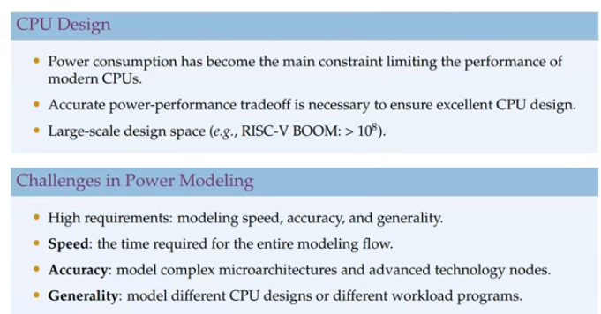
1.3 CPU Design and Power Modeling
https://www.youtube.com/watch?v=L2e-55iSA_8&list=PLfrN7RIcMe6g2LBRJLTHTdhyj5s8ag0Rg&index=1
CPU Design and Power Modeling (0:53-2:08/21:59)
1. Power consumption is the main constraint which limit the performance of modern CPUs Design.
2. We need to evaluate the power vs. performance trade-off at the early design phase to ensure the the optimal CPUs design.
3. Design space of modern CPU become very large.
4. Design Space Exploration and Optimization for power modeling for speed, accuracy, and generality are required.
5. We need accurate model multi-core power, area, and timing/performance.
6. The generality model the power for different CPU design and different workload programs.

Slide 7
1.4 Power Model Comparison

Slide 8
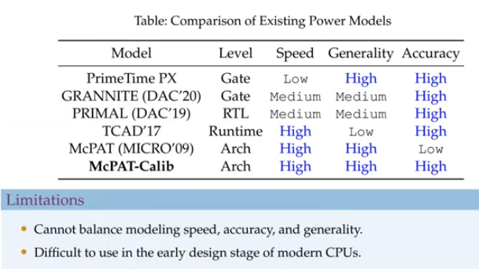
1.4 Power Model Comparison
https://www.youtube.com/watch?v=L2e-55iSA_8&list=PLfrN7RIcMe6g2LBRJLTHTdhyj5s8ag0Rg&index=1
Power Model Comparison (2:09-5:58/21:59)
1. Below, we compare PrimeTime, Granite, Primal, TCAD, McPAT, and McPAT-Calib.
2. Our design switches in power model are gate or RTL level.
3. The PrimeTime and GRANITE are based on Gate level. Primal is based on RTL. TCAD 17 is based on runtime.
4. These model are built based on simulation tools based on feature engineering and machine learning method. These models require design netlist and simulation which also time consuming. These models are design specific and cannot model the non-CPU design. The TCAD 17 is based on runtime power module for specific design, not for CPU design.
5. At higher micro-architecture level, power models use micro-architectural design parameters and statistics from power modeling which have the highest modeling speed, however, these models are difficult to capture the hardware details and low accuracy.
6. it is difficult to balance model speed, accuracy, and generality.
7. The model are difficult to use in early design stage.

Slide 9
1.5 McPAT Model

Slide 10
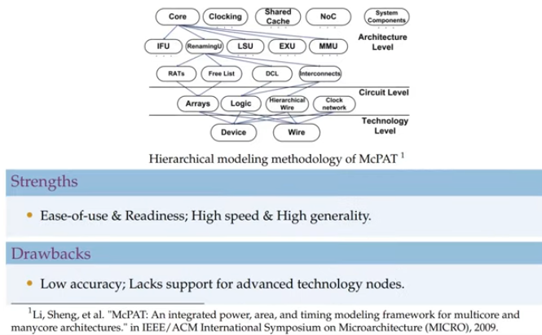
1.5 McPAT Model
https://www.youtube.com/watch?v=L2e-55iSA_8&list=PLfrN7RIcMe6g2LBRJLTHTdhyj5s8ag0Rg&index=1
McPAT Model (3:59-4:41/21:59)
1. Below is McPAT Model by Sheng Li.

Slide 11
End

