Slide 1

5.1 RISCV/LLVM and lowRISC
Peter H. Chen

Slide 2
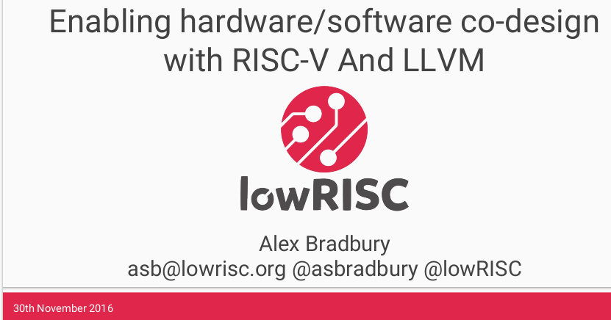
5.1 RISCV/LLVM and lowRISC
https://www.youtube.com/watch?v=eURfE6cTqZE&list=PLlu0CT-JnSasfpk8tq1ZDiE2G0AK1BhOg&index=5
RISCV/LLVM and lowRISC (0:00-0:18/24:34)
We discuss RISCV and LLVM with lowRISC.
What is lowRISC?
1. lowRISC (low cost RISC) is a UK-based company developed open source framework for RISCV architecture (UC Berkeley 128 bits SoC)
2. Integrate RISCV and LLVM (Low level virtual machine)
3. Provides RISCV co-design
4. Integrate tool chain: assembly language, C++, machine code generation
5. User guide/document/guide

Slide 3
5.2 Why Do We Need LLVM?

Slide 4
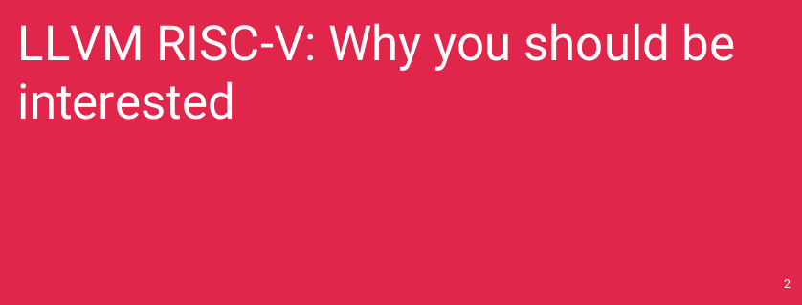
5.2 Why Do We Need LLVM?
https://www.youtube.com/watch?v=eURfE6cTqZE&list=PLlu0CT-JnSasfpk8tq1ZDiE2G0AK1BhOg&index=5
Why Do We Need LLVM? (0:19-1:20/24:34)
Why do we need LLVM and why should we be interested?

Slide 5
5.3 What Is Not LLVM?

Slide 6
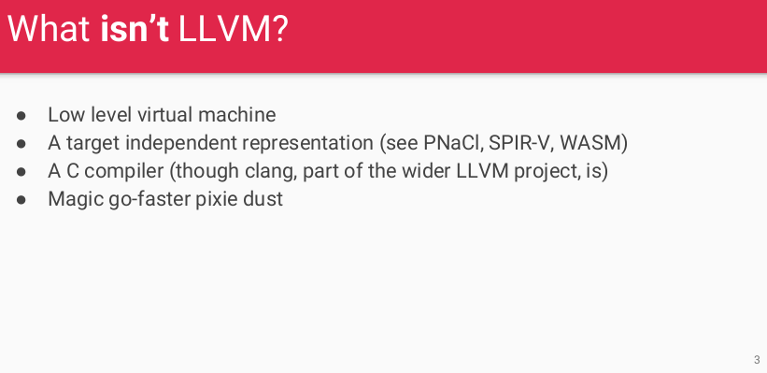
5.3 What Is Not LLVM?
https://www.youtube.com/watch?v=eURfE6cTqZE&list=PLlu0CT-JnSasfpk8tq1ZDiE2G0AK1BhOg&index=5
What Is Not LLVM? (0:21-1:20/24:34)
LLVM (Low Level Virtual Machine) is a framework that generates object code from source code, and is not a compiler for any specific language.
LLVM is not longer as below:
1. An acronym of “Low Level Virtual Machine”: The name LLVM was originally an acronym for "Low Level Virtual Machine", but it's no longer an acronym and is now considered a brand.
2. A compiler: LLVM is not a compiler for any specific language as below, but it can be used as a background for compilers in multiple languages.
  PNaCl (Portable Native Client): Google technology to run web app as the same speed as native app.
  SPIR-V (Standard, Portable Intermediate Representation-V): Intermediate language for parallel computing.
  WASM (Web Assembly): A portable Binary/text format for executable program and software interface.
3. A virtual machine: The LLVM is no longer a virtual machine.

Slide 7
5.4 What is LLVM?

Slide 8
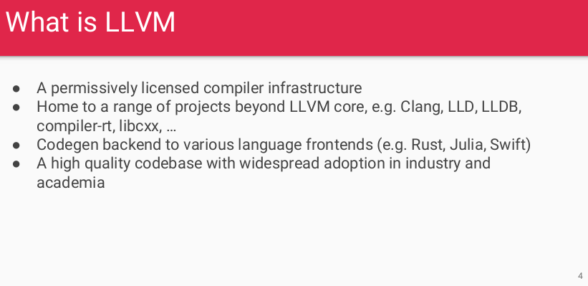
5.4 What is LLVM?
https://www.youtube.com/watch?v=eURfE6cTqZE&list=PLlu0CT-JnSasfpk8tq1ZDiE2G0AK1BhOg&index=5
What is LLVM? (1:26-2:30/24:34)
1. Compiler Infrastructure
2. LLVM is a collection of reusable compiler and toolchain technologies that includes sub-projects like MLIR (Multi-Level Intermediate Representation) and polly (data optimizer of LLVM).
3. LLVM-backed languages include C/C++, Swift, GHC (Glasgow Haskell Compiler) Haskell, Rust, Julia, scala-native, ldc, and Crystal.
4. a number of project
5. a set of libraries.
6. Used for RISCV code generation.

Slide 9
5.5 Why is LowRISC?

Slide 10
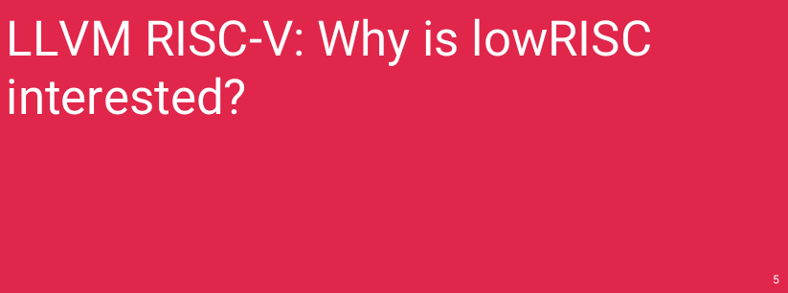
5.5 Why is LowRISC?
https://www.youtube.com/watch?v=eURfE6cTqZE&list=PLlu0CT-JnSasfpk8tq1ZDiE2G0AK1BhOg&index=5
Why is LowRISC? (2:31-2:47/24:34)

Slide 11
End

