Slide 1

5.6 What is LowRISC?
Peter H. Chen

Slide 2
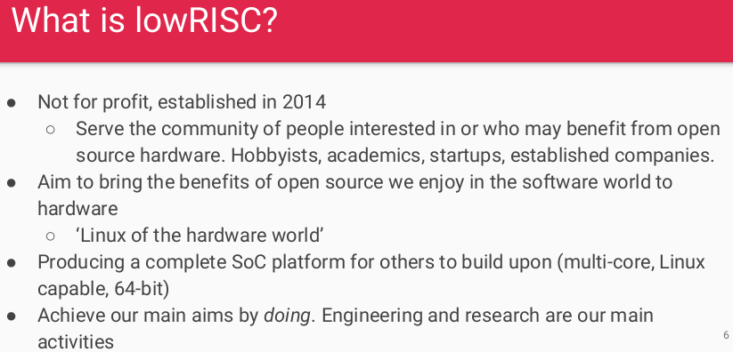
5.6 What is LowRISC?
https://www.youtube.com/watch?v=eURfE6cTqZE&list=PLlu0CT-JnSasfpk8tq1ZDiE2G0AK1BhOg&index=5
What is LowRISC? (2:48-3:47/24:34)
LowRISC (Low cost Reduce Instruction Set Computer): Create community of RISCV.
Software, hardware platform.
Engineering research and development.

Slide 3
5.7 Tagged Memory

Slide 4
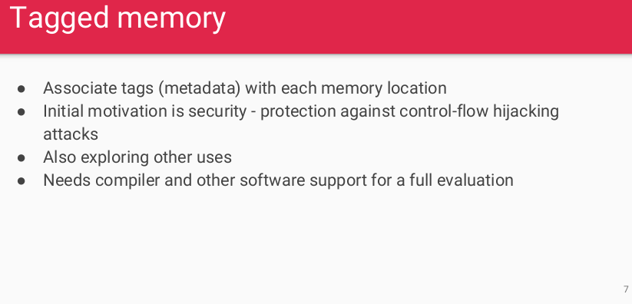
5.7 Tagged Memory
https://www.youtube.com/watch?v=eURfE6cTqZE&list=PLlu0CT-JnSasfpk8tq1ZDiE2G0AK1BhOg&index=5
Tagged Memory (3:48-5:44/24:34)
Tagged Memory: Meta memory.

Slide 5
5.8 Minion Core

Slide 6
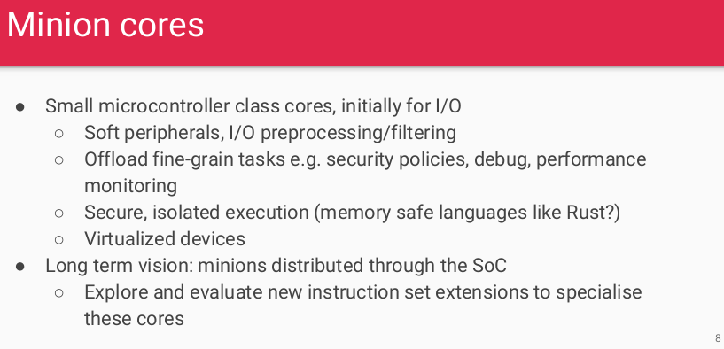
5.8 Minion Core
https://www.youtube.com/watch?v=eURfE6cTqZE&list=PLlu0CT-JnSasfpk8tq1ZDiE2G0AK1BhOg&index=5
Minion Core (5:45-7:11/24:34)
Minion (奴才) Core: Small Micro-controller cores.
Long term distributed software for SoC.

Slide 7
5.9 RISCV-LLVM Backend

Slide 8
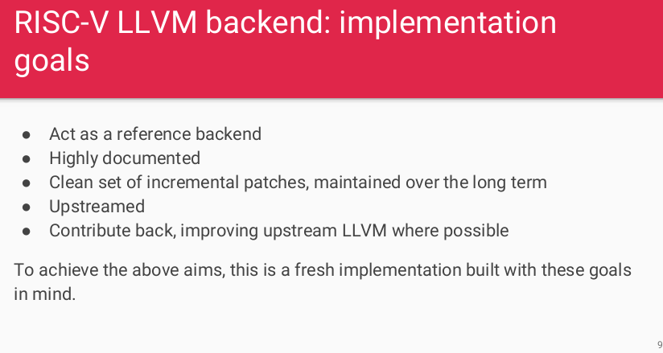
5.9 RISCV-LLVM Backend
https://www.youtube.com/watch?v=eURfE6cTqZE&list=PLlu0CT-JnSasfpk8tq1ZDiE2G0AK1BhOg&index=5
RISCV-LLVM Backend (7:12-9:14/24:34)
RISCV-LLVM backend: compiler, toolchain, release management, hardware/software implementation document, and framework.

Slide 9
5.9 RISCV-LLVM Backend: Goal

Slide 10
5.9 RISCV-LLVM Backend: Goal
https://www.youtube.com/watch?v=eURfE6cTqZE&list=PLlu0CT-JnSasfpk8tq1ZDiE2G0AK1BhOg&index=5
RISCV-LLVM Backend: Goal (7:12-7:47/24:34)
RISCV-LLVM backend: compiler framework.

Slide 11
5.10 RISCV-LLVM Backend: Goal Justification

Slide 12
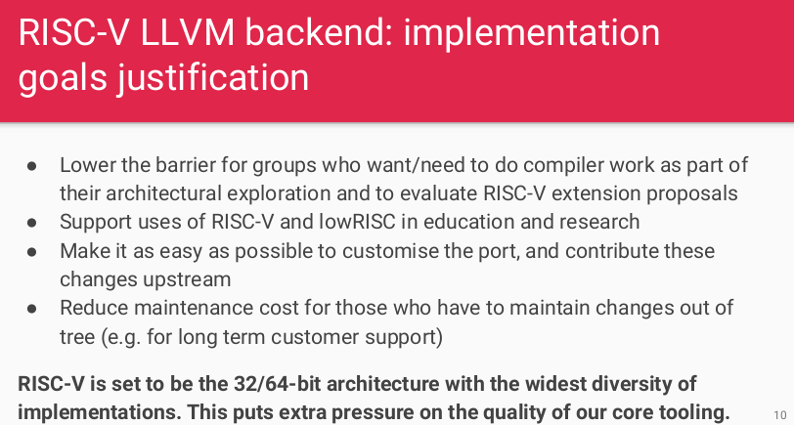
5.10 RISCV-LLVM Backend: Goal Justification
https://www.youtube.com/watch?v=eURfE6cTqZE&list=PLlu0CT-JnSasfpk8tq1ZDiE2G0AK1BhOg&index=5
RISCV-LLVM Backend: Goal Justification (7:48-11:02/24:34)
Education
Support
maintenance

Slide 13
End

