Slide 1

5.11 RISCV-LLVM Backend: Approach
Peter H. Chen

Slide 2
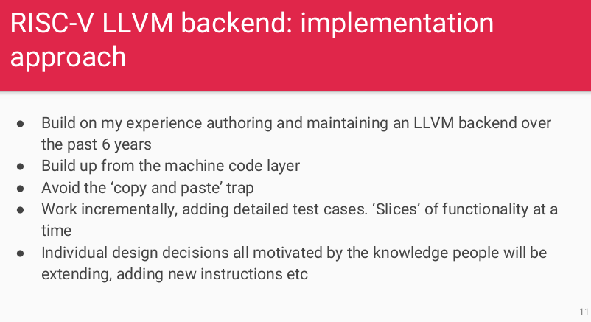
5.11 RISCV-LLVM Backend: Approach
https://www.youtube.com/watch?v=eURfE6cTqZE&list=PLlu0CT-JnSasfpk8tq1ZDiE2G0AK1BhOg&index=5
RISCV-LLVM Backend: Approach (11:03-12:55/24:34)

Slide 3
5.12 Compile with LLVM: RISCV Assembly

Slide 4
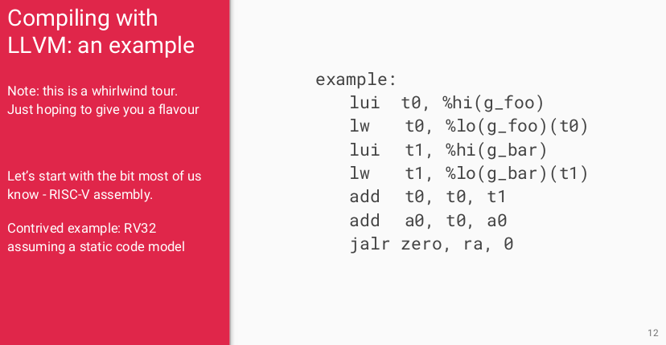
5.12 Compile with LLVM: RISCV Assembly
https://www.youtube.com/watch?v=eURfE6cTqZE&list=PLlu0CT-JnSasfpk8tq1ZDiE2G0AK1BhOg&index=5
Compile with LLVM: RISCV Assembly (12:56-13:35/24:34)
Basic assembly:
lui (load upper immediate) t0, %h1 (g_foo): place hi value of (g_foo) into register t0.
lw (store data from memory) t0, %lo (g_foo)(t0): load word at address %lo(g_foo)(t0) into register t0.
lui t1, %hi(g_bar): load hi value of (g_bar) into register r1.
add t0, t0, t1: add register t0 and register t1 and then put into register t0
add a0, t0, a0: add t0 and a0 and then put into reister a0.
jalr zero, ra, 0: # zero = pc + 4; pc = ra + 0
jal (jump and link): store the return address in a register, e.g., jal rd, imm # rd = pc + 4; pc += imm
jalr (jump and link register): jump with the address in a register and store the return address in another address, e.g., rd, rs1, imm # rd = pc + 4; pc = rs1 + imm

Slide 5
5.13 Compile with LLVM: MC Layer

Slide 6
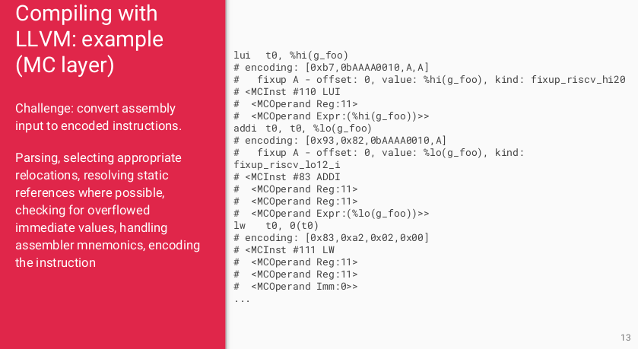
5.13 Compile with LLVM: MC Layer
https://www.youtube.com/watch?v=eURfE6cTqZE&list=PLlu0CT-JnSasfpk8tq1ZDiE2G0AK1BhOg&index=5
Compile with LLVM: MC Layer (13:36-14:10/24:34)
MC (Machine Code) Layer

Slide 7
5.14 Compile with LLVM: IR

Slide 8
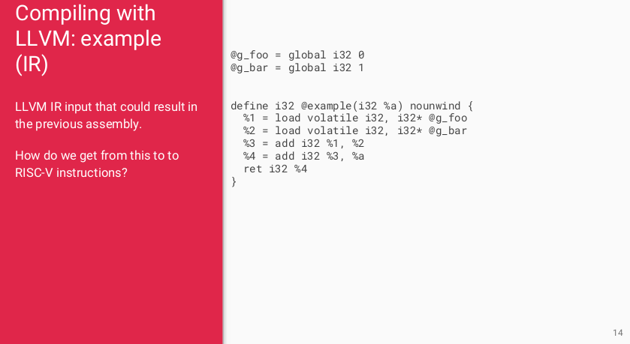
5.14 Compile with LLVM: IR
https://www.youtube.com/watch?v=eURfE6cTqZE&list=PLlu0CT-JnSasfpk8tq1ZDiE2G0AK1BhOg&index=5
Compile with LLVM: IR (14:11-15:45/24:34)
IR (Intermediate Representation): From assembly to encode instruction is too complication, we have the Intermediate Representation.
How do we translate from IR level into MC layer.

Slide 9
5.15 Instruction Selection in DAG

Slide 10
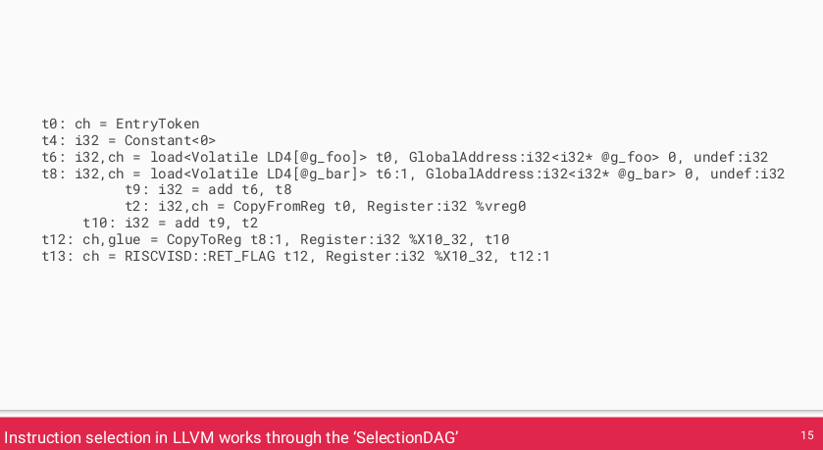
5.15 Instruction Selection in DAG
https://www.youtube.com/watch?v=eURfE6cTqZE&list=PLlu0CT-JnSasfpk8tq1ZDiE2G0AK1BhOg&index=5
Instruction Selection in DAG (15:46-15:59/24:34)
DAG (Directed Acyclic Graph): The SelectionDAG provides an abstraction for code representation in a way that is amenable to instruction selection using automatic techniques (e.g. dynamic-programming based optimal pattern matching selectors). I
https://llvm.org/docs/CodeGenerator.html#target-independent-code-generation-algorithms

Slide 11
End

