Slide 1

1.13 Transformation

Slide 2
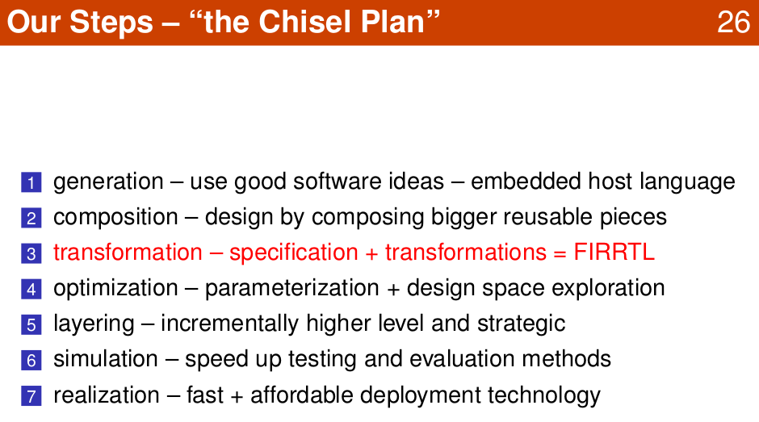
1.13 Transformation
https://www.youtube.com/watch?v=pfM1WUWbfBs&list=PLlu0CT-JnSasfpk8tq1ZDiE2G0AK1BhOg&index=1
Transformation: FIRRTL (20:53-21:55/51:50)

Slide 3
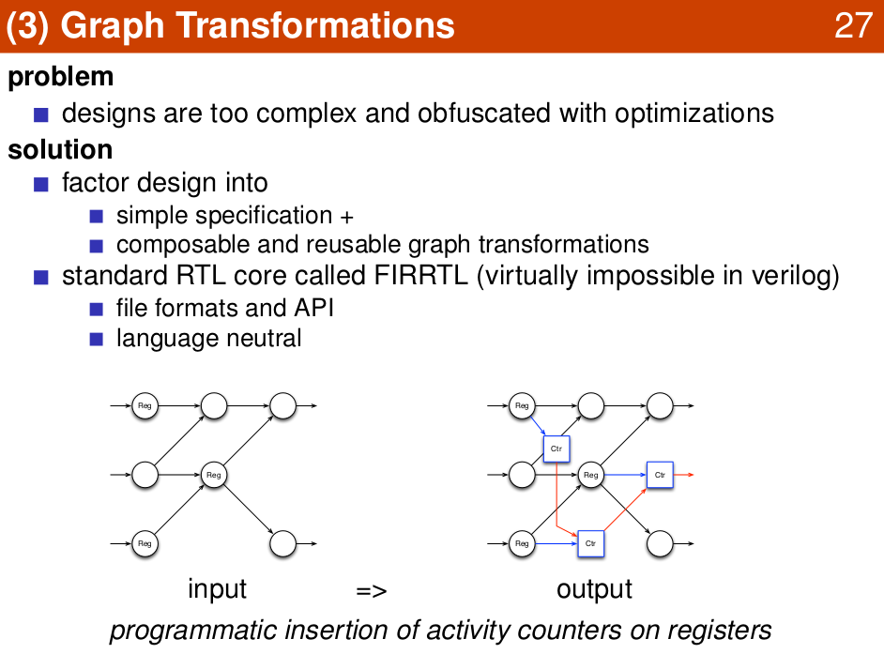
1.13 Transformation
https://www.youtube.com/watch?v=pfM1WUWbfBs&list=PLlu0CT-JnSasfpk8tq1ZDiE2G0AK1BhOg&index=1
Graph Transformation (20:53-21:55/51:50)

Slide 4
1.14 LLVM

Slide 5
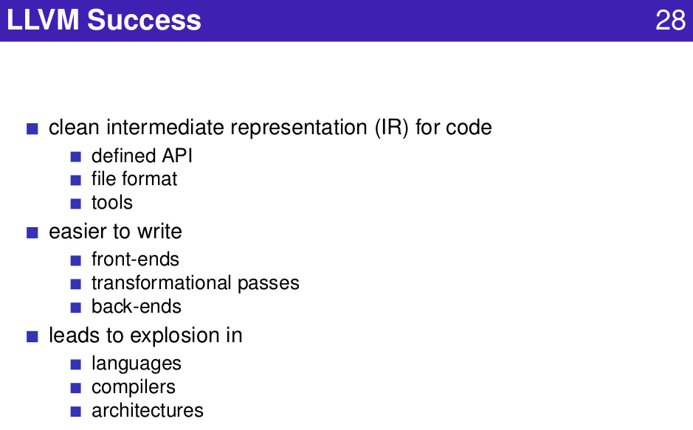
1.14 LLVM
https://www.youtube.com/watch?v=pfM1WUWbfBs&list=PLlu0CT-JnSasfpk8tq1ZDiE2G0AK1BhOg&index=1
LLVM (21:56-23:16/51:50)

Slide 6
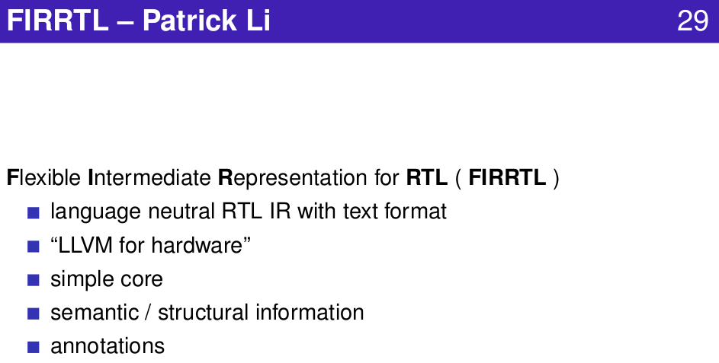
1.14 LLVM
https://www.youtube.com/watch?v=pfM1WUWbfBs&list=PLlu0CT-JnSasfpk8tq1ZDiE2G0AK1BhOg&index=1
FIRRTL (21:56-23:16/51:50)

Slide 7
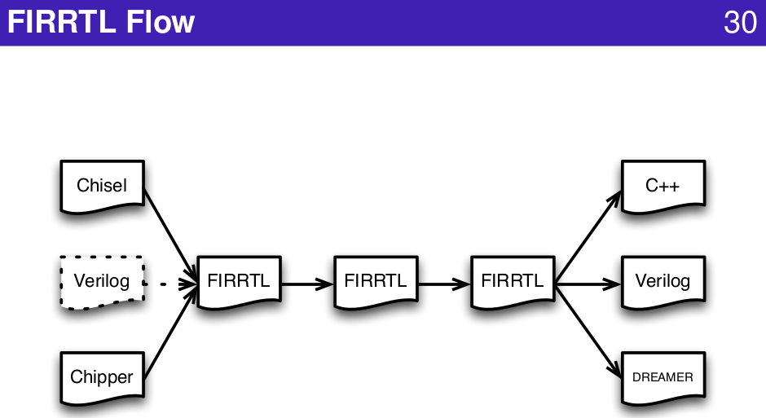
1.14 LLVM
https://www.youtube.com/watch?v=pfM1WUWbfBs&list=PLlu0CT-JnSasfpk8tq1ZDiE2G0AK1BhOg&index=1
FIRRTL Flow (21:56-23:16/51:50)

Slide 8
1.15 CPU Pipeline

Slide 9
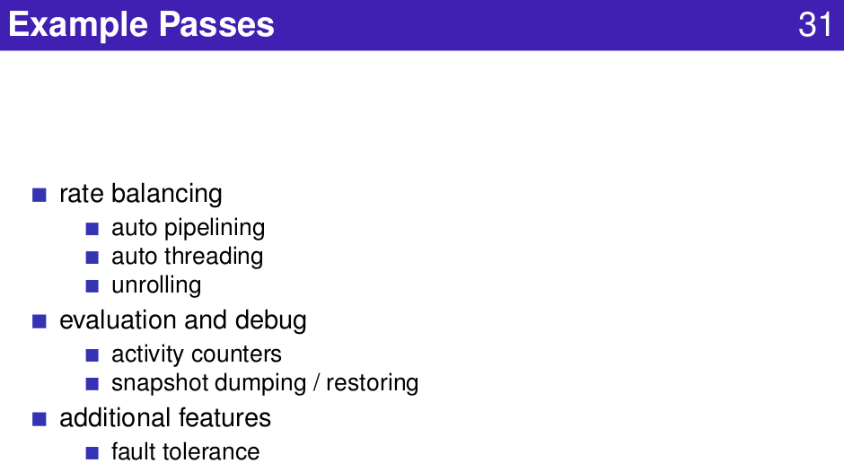
1.15 CPU Pipeline
https://www.youtube.com/watch?v=pfM1WUWbfBs&list=PLlu0CT-JnSasfpk8tq1ZDiE2G0AK1BhOg&index=1
CPU Pipeline (23:17-24:29/51:50)

Slide 10
1.16 DSE (Design Space Exploration)

Slide 11
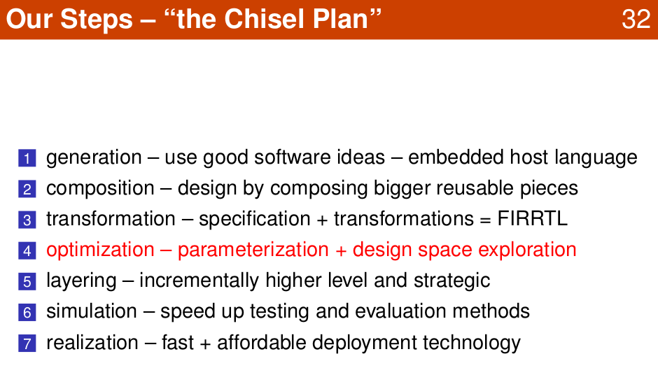
1.16 DSE (Design Space Exploration)
https://www.youtube.com/watch?v=pfM1WUWbfBs&list=PLlu0CT-JnSasfpk8tq1ZDiE2G0AK1BhOg&index=1
Optimization: Parameter and Design Space (24:30-26:15/51:50)

Slide 12
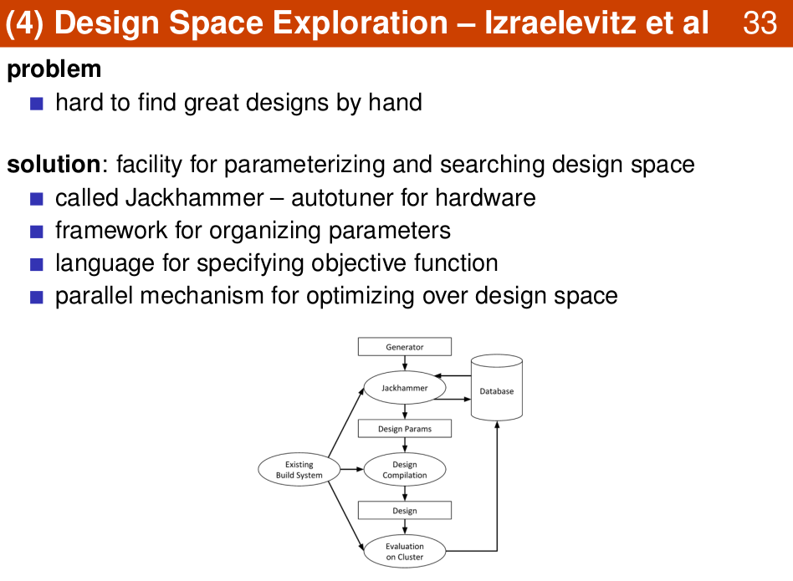
1.16 DSE (Design Space Exploration)
https://www.youtube.com/watch?v=pfM1WUWbfBs&list=PLlu0CT-JnSasfpk8tq1ZDiE2G0AK1BhOg&index=1
Design Space Exploration (24:30-26:15/51:50)

Slide 13
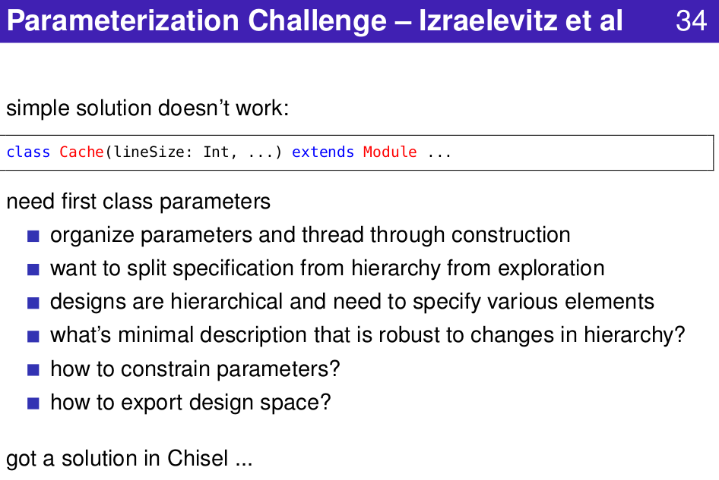
1.16 DSE (Design Space Exploration)
https://www.youtube.com/watch?v=pfM1WUWbfBs&list=PLlu0CT-JnSasfpk8tq1ZDiE2G0AK1BhOg&index=1
Parametrization (24:30-26:15/51:50)

Slide 14
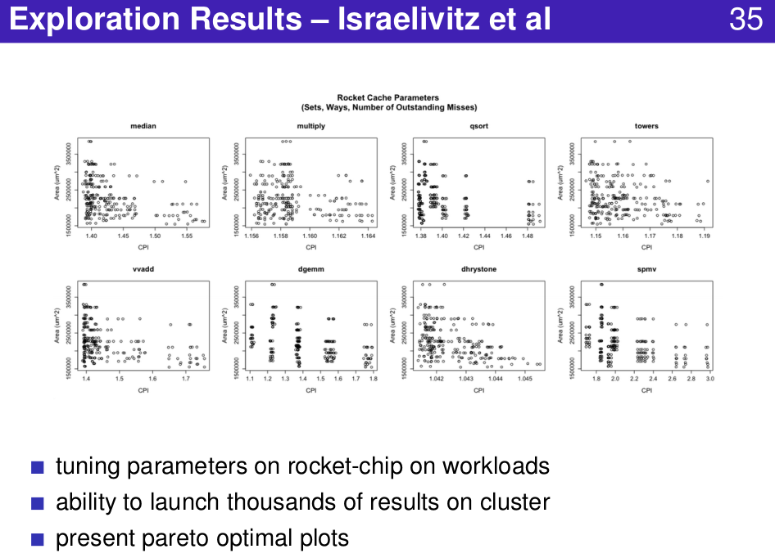
1.16 DSE (Design Space Exploration)
https://www.youtube.com/watch?v=pfM1WUWbfBs&list=PLlu0CT-JnSasfpk8tq1ZDiE2G0AK1BhOg&index=1
Exploration Results (24:30-26:15/51:50)

Slide 15
1.17 Layer Language

Slide 16
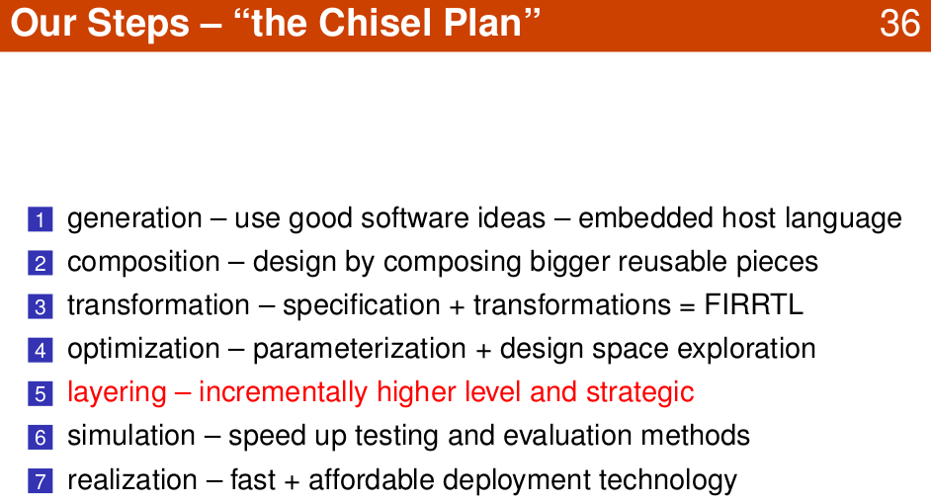
1.17 Layer Language
https://www.youtube.com/watch?v=pfM1WUWbfBs&list=PLlu0CT-JnSasfpk8tq1ZDiE2G0AK1BhOg&index=1
Layering (26:16-28:27/51:50)

Slide 17
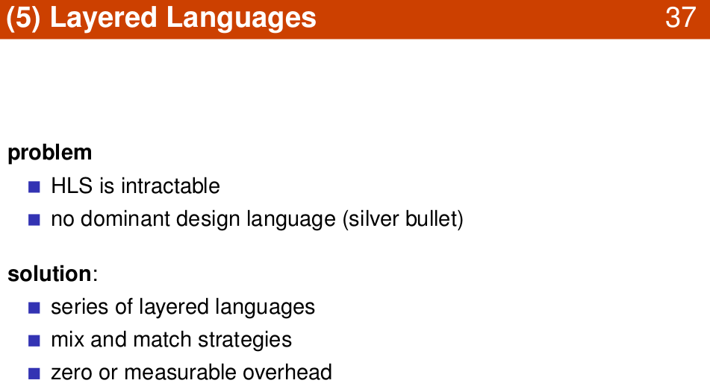
1.17 Layer Language
https://www.youtube.com/watch?v=pfM1WUWbfBs&list=PLlu0CT-JnSasfpk8tq1ZDiE2G0AK1BhOg&index=1
Layered Language (26:16-28:27/51:50)

Slide 18
1.18 Simulation

Slide 19
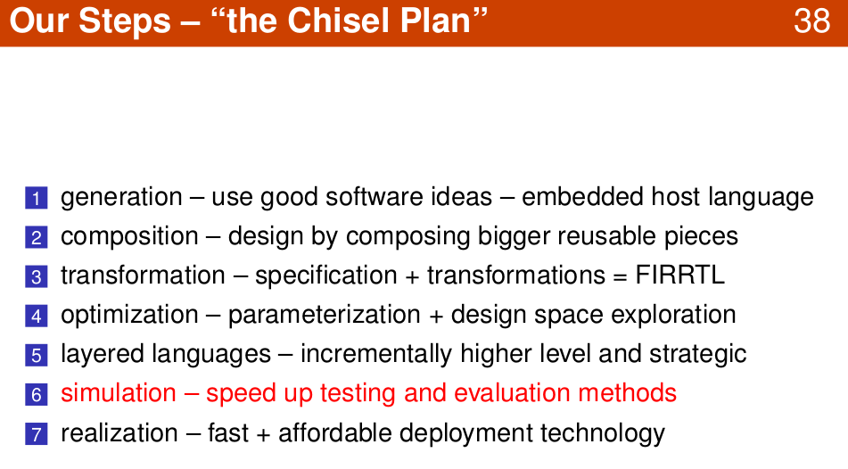
1.18 Simulation
https://www.youtube.com/watch?v=pfM1WUWbfBs&list=PLlu0CT-JnSasfpk8tq1ZDiE2G0AK1BhOg&index=1
Simulation (28:28-29:08/51:50)

Slide 20
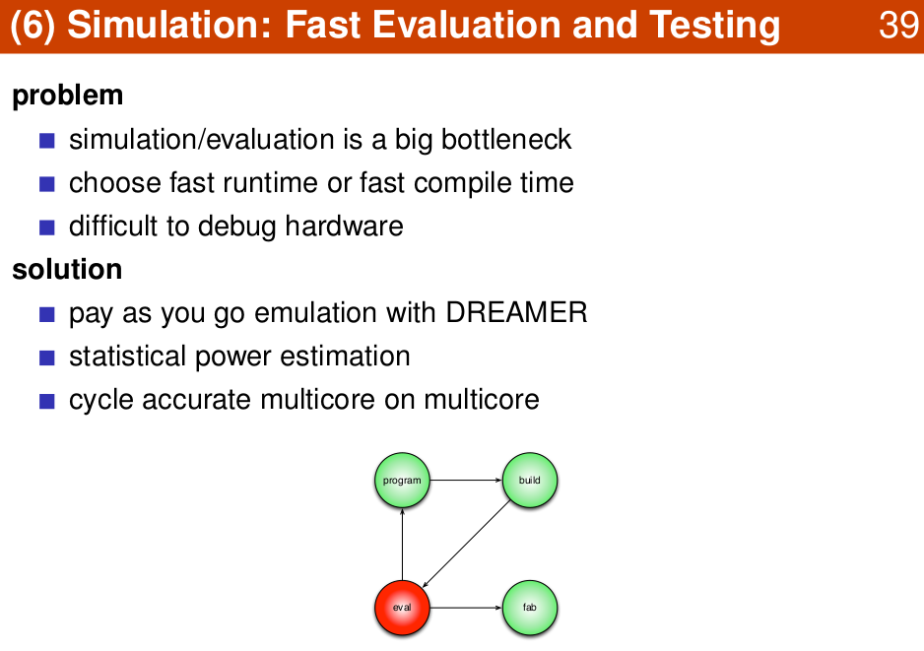
1.18 Simulation
https://www.youtube.com/watch?v=pfM1WUWbfBs&list=PLlu0CT-JnSasfpk8tq1ZDiE2G0AK1BhOg&index=1
Evaluation and Test (28:28-29:08/51:50)

Slide 21
1.19 C++ Simulator

Slide 22
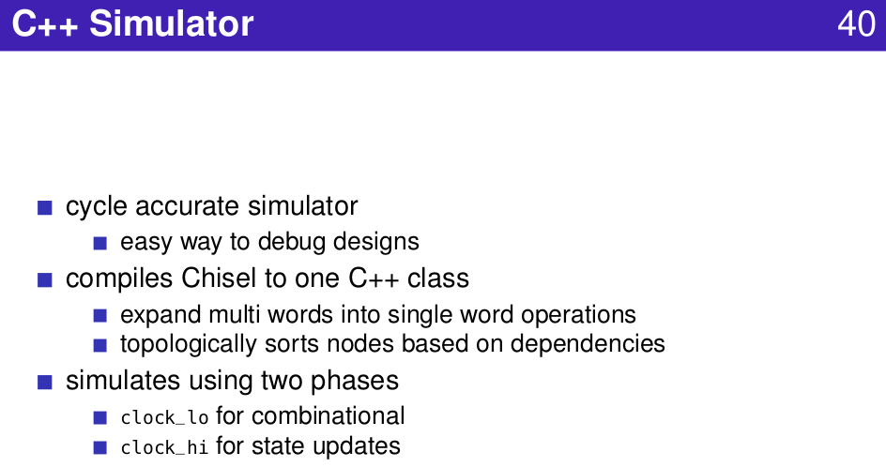
1.19 C++ Simulator
https://www.youtube.com/watch?v=pfM1WUWbfBs&list=PLlu0CT-JnSasfpk8tq1ZDiE2G0AK1BhOg&index=1
C++ Simulator (29:09-29:34/51:50)

Slide 23
1.20 Simulator Comparison

Slide 24
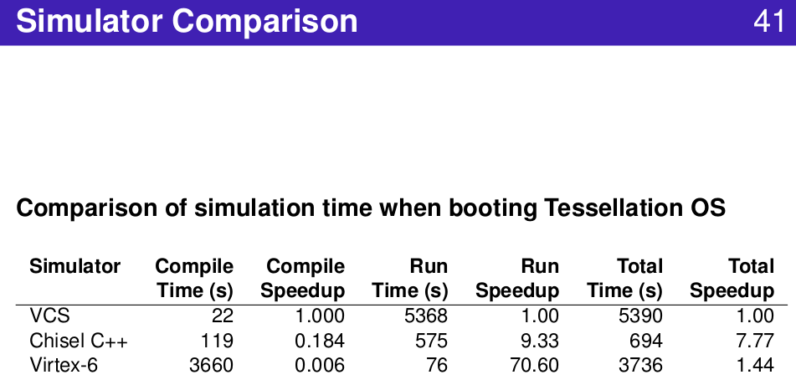
1.20 Simulator Comparison
https://www.youtube.com/watch?v=pfM1WUWbfBs&list=PLlu0CT-JnSasfpk8tq1ZDiE2G0AK1BhOg&index=1
Simulator Comparison (29:35-30:21/51:50)

Slide 25
End

