Slide 1

1.25 Next Step to Learn Chisel

Slide 2
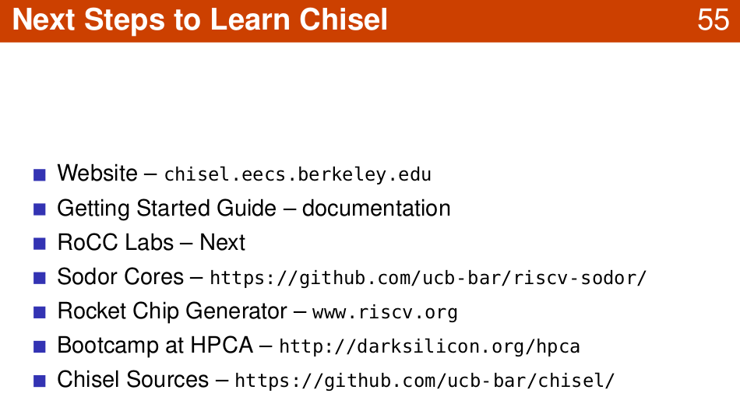
1.25 Next Step to Learn Chisel
https://www.youtube.com/watch?v=pfM1WUWbfBs&list=PLlu0CT-JnSasfpk8tq1ZDiE2G0AK1BhOg&index=1
Next Step to Learn Chisel (41:46-42:57/51:50)

Slide 3
1.26 Chisel Bootcamp

Slide 4
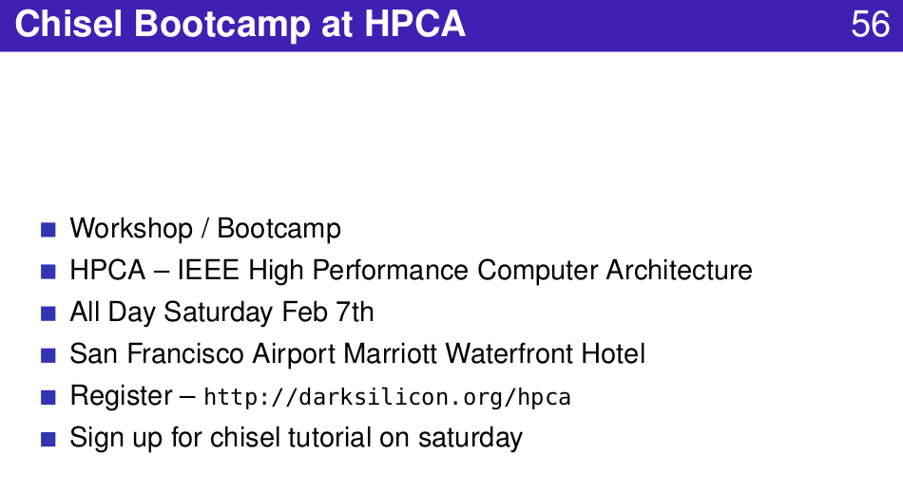
1.26 Chisel Bootcamp
https://www.youtube.com/watch?v=pfM1WUWbfBs&list=PLlu0CT-JnSasfpk8tq1ZDiE2G0AK1BhOg&index=1
Chisel Bootcamp (42:58-43:42/51:50)

Slide 5
1.27 Get Chisel Tutorial

Slide 6
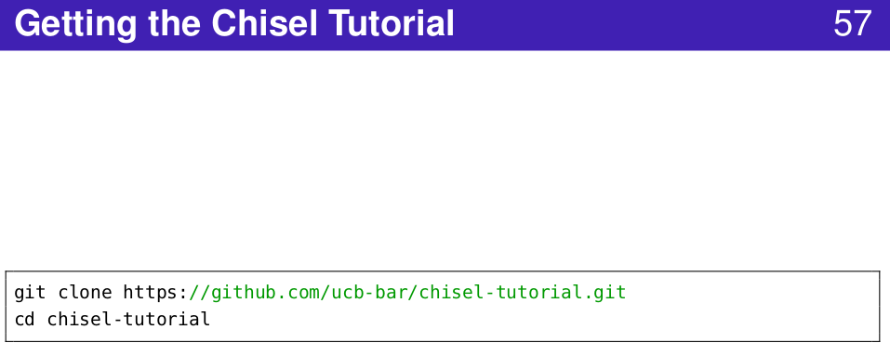
1.27 Get Chisel Tutorial
https://www.youtube.com/watch?v=pfM1WUWbfBs&list=PLlu0CT-JnSasfpk8tq1ZDiE2G0AK1BhOg&index=1
Get Chisel Tutorial (43:43-43:50/51:50)

Slide 7
1.28 Chisel Resources

Slide 8
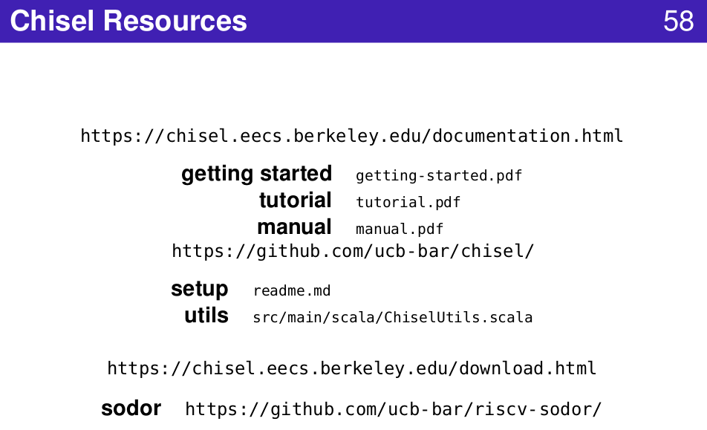
1.28 Chisel Resources
https://www.youtube.com/watch?v=pfM1WUWbfBs&list=PLlu0CT-JnSasfpk8tq1ZDiE2G0AK1BhOg&index=1
Chisel Resources (43:51-51:50/51:50)

Slide 9

1.28 Chisel Resources
https://www.youtube.com/watch?v=pfM1WUWbfBs&list=PLlu0CT-JnSasfpk8tq1ZDiE2G0AK1BhOg&index=1
Scala Resources (43:51-51:50/51:50)

Slide 10
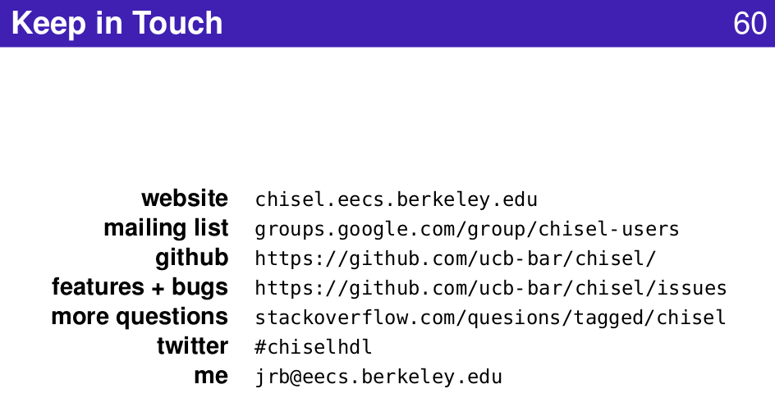
1.28 Chisel Resources
https://www.youtube.com/watch?v=pfM1WUWbfBs&list=PLlu0CT-JnSasfpk8tq1ZDiE2G0AK1BhOg&index=1
Keep in Touch (43:51-51:50/51:50)

Slide 11
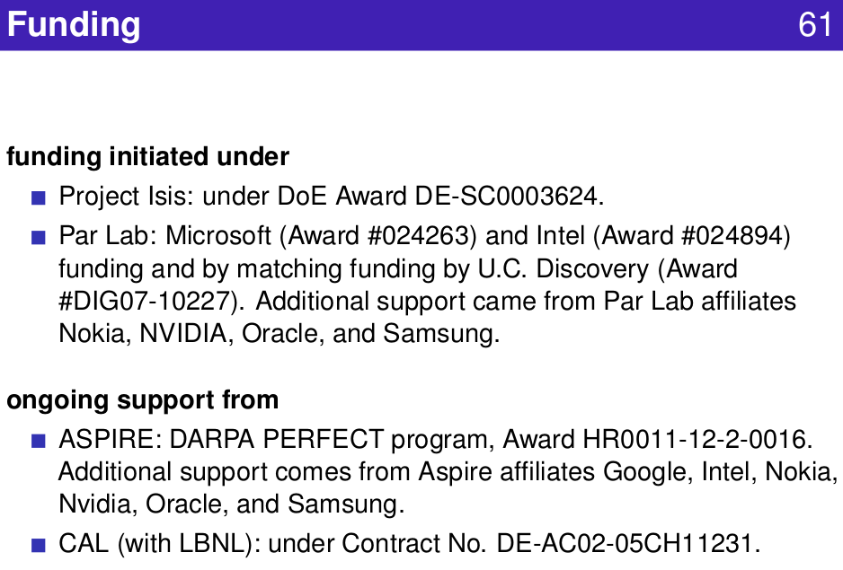
1.28 Chisel Resources
https://www.youtube.com/watch?v=pfM1WUWbfBs&list=PLlu0CT-JnSasfpk8tq1ZDiE2G0AK1BhOg&index=1
Funding (43:51-51:50/51:50)

Slide 12
End

