Slide 1

2 Chisel Installation
Peter H. Chen

Slide 2
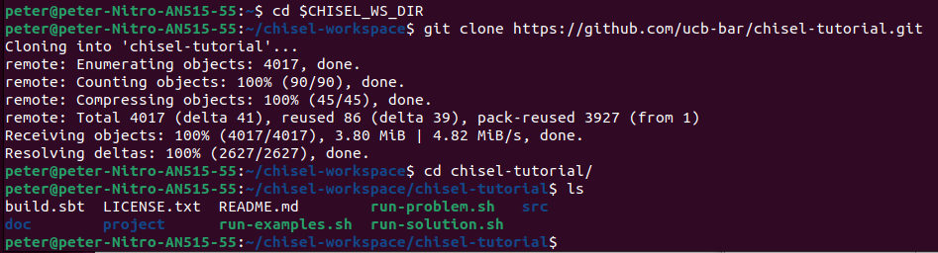
2 Chisel Installation
https://github.com/ucb-bar/chisel-tutorial/wiki/Chisel-Installation
Chisel Installation
We discus Chisel (Constructing Hardware In a Scala Embedded Language) installation:
1. Prepare our Linux OS for subsequent study.
2. Chisel is a hardware construction language embedded in the high-level programming language Scala.
https://github.com/chipsalliance/chisel
3. Setup Tutorial:
Chisel is a library of Scala, therefore, first, we need to get the chisel library.
> export CHISEL_WS_DIR=~/chisel-workspace
> mkdir -p $CHISEL_WS_DIR
> cd $CHISEL_WS_DIR
> git clone https://github.com/ucb-bar/chisel-tutorial.git
> cd chisel-tutorial
3

Slide 3

2 Chisel Installation
https://github.com/ucb-bar/chisel-tutorial/wiki/Chisel-Installation
Chisel Installation
> code ~/.bashrc
1. Add the below statement at the end.
> export CHISEL_WS_DIR=~/chisel-workspace
> export CHISEL_TUT_DIR=$CHISEL_WS_WORK_DIR/chisel-tutorial
Save the ~/.bashrc
1

Slide 4
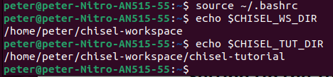
2 Chisel Installation
https://github.com/ucb-bar/chisel-tutorial/wiki/Chisel-Installation
Chisel Installation
1. > source ~/.bashrc
2. Now, environment variables CHISEL_WS_DIR and CHISEL_TUT_DIR are configured.
> echo $CHISEL_WS_DIR
>> /home/peter/chisel-workspace
> echo $CHISEL_TUT_DIR
>> /home/peter/chisel-workspace/chisel-tutorial
1
2

Slide 5
End

