Slide 1

5.1 Dockerfile
Peter H. Chen

Slide 2
5.1 Dockerfile
https://github.com/freechipsproject/chisel-bootcamp
Dockerfile
We discuss Dockerfile. We install our own jupyter notebook and scala.
We do not use Docker and Dockerfile.
Topics:

Slide 3
5.1.1 Download Dockerfile

Slide 4
5.1.1 Download Dockerfile
https://github.com/freechipsproject/chisel-bootcamp
Download Dockerfile
1. Change folder to chisel-bootcamp. If you want to work on your working space, copy image folder and source folder to your working directory.
> cd chisel-bootcamp
2. Start Jupyter notebook
> jupyter notebook 4.4_firrtl_add_ops_per_module.ipynb
3. Select the scala interpreter: > Kernel > Change Kernel… >Scala 2.12.11

Slide 5
5.1.2 Install Docker on Ubuntu

Slide 6
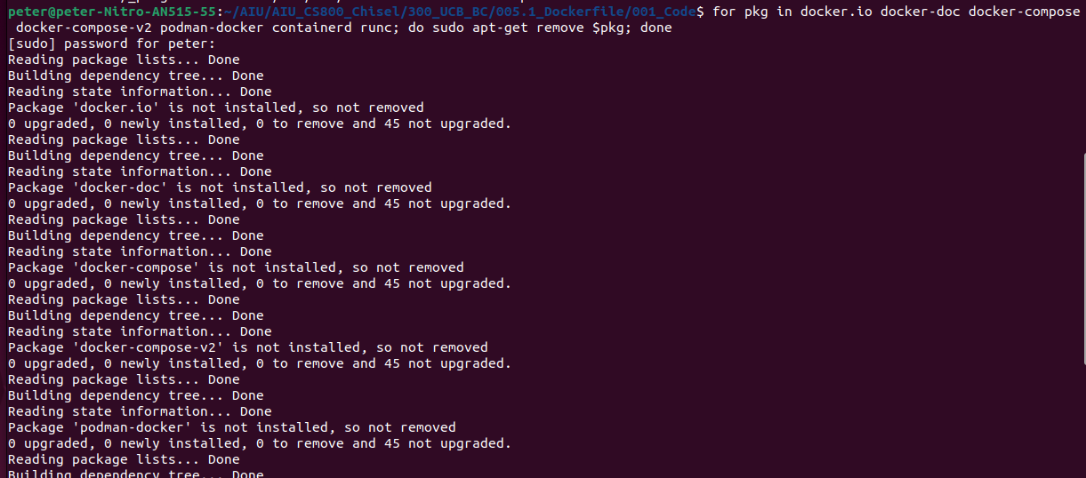
5.1.2 Install Docker on Ubuntu
https://github.com/freechipsproject/chisel-bootcamp
Install Docker on Ubuntu
1. We download the docker on Ubuntu with the below command:
> for pkg in docker.io docker-doc docker-compose docker-compose-v2 podman-docker containerd runc; do sudo apt-get remove $pkg; done
https://docs.docker.com/engine/install/ubuntu/#prerequisites

Slide 7
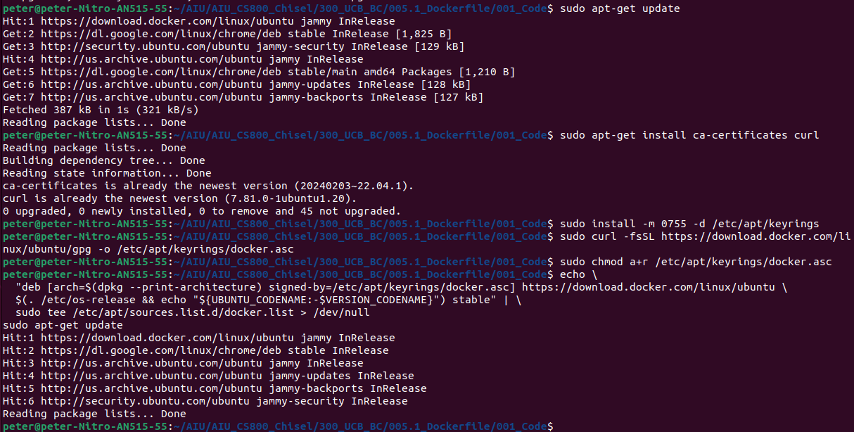
5.1.2 Install Docker on Ubuntu
https://github.com/freechipsproject/chisel-bootcamp
Install Docker on Ubuntu
1. Copy and paste the command as below to Install Docker
> # Add Docker's official GPG key:
> sudo apt-get update
>sudo apt-get install ca-certificates curl
> sudo install -m 0755 -d /etc/apt/keyrings
> sudo curl -fsSL https://download.docker.com/linux/ubuntu/gpg -o /etc/apt/keyrings/docker.asc
> sudo chmod a+r /etc/apt/keyrings/docker.asc
> # Add the repository to Apt sources:
> echo \
> "deb [arch=$(dpkg --print-architecture) signed-by=/etc/apt/keyrings/docker.asc]
> https://download.docker.com/linux/ubuntu \
> $(. /etc/os-release && echo "${UBUNTU_CODENAME:-$VERSION_CODENAME}") stable" | \
> sudo tee /etc/apt/sources.list.d/docker.list > /dev/null
> sudo apt-get update
https://docs.docker.com/engine/install/ubuntu/#prerequisites

Slide 8
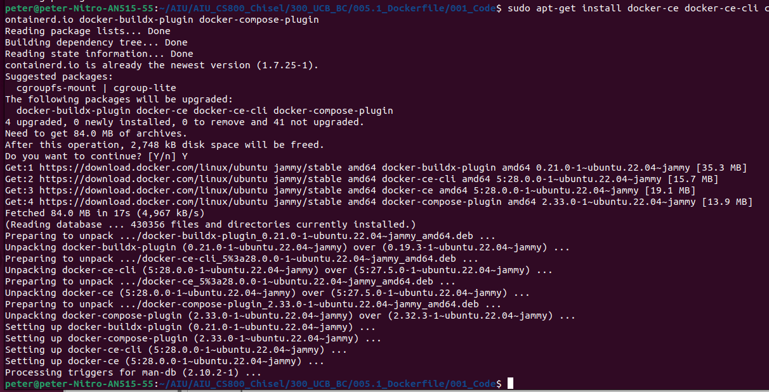
5.1.2 Install Docker on Ubuntu
https://github.com/freechipsproject/chisel-bootcamp
Install Docker on Ubuntu
1. Install Docker package:
> sudo apt-get install docker-ce docker-ce-cli containerd.io docker-buildx-plugin docker-compose-plugin
https://docs.docker.com/engine/install/ubuntu/#prerequisites

Slide 9
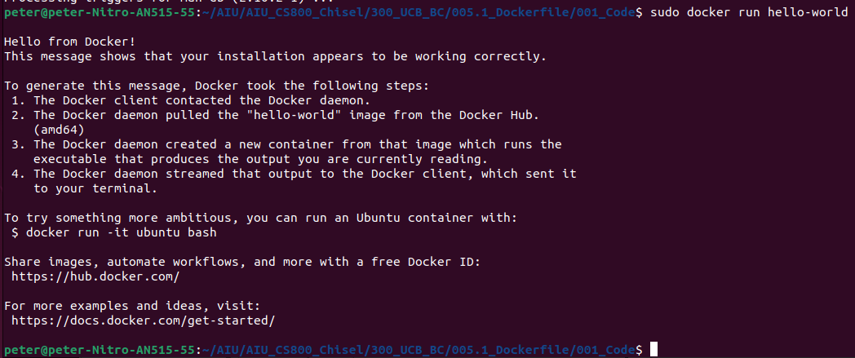
5.1.2 Install Docker on Ubuntu
https://github.com/freechipsproject/chisel-bootcamp
Install Docker on Ubuntu
1. Verify the Docker Installation:
> sudo docker run hello-world
We get the response “Hello from Docker!”. Our installation is good.
https://docs.docker.com/engine/install/ubuntu/#prerequisites

Slide 10
5.1.3 Build Chisel with Dockerfile

Slide 11
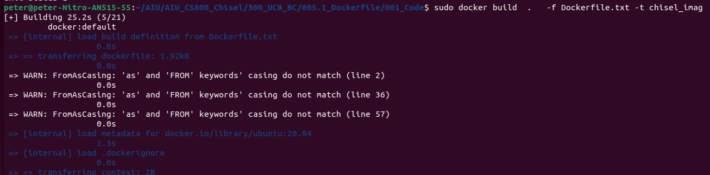
5.1.3 Build Image with Dockerfile
https://github.com/freechipsproject/chisel-bootcamp
Build Image with Dockerfile
Below command is used to build Docker image:
> cd ~/<working directory>, such as, cd ~/AIU/AIU_CS800_Chisel/300_UCB_BC/005.1_Dockerfile/001_Code
> sudo docker build . -f Dockerfile.txt -t chisel_imag
https://www.linode.com/docs/guides/how-to-use-dockerfiles/

Slide 12
End

