Slide 1

5.2 Run Chisel in Docker
Peter H. Chen

Slide 2
5.2 Run Chisel in Docke
https://github.com/freechipsproject/chisel-bootcamp
Run Chisel with Docker
We discuss Run Chisel with Docker
Topics:
1. Setup: Jupyter notebook and select scala interpreter.
2. Class Ledger: Define the class Ledger for matching module name, get module name, set module name, and serialization.
3. Class AnalyzeCircuit: Traverse the Circuit, Module, Statement, and Expression,
4. Transform Chisel into FIRRTL: There is has a bug in FIRRTL Compilation.

Slide 3
5.2.1 Register Dockerhub

Slide 4
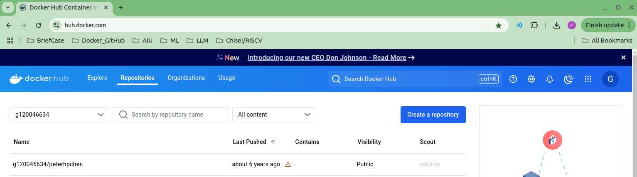
5.2.1 Register Dockerhub
https://github.com/freechipsproject/chisel-bootcamp
Download Dockerfile
1. Go to dokerhub.com (https://hub.docker.com/)
2. register Id and name.
My ID is: g120046634
Name is: peterhpchen
3. After register, you will able to download the search “chisel” in the docker hub.

Slide 5
5.2.2 Search Chisel on Dockerhub

Slide 6
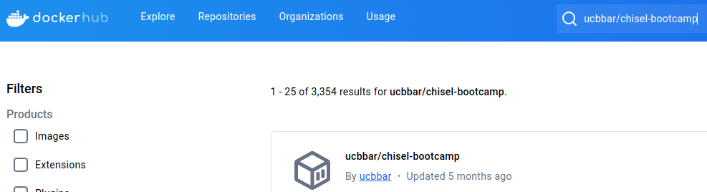
5.2.2 Search Chisel on Dockerhub
https://github.com/freechipsproject/chisel-bootcamp
Search Chisel on Dockerhub
On Dockerhub, we search for “ucbbar/chisel-bootcamp” [BAR (Berkeley Architecture Research Group) from UCB (UC Berkeley)] .

Slide 7
End

