Slide 1

4.4 Count The Add Operation
Peter H. Chen

Slide 2
4.4 Count The Add Operation
https://github.com/freechipsproject/chisel-bootcamp
Count the Add Operation
We discuss how to count the add operations in a Chisel Module.
A FIRRTL Circuit contains a sequence of modules, a modules contains a sequence of port and statement, a statement contains other statement and expression, an expression contains other expressions.
Topics:
1. Setup: Jupyter notebook and select scala interpreter.
2. Class Ledger: Define the class Ledger for matching module name, get module name, set module name, and serialization.
3. Class AnalyzeCircuit: Traverse the Circuit, Module, Statement, and Expression,
4. Transform Chisel into FIRRTL: There is has a bug in FIRRTL Compilation.

Slide 3
4.4.1 Setup

Slide 4
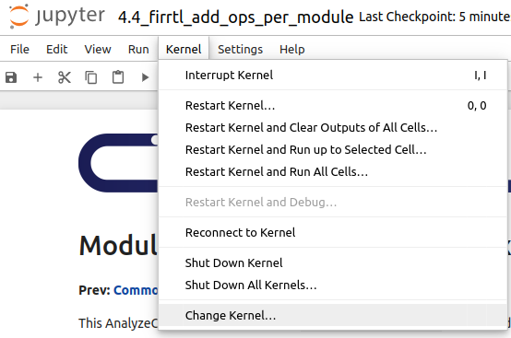
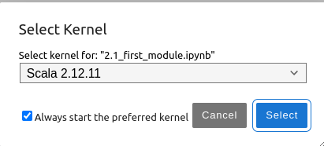
4.4.1 Setup
https://github.com/freechipsproject/chisel-bootcamp
Setup
1. Change folder to chisel-bootcamp. If you want to work on your working space, copy image folder and source folder to your working directory.
> cd chisel-bootcamp
2. Start Jupyter notebook
> jupyter notebook 4.4_firrtl_add_ops_per_module.ipynb
3. Select the scala interpreter: > Kernel > Change Kernel… >Scala 2.12.11
3

Slide 5
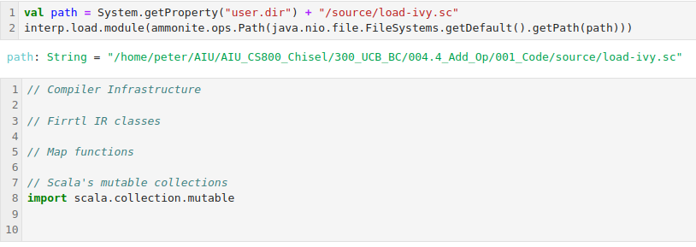
4.4.1 Setup
https://github.com/freechipsproject/chisel-bootcamp
Setup
1. Setup path and load path.

Slide 6
4.4.2 Class Ledger

Slide 7
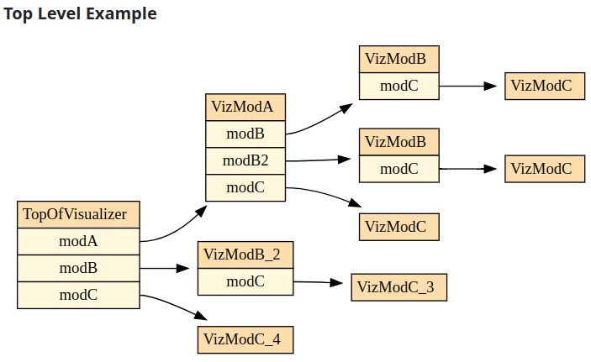
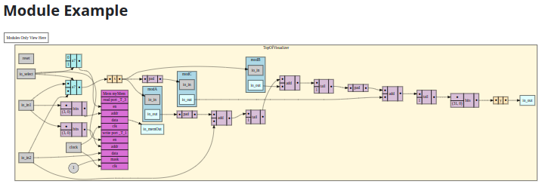
4.4.2 Class Ledger
https://github.com/freechipsproject/chisel-bootcamp
Class Ledger
1. The FIRRTL Circuit contains the following sequences:
  a. A FIRRTL Circuit contains a sequence of DefModules.
  b. A DefModule contains a sequence of Ports, and maybe a Statement.
  c. A Statement can contain other Statements, or Expressions.
  d. A Expression can contain other Expressions.
https://github.com/freechipsproject/diagrammer

Slide 8
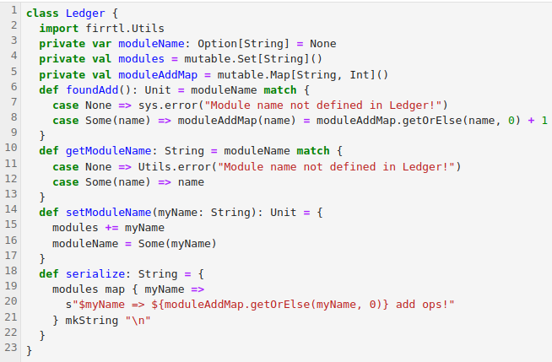
4.4.2 Class Ledger
https://github.com/freechipsproject/chisel-bootcamp
Class Ledger (分类帐)
1. To traverse all FIRRTL IR nodes in a circuit, we write functions that recursively walk down this tree.
2. To record statistics, we will pass along a Ledger class and use it when we come across an add op.
3. Below, we define the class Ledger for matching module name, get module name, set module name, and serialization.

Slide 9
4.4.3 Class AnalyzeCircuit

Slide 10
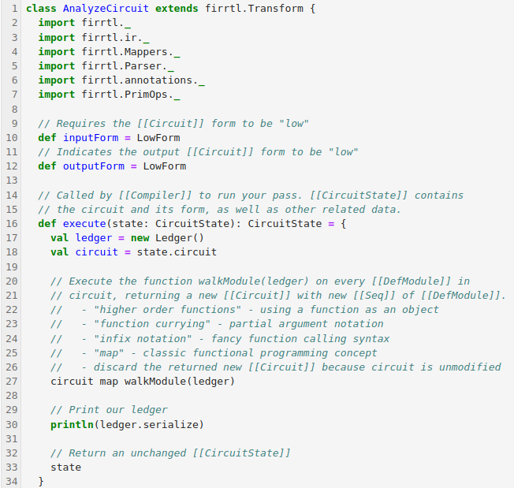
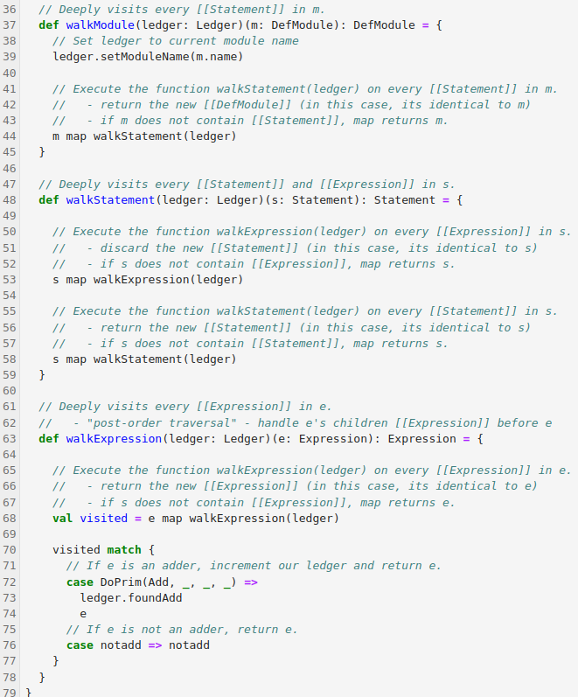
4.4.3 Class AnalyzeCircuit
https://github.com/freechipsproject/chisel-bootcamp
Class AnalyzeCircuit
1. Here, we define a FIRRTL Transform that walks the circuit and updates our Ledger whenever it comes across an adder (DoPrim with op argument Add). Don't worry about inputForm or outputForm for now.
2. Take some time to understand how walkModule, walkStatement, and walkExpression enable traversing all DefModule, Statement, and Expression nodes in the FIRRTL AST.

Slide 11
4.4.3 Class AnalyzeCircuit
https://github.com/freechipsproject/chisel-bootcamp
Class AnalyzeCircuit
1. Questions to answer:
  a. Why doesn't walkModule call walkExpression?
  b. Why does walkExpression do a post-order traversal?
  c. Can you modify walkExpression to do a pre-order traversal of Expressions?

Slide 12
4.4.4 Run Transform

Slide 13
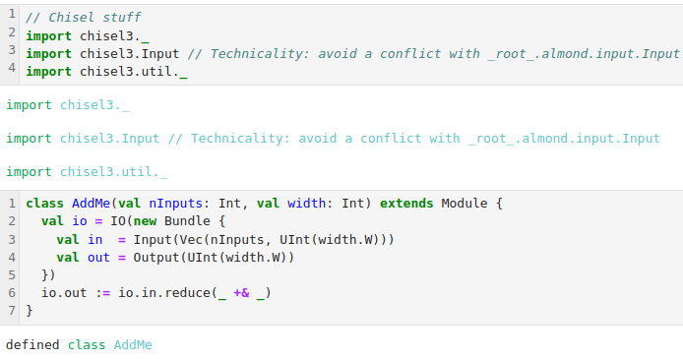
4.4.4 Run Transform
https://github.com/freechipsproject/chisel-bootcamp
Run Transform
1. Below, we have defined the transform. We will run the transform on a Chisel design.
2. First, we import libraries.
3. Then, we define a Chisel module (AddMe)

Slide 14
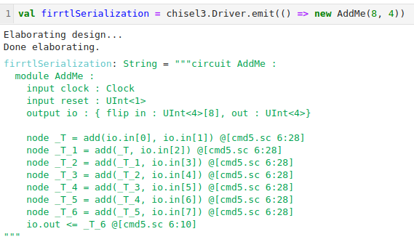
4.4.4 Run Transform
https://github.com/freechipsproject/chisel-bootcamp
Run Transform
1. Next, we elaborate Module AddMe into FIRRTL AST syntax.

Slide 15
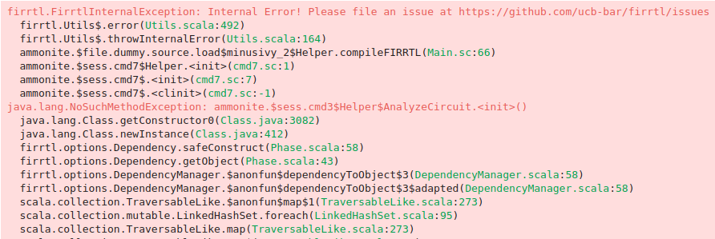
4.4.4 Run Transform
https://github.com/freechipsproject/chisel-bootcamp
Run Transform
1. Then, we compile our FIRRTL into Verilog, but include our custom transform into the compilation. Note that it prints out the number of add ops it found!
Note (January 2021): The following line may be broken due to a bug.
The compileFIRRTL function is defined only in this tutorial - in a future section, we will describe how the process of inserting customTransforms.

Slide 16
End

