Slide 1

12 Functional Programming: Pattern Match
Peter H. Chen

Slide 2
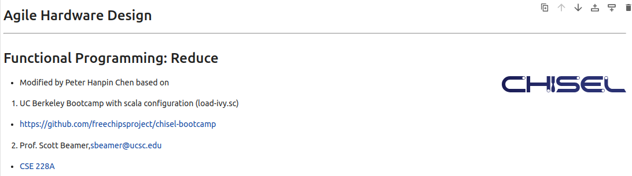
12 Functional Programming: Pattern Match
https://www.youtube.com/watch?v=zlYkaS63UY8&list=PLfrN7RIcMe6g2LBRJLTHTdhyj5s8ag0Rg&index=12
Functional Programming: Pattern Match (0:00-0:01/1:01:02)
We used UCB bootcamp configuration file (load_ivy.sc)
source/load-ivy.sc (https://github.com/freechipsproject/chisel-bootcamp)

Slide 3
12 Functional Programming: Pattern Match
https://www.youtube.com/watch?v=zlYkaS63UY8&list=PLfrN7RIcMe6g2LBRJLTHTdhyj5s8ag0Rg&index=12
Functional Programming: Pattern Match (0:02-0:03/1:01:02)
We discus the Functional Programming in map, foreach, and zip. New, we talk about the reduce and fold.
Topics:
1. Setup: jupyter notebook, select scala, and run cells.

Slide 4
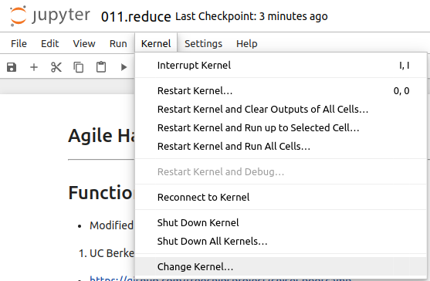
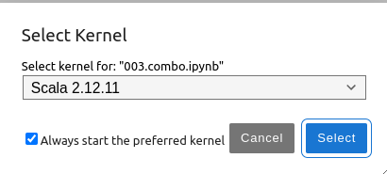
12 Functional Programming: Pattern Match
https://www.youtube.com/watch?v=zlYkaS63UY8&list=PLfrN7RIcMe6g2LBRJLTHTdhyj5s8ag0Rg&index=12
Functional Programming: Pattern Match (0:03-0:28/1:01:02)
We discuss Chisel Collection.
> jupyter notebook 006.combo.ipynb > Kernel > Change Kernel … > Select Scala2.21.22
> Run All Cells

Slide 5
12.1 Plan

Slide 6
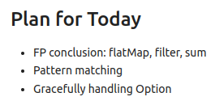
12.1 Plan
https://www.youtube.com/watch?v=zlYkaS63UY8&list=PLfrN7RIcMe6g2LBRJLTHTdhyj5s8ag0Rg&index=12
Plan (0:29-0:40/1:01:02)
Today, we talk about FP conclusion (flatMap, filter, sum) and pattern matching.

Slide 7
12.2 Import Chisel Library

Slide 8
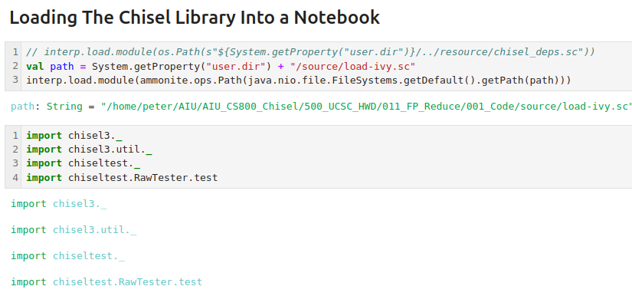
12.2 Import Chisel Library
https://www.youtube.com/watch?v=zlYkaS63UY8&list=PLfrN7RIcMe6g2LBRJLTHTdhyj5s8ag0Rg&index=12
Import Chisel Library (0:41-0:43/1:01:02)

Slide 9
12.3 Scala: flatMap

Slide 10
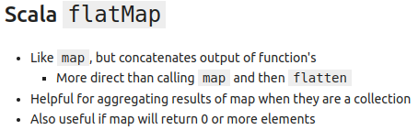
12.3 Scala: flatMap
https://www.youtube.com/watch?v=zlYkaS63UY8&list=PLfrN7RIcMe6g2LBRJLTHTdhyj5s8ag0Rg&index=12
Scala: flatMap (0:44-1:43/1:01:02)
Q. What is difference between the map and flatMap?
Ans:
map: list to list, flatMap: list to multi-list.
1. map turns a list into another, where for every element in the original list, the supplied function is apply.
2. flatMap runs a function on every element on the list, resulting in many mini-lists; these lists are then concatenated into the final result.

Slide 11
End

