Slide 1

6 Vending Machine
Peter H. Chen

Slide 2
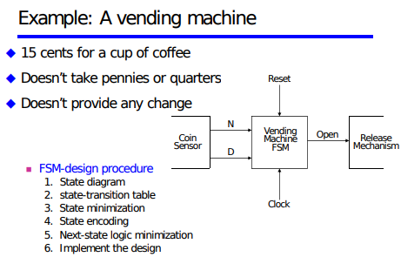
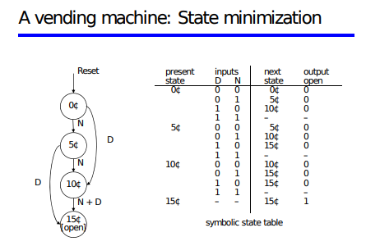
6 Vending Machine
https://github.com/ucb-bar/chisel-tutorial?tab=readme-ov-file
Vending Machine
Vending Machine Schematic and State.
https://courses.cs.washington.edu/courses/cse370/08sp/Lecture%20Slides/Lec22.pdf

Slide 3
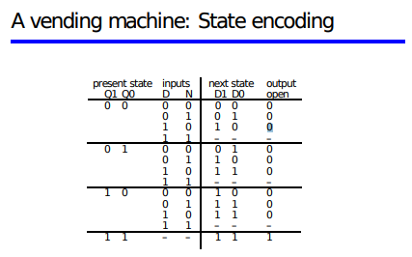
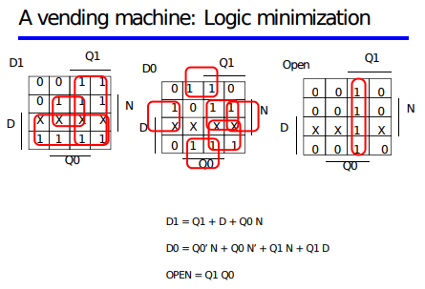
6 Vending Machine
https://github.com/ucb-bar/chisel-tutorial?tab=readme-ov-file
Vending Machine
State encoding and logic minimization.
https://courses.cs.washington.edu/courses/cse370/08sp/Lecture%20Slides/Lec22.pdf

Slide 4
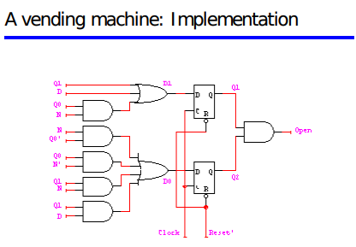
6 Vending Machine
https://github.com/ucb-bar/chisel-tutorial?tab=readme-ov-file
Vending Machine
Schematic Diagram.
https://courses.cs.washington.edu/courses/cse370/08sp/Lecture%20Slides/Lec22.pdf

Slide 5
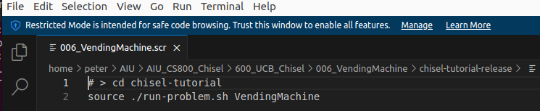
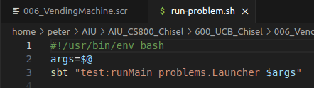
6 Vending Machine
https://github.com/ucb-bar/chisel-tutorial?tab=readme-ov-file
Vending Machine
1. > source ./run-problem.sh VendingMachine
2. run-problem.sh
> args = $@
> sbt “test:runMain problems.Launcher $args

Slide 6
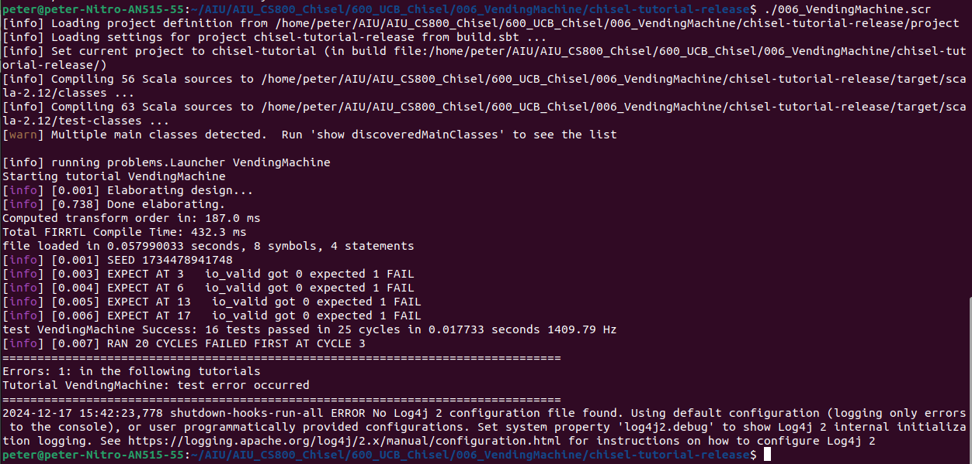
6 Vending Machine
https://github.com/ucb-bar/chisel-tutorial?tab=readme-ov-file
Vending Machine
Test result.
We will discuss more later on.

Slide 7
End

