Slide 1

2.2 Combinational Logic
Peter H. Chen

Slide 2
2.2 Combinational Logic
https://github.com/freechipsproject/chisel-bootcamp
Combinational Logic
We discuss how to implement the Combinational Logic with Scala.
Topics:
1. Setup: Setup Chisel Libraries.
2. Common Operators Description: Add, Subtract, Multiplication, Mux, and Concatenation.
3. Code 1: Cast incompatible data type into same data type.
4. Code 2: Add, Subtract, Multiplication.
5. Code 3: Get test harness simulation results with expect.
6. Code 4: Chisel call Mux (Multiplexer) and Cat (Concatenation)
7. Exercise 1: Implement Chisel, simulation test bench, and generate Verilog/FIRRTL for MAC (Multiple Accumulator) with input a, b, carry c, and output.
8. Exercise 2: Implement Chisel, simulation test bench, and generate Verilog/FIRRTL for Arbiter for input FIFO and two pipelines (pipe 1 and pipe 2).
9. Exercise 3: Implement Chisel, simulation test bench, and generate Verilog/FIRRTL for Parameterized Adder.

Slide 3
2.2.1 Setup

Slide 4
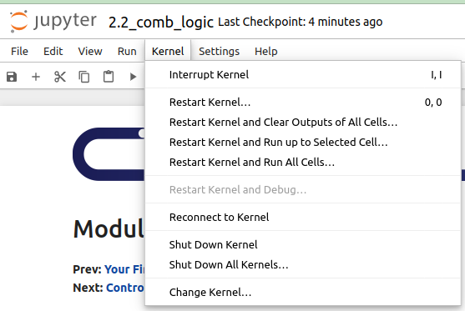
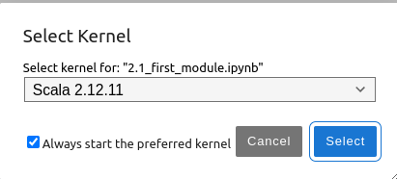
2.1.1 Setup
https://github.com/freechipsproject/chisel-bootcamp
Setup
1. Change folder to chisel-bootcamp. If you want to work on your working space, copy image folder and source folder to your working directory.
> cd chisel-bootcamp
2. Start Jupyter notebook
> jupyter notebook 2.2_comb_logic.ipynb
3. Select the scala interpreter: > Kernel > Change Kernel… >Scala 2.12.11
3

Slide 5
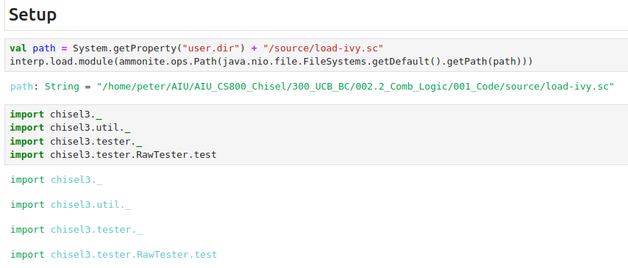
2.1.1 Setup
https://github.com/freechipsproject/chisel-bootcamp
Setup
1. Setup path to with for source folder for Scala Libraries and get Scala Property.
2. import chisel3 library, utility, tester harness (horse controller), and test interface function.

Slide 6
2.2.2 Common Operator

Slide 7
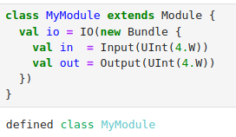
2.2.2 Common Operator
https://github.com/freechipsproject/chisel-bootcamp
Common Operator
Below, we constructed the module.
1. We've called our class MyModule, and it extends Module. This class MyModule gets mapped to a hardware module in Verilog.
2. Our MyModule module has one input and one output.
3. The input is a 4-bit unsigned integer: UInt (4.W). The output is 4 bits unsigned integer: UInt(4.W).
1
2
3

Slide 8
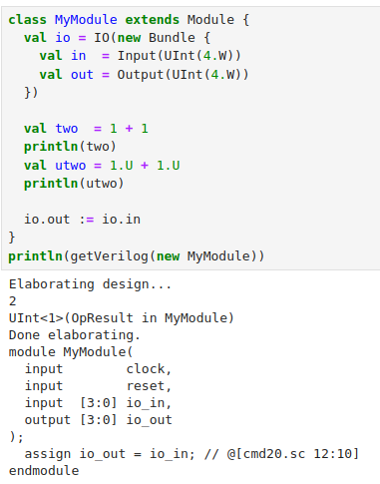
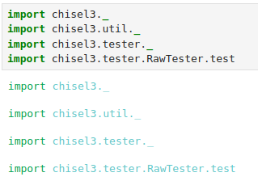
2.2.2 Common Operator
https://github.com/freechipsproject/chisel-bootcamp
Common Operator
1. In the import libraries, we import the Chisel Library and specify the Chisel as the domain language. We use the Chisel library to print Verilog, FIRRTL, and etc. results.
2. Define the Class Module
3. Define IO.
4. Create two immutable variables in and out. We have same operators between Chisel Operators.
5. On the right, we use getVerilog (new MyModule) to transform the Scala into Verilog codes.
6. Verilog Results
2
3
4
5
6
1

Slide 9
2.2.3 Incompatible Operation

Slide 10
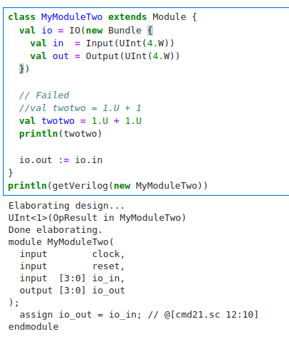
2.2.3 Incompatible Operation
https://github.com/freechipsproject/chisel-bootcamp
Incompatible Operator
1. If we have incompatible operator for different data types, for example, error in val twotwo = 1.U + 1. the values 1.U and 1 are different types. They cause the Chisel Compilation error.
2. In order to do the summation, we need to cast/correct different data types into same data type. Here, we correct both data types are Unsigned Integer (val twotwo = 1.U + 1.U). Then, we pass the Chisel compiler.
1
2

Slide 11
2.2.4 More Chisel Operation

Slide 12
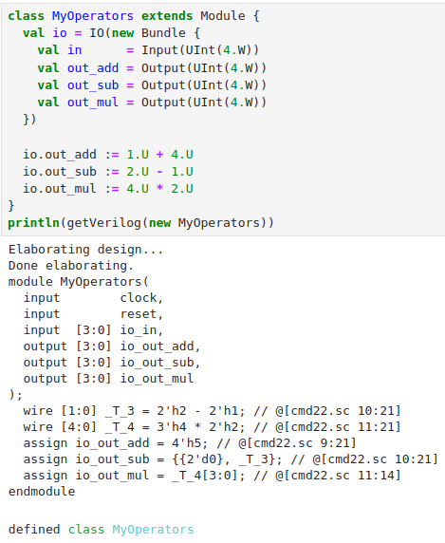
2.2.4 More Chisel Operation
https://github.com/freechipsproject/chisel-bootcamp
More Chisel Operation
1.On the right, we have three different operations, i.e., add, subtract, and multiply operations.
1

Slide 13
2.2.5 Get Result with expect

Slide 14
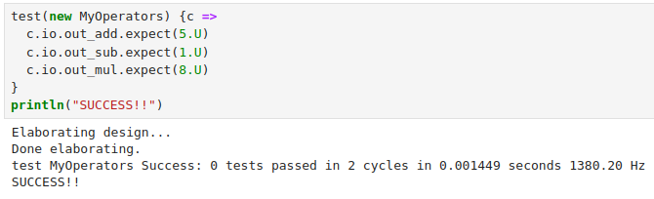
2.2.5 Get Result with expect
https://github.com/freechipsproject/chisel-bootcamp
Get Result with expect
We use test harness and expect method to put the results of add, subtract, and multiply.
We can check the results and give more details in verification.

Slide 15
2.2.6 Mux and Concatenation

Slide 16
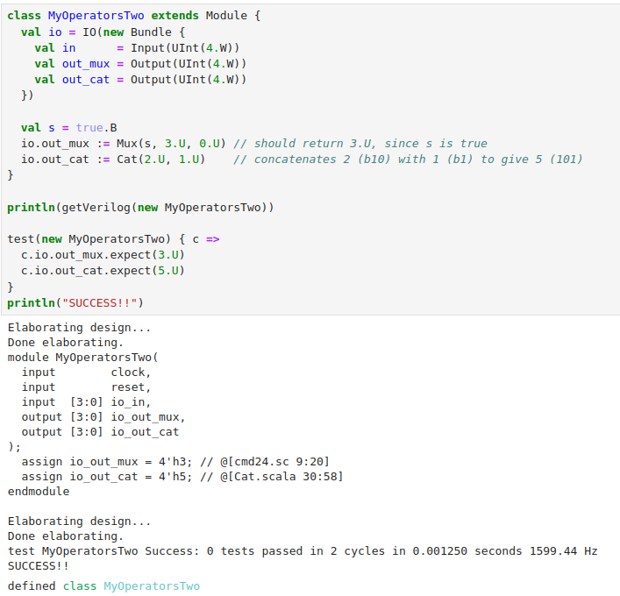
2.2.6 Mux and Concatenation
https://github.com/freechipsproject/chisel-bootcamp
Mux and Concatenation
1. On the right, define class MyOperatorsTwo ().
2. we call Mux() and Cat() to do the Multiplexer and Concatenation and store in io.out_mux and io.out_cat.
3. We dump the Verilog code with getVerilog(new MyOperatorsTwo)
4. We use test harness test()
5. We print results with out_mux.expect (3.U). out_cat.expect (5.U)
6. Result Verilog Code.
Note:
7. Verilog contains constants instead of actual mux/concatenation logic. This is because FIRRTL transformations simplified the circuit, eliminating obvious logic.
1
2
3
4
5
5
6
7

Slide 17
2.2.7 Exercise 1: Multiply Accumulator

Slide 18
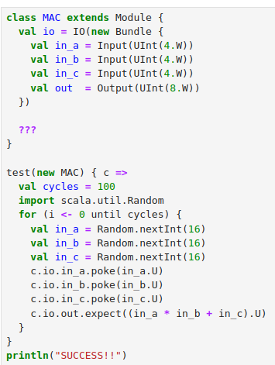
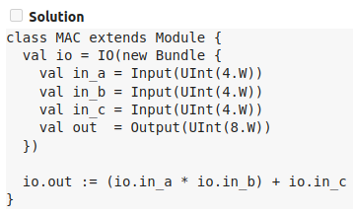
2.2.7 Exercise 1: Multiply Accumulator
https://github.com/freechipsproject/chisel-bootcamp
Exercise 1: Multiply Accumulator
Create a Chisel module that implements the multiply accumulate function, (A*B)+C, and passes the testbench.

Slide 19
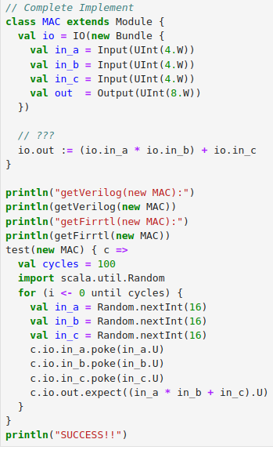
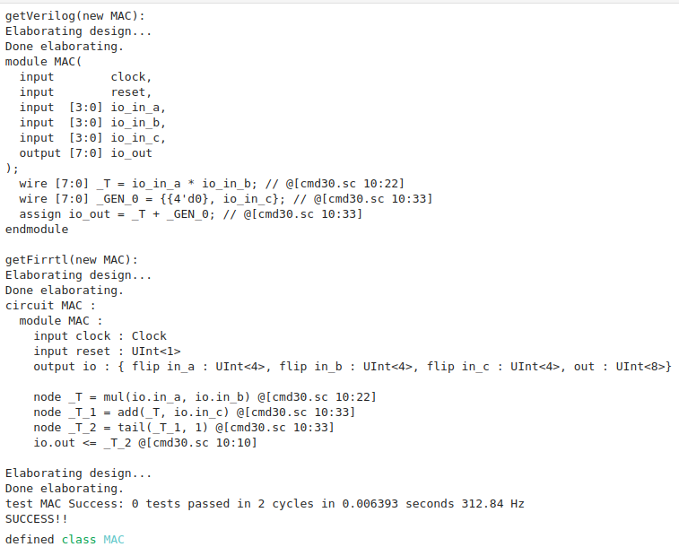
2.2.7 Exercise 1: Multiply Accumulator
https://github.com/freechipsproject/chisel-bootcamp
Exercise 1: Multiply Accumulator Solution
1. Replace “???” with
> io.out := (io.in_a * io.in_b) + io.in_c
2. Print Verilog and Print FIRRTL
3. Check Outputs.
1
2
3

Slide 20
2.2.8 Exercise 2: Arbiter

Slide 21
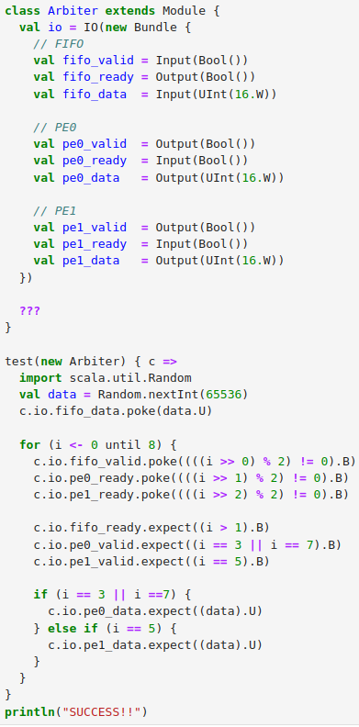
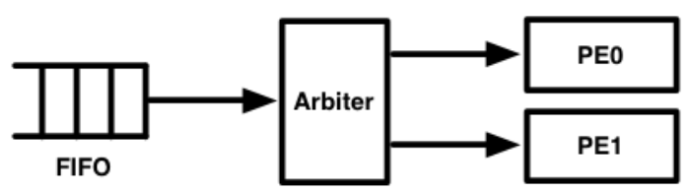
2.2.8 Exercise 2: Arbiter
https://github.com/freechipsproject/chisel-bootcamp
Exercise 2: Arbiter
We have circuit diagram below:
1. The circuit arbitrates data coming from a FIFO into two parallel processing units.
2. The FIFO and processing elements (PEs) communicate with ready-valid interfaces.
3. Construct the arbiter to send data to whichever PE is ready to receive data, prioritizing PE0 if both are ready to receive data.
4. Here, The arbiter should tell the FIFO that it's ready to receive data when at least one of the PEs can receive data.
5. Wait for a PE to assert that it's ready before asserting that the data are valid.
6. On the right is The problem to be implement (“???”)
7. We need to add binary operators to complete (“???”).

Slide 22
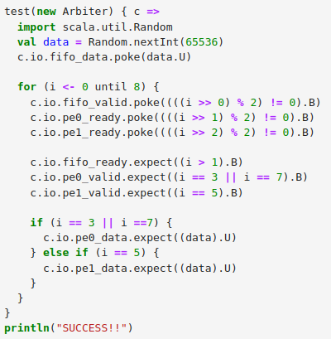
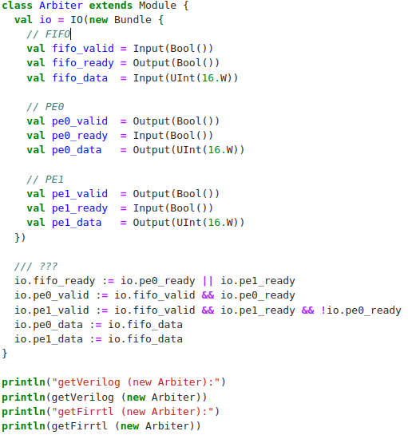
2.2.8 Exercise 2: Arbiter
https://github.com/freechipsproject/chisel-bootcamp
Exercise 2: Arbiter
On the right, we implement.
1. fifo_ready.
2. p0_valid
3. p1_valid
4. p0_data
5. pe1_data
6. Dump Verilog code
7. dump FIRRTL code

Slide 23
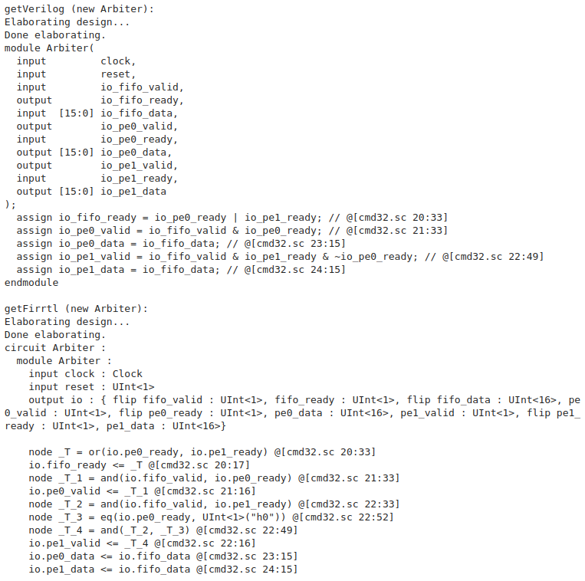
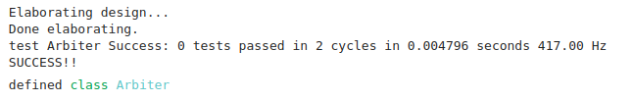
2.2.8 Exercise 2: Arbiter
1
https://github.com/freechipsproject/chisel-bootcamp
Exercise 2: Arbiter
On the right, we implement.
1. Verilog,
2. FIRRTL
3. Simulation Result
2
3

Slide 24
2.2.9 Exercise 3: Parameterized Adder

Slide 25
2.2.9 Exercise 3: Parameterized Adder
https://github.com/freechipsproject/chisel-bootcamp
Exercise 3: Parameterized Adder
This exercise construct a parameterized adder that can either saturate the output when overflow occurs, or truncate the results (i.e. wrap around).
1. First, look at the Module below. The parameter we pass into it is called saturate and has type Scala Boolean. This is not a Chisel Bool. So, we're not creating a single hardware adder that can either saturate or truncate, but rather we're creating a generator that produces either a saturating hardware adder or a truncating hardware adder. The decision is made at compile time.
2. Next, notice the inputs and outputs are all 4-bit UInts. Chisel has built-in width inferencing, and if you look at the cheatsheet, you'll see that the bitwidth of a normal summation is equal to the maximum bitwidth of the two inputs. This means that
> val sum = io.in_a + io.in_b
will make sum a 4-bit wire, and the value will be the truncated result for 4-bit inputs. To check if the summation should saturate, you need to place the result in a 5-bit wire. This can be done with the +& summation, as seen on the cheatsheet.
> val sum = io.in_a +& io.in_b
3. Finally, note that connecting a 4-bit UInt wire to a 5-bit UInt wire will truncate the MSB by default. You can use this to easily truncate the 5-bit sum for the non-saturating adder.

Slide 26
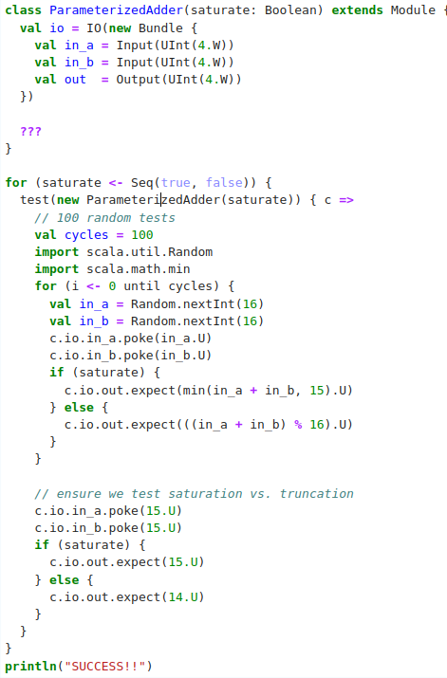
2.2.9 Exercise 3: Parameterized Adder
https://github.com/freechipsproject/chisel-bootcamp
Exercise 3: Parameterized Adder
On the right, we want to implement the problem code “???”.

Slide 27
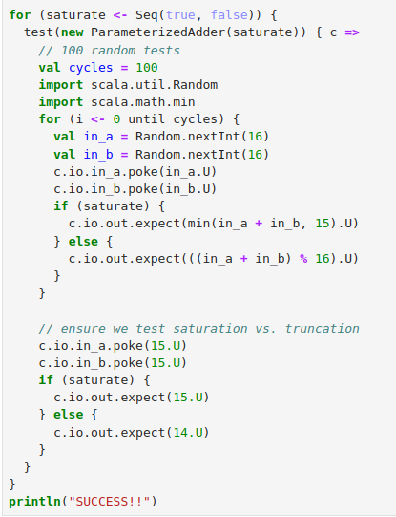
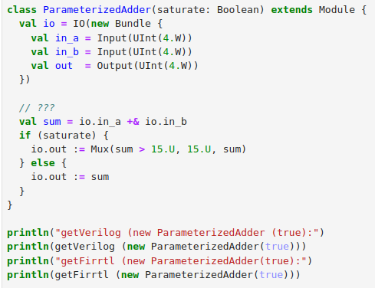
2.2.9 Exercise 3: Parameterized Adder
https://github.com/freechipsproject/chisel-bootcamp
Exercise 3: Parameterized Adder
Below, we implement
1. Parameterized Add with flag “saturate”
2. Dump Verilog
3. Dump FIRRTL
1
2

Slide 28
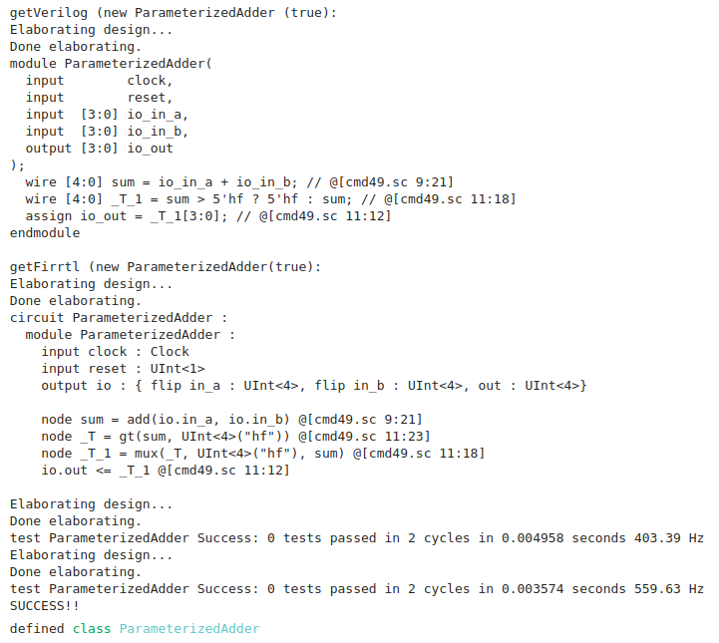
2.2.9 Exercise 3: Parameterized Adder
https://github.com/freechipsproject/chisel-bootcamp
Exercise 3: Parameterized Adder
Results:
1. Dump Verilog
2. Dump FIRRTL
3. Simulation Result
1
2
3

Slide 29
End

