Slide 1

22 Formal Verification
Peter H. Chen

Slide 2
22 Formal Verification
https://www.youtube.com/watch?v=PBpKPNFwiYI&list=PLfrN7RIcMe6g2LBRJLTHTdhyj5s8ag0Rg&index=18
Open Source Project Development (0:02-0:05/1:04:42)
Open Source Project Development
Topics:
1. Setup: jupyter notebook and run cells. This code is not ready.
2. Rest tops are not ready.

Slide 3
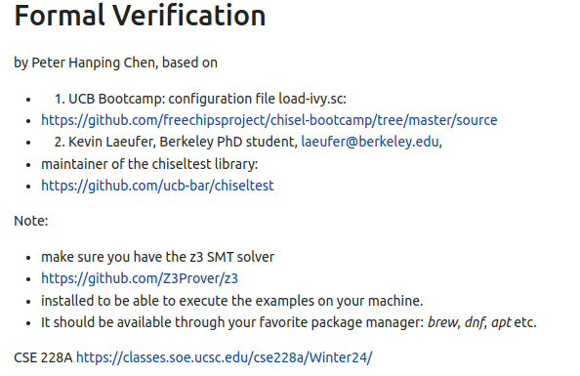
22 Formal Verification
https://www.youtube.com/watch?v=PBpKPNFwiYI&list=PLfrN7RIcMe6g2LBRJLTHTdhyj5s8ag0Rg&index=18
Open Source Project Development (0:06-1:30/1:04:42)

Slide 4
22.1 Plan

Slide 5
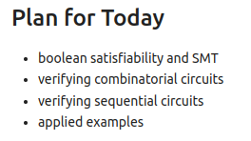
22.1 Plan
https://www.youtube.com/watch?v=PBpKPNFwiYI&list=PLfrN7RIcMe6g2LBRJLTHTdhyj5s8ag0Rg&index=18
Plan (3:38-3:55/1:04:42)
Today, we talk
1. Q: What is Formal Verification
Ans: Formal verification is a process that uses mathematical techniques to prove or disprove that a system's behavior, described in a formal model, adheres to a given property, also described formally. It's a method for ensuring a system's correctness by mathematically verifying its design against its intended functionality.
2. Q: What is SMT?
Ans: In formal Verification, SMT (Satisfiability Modulo Theory) solvers are tools that use these theories to determine if a mathematical formula is true or false, which is crucial for verifying the correctness of complex systems.
3. Boolean Satisfiability and SMT (Satisfiability Modulo Theory)
4. Combinational Circuit
5. Sequential Logic
6. Example

Slide 6
22.2 Import Library

Slide 7
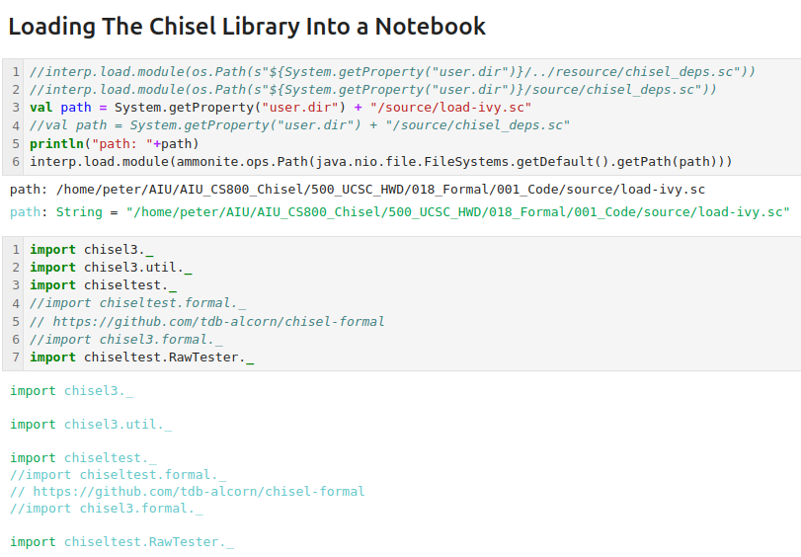
22.2 Import Library
https://www.youtube.com/watch?v=PBpKPNFwiYI&list=PLfrN7RIcMe6g2LBRJLTHTdhyj5s8ag0Rg&index=18
Import Library(3:56-6:00/1:04:42)

Slide 8
22.3 Boolean Satisfaction

Slide 9
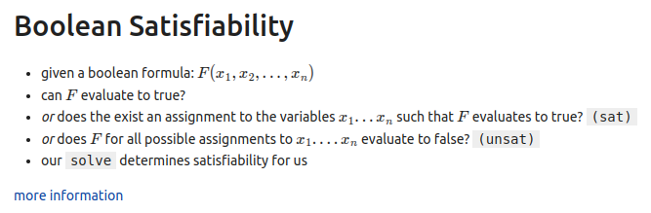
22.3 Boolean Satisfaction
https://www.youtube.com/watch?v=PBpKPNFwiYI&list=PLfrN7RIcMe6g2LBRJLTHTdhyj5s8ag0Rg&index=18
Boolean Satisfaction (6:01-7:00/1:04:42)

Slide 10
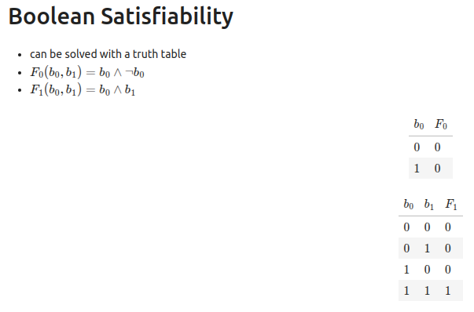
22.3 Boolean Satisfaction
https://www.youtube.com/watch?v=PBpKPNFwiYI&list=PLfrN7RIcMe6g2LBRJLTHTdhyj5s8ag0Rg&index=18
Boolean Satisfaction (7:01-8:53/1:04:42)

Slide 11
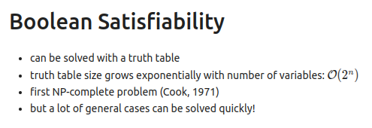
22.3 Boolean Satisfaction
https://www.youtube.com/watch?v=PBpKPNFwiYI&list=PLfrN7RIcMe6g2LBRJLTHTdhyj5s8ag0Rg&index=18
Boolean Satisfaction (8:54-9:02/1:04:42)

Slide 12
22.4 SMT (Satisfiability Modulo Theory)

Slide 13
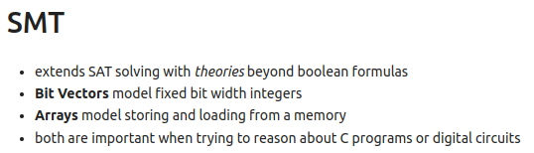
22.4 SMT (Satisfiability Modulo Theory)
https://www.youtube.com/watch?v=PBpKPNFwiYI&list=PLfrN7RIcMe6g2LBRJLTHTdhyj5s8ag0Rg&index=18
SMT (Satisfiability Modulo Theory) (9:03-13:02/1:04:42)
SMT (Satisfiability Modulo Theory) extends the SAT (Boolean Satisfiability)

Slide 14
22.5 Verify Combinational Circuit

Slide 15
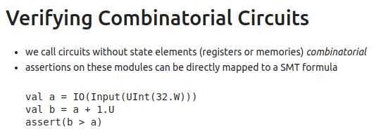
22.5 Verify Combinational Circuit
https://www.youtube.com/watch?v=PBpKPNFwiYI&list=PLfrN7RIcMe6g2LBRJLTHTdhyj5s8ag0Rg&index=18
Verify Combinational Circuit (13:03-17:06/1:04:42)

Slide 16
22.6 Verify Combinational Circuit Application

Slide 17
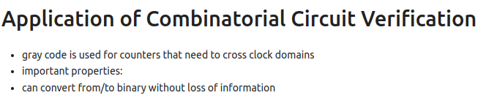
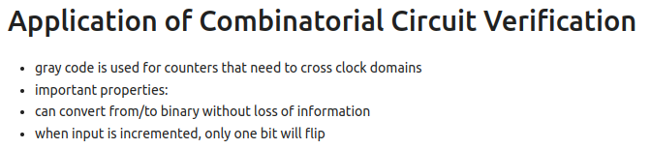
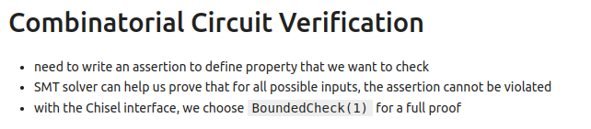
22.6 Verify Combinational Circuit Application
https://www.youtube.com/watch?v=PBpKPNFwiYI&list=PLfrN7RIcMe6g2LBRJLTHTdhyj5s8ag0Rg&index=18
Verify Combinational Circuit Application (17:07-22:00/1:04:42)

Slide 18
22.7 Verify Sequential Circuit

Slide 19

22.7 Verify Sequential Circuit
https://www.youtube.com/watch?v=PBpKPNFwiYI&list=PLfrN7RIcMe6g2LBRJLTHTdhyj5s8ag0Rg&index=18
Verify Sequential Circuit (22:01-24:00/1:04:42)

Slide 20
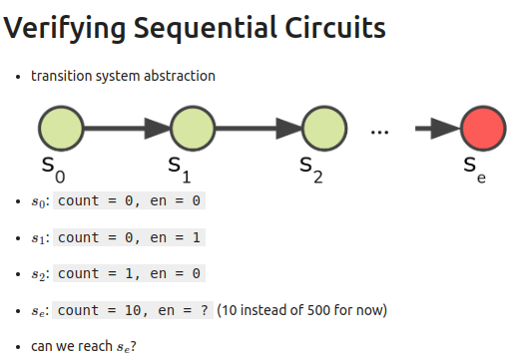
22.7 Verify Sequential Circuit
https://www.youtube.com/watch?v=PBpKPNFwiYI&list=PLfrN7RIcMe6g2LBRJLTHTdhyj5s8ag0Rg&index=18
Verify Sequential Circuit (24:01-29:10/1:04:42)

Slide 21
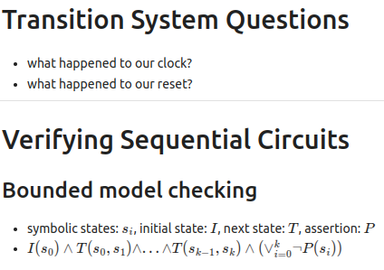
22.7 Verify Sequential Circuit
https://www.youtube.com/watch?v=PBpKPNFwiYI&list=PLfrN7RIcMe6g2LBRJLTHTdhyj5s8ag0Rg&index=18
Verify Sequential Circuit (29:11-31:36/1:04:42)

Slide 22
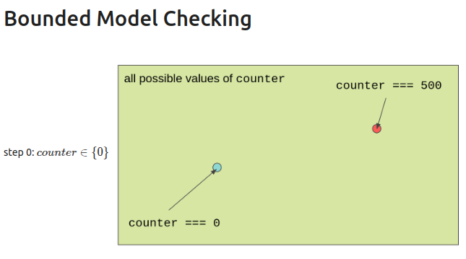
22.7 Verify Sequential Circuit
https://www.youtube.com/watch?v=PBpKPNFwiYI&list=PLfrN7RIcMe6g2LBRJLTHTdhyj5s8ag0Rg&index=18
Verify Sequential Circuit (31:37-32:48/1:04:42)

Slide 23
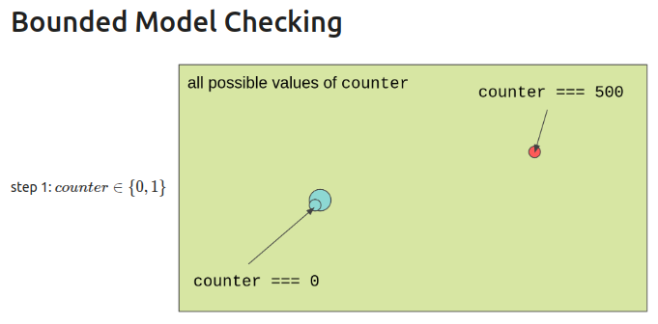
22.7 Verify Sequential Circuit
https://www.youtube.com/watch?v=PBpKPNFwiYI&list=PLfrN7RIcMe6g2LBRJLTHTdhyj5s8ag0Rg&index=18
Verify Sequential Circuit (32:49-32:50/1:04:42)

Slide 24
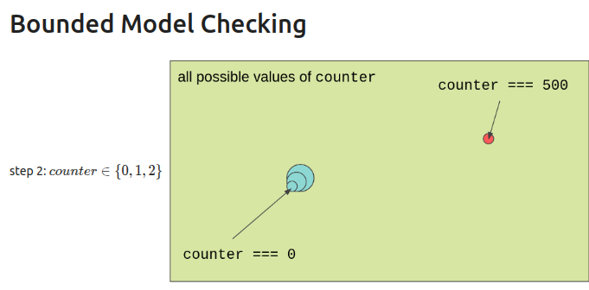
22.7 Verify Sequential Circuit
https://www.youtube.com/watch?v=PBpKPNFwiYI&list=PLfrN7RIcMe6g2LBRJLTHTdhyj5s8ag0Rg&index=18
Verify Sequential Circuit (32:51-33:38/1:04:42)

Slide 25
22.8 Application Queue

Slide 26
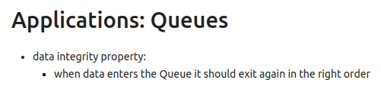
22.8 Application Queue
https://www.youtube.com/watch?v=PBpKPNFwiYI&list=PLfrN7RIcMe6g2LBRJLTHTdhyj5s8ag0Rg&index=18
Application Queue (33:39-44:27/1:04:42)

Slide 27
22.9 Formal Verification With Chisel

Slide 28
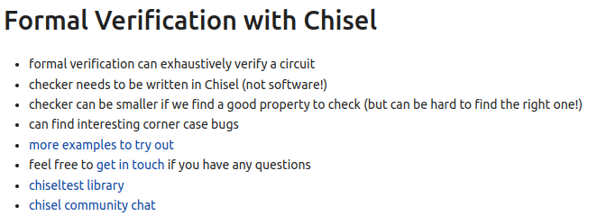
22.9 Formal Verification With Chisel
https://www.youtube.com/watch?v=PBpKPNFwiYI&list=PLfrN7RIcMe6g2LBRJLTHTdhyj5s8ag0Rg&index=18
Formal Verification with Chisel (44:28-52:50/1:04:42)

Slide 29
22.10 Temporal Assertion

Slide 30
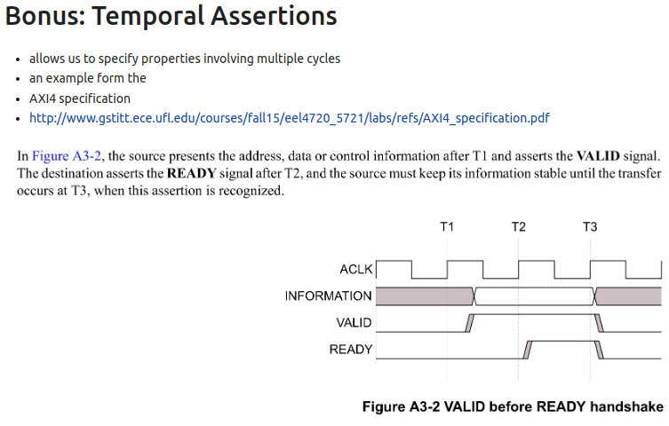
22.10 Temporal Assertion
https://www.youtube.com/watch?v=PBpKPNFwiYI&list=PLfrN7RIcMe6g2LBRJLTHTdhyj5s8ag0Rg&index=18
Temporal Assertion (52:51-54:50/1:04:42)

Slide 31
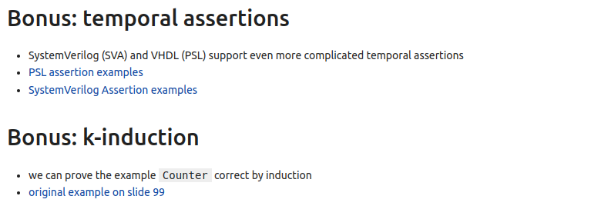
22.10 Temporal Assertion
https://www.youtube.com/watch?v=PBpKPNFwiYI&list=PLfrN7RIcMe6g2LBRJLTHTdhyj5s8ag0Rg&index=18
Temporal Assertion (54:51-57:15/1:04:42)

Slide 32
22.11 Bounded Model Checking

Slide 33
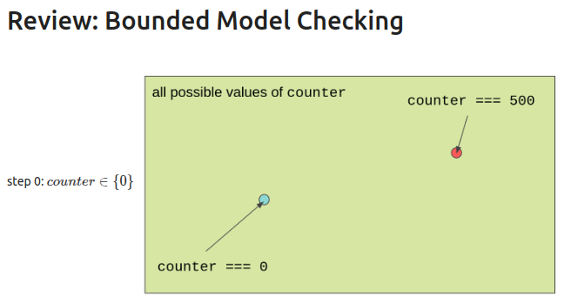
22.11 Bounded Model Checking
https://www.youtube.com/watch?v=PBpKPNFwiYI&list=PLfrN7RIcMe6g2LBRJLTHTdhyj5s8ag0Rg&index=18
Bounded Model Checking (57:16-57:50/1:04:42)

Slide 34
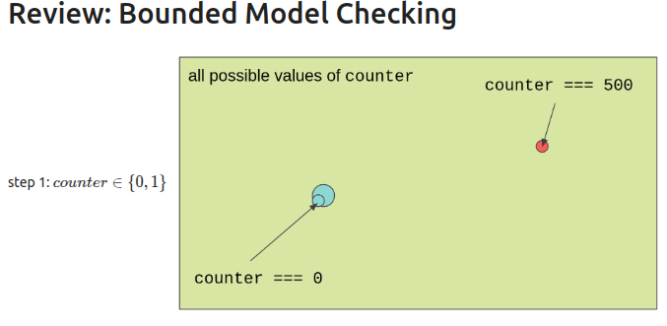
22.11 Bounded Model Checking
https://www.youtube.com/watch?v=PBpKPNFwiYI&list=PLfrN7RIcMe6g2LBRJLTHTdhyj5s8ag0Rg&index=18
Bounded Model Checking (57:51-58:00/1:04:42)

Slide 35
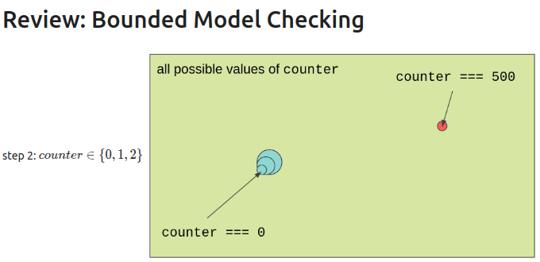
22.11 Bounded Model Checking
https://www.youtube.com/watch?v=PBpKPNFwiYI&list=PLfrN7RIcMe6g2LBRJLTHTdhyj5s8ag0Rg&index=18
Bounded Model Checking (58:01-58:20/1:04:42)

Slide 36
22.12 K-Induction

Slide 37
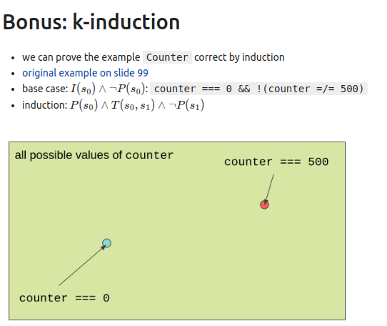
22.12 K-Induction
https://www.youtube.com/watch?v=PBpKPNFwiYI&list=PLfrN7RIcMe6g2LBRJLTHTdhyj5s8ag0Rg&index=18
K-Induction (58:21-59:50/1:04:42)

Slide 38
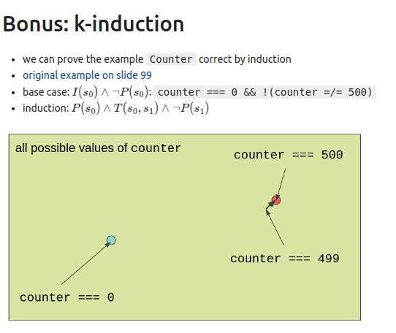
22.12 K-Induction
https://www.youtube.com/watch?v=PBpKPNFwiYI&list=PLfrN7RIcMe6g2LBRJLTHTdhyj5s8ag0Rg&index=18
K-Induction (59:41-59:50/1:04:42)

Slide 39
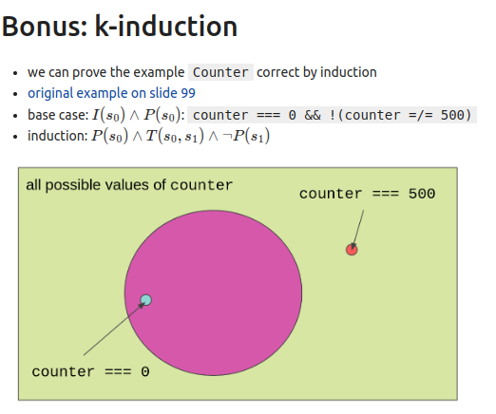
22.12 K-Induction
https://www.youtube.com/watch?v=PBpKPNFwiYI&list=PLfrN7RIcMe6g2LBRJLTHTdhyj5s8ag0Rg&index=18
K-Induction (59:51-1:00:00/1:04:42)

Slide 40
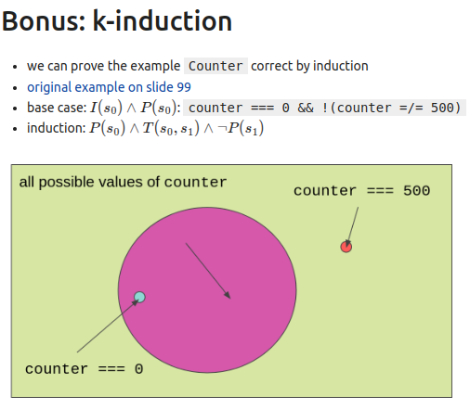
22.12 K-Induction
https://www.youtube.com/watch?v=PBpKPNFwiYI&list=PLfrN7RIcMe6g2LBRJLTHTdhyj5s8ag0Rg&index=18
K-Induction (1:00:01-1:02:00/1:04:42)

Slide 41
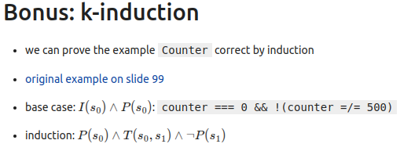
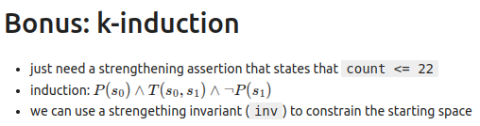
22.12 K-Induction
https://www.youtube.com/watch?v=PBpKPNFwiYI&list=PLfrN7RIcMe6g2LBRJLTHTdhyj5s8ag0Rg&index=18
K-Induction (1:02:01-1:04:42/1:04:42)

Slide 42
End

