Slide 1

1 Introduction
Peter H. Chen

Slide 2
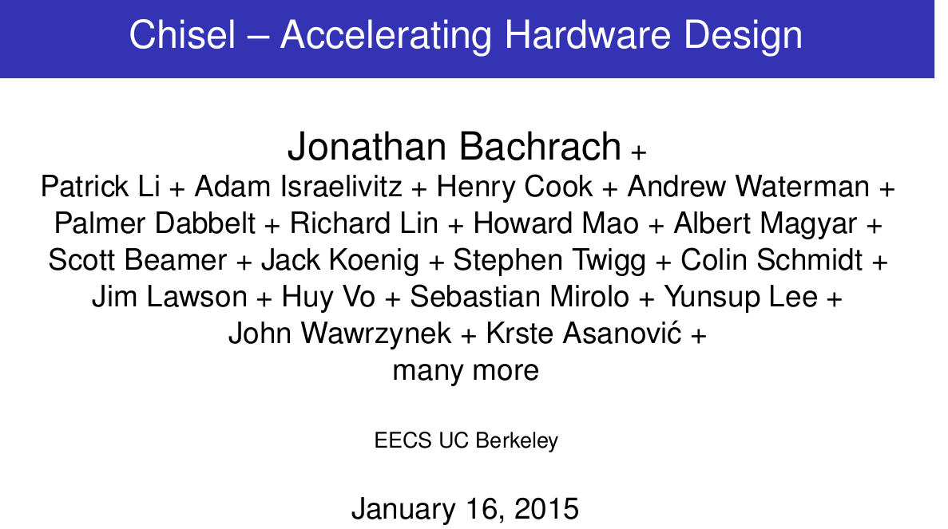
1 Team
https://www.youtube.com/watch?v=pfM1WUWbfBs&list=PLlu0CT-JnSasfpk8tq1ZDiE2G0AK1BhOg&index=1
Team (0:00-1:05/51:50)
This tutorial is provided by Jonathan Bachrach who is a faculty of UC Berkeley. Below is a list of associated engineers and users.
We started to work on Chisel since 4-5 years ago (2010-2011).
Related notes:
https://riscv.org/wp-content/uploads/2015/01/riscv-chisel-tutorial-bootcamp-jan2015.pdf

Slide 3
1.1 Team

Slide 4
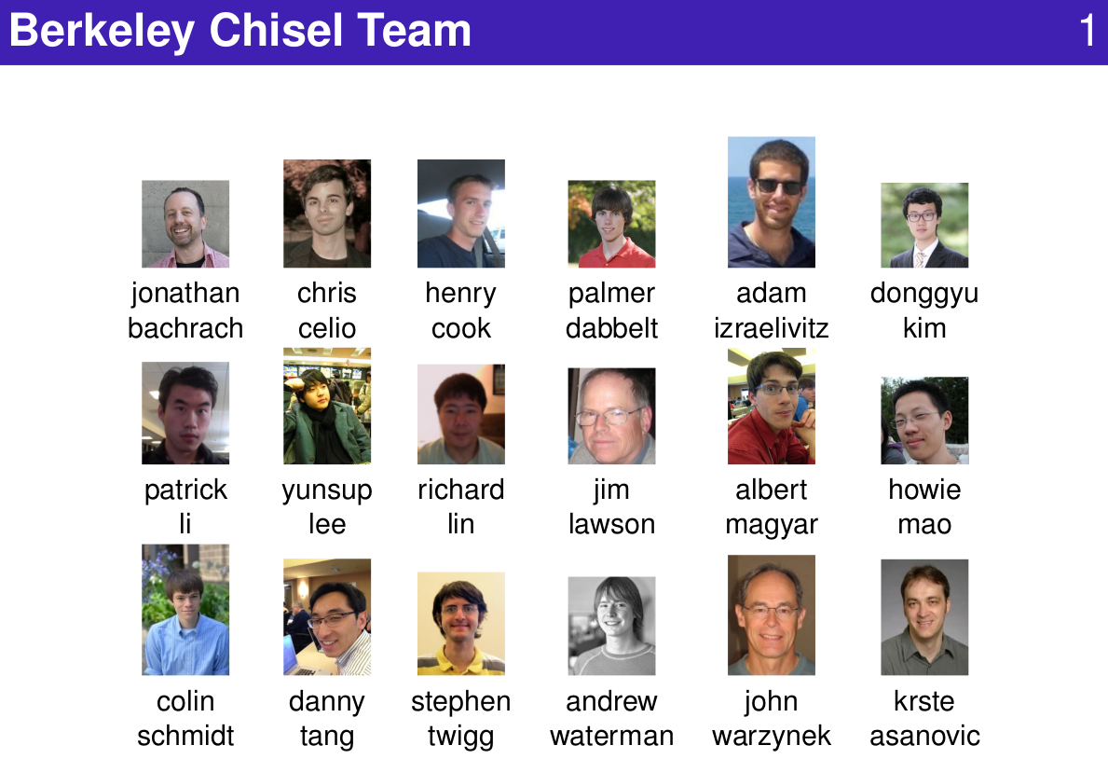
1.1 Team
https://www.youtube.com/watch?v=pfM1WUWbfBs&list=PLlu0CT-JnSasfpk8tq1ZDiE2G0AK1BhOg&index=1
Team (1:06-1:19/51:50)
Below is the partial list of people involved to develop the Chisel.
The major Chisel developer includes: Jonathan Bachrach, Chris Celio, etc.
Chisels is used to develop chip design and simulation.
We have students, designer, projects, full time engineer work for Chisel project.
The major Chisel release engineer is Jim Lawson for bug fix, bug request, examples.

Slide 5
1.2 Hardware Design

Slide 6
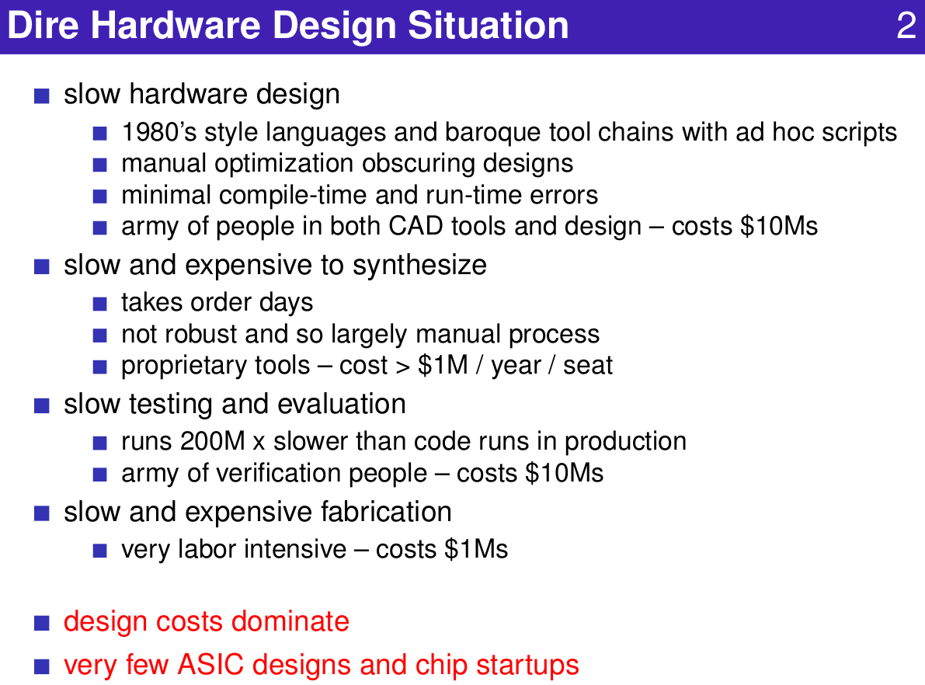
1.2 Hardware Design
https://www.youtube.com/watch?v=pfM1WUWbfBs&list=PLlu0CT-JnSasfpk8tq1ZDiE2G0AK1BhOg&index=1
Hardware Design (1:20-1:46/51:50)
Below is the old and very slow approach for ASIC and chip designs.

Slide 7
1.3 Design Loop

Slide 8
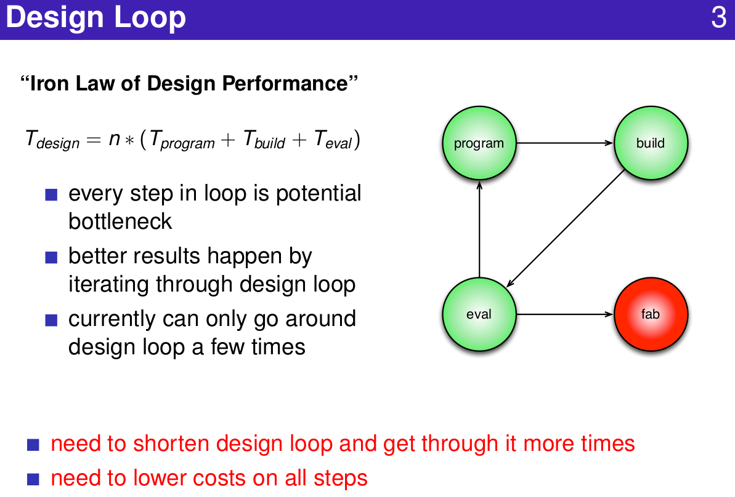
1.3 Design Loop
https://www.youtube.com/watch?v=pfM1WUWbfBs&list=PLlu0CT-JnSasfpk8tq1ZDiE2G0AK1BhOg&index=1
Design Loop (1:47-2:32/51:50)
We need to reduce the design time.

Slide 9
1.4 Chisel Plan

Slide 10
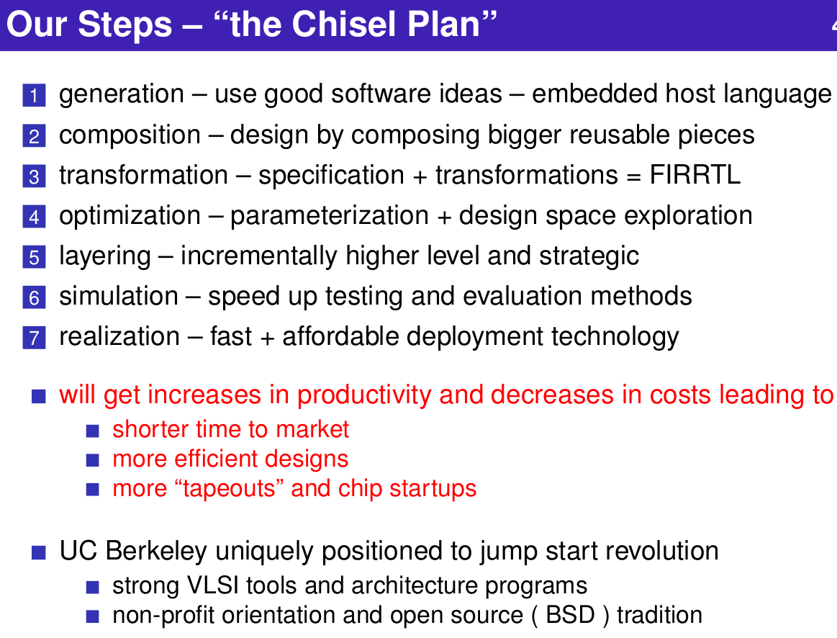
1.4 Chisel Plan
https://www.youtube.com/watch?v=pfM1WUWbfBs&list=PLlu0CT-JnSasfpk8tq1ZDiE2G0AK1BhOg&index=1
Chisel Plan (2:33-4:27/51:50)
Chisel is an Open source tool for RISCV chip design by UC Berkeley.

Slide 11
1.5 Hardware Generator

Slide 12
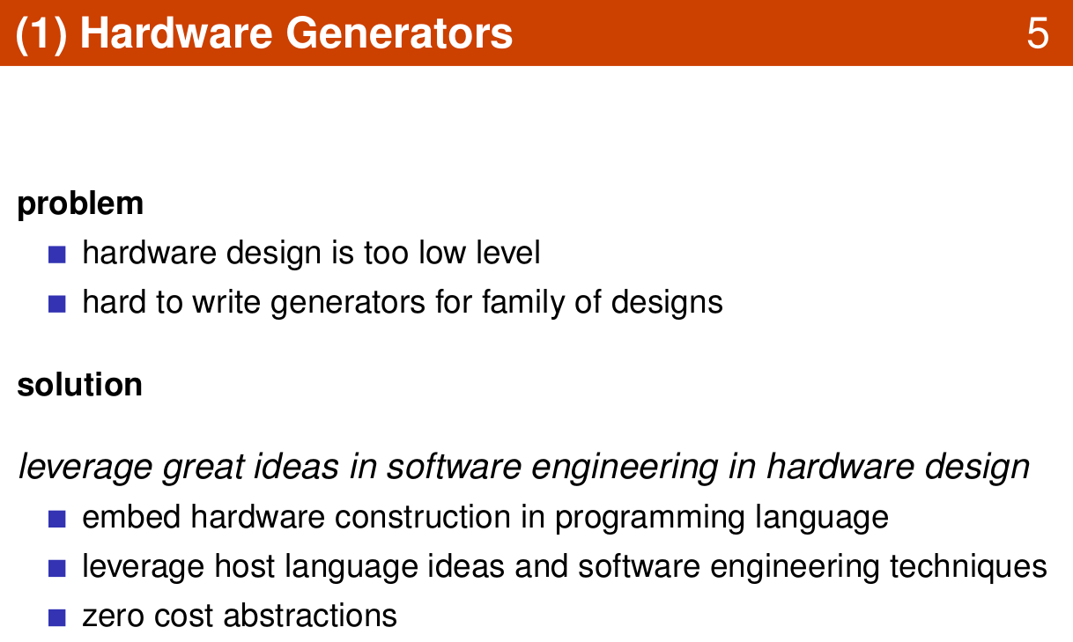
1.5 Hardware Generator
https://www.youtube.com/watch?v=pfM1WUWbfBs&list=PLlu0CT-JnSasfpk8tq1ZDiE2G0AK1BhOg&index=1
Hardware Generator (4:28-6:54/51:50)
Hardware Generator: Embed Hardware in programming language.

Slide 13
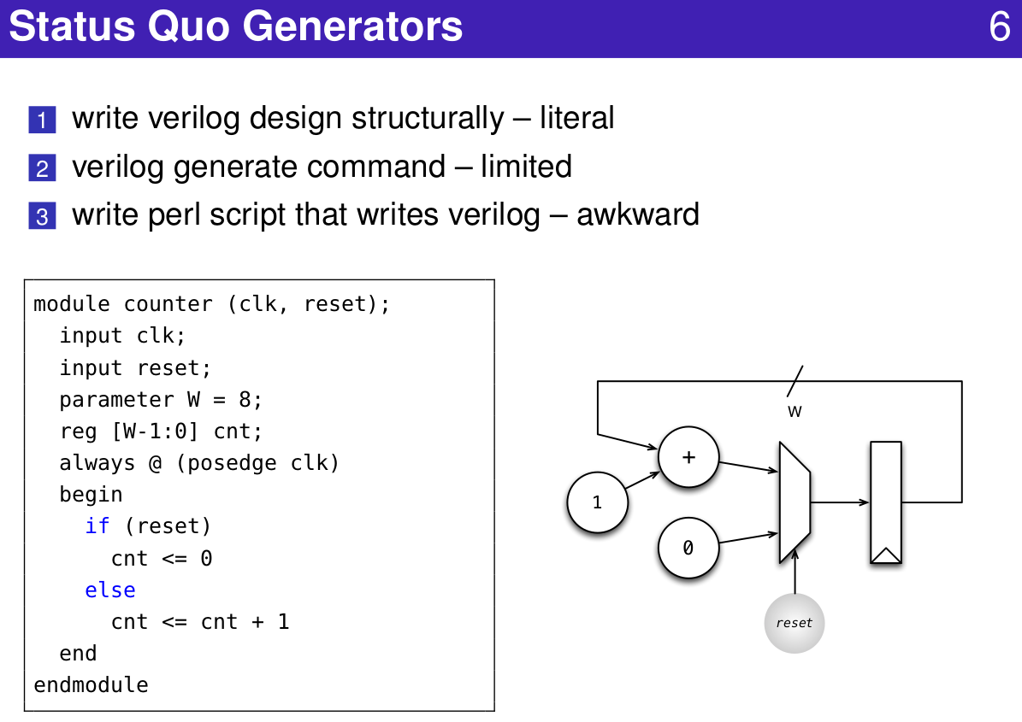
1.5 Hardware Generator
https://www.youtube.com/watch?v=pfM1WUWbfBs&list=PLlu0CT-JnSasfpk8tq1ZDiE2G0AK1BhOg&index=1
Hardware Generator (4:28-6:54/51:50)

Slide 14
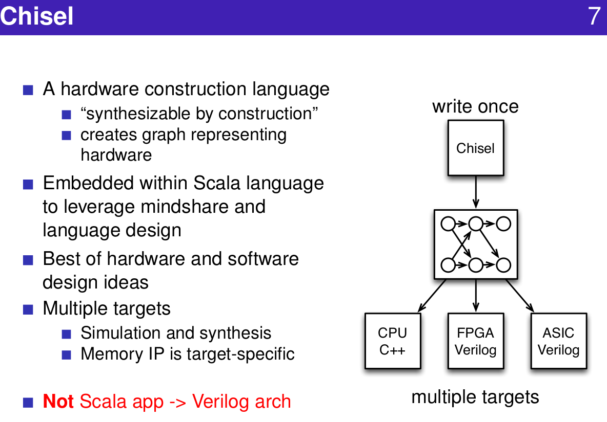
1.5 Hardware Generator
https://www.youtube.com/watch?v=pfM1WUWbfBs&list=PLlu0CT-JnSasfpk8tq1ZDiE2G0AK1BhOg&index=1
Hardware Generator (4:28-6:54/51:50)

Slide 15
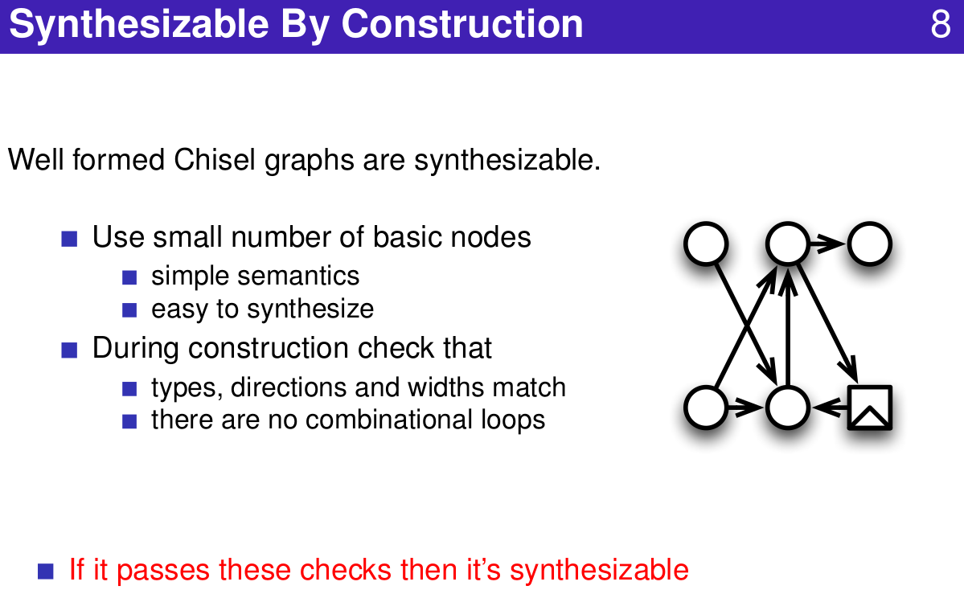
1.5 Hardware Generator
https://www.youtube.com/watch?v=pfM1WUWbfBs&list=PLlu0CT-JnSasfpk8tq1ZDiE2G0AK1BhOg&index=1
Hardware Generator (4:28-6:54/51:50)

Slide 16
1.6 Scala Programming

Slide 17
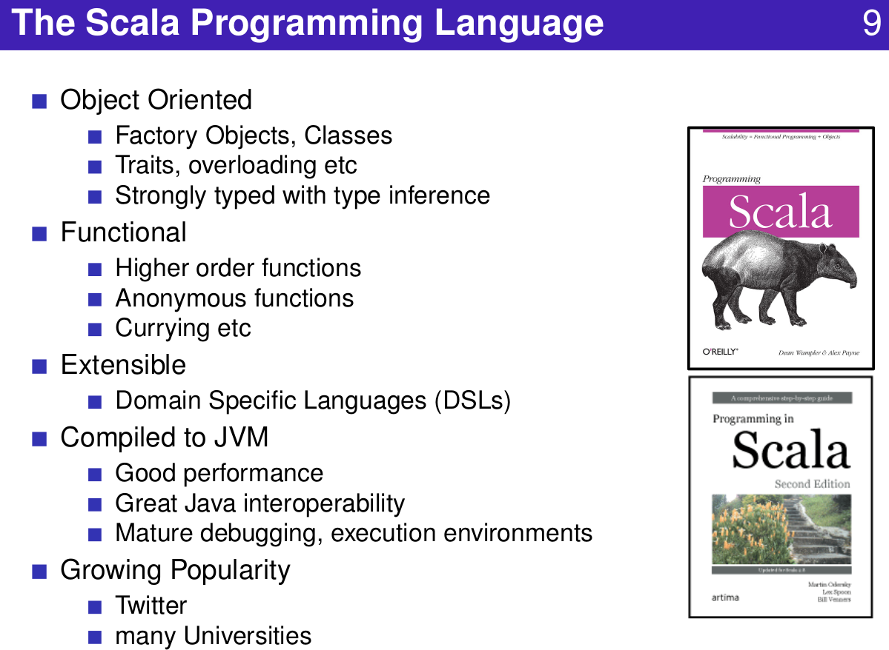
1.6 Scala Programming
https://www.youtube.com/watch?v=pfM1WUWbfBs&list=PLlu0CT-JnSasfpk8tq1ZDiE2G0AK1BhOg&index=1
Scala Programming (6:55-7:46/51:50)
Scale Programming Language

Slide 18
1.7 Primitive Data Type

Slide 19
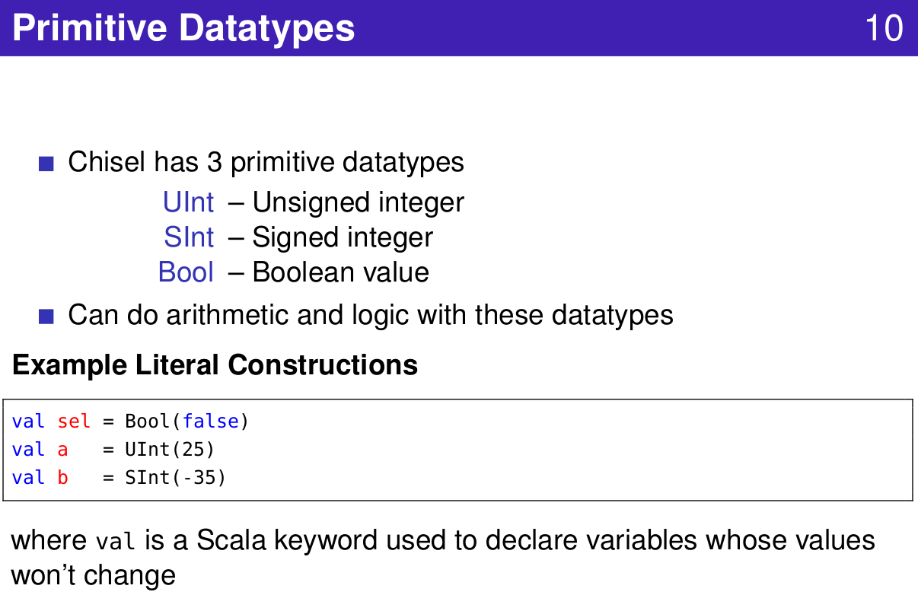
1.7 Primitive Data Type
https://www.youtube.com/watch?v=pfM1WUWbfBs&list=PLlu0CT-JnSasfpk8tq1ZDiE2G0AK1BhOg&index=1
Primitive Data Type (6:55-9:21/51:50)
Primitive Data Types

Slide 20
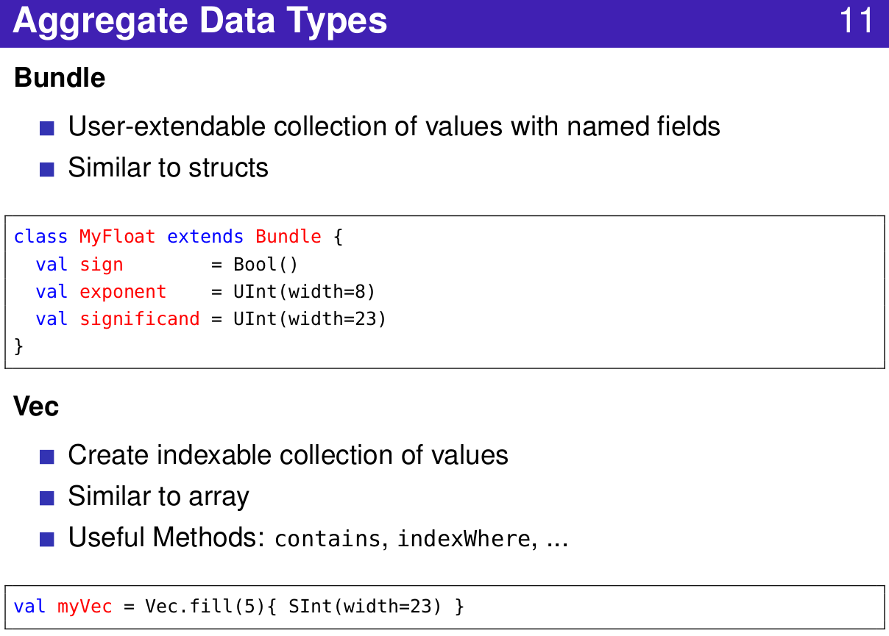
1.7 Primitive Data Type
https://www.youtube.com/watch?v=pfM1WUWbfBs&list=PLlu0CT-JnSasfpk8tq1ZDiE2G0AK1BhOg&index=1
Primitive Data Type (6:55-9:21/51:50)
Aggregate Data Types

Slide 21
1.8 Abstract Data Type

Slide 22
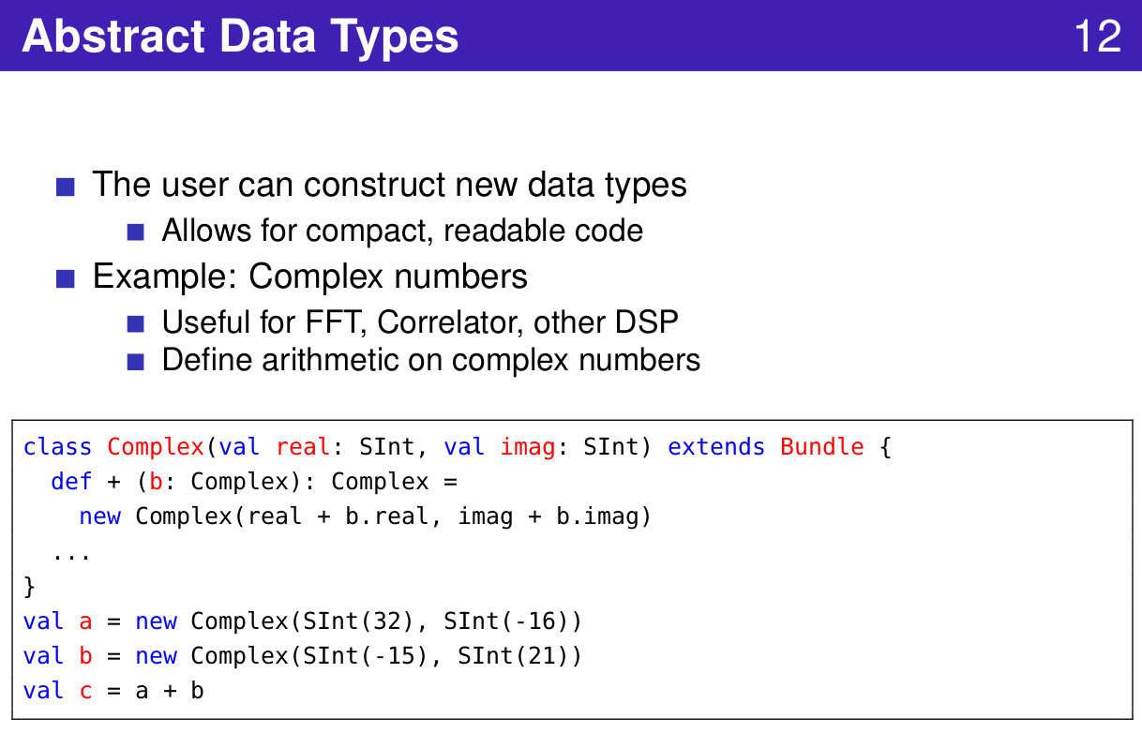
1.8 Abstract Data Type
https://www.youtube.com/watch?v=pfM1WUWbfBs&list=PLlu0CT-JnSasfpk8tq1ZDiE2G0AK1BhOg&index=1
Abstract Data Type (9:22-11:46/51:50)
Abstract Data Types

Slide 23
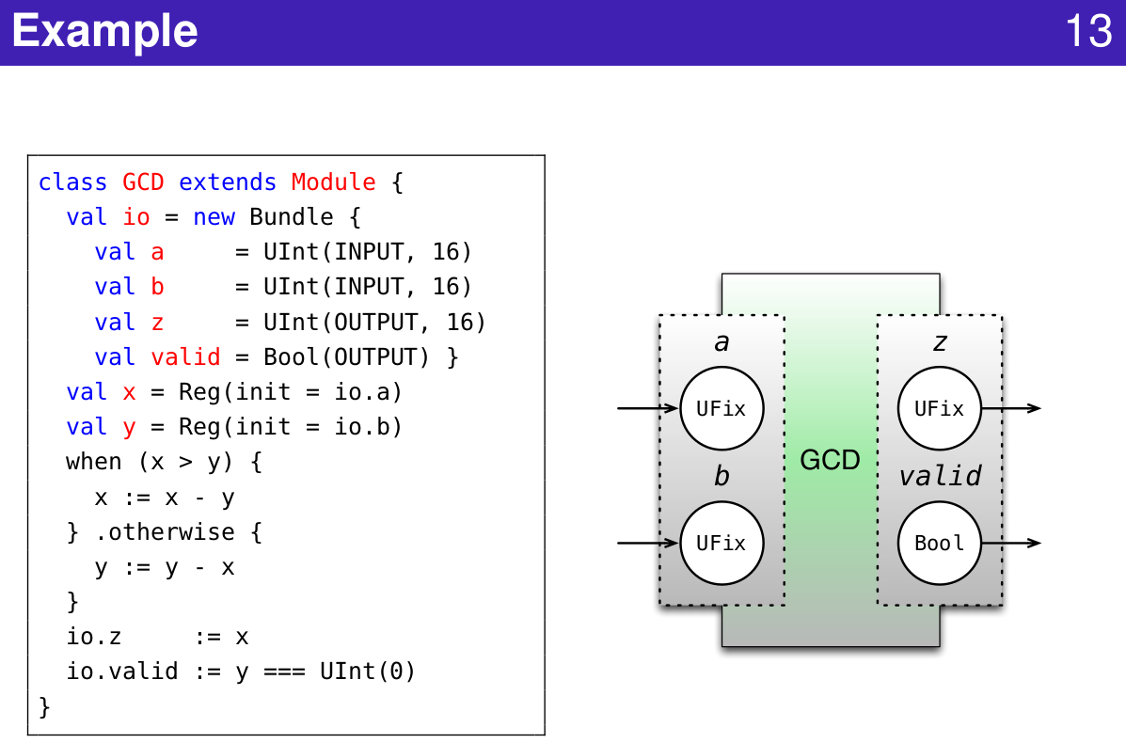
1.8 Abstract Data Type
https://www.youtube.com/watch?v=pfM1WUWbfBs&list=PLlu0CT-JnSasfpk8tq1ZDiE2G0AK1BhOg&index=1
Abstract Data Type (9:22-11:46/51:50)
Example

Slide 24
1.9 Valid Wrapper

Slide 25
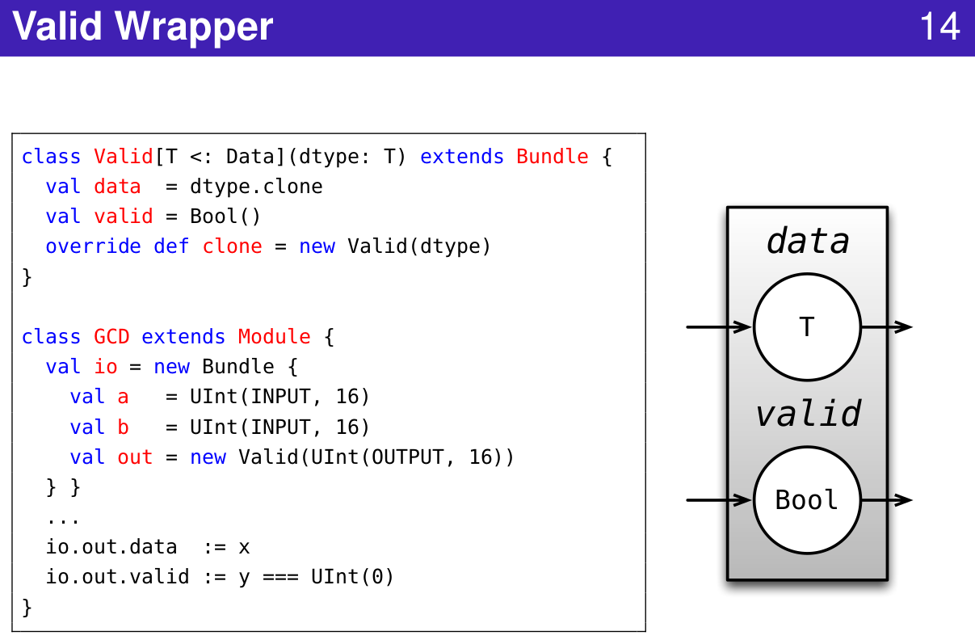
1.9 Valid Wrapper
https://www.youtube.com/watch?v=pfM1WUWbfBs&list=PLlu0CT-JnSasfpk8tq1ZDiE2G0AK1BhOg&index=1
Valid Wrapper (11:47-12:29/51:50)
Valid Wrapper

Slide 26
End

