Slide 1

8 Multiplier
Peter H. Chen

Slide 2
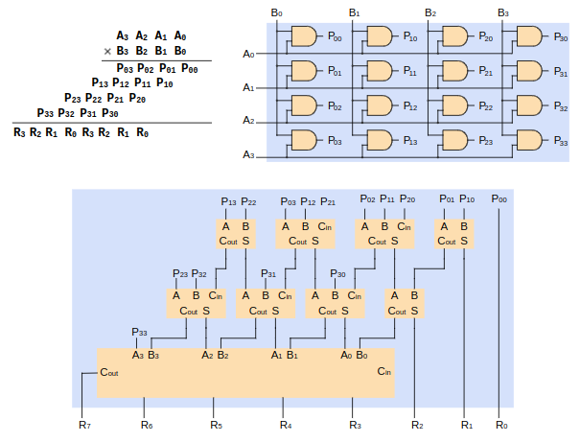
8 Multiplier
https://github.com/ucb-bar/chisel-tutorial?tab=readme-ov-file
Multiplier
Multiplier block.
https://www.realdigital.org/doc/42f40f5d5d502c3672477a2bbd78b697

Slide 3
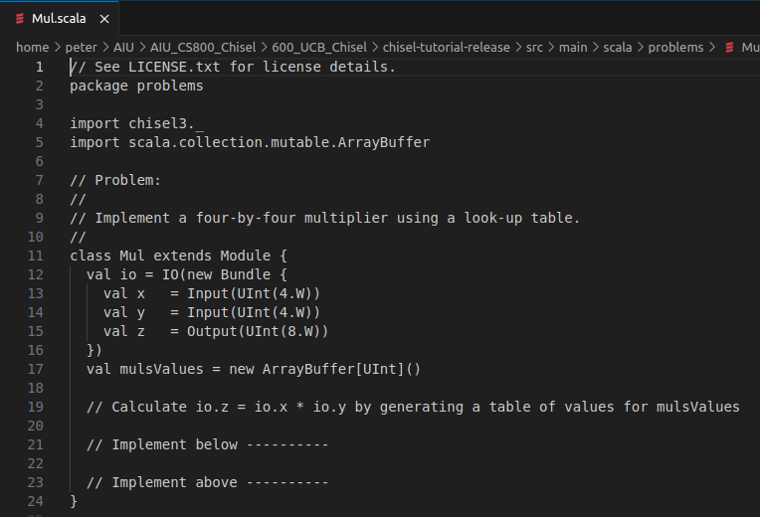
8 Multiplier
https://github.com/ucb-bar/chisel-tutorial?tab=readme-ov-file
Multiplier
Multiplier Cell.
https://www.realdigital.org/doc/42f40f5d5d502c3672477a2bbd78b697

Slide 4
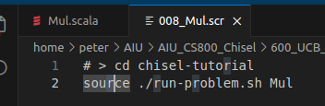
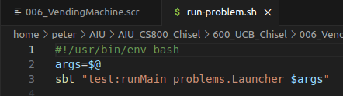
8 Multiplier
https://github.com/ucb-bar/chisel-tutorial?tab=readme-ov-file
Multiplier
1. > source ./run-problem.sh Mul
2. run-problem.sh
> args = $@
> sbt “test:runMain problems.Launcher $args

Slide 5
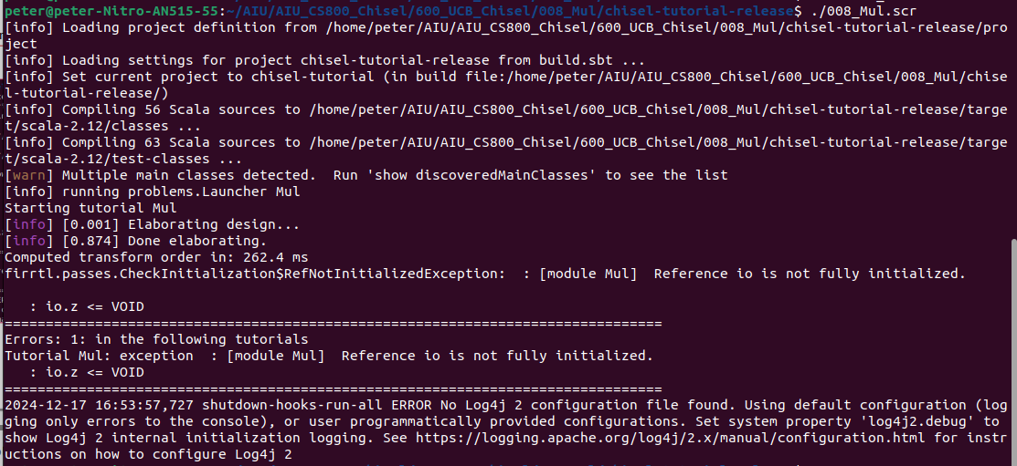
8 Multiplier
https://github.com/ucb-bar/chisel-tutorial?tab=readme-ov-file
Multiplier
Test result.
There are some errors. We will discuss more later on.

Slide 6
End

