Slide 1

9 RealGCD
Peter H. Chen

Slide 2
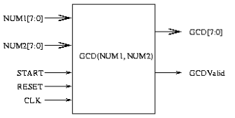
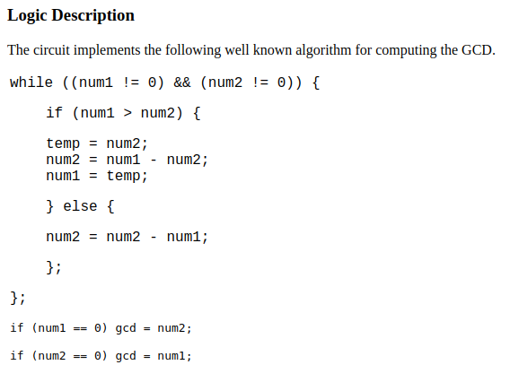
9 RealGCD
https://github.com/ucb-bar/chisel-tutorial?tab=readme-ov-file
RealGCD
RealGCD block diagram and algrotihm.
https://web.cecs.pdx.edu/~mperkows/CLASS_VHDL/VHDL/gcd/assignme.htm

Slide 3
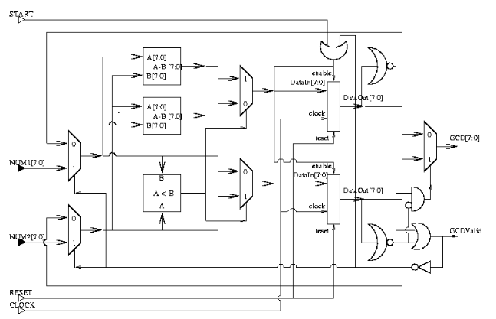
9 RealGCD
https://github.com/ucb-bar/chisel-tutorial?tab=readme-ov-file
RealGCD
GCD Schematic Diagram
https://web.cecs.pdx.edu/~mperkows/CLASS_VHDL/VHDL/gcd/assignme.htm

Slide 4
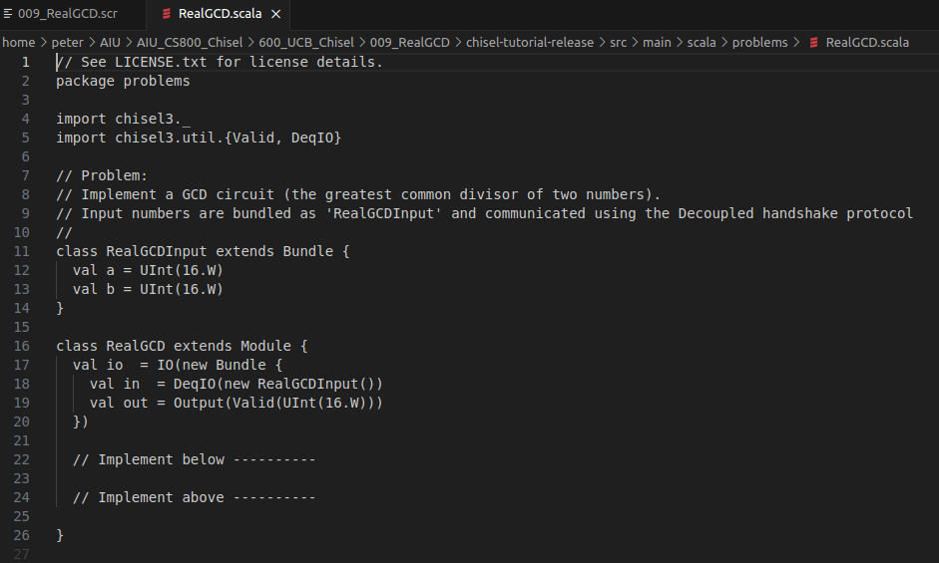
9 RealGCD
https://github.com/ucb-bar/chisel-tutorial?tab=readme-ov-file
RealGCD
GCD (Greatest Common Divisor of the number) Circuit
https://web.cecs.pdx.edu/~mperkows/CLASS_VHDL/VHDL/gcd/assignme.htm

Slide 5
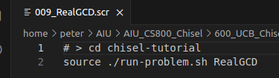
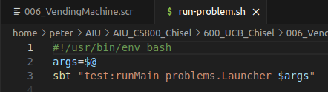
9 RealGCD
https://github.com/ucb-bar/chisel-tutorial?tab=readme-ov-file
RealGCD
1. > source ./run-problem.sh RealGCD
2. run-problem.sh
> args = $@
> sbt “test:runMain problems.Launcher $args

Slide 6
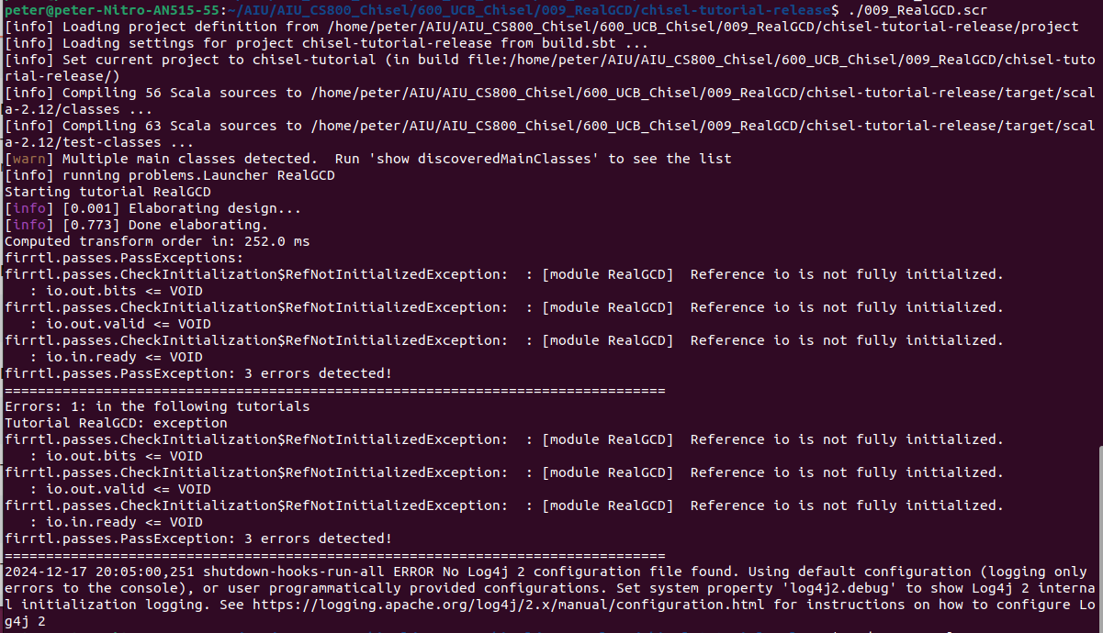
9 RealGCD
https://github.com/ucb-bar/chisel-tutorial?tab=readme-ov-file
RealGCD
Test result.
There are some errors. We will discuss more later on.

Slide 7
End

