Slide 1

22 Model Port (02)
Peter H. Chen

Slide 2
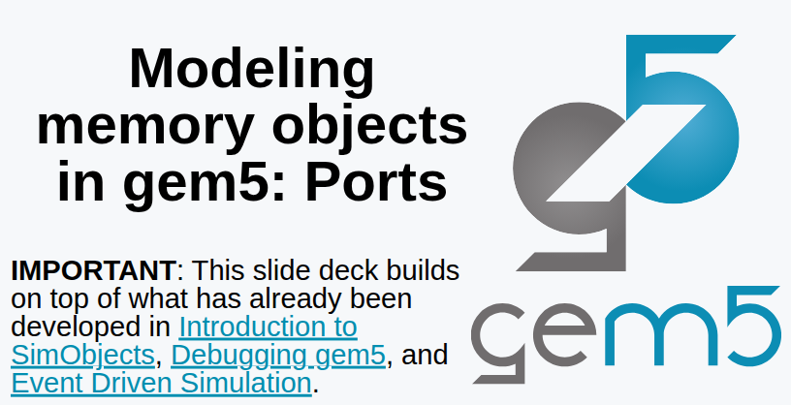
22 Model Port (02)
https://www.youtube.com/watch?v=IAPlbIZg518&list=PL_hVbFs_loVR_8ntTTmmG6YEq3Po_4snu&index=22
Model Port (02) (0:00-0:20/1:36:50)
Last time, we discussed a little bit about Ports.

Slide 3
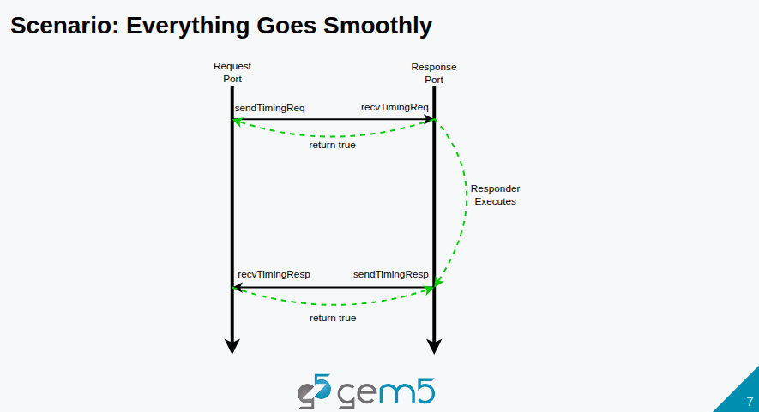
22 Model Port (02)
https://www.youtube.com/watch?v=IAPlbIZg518&list=PL_hVbFs_loVR_8ntTTmmG6YEq3Po_4snu&index=22
Model Port (02) (0:21-0:30/1:36:50)
We have below request, execution, and response diagram.
Gem5 has two types of ports: request port and response port.

Slide 4
22 Model Port (02)
https://www.youtube.com/watch?v=IAPlbIZg518&list=PL_hVbFs_loVR_8ntTTmmG6YEq3Po_4snu&index=22
Model Port (02) (0:31-1:40/1:36:50)
In Gem5, the concept of connected peers: Request port is connected to response port are always operated as connected peers.
The types of Ports are different. Usually, the SimObject has ports. We send the from the request port. The request and response ports are connected together. The signal propagates back from request to response port within the bandwidth.

Slide 5
22 Model Port (02)
https://www.youtube.com/watch?v=IAPlbIZg518&list=PL_hVbFs_loVR_8ntTTmmG6YEq3Po_4snu&index=22
Model Port (02) (1:41-2:20/1:36:50)
If cache is busy and cache is missing the status of handling registers. We get a miss and return False. Time continue to move on.
In some time, if cache is ready and port will return true. It is the responsibility of responder object to send the response back.
We call this is the timing response on the response port or receiving timing response on the request port.

Slide 6
22 Model Port (02)
https://www.youtube.com/watch?v=IAPlbIZg518&list=PL_hVbFs_loVR_8ntTTmmG6YEq3Po_4snu&index=22
Model Port (02) (2:21-2:55/1:36:50)
So, request ports send requests, receive responses. Response ports receive requests, send responses.
We will see in the code, the only functions that relate to receiving are pure virtual functions.
This means that response sending is very straightforward. We get the peer and ask peer to receive.

Slide 7
22.0 Topics

Slide 8
22.0 Topics
https://www.youtube.com/watch?v=IAPlbIZg518&list=PL_hVbFs_loVR_8ntTTmmG6YEq3Po_4snu&index=22
Model Port (02) (2:56-3:00/1:36:50)
1.

Slide 9
22.1 InspectorGadget

Slide 10
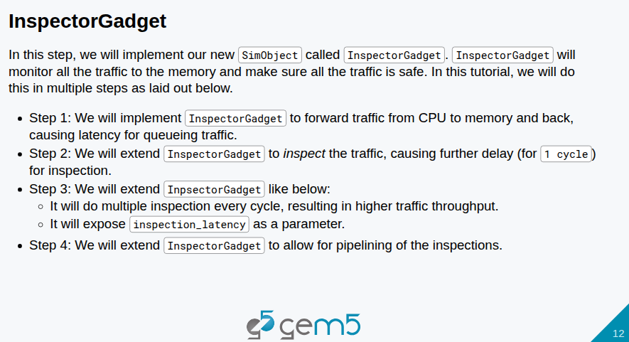
22.1 InspectorGadget
https://www.youtube.com/watch?v=IAPlbIZg518&list=PL_hVbFs_loVR_8ntTTmmG6YEq3Po_4snu&index=22
InspectorGadget (3:01-3:20/1:36:50)
1. Here, we implement InspectorGadget() in SimObject class.
2. InspectorGadget() will monitor all the traffic to the memory and make sure traffic is safe.
3. We will do this monitor in four steps.

Slide 11
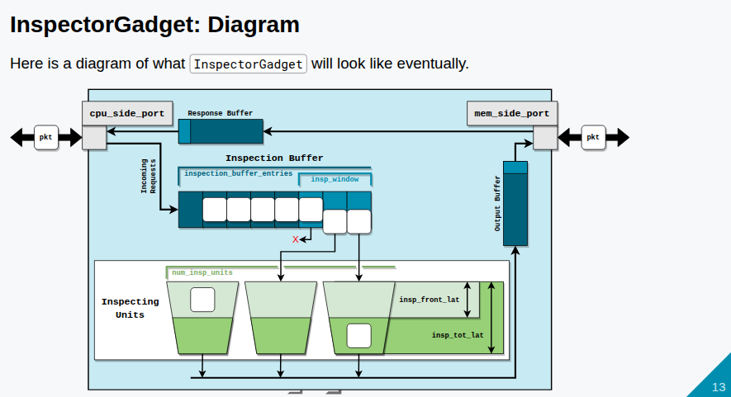
22.1 InspectorGadget
https://www.youtube.com/watch?v=IAPlbIZg518&list=PL_hVbFs_loVR_8ntTTmmG6YEq3Po_4snu&index=22
InspectorGadget (3:31-4:30/1:36:50)
Below is the diagram of high level view of InspectorGadget().
First step: At the left of the diagram, we have cpu_side_port. This is the model of the port on CPU side, a response port on CPU side. We have the buffer called Inspection Buffer. At the first step, we do not discuss the details of modeling any inspection.
Below describes how the protocol:
1. Create the inspection buffer.
2. Send inspection buffer through the memory side port to the memory.
3. Make a request
4. Get the responses
5. Forward the responses back.

Slide 12
22.1 InspectorGadget
https://www.youtube.com/watch?v=IAPlbIZg518&list=PL_hVbFs_loVR_8ntTTmmG6YEq3Po_4snu&index=22
InspectorGadget (4:31-4:45/1:36:50)
It seems to be easy, however, we have 73 slides to describe the protocol.
Because we cannot have infinite size of buffer in the hardware, we need to parameterize the size of memory buffers.

Slide 13
22.2 Step 1: Buffering Traffic

Slide 14
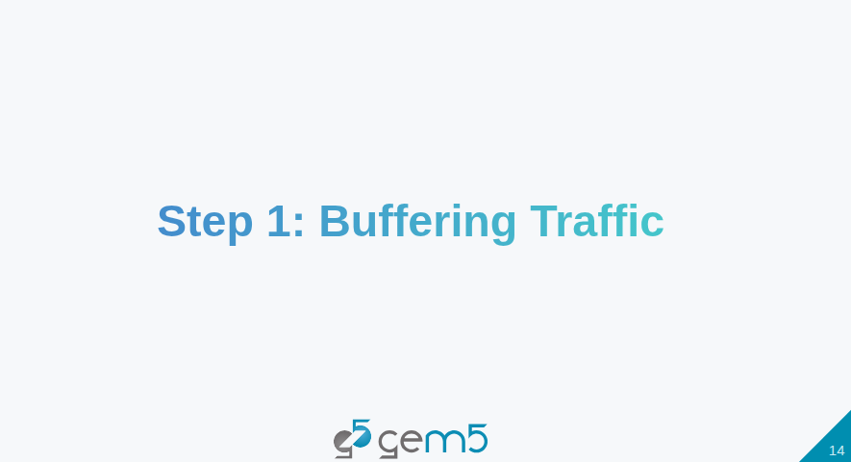
22.2 Step 1: Buffering Traffic
https://www.youtube.com/watch?v=IAPlbIZg518&list=PL_hVbFs_loVR_8ntTTmmG6YEq3Po_4snu&index=22
Step 1: Buffering Traffic (4:46-4:50/1:36:50)

Slide 15
22.3 ClockedObject

Slide 16
22.3 ClockedObject
https://www.youtube.com/watch?v=IAPlbIZg518&list=PL_hVbFs_loVR_8ntTTmmG6YEq3Po_4snu&index=22
ClockedObject (4:51-5:50/1:36:50)

Slide 17
End

