Slide 1

27 Contribution
Peter H. Chen

Slide 2

27 Contribution
https://www.youtube.com/watch?v=xbeIU-MQJJk&list=PL_hVbFs_loVR_8ntTTmmG6YEq3Po_4snu&index=27
Contribution (0:00 - 0:30/1:18:33)
We already know how to use gem5. Now, we want to know how to make contribution to gem5.
gem5 is an open-source project. The GitHub is the repository for the community.

Slide 3
27.0 Contribution Topics

Slide 4
27.0 Contribution Topics
https://www.youtube.com/watch?v=xbeIU-MQJJk&list=PL_hVbFs_loVR_8ntTTmmG6YEq3Po_4snu&index=27
Contribution Topics (0:31 – 1:32/1:18:33)
Contribute Topics:

Slide 5
27.1 Introduction

Slide 6
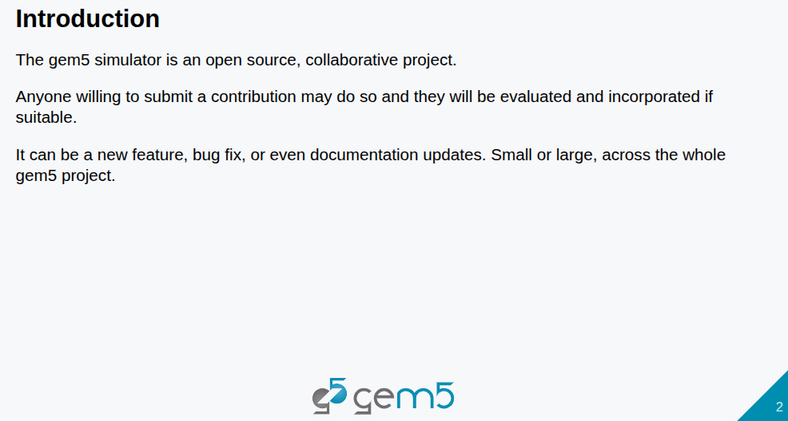
27.1 Introduction
https://www.youtube.com/watch?v=xbeIU-MQJJk&list=PL_hVbFs_loVR_8ntTTmmG6YEq3Po_4snu&index=27
Introduction (0:33 – 1:10/1:18:33)
1. gem5 is an open-source, collaborative project.
2. Anyone can submit contribution and they will be evaluated and incorporated if they are suitable.
3. They submission can be anything. We cannot always focus on code, bug fixes, or documentation updates are all welcome.

Slide 7
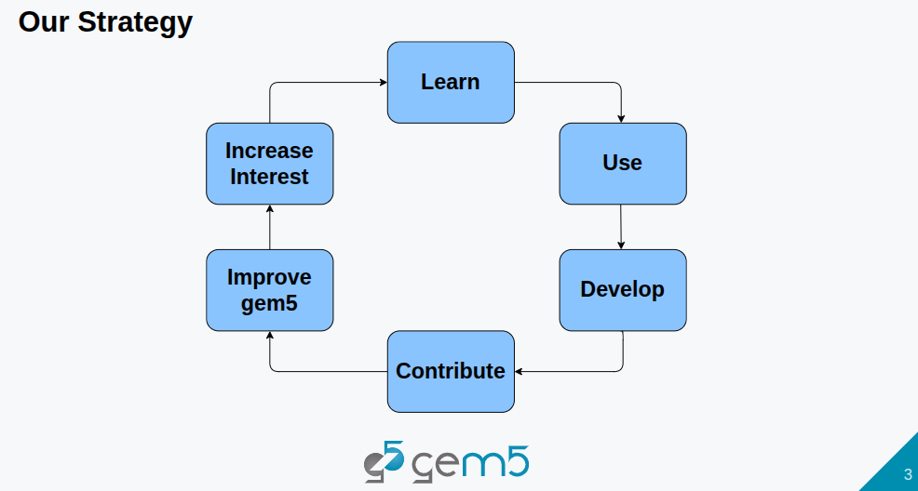
27.1 Introduction
https://www.youtube.com/watch?v=xbeIU-MQJJk&list=PL_hVbFs_loVR_8ntTTmmG6YEq3Po_4snu&index=27
Introduction (1:11 – 1:55/1:18:33)
1. The gem5 strategy is: we learn, use, then through the use of gem5, we develop new things.
2. Then through the develop the new things, we we make contribution to gem5.
3. Then, through the contribution of gem5, we improve gem5 and increase interest.
4. Then we have more people to learn
5. In the bootcamp. We have more people in the first cycle, then we have more user and developer to make contribution, improve gem5, and increase interest, etc.

Slide 8
27.2 Contribution

Slide 9
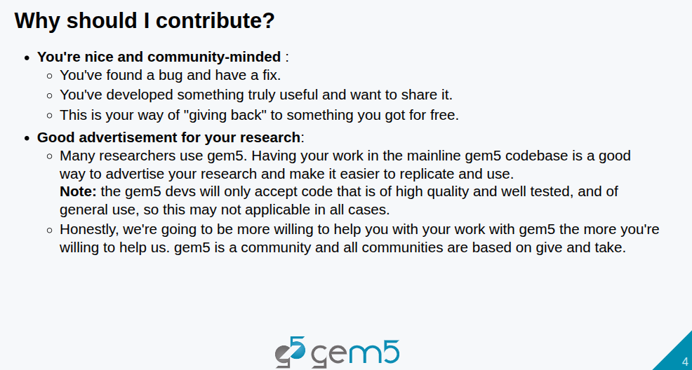
27.2 Contribution
https://www.youtube.com/watch?v=xbeIU-MQJJk&list=PL_hVbFs_loVR_8ntTTmmG6YEq3Po_4snu&index=27
Contribution (1:11 – 3:55/1:18:33)
Why should I make contribution?
You are nice and community-minded. Found a bud and fixed it whatever you can and share with other users.
Good for your research project. You can expand your research work in open source. You can have a new model and new way to do your project.

Slide 10
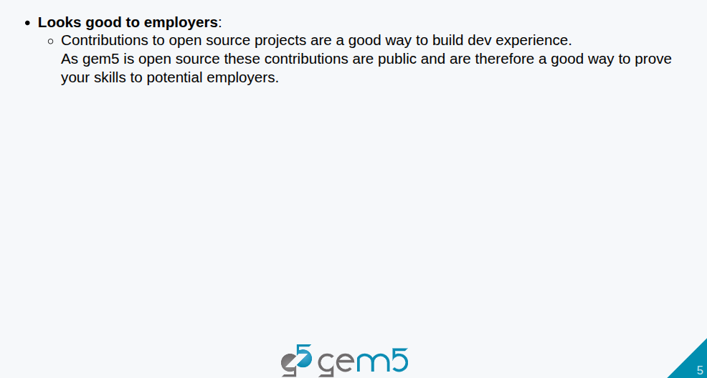
27.2 Contribution
https://www.youtube.com/watch?v=xbeIU-MQJJk&list=PL_hVbFs_loVR_8ntTTmmG6YEq3Po_4snu&index=27
Contribution (3:56 – 4:50/1:18:33)
If you are in PhD or MS study, contribute to open source projects are a good way to build experience.
It is a good way to prove your skill to the employers through the GitHub.

Slide 11
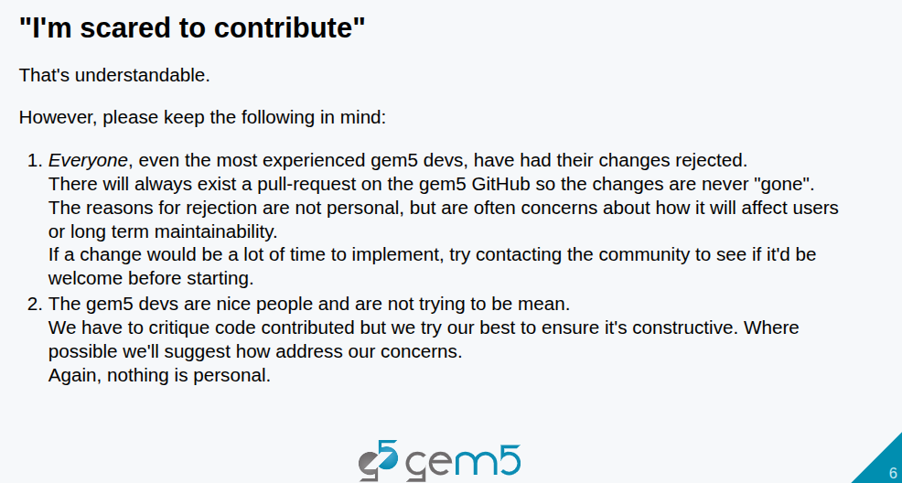
27.2 Contribution
https://www.youtube.com/watch?v=xbeIU-MQJJk&list=PL_hVbFs_loVR_8ntTTmmG6YEq3Po_4snu&index=27
Contribution (4:51 – 6:45/1:18:33)
Scare to contribute:
1. Everyone, even the most experienced gem5 users have changes rejected. The changes are in GitHub and never gone. Contact the community before start.
2. gem5 community are nice to review the code, nothing personal.

Slide 12
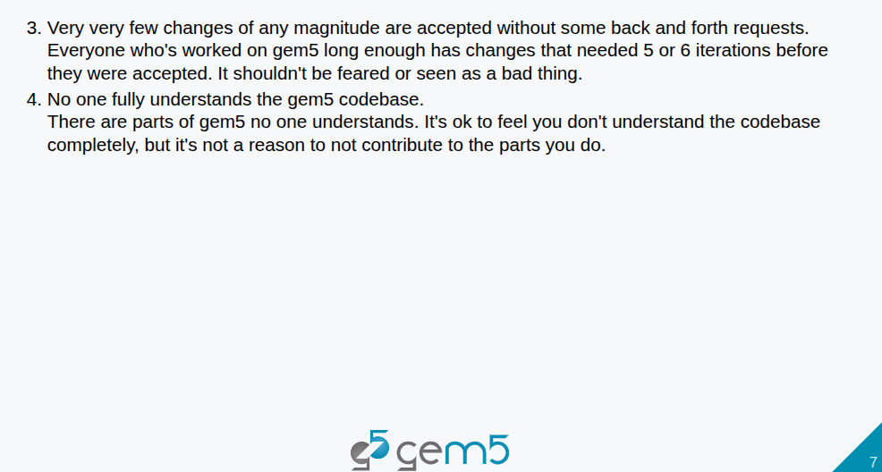
27.2 Contribution
https://www.youtube.com/watch?v=xbeIU-MQJJk&list=PL_hVbFs_loVR_8ntTTmmG6YEq3Po_4snu&index=27
Contribution (6:46 – 8:35/1:18:33)
3. Very normal to have 5 to 6 iterations to get accept.
4. gem5 is very huge code. No one understand the entire code.

Slide 13
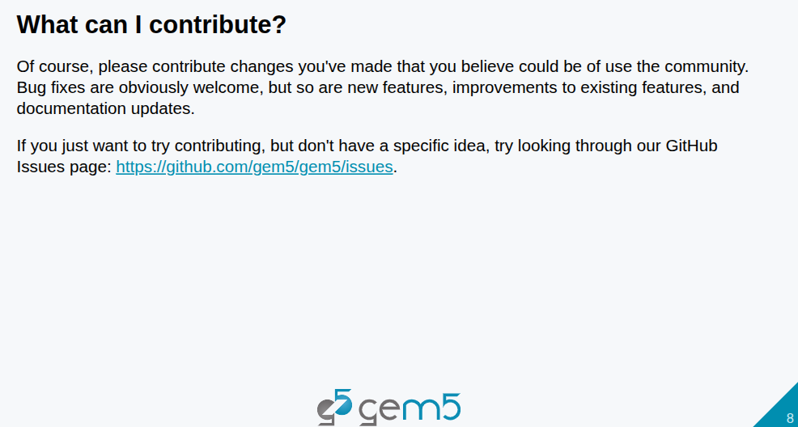
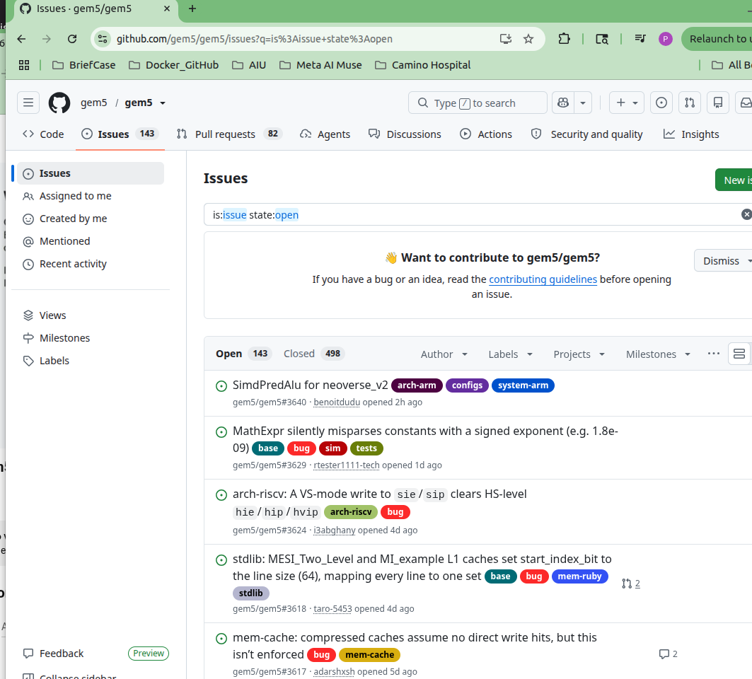
27.2 Contribution
https://www.youtube.com/watch?v=xbeIU-MQJJk&list=PL_hVbFs_loVR_8ntTTmmG6YEq3Po_4snu&index=27
Contribution (8:36 – 9:45/1:18:33)
You are welcome to contribute something is meaningful, bug fixing, improvement to exiting features, and good documentation.
If you don’t have idea, you can go through the GitHub Issues page: https://github.com/gem5/gem5/issues.

Slide 14
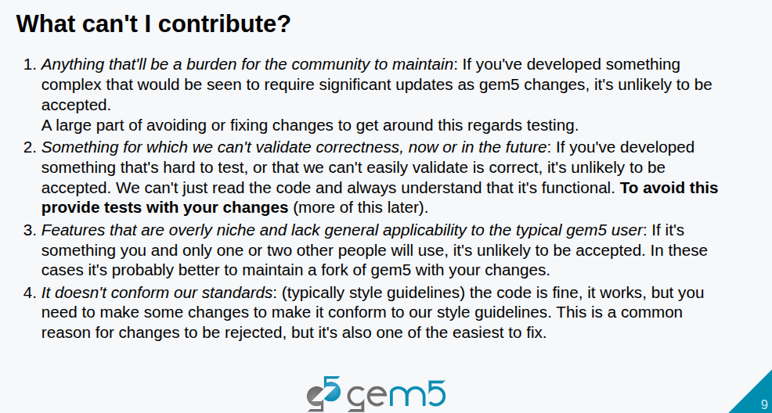
27.2 Contribution
https://www.youtube.com/watch?v=xbeIU-MQJJk&list=PL_hVbFs_loVR_8ntTTmmG6YEq3Po_4snu&index=27
Contribution (9:46 – 12:15/1:18:33)
What cannot be contributed?
1. Anything create the community burden to maintain. Avoid a large number of test,
2. Anything that cannot be validated the correctness. To avoid this, you need to provide test to prove you change is good.
3. Features are too small and lack of general application.
4. Code does not confirm the code standard. This is easiest to fix.

Slide 15
27.3 Fork Repository

Slide 16
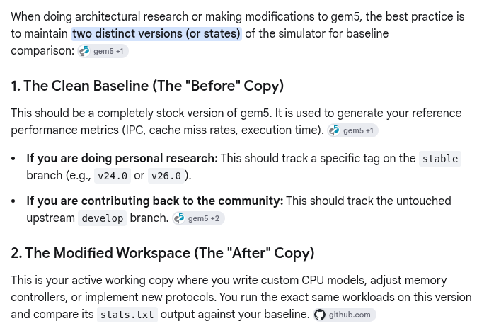
27.3 Fork Repository
https://www.youtube.com/watch?v=xbeIU-MQJJk&list=PL_hVbFs_loVR_8ntTTmmG6YEq3Po_4snu&index=27
Fork Repository (12:16 – 12:17/1:18:33)
We keep at least two distinct copies of gem5: One for baseline (‘origin/develop’) for comparison and one for modification (‘gem5-change’ or ‘my-change’).
gem5
Clone two copies
develop
(for development reference)
develop
gem5-change
(for development modification)

Slide 17
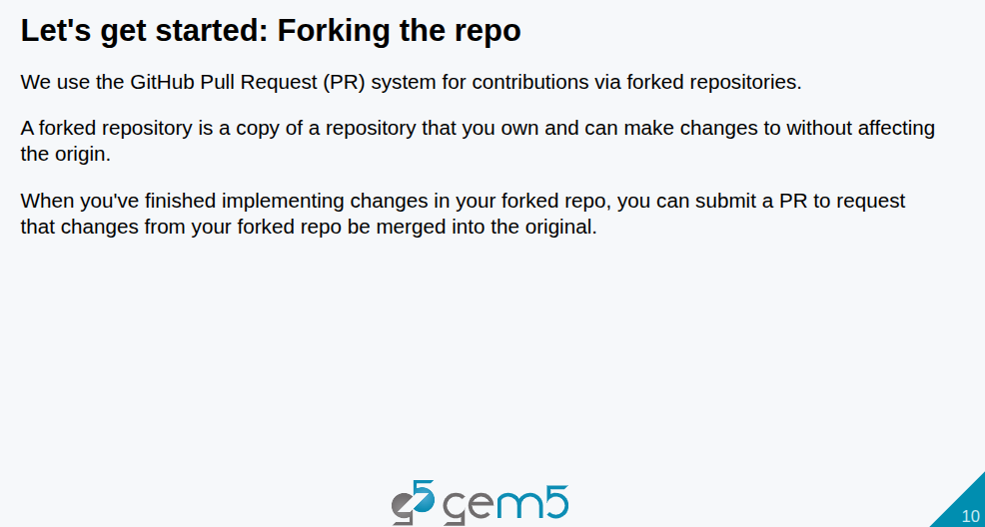
27.3 Fork Repository
https://www.youtube.com/watch?v=xbeIU-MQJJk&list=PL_hVbFs_loVR_8ntTTmmG6YEq3Po_4snu&index=27
Fork Repository (12:18 – 12:45/1:18:33)
We go through step-by-step with make the contribution of gem5.
Let’s started with Fork the code to your local repository.
You will push the pool request to make the contribution.

Slide 18
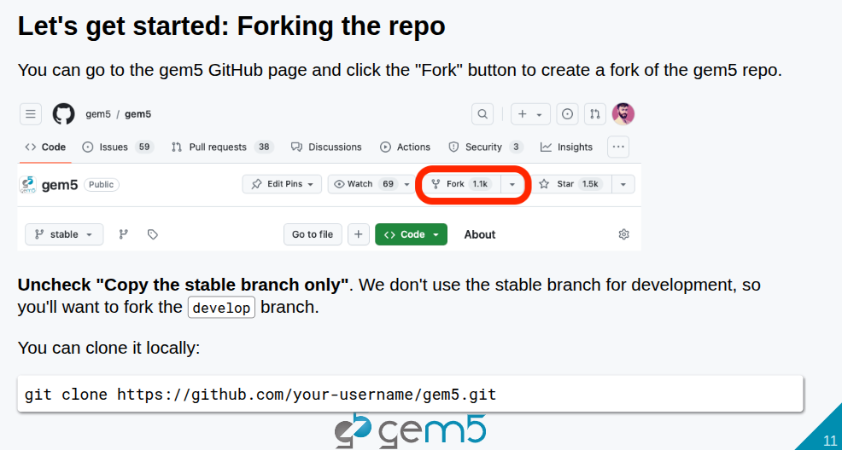
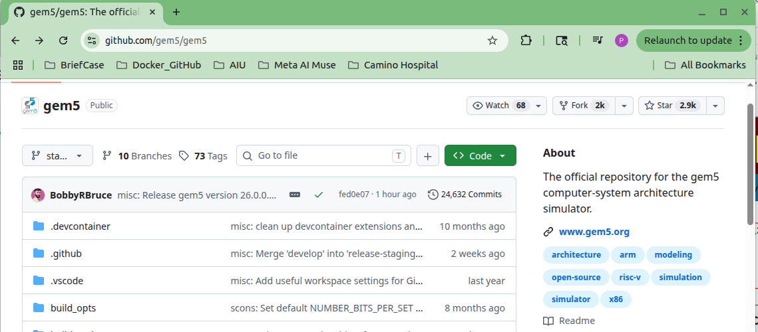
27.3 Fork Repository
https://www.youtube.com/watch?v=xbeIU-MQJJk&list=PL_hVbFs_loVR_8ntTTmmG6YEq3Po_4snu&index=27
Fork Repository (12:46 – 13:05/1:18:33)
Go to gem5 GitHub. We use the pool request model.
Click “Fork” to clone your local copy.

Slide 19
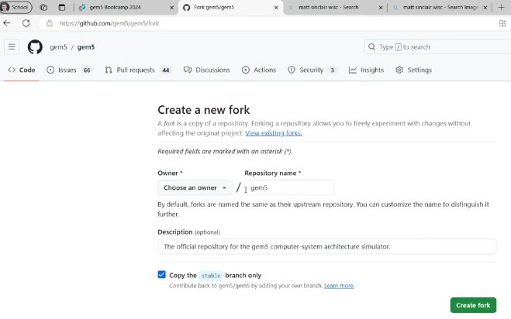
27.3 Fork Repository
https://www.youtube.com/watch?v=xbeIU-MQJJk&list=PL_hVbFs_loVR_8ntTTmmG6YEq3Po_4snu&index=27
Fork Repository (12:56 – 13:55/1:18:33)
First thing we would do is to fork. You have your own GitHub Account.
1. Create ‘origin/develop’: We create a Fork (’origin/develop’)and clone gem5 repository for our own.
2. Create ‘gem5-change’: We can modify the gem5 repository (‘gem5-change’) and make the change.
3. We make a pool request which merge these changes.

Slide 20
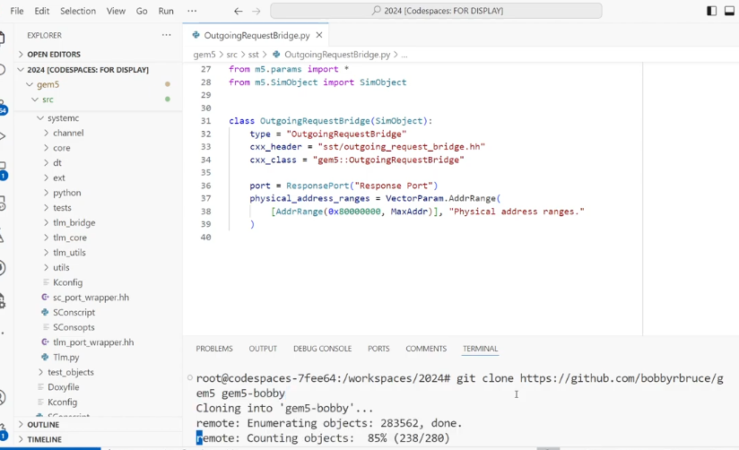
27.3 Fork Repository
https://www.youtube.com/watch?v=xbeIU-MQJJk&list=PL_hVbFs_loVR_8ntTTmmG6YEq3Po_4snu&index=27
Fork Repository (13:56 – 14:40/1:18:33)
The command shows we clone the gem5.git for mortification.
> git clone https://github.com/<your-user-name>/gem5.git
For the example on the right below is for user name “bobbybruce” to clone into his local repository folder “gem5-bobby”.
> git clone https://github.com/bobbybruce/gem5 gem5-bobby

Slide 21
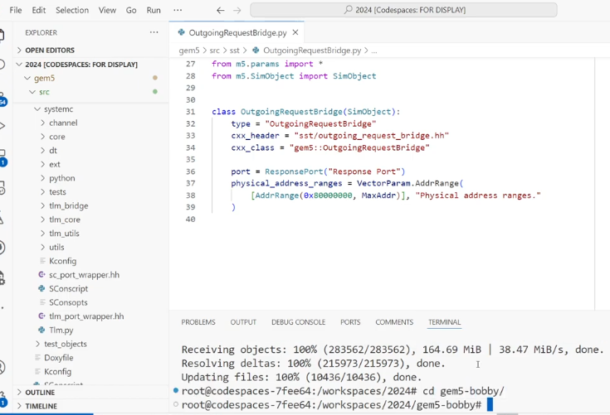
27.3 Fork Repository
https://www.youtube.com/watch?v=xbeIU-MQJJk&list=PL_hVbFs_loVR_8ntTTmmG6YEq3Po_4snu&index=27
Fork Repository (14:41 – 14:43/1:18:33)
In the right below, after we clone the local repository folder “gem5-bobby” (> git clone https://github.com/bobbybruce/gem5 gem5-bobby)
We can to the working directory
> cd gem5-bobby

Slide 22
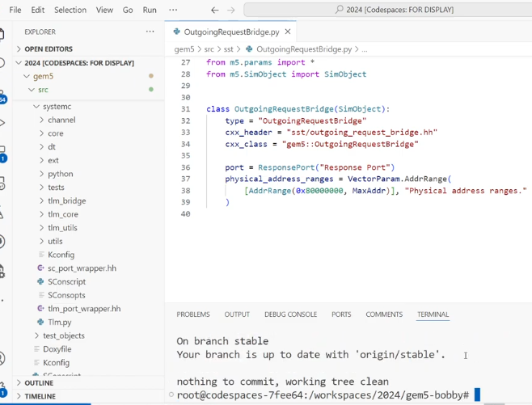
27.3 Fork Repository
https://www.youtube.com/watch?v=xbeIU-MQJJk&list=PL_hVbFs_loVR_8ntTTmmG6YEq3Po_4snu&index=27
Fork Repository (14:44 – 14:45/1:18:33)
In the gem5-hobby directory (> cd gem5-bobby),

Slide 23
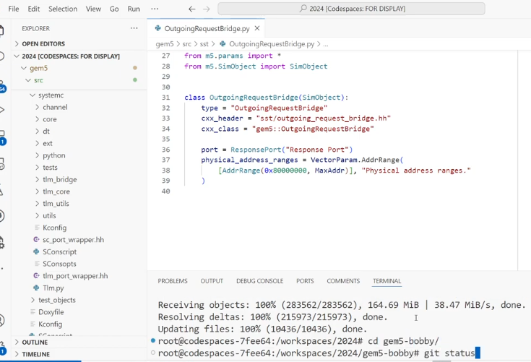
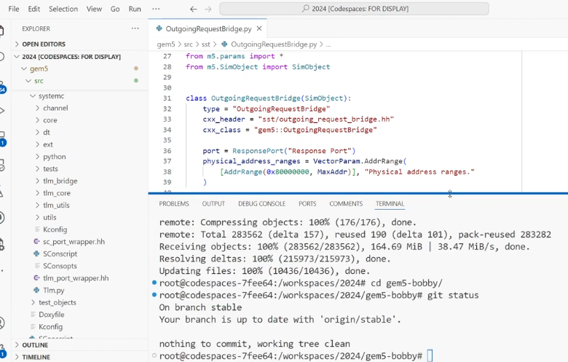
27.3 Fork Repository
https://www.youtube.com/watch?v=xbeIU-MQJJk&list=PL_hVbFs_loVR_8ntTTmmG6YEq3Po_4snu&index=27
Fork Repository (14:46 – 15:10/1:18:33)
We check the git status
> git status
We got the stable release of git status.
This mean that I own the local repository and can make the modification

Slide 24
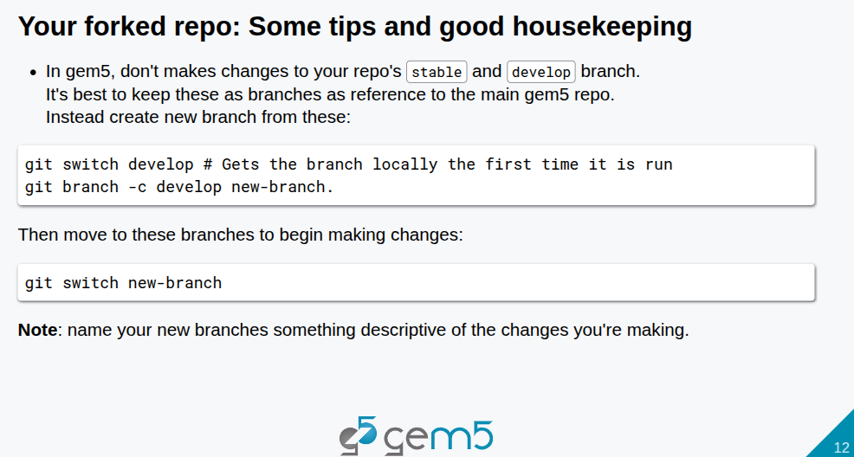
27.3 Fork Repository
https://www.youtube.com/watch?v=xbeIU-MQJJk&list=PL_hVbFs_loVR_8ntTTmmG6YEq3Po_4snu&index=27
Fork Repository (15:11 – 15:25/1:18:33)
Below are some good housekeeping tips.
In gem5, we don’t make changes to stable repository and stable develop branch. We keep both main gem5 branch and stable develop branch as reference.
Therefore, we create new branches for both gem5 main branch and stable develop branch
1. > git switch develop # Switch to develop branch
2. > git branch -c develop new-branch # Copy the develop branch to the new-branch. “-c” stands for “copy”
3. > git switch new-branch # Switch to the new branch

Slide 25
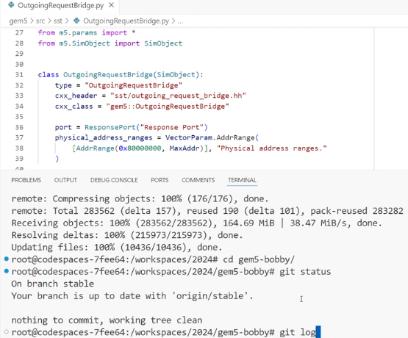
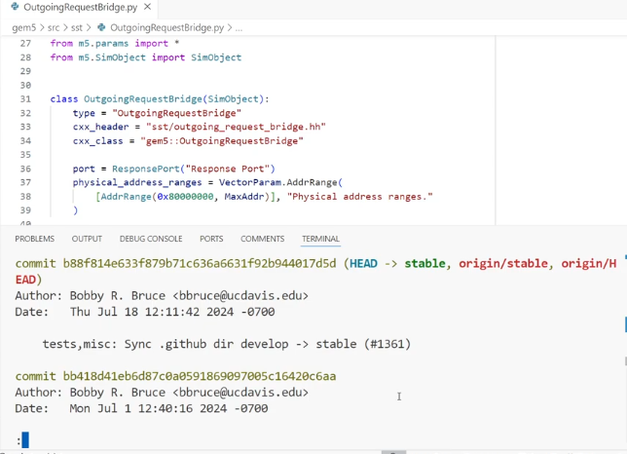
27.3 Fork Repository
https://www.youtube.com/watch?v=xbeIU-MQJJk&list=PL_hVbFs_loVR_8ntTTmmG6YEq3Po_4snu&index=27
Fork Repository (15:26 – 15:50/1:18:33)
This is the latest version of gem5. We check the log information
> git log
>> Author
>> Date: 2024
>> ….
This version is 24.0.0

Slide 26
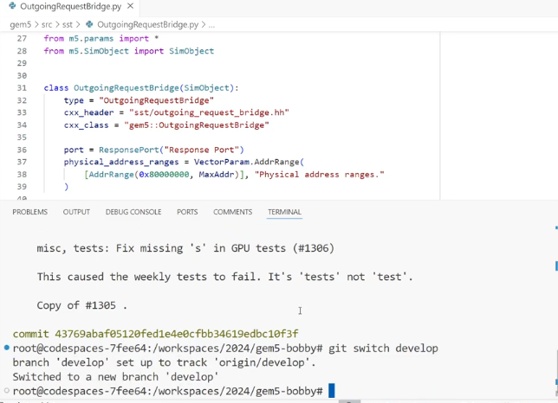
27.3 Fork Repository
https://www.youtube.com/watch?v=xbeIU-MQJJk&list=PL_hVbFs_loVR_8ntTTmmG6YEq3Po_4snu&index=27
Fork Repository (15:51 – 16:00/1:18:33)
1. We switch to develop branch
> git switch develop
>> branch ‘develop’ set up to track ‘origin/develop’.
>> switched to a new branch ‘develop’
We created copy of ‘develop’ branch before and we switch to ‘develop’ branch.

Slide 27
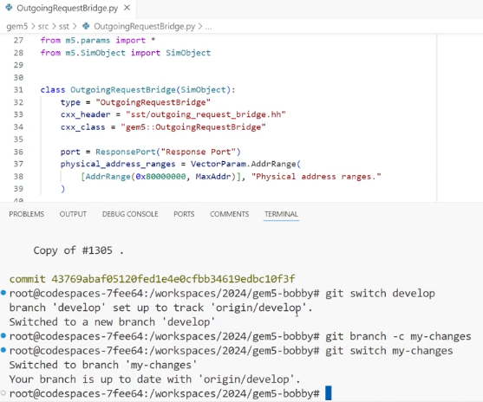
27.3 Fork Repository
https://www.youtube.com/watch?v=xbeIU-MQJJk&list=PL_hVbFs_loVR_8ntTTmmG6YEq3Po_4snu&index=27
Fork Repository (16:01 – 16:55/1:18:33)
We change to ‘develop’ branch to ‘my-changes’
> git branch -c my-changes
We switch from ‘develop’ branch to ‘my-change’ to make change for ‘develop’.
> git switch my-changes
We can start working on the develop branch, i.e., ‘my-changes’ branch.
It is nice to keep develop (‘origin/develop’) branch clean to sync with the current gem5. It will make the development a lot of easier and become clear for the next few slides.

Slide 28
27.3 Sync Repository

Slide 29
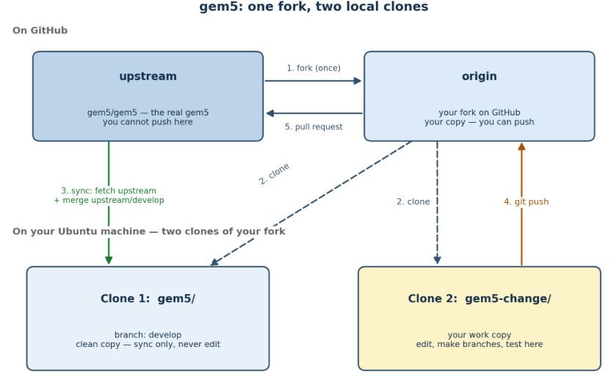
27.3 Sync Repository
https://www.youtube.com/watch?v=xbeIU-MQJJk&list=PL_hVbFs_loVR_8ntTTmmG6YEq3Po_4snu&index=27
Sync Repository (16:56 – 16:57/1:18:33)
Working alone, we have one copy and no one to coordinate with. Working in a group, ten people edit the same code at the same time. We need forks to keep everyone's work separate, syncing to stay current, and pull requests so a maintainer checks the work before it lands in the real gem5.
In the below Diagram, we have four repositories (two on GitHub and two on Local Ubuntu Machine)for gem5 development:
1. Top row: Two repositories on GitHub (the website)
  a. upstream = gem5/gem5, the real, official gem5. Everybody reads from it, but you cannot push to it.
  b. origin = Our fork on GitHub. We can push to this one.
  c. "origin" and "upstream" are just nicknames for two addresses on GitHub.
2. Bottom row: on our Ubuntu machine. We download our fork twice, into two separate folders:
  a. Clone 1, gem5/ — stays on the develop branch. This is our clean copy. You never edit code here.
  b. Clone 2, gem5-change/ — this is our work copy. You edit, make branches, and test here.

Slide 30
27.3 Sync Repository
https://www.youtube.com/watch?v=xbeIU-MQJJk&list=PL_hVbFs_loVR_8ntTTmmG6YEq3Po_4snu&index=27
Sync Repository (16:58 – 16:59/1:18:33)
In the below Diagram (Cont), we have arrows:
1. Fork (once) — on GitHub, copy the real gem5 into our account. You do this only once.
2. Clone (twice) — download our fork into the two folders on our computer.
3. Sync (green arrow) — from the real gem5 down into Clone 1: fetch upstream's new changes and merge them into develop. This is how the clean copy stays up to date.
4. Git push (brown arrow) — when our work in Clone 2 is ready, push it up to our fork on GitHub.
5. Pull request — from my fork back to the real gem5. Here, I ask the gem5 maintainers: "please take my changes."
The one idea behind the whole picture: code moves in a circle — real gem5 → our clean copy → (we work in the second copy) → our fork → back to the real gem5. And the reason for two clones is separation: one copy stays clean and current, so even if our work breaks, you always have a good copy to fall back on.

Slide 31
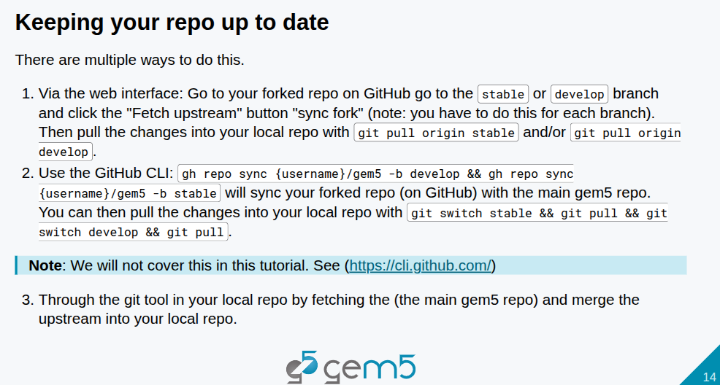
27.3 Sync Repository
https://www.youtube.com/watch?v=xbeIU-MQJJk&list=PL_hVbFs_loVR_8ntTTmmG6YEq3Po_4snu&index=27
Fork Repository (16:60 – 18:00/1:18:33)
It is really good to keep our repo (repository) up to date all the time. Our fork of develop keep up to date with the main gem5 repo (repository).
There are several ways to keep the develop update to date. Below are two ways to keep repo up to data. The gem5 is up to date with main gem5 repo.
To keep the local repo up to date:
1. GitHub click “Fetch upstream” button to “sync fork”.
> git pull origin stable / git pull origin develop
2. GitHub CLI:
> gh repo sync <user-name> / gem5 -b develop && gh repo sync
Your local report fetching the main gem5 repo and merge into our local repo.
gem5
Clone two copies
develop
(keep update to date)
develop
gem5-change
(for development modification)

Slide 32
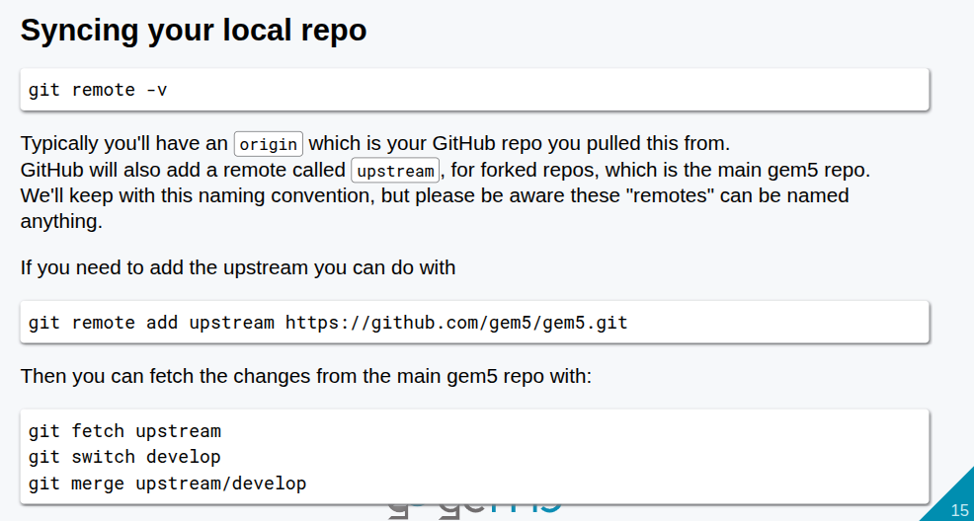
27.3 Sync Repository
https://www.youtube.com/watch?v=xbeIU-MQJJk&list=PL_hVbFs_loVR_8ntTTmmG6YEq3Po_4snu&index=27
Fork Repository (18:01 – 18:25/1:18:33)
We have remote repo origin and upstream on GitHub.
1. Add remote upstream (No code is copy. Just create a phone number)
> git remote add upstream https://github.com/gem5/gem5.git # create a phone number for GitHub
2. We get code from remote “upstream” to local “develop”
> git fetch upstream # Download code from remote “upstream” into local “upstream/develop”
> git switch develop # change to local Ubuntu machine “develop”
> git merge upstream/develop # merge code from remote “upstream” to local “develop”

Slide 33
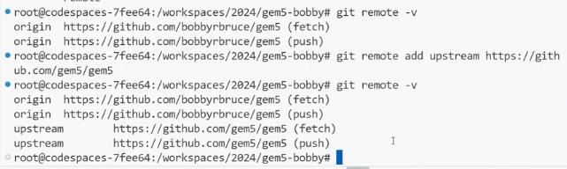
27.3 Sync Repository
https://www.youtube.com/watch?v=xbeIU-MQJJk&list=PL_hVbFs_loVR_8ntTTmmG6YEq3Po_4snu&index=27
Fork Repository (18:26 – 19:10/1:18:33)
a. > git remote -v # -v is verbose
We can see the status of remote origin: (fetch), (push)
b. We add the remote name “upstream” for gem5.git
> git remote add upstream https://github.com/gem5/gem5.git
c. > git remote -v
We can see both remote origin and upstream
Note: The above a, b, c are not in the upper-right diagram yet.
a
c
gem5
b
b. Add remote name “upstream” for gem5.git
a
develop
origin
upstream
b
c

Slide 34
27.3 Sync Repository
https://www.youtube.com/watch?v=xbeIU-MQJJk&list=PL_hVbFs_loVR_8ntTTmmG6YEq3Po_4snu&index=27
Fork Repository (19:11 – 19:12/1:18:33)
Now, we fetch the changes:
a. git fetch upstream: downloads the new refs from the real gem5 repo into the local clone's upstream/* refs.
b. git switch develop — moves the clone onto the local develop branch. Evidence: "Switched to branch 'develop'".
c. git merge upstream/develop — merges the freshly fetched upstream/develop into the now-current develop branch.

Slide 35
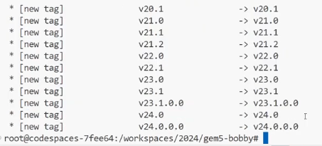
27.3 Sync Repository
https://www.youtube.com/watch?v=xbeIU-MQJJk&list=PL_hVbFs_loVR_8ntTTmmG6YEq3Po_4snu&index=27
Fork Repository (19:13 – 19:15/1:18:33)
> git fetch upstream
>> * [new tag] v20.1 -> v20.1
>> ...
gem5
> git fetch upstream
origin
upstream

Slide 36
27.3 Sync Repository
https://www.youtube.com/watch?v=xbeIU-MQJJk&list=PL_hVbFs_loVR_8ntTTmmG6YEq3Po_4snu&index=27
Fork Repository (19:16 – 19:18/1:18:33)
> git switch develop
>> switch to branch ‘develop’
>> Your branch is up to date with ‘origin/develop’
gem5
> git switch develop
origin
upstream
develop
gem5-change

Slide 37
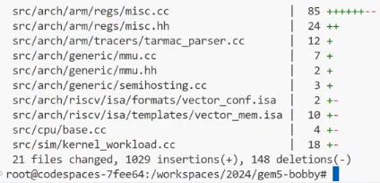
27.3 Sync Repository
https://www.youtube.com/watch?v=xbeIU-MQJJk&list=PL_hVbFs_loVR_8ntTTmmG6YEq3Po_4snu&index=27
Fork Repository (19:19 – 19:40/1:18:33)
> git merge upstream/develop
>> switch to branch ‘develop’
>> Your branch is up to date with ‘origin/develop’
gem5
origin
upstream
> git merge upstream/develop
develop
gem5-change

Slide 38
End

