Slide 1

1.1 Computer Architecture Simulator
Peter H. Chen

Slide 2
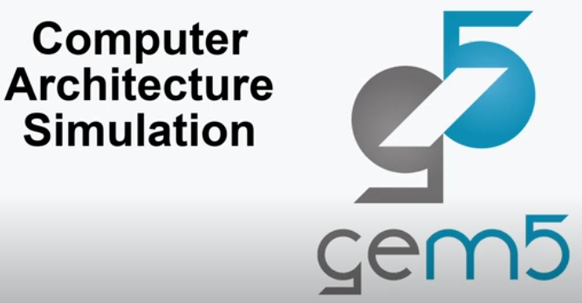
1.1 Computer Architecture Simulator
https://www.youtube.com/watch?v=6ThcR6jKwkc&list=PL_hVbFs_loVR_8ntTTmmG6YEq3Po_4snu
Computer Architecture Simulator (0:00-0:13/34:40)
We talked about the General Computer Architecture Simulation with Gem5.

Slide 3
1.2 Topics

Slide 4
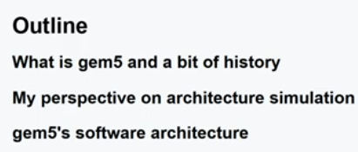
1.2 Topics
https://www.youtube.com/watch?v=6ThcR6jKwkc&list=PL_hVbFs_loVR_8ntTTmmG6YEq3Po_4snu
Topics (0:14-0:32/34:30)
1. What is Gem5 and Gem5 history?
2. Perspective of Computer Architecture Simulation
3. Gem5 Software Architecture

Slide 5
1.3 Gem5 History

Slide 6
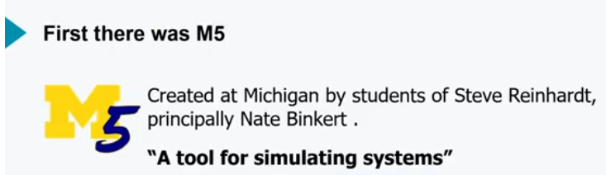
1.3 Gem5 History
https://www.youtube.com/watch?v=6ThcR6jKwkc&list=PL_hVbFs_loVR_8ntTTmmG6YEq3Po_4snu
Gem5 History (0:33-1:04/34:30)
Gem5 come from M5.
M5 (University of Michigan Version 5) is created by Steve Reinhardt and his students, mostly by Nate Binkert.
M5 is a put together for the software simulation system since August 2011.
M5 is a a tool for simulating system.

Slide 7
End

