Slide 1

25 GPU Model (Part 01)
Peter H. Chen

Slide 2

25 GPU Model
https://www.youtube.com/watch?v=Kjd1hTFOI44&list=PL_hVbFs_loVR_8ntTTmmG6YEq3Po_4snu&index=25
GPU Model (0:00 - 0:10/2:01:30)
We discuss how to use Gem5 GPU Model.
Slides are made by Professor Matthew Sinclair, University of Wisconsin-Madison, sinclair@cs.wisc.edu.

Slide 3
25.0 Topics

Slide 4
25.0 Topics
https://www.youtube.com/watch?v=Kjd1hTFOI44&list=PL_hVbFs_loVR_8ntTTmmG6YEq3Po_4snu&index=25
GPU Model (0:10 – 0:15/2:01:30)
Below topics are summarized from Professor Matthew Sinclair at University Wisconsin
Topics:
1. Accelerator: GPU is transformed from Graphic Display Accelerator
2. GPU Threads vs CPU Memory Latency: GPU uses Parallel Threads vs. CPU Caches to handle Memory latency
3. NVIDIA CUDA/HIP vs. AMD OpenCL: Thread, Warp, Thread Block, and Kerne)l
4. GPGPU Programming Model: GPU offload the CPU in different phase (kernel).
5. GPU Hardware: GPU, Shared L2 Cache; Thread/SIMT runs inside Core with private L1 Cache, register, and DDR/HBM memory.
6. Address Coalescing vs. divergence: We want thread hit memory continuously (coalescing), we do not want divergence (memory segment discontinuously).
7. SIMT (Single Instruction, Multiple thread) Pipeline
8. AMD Matrix Core Engines vs. NVIDIA TensorCores
9. Memory system optimization: CPU optimize latency, GPU Optimize throughput.
10. CPU Cache vs. GPU Cache: CPU Cache latency reduction. GPU Cache bandwidth filtering (Prevent redundant DRAM traffic).
11. APU (Accelerated Process Unit, CPU + GPU in one chip) vs. dGPU (Discrete GPU, separated graphics card)
12. gem5 only support AMD GPU: AMD ROCm (Radeon Open Compute) Stack
13. gem5 has SE (Syscall Emulation) mode simulation and FS (Full System) Mode Simulation. In GPU simulation, gem5 only fully supports FS mode.
14. gem5 simulator is too complicated, gem5 recommends users to use the docker version (download from docker hub) instead of compiling on your own.
15. checkpoint/restoration: Since gem5 simulation may take a long time (e.g., PyTorch Machine learning training, takes several days or longer). gem5 users can put the checkpoint after the workloads (setup time for kernel, parameters configuration for cache/memory, etc.).
We want to do the workloads once. Then, we skip the checkpoint/restore the configuration and start simulation after the restoration to the same run time.
16. Run PyTorch FS Mode
17. Run PyTorch example of MNIST (Modified National Institute Standards and Technology) dataset.
18. Run nanoGPT (Smaller chatGPT) Example.

Slide 5
25.1 Disclaim/Contributor

Slide 6
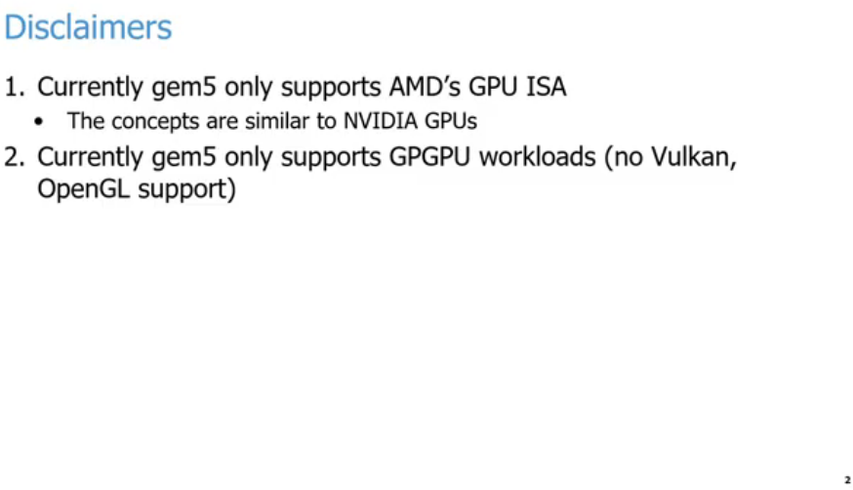
25.1 Disclaim/Contributor
https://www.youtube.com/watch?v=Kjd1hTFOI44&list=PL_hVbFs_loVR_8ntTTmmG6YEq3Po_4snu&index=25
Disclaim: AMD GPU ISA (0:16 - 2:14/2:01:30)
Right now, Gem5 only support AMD GPU/ISA and a little to ARM. But mostly in AMD GPU.
The concepts are similar to other companies, such as, NVIDIA GPU.
We also talks about the general purpose GPU or GPGPU workloads. There is no support for OpenGL or Vulcan.
If you are trying to run the true Graphics workloads. We are not going to talk that today,

Slide 7
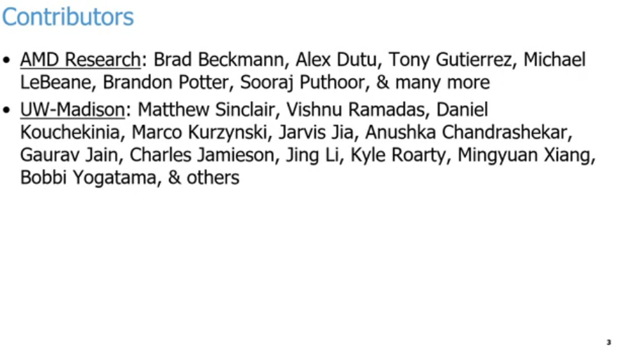
25.1 Disclaim/Contributor
https://www.youtube.com/watch?v=Kjd1hTFOI44&list=PL_hVbFs_loVR_8ntTTmmG6YEq3Po_4snu&index=25
Contributor (0:16 - 2:15/2:01:30)
Right now, Gem5 only support AMD GPU/ISA and a little to ARM. But mostly in AMD GPU.
The concepts are similar to other companies, such as, NVIDIA GPU.
We also talks about the general purpose GPU or GPGPU workloads. There is no support for OpenGL or Vulcan.
If you are trying to run the true Graphics workloads. We are not going to talk that today,

Slide 8
25.2 Setup Docker

Slide 9
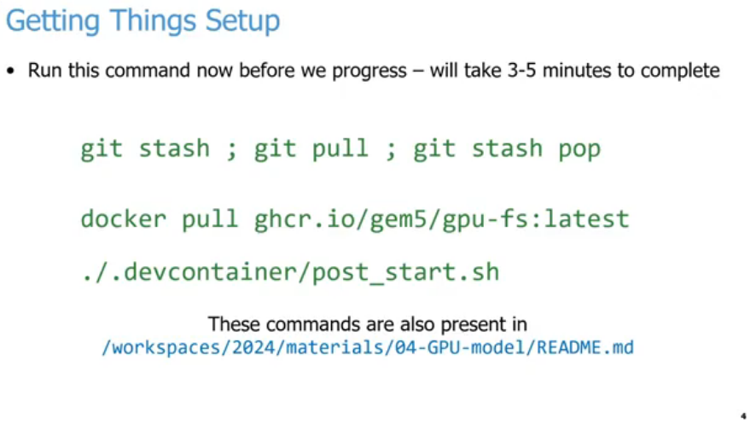
25.2 Setup Docker
https://www.youtube.com/watch?v=Kjd1hTFOI44&list=PL_hVbFs_loVR_8ntTTmmG6YEq3Po_4snu&index=25
Setup Docker (2:16 - 4:30/2:01:30)
Below is the commands to setup docker image code to run the code.

Slide 10
25.3 Programmability vs Efficiency

Slide 11
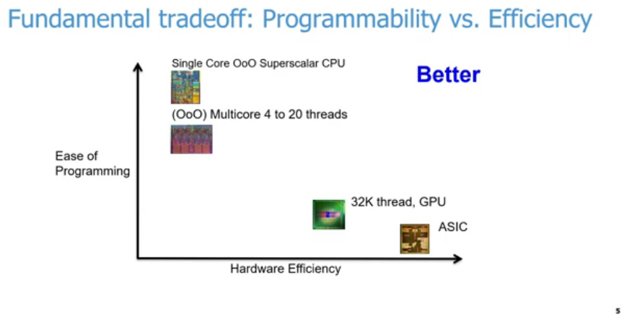
25.3 Programmability vs Efficiency
https://www.youtube.com/watch?v=Kjd1hTFOI44&list=PL_hVbFs_loVR_8ntTTmmG6YEq3Po_4snu&index=25
Programmability vs Efficiency (4:31-6:00/2:01:30)
Below diagram, we have trade-off of easy program in y-axis versus hardware efficiency in x-axis. We want to have both as much as possible but not always in agreement.
1. We have single CPU with OoO (out of order) core is the superscalar processor is easier to write our code. The compiler will compile it and run on X86, AMD, ARM, etc. We don’t need to specify optimization to get result easily. The easy of programming is very high. It is a general purpose of hardware system. We can run it for a lot of hardware. but the efficiency is low.
1
3
4
2

Slide 12
25.3 Programmability vs Efficiency
https://www.youtube.com/watch?v=Kjd1hTFOI44&list=PL_hVbFs_loVR_8ntTTmmG6YEq3Po_4snu&index=25
Programmability vs Efficiency (6:01-6:30/2:01:30)
2. On the other end of the spectrum, we have ASIC ( A specific IC). We design ASIC for specific functionality with specific hardware. The hardware efficiency is good but very difficult to write the program. The easy of programming will be very low. We have to write assembly (simpler if provided) or analog accelerator to tune up hardware wires (very complicated).
1
3
4
2

Slide 13
25.3 Programmability vs Efficiency
https://www.youtube.com/watch?v=Kjd1hTFOI44&list=PL_hVbFs_loVR_8ntTTmmG6YEq3Po_4snu&index=25
Programmability vs Efficiency (6:31-6:50/2:01:30)
3. In the middle of the spectrum is OoO (Out of Order) Multicore CPUs with 4 to 20 threads. Now, we have to write the CPU code to harness for parallelism. We have better hardware efficiency tan single threaded core OoO CPU in code parallelism.
1
3
4
2

Slide 14
25.3 Programmability vs Efficiency
https://www.youtube.com/watch?v=Kjd1hTFOI44&list=PL_hVbFs_loVR_8ntTTmmG6YEq3Po_4snu&index=25
Programmability vs Efficiency (6:51-7:40/2:01:30)
4. GPUs fall at somewhere on the other end of below diagram. We can have thousands, millions, billions, etc. of threads running in parallel. The hardware efficiency is better than those CU based solutions but they will not reach the level of ASIC. The programming of GPUs will be harder than a CPU.
In GPUs. we need to think of thousands, millions, billions, etc. threads.
In the CPU, the threads is only at maximum of 64 threads.
In GPUs, we have more magnitude or more concurrency to think than CPU. The trade off is between the harder of write code and better hardware efficiency.
1
3
4
2

Slide 15
25.4 Accelerator

Slide 16
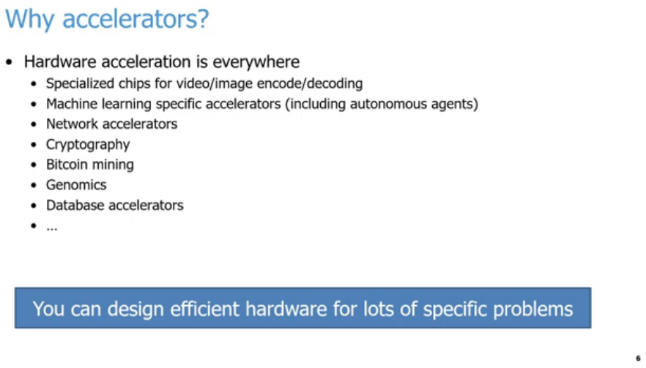
25.4 Accelerator
https://www.youtube.com/watch?v=Kjd1hTFOI44&list=PL_hVbFs_loVR_8ntTTmmG6YEq3Po_4snu&index=25
Accelerator (7:41-8:10/2:01:30)
In modern day, hardware accelerators is everywhere, especially in encoding and decoding in video, image, cryptography, bitcoin, mining, genomics, database accelerator, network accelerator, machine learning accelerator, deep learning accelerator, Large Language Model accelerator, etc. This is the first reason why we use accelerators.
Computer Architecture: A Quantitative Approach”, John L. Hennessy and David A. Patterson: “We are in golden age of architecture where we can design efficient hardware for lots of specific problems.”

Slide 17
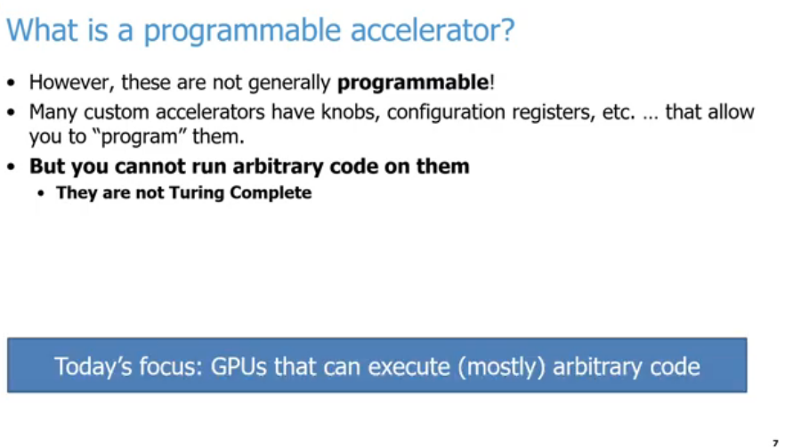
25.4 Accelerator
https://www.youtube.com/watch?v=Kjd1hTFOI44&list=PL_hVbFs_loVR_8ntTTmmG6YEq3Po_4snu&index=25
Accelerator (8:11-8:40/2:01:30)
In general, most of the accelerators are not programmable.
These accelerators programming includes custom knobs, configurations registers, etc. that allow you to program them in some abstract sense.
In general, the accelerators will not run arbitrary code.
Today, we focus a special kind of accelerator, CPUs. We focus on how to run mostly arbitrary code on accelerator, GPUs.

Slide 18
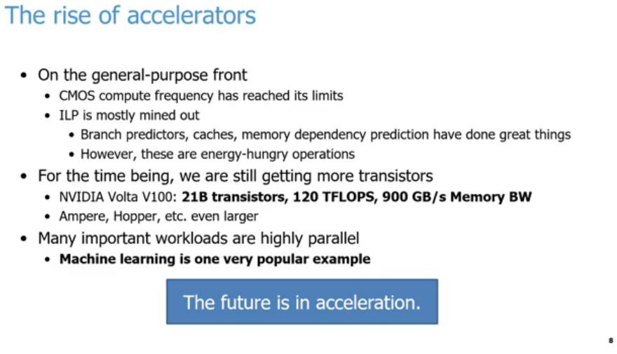
25.4 Accelerator
https://www.youtube.com/watch?v=Kjd1hTFOI44&list=PL_hVbFs_loVR_8ntTTmmG6YEq3Po_4snu&index=25
Accelerator (8:41-9:40/2:01:30)
The second reason why accelerators are becoming so prominent.
1. On the general purpose front end CPU, CMOS compute frequency has reached its limit. We don’t see Intel and AMD really can scaling frequency anymore in the past 10-20 years. The CPU frequency is 1, 2, 4 GHz. They cannot run faster.
2. ILP (Instruction Level Parallelism) is almost dig out their capability for CPU to improve the performance. ILP does a lot of jobs, such as, branch predictors, cache, memory dependency prediction, etc. ILP is a wide variety of techniques to help CPU performance. ILP have done great jobs but ILP are also energy hungry operations.
1
2
3
4
5

Slide 19
25.4 Accelerator
https://www.youtube.com/watch?v=Kjd1hTFOI44&list=PL_hVbFs_loVR_8ntTTmmG6YEq3Po_4snu&index=25
Accelerator (9:41-10:20/2:01:30)
3. Now, we are still get more transistors for Moore’s law. We have NVIDIA GPU continue to grow in billions of transistors, Tera FLOPS of performance, and Terabyte of bandwidth per second.
4. The reason why workloads are highly parallel
5. The reason why accelerator works so well is the workloads are matrix computation. The matrix computation can be paralleled by high speed hardware logic (such as, adder, subtractor, multiplier, and divider) to replace slow software matrix computation. Machine learning, deep learning, and LLM (Large Language Model) are primary reason in recent years.
1
2
3
4
5

Slide 20
25.5 GPU

Slide 21
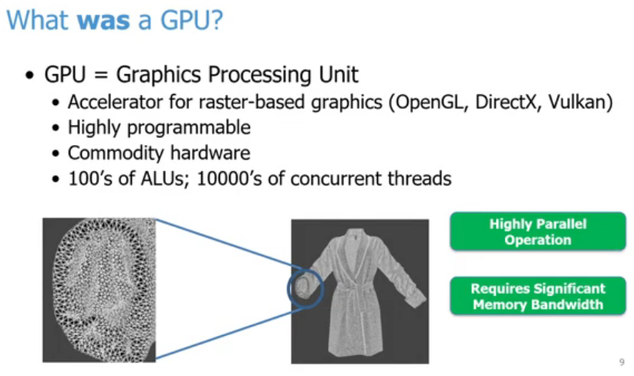
25.5 GPU
https://www.youtube.com/watch?v=Kjd1hTFOI44&list=PL_hVbFs_loVR_8ntTTmmG6YEq3Po_4snu&index=25
GPU (10:21-11:10/2:01:30)
Machine learning began in the 1950s, the commercial GPU was launched in 1999 by NVIDIA GeForce 256, and combining them started around 2004–2006.
In 2012, a famous image-recognition computer model called AlexNet used GPUs to win a major contest. This big win proved how well GPUs worked for deep learning and started the modern AI boom.

Slide 22
25.5 GPU
https://www.youtube.com/watch?v=Kjd1hTFOI44&list=PL_hVbFs_loVR_8ntTTmmG6YEq3Po_4snu&index=25
GPU (11:01-12:15/2:01:30)
GPU (Graphics Processing Unit) is original designed for accelerator for raster based graphics, such as, OpenGL, Direct, Vulkan, etc.
GPU is highly programmable and can use commodity (商品) hardware
GPU is different from CPU. GPU is dedicated for hardware logic computation with hundreds of ALU and tens of thousands of concurrent threads. CPU allows us in game, Pixar, and movie.
For example, in 1990s, we started to draw independent and highly parallel triangle with big bandwidth of memory for any objects. The movie Toy Story uses a lot of rasterization for image and pictures.

Slide 23
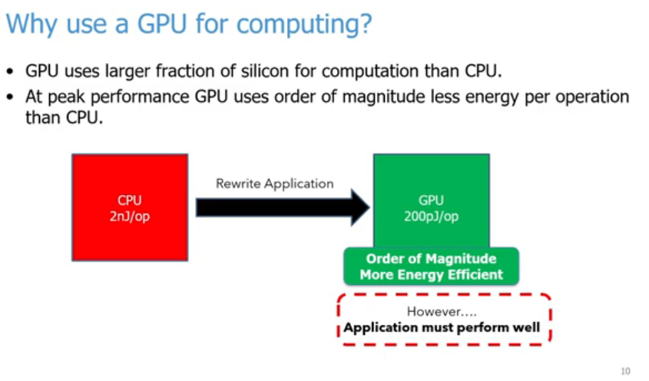
25.5 GPU
https://www.youtube.com/watch?v=Kjd1hTFOI44&list=PL_hVbFs_loVR_8ntTTmmG6YEq3Po_4snu&index=25
Why Use GPU for Computing? (12:16 - 13:30/2:01:30)
GPU implement silicon hardware (adder, subtractor, multiplier, divider) computation to replace CPU software computation.
1. GPU has larger hardware silicon for computation than CPU.
2. GPU has less energy consumption than CPU.
3. We have to rewrite the code from CPU to GPU.

Slide 24
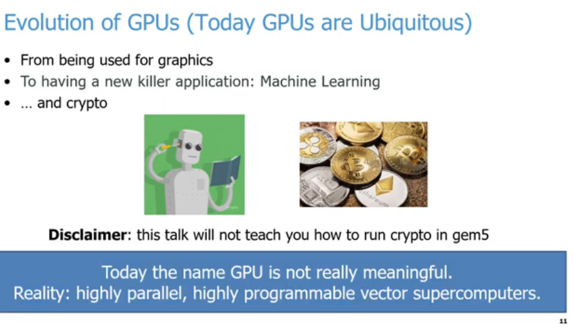
25.5 GPU
https://www.youtube.com/watch?v=Kjd1hTFOI44&list=PL_hVbFs_loVR_8ntTTmmG6YEq3Po_4snu&index=25
Evolution (13:31-15:50/2:01:30)
Today, GPU are Ubiquitous (existed everywhere). GPU is switched from graphics processing into killer AI applications, such as, Mathematical ML (Machine Learning), Neural Network DL (Deep Learning), LLM (Large Language Model), Crypto, Bitcom mining, etc.
In gem5, we will not talk about how to run ML, DL, LLM, Crypto, etc.
Nowadays, GPU are widely used in highly parallel, highly programmable vector computations in entire AI worlds.

Slide 25
25.6 Objective and Outline

Slide 26
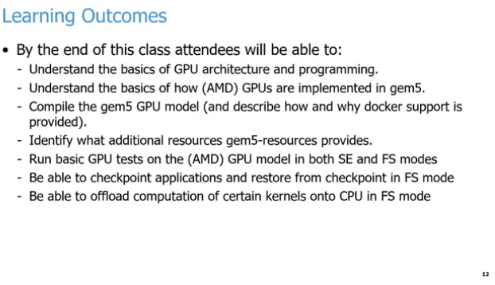
25.6 Objective and Outline
https://www.youtube.com/watch?v=Kjd1hTFOI44&list=PL_hVbFs_loVR_8ntTTmmG6YEq3Po_4snu&index=25
Objective (15:51-16:50/2:01:30)
We will discuss:
1. GPU architecture and GPU programming
2. AMD GPUs implemented in Gem5.
3. Compile Gem5 GPUs Model
4. Gem5 resources
5. GPU Model in SE (Standard edition) and FS (Full System) mode.
6. Checkpoint for applications and restore
7. Offload computation of kernels on CPU.
Using FS (Full System) mode, we can run MNIST (Modified National Institute Standard and Technology) or Nano-GPT (Generative Pre-Trained Transformer) Simulation in GPU model.

Slide 27
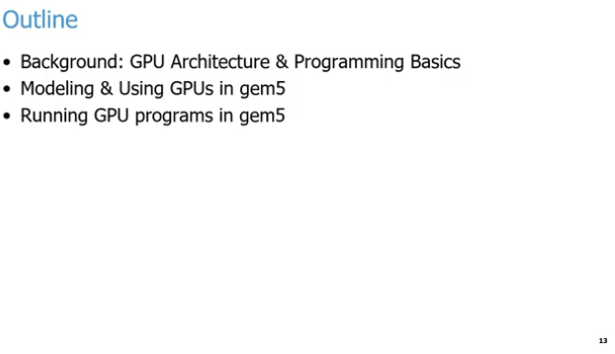
25.6 Objective and Outline
https://www.youtube.com/watch?v=Kjd1hTFOI44&list=PL_hVbFs_loVR_8ntTTmmG6YEq3Po_4snu&index=25
Outline (15:51-17:00/2:01:30)
We discuss the following:
1. GPU Architecture and Programming
2. Gem5 GPU modeling
3. Run Gem5 GPU program

Slide 28
25.7 Parallelism

Slide 29
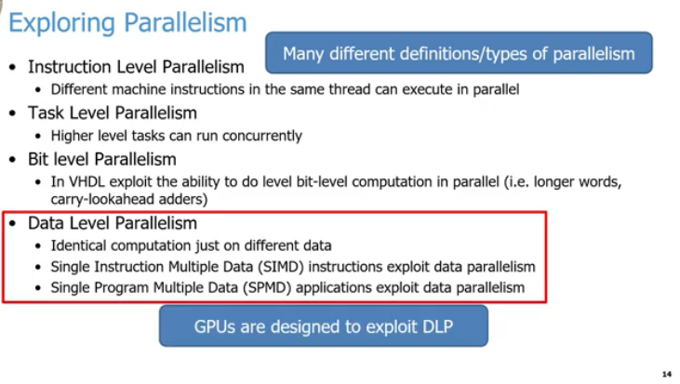
25.7 Parallelism
https://www.youtube.com/watch?v=Kjd1hTFOI44&list=PL_hVbFs_loVR_8ntTTmmG6YEq3Po_4snu&index=25
Parallelism Type (17:01-18:15/2:01:30)
Instruction parallelism is very popular in CPU.
1. Instruction Level Parallelism: If we have different instructions (usually assembly or machine code instructions) are running in the same thread but can be executed in parallel without affecting the correctness of our program. This is Intel, AMD, ARM, etc have been exploiting for 30 years.
2. Task Level Parallelism: We have several tasks running in parallel at the same time. This is Microsoft, Google, etc. do their different queries, such as, when users take a food picture in restaurant and ask to translate a menu. The requests running concurrently for more efficiency in the cloud and figure out the users want.
5
1
2
3
4
6

Slide 30
25.7 Parallelism
https://www.youtube.com/watch?v=Kjd1hTFOI44&list=PL_hVbFs_loVR_8ntTTmmG6YEq3Po_4snu&index=25
Parallelism Type (19:46 - 19:55/2:01:30)
3. Bit Level Parallelism: For Verilog (Verification and Logic) or VHDL (Very High Speed IC Hardware Description Language), we can run bits computation for parallel. We can do the parallel for longer word pr carry look-ahead in adders.
4. Data Level Parallelism: When we do the same computation across many different threads with different data for each of the threads. For example, we can have thread A and thread B to do the addition, each thread add different address from memory. We can load these addresses concurrently and then add them concurrently. We have Data Level Parallelism for SIMD (Single Instruction Multiple Data), SIMT (Single Instruction Multiple Threads) for GPU, or SPMD (Single Program Multiple Data). No matter SIMD or SIMT, the data can be operated in concurrent instructions identically. They just need to instruction fetching and instruction decoding and run parallel in threads to do the addition.
5
1
2
3
4
6

Slide 31
25.7 Parallelism
https://www.youtube.com/watch?v=Kjd1hTFOI44&list=PL_hVbFs_loVR_8ntTTmmG6YEq3Po_4snu&index=25
Parallelism Type (18:16 - 19:45/2:01:30)
5. There are many different definitions/types of parallelism.
6. Among the parallelism types, the most important is DLP (Data Level Parallelism).
Key point of GPUs are design to exploit DLP (Data Level Parallelism): SIMD (Single Instruction Multiple Data), SIMT (Single Instruction Multiple Threads), SPMD (Single Program Multiple Data).
5
1
2
3
4
6

Slide 32
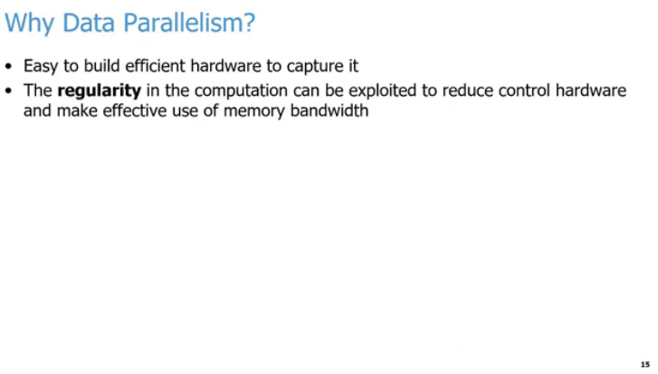
25.7 Parallelism
https://www.youtube.com/watch?v=Kjd1hTFOI44&list=PL_hVbFs_loVR_8ntTTmmG6YEq3Po_4snu&index=25
Data Parallelism (19:46 - 20:30/2:01:30)
We might wonder why mention the Data Parallelism?
When we done with fetching and decoding instructions, it is easy to build efficient hardware for compute the same data.
We don’t need to fetched and decode the instructions again and again.
We do the same fetched/decoded instructions for different data for parallelism.
We can reduce the logic for the regularity of computation. We need for fetching, decoding, logic controlling, logic branches, etc. We can uses more resources, for example, more memory bandwidth, more ALUs, etc. to process more data computation.

Slide 33
25.8 Parallelism Execution Model

Slide 34
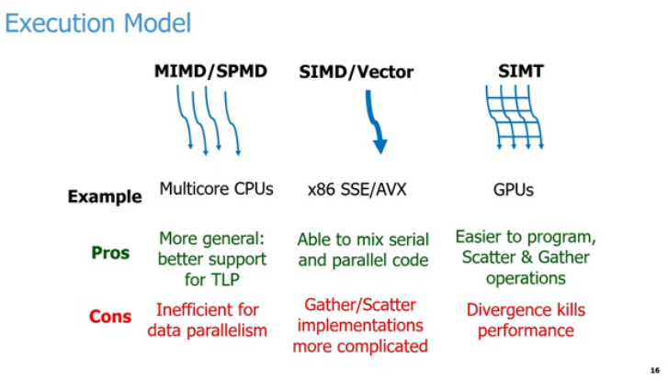
25.8 Parallelism Execution Model
https://www.youtube.com/watch?v=Kjd1hTFOI44&list=PL_hVbFs_loVR_8ntTTmmG6YEq3Po_4snu&index=25
Parallelism Execution Model (20:31-20:32/2:01:30)
Below, we compares three parallel computing execution models by their examples, advantages, and disadvantages.
1. MIMD / SPMD Example: Multicore
  a. CPUs. Pro: Better support for Thread-Level Parallelism (TLP).
  b. Con: Inefficient for data parallelism.
2. SIMD / Vector Example: x86 SSE (Streaming SIMD Extension)/AVX (Advanced Vector Extension) extensions:
  a. Pro: Blends serial and parallel code execution easily.
  b. Con: Complicated Gather and Scatter hardware implementations.
3. SIMT (Single Instruction Multiple Threads) Example: Graphics Processing Units (GPUs).
  a. Pro: Built-in support for Gather and Scatter operations.
  b. Con: Thread divergence heavily degrades performance.

Slide 35
25.8 Parallelism Execution Model
https://www.youtube.com/watch?v=Kjd1hTFOI44&list=PL_hVbFs_loVR_8ntTTmmG6YEq3Po_4snu&index=25
Terminology: Thread Divergence (20:33-20:34/2:01:30)
Thread divergence occurs in SIMT (GPUs) when threads inside the same execution block (warp or wavefront) take different paths during a conditional statement (if-else).
Because hardware executes the exact same instruction across all threads simultaneously, it cannot run different paths at the same time.
1. How It Works?
  a. The Problem: An if-else branch splits the threads.
  b. The Execution: The GPU serializes the execution paths.
  c. The Penalty: It runs the if path while disabling else threads.
  d. The Flip: It runs the else path while disabling if threads.
  e. The Impact: Total execution time doubles, cutting efficiency in half.
2. Visual Example: Imagine 4 threads executing a conditional block:
> If (thread_id % 2 == 0) {
> Do Path A;
> } else {
> Do Path B;
> }
3. Use code with caution.
  a. Step 1: Threads 0 and 2 execute Path A. Threads 1 and 3 sit idle.
  b. Step 2: Threads 1 and 3 execute Path B. Threads 0 and 2 sit idle.
4. How to Fix It?
  a. Avoid branching: Minimize deep if-else structures inside GPU kernels.
  b. Sort data: Group similar data together so adjacent threads take identical paths.
  c. Use math: Replace branches with mathematical operations or predication when possible.

Slide 36
25.8 Parallelism Execution Model
https://www.youtube.com/watch?v=Kjd1hTFOI44&list=PL_hVbFs_loVR_8ntTTmmG6YEq3Po_4snu&index=25
Terminology: Gather and Scatter (20:35-20:36/2:01:30)
1. Gather and Scatter are memory operations used in parallel computing to handle data that is scattered across different, non-contiguous locations in memory. They allow parallel processors to read or write multiple data points simultaneously using an array of pointers or offsets.
2. The Two Operations:
  a. Gather (Read): Fetches data from multiple separate memory addresses and packages them into a single, contiguous register.
  b. Scatter (Write): Takes data from a contiguous register and writes it out to multiple separate memory addresses.
3. Conceptual Example: Imagine processing a sparse matrix or a list of specific indices (e.g., pulling only the even-indexed elements from a large array).
  a. Standard Memory Access: Expects data to be sequential (Index 0, then 1, then 2).
  b. Gather Operation: Can read Index 4, Index 12, and Index 97 all in a single vectorized step using an index vector [4, 12, 97].
4. Architectural Differences:
  a. SIMD / Vector (x86 SSE/AVX): Implementing Gather/Scatter in hardware is highly complex. Older or simpler SIMD extensions have to emulate these operations by generating multiple traditional serial memory requests, which creates a performance bottleneck.
  b. SIMT (GPUs): GPUs are explicitly designed with massively parallel memory controllers. They natively handle highly irregular memory addresses via "coalescing" hardware logic, making Gather/Scatter operations much more efficient.

Slide 37
25.8 Parallelism Execution Model
https://www.youtube.com/watch?v=Kjd1hTFOI44&list=PL_hVbFs_loVR_8ntTTmmG6YEq3Po_4snu&index=25
Parallelism Execution Model (21:37-23:20/2:01:30)
Below, we executed four threads. The threads can be thousands, millions, etc. with level of parallelism:
1. Multicore CPUs: MIMD (Multiple Instruction Multiple Data)/SPMD (Single Program Multiple Data):
  a. Advantage: more general and better support for TLP (Thread Level Parallelism).
  b. Disadvantage: insufficient for data parallelism.
2. Intel x86 SSE (Streaming SIMD Extension)/AVX (Advanced Vector Extension): SIMD (Single Instruction Multiple Data)/Vector:
  a. Advantage: can mix serial and parallel code for thick threads (128 or 256 bits/bytes).
  b. Disadvantage: too complicate for Gather (memory read) and Scatter (memory write) implementation for thick thread (128 or 250 bit/bytes).
3. GPUs: SIMT (Single Instruction Multiple threads):
  a. Advantage: easy to program and easy to do Gather (memory read) and Scatter (memory write) operation for thick threads.
  b. Disadvantage: hardware cannot run divergence (logic in different paths) at the same time. The performance will go down.

Slide 38
25.9 GPU Thread vs Memory Latency

Slide 39
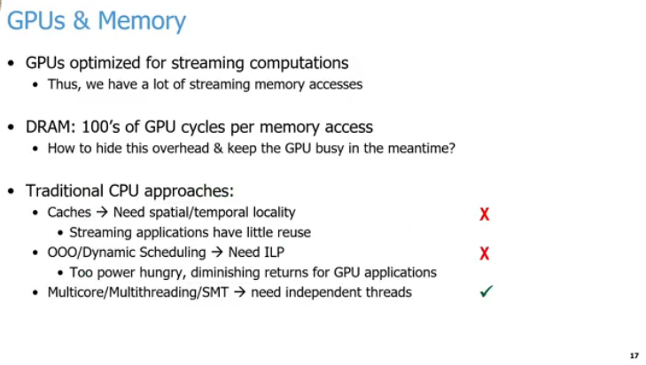
25.9 GPU Thread vs CPU Memory Latency
https://www.youtube.com/watch?v=Kjd1hTFOI44&list=PL_hVbFs_loVR_8ntTTmmG6YEq3Po_4snu&index=25
GPU Thread vs CPU Memory Latency (23:21-24:20/2:01:30)
1. GPUs use a lot of efficient hardware resource to do tasks in parallel.
The concurrent tasks are optimized for streaming computation.
There a lot of memory accesses going through the memory subsystem at the same time.
2. The main memory or DRAM will take hundreds of CPU cycles to do the memory access.
The CPU will wait of cycles for GPU to finish their work and data to come back.
1
2
3
a
b
c

Slide 40
25.9 GPU Thread vs CPU Memory Latency
https://www.youtube.com/watch?v=Kjd1hTFOI44&list=PL_hVbFs_loVR_8ntTTmmG6YEq3Po_4snu&index=25
GPU Thread vs CPU Memory Latency (24:21-25:50/2:01:30)
3. Traditional CPU vs GPU approaches:
  a. The CPU has problem in cache, The cache need spatial (空間的) or temporal (時間的) locality. The problem of these workloads for GPUs are streaming meaning that they are not reuse data. GPU does not have spatial and temporal locality. So cache in the CPU does not work.
  b. CPU use OOO (Out of Order) or Dynamic Scheduling to exploit ILP (Instruction Level Parallelism): CPU identify the independent instruction within a thread that can reorder to help hide that delay. GPU does not have a lot of independent instructions to reorder and implement this kind of behavior. The CPU reorder need power hungry and does not work for GPU task.
1
2
3
a
b
c

Slide 41
25.9 GPU Thread vs CPU Memory Latency
https://www.youtube.com/watch?v=Kjd1hTFOI44&list=PL_hVbFs_loVR_8ntTTmmG6YEq3Po_4snu&index=25
GPU Thread vs CPU Memory Latency (24:21-25:50/2:01:30)
3. Traditional CPU vs GPU approaches:
  c. GPU uses Multicore, SMT (Simultaneously Multi-threading), or Multi-threading: GPU run multi-thread in the same time and let long latency operation. At that point, GPU switch to another thread to do the work. That work very well since the GPU has thousand or million of threads. The thread with long memory latency have no big deal since the rest of 999,999 threads will find one of them to do the rest tasks. So millions of threads will hide the memory latency.
1
2
3
a
b
c

Slide 42
25.10 Multicore/Multithreading/SMT

Slide 43
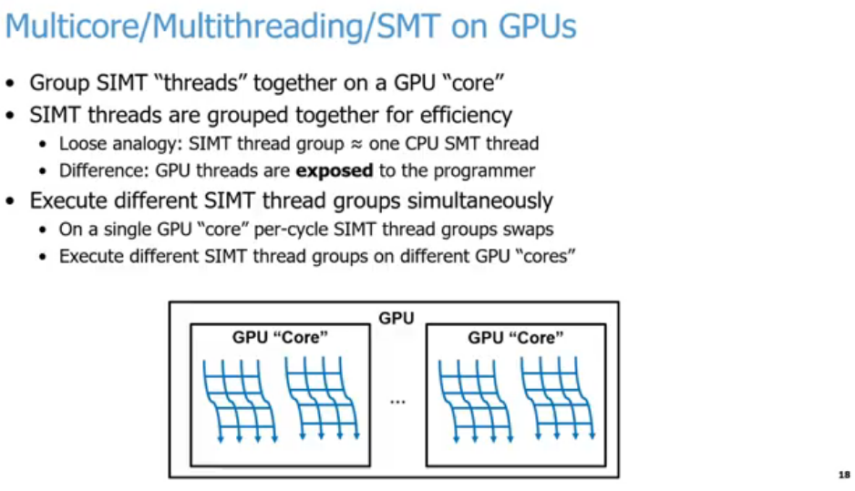
25.10 Multicore/Multithreading/SMT
https://www.youtube.com/watch?v=Kjd1hTFOI44&list=PL_hVbFs_loVR_8ntTTmmG6YEq3Po_4snu&index=25
Multicore/Multithreading/SMT (25:51-25:52/2:01:30)
Core Aggregation:
  Multiple SIMT "threads" are bundled together to run on a single physical GPU "core" (Streaming Multiprocessor).
CPU vs. GPU SMT:
  A GPU SIMT thread group functions roughly like a single CPU SMT thread.
  Unlike CPU hardware threads, GPU SIMT threads are explicitly exposed to the programmer (e.g., as warps or wavefronts).
Simultaneous Execution:
  Intra-core: A single GPU core can context-switch or swap SIMT thread groups every clock cycle to hide latency.
  Inter-core: Different SIMT thread groups run across completely different physical GPU cores concurrently.

Slide 44
25.10 Multicore/Multithreading/SMT
https://www.youtube.com/watch?v=Kjd1hTFOI44&list=PL_hVbFs_loVR_8ntTTmmG6YEq3Po_4snu&index=25
Multicore/Multithreading/SMT (25:53-26:30/2:01:30)
We design architecture around the threads parallelism idea.
1. We can group those millions of threads into subgroups to run on GPU. Each subgroup is called a GPU “core”. We will discuss more GPU “core” later on. The CPU core and GPU “core” are different. Their behavior are different.
2. One group of SIMT (Single Instruction Multiple Threads) running on GPU is approximately equal to one SMT (Simultaneously Multi-Thread) running on CPU.
For example, CPU with four cores. Each core can run two threads. We can running 8 thread concurrently on our CPU. Any one of the eight threads is loosely (not exactly, CPU is heavy weight and GPU is light weight) logically equivalent to one thread group run on GPU.
The key difference is GPU threads are exposed to the programmer. We can see a single one of them run on GPU.
1
2
3

Slide 45
25.10 Multicore/Multithreading/SMT
https://www.youtube.com/watch?v=Kjd1hTFOI44&list=PL_hVbFs_loVR_8ntTTmmG6YEq3Po_4snu&index=25
Multicore/Multithreading/SMT (26:31-27:40/2:01:30)
3. The programmer can run CPU SIMT (Single Instruction Multiple Threads) in GPU thread group simultaneously.
In Thread groups, we can switch between those thread groups at per cycle basis.
We also can start CPU SIMT in GPU thread group on different GPU “core”.
Below, we have two GPU “Core” to run CPU SIMT or GPU SMT in the thread groups.
1
2
3

Slide 46
25.11 GPU Component

Slide 47
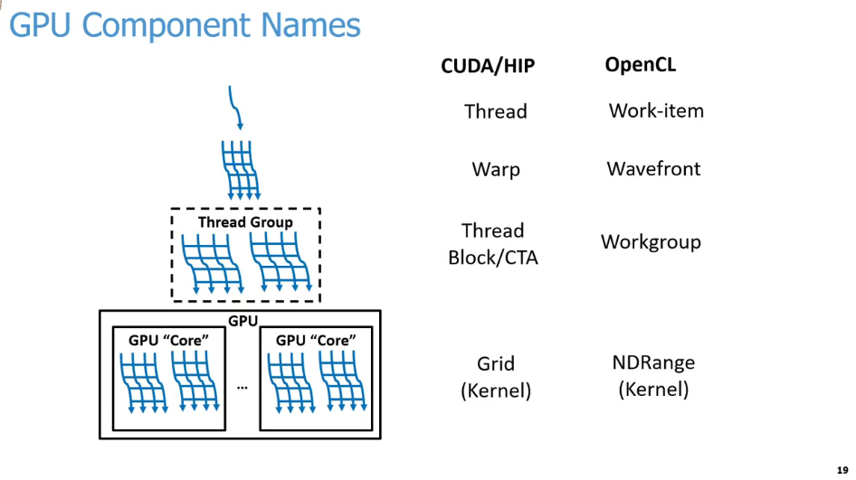
25.11 GPU Component
https://www.youtube.com/watch?v=Kjd1hTFOI44&list=PL_hVbFs_loVR_8ntTTmmG6YEq3Po_4snu&index=25
GPU Component (27:41-27:42/2:01:30)
Below is a comparison terminology between NVIDIA CUDA (Compute Unified Device Architecture), AMD HIP (Heterogeneous Interface for Portability), and Google OpenCL (Open Computing Language).
CUDA or HIP | OpenCL | Description
Thread | Work-Item | 1. The smallest unit of execution. 2. Executes a single instance of a kernel.
Warp | Wavefront | 1. A collection of threads/work-items executed physically in lockstep. 2. Typically consists of 32 threads in CUDA or 32/64 work-items in OpenCL.
Thread Block/ CTA (Cooperative Thread Array) | Workgroup | 1. A logical grouping of threads/work-items. 2. Executes on a single GPU compute unit, SM 9streaming Multi-process or CU (Compute Unit). 3. Shares local memory and synchronization resources.
Grid [Kernel] | NDRange (N-Dimensional Range) [Kernel] | 1. The entire execution space for a given program launch. 2. Encompasses all blocks/workgroups scheduled across the entire GPU.

Slide 48
25.11 GPU Component
https://www.youtube.com/watch?v=Kjd1hTFOI44&list=PL_hVbFs_loVR_8ntTTmmG6YEq3Po_4snu&index=25
GPU Component (27:43-28:30/2:01:30)
Below, we assign the name of each GPU components for GPU Programming Language, such as, CUDA, HIP, or OpenCL.
1. A single Thread within those SIMT threads: In CUDA and HIP, the SIMT threads are calls a thread. OpenCL calls a Work-Item.
2. A group of SIMT threads: In CUDA and Hip, the group SIMT threads call Warp. OpenCL calls Wavefront.
3. Multiple groups of threads that logically run together: CUDA and HIP call Thread Block/CTA (Cooperate Thread Array). OpenCL calls Workgroup.
1
2
3
4

Slide 49
25.11 GPU Component
https://www.youtube.com/watch?v=Kjd1hTFOI44&list=PL_hVbFs_loVR_8ntTTmmG6YEq3Po_4snu&index=25
GPU Component (28:31-28:50/2:01:30)
4. All those groups of threads running across all of the cords concurrently: CUDA and HP call Grid running (launched with) a kernel. OpenCL calls NDRange (D-Dimensional Range) running (launched with) a kernel.
Note: When Grid launch with kernel, the Grid contains the parent and child relationship.
In GPU programming, when people talk about Thread, Warp, Thread Block/CTA, Grid, etc. They talk those abstract concept which mapping to the hardware architecture in specific documentation.
1
2
3
4

Slide 50
25.12 GPU Programming

Slide 51
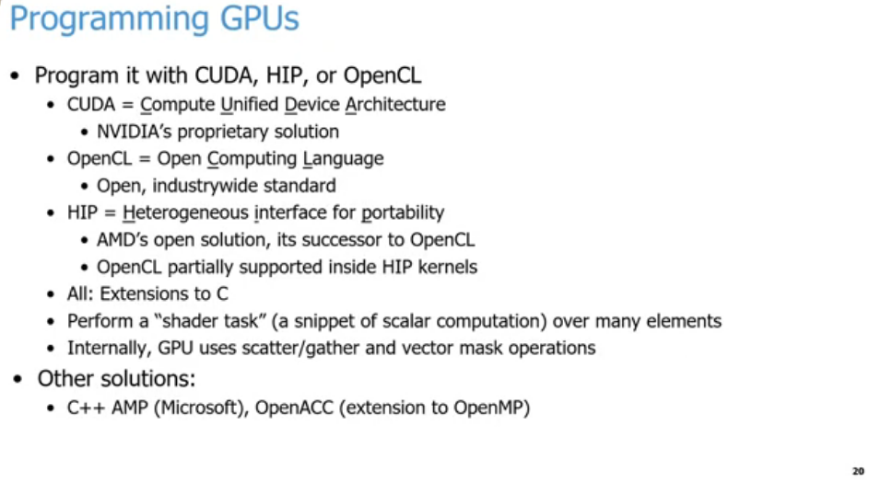
25.12 GPU Programming
https://www.youtube.com/watch?v=Kjd1hTFOI44&list=PL_hVbFs_loVR_8ntTTmmG6YEq3Po_4snu&index=25
GPU Programming (28:51-29:40/2:01:30)
Program GPU:
1. NVIDIA provides CUDA (Compute Unified Device Architecture). CUDA is NVIDIA’s GPU programming language.
2. AMD provides HIP (Heterogeneous Interface for Portability). HIP is equivalent to CUDA.
3. Google provide OpenCL (google Open Computing Language). OpenCL is partially supported inside HIP. OpenCL is wide industry-wide standard that is technically run by Apple.
1
2
3
4
5
6
7

Slide 52
25.12 GPU Programming
https://www.youtube.com/watch?v=Kjd1hTFOI44&list=PL_hVbFs_loVR_8ntTTmmG6YEq3Po_4snu&index=25
GPU Programming (29:41 - 3 0:15/2:01:30)
4. CUDA, HIP, and OpenCL use high level programming language. They have extensions to C/C++. We can run them with C/C++ style code with vector extension to run lots of threads concurrently.
5. CUDA, HIP, and OpenCL perform a “Shader Task” or a Snippet of computation across many elements.
6. Internally, GPU uses scatter and gather and vector mask operation for every thread. The GPU will do the same thing for all the threads at a given time no matter the thread want or not.
7. We also have other solutions, such as, OpenACC and C++ Amp from Microsoft. They are not so popular today but they are around if you are interested.
1
2
3
4
5
6
7

Slide 53
25.13 GPGPU Programming Model

Slide 54
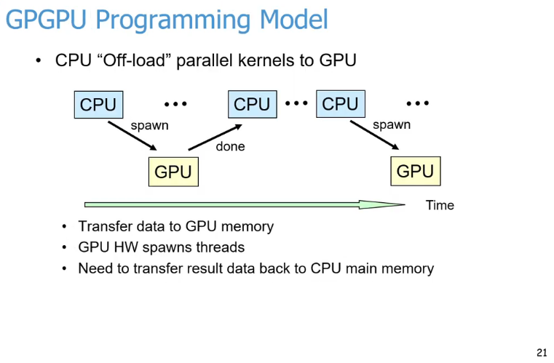
25.13 GPGPU Programming Model
https://www.youtube.com/watch?v=Kjd1hTFOI44&list=PL_hVbFs_loVR_8ntTTmmG6YEq3Po_4snu&index=25
GPGPU Programming Model (30:16-31:40/2:01:30)
What is the practice in GPU to run a program?
1. When we run a program, we offload some highly parallel piece of work from CPU to GPU.
2. We spawn this highly parallel piece of work, offload from CPU, and pass it to GPU. When GPU done the work,
3. the result come back to CPU.
4
5
6
1
2
3

Slide 55
25.13 GPGPU Programming Model
https://www.youtube.com/watch?v=Kjd1hTFOI44&list=PL_hVbFs_loVR_8ntTTmmG6YEq3Po_4snu&index=25
GPGPU Programming Model (30:41 - 3 1:15/2:01:30)
4. In the below diagram, we have CPU do some more work, and spawn another parallel piece of work, offload from CPU, and pass it to GPU, etc.
5. We have many threads need to spawn, to pass/transfer data to GPU. When GPU are done, we need to transfer all the results back to CPU.
6. What is Kernel?
Each phases of work that we offload to GPU to run. We call a Kernel. In the below diagram, each yellow box is a different kernel or a different phase of our program.
4
5
6
1
2
3

Slide 56
25.14 GPU Hardware Overview

Slide 57
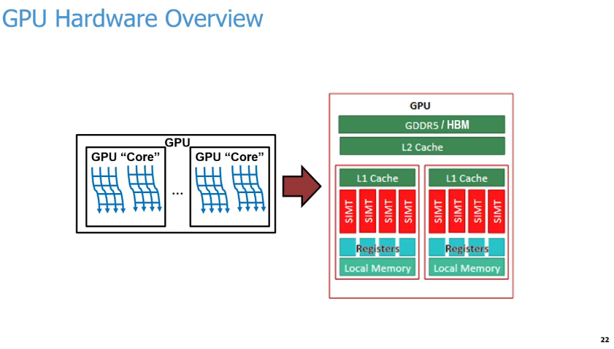
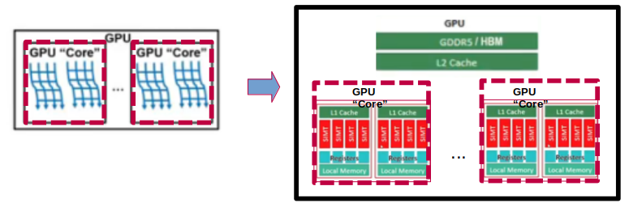
25.14 GPU Hardware Overview
https://www.youtube.com/watch?v=Kjd1hTFOI44&list=PL_hVbFs_loVR_8ntTTmmG6YEq3Po_4snu&index=25
GPU Hardware Overview (31:16-31:17/2:01:30)
Below diagram abstracts GPU processing units to their physical hardware layout.
Hardware layout Breakdown
1. GPU "Core" (Left): Represents a Streaming Multiprocessor (SM) or compute unit that executes many parallel threads simultaneously (wavy blue lines).
2. Memory Hierarchy (Right): Shows the breakdown of memory from fastest/smallest to slowest/largest:
  a. Registers & Local Memory: Dedicated directly to individual execution units.
  b. L1 Cache: Shared within a single GPU "Core" cluster.L2 Cache: Shared across all compute units on the GPU.
  c. GDDR5/HBM: The high-capacity global device memory.
3. SIMT (Single Instruction, Multiple Threads): The red blocks highlight the execution lanes that process parallel instructions.

Slide 58
25.14 GPU Hardware Overview
https://www.youtube.com/watch?v=Kjd1hTFOI44&list=PL_hVbFs_loVR_8ntTTmmG6YEq3Po_4snu&index=25
GPU Hardware Overview (31:18-32:15/2:01:30)
In GPU, we have a lot of logical cores. Each of cores runs many groups of SIMT threads concurrently.
GPU have multiple levels of memory: DDR (Double Data Rate) or HBM (High Bandwidth Memory),
CPU also have multiple levels of Cache:
L2 Shared cache across all of the compute units or cores,
L1 cache: Locally within each one of the GPU “core” that run and used by multiple ALUs. These ALUs designed to run on SIMT with very wide vectors and below picture.
We have one CPU core. Each GPU “core” have two Warps. Each Warp has one L1 Cache and four threads (SIMT).
Each GPU “Core” have a bunch of registers and local memory to run the tasks.

Slide 59
25.15 CU (Compute Unit): GPU Core

Slide 60
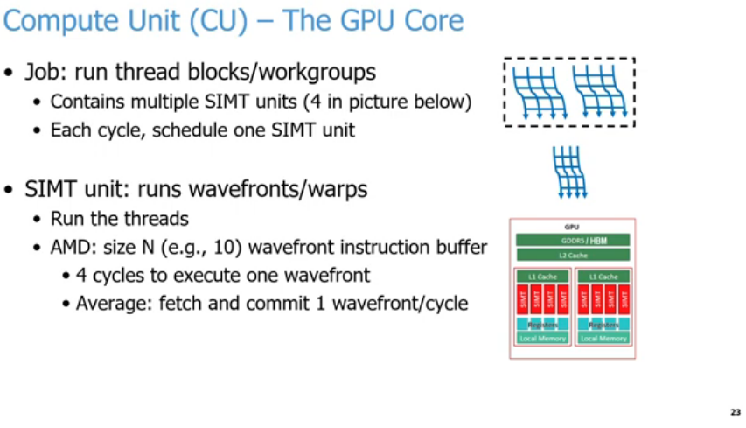

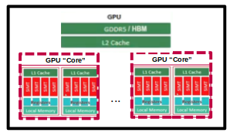
25.15 CU (Compute Unit): GPU Core
https://www.youtube.com/watch?v=Kjd1hTFOI44&list=PL_hVbFs_loVR_8ntTTmmG6YEq3Po_4snu&index=25
CU (Computer Unit): GPU Core (32:16-32:17/2:01:30)
Below slide explains the internal architecture of a Compute Unit (CU), which functions as the core of a Graphics Processing Unit (GPU).
1. Responsibilities of a Compute Unit (CU)
  a. Thread Execution: The primary job of a CU is to execute thread blocks (NVIDIA terminology) or workgroups (AMD/OpenCL terminology).
  b. Internal Components: A single CU contains multiple SIMT units (the provided diagram illustrates 4 SIMT units per CU).
  c. Scheduling: The hardware schedules exactly one SIMT unit per clock cycle.

Slide 61
25.15 CU (Compute Unit): GPU Core
https://www.youtube.com/watch?v=Kjd1hTFOI44&list=PL_hVbFs_loVR_8ntTTmmG6YEq3Po_4snu&index=25
CU (Computer Unit): GPU Core (32:18-32:19/2:01:30)
2. How a SIMT Unit Operates
  a. Target Workloads: SIMT units are responsible for running groups of threads known as wavefronts (AMD) or warps (NVIDIA).
  b. Instruction Buffering: In AMD architectures, the unit utilizes a wavefront instruction buffer of size N (e.g., capable of holding 10 instructions).
  c. Execution Latency: It requires 4 clock cycles to fully execute a single wavefront.
  d. Throughput Efficiency: Despite the 4-cycle execution latency, pipelining allows the hardware to achieve an average throughput of fetching and committing 1 wavefront per cycle.

Slide 62
25.15 CU (Compute Unit): GPU Core
https://www.youtube.com/watch?v=Kjd1hTFOI44&list=PL_hVbFs_loVR_8ntTTmmG6YEq3Po_4snu&index=25
CU (Computer Unit): GPU Core (32:20-33:00/2:01:30)
We will talk GPU components one by one. We use GPU “Core” (in quote) because it is very different from CPU Core. That is why we call GPU “Core” a computer unit. NVIDIA call GPU “Core” a SM (Streaming Multi-processor).
Regardless what terminology we use, the job to run those thread blocks or work groups in parallel on GPU “Core” underline hardware. GPU “Core” run SIMT (Single Instruction Multiple Thread) units. Every cycle will schedule something to run each one of those SIMT units.
Assume we have enough work groups. Every SIMT units job will be run in a wavefront or a warp.

Slide 63
25.15 CU (Compute Unit): GPU Core
https://www.youtube.com/watch?v=Kjd1hTFOI44&list=PL_hVbFs_loVR_8ntTTmmG6YEq3Po_4snu&index=25
CU (Computer Unit): GPU Core (33:01 - 3 3:25/2:01:30)
Every thread in the wavefront or warp to run.
AMD has size 10 of the buffer to hold the threads to run the instructions.
We assume that threads take at least 10 cycles to run inside the wavefront.
The goal to fetch and commit with average 1 wavefront/cycle to run through 1 SIMT unit.

Slide 64
25.16 Address Coalescing

Slide 65
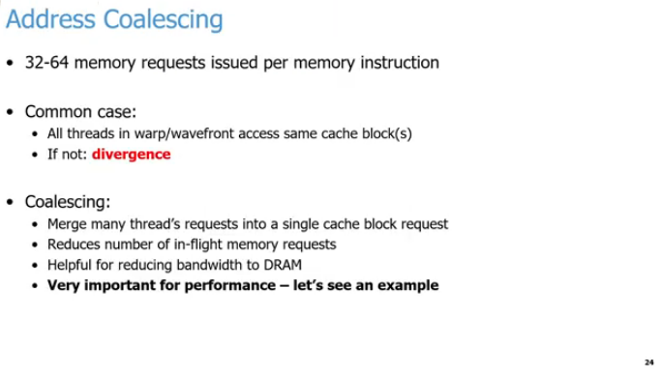
25.16 Address Coalescing
https://www.youtube.com/watch?v=Kjd1hTFOI44&list=PL_hVbFs_loVR_8ntTTmmG6YEq3Po_4snu&index=25
Address Coalescing (33:26-33:27/2:01:30)
This slide covers Address Coalescing, a critical optimization technique used by GPUs to maximize memory bandwidth during SIMT execution.
1. Memory Requests
  High Volume: A single memory instruction can issue between 32 to 64 memory requests simultaneously across a warp or wavefront.
1
2
3

Slide 66
25.16 Address Coalescing
https://www.youtube.com/watch?v=Kjd1hTFOI44&list=PL_hVbFs_loVR_8ntTTmmG6YEq3Po_4snu&index=25
Address Coalescing (33:26-33:27/2:01:30)
The Ideal Scenario vs. Divergence
  a. Common Case: Ideally, all threads within a single warp or wavefront access the exact same cache block or contiguous blocks.
  b. Memory Divergence: When threads within a warp look for widely different, scattered memory locations, it creates divergence. This forces the GPU to make multiple slow, serial memory fetches.
1
2
3

Slide 67
25.16 Address Coalescing
https://www.youtube.com/watch?v=Kjd1hTFOI44&list=PL_hVbFs_loVR_8ntTTmmG6YEq3Po_4snu&index=25
Address Coalescing (33:26-33:27/2:01:30)
Benefits of Coalescing
  a. Request Merging: It combines the independent memory demands of many individual threads into one single cache block request.
  b. Traffic Reduction: This significantly reduces the total number of in-flight memory requests actively hitting the hardware.
  c. Bandwidth Optimization: It saves massive amounts of DRAM bandwidth, making it absolutely vital for achieving high GPU performance.
1
2
3

Slide 68
25.16 Address Coalescing
https://www.youtube.com/watch?v=Kjd1hTFOI44&list=PL_hVbFs_loVR_8ntTTmmG6YEq3Po_4snu&index=25
Address Coalescing (33:28-34:20/2:01:30)
Second GPU Component here is called Address Coalescing.
Because we have same instruction to access different data, when we run those waves or run those warps, the GPU will issue a whole bunch of memory requests.
We will have thousands or millions of threads. If all of the threads issue a memory request concurrently. It will be overwhelm the memory system no matter how hard we try.
The threads in the same wavefront or in the same warp will access data in cache line over and over again.
1. Normally, the thread make 32 or 64 requests in parallel a the same time. If the threads request data is in the cache line, the thread is satisfied.
1
2
3

Slide 69
25.16 Address Coalescing
https://www.youtube.com/watch?v=Kjd1hTFOI44&list=PL_hVbFs_loVR_8ntTTmmG6YEq3Po_4snu&index=25
Address Coalescing (34:21 - 3 5:20/2:01:30)
2. If requests cannot access data cache line, we call Divergence.
3. The process we send requests for many data in parallel is called coalescing.
The job of many threads requests as many as possible in the warp or wavefront into a single cache block request. This greatly reduce the number of in-flight memory. That will save bandwidth of the DRAM that actually need it. It is very important for performance.
1
2
3

Slide 70
25.17 Memory Access

Slide 71
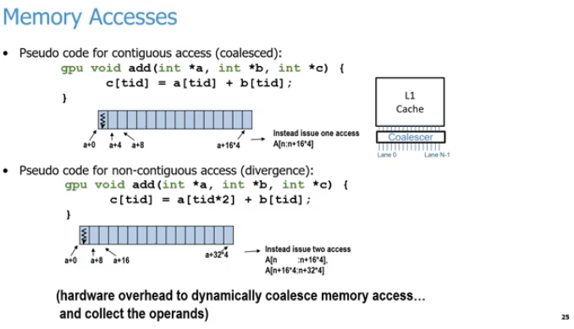
25.17 Memory Access
https://www.youtube.com/watch?v=Kjd1hTFOI44&list=PL_hVbFs_loVR_8ntTTmmG6YEq3Po_4snu&index=25
Memory Access (35:21 - 3 5:22/2:01:30)
Here is the explanation for each numbered region marked on the slide:
1. Memory Accesses: How parallel threads retrieve data from global memory.
2. L1 Cache and Coalescer Hardware:
  a. The hardware intercepts memory requests from thread lanes (Lane 0 to N-1),
  b. Combine the memory data in thread lanes (Lane 0 to Lane N-1),
  c. Put data into the cache.
1
3
2
4
5

Slide 72
25.17 Memory Access
https://www.youtube.com/watch?v=Kjd1hTFOI44&list=PL_hVbFs_loVR_8ntTTmmG6YEq3Po_4snu&index=25
Memory Access (35:23-35:24/2:01:30)
3. Contiguous (Coalesced) Access:
  a. Contiguous (Coalesced) access is the optimal execution
  b. The data is in neighboring threads.
  c. The threads access neighboring memory addresses (a+0, a+4, a+8), resulting in a single memory transaction.
1
3
2
4
5

Slide 73
25.17 Memory Access
https://www.youtube.com/watch?v=Kjd1hTFOI44&list=PL_hVbFs_loVR_8ntTTmmG6YEq3Po_4snu&index=25
Memory Access (35:25-35:26/2:01:30)
4. Non-Contiguous (Strided) Access:
  a. Non-Contiguous (Strided) Access is the non-optimal execution
  b. The thread index multipliers (tid*2) cause memory gaps (a+0, a+8, a+16)
  c. The threads splitting the request into multiple memory transactions.
1
3
2
4
5

Slide 74
25.17 Memory Access
https://www.youtube.com/watch?v=Kjd1hTFOI44&list=PL_hVbFs_loVR_8ntTTmmG6YEq3Po_4snu&index=25
Memory Access (35:27-35:28/2:01:30)
5. Hardware Penalty Note:
  Highlights the cost of poor alignment, as the GPU must use extra hardware cycles to dynamically merge spread-out requests and assemble the necessary operands.
1
3
2
4
5

Slide 75
25.17 Memory Access
https://www.youtube.com/watch?v=Kjd1hTFOI44&list=PL_hVbFs_loVR_8ntTTmmG6YEq3Po_4snu&index=25
Memory Access (35:29-38:20/2:01:30)
Below is the pseudo code that we add on GPU.
We pass in three arrays a, b, and c. They are all integers. At each tid (thread id) index, we access data of array a and array b at that tid index. Then, we add the data together and store in array c in tid index. We can see the data at tid index = 0 of arrays a, b, and c.
For coalesced case, the memory location is contiguous, integer is 4 bytes, a+0, a+4, a+8, etc. for integer array. The array elements are continuous. Thread requests take minimum cycles to access the array elements. The coalesced is efficient and has much better performance.
For divergence case, the memory has gap, he memory location is non-contiguous, a =0, a + 8, a +16, etc. There are extra 4 bytes gap in the array elements. Thread requests take longer cycles to access the array elements.
1
3
2
4
5

Slide 76
25.18 SIMT Pipeline

Slide 77
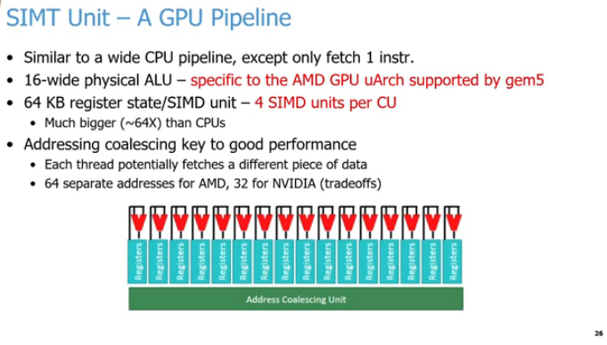
25.18 SIMT Pipeline
https://www.youtube.com/watch?v=Kjd1hTFOI44&list=PL_hVbFs_loVR_8ntTTmmG6YEq3Po_4snu&index=25
SIMT Pipeline (38:21 - 3 9:00/2:01:30)
1. SIMT Pipeline Definition
  The SIMT (Single Instruction, Multiple Threads) Unit is the core execution pipeline of a modern GPU architecture.
2. Instruction Fetch Mechanics
  a. Unlike a standard superscalar CPU pipeline that fetches multiple unique instructions per cycle, a GPU pipeline is wide but only fetches one instruction at a time.
  b. This single instruction is subsequently broadcasted down the pipeline to all active executing threads.
1
2
3
4
5
6

Slide 78
25.18 SIMT Pipeline
https://www.youtube.com/watch?v=Kjd1hTFOI44&list=PL_hVbFs_loVR_8ntTTmmG6YEq3Po_4snu&index=25
SIMT Pipeline (39:01 - 3 9:30/2:01:30)
3. ALU Execution Width
  a. All active components within the execution block operate concurrently on that same broadcasted instruction.
  b. The underlying physical execution layer relies on a 16-wide physical ALU array (specifically based on the AMD microarchitecture parameters used in gem5).
  c. The 16 physical ALUs simultaneously compute unique pieces of data in parallel across distinct vector lanes or data channels.
1
2
3
4
5
6

Slide 79
25.18 SIMT Pipeline
https://www.youtube.com/watch?v=Kjd1hTFOI44&list=PL_hVbFs_loVR_8ntTTmmG6YEq3Po_4snu&index=25
SIMT Pipeline (39:31 - 40:00/2:01:30)
4. Massive Register Capacity
  a. To ensure execution pipelines stay saturated without needing complex out-of-order CPU scheduling, each SIMD unit contains 64 KB of register state allocation.
  b. Even though conceptual hardware diagrams might only show a handful of visual registers (like 16) for simplicity, the physical storage is massive.
  c. This total storage capacity per Compute Unit (CU) is roughly 64 times larger than what is provisioned inside a traditional CPU core.
1
2
3
4
5
6

Slide 80
25.18 SIMT Pipeline
https://www.youtube.com/watch?v=Kjd1hTFOI44&list=PL_hVbFs_loVR_8ntTTmmG6YEq3Po_4snu&index=25
SIMT Pipeline (40:01 - 40:35/2:01:30)
5. Address Coalescing Functionality
  a. When an entire thread grouping executes a memory load or store command, the GPU attempts to process multiple requests at once.
  b. The AMD microarchitecture handles a wavefront of 64 threads (addresses) simultaneously, while NVIDIA handles a warp of 32 threads (addresses) concurrently.
  c. The Address Coalescing Unit automatically groups these 32 or 64 distinct memory addresses into a single combined memory block transaction.
  d. Maximizing coalescing is a primary goal in GPU programming because it prevents slow, serialized, unaligned memory accesses, significantly improving overall calculation throughput and performance.
1
2
3
4
5
6

Slide 81
25.19 L1 Cache

Slide 82
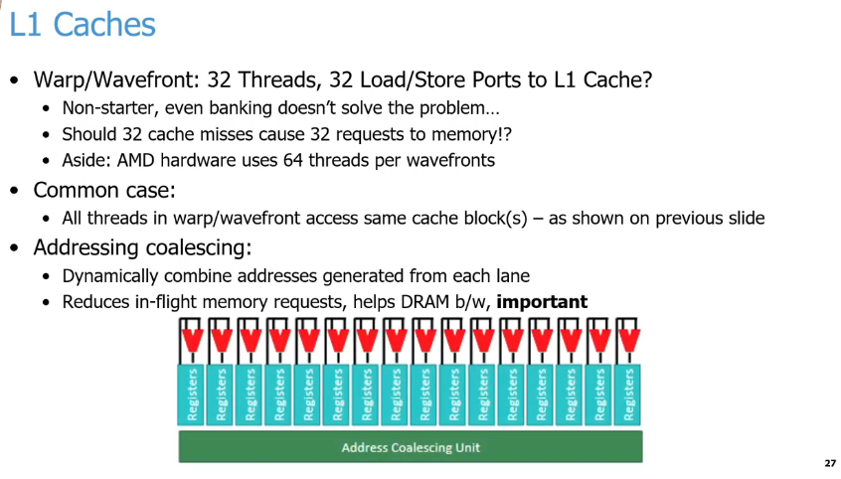
25.19 L1 Cache
https://www.youtube.com/watch?v=Kjd1hTFOI44&list=PL_hVbFs_loVR_8ntTTmmG6YEq3Po_4snu&index=25
L1 Cache (40:36 - 40:40/2:01:30)
1. L1 Caches Challenge:
  Caches are an excellent latency solution for standard CPUs, but they face severe architectural limitations in GPUs due to the massive number of parallel requests generated simultaneously.
1
2
3
4
5

Slide 83
25.19 L1 Cache
https://www.youtube.com/watch?v=Kjd1hTFOI44&list=PL_hVbFs_loVR_8ntTTmmG6YEq3Po_4snu&index=25
L1 Cache (40:41 - 41:00/2:01:30)
2. The Port Bottleneck & Cache Miss Storm
  a. The Problem: A standard GPU execution group features dozens of concurrent threads (32 for an NVIDIA warp, 64 for an AMD wavefront).
  b. Why it fails: Building 32 unique physical Load/Store ports to an L1 Cache to handle every thread at once is a hardware "non-starter" (行不通的, it takes up too much chip space and wiring overhead). Even dividing the cache into memory banks cannot solve this structural bottleneck.
  c. The Risk: If 32 threads encounter an L1 cache miss at the exact same moment, sending 32 individual, isolated requests out to external memory would completely flood the system.
1
2
3
4
5

Slide 84
25.19 L1 Cache
https://www.youtube.com/watch?v=Kjd1hTFOI44&list=PL_hVbFs_loVR_8ntTTmmG6YEq3Po_4snu&index=25
L1 Cache (41:01 - 41:30/2:01:30)
3. The Exploited Design Optimization (Common Case)
  a. To bypass the port bottleneck, GPU hardware explicitly exploits the common case.
  b. Programs are optimized so that threads within a warp or wavefront typically access data located inside the exact same local cache block.
1
2
3
4
5

Slide 85
25.19 L1 Cache
https://www.youtube.com/watch?v=Kjd1hTFOI44&list=PL_hVbFs_loVR_8ntTTmmG6YEq3Po_4snu&index=25
L1 Cache (40:31 - 41:45/2:01:30)
4. Hardware Coalescing Layer (Diagram)
  The hardware diagram visually depicts how separate parallel thread execution lanes and register data (the vertical blocks) are intercepted and funneled (漏斗狀的輸送) directly into a unified Address Coalescing Unit (the green horizontal block) before touching the main memory infrastructure.
1
2
3
4
5

Slide 86
25.20 Matrix Core Engines (AMD) / TensorCores (NVIDIA)

Slide 87
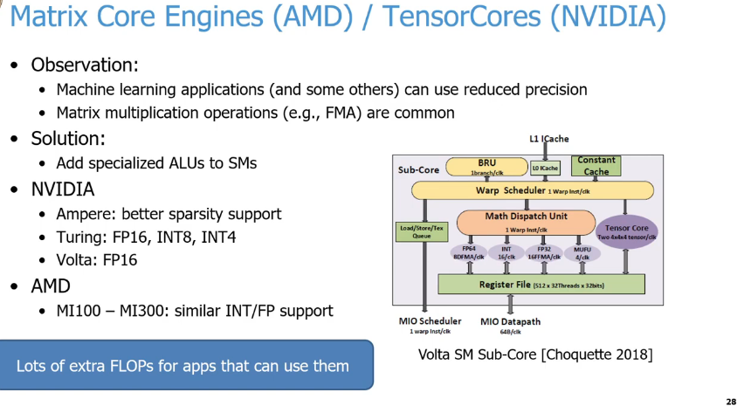
25.20 Matrix Core Engines (AMD) / TensorCores (NVIDIA)
https://www.youtube.com/watch?v=Kjd1hTFOI44&list=PL_hVbFs_loVR_8ntTTmmG6YEq3Po_4snu&index=25
Matrix Core Engines (AMD) / TensorCores (NVIDIA) (41:46 - 42:00/2:01:30)
1. Key Drivers for Specialization:
  a. Reduced Precision: Machine learning models (LLMs, Neural Networks) often do not require high-precision FP64 math. Lower precision (FP16, INT8, INT4) drastically increases throughput and reduces memory bandwidth requirements.
  b. Algorithmic Patterns: These workloads heavily rely on matrix multiplications and Fused Multiply-Add (FMA) operations (e.g., D = A x B + C).
2. Architectural Solution:
Specialized Hardware: Instead of relying on general-purpose ALUs, vendors integrated dedicated hardware blocks inside the Compute Units (AMD) and Streaming Multiprocessors (NVIDIA)
  a. Dedicated Silicon: Offloads matrix math from standard ALUs.
  b. SM Integration: Placed directly inside the GPU execution datapath.
1
2
6
3
4
5

Slide 88
25.20 Matrix Core Engines (AMD) / TensorCores (NVIDIA)
https://www.youtube.com/watch?v=Kjd1hTFOI44&list=PL_hVbFs_loVR_8ntTTmmG6YEq3Po_4snu&index=25
Matrix Core Engines (AMD) / TensorCores (NVIDIA) (42:01 - 43:00/2:01:30)
3. NVIDIA Tensor Cores:
  a. Volta Era: Introduced dedicated FP16 TensorCores.
  b. Turing Era: Added tighter precision limits (INT8/INT4).
  c. Ampere Era: Native 2:4 structured sparsity acceleration.
4. AMD Matrix Core Engines:
  a. Hardware Matrix: Matrix Core Engines deployed in Instinct MI100–MI300.
  b. Feature Parity: Delivers matching deep-learning INT/FP data formats.
1
2
6
3
4
5

Slide 89
25.20 Matrix Core Engines (AMD) / TensorCores (NVIDIA)
https://www.youtube.com/watch?v=Kjd1hTFOI44&list=PL_hVbFs_loVR_8ntTTmmG6YEq3Po_4snu&index=25
Matrix Core Engines (AMD) / TensorCores (NVIDIA) (43:01 - 43:45/2:01:30)
5. Efficiency Gains (Footer in Slide):
  a. Instruction Collapse: Replaces dozens of scalar instructions with one warp instruction.
  b. FLOPS Density: Packs massive compute capability into localized silicon.
6. Sub-Core Datapath Execution (Diagram in Slide)
  a. Warp Scheduler: Issues one warp instruction per clock cycle.
  b. Math Dispatch Unit: Directs the workload down to parallel execution units.
  c. Tensor Core (Purple Block): Processes 4 x 4 x 4 matrix dots over multiple cycles.
  d. Register File (Green Block): Provides a high-bandwidth 512 x 32-threads}x 32-bit lane.
1
2
6
3
4
5

Slide 90
25.21 Memory System Optimization

Slide 91
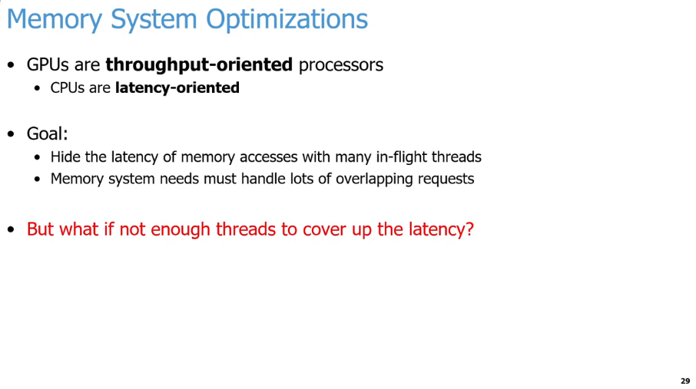
25.21 Memory System Optimization
https://www.youtube.com/watch?v=Kjd1hTFOI44&list=PL_hVbFs_loVR_8ntTTmmG6YEq3Po_4snu&index=25
Memory System Optimization (43:46 - 43:50/2:01:30)
GPUs re throughput-oriented processors
CPUs are latency-oriented processors,
Our goal for GPUs is
1. GPUs need to hide the latency of memory with a lot of in-flight threads.
2. GPUs Memory system need to handle a lot overlapping request
Conclusion:
In GPUs, we need a lot of threads to cover the memory latency.

Slide 92
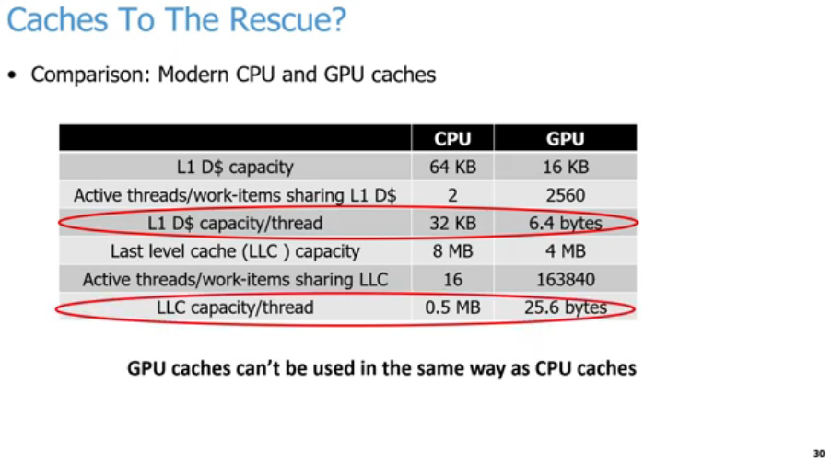
25.21 Memory System Optimization
https://www.youtube.com/watch?v=Kjd1hTFOI44&list=PL_hVbFs_loVR_8ntTTmmG6YEq3Po_4snu&index=25
Memory System Optimization (43:51 - 45:00/2:01:30)
We heard many times that we don’t use caches in the same way in CPUs and GPUs.
Below examples shows different sizes cache of CPU and GPU.
1. L1 D$ (Data Cache) in a CPU is about 64KB. CPU is 16KB (In real world, it is around 16 KB to to 32KB).
2. Number of threads/work-items that are sharing L1 D$ (Data Cache) that is huge different. For example, on a Intel/AMD/ARM CPU, we have two threads that are sharing those 64 KB L1 Cache. That means each thread get 32 KB roughly for each L1 Data Cache. In the GPU, we have 2560 threads that are running concurrently on our CU (Compute Unit).
1
2
3
4
5
6
7

Slide 93
25.21 Memory System Optimization
https://www.youtube.com/watch?v=Kjd1hTFOI44&list=PL_hVbFs_loVR_8ntTTmmG6YEq3Po_4snu&index=25
Memory System Optimization (45:01 - 45:40/2:01:30)
3. For each threads, we get 32KB in L1 Cache for CPU and 6.4 byes L1 Cache for GPU.
4. In the LLC (Last Level Cache), CPU has 8 MB and GPU has 4 MB.
5. For example, in CPUs, we have 16 threads per CPU core. In GPS, we have 32 GPU cores and 163840 threads per LLC (Last Level Cache). Each GPU core average is 5120 threads/core (= 163840/32)
6. In CPUs, if we have 8 cores and 16 threads, we have 2 thread of each core and 0.5MB [= 8 MB / (8 cores x 2 threads/core)] for each thread in the LLC. In GPUs, if we have 32 CU (Compute Unit) and 5120 threads fro each CU, we have 25.6 bytes/thread [= 4 MB / (32 CU x 5120 threads/CU) = 4 x 1048.576/163840 = 25.6 bytes/thread]
1
2
3
4
5
6
7

Slide 94
25.21 Memory System Optimization
https://www.youtube.com/watch?v=Kjd1hTFOI44&list=PL_hVbFs_loVR_8ntTTmmG6YEq3Po_4snu&index=25
Memory System Optimization (45:41 - 46:00/2:01:30)
7. From the table, we see why we cannot use L1 Cache from CPU to GPU.
  In point 3. GPU has too many threads run concurrently. We cannot keep all the threads in the caches as we traditional do in the CPUs. In stead, GPUs are designed to maximize throughput, not latency. Because GPUs do not have any locality to exploit, we only have 6.4 bytes/thread. In GPUs, we only access in the Warp once. In CPU, we have all threads to get the 32 KB/thread data in one time before somebody kick it. In GPUs, we only have 6.4 bytes/thread, we use coalescing to reduce the number of requests when we send to DRAM.
  In point 6, In the LLC (Last Level of Cache or L2 Cache), the GPUs have 25.6 bytes/threads. L1 is the staging buffer with a little bit of reuse.
1
2
3
4
5
6
7

Slide 95
25.22 GPU Cache

Slide 96
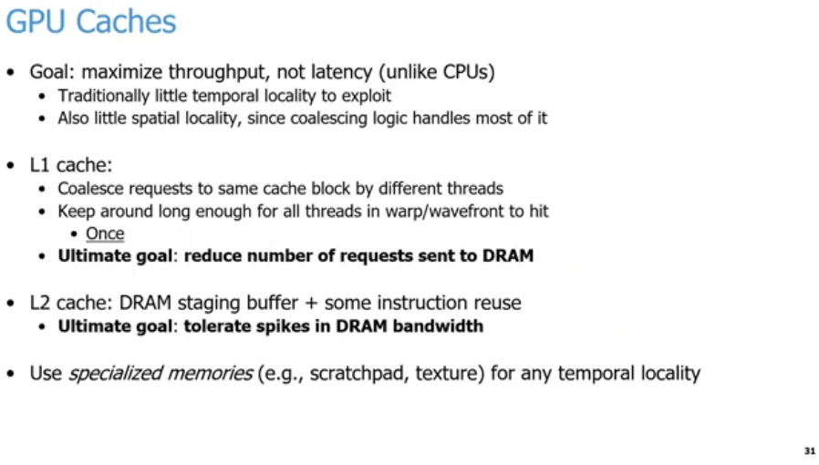
25.22 GPU Cache
https://www.youtube.com/watch?v=Kjd1hTFOI44&list=PL_hVbFs_loVR_8ntTTmmG6YEq3Po_4snu&index=25
GPU Cache (46:01 - 47:15/2:01:30)
1. GPU Cache goal is to Maximize throughput (not like CPUs cache is to minimize memory latency). In the previous slide, we know the GPUs only have 6.4 bytes per thread for Data Cache (L1 D$). There is very little or no locality to exploit. Also, we do not have spatial locality since the coalescing logic handles most of it.
2. We want to keep the data around in the cache long enough for all the threads in our warp or wavefront to access it once, not like access many times in CPUs. We want all 32 or 64 of those threads to get the data. GPUs cache just need one time before somebody else kicks it out of it and GPUs L1 Data cache need 6.4 bytes. BY doing so, especially by exploiting coalescing that allows us to reduce the number of request the we send to DRAM.
3. L2 Cache: The last level of cache in the GPU tends to be L2 Cache. This goal is basically to act as a staging buffer with a little bit in instruction reuse. The goal is to tolerate spikes in DRAM bandwidth.
4. But not ALL Is Lost here, GPUs also add specialize memories, such as, scratch pads and textures that allows us to exploit, such as, spatial and locality in these specialized memories. The programmer control what should be in there, for example, scratch pad.
1
2
3
4

Slide 97
End

