Slide 1

25 GPU Model (Part 03)
Peter H. Chen

Slide 2
25.43 Checkpoint/Restoration in GPU

Slide 3
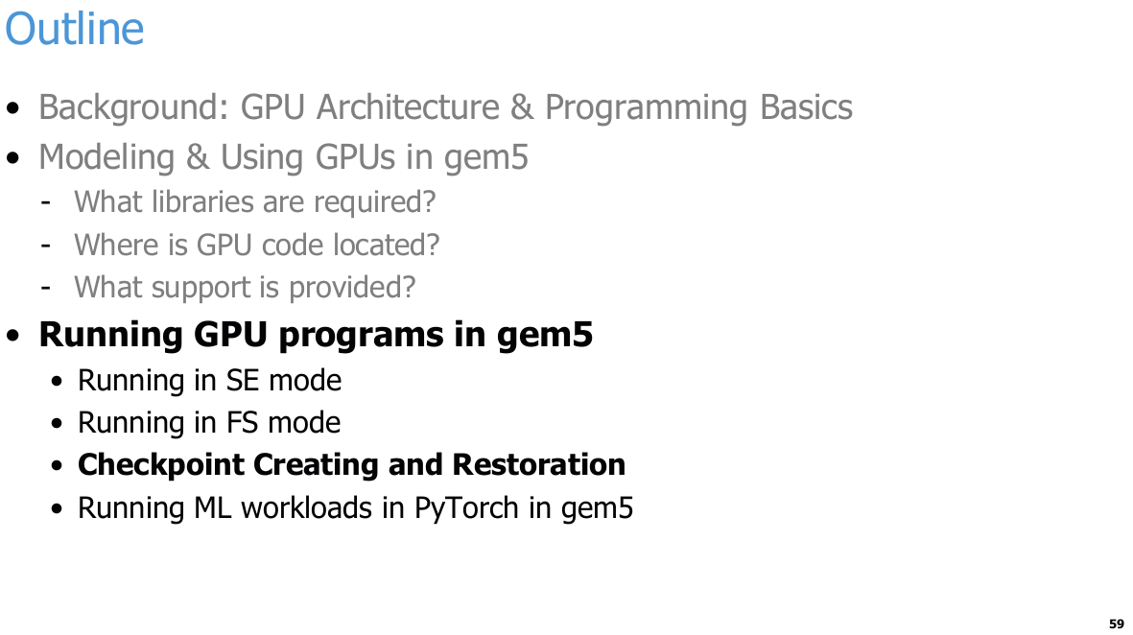
25.43 Checkpoint/Restoration in GPU
https://www.youtube.com/watch?v=Kjd1hTFOI44&list=PL_hVbFs_loVR_8ntTTmmG6YEq3Po_4snu&index=25
Checkpoint/Restoration in GPU (1:39:21 - 1:39:25/2:01:30)
Next, we talk about the checkpoint for GPU.

Slide 4
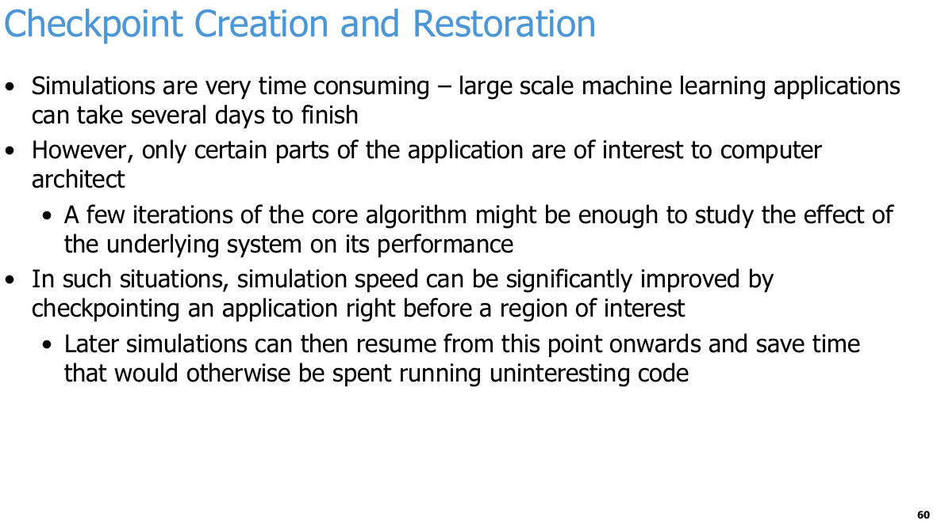
25.43 Checkpoint/Restoration in GPU
https://www.youtube.com/watch?v=Kjd1hTFOI44&list=PL_hVbFs_loVR_8ntTTmmG6YEq3Po_4snu&index=25
Checkpoint/Restoration in GPU (1:39:26 - 1:39:50/2:01:30)
Simulations are very time consuming in large scale machine learning, The workload is time consuming. We can skip the workload and only run the ROI (Region/Area Of Interest).
1. A checkpoint is a complete "snapshot" of a computer system's state at a specific point in time.
Checkpoint is like a "save game" feature in video games.
In gem5 simulator, a checkpoint saves all the critical information of the system at that moment:
  a. Register States: The data and instruction locations currently being processed by the CPU.
  b. Memory Content: All the data inside the entire system RAM.
  c. Hardware Device States: The current status of disks, caches, and peripherals.
2. Why Do We Need Checkpoints?
If your simulation takes 10 hours to run, but you only care about a matrix multiplication that happens in the last 5 minutes:
  a. We can create a checkpoint (save) at the 9-hour-and-55-minute mark, right before the critical code starts.
  b. For all your future experiments, you do not need to rerun the first 9 hours and 55 minutes.
  c. We can simply load the checkpoint (load save) to instantly jump to that exact moment and start your detailed study.

Slide 5
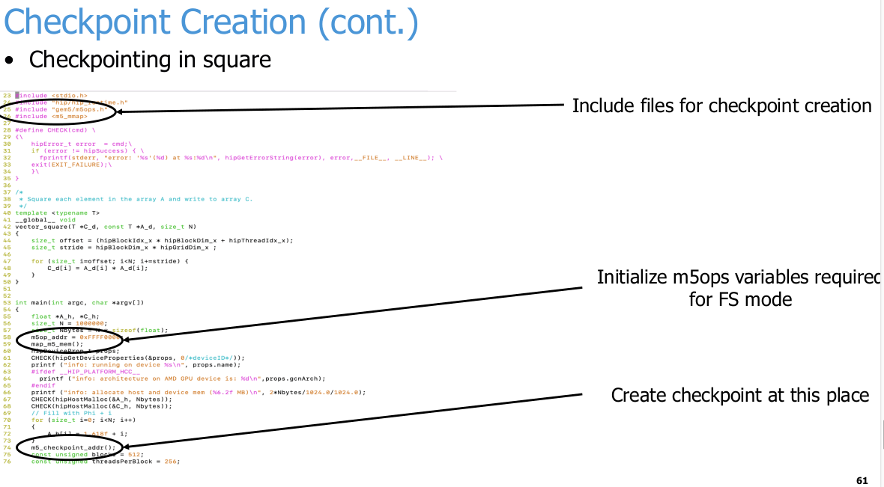
25.43 Checkpoint/Restoration in GPU
https://www.youtube.com/watch?v=Kjd1hTFOI44&list=PL_hVbFs_loVR_8ntTTmmG6YEq3Po_4snu&index=25
Checkpoint/Restoration in GPU (1:39:51 - 1:30:52/2:01:30)
The checkpoint cpp code is as below.

Slide 6
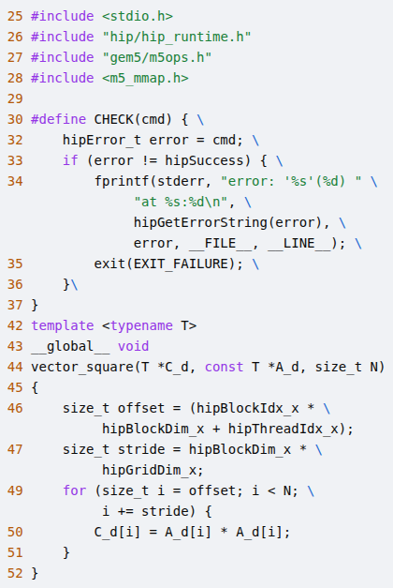
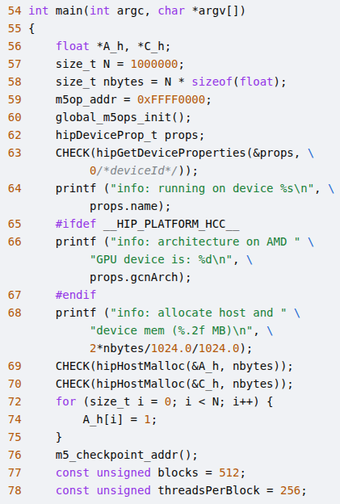
25.43 Checkpoint/Restoration in GPU
https://www.youtube.com/watch?v=Kjd1hTFOI44&list=PL_hVbFs_loVR_8ntTTmmG6YEq3Po_4snu&index=25
Checkpoint/Restoration in GPU (1:39:53 - 1:39:54/2:01:30)
Extract the code on the right.
1. Include files for checkpoint creation
2. Initialize m5ops variables required for FS Mode
3. Create checkpoint at this place.
1
2
1
2
3
3

Slide 7
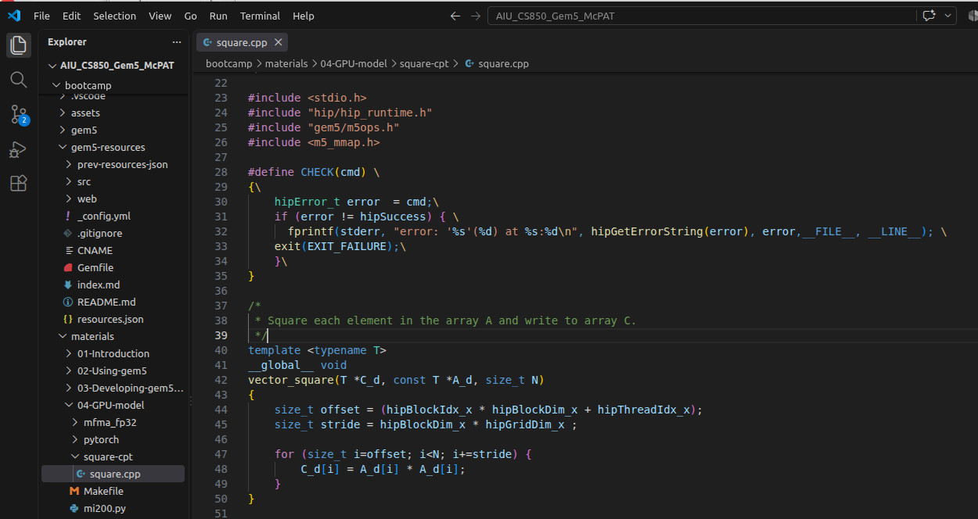
25.43 Checkpoint/Restoration in GPU
https://www.youtube.com/watch?v=Kjd1hTFOI44&list=PL_hVbFs_loVR_8ntTTmmG6YEq3Po_4snu&index=25
Checkpoint/Restoration in GPU (1:39:55 - 1:39:56/2:01:30)
The square.cpp is located under
> ~bootcamp/materials/src/square.cpp

Slide 8
25.43 Checkpoint/Restoration in GPU
https://www.youtube.com/watch?v=Kjd1hTFOI44&list=PL_hVbFs_loVR_8ntTTmmG6YEq3Po_4snu&index=25
Checkpoint/Restoration in GPU (1:39:57 - 1:39:58/2:01:30)
Extract the code on the right.
1. Include files for checkpoint creation
2. Initialize m5ops variables required for FS Mode
3. Create checkpoint at this place.
1
2
1
2
3
3

Slide 9
25.43 Checkpoint/Restoration in GPU
https://www.youtube.com/watch?v=Kjd1hTFOI44&list=PL_hVbFs_loVR_8ntTTmmG6YEq3Po_4snu&index=25
Checkpoint/Restoration in GPU (1:39:59 - 1:40:05/2:01:30)
With the checkpoint, we can restore all subsequent simulations for the same app and input for that given app from that point.
So, if you need to run this simulation many times, creating a checkpoint once can be well worth our app.

Slide 10
25.43 Checkpoint/Restoration in GPU
https://www.youtube.com/watch?v=Kjd1hTFOI44&list=PL_hVbFs_loVR_8ntTTmmG6YEq3Po_4snu&index=25
Checkpoint/Restoration in GPU (1:40:06 - 1:40:30/2:01:30)
For checkpoint, we need to
1. Include “gem5/m5ops.h”
2. Initialize variable for FS (Full System) mode;
3. Call m5_checkpoint_addr () to create checkpoint to load the application workload.

Slide 11
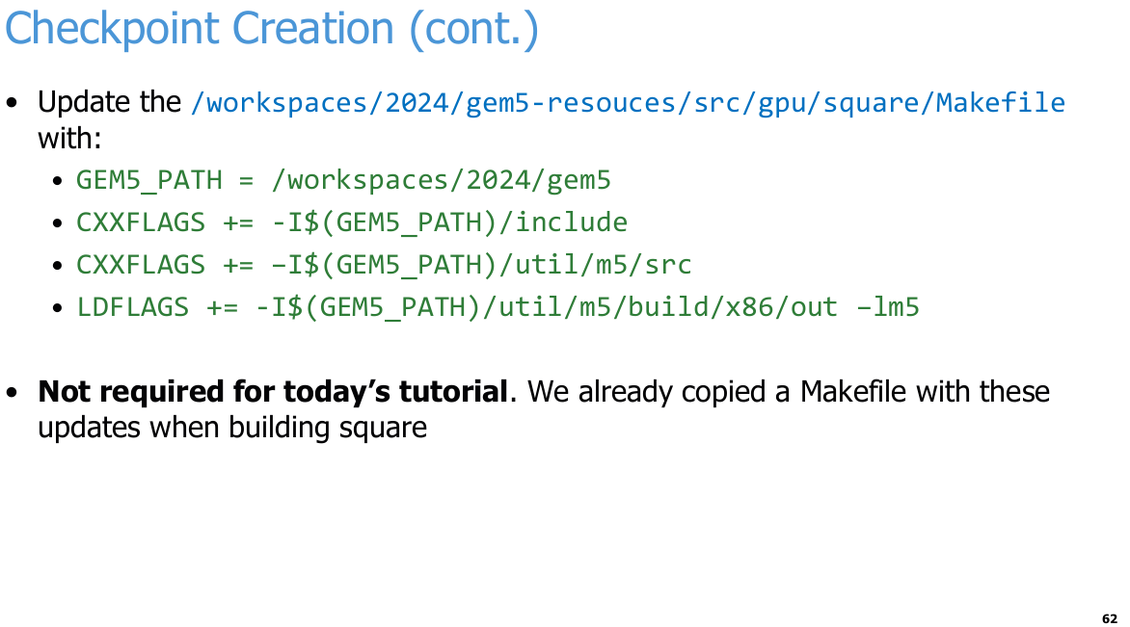
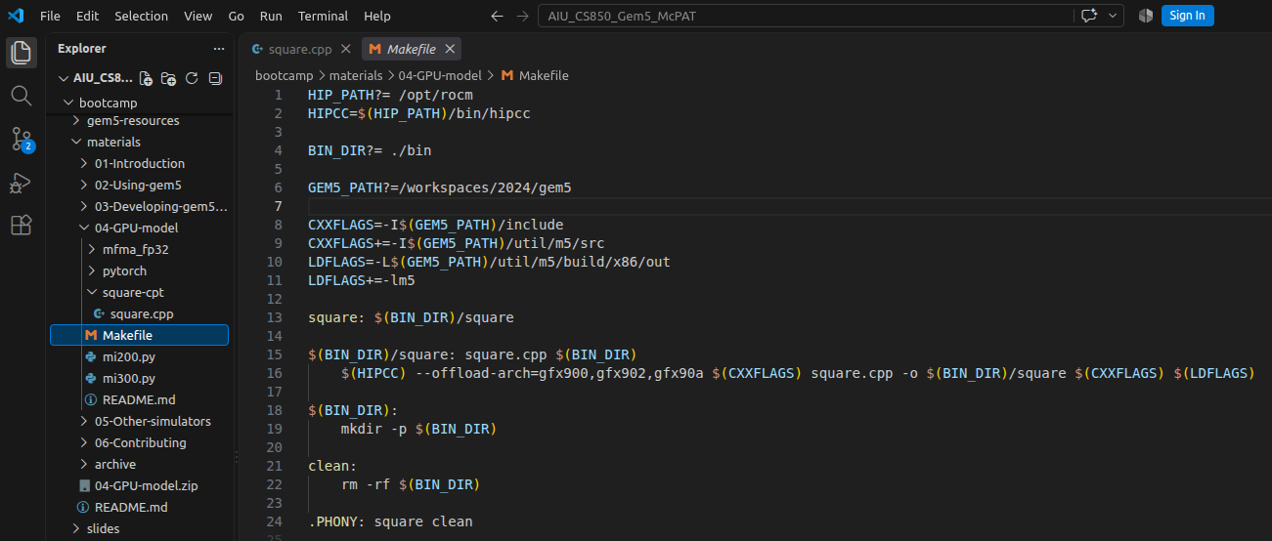
25.43 Checkpoint/Restoration in GPU
https://www.youtube.com/watch?v=Kjd1hTFOI44&list=PL_hVbFs_loVR_8ntTTmmG6YEq3Po_4snu&index=25
Checkpoint/Restoration in GPU (1:40:31 - 1:41:00/2:01:30)
We need to update the Makefile
> ~materials/04-GPU-model/Makefile

Slide 12
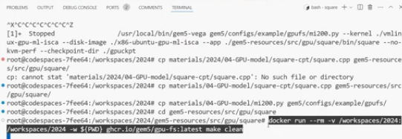
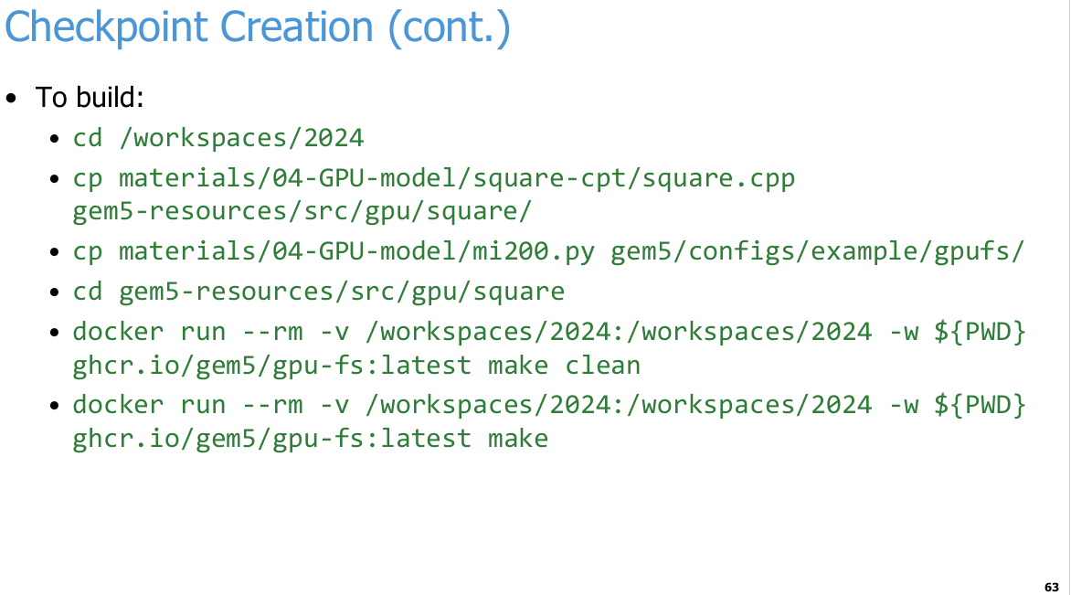
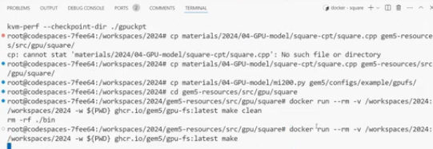
25.43 Checkpoint/Restoration in GPU
https://www.youtube.com/watch?v=Kjd1hTFOI44&list=PL_hVbFs_loVR_8ntTTmmG6YEq3Po_4snu&index=25
Checkpoint/Restoration in GPU (1:41:01 - 1:46:40/2:01:30)
We build the checkpoint for square application.

Slide 13
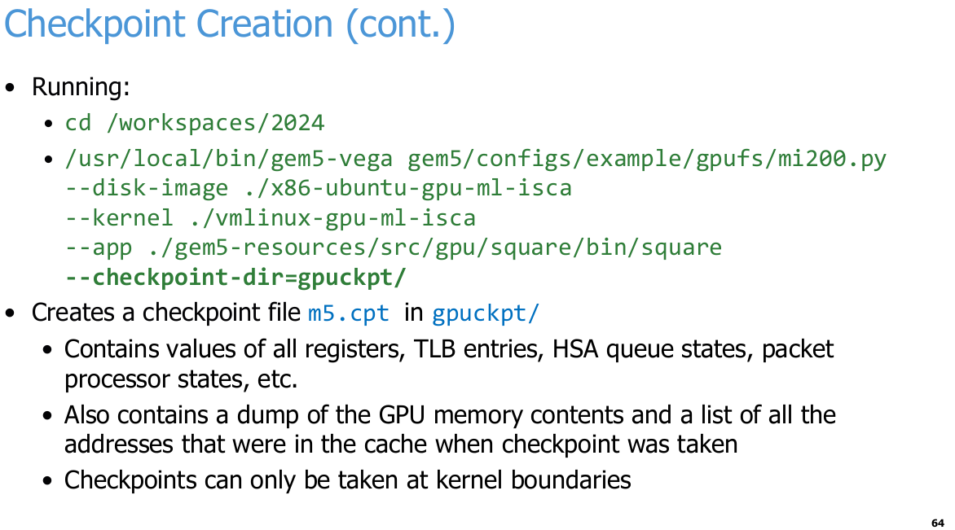
25.43 Checkpoint/Restoration in GPU
https://www.youtube.com/watch?v=Kjd1hTFOI44&list=PL_hVbFs_loVR_8ntTTmmG6YEq3Po_4snu&index=25
Checkpoint/Restoration in GPU (1:46:41 - 1:47:40/2:01:30)
Finally, we docker run the checkpoint for square application.
We passed in the specified directory <gpuckpt> to hold the checkpoint.
> --checkpoint-dir = gpuckpt/
In the <gpuckpt> folder, we can see it creates a file called m5.cpt. This file contains values of all registers, TLB (Translation Lookahead Buffer) entries, HSA (Heterogeneous System Architecture) queue states, packet processor states, memory contents, etc.
Basically, everything we need to restart the state of the simulation at this checkpoint to move forward.
Checkpoint can only be taken at kernel boundaries. We cannot take checkpoint inside a kernel.

Slide 14
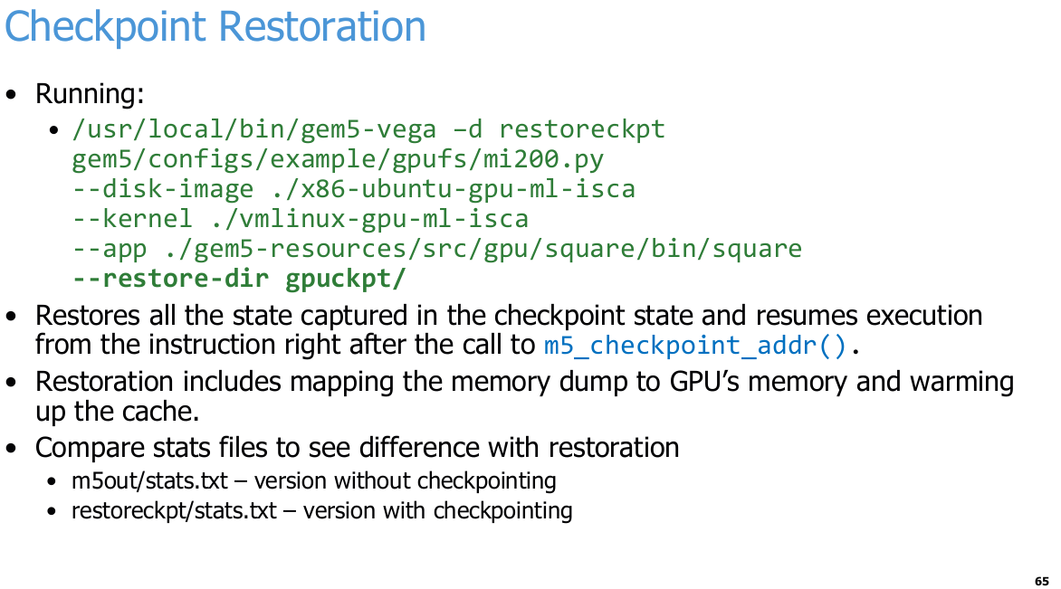
25.43 Checkpoint/Restoration in GPU
https://www.youtube.com/watch?v=Kjd1hTFOI44&list=PL_hVbFs_loVR_8ntTTmmG6YEq3Po_4snu&index=25
Checkpoint/Restoration in GPU (1:47:41 - 1:49:00/2:01:30)
Now, we look at the <gpuckpt> folder and use restore all the states.
This will restore the states of simulator to exactly the point that it was. Right after the line we added that does m5 checkpoint adder.
The restoration will include mapping all the memory back to the GPU, warming up the caches, setting the registers to the appropriate state, the CU use, etc.

Slide 15
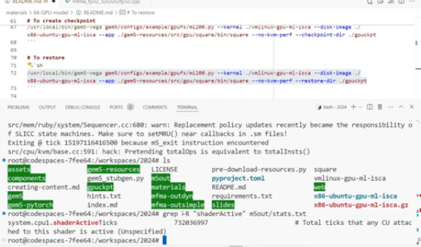
25.43 Checkpoint/Restoration in GPU
https://www.youtube.com/watch?v=Kjd1hTFOI44&list=PL_hVbFs_loVR_8ntTTmmG6YEq3Po_4snu&index=25
Checkpoint/Restoration in GPU (1:49:01 - 1:51:50/2:01:30)
After the running, we look at the
a. m5out/stats.txt which is the original version of square we ran without the checkpoint.
b. restoreckpt/stats.txt which is the checkpoint version of square with checkpoint.
We can compare the statistics for various features and see the behavior of checkpoint. The results should be the same with checkpoint and without checkpoint.
> grep -R “shaderActive” m5out/stats.txt
>> system.cppu1.shaderActiveTicks 732036997 # Total ticks that any CU attached to this shader is active (Unspecified)
> grep -R “shaderActive” restoreckpt/stats.txt
>> system.cppu1.shaderActiveTicks 732036997 # Total ticks that any CU attached to this shader is active (Unspecified)
shaderActiveTicks with checkpoint and without check are the same. But With checkpoints, the run time will be much shorter.
Shader is a small program run on GPU.

Slide 16
25.44 Run PyTorch with FS Mode in gem5

Slide 17
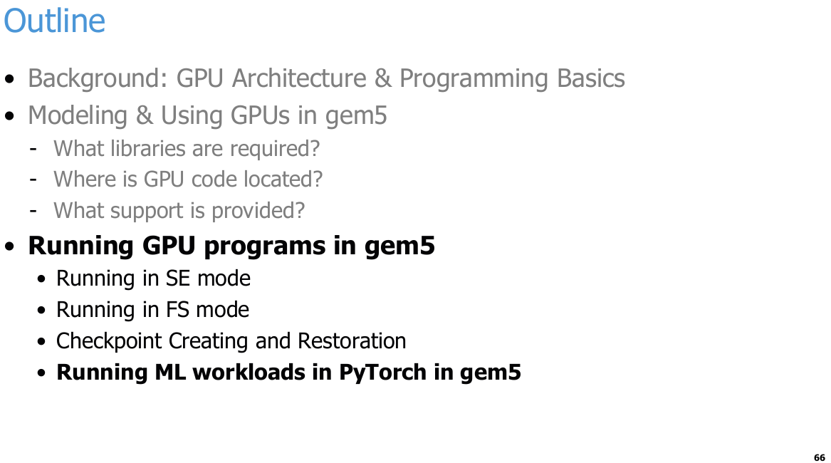
25.44 Run PyTorch with FS Mode in gem5
https://www.youtube.com/watch?v=Kjd1hTFOI44&list=PL_hVbFs_loVR_8ntTTmmG6YEq3Po_4snu&index=25
Run PyTorch with FS Mode in gem5 (1:51:51 - 1:51:52/2:01:30)
Run ML (Machine Learning) workloads in PyTorch in gem5.

Slide 18
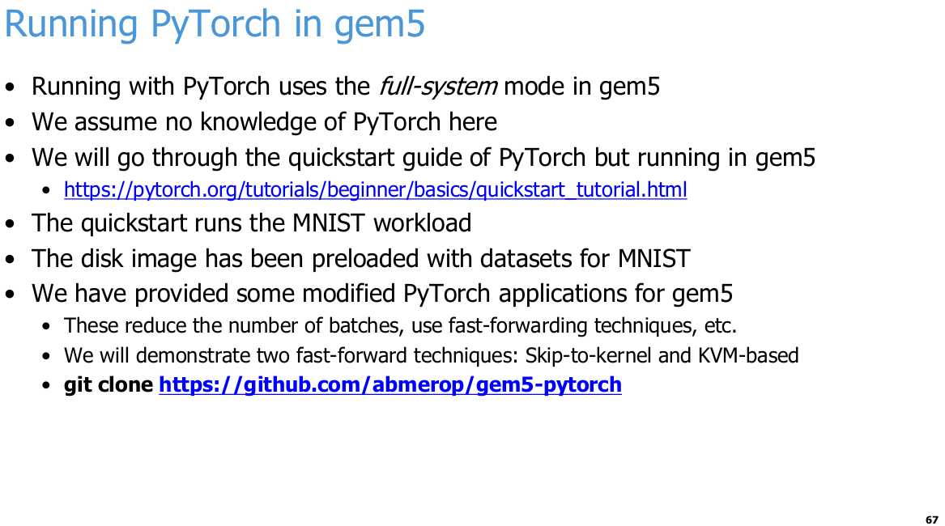
25.44 Run PyTorch with FS Mode in gem5
https://www.youtube.com/watch?v=Kjd1hTFOI44&list=PL_hVbFs_loVR_8ntTTmmG6YEq3Po_4snu&index=25
Run PyTorch with FS Mode in gem5 (1:51:53 - 1:53:05/2:01:30)
We talk how to run PyTorch (or TensorFlow) framework with FS Mode in gem5 GPFS support.
We assume that we don’t have knowledge in PyTorch.
We will take MNIST (Modified National Institute of Standards and Technology database) dataset for model training. MNIST is a simple and famous in 1980s for machine learning workloads for handwriting digit recognition up to 100 or more. For quick way checking, we use pre-loaded digits 0, 1, 2, ..., 9.

Slide 19
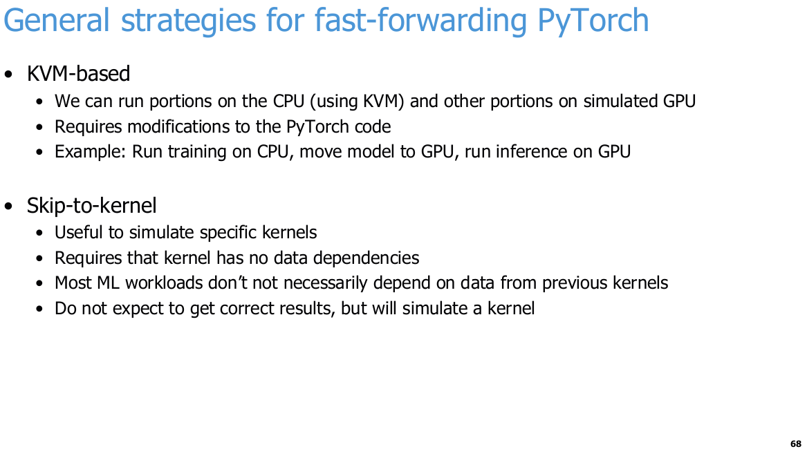
25.44 Run PyTorch with FS Mode in gem5
https://www.youtube.com/watch?v=Kjd1hTFOI44&list=PL_hVbFs_loVR_8ntTTmmG6YEq3Po_4snu&index=25
Run PyTorch with FS Mode in gem5 (1:53:06 - 1:54:05/2:01:30)
We have two features that gem5 support for PyTorch FS Mode. When we run the large workloads of PyTorch, there is many layers of software and a lot of simulation we need to setup for fast forwarding.
We integrate the gem5 KVM (Kernel based Virtual Machine) where we run portions of workloads CPU using KVM and other portions in the simulated GPU. This requires modifying the PyTorch code which gem5 have done for you in this case.
In this example, we train on CPU, move the model to the GPU, and run inference on GPU.

Slide 20
25.44 Run PyTorch with FS Mode in gem5
https://www.youtube.com/watch?v=Kjd1hTFOI44&list=PL_hVbFs_loVR_8ntTTmmG6YEq3Po_4snu&index=25
Run PyTorch with FS Mode in gem5 (1:54:06 - 1:55:05/2:01:30)
We also have a second feature which called “skip to kernel” where we simulate the kernels and skip the running of GPU kernels.
To skip the kernel, we assume kernels have no data dependencies.
Most of Machine learning workloads are independent of data from previous kernels.
The kernels simulation maybe not accurate but will skip the kernel time by simulation.

Slide 21
25.45 Run FS Mode in gem5

Slide 22
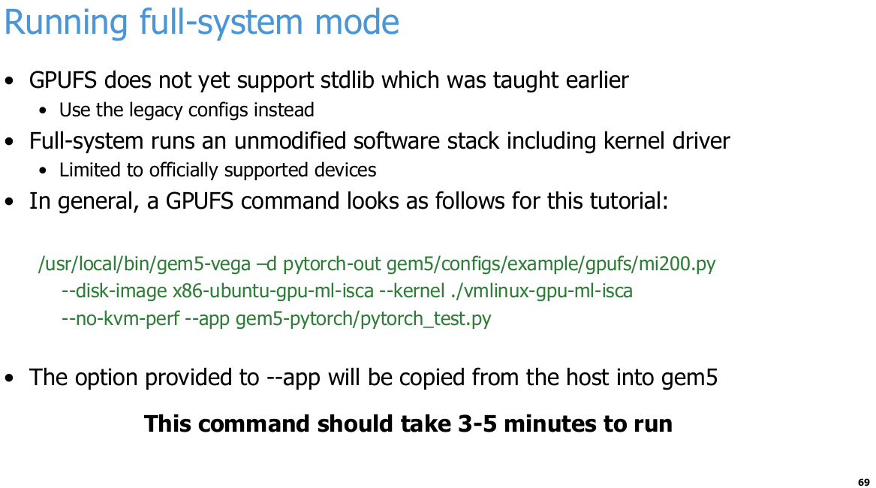
25.45 Run FS Mode in gem5
https://www.youtube.com/watch?v=Kjd1hTFOI44&list=PL_hVbFs_loVR_8ntTTmmG6YEq3Po_4snu&index=25
Ru FS Mode in gem5 (1:55:06 - 1:55:07/2:01:30)
Q. What is difference of gem5 Full-System and GPUFS?
Ans:
1. GPUFS (GPU Full System) is a specific subset of gem5's broader Full System (FS) simulation mode tailored for running graphics and compute accelerators.
2. While standard Full System (FS) simulation in gem5 boots a complete operating system (using a kernel and disk image) to model general CPU-based computer systems, GPUFS specifically extends that full-system environment to support discrete GPUs (dGPUs) and their actual kernel-space driver software stacks (such as AMD's ROCm/ROCk driver) rather than emulating them.
Key Differences and Relationships
1. Full System (FS): The general architecture mode in gem5 where an entire software stack—including a bootloader, a real Linux kernel, and a disk image—runs inside the simulator to execute both OS and user-space code. It can be configured for CPUs only or with various simulated devices.
2. GPUFS (GPU Full System): A specialized configuration of FS mode that adds cycle-level or functional modeling of GPU hardware components (like DMA engines, packet processors, and virtual memory/tlb hardware) and boots an OS containing the actual GPU kernel driver.
3. GPUFS vs. GPU SE (System Emulation):
  In GPU SE mode, gem5 runs user-space GPU code directly on the host and intercepts/emulates driver and system services.
  In GPUFS mode, the guest OS runs inside gem5, and the actual kernel driver (ROCk) is fully simulated alongside modeled GPU hardware queues.

Slide 23
25.45 Run FS Mode in gem5
https://www.youtube.com/watch?v=Kjd1hTFOI44&list=PL_hVbFs_loVR_8ntTTmmG6YEq3Po_4snu&index=25
Ru FS Mode in gem5 (1:55:08 - 1:55:45/2:01:30)
We run FS mode in gem5:
> /usr/local/bin/gem5-vega gem5/configs/example/gpufs/mi300.py \
> --disk-image /tmp/x86-ubuntu-gpu-ml-isca --kernel ./vmlinux-gpu-ml-isca \
> --no-kvm-perf --app gem5-pytorch/pytorch_test.py

Slide 24
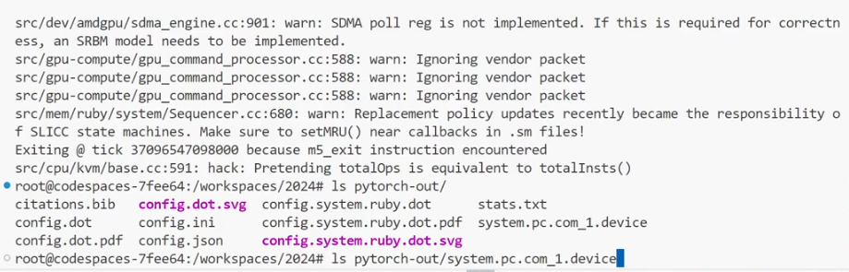
25.45 Run FS Mode in gem5
https://www.youtube.com/watch?v=Kjd1hTFOI44&list=PL_hVbFs_loVR_8ntTTmmG6YEq3Po_4snu&index=25
Ru FS Mode in gem5 (1:55:46- 1:55:50/2:01:30)
After we run, check the pytorch-out directory.
> ls pytorch-out

Slide 25
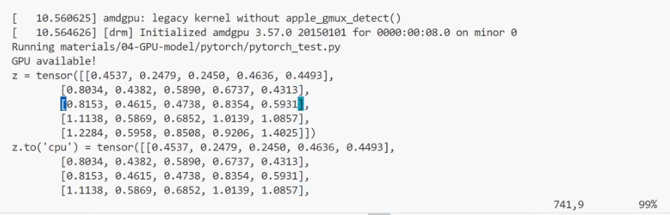
25.45 Run FS Mode in gem5
https://www.youtube.com/watch?v=Kjd1hTFOI44&list=PL_hVbFs_loVR_8ntTTmmG6YEq3Po_4snu&index=25
Ru FS Mode in gem5 (1:55:51- 1:56:40/2:01:30)
Check system.pc.com_1.device
> vim pytorch-out/system.pc.com_1.device
We can run the pytorch test and can see the result tensor with the values that can go back into the pytorch test with different weight for different random behavior.
Do not need to worry the meaning of values in the tensor. These weight in tensor are randomly generated for matrix calculation,

Slide 26
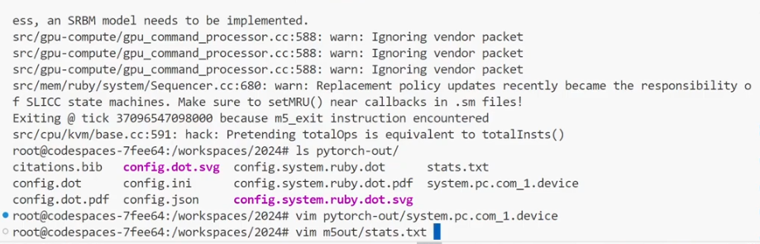
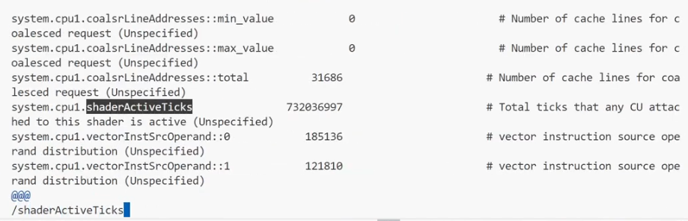
25.45 Run FS Mode in gem5
https://www.youtube.com/watch?v=Kjd1hTFOI44&list=PL_hVbFs_loVR_8ntTTmmG6YEq3Po_4snu&index=25
Ru FS Mode in gem5 (1:56:41- 1:57:10/2:01:30)
Check stats.txt
> vim pytorch-out/stats.txt
Check shaderActiveTicks 732036997 # Total ticks that any CU attached to this shader is active (Unspecified).

Slide 27
25.46 PyTorch MNIST Example

Slide 28
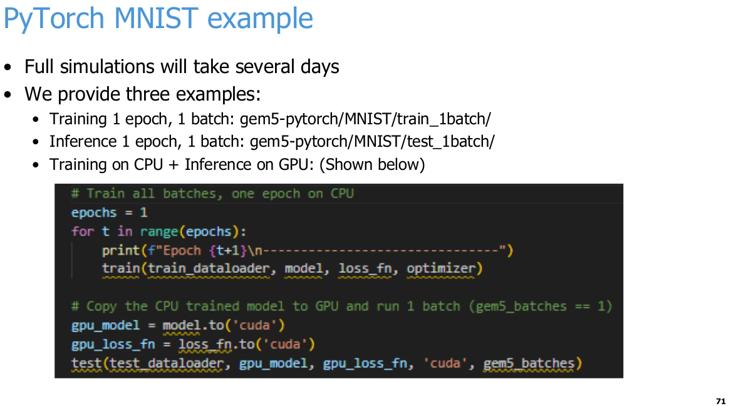
25.46 PyTorch MNIST Example
https://www.youtube.com/watch?v=Kjd1hTFOI44&list=PL_hVbFs_loVR_8ntTTmmG6YEq3Po_4snu&index=25
PyTorch MNIST Example (1:57:16- 1:57:45/2:01:30)
Full simulation of PyTorch MNIST will take several days.
Below, below example is only for
1. training 1 epoch, 1 batch
2. Inference 1 epoch, 1 batch
3. training on GPU and Inference on GPU

Slide 29
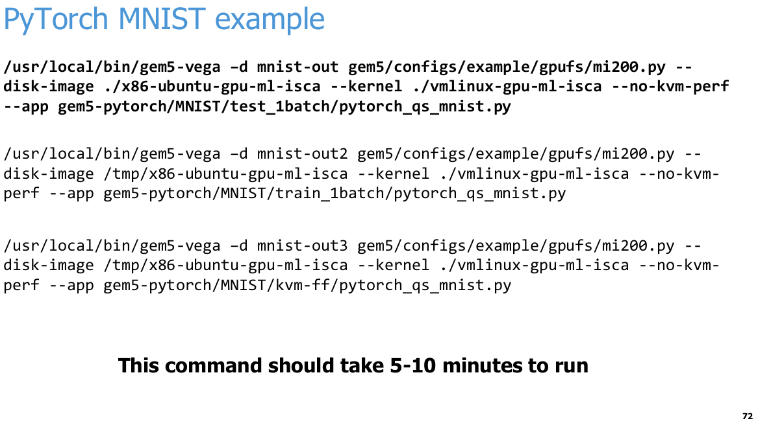
25.46 PyTorch MNIST Example
https://www.youtube.com/watch?v=Kjd1hTFOI44&list=PL_hVbFs_loVR_8ntTTmmG6YEq3Po_4snu&index=25
PyTorch MNIST Example (1:57:46- 1:58:15/2:01:30)
General Command to run PyTorch MNIST.
> /usr/local/bin/gem5-vega -d mnist-out gem5/configs/example/gpufs/mi200.py --disk-image ./x86-ubuntu-gpu-ml-isca --kernel ./vmlinux-gpu-ml-isca –no-kvm-perf \
> --app gem5-pytorch/MNIST/test_1batch/pytorch_qs_mnist.py
1. For disk image in /tmp and train 1 batch.
> /usr/local/bin/gem5-vega -d mnist-out2 gem5/configs/example/gpufs/mi200.py --disk-image /tmp/x86-ubuntu-gpu-ml-isca --kernel ./vmlinux-gpu-ml-isca --no-kvm-perf \
> --app gem5-pytorch/MNIST/train_1batch/pytorch_qs_mnist.py
2.for disk image in tmp and fast forward KVM (Kernel Virtual Machine).
> /usr/local/bin/gem5-vega -d mnist-out3 gem5/configs/example/gpufs/mi200.py --disk-image /tmp/x86-ubuntu-gpu-ml-isca --kernel ./vmlinux-gpu-ml-isca –no-kvm-perf \
> --app gem5-pytorch/MNIST/kvm-ff/pytorch_qs_mnist.py

Slide 30
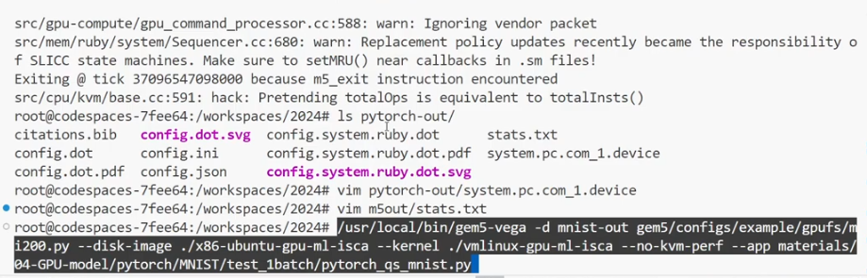
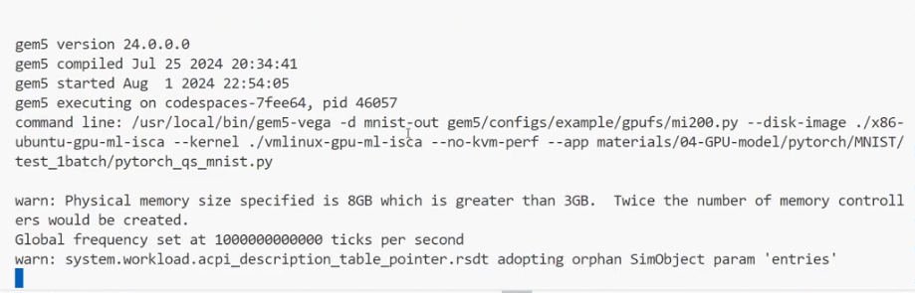
25.46 PyTorch MNIST Example
https://www.youtube.com/watch?v=Kjd1hTFOI44&list=PL_hVbFs_loVR_8ntTTmmG6YEq3Po_4snu&index=25
PyTorch MNIST Example (1:58:16- 1:58:30/2:01:30)
Run first command:
1. For disk image in /tmp and train 1 batch.
> /usr/local/bin/gem5-vega -d mnist-out2 gem5/configs/example/gpufs/mi200.py --disk-image /tmp/x86-ubuntu-gpu-ml-isca --kernel ./vmlinux-gpu-ml-isca --no-kvm-perf \
> --app gem5-pytorch/MNIST/train_1batch/pytorch_qs_mnist.py

Slide 31
25.47 Add Files to Disk Image

Slide 32
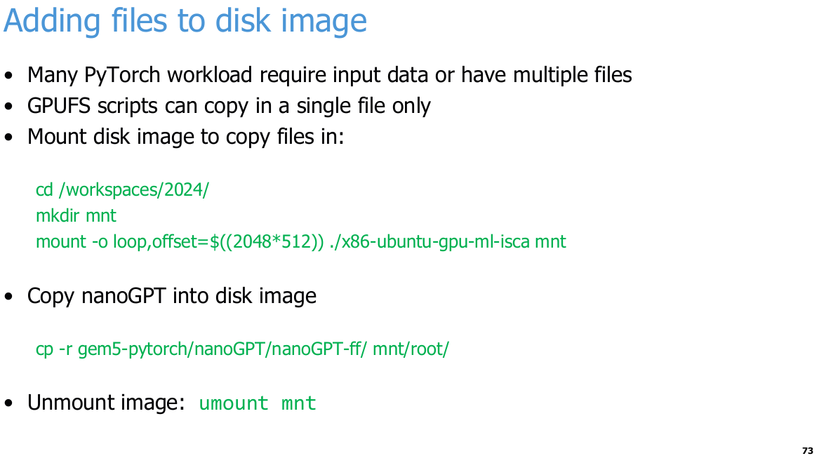
25.47 Add Files to Disk Image
https://www.youtube.com/watch?v=Kjd1hTFOI44&list=PL_hVbFs_loVR_8ntTTmmG6YEq3Po_4snu&index=25
Add Files to Disk Image (1:58:31- 1:58:32/2:01:30)
Many PyTorch workload require input data or have multiple files
GPUFS scripts can copy in a single file only
Mount disk image to copy files in:
> cd /workspaces/2024/
> mkdir mnt
> mount -o loop,offset=$((2048*512)) ./x86-ubuntu-gpu-ml-isca mnt
  This mounts the disk image file so you can copy files into it directly. Piece by piece:
  mount — attaches a filesystem to a directory (mnt)
  -o loop — treats the image file as if it were a physical disk, via a loop device
  offset=$((2048*512)) — skips the first 1,048,576 bytes (1 MiB) of the file. A raw disk image starts with a partition table (MBR), not the filesystem itself. The first partition typically begins at sector 2048, and each sector is 512 bytes, so this offset jumps past the partition table to where the actual ext4 filesystem starts
  ./x86-ubuntu-gpu-ml-isca — the disk image file
  mnt — the directory it gets mounted on
  Why do it this way: the GPUFS scripts can only copy a single file into the image, so when you need to add a whole tree like nanoGPT, you mount the image and use plain cp -r instead. Then umount mnt detaches it when you're done.
Q. Difference of Copy and mount
Ans:
a. cp puts the image filesystem into a directory.
We still cannot see the content of the image file.
b. mount makes the image's filesystem visible at a directory.
If your goal is to read or write files inside the image, only the second one helps.

Slide 33
25.47 Add Files to Disk Image
https://www.youtube.com/watch?v=Kjd1hTFOI44&list=PL_hVbFs_loVR_8ntTTmmG6YEq3Po_4snu&index=25
Add Files to Disk Image (1:58:33- 1:58:50/2:01:30)
Copy nanoGPT into disk image
> cp -r gem5-pytorch/nanoGPT/nanoGPT-ff/ mnt/root/
> Unmount image: umount mnt

Slide 34
25.48 PyTorch nanoGPT Example

Slide 35
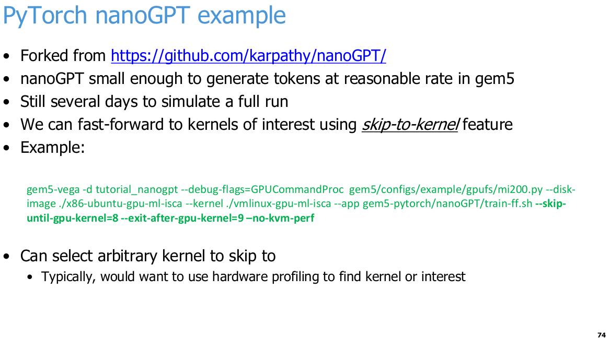
25.48 PyTorch nanoGPT Example
https://www.youtube.com/watch?v=Kjd1hTFOI44&list=PL_hVbFs_loVR_8ntTTmmG6YEq3Po_4snu&index=25
PyTorch nanoGPT Example (1:58:51- 1:59:05/2:01:30)
The nanoGPT is smaller chatGPT from OpenAI.
We can fast forward the workloads and still need several days to run.

Slide 36
25.49 Conclusion

Slide 37
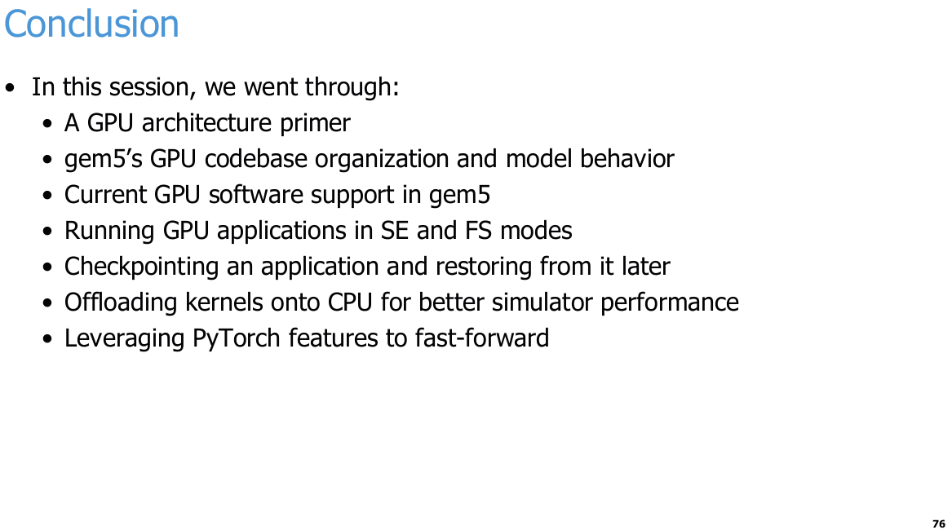
25.49 Conclusion
https://www.youtube.com/watch?v=Kjd1hTFOI44&list=PL_hVbFs_loVR_8ntTTmmG6YEq3Po_4snu&index=25
Conclusion (1:59:06 - 1:59:50/2:01:30)
We talk about gem5 GPU SE and FS modes, checkpoint and restore, fast forward with KVM (Kernel based Virtual Machine).
Q. What is difference for Fast-Forward and KVM?
Ans:
Fast-forward is the technique: skipping uninteresting parts of the simulation (kernel boot, app initialization) as quickly as possible so you reach the region of interest, then switching to the slow, detailed timing model (your Vega GPU model) for the part you actually want to measure. KVM is part of Fast-Forward technique.

Slide 38
End

