Slide 1

8.1 Cache Model: Slides
Peter H. Chen

Slide 2

8.1 Cache Model: Slides
https://gem5bootcamp.github.io/2024/#02-Using-gem5/05-cache-hierarchies
Cache Model: Slides

Slide 3
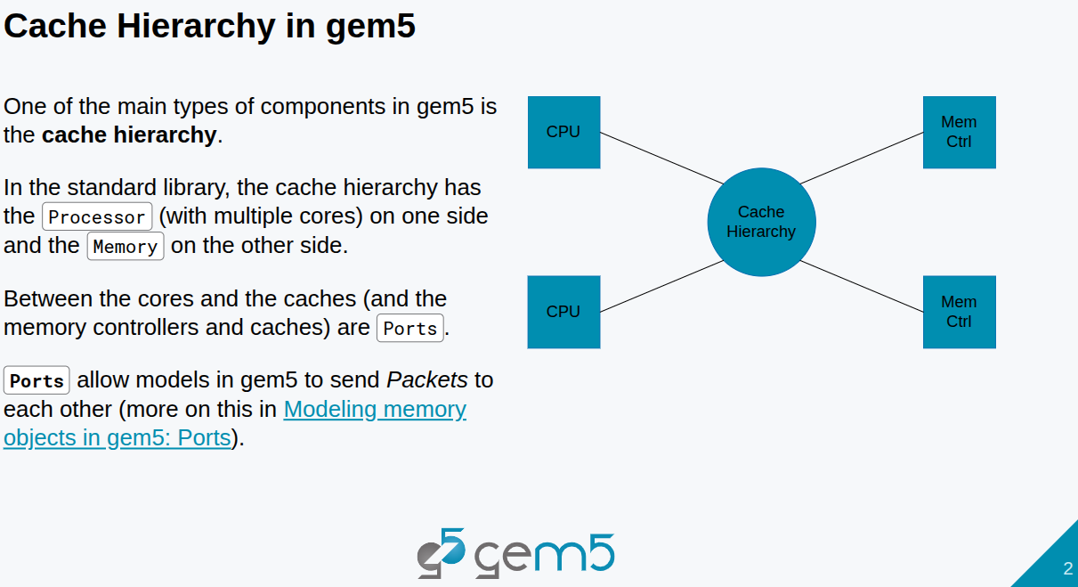
8.1 Cache Model: Slides
https://gem5bootcamp.github.io/2024/#02-Using-gem5/05-cache-hierarchies
Cache Model: Slides

Slide 4
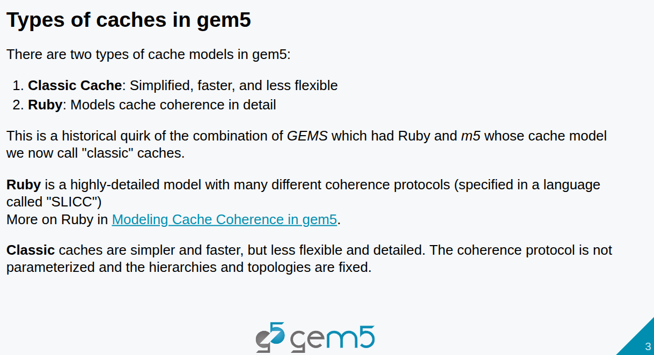
8.1 Cache Model: Slides
https://gem5bootcamp.github.io/2024/#02-Using-gem5/05-cache-hierarchies
Cache Model: Slides

Slide 5
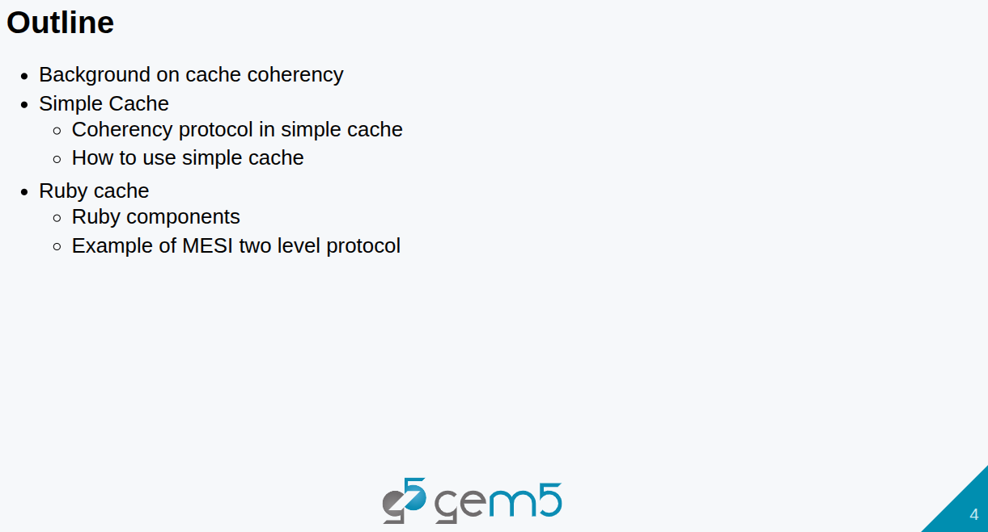
8.1 Cache Model: Slides
https://gem5bootcamp.github.io/2024/#02-Using-gem5/05-cache-hierarchies
Cache Model: Slides

Slide 6
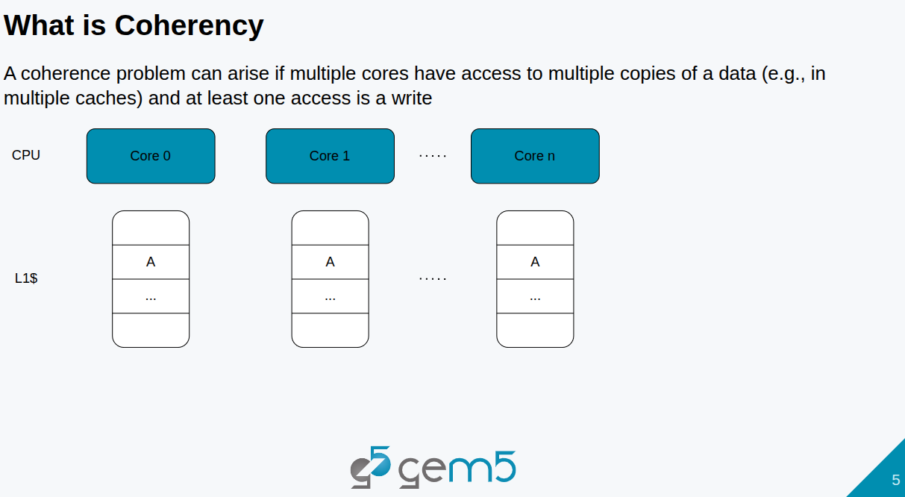
8.1 Cache Model: Slides
https://gem5bootcamp.github.io/2024/#02-Using-gem5/05-cache-hierarchies
Cache Model: Slides

Slide 7

8.1 Cache Model: Slides
https://gem5bootcamp.github.io/2024/#02-Using-gem5/05-cache-hierarchies
Cache Model: Slides

Slide 8

8.1 Cache Model: Slides
https://gem5bootcamp.github.io/2024/#02-Using-gem5/05-cache-hierarchies
Cache Model: Slides

Slide 9
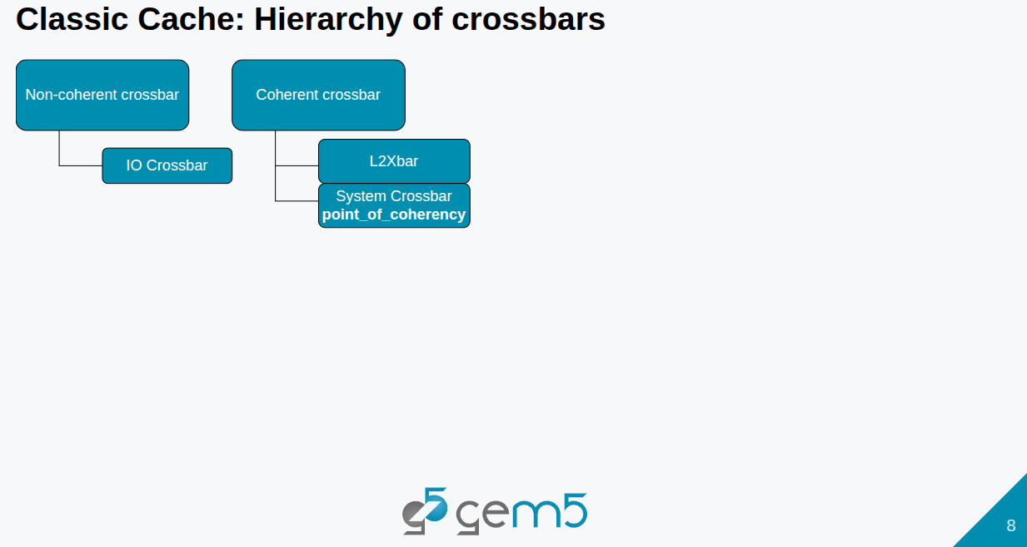
8.1 Cache Model: Slides
https://gem5bootcamp.github.io/2024/#02-Using-gem5/05-cache-hierarchies
Cache Model: Slides

Slide 10
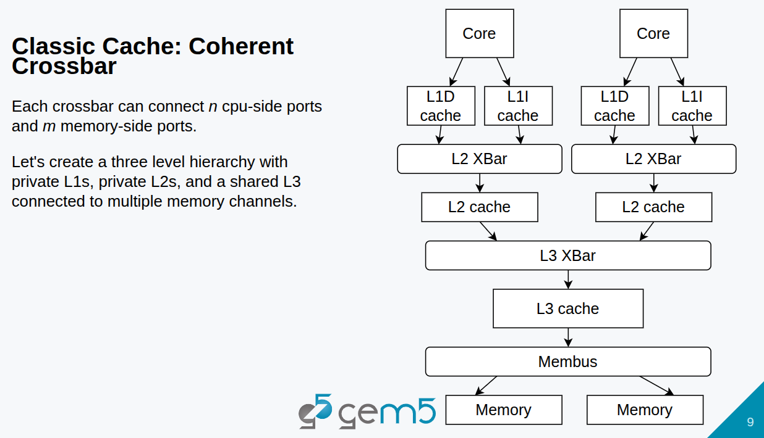
8.1 Cache Model: Slides
https://gem5bootcamp.github.io/2024/#02-Using-gem5/05-cache-hierarchies
Cache Model: Slides

Slide 11
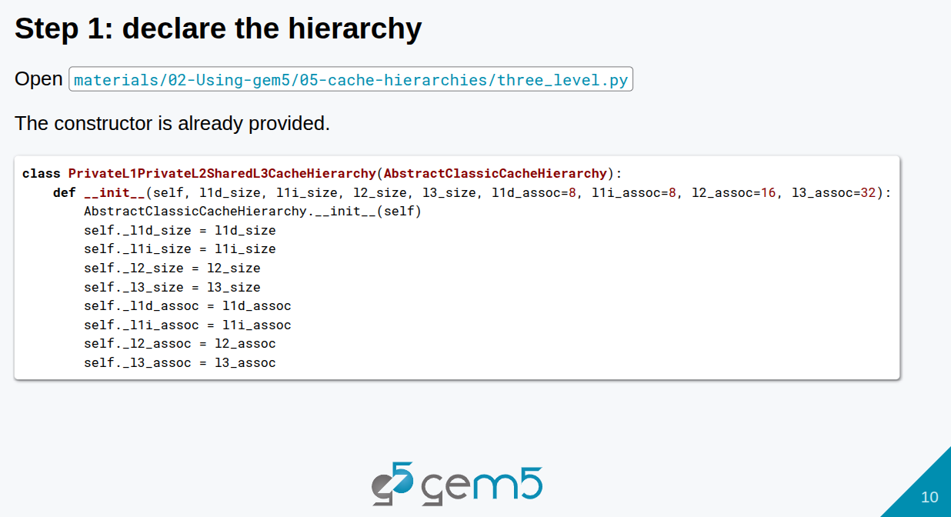
8.1 Cache Model: Slides
https://gem5bootcamp.github.io/2024/#02-Using-gem5/05-cache-hierarchies
Cache Model: Slides

Slide 12
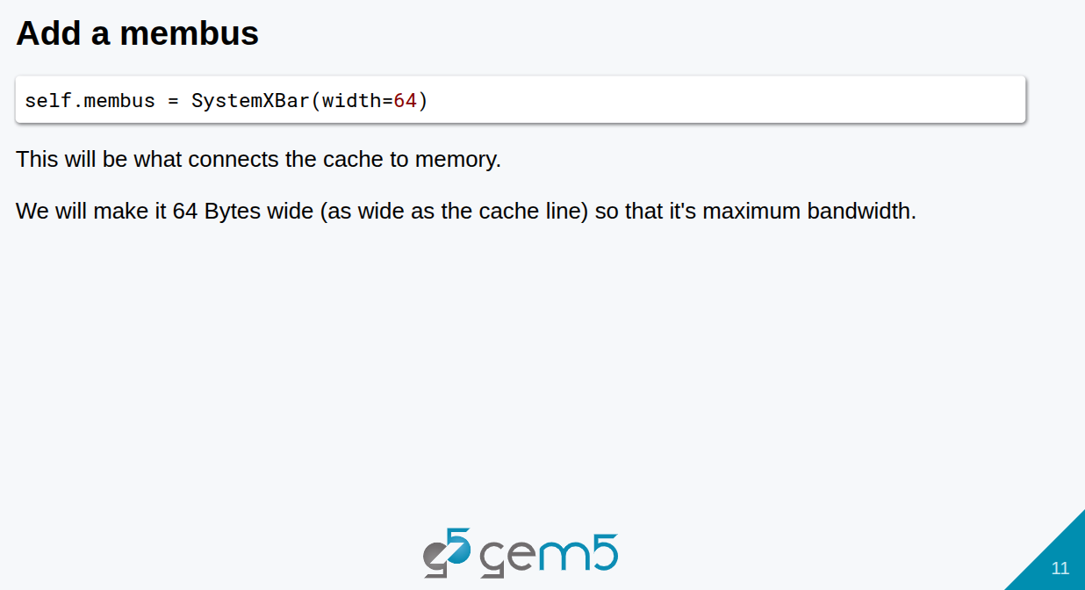
8.1 Cache Model: Slides
https://gem5bootcamp.github.io/2024/#02-Using-gem5/05-cache-hierarchies
Cache Model: Slides

Slide 13
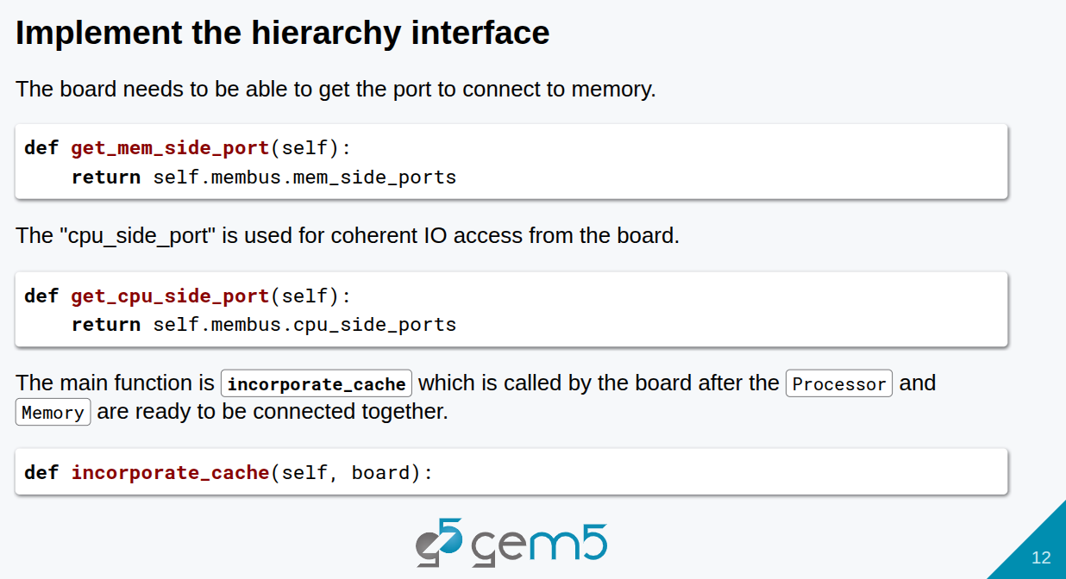
8.1 Cache Model: Slides
https://gem5bootcamp.github.io/2024/#02-Using-gem5/05-cache-hierarchies
Cache Model: Slides

Slide 14
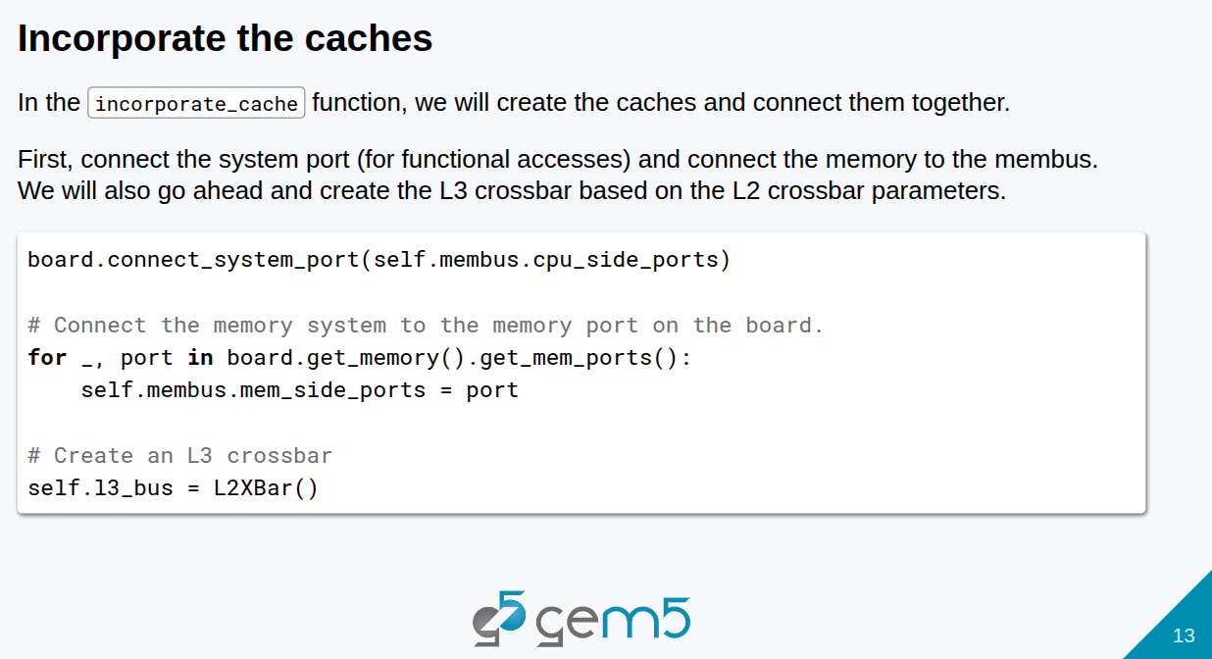
8.1 Cache Model: Slides
https://gem5bootcamp.github.io/2024/#02-Using-gem5/05-cache-hierarchies
Cache Model: Slides

Slide 15
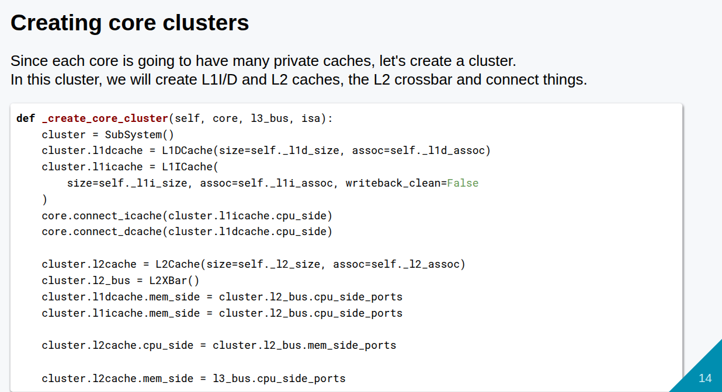
8.1 Cache Model: Slides
https://gem5bootcamp.github.io/2024/#02-Using-gem5/05-cache-hierarchies
Cache Model: Slides

Slide 16
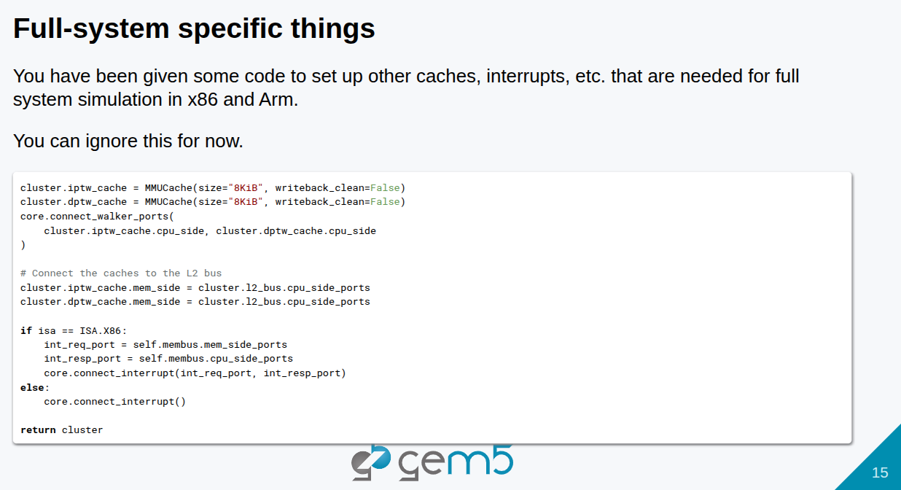
8.1 Cache Model: Slides
https://gem5bootcamp.github.io/2024/#02-Using-gem5/05-cache-hierarchies
Cache Model: Slides

Slide 17
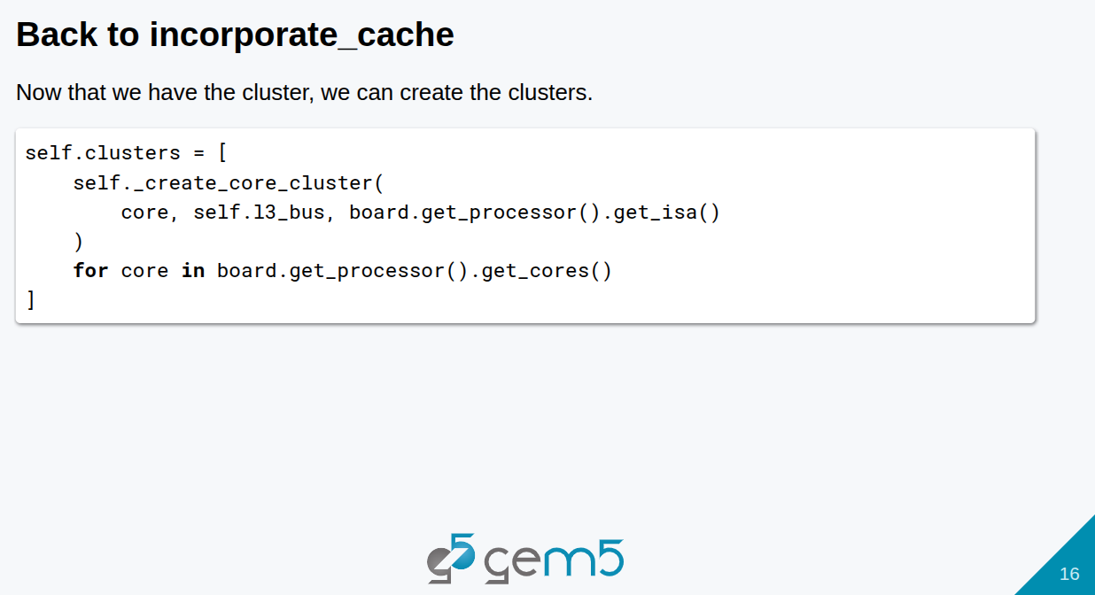
8.1 Cache Model: Slides
https://gem5bootcamp.github.io/2024/#02-Using-gem5/05-cache-hierarchies
Cache Model: Slides

Slide 18
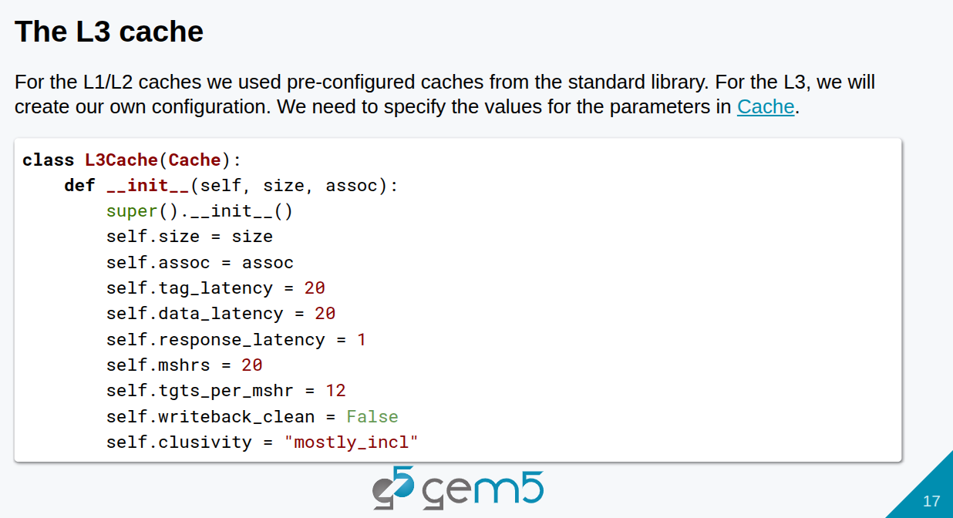
8.1 Cache Model: Slides
https://gem5bootcamp.github.io/2024/#02-Using-gem5/05-cache-hierarchies
Cache Model: Slides

Slide 19
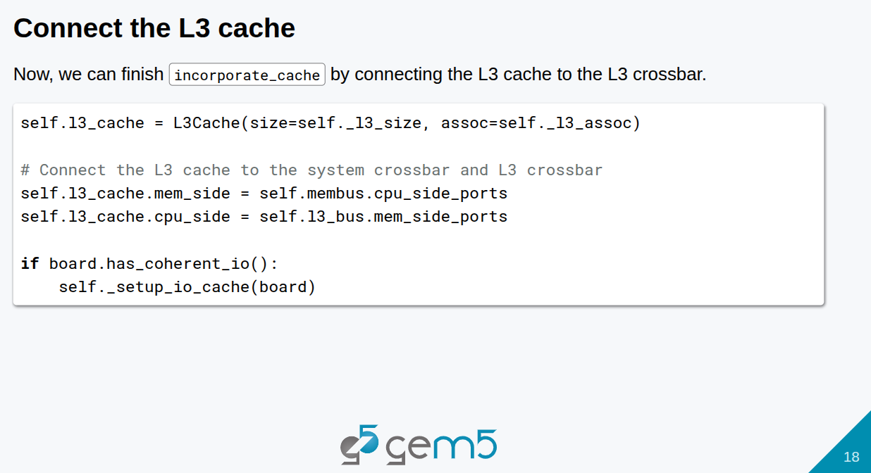
8.1 Cache Model: Slides
https://gem5bootcamp.github.io/2024/#02-Using-gem5/05-cache-hierarchies
Cache Model: Slides

Slide 20
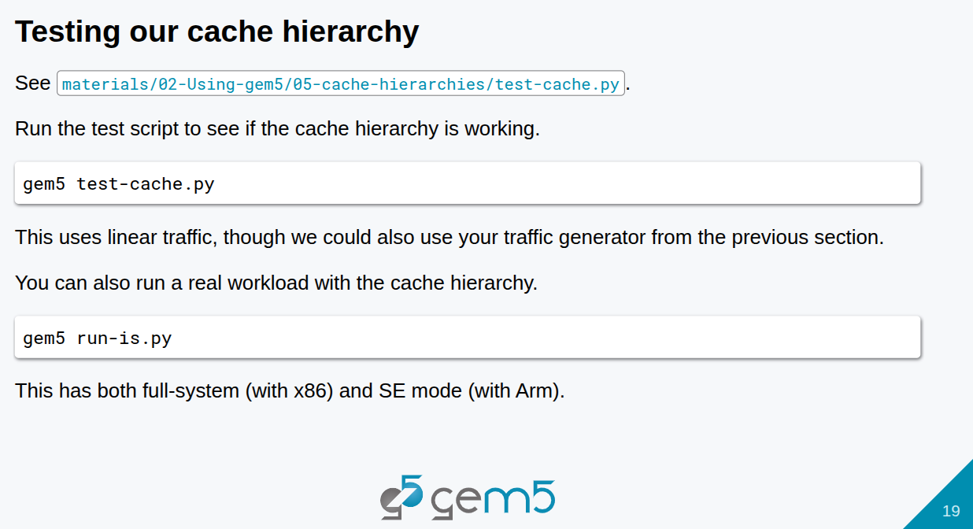
8.1 Cache Model: Slides
https://gem5bootcamp.github.io/2024/#02-Using-gem5/05-cache-hierarchies
Cache Model: Slides

Slide 21
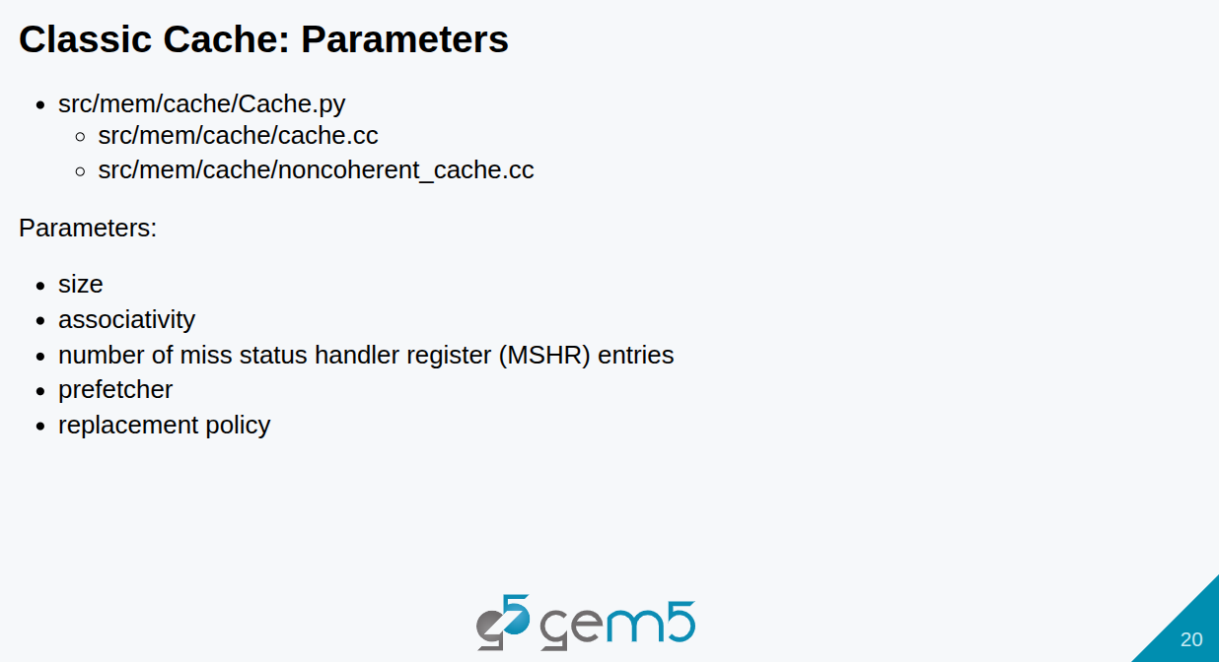
8.1 Cache Model: Slides
https://gem5bootcamp.github.io/2024/#02-Using-gem5/05-cache-hierarchies
Cache Model: Slides

Slide 22

8.1 Cache Model: Slides
https://gem5bootcamp.github.io/2024/#02-Using-gem5/05-cache-hierarchies
Cache Model: Slides

Slide 23
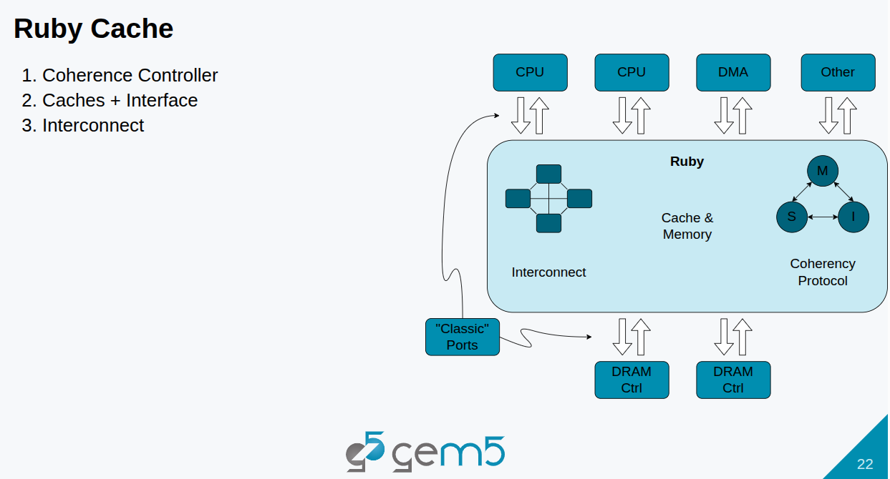
8.1 Cache Model: Slides
https://gem5bootcamp.github.io/2024/#02-Using-gem5/05-cache-hierarchies
Cache Model: Slides

Slide 24
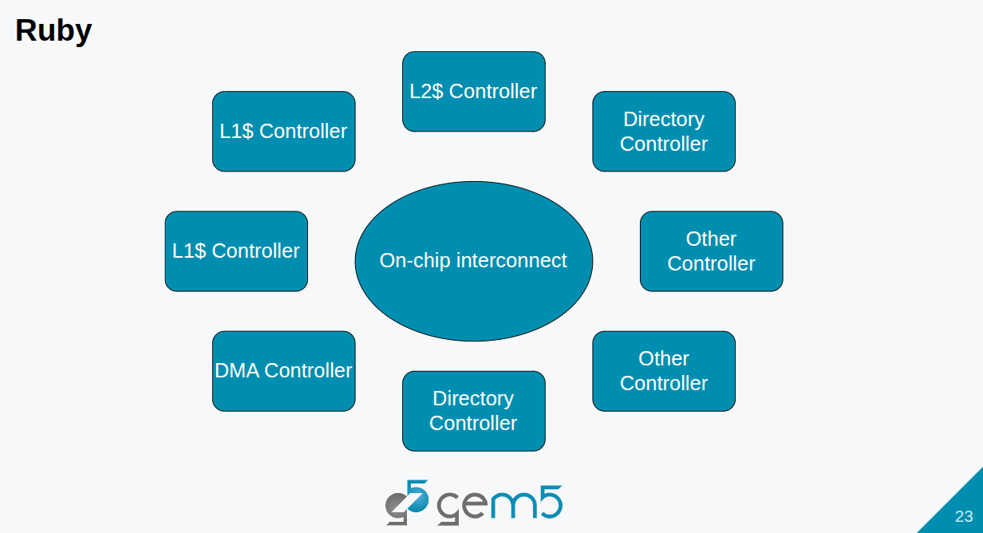
8.1 Cache Model: Slides
https://gem5bootcamp.github.io/2024/#02-Using-gem5/05-cache-hierarchies
Cache Model: Slides

Slide 25
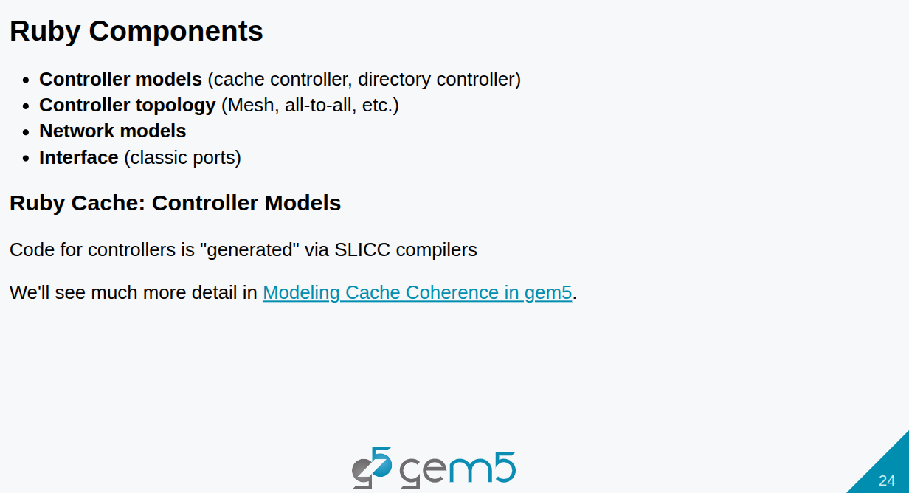
8.1 Cache Model: Slides
https://gem5bootcamp.github.io/2024/#02-Using-gem5/05-cache-hierarchies
Cache Model: Slides

Slide 26
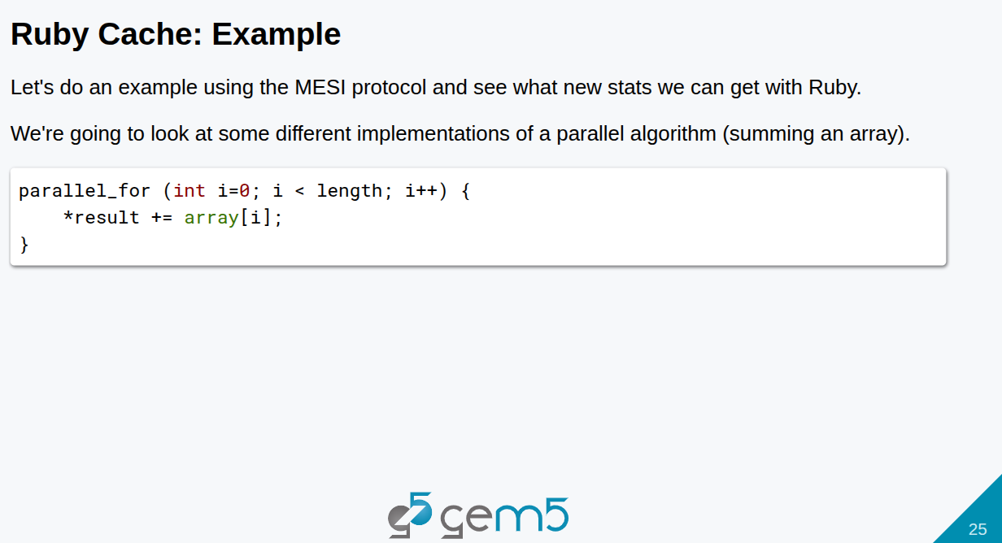
8.1 Cache Model: Slides
https://gem5bootcamp.github.io/2024/#02-Using-gem5/05-cache-hierarchies
Cache Model: Slides

Slide 27
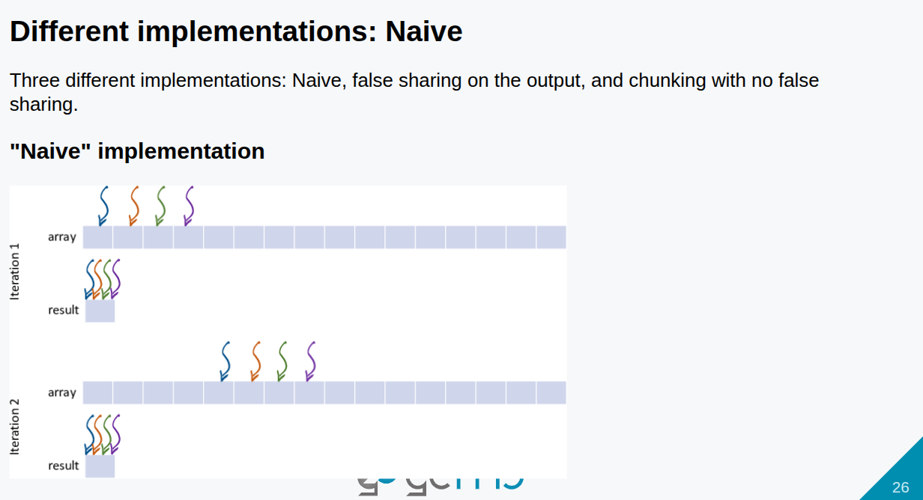
8.1 Cache Model: Slides
https://gem5bootcamp.github.io/2024/#02-Using-gem5/05-cache-hierarchies
Cache Model: Slides

Slide 28
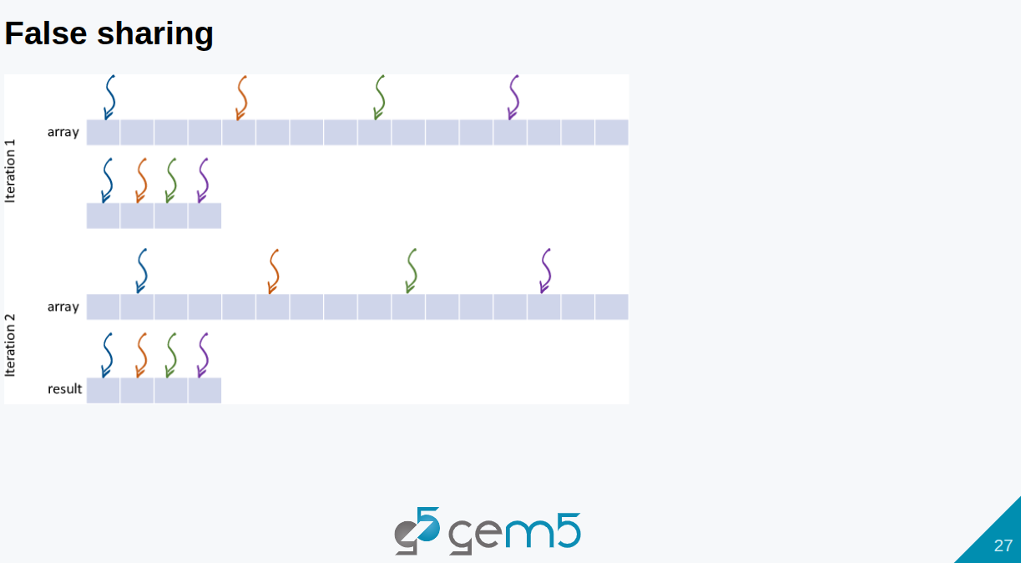
8.1 Cache Model: Slides
https://gem5bootcamp.github.io/2024/#02-Using-gem5/05-cache-hierarchies
Cache Model: Slides

Slide 29
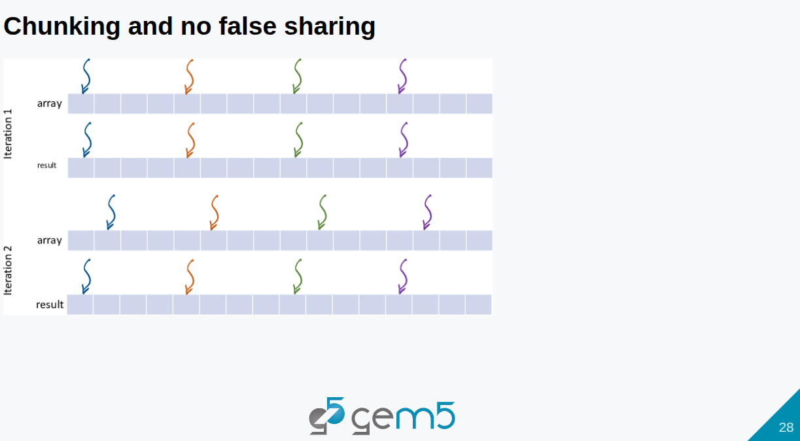
8.1 Cache Model: Slides
https://gem5bootcamp.github.io/2024/#02-Using-gem5/05-cache-hierarchies
Cache Model: Slides

Slide 30
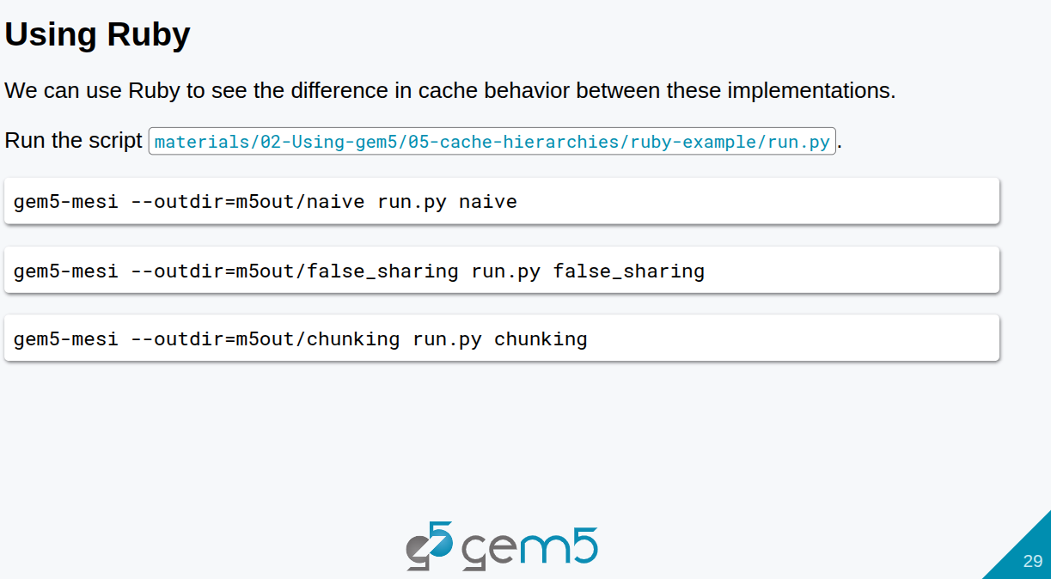
8.1 Cache Model: Slides
https://gem5bootcamp.github.io/2024/#02-Using-gem5/05-cache-hierarchies
Cache Model: Slides

Slide 31
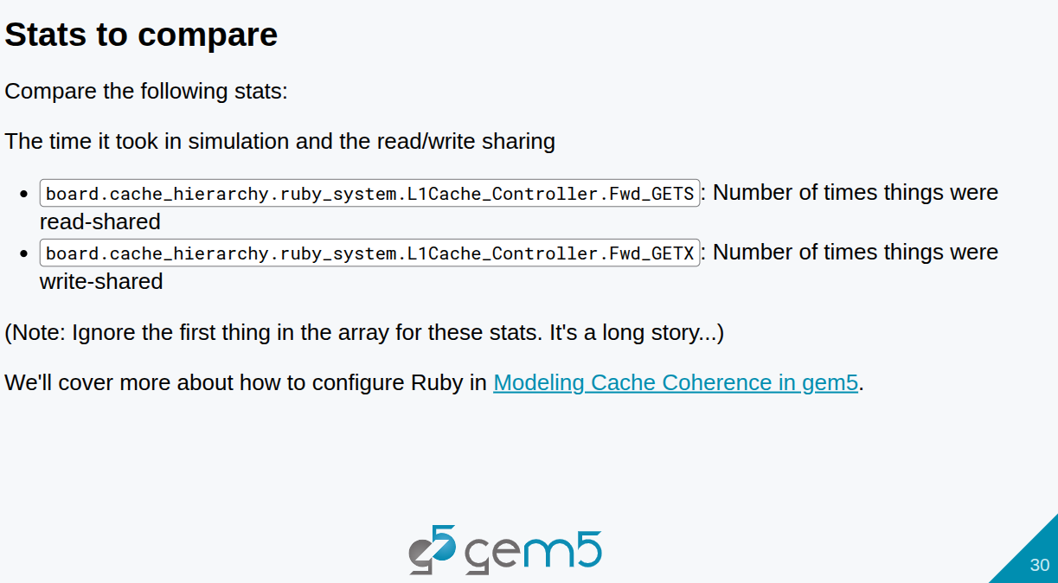
8.1 Cache Model: Slides
https://gem5bootcamp.github.io/2024/#02-Using-gem5/05-cache-hierarchies
Cache Model: Slides

Slide 32
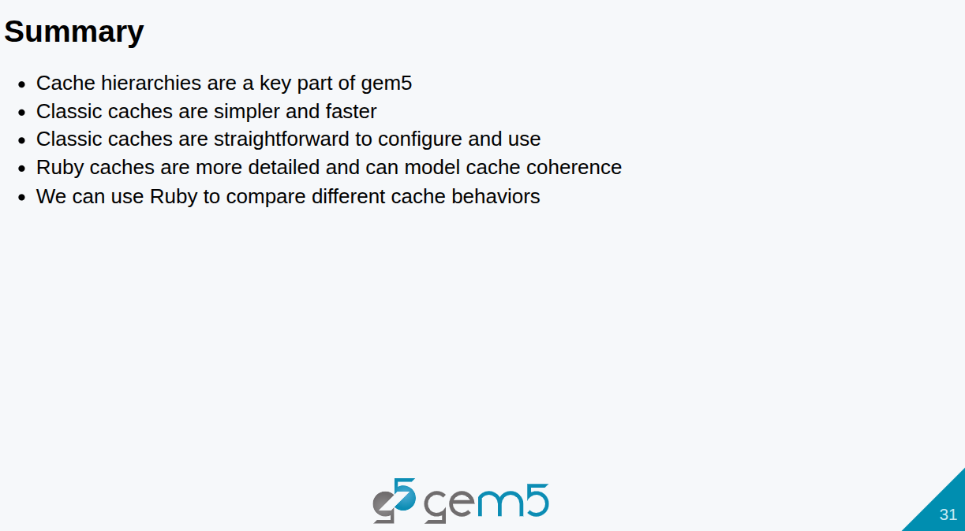
8.1 Cache Model: Slides
https://gem5bootcamp.github.io/2024/#02-Using-gem5/05-cache-hierarchies
Cache Model: Slides

Slide 33
End

