Slide 1

10 Full System Simulation
Peter H. Chen

Slide 2

10 Full System Simulation
https://www.youtube.com/watch?v=Ng8A6Cd5HAQ&list=PL_hVbFs_loVR_8ntTTmmG6YEq3Po_4snu&index=10
Full System Simulation (0:00-0:01/35:37)
We talk Full System Simulation in Gem5.

Slide 3
10.1 Topics

Slide 4
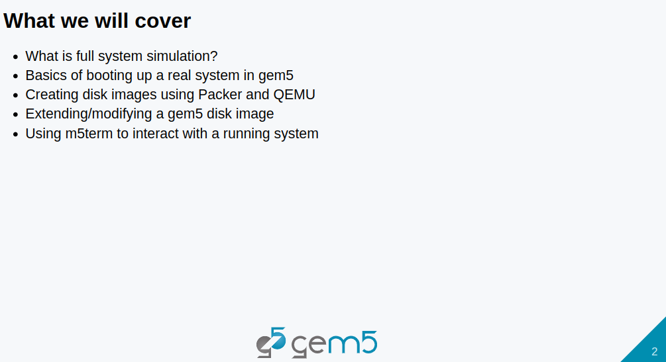
10.1 Topics
https://www.youtube.com/watch?v=Ng8A6Cd5HAQ&list=PL_hVbFs_loVR_8ntTTmmG6YEq3Po_4snu&index=10
Topics (0:02-0:04/35:37)
Topics:
1. What is full system simulation?
2. Basics of booting up a real system in gem5
3. How to Setup Gem5 Resource for Full System Simulation?
a. Go to “https://resources.gem5.org/”
b. Search for “x84 ubuntu22.04 with systemd” (systemd mean system demon”
c. Get the string name “x86-ubuntu-22.04-boot-with-systemd” and version “1.0.0”
d. In the folder
> bootcamp/materials/02-Using-gem5/07-full-system/X86-fs-kvm-run.py
e. Modify the below code
> workload= obtain-resource (“x86-ubuntu-22.04-boot-with-systemd”, resource_version = “1.0,0”)
> board.set_workload (workload)
f. Run the Full System sumulation
3. Creating disk images using Packer and QEMU
4. Extending/modifying a gem5 disk image
5. Using m5term to interact with a running system

Slide 5
10.2 What is Full System Simulation?

Slide 6
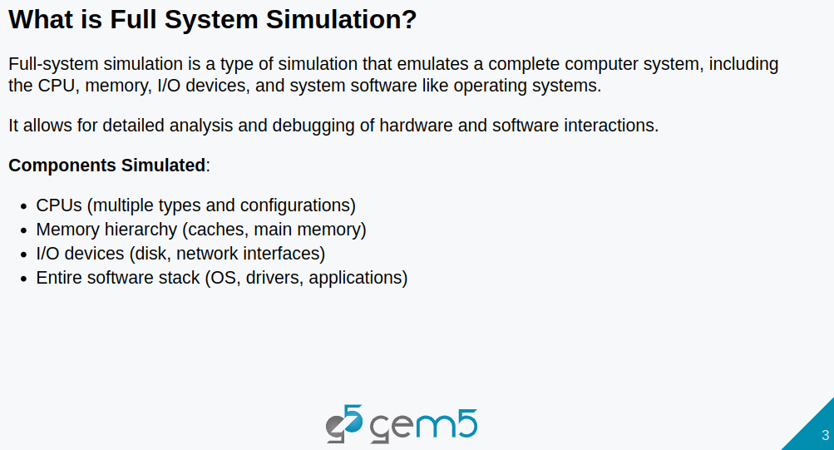
10.2 What is Full System Simulation?
https://www.youtube.com/watch?v=Ng8A6Cd5HAQ&list=PL_hVbFs_loVR_8ntTTmmG6YEq3Po_4snu&index=10
What is Full System Simulation? (0:05-0:28/35:37)
Full system simulation will simulate an entire computer system, such as,
a. CPUs,
b. Memory system (Caches and Main Memory)
c. IO Devices (disk, network, GPU)
d. Software system (OS, drivers, applications, other benchmark).

Slide 7
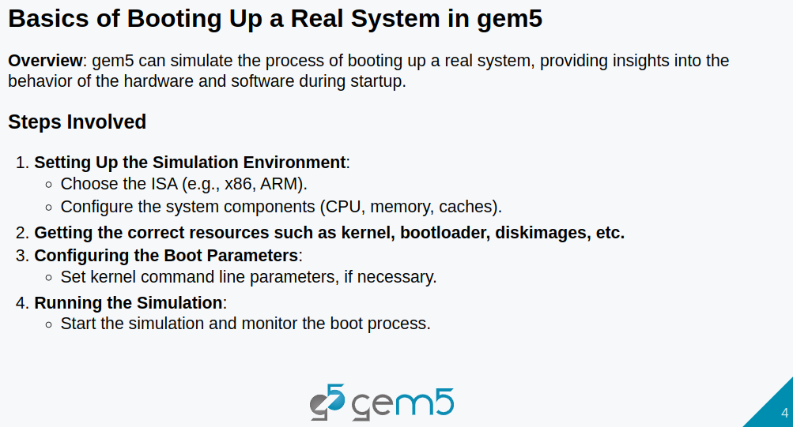
10.2 What is Full System Simulation?
https://www.youtube.com/watch?v=Ng8A6Cd5HAQ&list=PL_hVbFs_loVR_8ntTTmmG6YEq3Po_4snu&index=10
What is Full System Simulation? (0:29-1:20/35:37)
Gem5 can simulate the process of real system.
If we want to boot full system on Gem5. We have to follow the below steps:
a. Setup the simulation enviroment:
  Select ISA (Instruction Set Architecture), such as, RISCV, X86, ARM, etc.
  Configure the system components, such as, CPU, caches, memory, etc.
b. Get the correct resource, such as, kernel, boot loader, disk image, etc.
c. Configure the boot parameters: Setup Kernel commands
d. Run Simulation

Slide 8
10.3 Run Full System Simulation in Gem5

Slide 9
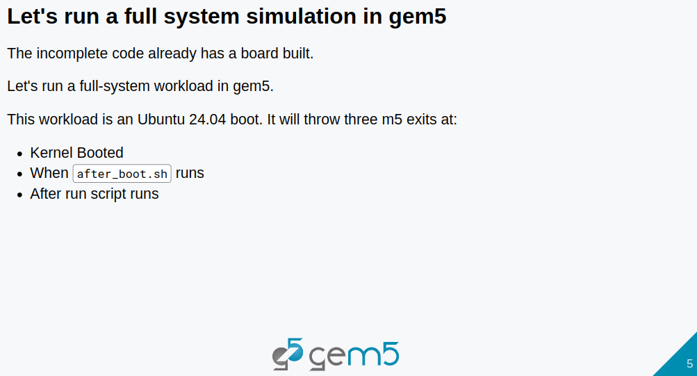
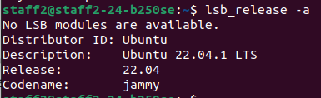
10.3 Run Full System Simulation in Gem5
https://www.youtube.com/watch?v=Ng8A6Cd5HAQ&list=PL_hVbFs_loVR_8ntTTmmG6YEq3Po_4snu&index=10
Run Full System Simulation in Gem5 (1:21-2:07/35:37)
Let’s run a full system simulation in Gem5.
a. Check Ubuntu Version:
> lsb_release -a
>> 22.04
With systemd resource on gem5 resources. This disk image throw 3 exit events (3 m5 exits) at:
1. The first exit event is when kernel is booted,
2. The second exit event is when the after_boot.sh. The script is run: After systemd is initialized and setup.
3. The third exit event is after our run script is finished.
We can specify the script on the disk image or some command on the terminal.
After the command is run, another exit event will be thrown.

Slide 10
10.4 Setup Gem5 Resource for FS Simulation

Slide 11
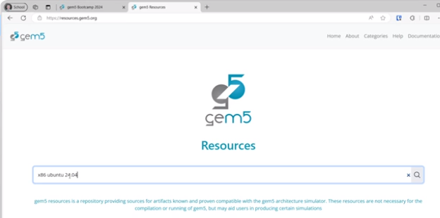
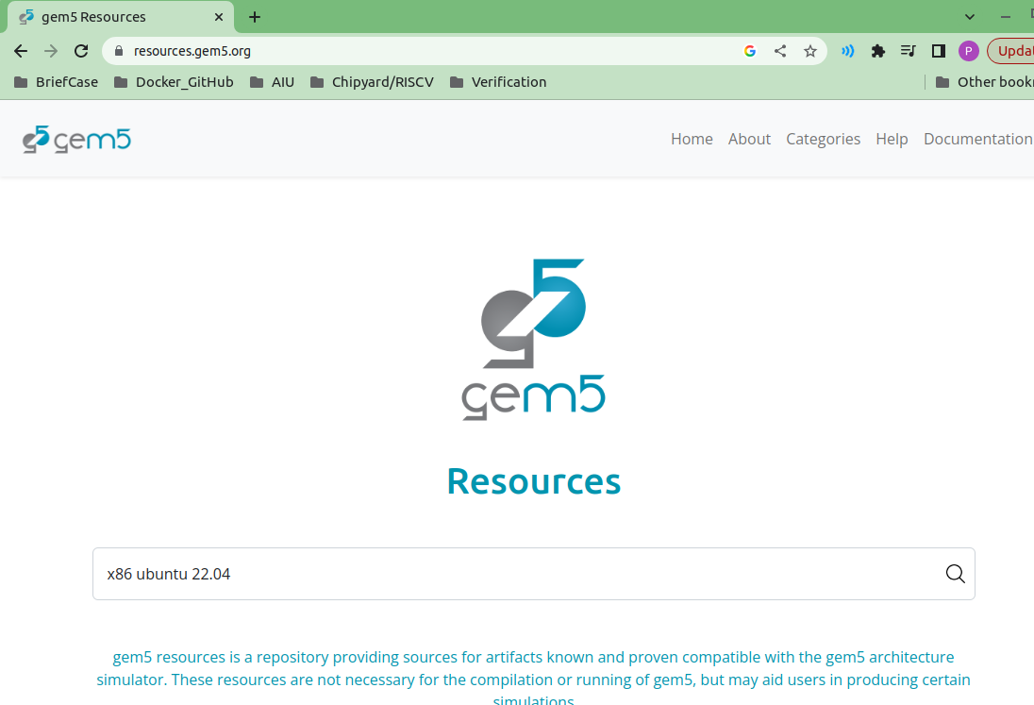
10.4 Setup Gem5 Resource for FS Simulation
https://www.youtube.com/watch?v=Ng8A6Cd5HAQ&list=PL_hVbFs_loVR_8ntTTmmG6YEq3Po_4snu&index=10
Setup Gem5 Resource for Full System Simulation (2:08-2:16/35:37)
> resources.gem5.org
Type
> x86 ubuntu 22.04

Slide 12
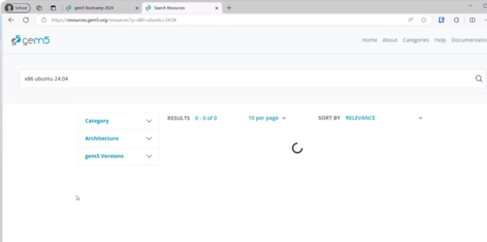
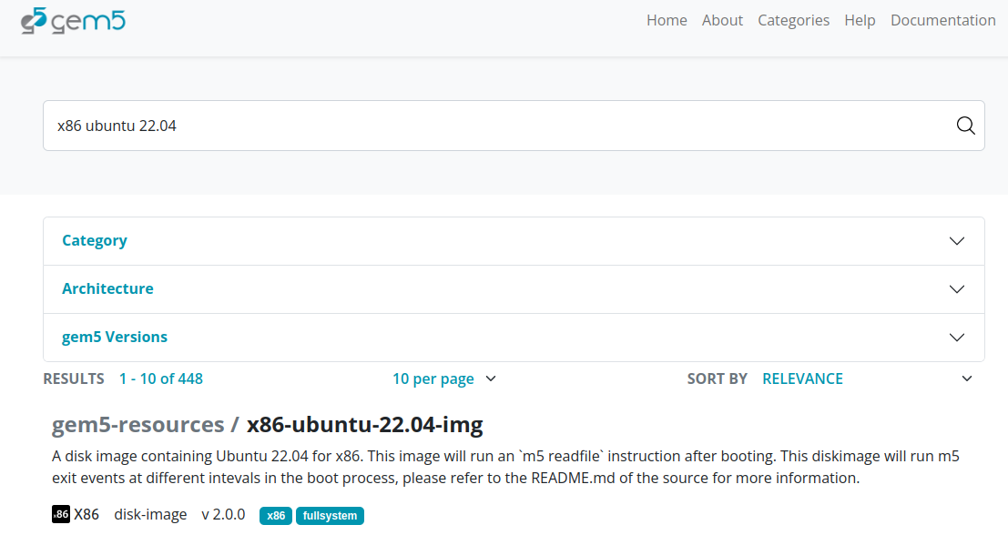
10.4 Setup Gem5 Resource for FS Simulation
https://www.youtube.com/watch?v=Ng8A6Cd5HAQ&list=PL_hVbFs_loVR_8ntTTmmG6YEq3Po_4snu&index=10
Setup Gem5 Resource for Full System Simulation (2:17-2:16/35:37)
We have page for “x86 ubuntu 22.04”

Slide 13
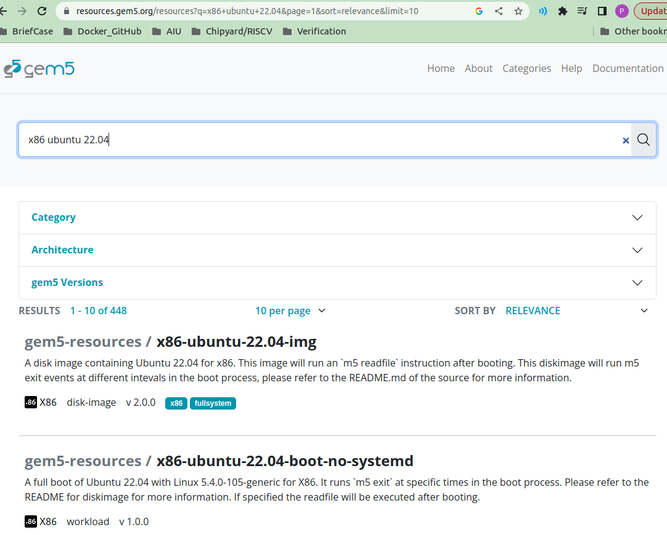
10.4 Setup Gem5 Resource for FS Simulation
https://www.youtube.com/watch?v=Ng8A6Cd5HAQ&list=PL_hVbFs_loVR_8ntTTmmG6YEq3Po_4snu&index=10
Setup Gem5 Resource for Full System Simulation (2:17-2:18/35:37)
Scroll down page of “x86 ubuntu 22.04”
We want the systemd.

Slide 14
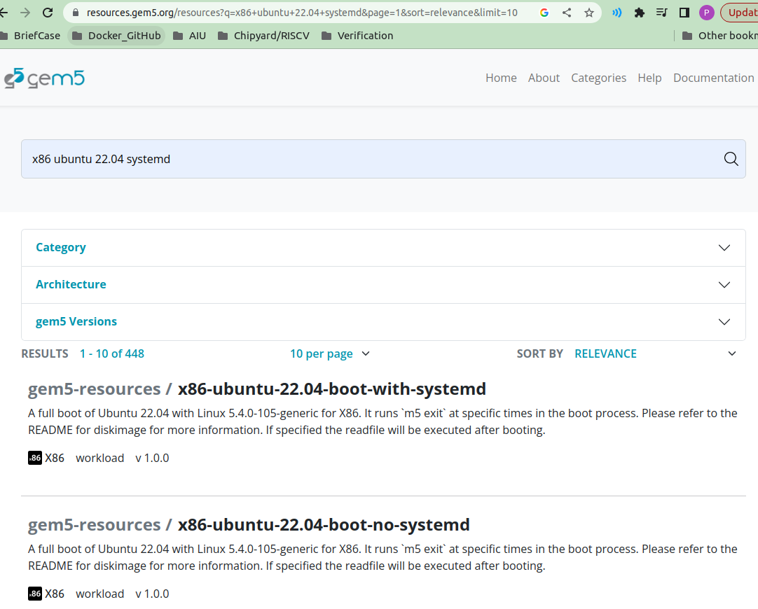
10.4 Setup Gem5 Resource for FS Simulation
https://www.youtube.com/watch?v=Ng8A6Cd5HAQ&list=PL_hVbFs_loVR_8ntTTmmG6YEq3Po_4snu&index=10
Setup Gem5 Resource for Full System Simulation (2:19-2:25/35:37)
Click “x86-ubuntu-22.04-boot-with-systemd”

Slide 15
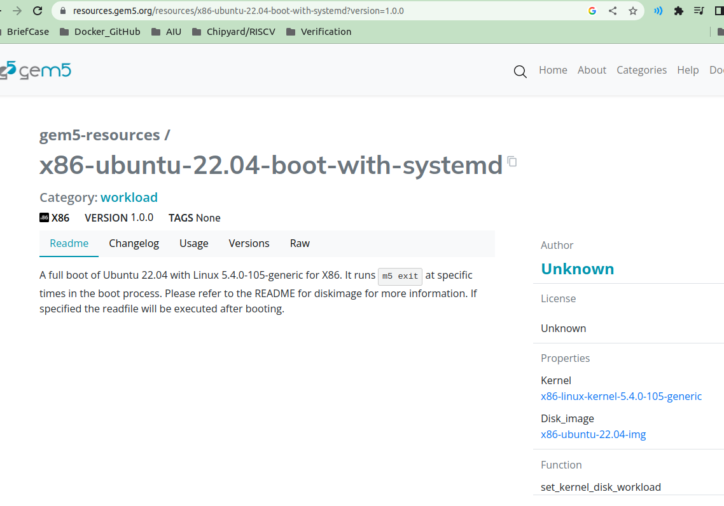
10.4 Setup Gem5 Resource for FS Simulation
https://www.youtube.com/watch?v=Ng8A6Cd5HAQ&list=PL_hVbFs_loVR_8ntTTmmG6YEq3Po_4snu&index=10
Setup Gem5 Resource for Full System Simulation (2:26-2:35/35:37)
We have page of “x86-ubuntu-22.04-boot-with-systemd”
This is how we got
1. the unique resource version name is “x86-ubuntu-22.04-boot-with-systemd” and
2.version is “1.0.0”.

Slide 16
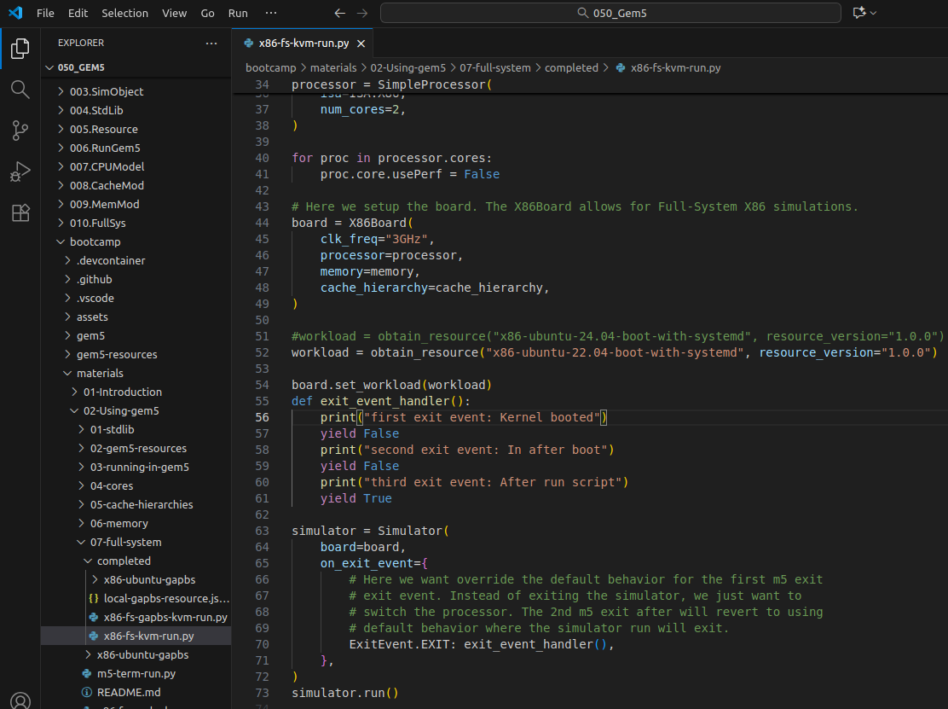
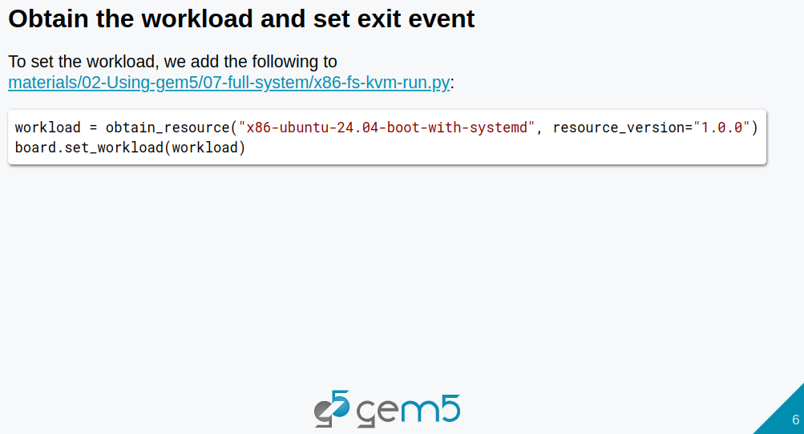
10.4 Setup Gem5 Resource for FS Simulation
https://www.youtube.com/watch?v=Ng8A6Cd5HAQ&list=PL_hVbFs_loVR_8ntTTmmG6YEq3Po_4snu&index=10
Setup Gem5 Resource for Full System Simulation (2:36-3:35/35:37)
Now, we have the unique resource version name is “x86-ubuntu-22.04-boot-with-systemd”
In the
> bootcamp/materials/02-Using-gem5/07-full-system/X86-fs-kvm-run.py
We need to modify the below code
> workload= obtain-resource (“x86-ubuntu-22.04-boot-with-systemd”, resource_version = “1.0,0”)
> board.set_workload (workload)
x

Slide 17
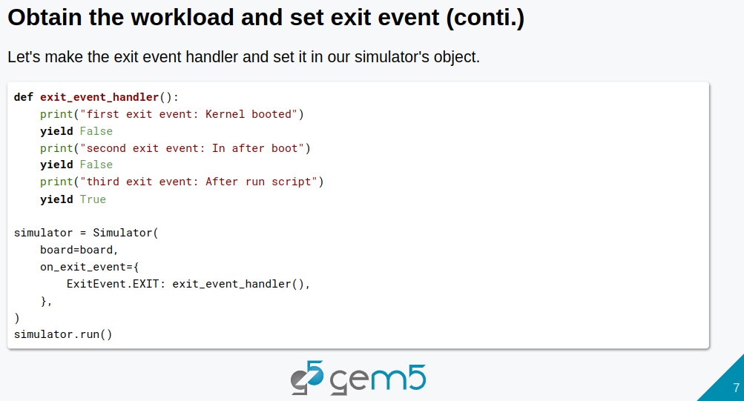
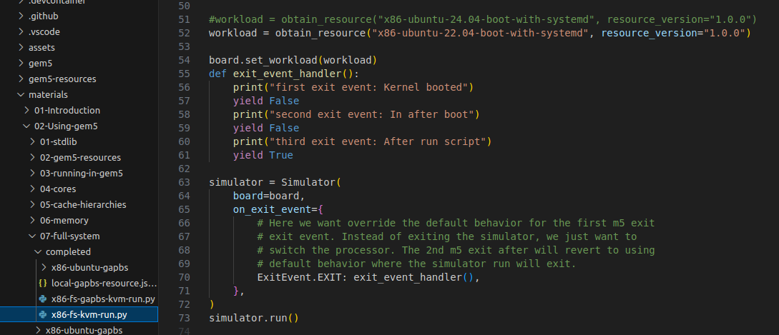
10.4 Setup Gem5 Resource for FS Simulation
https://www.youtube.com/watch?v=Ng8A6Cd5HAQ&list=PL_hVbFs_loVR_8ntTTmmG6YEq3Po_4snu&index=10
Setup Gem5 Resource for Full System Simulation (2:36-3:35/35:37)
We
1. Setup the workload = obtain_resource(“x86-ubuntu-22.04-boot-with-systemd”, resource_version = “1.0.0”))
2. Define exit_event_handler()
3. Add event handler for simulator simulator with on_exit_event = { EcitEvent.EXIT: exit_event_handler()

Slide 18
End

