Slide 1

21 Model Port (01)
Peter H. Chen

Slide 2
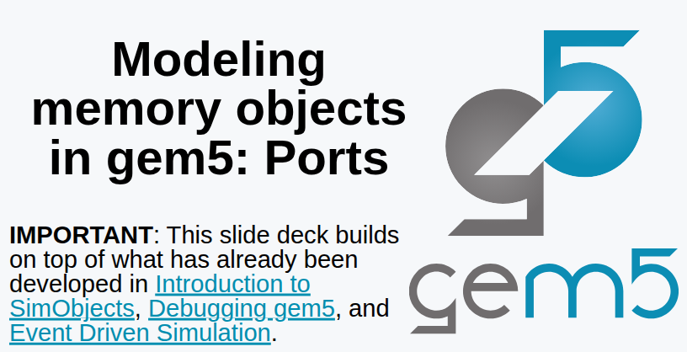
21 Model Port (01)
https://www.youtube.com/watch?v=Ka6xuIr6-oo&list=PL_hVbFs_loVR_8ntTTmmG6YEq3Po_4snu&index=21
Model Port (01) (0:00-0:10/11:44)
We have been talked about SimObjects, Debugging gem5, Event driven simulation.
Now, we talk about the Model Port (01).

Slide 3
21.0 Topics

Slide 4
21.0 Topics
https://www.youtube.com/watch?v=Ka6xuIr6-oo&list=PL_hVbFs_loVR_8ntTTmmG6YEq3Po_4snu&index=21
Model Port (01) (0:11-0:15/11:44)
1.

Slide 5
21.1 Port

Slide 6
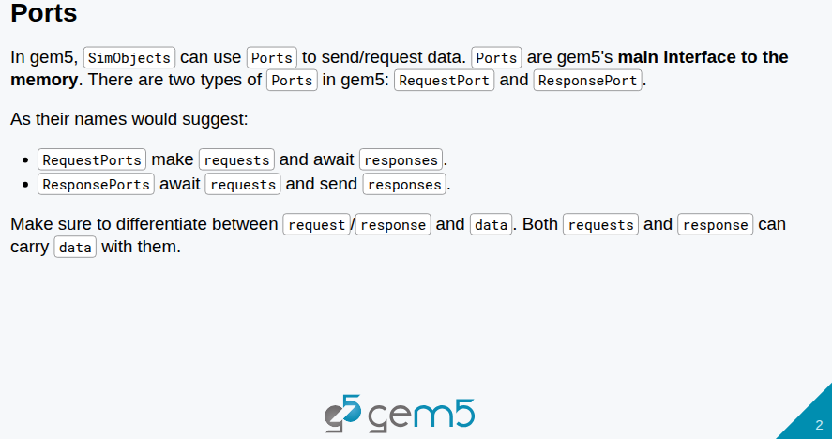
21.1 Port
https://www.youtube.com/watch?v=Ka6xuIr6-oo&list=PL_hVbFs_loVR_8ntTTmmG6YEq3Po_4snu&index=21
Port (0:16-1:00/11:44)
1. In Gem5, Ports are the interface to move data.
2. We can request for data, responses for data or request for writes, request for reads.
3. We all need to differentiate between request/response and data.
4. So, both requests and responses can have or not have data.
5. For example, a read request does not have a data and a write request has data.
6. The read response may have data and the write response may not have data.

Slide 7
21.2 Packet

Slide 8
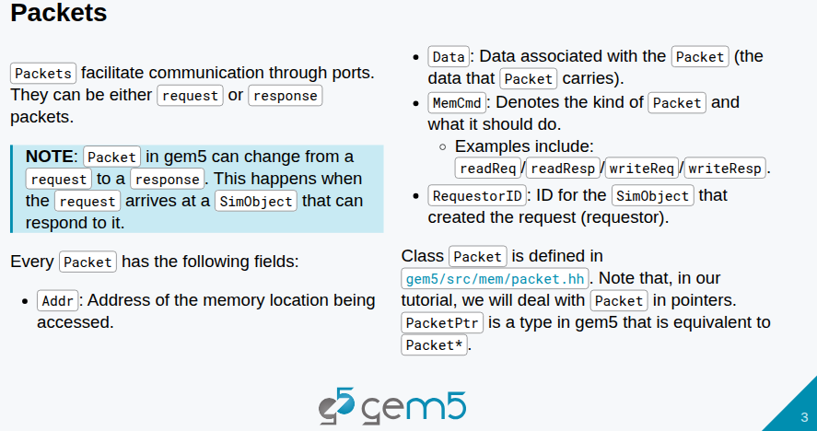
21.2 Packet
https://www.youtube.com/watch?v=Ka6xuIr6-oo&list=PL_hVbFs_loVR_8ntTTmmG6YEq3Po_4snu&index=21
Packet (1:01-1:20/11:44)
1. In Gem5, All the information are encapsulated in the packet class
2. Ports and packets work together to move data from one end of you system to anther end.
3. An packet encapsulate a bunch of information.

Slide 9
21.2 Packet
https://www.youtube.com/watch?v=Ka6xuIr6-oo&list=PL_hVbFs_loVR_8ntTTmmG6YEq3Po_4snu&index=21
Packet (1:21-1:50/11:44)
4. Packet includes address, for example, I want to read an address from the memory. We create a packet and set the address, filled in the packet with the address which we want to access. The data field may or may not be null depending on the actual packet trying to achieve.
5. In the packet, there is a memory command which can be read/write. It can be read request, write request, read response, or write response.
6. There is a long list of memory commands in Gem5.

Slide 10
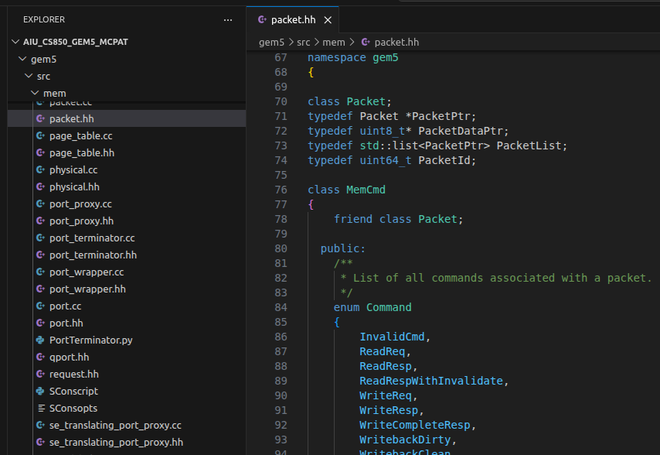
21.2 Packet
https://www.youtube.com/watch?v=Ka6xuIr6-oo&list=PL_hVbFs_loVR_8ntTTmmG6YEq3Po_4snu&index=21
Packet (1:51-2:10/11:44)
7. The Packet class defines all the memory command in below:
> gem5/src/mem/packet.hh
8. There are request ID which is a global ID for the SimObject that requested. The global ID need to send to packet.

Slide 11
21.3 Port Code

Slide 12
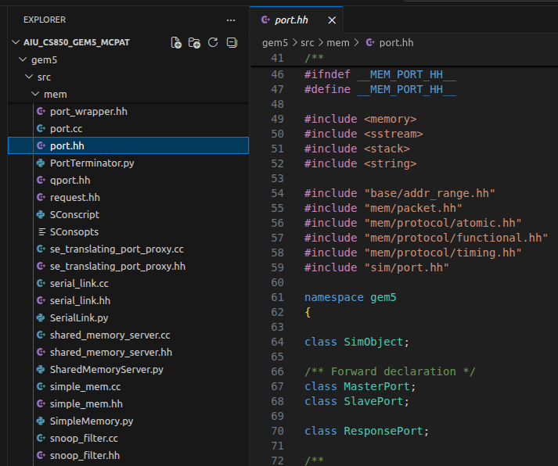
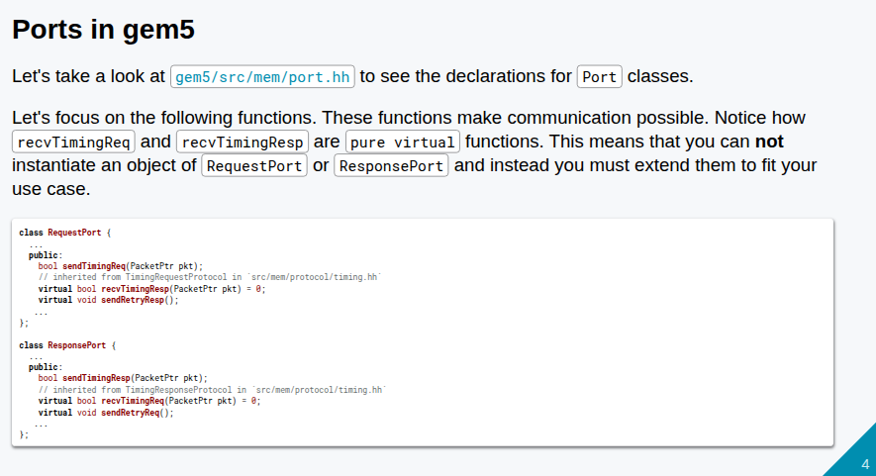
21.3 Port Code
https://www.youtube.com/watch?v=Ka6xuIr6-oo&list=PL_hVbFs_loVR_8ntTTmmG6YEq3Po_4snu&index=21
Port Code (2:11-2:20/11:44)
1. If we look at the port class in:
> gem5/src/mem/port.hh

Slide 13
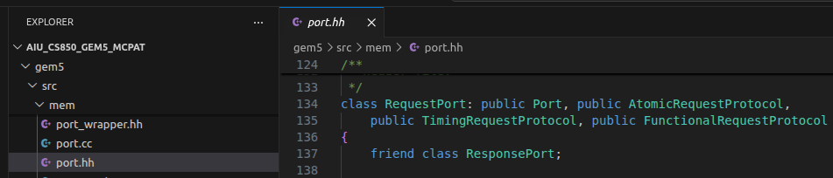
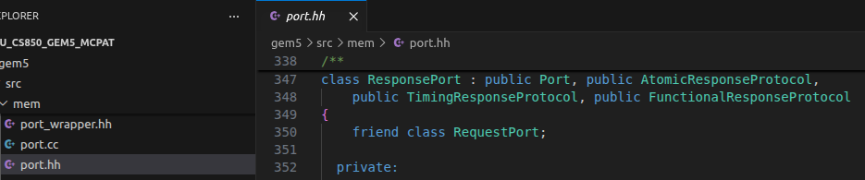
21.3 Port Code
https://www.youtube.com/watch?v=Ka6xuIr6-oo&list=PL_hVbFs_loVR_8ntTTmmG6YEq3Po_4snu&index=21
Port Code (2:21-2:40/11:44)
2. We see two types of ports: RequestPort and ResponsePort.
3. The difference between the request and response ports:
  Request is for request some service.
  Response provides that service.

Slide 14
21.3 Port Code
https://www.youtube.com/watch?v=Ka6xuIr6-oo&list=PL_hVbFs_loVR_8ntTTmmG6YEq3Po_4snu&index=21
Port Code (2:41-3:20/11:44)
4. The initiator of any transaction is a request port.
5. for example, the port between the our cache and our CPU. There are two ports there.
There is a port on our CPU that is a request port.
There is a port on our cache that is a response port.
6. When we put the equal sign between these ports in Python. The ports are connected together,
7. When CPU want some something, CPU will use the request port to send a packet to the response port. The response port is connected to the request port.

Slide 15
21.3 Port Code
https://www.youtube.com/watch?v=Ka6xuIr6-oo&list=PL_hVbFs_loVR_8ntTTmmG6YEq3Po_4snu&index=21
Port Code (3:21-4:25/11:44)
8. The request port and the response port are called peer. The request port can have a peer that is a response port. We never see two request ports are the peer. Only request and response port can be the peers.
9. Below, we have a bunch of pure virtual functions. These virtual functions are abstract classes. We cannot instantiate an object of the abstract class. In the code, we can extend the virtual function and define our own actions.
10. The virtual functions are related to receiving no matter it is q request or a response. The virtual function only relates to receiving requests. That is because the sending is very straightforward.
11. These request or response virtual functions that we cannot instantiate.

Slide 16
21.4 Access Modes: Timing, Atomic, Functional

Slide 17
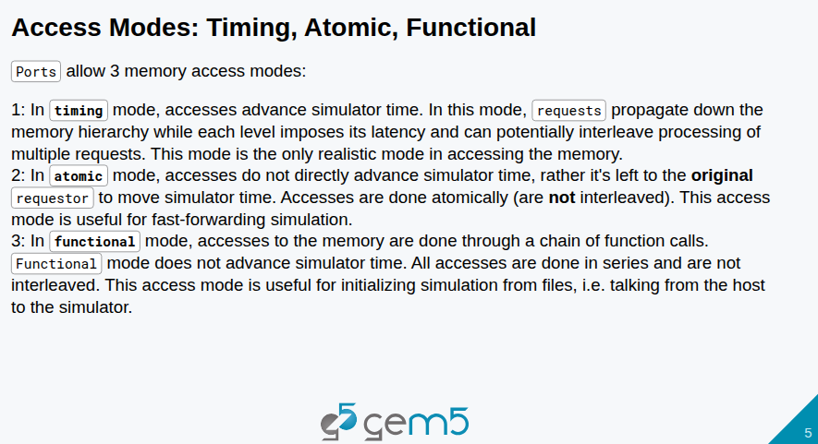
21.4 Access Modes: Timing, Atomic, Functional
https://www.youtube.com/watch?v=Ka6xuIr6-oo&list=PL_hVbFs_loVR_8ntTTmmG6YEq3Po_4snu&index=21
Access Modes: Timing, Atomic, Functional (4:26-5:15/11:44)
In our C++ code, we extend the functions from defined headers.
We can use these functions to access the memory timing, atomic, and functional.
1. In timing, what we will follow the convention to send the request, then gem5 will do the simulation, it will take longer time to do the simulation, we will get the requested data in future. The timing mode is an advanced simulator.

Slide 18
21.4 Access Modes: Timing, Atomic, Functional
https://www.youtube.com/watch?v=Ka6xuIr6-oo&list=PL_hVbFs_loVR_8ntTTmmG6YEq3Po_4snu&index=21
Access Modes: Timing, Atomic, Functional (5:16-6:50/11:44)
2. The Atomic mode is a fast-forward simulator. The atomic mode not the advanced timing mode, it will return the request immediately.
In Atomic mode, we still need the simulator time but the simulator time is much shorter and less accurate.
The atomic mode return the tick value for latency time. It has access 1 service for memory controller and access 2 service for L1 cache.
In gem5, there is the CPU time. In Atomic mode, the CPU time may not move forward.

Slide 19
21.4 Access Modes: Timing, Atomic, Functional
https://www.youtube.com/watch?v=Ka6xuIr6-oo&list=PL_hVbFs_loVR_8ntTTmmG6YEq3Po_4snu&index=21
Access Modes: Timing, Atomic, Functional (6:51-7:00/11:44)
3. In Functional mode, it even does not return the a latency time. Functional mode does not access the caches.
Functional mode is a backdoor to the memory and only do the transaction.
Functional Model is very useful for initialization of simulator. If we want to load a image into the DRAM memory.

Slide 20
21.5 Timing Protocol

Slide 21
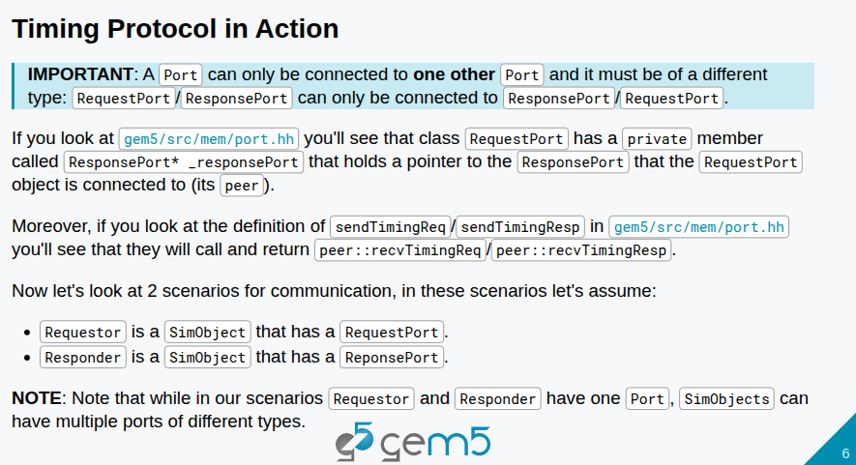
21.5 Timing Protocol
https://www.youtube.com/watch?v=Ka6xuIr6-oo&list=PL_hVbFs_loVR_8ntTTmmG6YEq3Po_4snu&index=21
Timing Protocol (7:01-8:00/11:44)
S A port can be connected to another port.

Slide 22
End

