Slide 1

26 DRAM Integration
Peter H. Chen

Slide 2
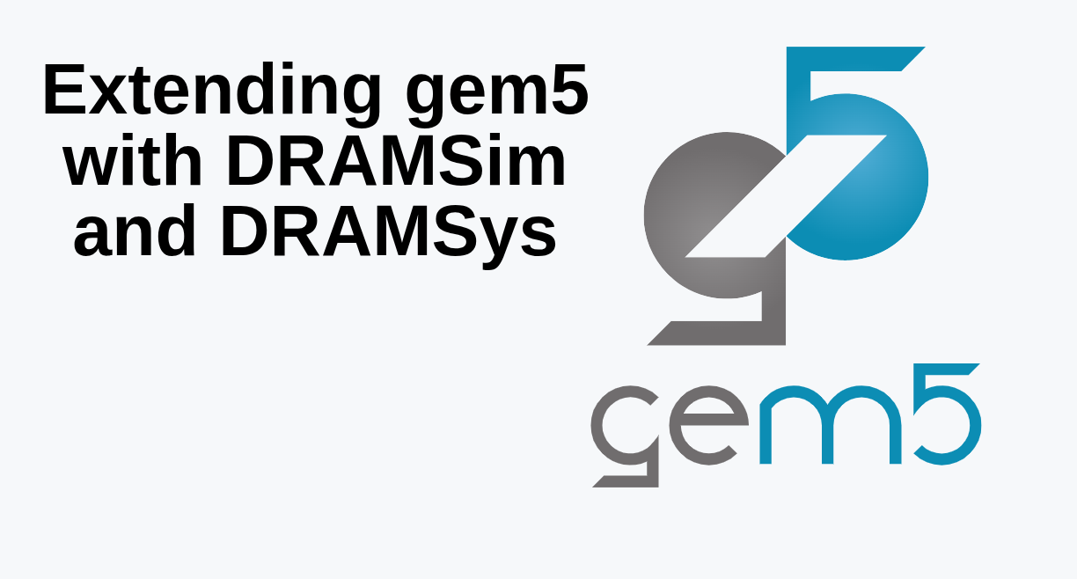
26 DRAM Integration
https://www.youtube.com/watch?v=ciSLhURk6OU&list=PL_hVbFs_loVR_8ntTTmmG6YEq3Po_4snu&index=26
DRAM Integration (12:10 - 12:11/20:37)
There is a lot of other simulator. Again, gem5 provide the port interface with these simulator.

Slide 3
26 DRAM Integration
https://www.youtube.com/watch?v=ciSLhURk6OU&list=PL_hVbFs_loVR_8ntTTmmG6YEq3Po_4snu&index=26
DRAM Integration (12:10 - 12:30/20:37)
Key Differences
1. Scope and Purpose:
a. gem5: Evaluates overall system-level performance, multi-core coherence, and software execution (supporting full-system OS boot or syscall emulation across ISAs like x86, ARM, and RISC-V). It includes a built-in, event-driven DRAM controller model.
b. DRAM Simulator: Focuses deeply on internal DRAM channel behavior, detailed bus queuing, command scheduling (FR-FCFS), and precise power/energy breakdowns per bank/rank.
2. Level of Detail vs. Speed:
a. gem5's built-in DRAM controller: Operates faster (often significantly more abstract/simpler) while capturing system-level bandwidth and latency trends.
b. Dedicated DRAM Simulators: Provide high-fidelity, cycle-accurate physical timing and state tracking for specific DDR standards, though they require memory request traces or integration into a full system.
3. Integration: Researchers often integrate gem5 with dedicated DRAM simulators (like DRAMSim2 or DRAMSim3) to get realistic, fine-grained memory behavior while running full-system workloads in gem5.

Slide 4
26.0 gem5/DRAM Topics

Slide 5
26.0 gem5/DRAM Topics
https://www.youtube.com/watch?v=ciSLhURk6OU&list=PL_hVbFs_loVR_8ntTTmmG6YEq3Po_4snu&index=26
gem5/DRAM Topics (12:31 – 12:40/20:37)
gem5/DRAM Topics:
Gem5 focuses on system and DRAM focus on detailed DRAM simulation.
1. DRAM Port interface between gem5 and DRAMSys.
2. Clone the DRAMSys
3. Build DRAMSys
4. Example of DRAMSys
5. Example of DRAMSIm3.

Slide 6
26.1 Port Interface

Slide 7
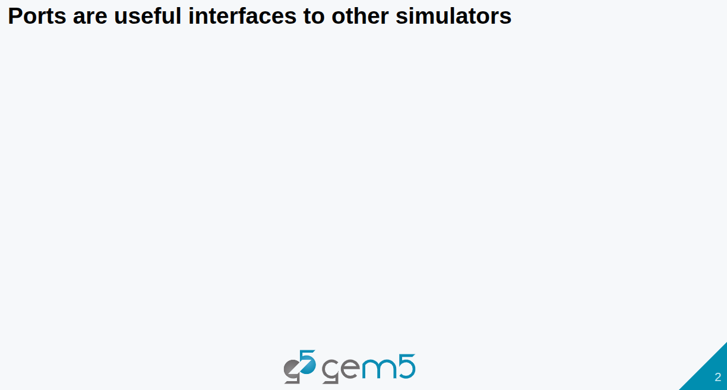
26.1 Port Interface
https://www.youtube.com/watch?v=ciSLhURk6OU&list=PL_hVbFs_loVR_8ntTTmmG6YEq3Po_4snu&index=26
Interface Port (12:41 – 12:50/20:37)
Gem5 has port interface for DRAM simulator. Port Interfaces are useful interface between gem5 and other simulators.

Slide 8
26.2 External Simulator

Slide 9
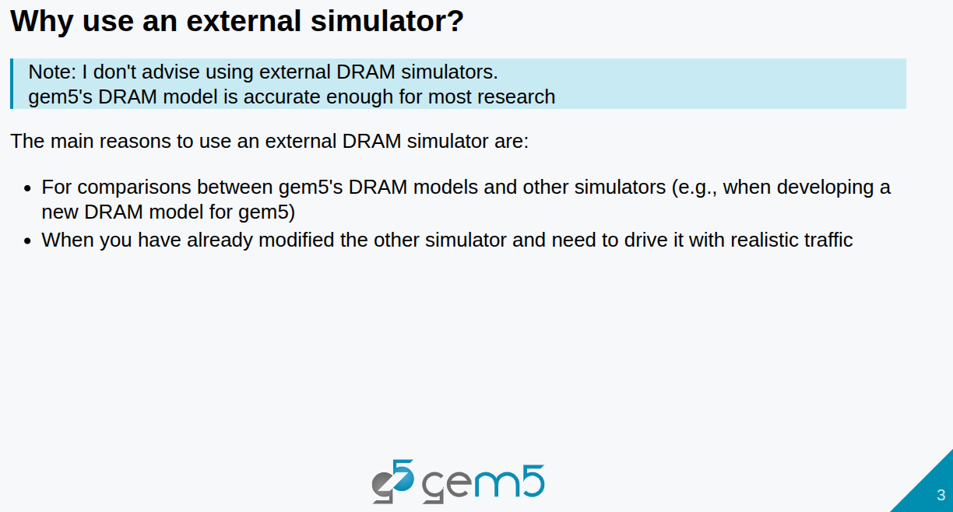
26.2 External Simulator
https://www.youtube.com/watch?v=ciSLhURk6OU&list=PL_hVbFs_loVR_8ntTTmmG6YEq3Po_4snu&index=26
External Simulator (12:51 – 13:50/20:37)
Why do we need the external simulator?
1. gem5 is better than DRAM simulator. We don’t need other simulator.
If we want to compare gem5 DRAM and other DRAM simulator
2. When you already have other simulator and you want to interface with gem5.

Slide 10
26.3 Clone DRAMSys

Slide 11
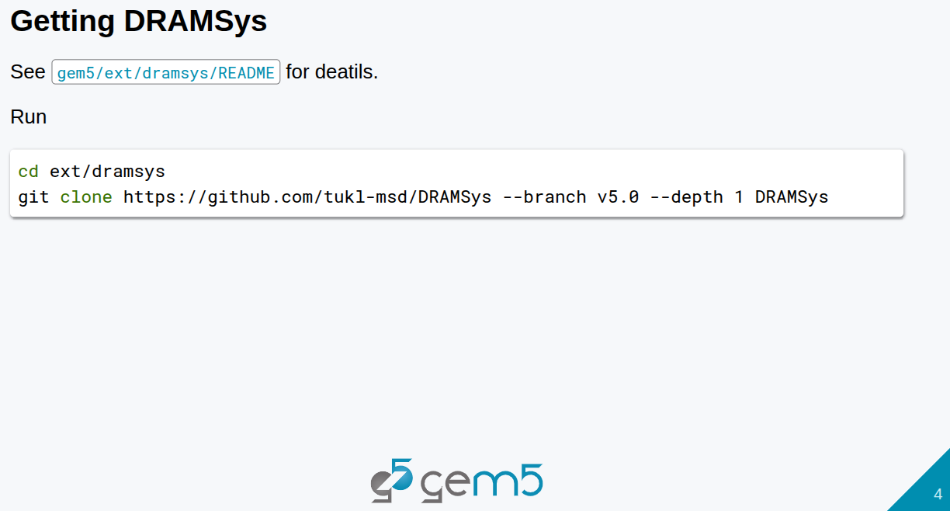
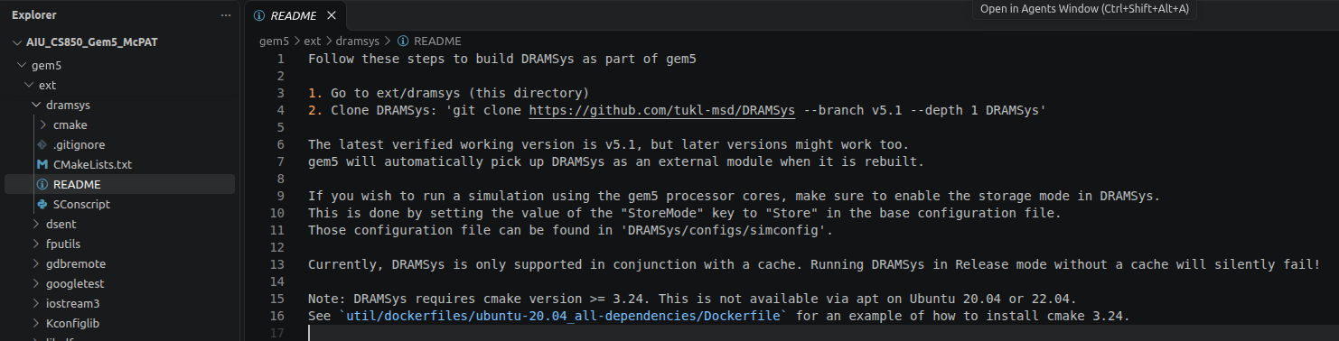
26.3 Clone DRAMSys
https://www.youtube.com/watch?v=ciSLhURk6OU&list=PL_hVbFs_loVR_8ntTTmmG6YEq3Po_4snu&index=26
Clone DRAMSys (13:51 – 14:20/20:37)
Go to working directory.
1. > cd gem5/ext/dramsys
2. We clone some external repo into gem5 ext to whatever directory we are in.
> git clone https://github/com/tukl-msd/DRAMSys --branch v5.0 –depth 1 DRAMSys
We use that clone external repo to build external tool and then integrate DRAM to gem5.

Slide 12
26.4 Build DRAMSys

Slide 13
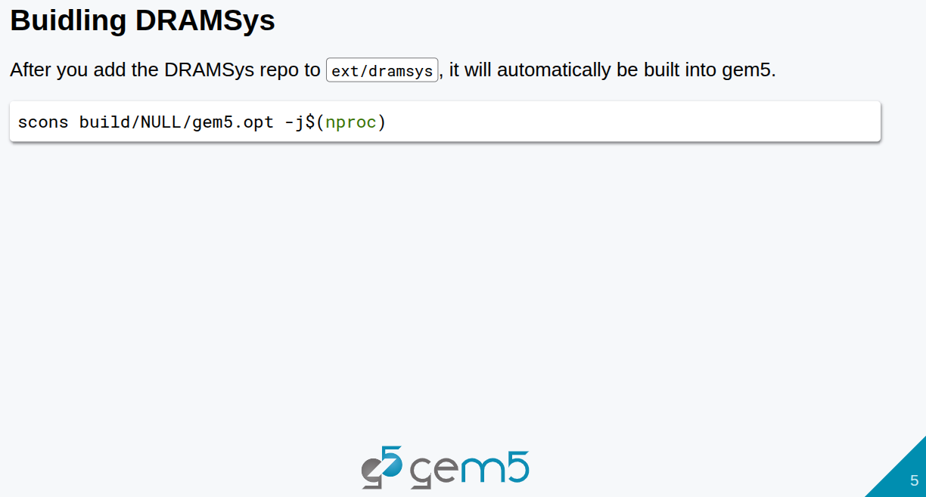
26.4 Build DRAMSys
https://www.youtube.com/watch?v=ciSLhURk6OU&list=PL_hVbFs_loVR_8ntTTmmG6YEq3Po_4snu&index=26
Build DRAMSys (14:21 – 14:30/20:37)
After we clone DRAMSys repo to gem5/ext/dramsys, DRAMSys will be automatically pick up and start to build into gem5 with below command.
> scons build/NULL/gem5.opt -j$(nproc)

Slide 14
26.5 Run DRAMSys

Slide 15
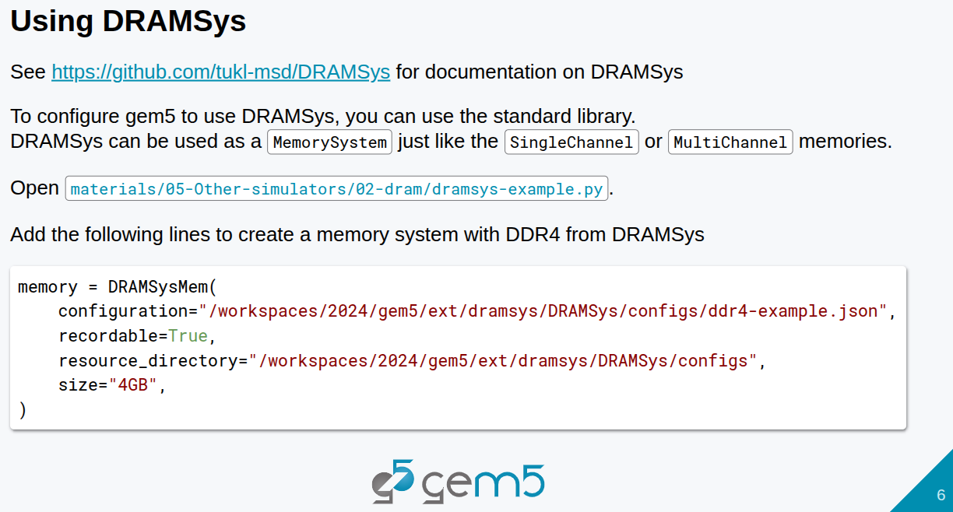
26.5 Run DRAMSys
https://www.youtube.com/watch?v=ciSLhURk6OU&list=PL_hVbFs_loVR_8ntTTmmG6YEq3Po_4snu&index=26
Run DRAMSys (14:31 – 15:10/20:37)
When we use DRAMSys, we need to configure gem5 standard library.
DRAMSys will replace gem5 MemorySystem (Single Channel or Multi-Channel) in the standard library.
Below is the commands are used to create the DRAMSys memory:
> memory = DRAMSysMem ( configuration = “<Path/JASON>”, recordable = True, resource_library = “…”, size = “4GB”, )
Both gem5 or DRAMSys simulators use JSON format for configuration. We need to provide the path for the configuration.

Slide 16
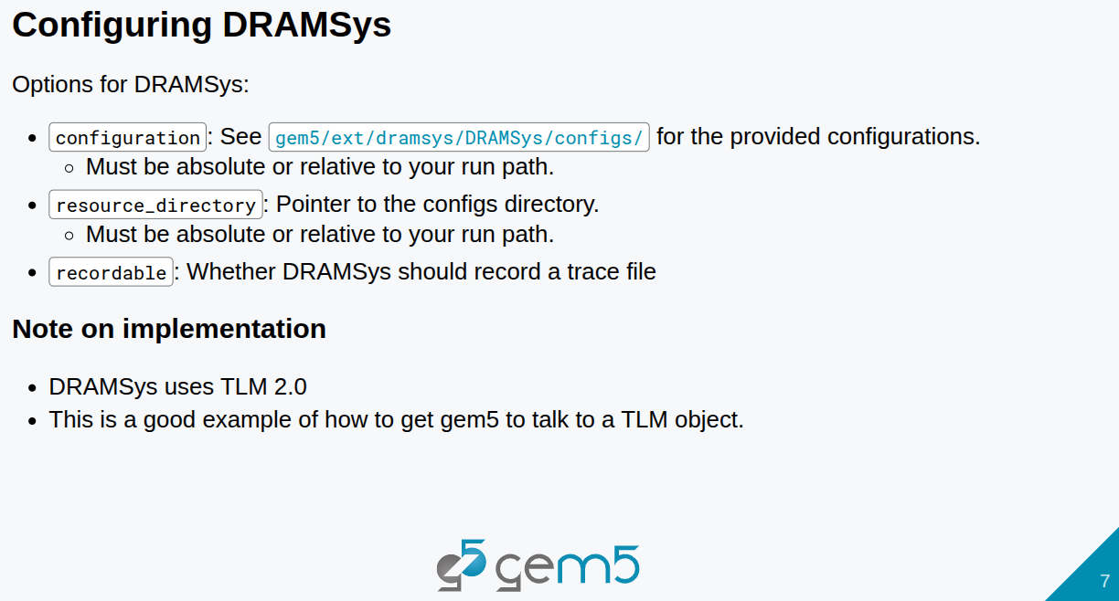
26.5 Run DRAMSys
https://www.youtube.com/watch?v=ciSLhURk6OU&list=PL_hVbFs_loVR_8ntTTmmG6YEq3Po_4snu&index=26
Run DRAMSys (14:31 – 16:00/20:37)
We need to configure the DRAMSys with configuration file, resource directory, and record the a trace file.
Note;
1. DRAMSys uses TLM (Transaction-Level Modeling) 2.0. TLM is a high-level approach to model (read/write) digital system communication between CPU and memory.
2. gem5 has a bridge between ports and TLM. gem5 talks to TLM object with bridges. TLM is a transaction level protocol and it models from system C.

Slide 17
26.6 DRAMSys Output

Slide 18
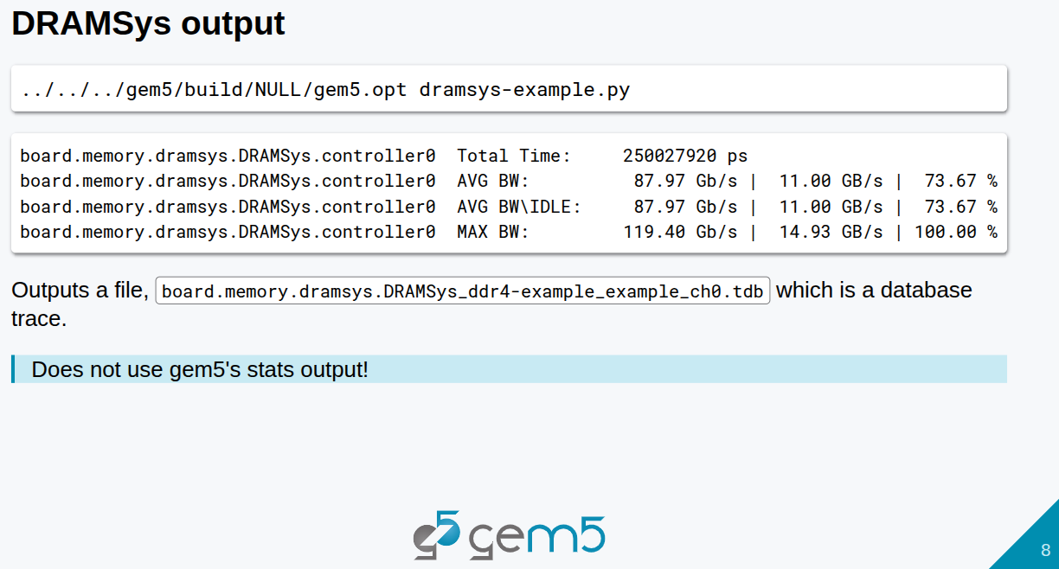
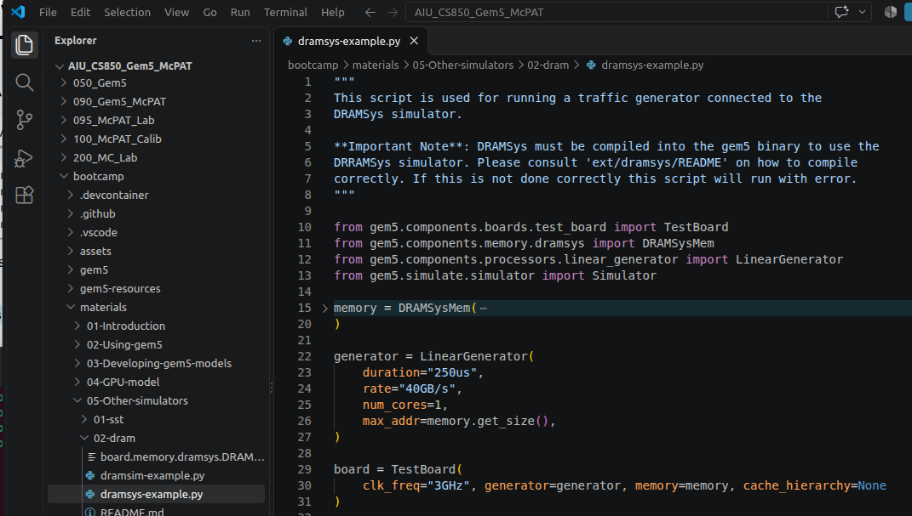
26.6 DRAMSys Output
https://www.youtube.com/watch?v=ciSLhURk6OU&list=PL_hVbFs_loVR_8ntTTmmG6YEq3Po_4snu&index=26
DRAMSys Output (16:01 – 16:45/20:37)
Below is the result in the ~bootcamp/materials/05-Other-simulators/02-dram/dramsys-example.py
Note:
There is no result in the stats from DRAMSys. The DRAMSys stats don’t exist.
The traces are written into the output file name is “board.memory.dramsys.DRAMSys_ddr4-example_example_ch0.tdb.

Slide 19
26.7 DRAMSim Output

Slide 20
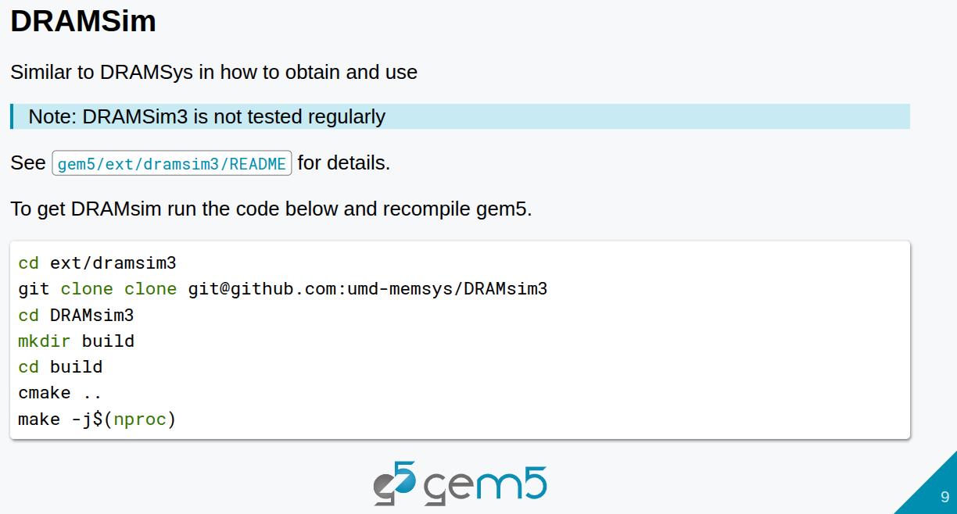
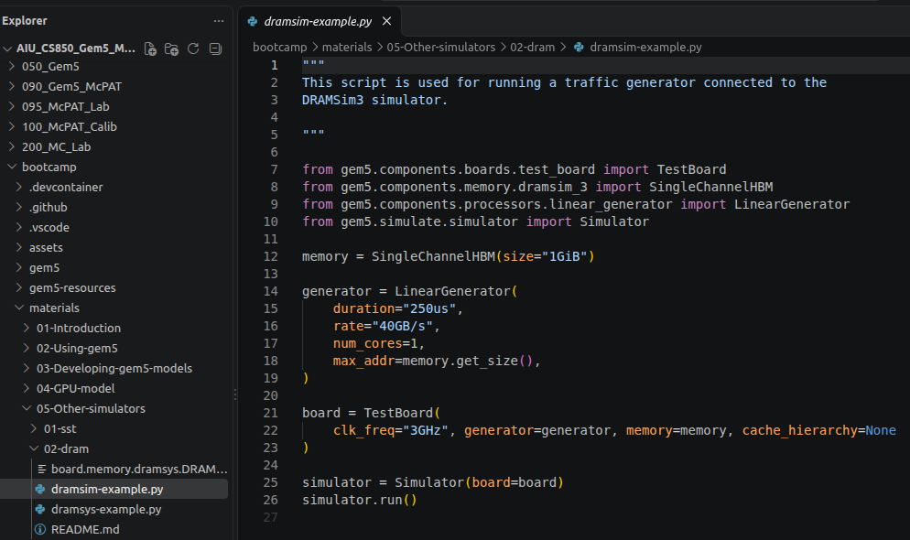
26.7 DRAMSim Output
https://www.youtube.com/watch?v=ciSLhURk6OU&list=PL_hVbFs_loVR_8ntTTmmG6YEq3Po_4snu&index=26
DRAMSim Output (16:46 – 17:15/20:37)
Now, we run DRAMSim in in the ~bootcamp/materials/05-Other-simulators/02-dram/dramsim-example.py
Note: DRAMSim3 is not well tested as DRAMsim2.
DRAMSim is not built. We need to clone repo and compile by users. Below code has a type of duplicated “clone”

Slide 21
26.8 Use DRAMSim3

Slide 22
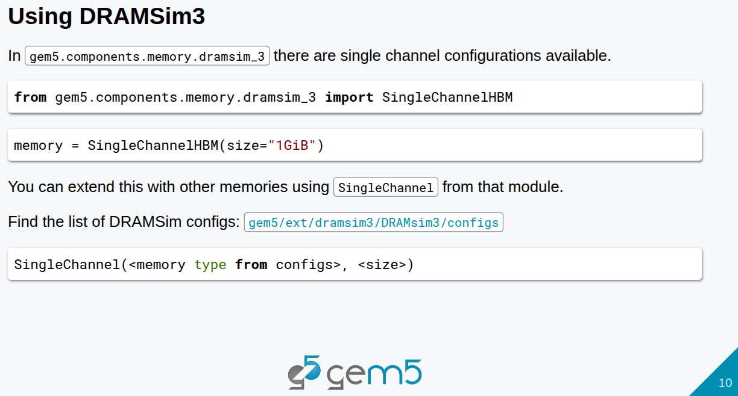
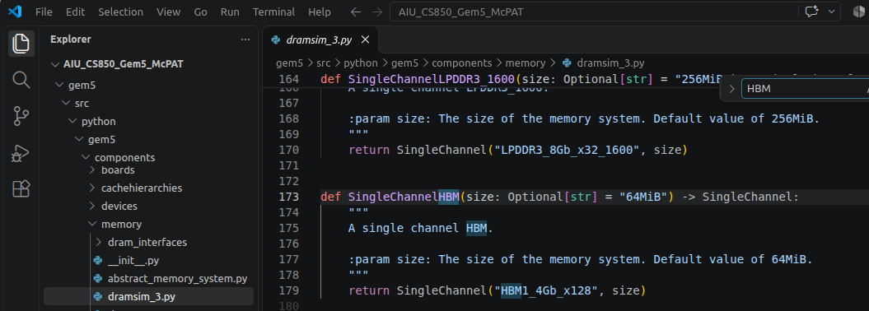
26.8 Use DRAMSim3
https://www.youtube.com/watch?v=ciSLhURk6OU&list=PL_hVbFs_loVR_8ntTTmmG6YEq3Po_4snu&index=26
Use DRAMSim3 (17:26 – 17:30/20:37)
In the gem5 stdlib (~gem5/src/python/gem5/components/memory/dramsim_3.py), we can find function SingleChannelHBM ().

Slide 23
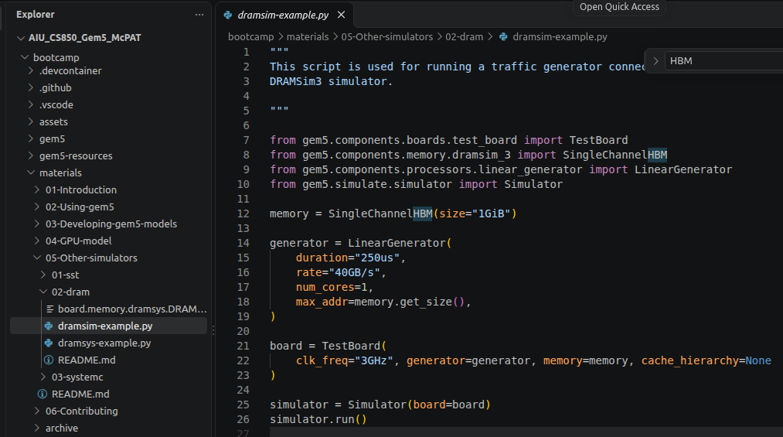
26.8 Use DRAMSim3
https://www.youtube.com/watch?v=ciSLhURk6OU&list=PL_hVbFs_loVR_8ntTTmmG6YEq3Po_4snu&index=26
Use DRAMSim3 (17:31 – 17:55/20:37)
In the ~bootcamp/materials/05-Other-simulators/dramsim-example.py, we have single channel example.
We imported
> from gem5.components.memory.dramsim_3 import SingleChannel1HBM
Create memory as below.
> memory= SingleChannelHBM (size = “1GiB”)
We can implement multi-channel if we want.

Slide 24
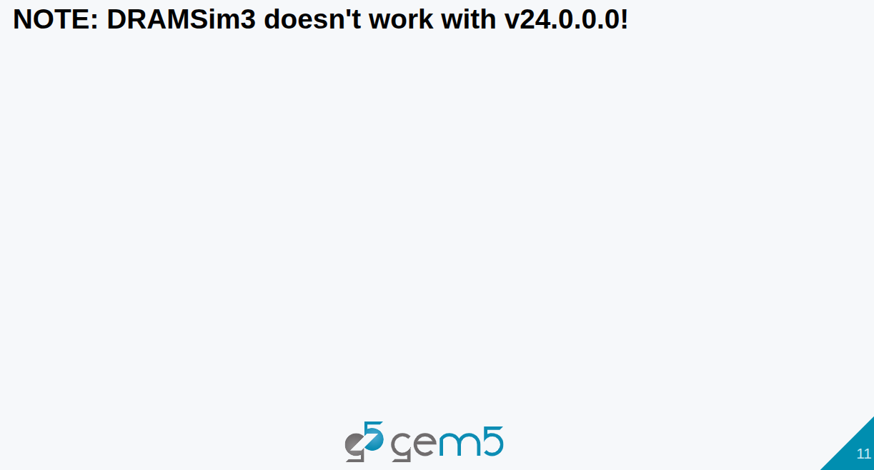
26.8 Use DRAMSim3
https://www.youtube.com/watch?v=ciSLhURk6OU&list=PL_hVbFs_loVR_8ntTTmmG6YEq3Po_4snu&index=26
Use DRAMSim3 (17:56 – 18:15/20:37)
DRAMSim3 is not working in v24.0.0.0.

Slide 25
End

