Slide 1

25 GPU Model (Part 02)
Peter H. Chen

Slide 2
25.43 Checkpoint/Restoration in GPU

Slide 3
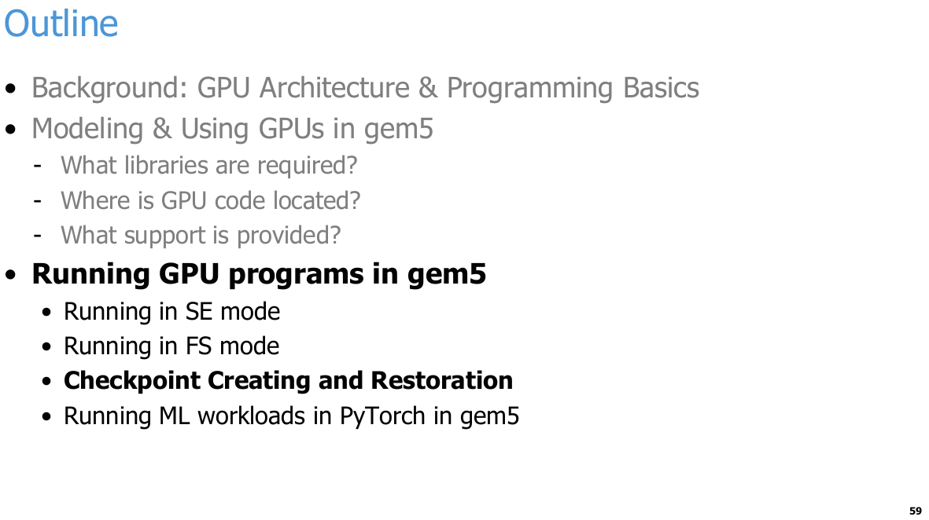
25.43 Checkpoint/Restoration in GPU
https://www.youtube.com/watch?v=Kjd1hTFOI44&list=PL_hVbFs_loVR_8ntTTmmG6YEq3Po_4snu&index=25
Checkpoint/Restoration in GPU (1:39:21 - 1:39:25/2:01:30)
Next, we talk about the checkpoint for GPU.

Slide 4
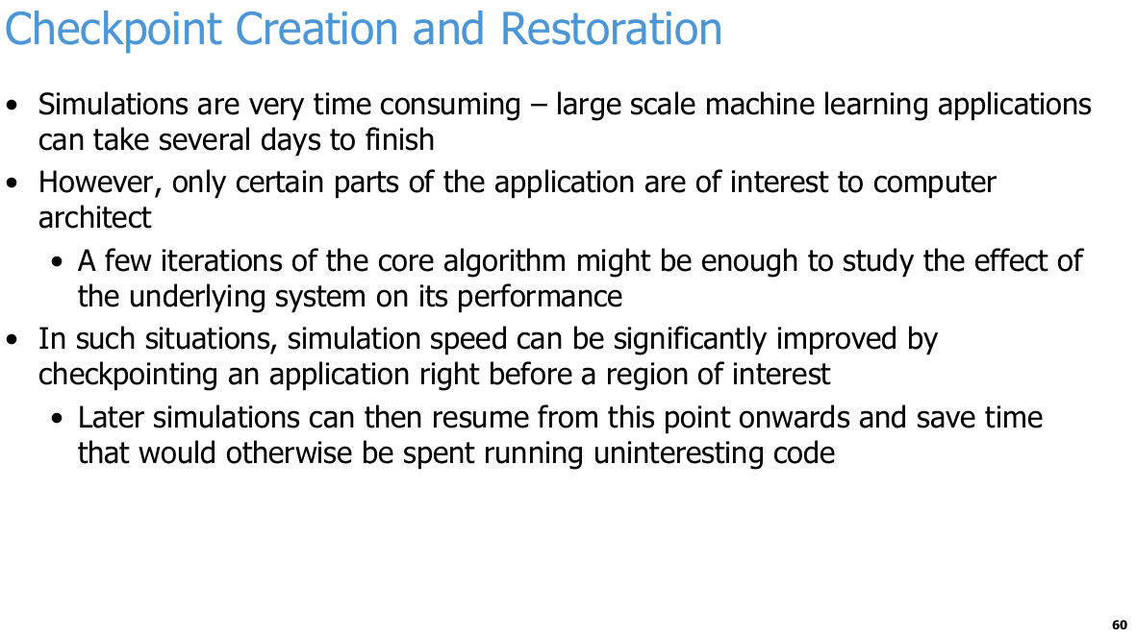
25.43 Checkpoint/Restoration in GPU
https://www.youtube.com/watch?v=Kjd1hTFOI44&list=PL_hVbFs_loVR_8ntTTmmG6YEq3Po_4snu&index=25
Checkpoint/Restoration in GPU (1:39:26 - 1:39:50/2:01:30)
Simulations are very time consuming in large scale machine learning, The workload is time consuming. We can skip the workload and only run the ROI (Region/Area Of Interest).
1. A checkpoint is a complete "snapshot" of a computer system's state at a specific point in time.
Checkpoint is like a "save game" feature in video games.
In gem5 simulator, a checkpoint saves all the critical information of the system at that moment:
  a. Register States: The data and instruction locations currently being processed by the CPU.
  b. Memory Content: All the data inside the entire system RAM.
  c. Hardware Device States: The current status of disks, caches, and peripherals.
2. Why Do We Need Checkpoints?
If your simulation takes 10 hours to run, but you only care about a matrix multiplication that happens in the last 5 minutes:
  a. We can create a checkpoint (save) at the 9-hour-and-55-minute mark, right before the critical code starts.
  b. For all your future experiments, you do not need to rerun the first 9 hours and 55 minutes.
  c. We can simply load the checkpoint (load save) to instantly jump to that exact moment and start your detailed study.

Slide 5
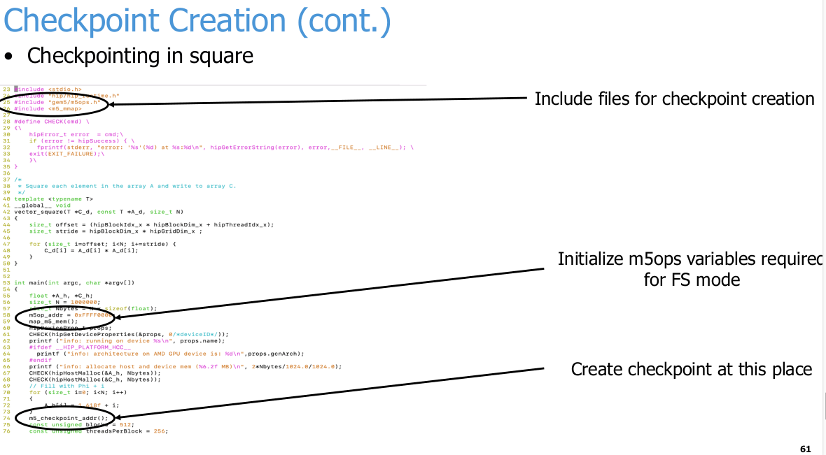
25.43 Checkpoint/Restoration in GPU
https://www.youtube.com/watch?v=Kjd1hTFOI44&list=PL_hVbFs_loVR_8ntTTmmG6YEq3Po_4snu&index=25
Checkpoint/Restoration in GPU (1:39:51 - 1:30:52/2:01:30)
The checkpoint cpp code is as below.

Slide 6
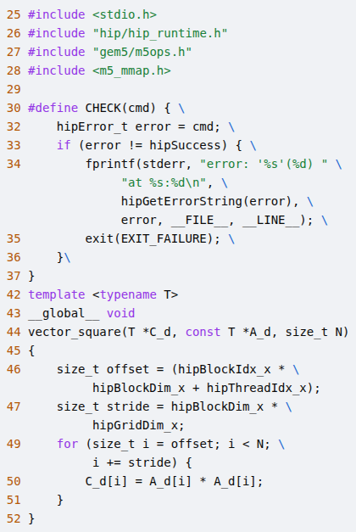
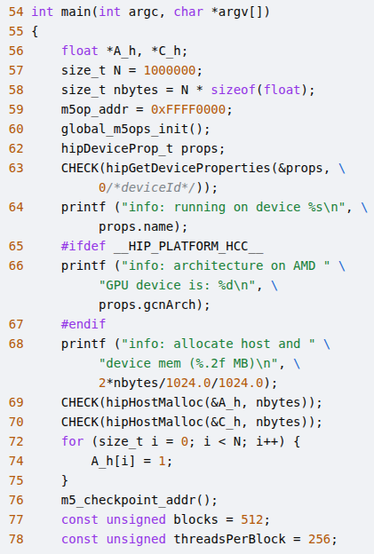
25.43 Checkpoint/Restoration in GPU
https://www.youtube.com/watch?v=Kjd1hTFOI44&list=PL_hVbFs_loVR_8ntTTmmG6YEq3Po_4snu&index=25
Checkpoint/Restoration in GPU (1:39:53 - 1:39:54/2:01:30)
Extract the code on the right.
1. Include files for checkpoint creation
2. Initialize m5ops variables required for FS Mode
3. Create checkpoint at this place.
1
2
1
2
3
3

Slide 7
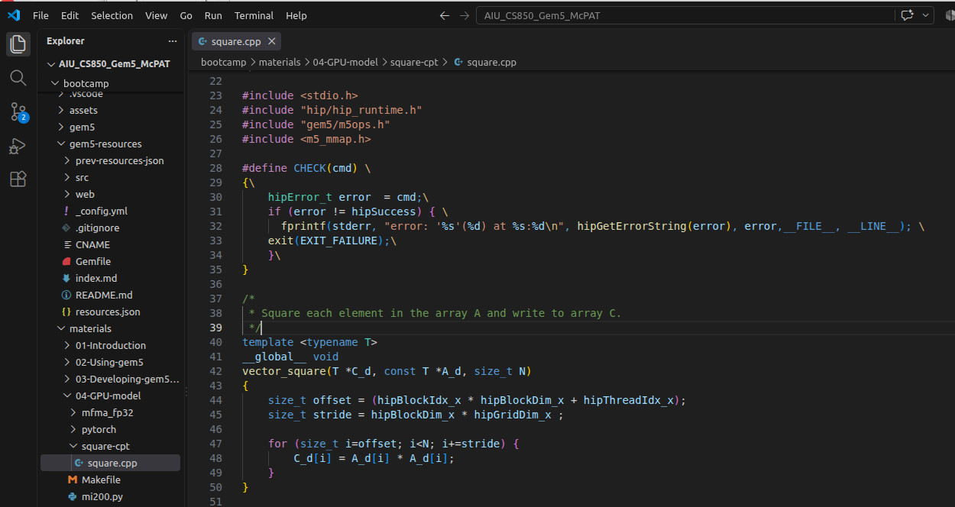
25.43 Checkpoint/Restoration in GPU
https://www.youtube.com/watch?v=Kjd1hTFOI44&list=PL_hVbFs_loVR_8ntTTmmG6YEq3Po_4snu&index=25
Checkpoint/Restoration in GPU (1:39:55 - 1:39:56/2:01:30)
The square.cpp is located under
> ~bootcamp/materials/src/square.cpp

Slide 8
25.43 Checkpoint/Restoration in GPU
https://www.youtube.com/watch?v=Kjd1hTFOI44&list=PL_hVbFs_loVR_8ntTTmmG6YEq3Po_4snu&index=25
Checkpoint/Restoration in GPU (1:39:57 - 1:39:58/2:01:30)
Extract the code on the right.
1. Include files for checkpoint creation
2. Initialize m5ops variables required for FS Mode
3. Create checkpoint at this place.
1
2
1
2
3
3

Slide 9
25.43 Checkpoint/Restoration in GPU
https://www.youtube.com/watch?v=Kjd1hTFOI44&list=PL_hVbFs_loVR_8ntTTmmG6YEq3Po_4snu&index=25
Checkpoint/Restoration in GPU (1:39:59 - 1:40:05/2:01:30)
With the checkpoint, we can restore all subsequent simulations for the same app and input for that given app from that point.
So, if you need to run this simulation many times, creating a checkpoint once can be well worth our app.

Slide 10
25.43 Checkpoint/Restoration in GPU
https://www.youtube.com/watch?v=Kjd1hTFOI44&list=PL_hVbFs_loVR_8ntTTmmG6YEq3Po_4snu&index=25
Checkpoint/Restoration in GPU (1:40:06 - 1:40:30/2:01:30)
For checkpoint, we need to
1. Include “gem5/m5ops.h”
2. Initialize variable for FS (Full System) mode;
3. Call m5_checkpoint_addr () to create checkpoint to load the application workload.

Slide 11
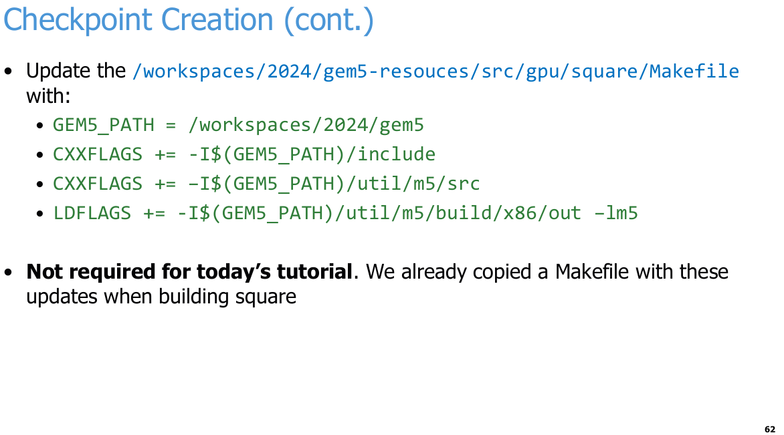
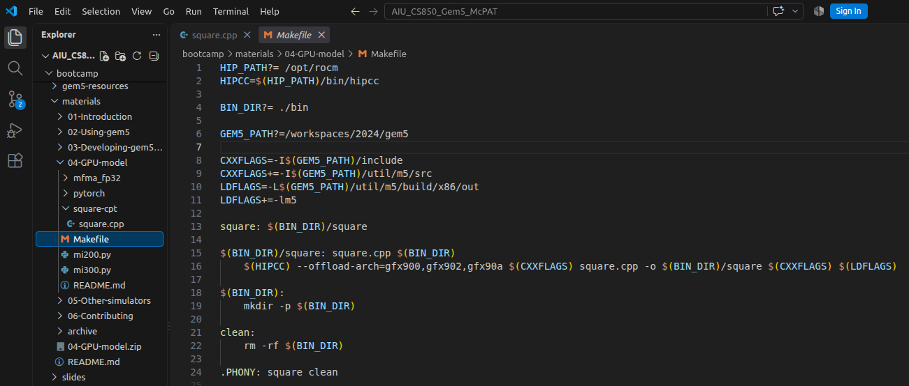
25.43 Checkpoint/Restoration in GPU
https://www.youtube.com/watch?v=Kjd1hTFOI44&list=PL_hVbFs_loVR_8ntTTmmG6YEq3Po_4snu&index=25
Checkpoint/Restoration in GPU (1:40:31 - 1:41:00/2:01:30)
We need to update the Makefile
> ~materials/04-GPU-model/Makefile

Slide 12
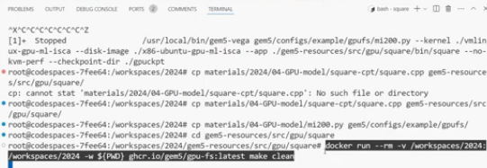
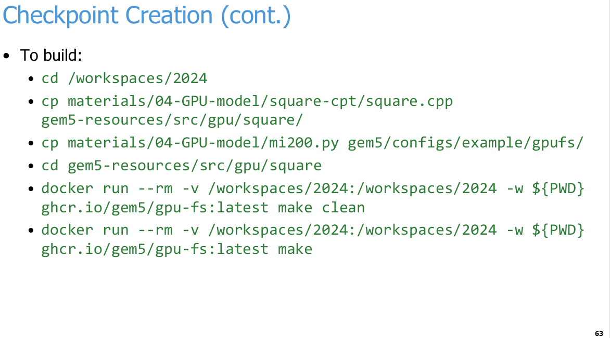
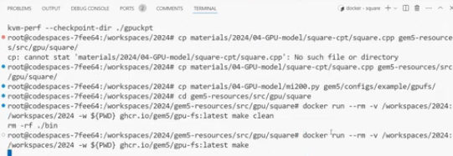
25.43 Checkpoint/Restoration in GPU
https://www.youtube.com/watch?v=Kjd1hTFOI44&list=PL_hVbFs_loVR_8ntTTmmG6YEq3Po_4snu&index=25
Checkpoint/Restoration in GPU (1:41:01 - 1:46:40/2:01:30)
We build the checkpoint for square application.

Slide 13
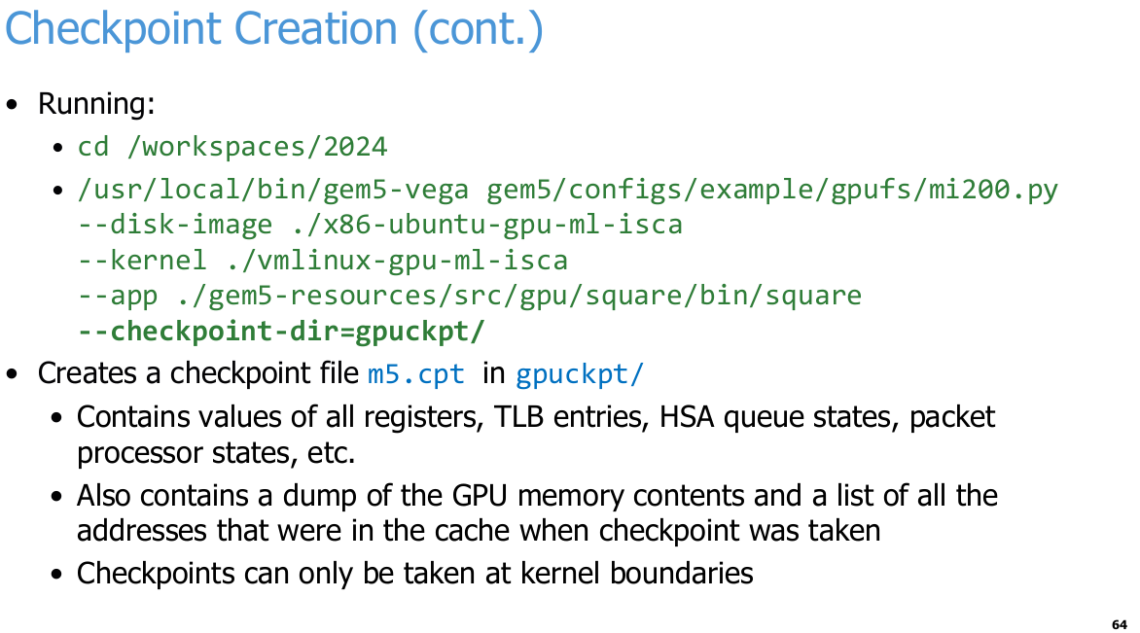
25.43 Checkpoint/Restoration in GPU
https://www.youtube.com/watch?v=Kjd1hTFOI44&list=PL_hVbFs_loVR_8ntTTmmG6YEq3Po_4snu&index=25
Checkpoint/Restoration in GPU (1:46:41 - 1:47:40/2:01:30)
Finally, we docker run the checkpoint for square application.
We passed in the specified directory <gpuckpt> to hold the checkpoint.
> --checkpoint-dir = gpuckpt/
In the <gpuckpt> folder, we can see it creates a file called m5.cpt. This file contains values of all registers, TLB (Translation Lookahead Buffer) entries, HSA (Heterogeneous System Architecture) queue states, packet processor states, memory contents, etc.
Basically, everything we need to restart the state of the simulation at this checkpoint to move forward.
Checkpoint can only be taken at kernel boundaries. We cannot take checkpoint inside a kernel.

Slide 14
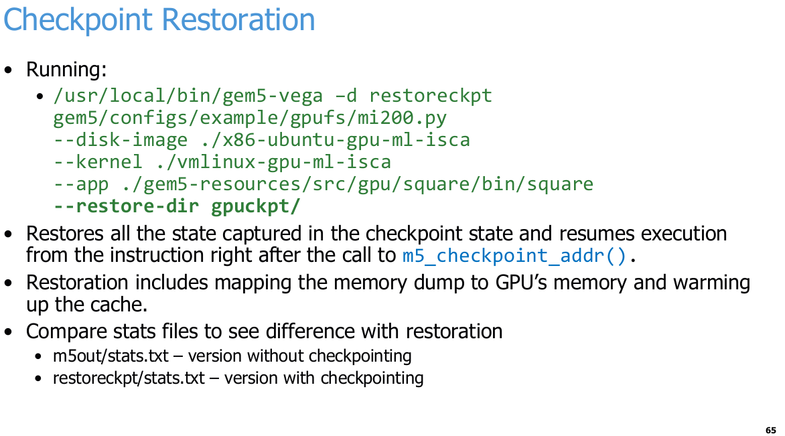
25.43 Checkpoint/Restoration in GPU
https://www.youtube.com/watch?v=Kjd1hTFOI44&list=PL_hVbFs_loVR_8ntTTmmG6YEq3Po_4snu&index=25
Checkpoint/Restoration in GPU (1:47:41 - 1:49:00/2:01:30)
Now, we look at the <gpuckpt> folder and use restore all the states.
This will restore the states of simulator to exactly the point that it was. Right after the line we added that does m5 checkpoint adder.
The restoration will include mapping all the memory back to the GPU, warming up the caches, setting the registers to the appropriate state, the CU use, etc.

Slide 15
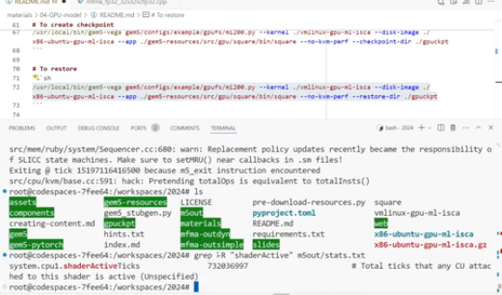
25.43 Checkpoint/Restoration in GPU
https://www.youtube.com/watch?v=Kjd1hTFOI44&list=PL_hVbFs_loVR_8ntTTmmG6YEq3Po_4snu&index=25
Checkpoint/Restoration in GPU (1:49:01 - 1:51:50/2:01:30)
After the running, we look at the
a. m5out/stats.txt which is the original version of square we ran without the checkpoint.
b. restoreckpt/stats.txt which is the checkpoint version of square with checkpoint.
We can compare the statistics for various features and see the behavior of checkpoint. The results should be the same with checkpoint and without checkpoint.
> grep -R “shaderActive” m5out/stats.txt
>> system.cppu1.shaderActiveTicks 732036997 # Total ticks that any CU attached to this shader is active (Unspecified)
> grep -R “shaderActive” restoreckpt/stats.txt
>> system.cppu1.shaderActiveTicks 732036997 # Total ticks that any CU attached to this shader is active (Unspecified)
shaderActiveTicks with checkpoint and without check are the same. But With checkpoints, the run time will be much shorter.
Shader is a small program run on GPU.

Slide 16
25.44 Run PyTorch with FS Mode in gem5

Slide 17
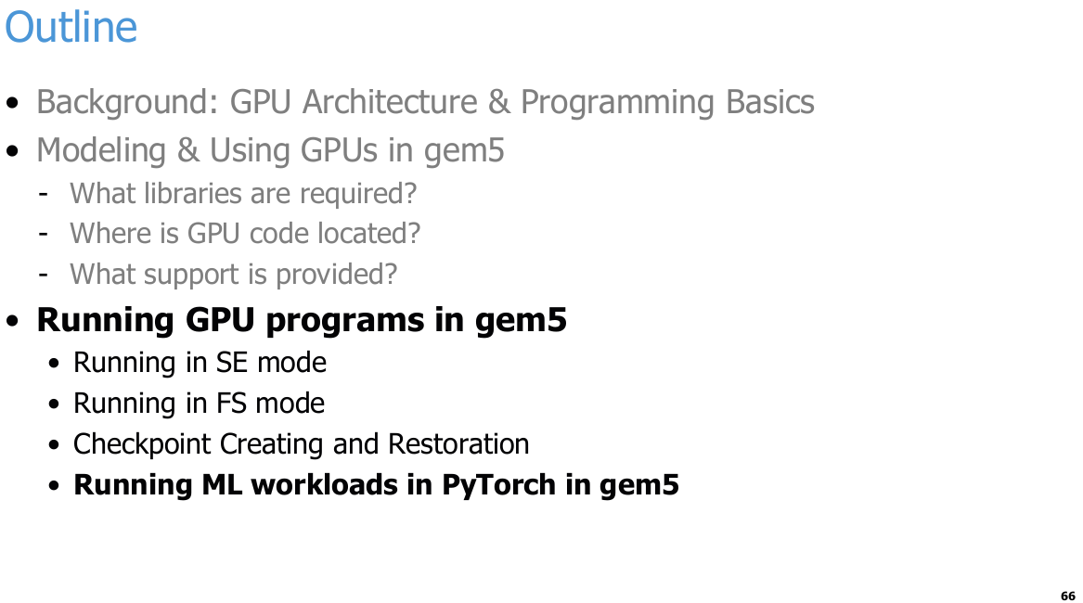
25.44 Run PyTorch with FS Mode in gem5
https://www.youtube.com/watch?v=Kjd1hTFOI44&list=PL_hVbFs_loVR_8ntTTmmG6YEq3Po_4snu&index=25
Run PyTorch with FS Mode in gem5 (1:51:51 - 1:51:52/2:01:30)
Run ML (Machine Learning) workloads in PyTorch in gem5.

Slide 18
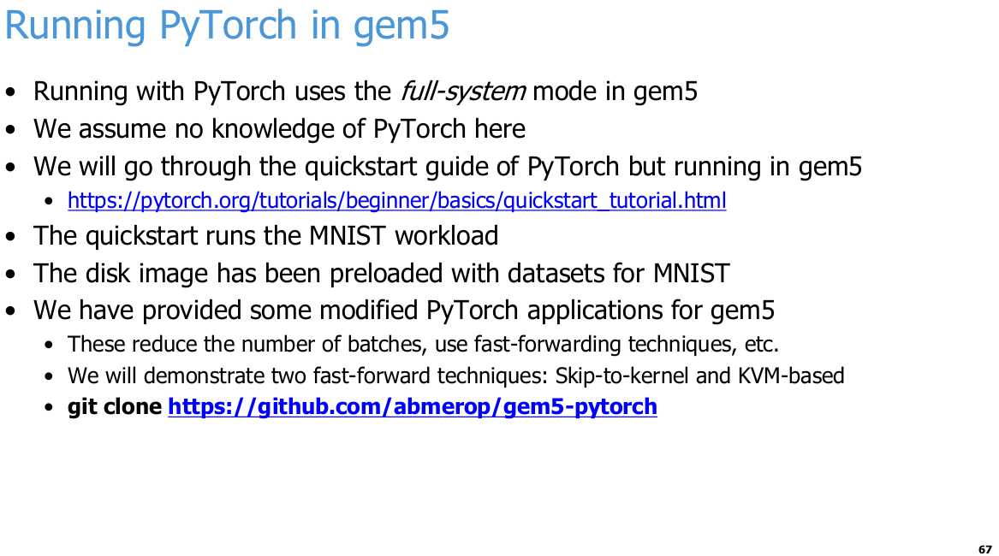
25.44 Run PyTorch with FS Mode in gem5
https://www.youtube.com/watch?v=Kjd1hTFOI44&list=PL_hVbFs_loVR_8ntTTmmG6YEq3Po_4snu&index=25
Run PyTorch with FS Mode in gem5 (1:51:53 - 1:53:05/2:01:30)
We talk how to run PyTorch (or TensorFlow) framework with FS Mode in gem5 GPFS support.
We assume that we don’t have knowledge in PyTorch.
We will take MNIST (Modified National Institute of Standards and Technology database) dataset for model training. MNIST is a simple and famous in 1980s for machine learning workloads for handwriting digit recognition up to 100 or more. For quick way checking, we use pre-loaded digits 0, 1, 2, ..., 9.

Slide 19
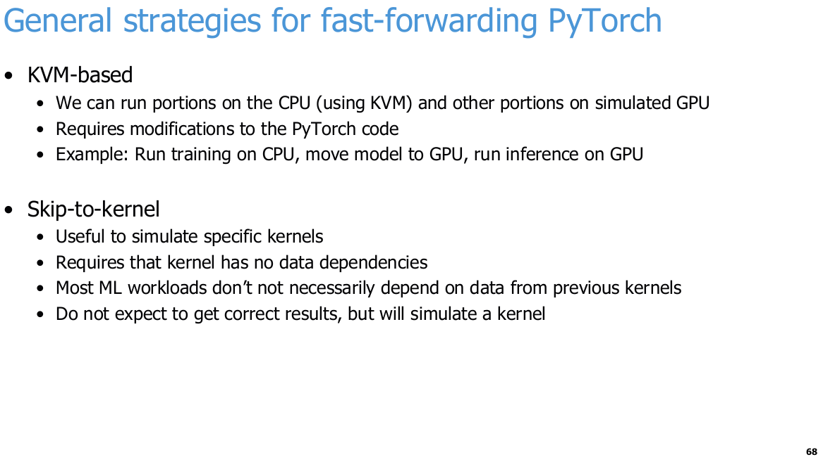
25.44 Run PyTorch with FS Mode in gem5
https://www.youtube.com/watch?v=Kjd1hTFOI44&list=PL_hVbFs_loVR_8ntTTmmG6YEq3Po_4snu&index=25
Run PyTorch with FS Mode in gem5 (1:53:06 - 1:54:05/2:01:30)
KVM (Kernel based Virtual Machine)-based.
Skip to kernel

Slide 20
End

