Slide 1

6 Run Gem5
Peter H. Chen

Slide 2

6 Run on Gem5
https://www.youtube.com/watch?v=pGp_41V0xf4&list=PL_hVbFs_loVR_8ntTTmmG6YEq3Po_4snu&index=6
Run on Gem5 (0:02-0:04/23:39)
We talk about Running Things on Gem5.

Slide 3
6.1 Topics

Slide 4
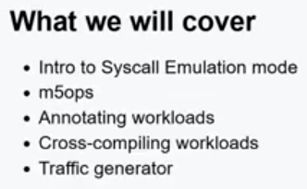
6.1 Topics
https://www.youtube.com/watch?v=pGp_41V0xf4&list=PL_hVbFs_loVR_8ntTTmmG6YEq3Po_4snu&index=6
Topics (0:05-0:42/1:10:12)
1. Syscall Emulation Mode
2. m5ops: gem5 operations
3. How to compile gem5 annotate binary?
a) In the directory bootcamp/materials/02-Using-gem5/03-running-in-gem5/02-annotate-this
b) In the Makefile, we add the compiler GXX = g++, ISA = x86. GEM5_PATH …
c) Change GEM5_PATH to our local gem5
> GEM_PATH = /home/peter/AIU/AIU_CS850_Gem5_McPAT/050_Gem5/gem5
d) Link directory for library search, for example, “-L out/m5”, link all libraries in “out/m5” director.
e) Link specify library, for example, -lm5 means “link libm5 library”
4. Annotate Workloads:
a) Use workbegin_handler() and workend_handler() for annotation.
b) Use gem5.opt -re code.py to see the annotation messages.
5. Cross-Compile workloads
6. Traffic Generator

Slide 5
6.2 Syscall Emulation Mode

Slide 6
6.2 Syscall Emulation Mode
https://www.youtube.com/watch?v=pGp_41V0xf4&list=PL_hVbFs_loVR_8ntTTmmG6YEq3Po_4snu&index=6
Syscall Emulation Mode (0:43-0:44/1:10:12)
First, Syscall Emulation Mode

Slide 7
6.3 What is Syscall Emulation Mode?

Slide 8
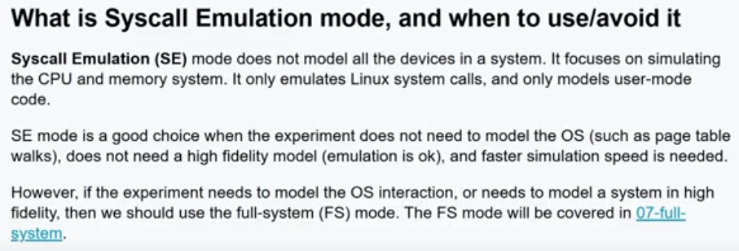
6.3 What is Syscall Emulation Mode?
https://www.youtube.com/watch?v=pGp_41V0xf4&list=PL_hVbFs_loVR_8ntTTmmG6YEq3Po_4snu&index=6
What is Syscall Emulation Mode? (0:45-1:44/1:10:12)
1. SE (Syscall Emulation) Mode does not model all the devices in a system.
2. SE only emulates CPU and memory system
3. SE only emulates Linux system calls
4. SE only for user-mode.
5. SE is a good choice without OS model, such as, Page Table Walk.
6. SE is not accurate model.
7. SE is for very fast simulation.
8. If we need to model OS interaction or high accuracy, then we need FS (Full System) mode.

Slide 9
6.4 SE Hello World

Slide 10
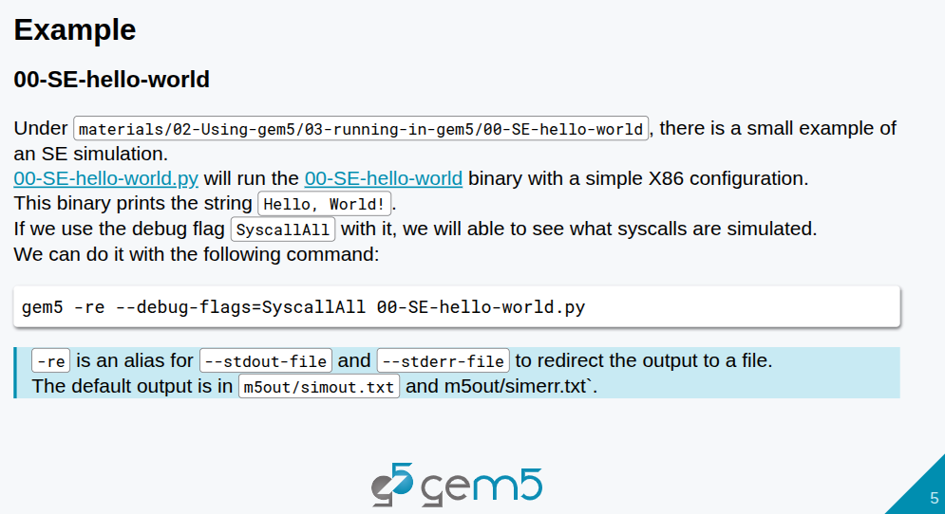
6.4 SE Hello World
https://www.youtube.com/watch?v=pGp_41V0xf4&list=PL_hVbFs_loVR_8ntTTmmG6YEq3Po_4snu&index=6
SE Hello World (1:45-1:55/1:10:12)
We run SE mode example in materials/02-using-gem5/03-running-in-gem5/00-SE-hello-world.py

Slide 11
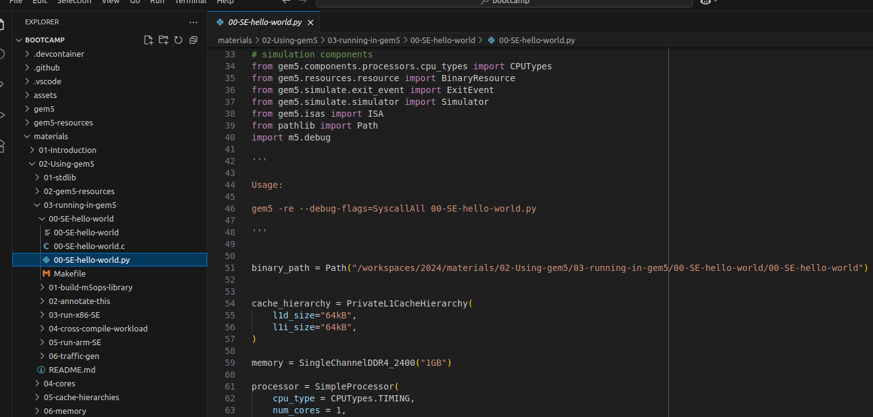
6.4 SE Hello World
https://www.youtube.com/watch?v=pGp_41V0xf4&list=PL_hVbFs_loVR_8ntTTmmG6YEq3Po_4snu&index=6
SE Hello World (1:56-3:20/1:10:12)
Example in materials/02-using-gem5/03-running-in-gem5/00-SE-hello-world.py
This example will run Hello World in X86 configuration.

Slide 12
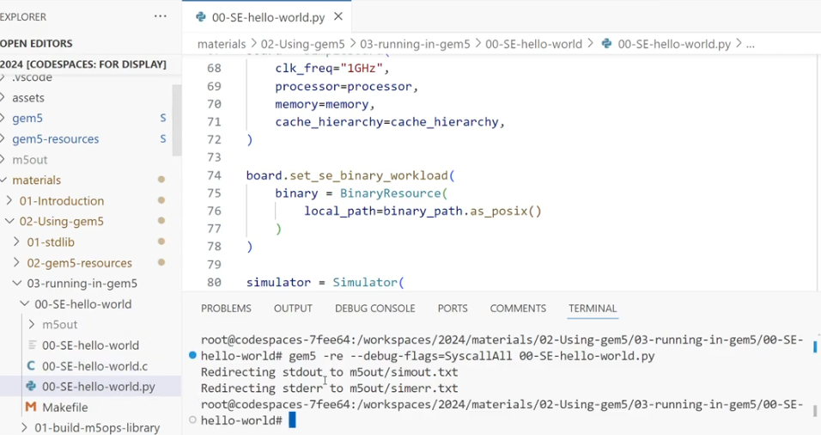
6.4 SE Hello World
https://www.youtube.com/watch?v=pGp_41V0xf4&list=PL_hVbFs_loVR_8ntTTmmG6YEq3Po_4snu&index=6
SE Hello World (3:21-5:10/1:10:12)
We run the SE mode hello world in Python.
> gem5 -re --debug-flags=SyscallAll 00-SE-hello-world.py

Slide 13
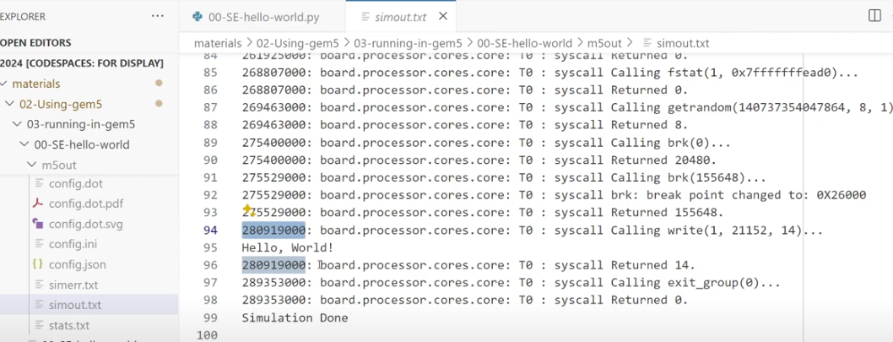
6.4 SE Hello World
https://www.youtube.com/watch?v=pGp_41V0xf4&list=PL_hVbFs_loVR_8ntTTmmG6YEq3Po_4snu&index=6
SE Hello World (5:11-5:59/1:10:12)
We check the simout.txt file.
We can see all the syscall messages in simout.txt
We can find “Hello, World!”

Slide 14
6.5 m5ops

Slide 15

6.5 m5ops
https://www.youtube.com/watch?v=pGp_41V0xf4&list=PL_hVbFs_loVR_8ntTTmmG6YEq3Po_4snu&index=6
m5ops (6:00-6:01/1:10:12)
Now, we talk m5ops

Slide 16
6.6 What is m5ops?

Slide 17
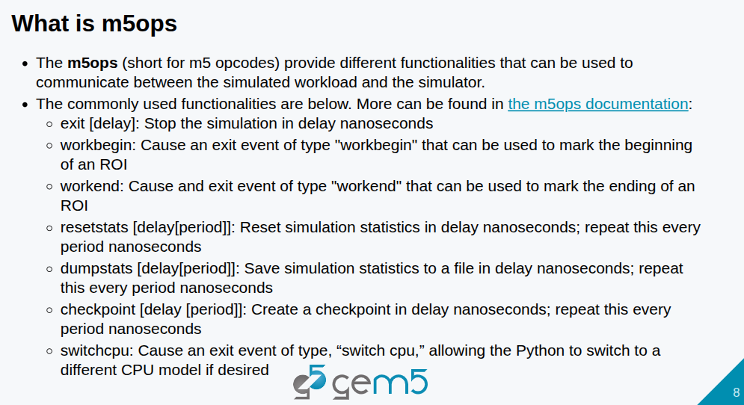
6.6 What is m5ops?
https://www.youtube.com/watch?v=pGp_41V0xf4&list=PL_hVbFs_loVR_8ntTTmmG6YEq3Po_4snu&index=6
What is m5ops? (6:02-7:00/1:10:12)
1. The m5ops means “m5 opcodes”. The m5 means gem5 simulator.
2. The m5ops provide different functions that communicate between workload and simulator.
3. Some common m5ops functions: exit, workbegin, workend, resetstats, dumpstats, checkpoint, switchcpu.

Slide 18
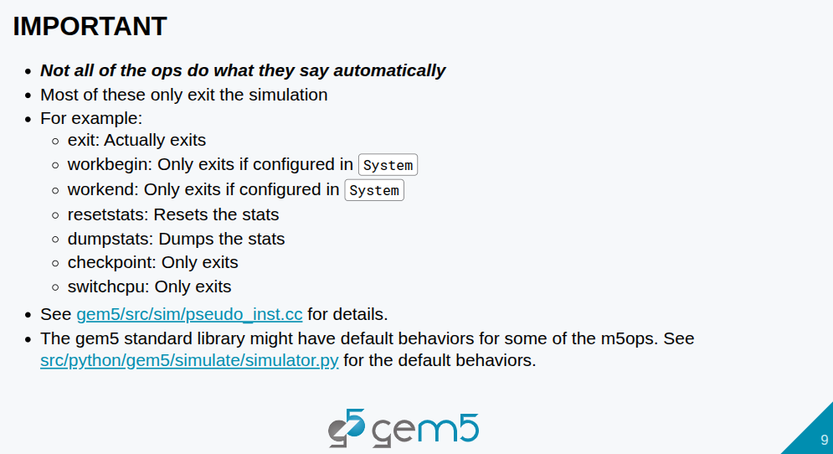
6.6 What is m5ops?
https://www.youtube.com/watch?v=pGp_41V0xf4&list=PL_hVbFs_loVR_8ntTTmmG6YEq3Po_4snu&index=6
What is m5ops? (7:01-8:07/1:10:12)
1. Not all of the ops do what that says. Most of them only do exit the simulation.
2. for example, exit is exit automatically. The workbegin and workend only exit if configured in System.
3. The resetstats and dumpstats do what they said.
4. The checkpoint and switchcpu only exit.
5. We can find gem5 standard library default behavior for some of m5ops.

Slide 19
6.7 m5ops Versions

Slide 20
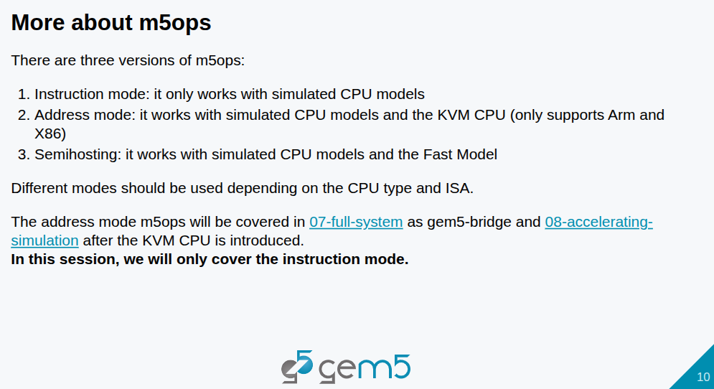
6.7 m5ops Versions
https://www.youtube.com/watch?v=pGp_41V0xf4&list=PL_hVbFs_loVR_8ntTTmmG6YEq3Po_4snu&index=6
m5ops Version (8:08-8:32/1:10:12)
There are three different version of m5ops.
1. The instruction mode that is only work with simulated CPU models, such as, Atomic CPU (Sequence of instruction cannot be interrupted), timing CPU (actual time CPU spend), O3CPU (Out-Of-Order in code executing) inside gem5.

Slide 21
6.7 m5ops Versions
https://www.youtube.com/watch?v=pGp_41V0xf4&list=PL_hVbFs_loVR_8ntTTmmG6YEq3Po_4snu&index=6
m5ops Version (8:33-9:00/1:10:12)
2. for the address mode, it work with the simulated CPU models and KVM (Kernel-based Virtual Machine) CPU. For now, gem5 only support the ARM and X86 KVM.
3. The last one is less commonly used. It is the Fast Model that we will not discuss.

Slide 22
6.7 m5ops Versions
https://www.youtube.com/watch?v=pGp_41V0xf4&list=PL_hVbFs_loVR_8ntTTmmG6YEq3Po_4snu&index=6
m5ops Version (9:01-9:13/1:10:12)
Different modes are used in different CPU type and ISA.
After KVM CPU, we discuss the address mode in section 07-full-system as gem5-bridge and section 08-accelerating simulation.
In this section, we only discuss the instruction mode.

Slide 23
6.8 When to use m5ops?

Slide 24
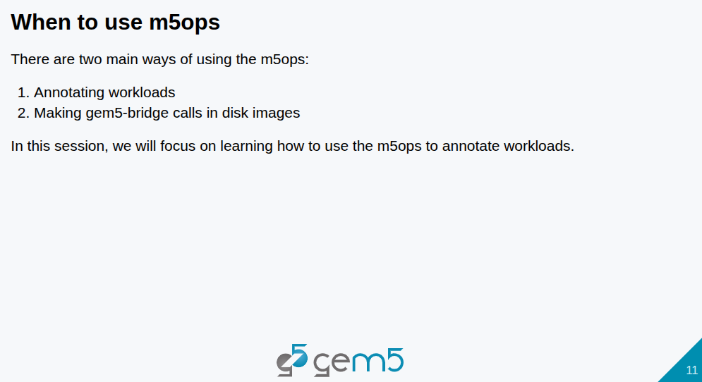
6.8 When to use m5ops?
https://www.youtube.com/watch?v=pGp_41V0xf4&list=PL_hVbFs_loVR_8ntTTmmG6YEq3Po_4snu&index=6
When to Use m5ops? (9:14-9:36/1:10:12)
When do we use gem5 ops (or m5ops)? There are two main ways of using m5ops:
1. Annotate workloads
2. make gem5 bridge call in disk image.
In this section, we focus on learning how to use use m5ops to annotate workload

Slide 25
6.9 How to use m5ops?

Slide 26
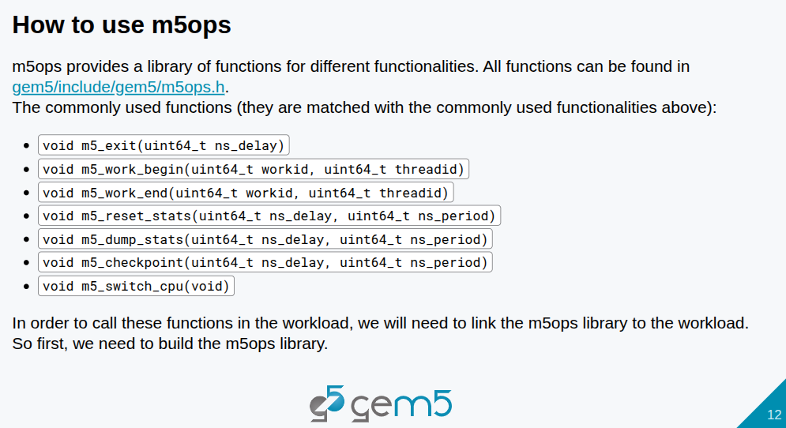
6.9 How to use m5ops?
https://www.youtube.com/watch?v=pGp_41V0xf4&list=PL_hVbFs_loVR_8ntTTmmG6YEq3Po_4snu&index=6
How to Use m5ops? (9:37-9:51/1:10:12)
How to use m5ops? G5ops provides a library of functions for different functionalities.

Slide 27
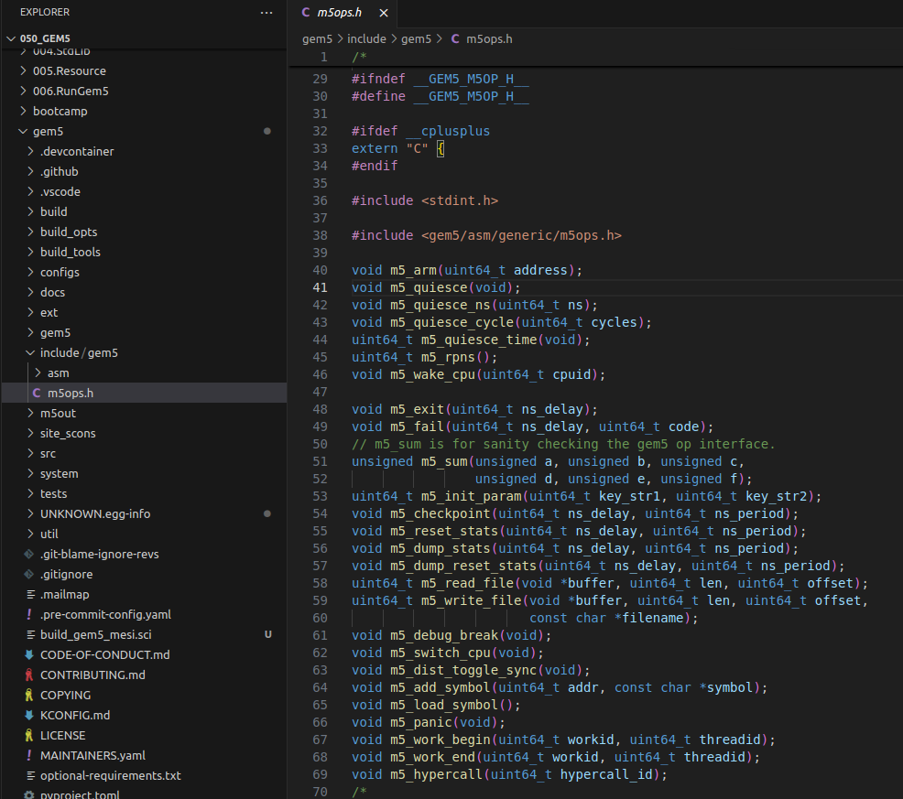
6.9 How to use m5ops?
https://www.youtube.com/watch?v=pGp_41V0xf4&list=PL_hVbFs_loVR_8ntTTmmG6YEq3Po_4snu&index=6
How to Use m5ops? (9:52-10:36/1:10:12)
All functions can be found in all gem5/include/gem5/m5ops.h
https://github.com/gem5/gem5/blob/stable/include/gem5/m5ops.h

Slide 28
6.9 How to use m5ops?
https://www.youtube.com/watch?v=pGp_41V0xf4&list=PL_hVbFs_loVR_8ntTTmmG6YEq3Po_4snu&index=6
How to Use m5ops? (9:52-10:07/1:10:12)
In the m5ops.h, we can find the function declaration of
1. m5_exit(),
2. m5_work_begin(), me_work_end,
3. m5_reset_stats, m5_dump_stats, m5_checkpoint(),
4. m5_switch_cpu()
1
3
4
2

Slide 29
6.9 How to use m5ops?
https://www.youtube.com/watch?v=pGp_41V0xf4&list=PL_hVbFs_loVR_8ntTTmmG6YEq3Po_4snu&index=6
How to Use m5ops? (10:08-10:17/1:10:12)
In order to call these functions in the workload, we need to link the m5ops library in the workload.
Therefore, we need to build the m5ops library.

Slide 30
6.10 Build m5ops Library

Slide 31
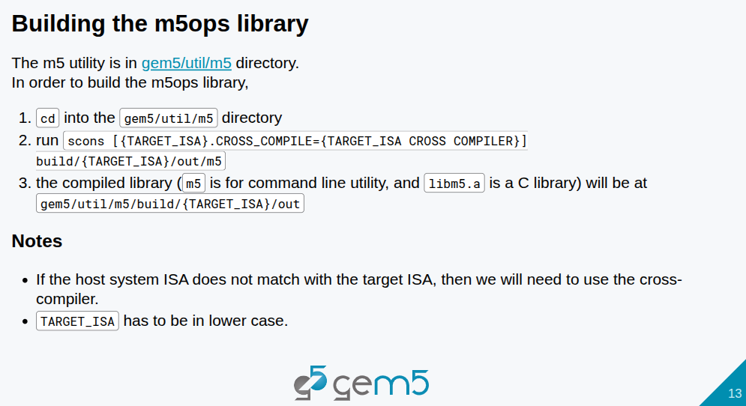
6.10 Build m5ops Library
https://www.youtube.com/watch?v=pGp_41V0xf4&list=PL_hVbFs_loVR_8ntTTmmG6YEq3Po_4snu&index=6
Build m5ops Library (10:18-11:13/1:10:12)
Compile the m5ops library.
1. > cd gem5/util/m5
2. > scons build/x86/out/m5
3. > scons...

Slide 32
6.11 Cross-Compile: arm64 m5ops Library

Slide 33
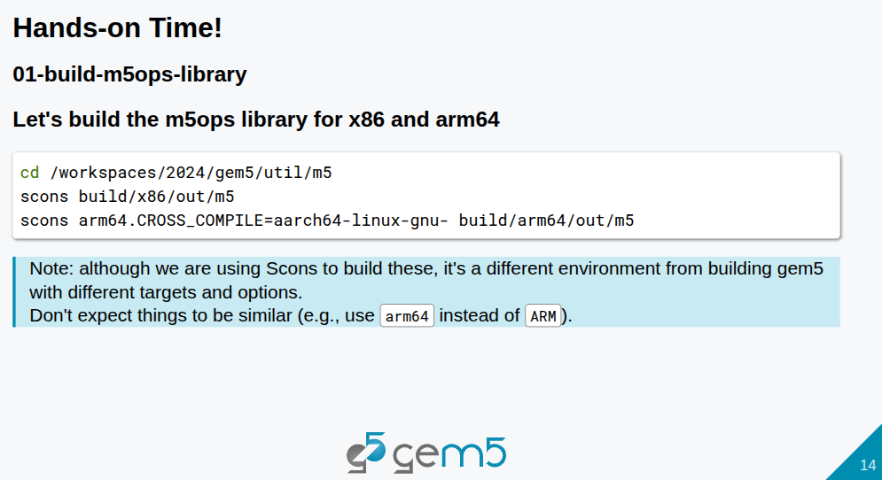
6.11 Cross-Compile: arm64 m5ops Library
https://www.youtube.com/watch?v=pGp_41V0xf4&list=PL_hVbFs_loVR_8ntTTmmG6YEq3Po_4snu&index=6
Cross-Compile: arm64 m5ops Library (11:14-11:15/1:10:12)
Compile the m5ops library.
1. > cd gem5/util/m5
2. > scons build/x86/out/m5
3. compiled library m5

Slide 34
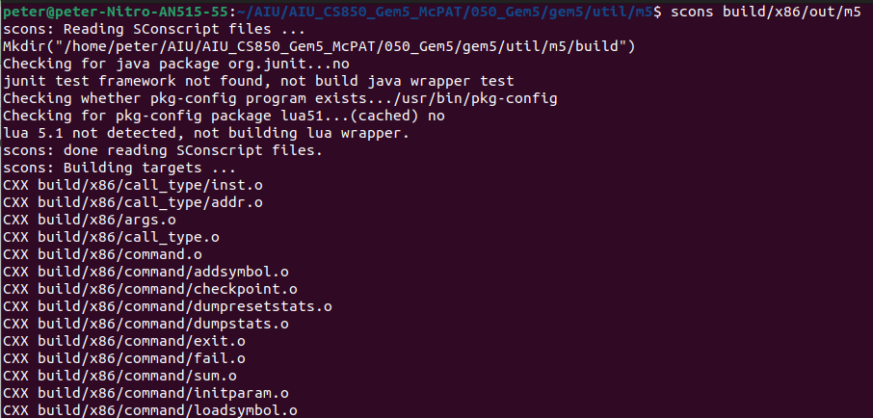

6.11 Cross-Compile: arm64 m5ops Library
https://www.youtube.com/watch?v=pGp_41V0xf4&list=PL_hVbFs_loVR_8ntTTmmG6YEq3Po_4snu&index=6
Cross-Compile: arm64 m5ops Library (11:15-11:16/1:10:12)
Compile the m5ops library.
1. > cd gem5/util/m5
2. > scons build/x86/out/m5

Slide 35
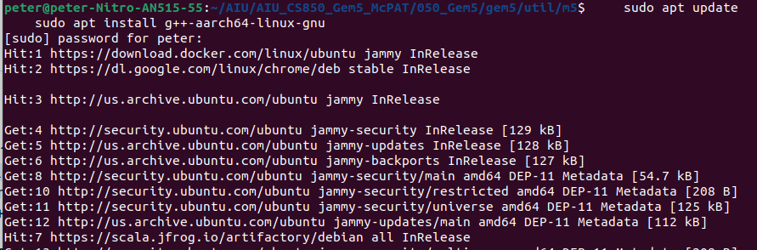
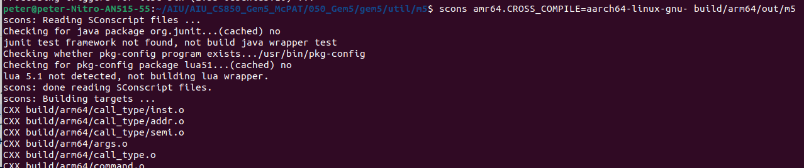
6.11 Cross-Compile: arm64 m5ops Library
https://www.youtube.com/watch?v=pGp_41V0xf4&list=PL_hVbFs_loVR_8ntTTmmG6YEq3Po_4snu&index=6
Cross-Compile: arm64 m5ops Library (11:16-11:17/1:10:12)
Google search “sh: 1: aarch64-linux-gnu-g++: not found
1. Install aarch64 g++
> sudo apt update
> sudo apt install g++-aarch64-linux-gnu
Then, we comple gem5 with cross colpiler.
2. scons amr64.CROSS_COMPILE=aarch64-linux-gnu- build/arm64/out/m5

Slide 36
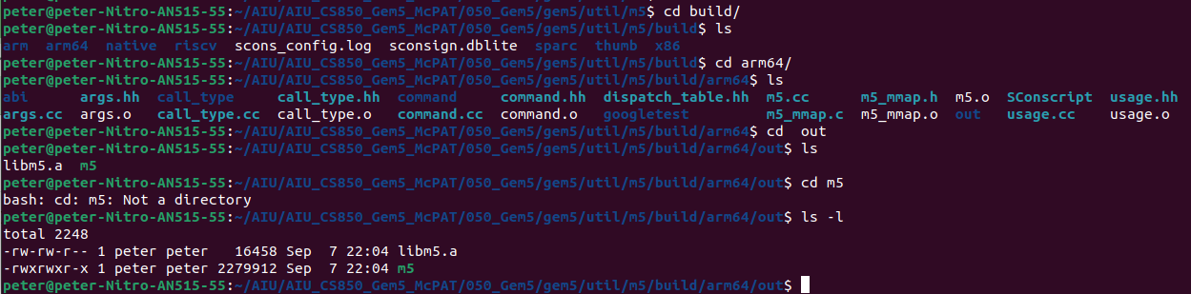
6.11 Cross-Compile: arm64 m5ops Library
https://www.youtube.com/watch?v=pGp_41V0xf4&list=PL_hVbFs_loVR_8ntTTmmG6YEq3Po_4snu&index=6
Cross-Compile: arm64 m5ops Library (11:17-12:20/1:10:12)
We can find the compiled build/arm64/out/m5 for arm64.

Slide 37
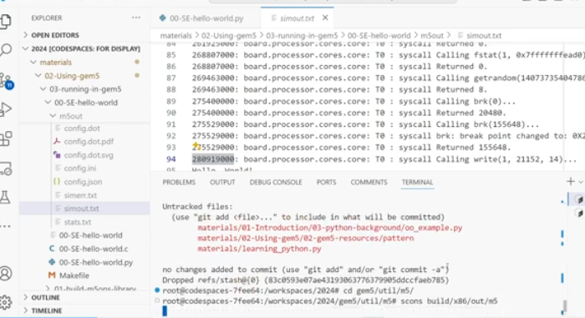
6.11 Cross-Compile: arm64 m5ops Library
https://www.youtube.com/watch?v=pGp_41V0xf4&list=PL_hVbFs_loVR_8ntTTmmG6YEq3Po_4snu&index=6
Cross-Compile: arm64 m5ops Library (12:21-12:21/1:10:12)
1. Compile the gem5 environment

Slide 38
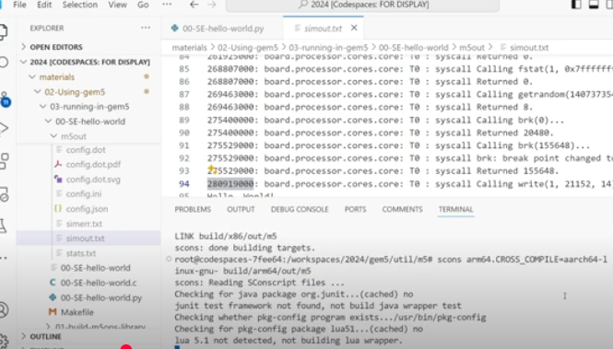
6.11 Cross-Compile: arm64 m5ops Library
https://www.youtube.com/watch?v=pGp_41V0xf4&list=PL_hVbFs_loVR_8ntTTmmG6YEq3Po_4snu&index=6
Cross-Compile: arm64 m5ops Library (12:22-12:53/1:10:12)
2. Cross-Compile the arm64 m5ops library

Slide 39
6.11 Cross-Compile: arm64 m5ops Library
https://www.youtube.com/watch?v=pGp_41V0xf4&list=PL_hVbFs_loVR_8ntTTmmG6YEq3Po_4snu&index=6
Cross-Compile: arm64 m5ops Library (12:54-14:53/1:10:12)
1. What is the reason we use the cross-compiler?
Ans: Because our host is x86, we want to build arm64 m5ops library. We need the cross-compiler.
We will talk more in the cross-compiler section.
Here, we built our first m5ops library.
2. Are we able to do other system?
Ans: We can do other system, for example, we can do the RISCV computer.

Slide 40
6.12 Link m5ops Library to C/C++

Slide 41
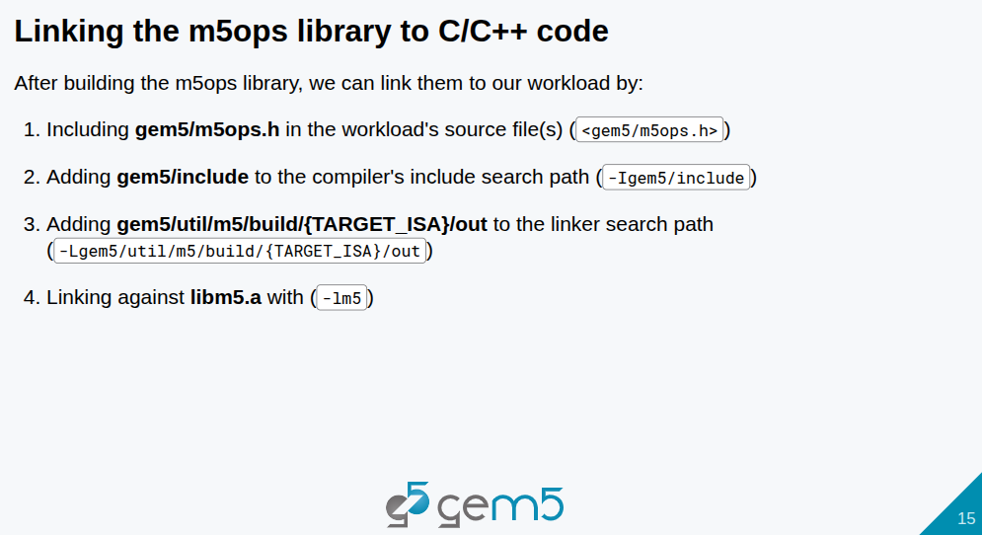
6.12 Link m5ops Library to C/C++
https://www.youtube.com/watch?v=pGp_41V0xf4&list=PL_hVbFs_loVR_8ntTTmmG6YEq3Po_4snu&index=6
Link m5ops Library to C/C++ (14:54-15:43/1:10:12)
1. Link the arm64 library to C/C++ Code. We need to:
2. include <gem5/m5ops.h> inside out source file.
3. for the compiler, we include search path gem5/include: -Igem5/include
4. for the linker, we have search path gem5/util/m5/build/{TARGE_ISA}/out: -Lgem5/util/m5/build/arm64/out/{libm5.a, m5}
5. link file name -lm5, means, “-llibm5”. The “lib” is automatically added after “-l”

Slide 42
6.13 Example: 02-annotate-this

Slide 43
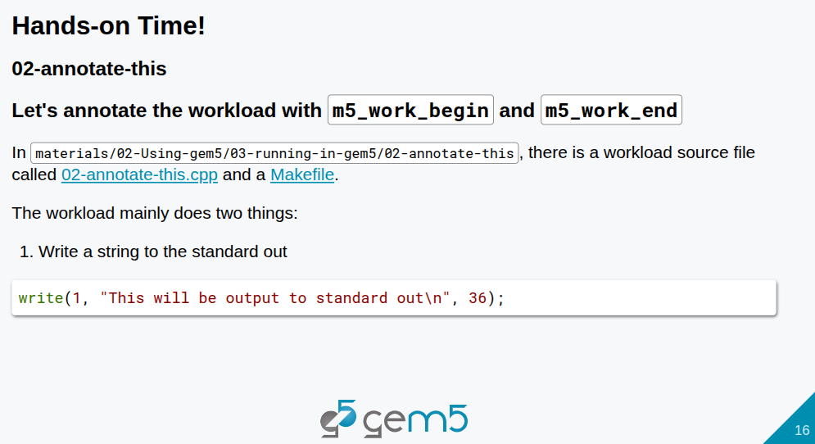
6.13 Example: 02-annotate-this
https://www.youtube.com/watch?v=pGp_41V0xf4&list=PL_hVbFs_loVR_8ntTTmmG6YEq3Po_4snu&index=6
Example: 02-annotate-this (15:44-15:45/1:10:12)
We look at the example 02-annotate-this.
There is a 02-annotate-this.cpp file.

Slide 44
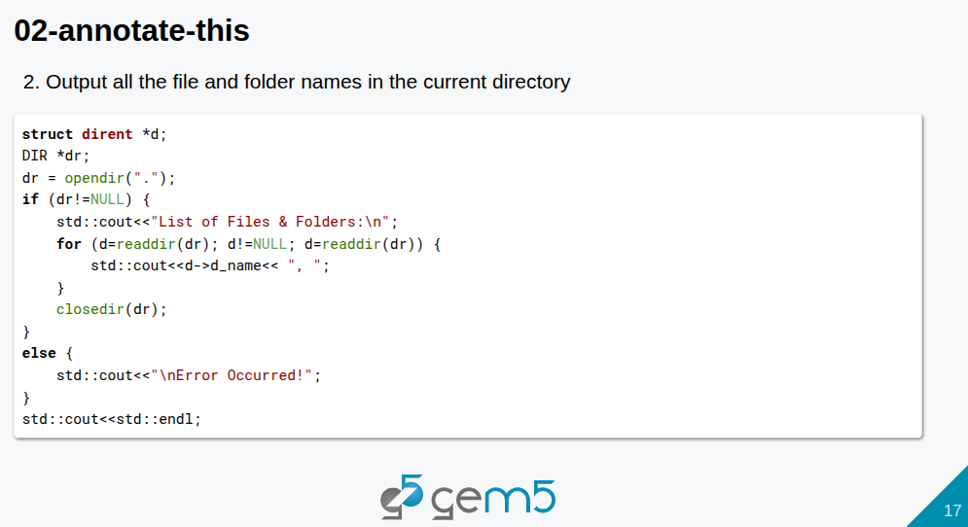
6.13 Example: 02-annotate-this
https://www.youtube.com/watch?v=pGp_41V0xf4&list=PL_hVbFs_loVR_8ntTTmmG6YEq3Po_4snu&index=6
Example: 02-annotate-this (15:46-15:47/1:10:12)
In 02-annotate-this.cpp file, we output file and folder in the current directory.

Slide 45
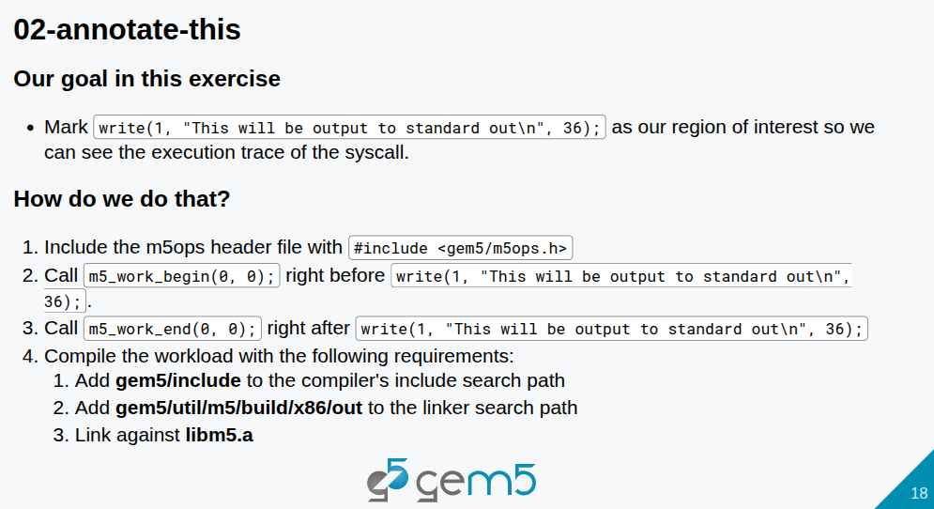
6.13 Example: 02-annotate-this
https://www.youtube.com/watch?v=pGp_41V0xf4&list=PL_hVbFs_loVR_8ntTTmmG6YEq3Po_4snu&index=6
Example: 02-annotate-this (15:48-15:49/1:10:12)

Slide 46
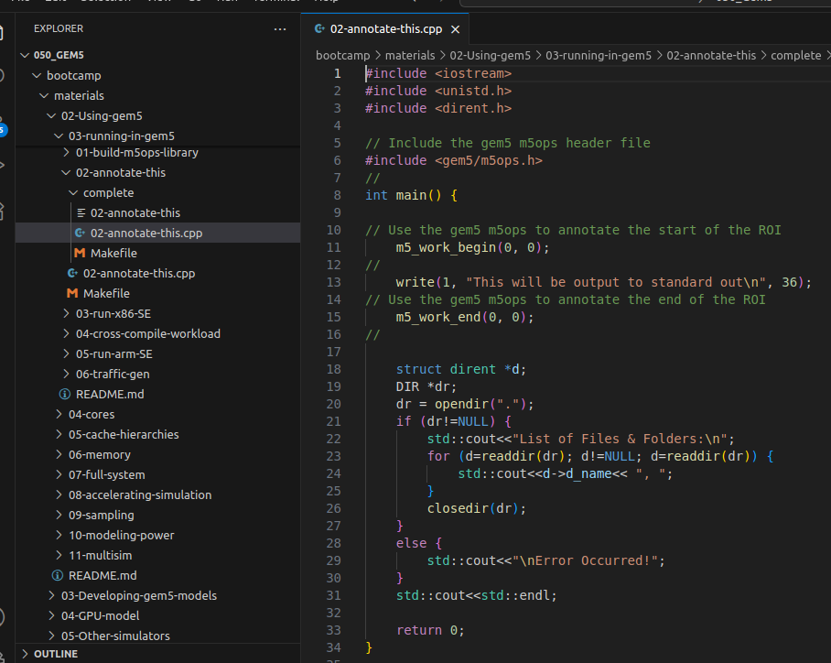
6.13 Example: 02-annotate-this
https://www.youtube.com/watch?v=pGp_41V0xf4&list=PL_hVbFs_loVR_8ntTTmmG6YEq3Po_4snu&index=6
Example: 02-annotate-this (15:50-18:30/1:10:12)
In the 02-annotate-this.cpp,
1. include <gem5/m5ops.h> header file.
2. ROI (Region of Interest): We use m5_work_begin() and m5_word_end() to put the the annotate message.

Slide 47
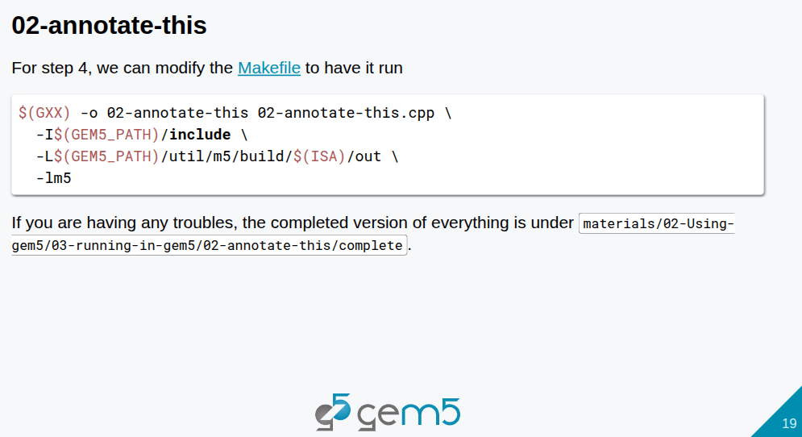
6.13 Example: 02-annotate-this
https://www.youtube.com/watch?v=pGp_41V0xf4&list=PL_hVbFs_loVR_8ntTTmmG6YEq3Po_4snu&index=6
Example: 02-annotate-this (18:31-18:44/1:10:12)
1. In the directory bootcamp/materials/02-Using-gem5/03-running-in-gem5/02-annotate-this
2. In the Makefile, we add the compiler GXX = g++, ISA = x86. GEM5_PATH …

Slide 48
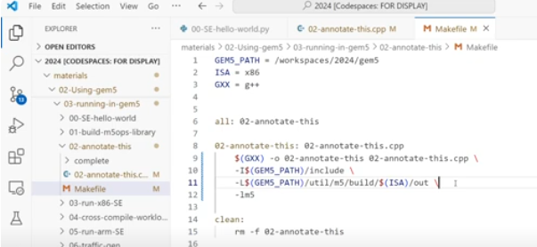
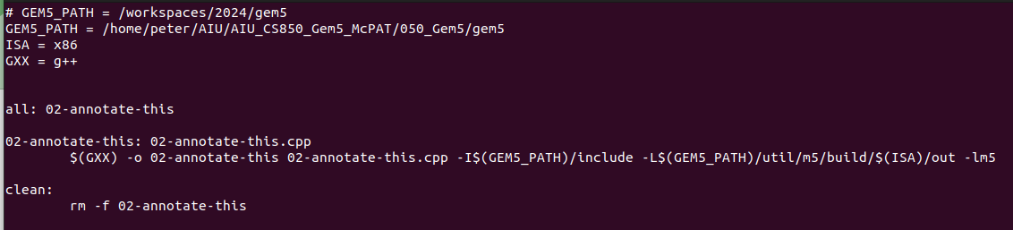
6.13 Example: 02-annotate-this
https://www.youtube.com/watch?v=pGp_41V0xf4&list=PL_hVbFs_loVR_8ntTTmmG6YEq3Po_4snu&index=6
Example: 02-annotate-this (18:45-19:44/1:10:12)
1. Change GEM5_PATH to our local gem5
> GEM_PATH = /home/peter/AIU/AIU_CS850_Gem5_McPAT/050_Gem5/gem5
2. Link directory for library search, for example, “-L out/m5”, link all libraries in “out/m5” director.
3. Link specify library, for example, -lm5 means “link libm5 library”

Slide 49
6.13 Example: 02-annotate-this
https://www.youtube.com/watch?v=pGp_41V0xf4&list=PL_hVbFs_loVR_8ntTTmmG6YEq3Po_4snu&index=6
Example: 02-annotate-this (19:44-19:51/1:10:12)
1. Remove all compilation
> make clean
2. Compile again
> make
3. Now, we got our first annotated binary.

Slide 50
6.14 Run 02-annotate-this

Slide 51
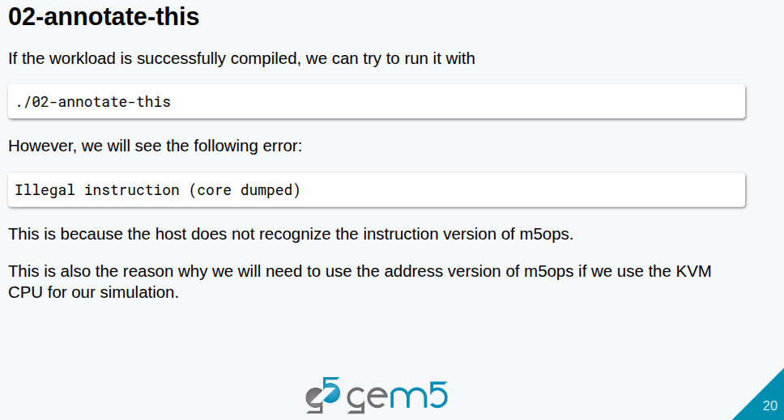
6.14 Run 02-annotate-this
https://www.youtube.com/watch?v=pGp_41V0xf4&list=PL_hVbFs_loVR_8ntTTmmG6YEq3Po_4snu&index=6
Run 02-annotate-this (19:52-20:00/1:10:12)
If we try to run
> ./02-annotate-this
We got the core dumped. The host does not recognize the m5ops instruction.

Slide 52
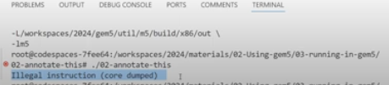
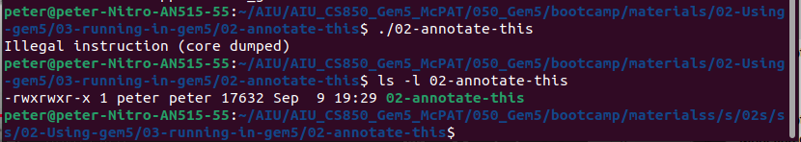
6.14 Run 02-annotate-this
https://www.youtube.com/watch?v=pGp_41V0xf4&list=PL_hVbFs_loVR_8ntTTmmG6YEq3Po_4snu&index=6
Run 02-annotate-this (20:01-20:27/1:10:12)
This is the reason why we need to use the address version of m5ops.
If we use the KVM (Kernel-Based Virtual Machine) CPU. The KVM integrates the Linux Kernel and use the hypervisor to run multiple operating system in a Virtual Machine on a single host.
This is why we use the KVM CPU for our simulation.

Slide 53
6.15 Example 03-run-x86-SE

Slide 54
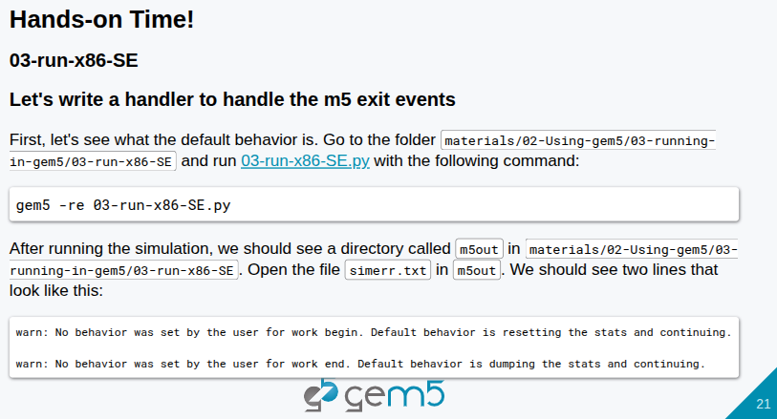
6.15 Example 03-run-x86-SE
https://www.youtube.com/watch?v=pGp_41V0xf4&list=PL_hVbFs_loVR_8ntTTmmG6YEq3Po_4snu&index=6
Example 03-run-x86-SE (20:28-21:00/1:10:12)
This is the third exercise.
We can run gem5 and output the error message to directory “m5out”

Slide 55

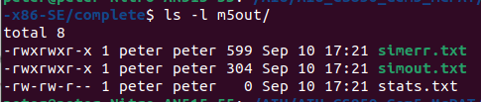
6.15 Example 03-run-x86-SE
https://www.youtube.com/watch?v=pGp_41V0xf4&list=PL_hVbFs_loVR_8ntTTmmG6YEq3Po_4snu&index=6
Example 03-run-x86-SE (21:01-21:24/1:10:12)
We link the binary gem5.opt:
> ln -s <path>/gem5/build/X86/gem5.opt .
Run gem5 with re (r: redirect output to file, e: redirect with std error to file)
> gem5.opt -re 03-run-x86-SE.py
> ls -l m5out
>> we can see simerr.txt, simout.txt, and stats.txt

Slide 56
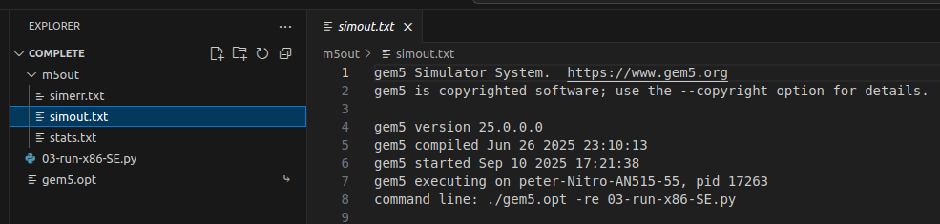
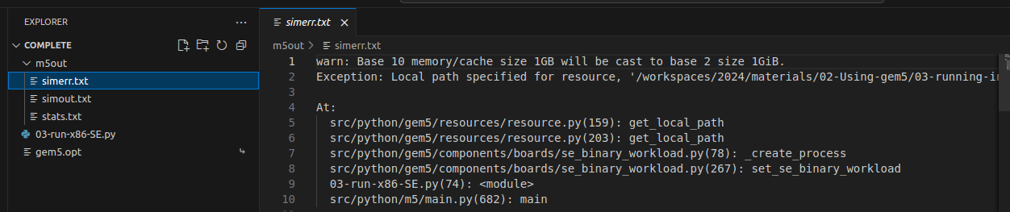
6.15 Example 03-run-x86-SE
https://www.youtube.com/watch?v=pGp_41V0xf4&list=PL_hVbFs_loVR_8ntTTmmG6YEq3Po_4snu&index=6
Example 03-run-x86-SE (21:25-22:00/1:10:12)
We can see the
1. simulation output: simout.txt and
2. simulation error: simerr.txt
3. stats.txt

Slide 57
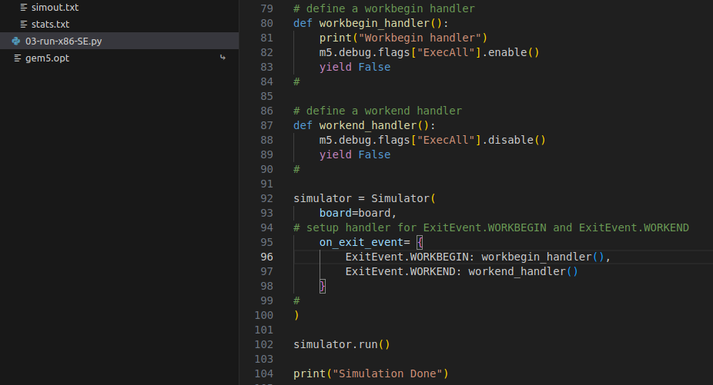
6.15 Example 03-run-x86-SE
https://www.youtube.com/watch?v=pGp_41V0xf4&list=PL_hVbFs_loVR_8ntTTmmG6YEq3Po_4snu&index=6
Example 03-run-x86-SE (22:01-26:21/1:10:12)
We add
1. workbegin_handler()
2. workend_handler()

Slide 58
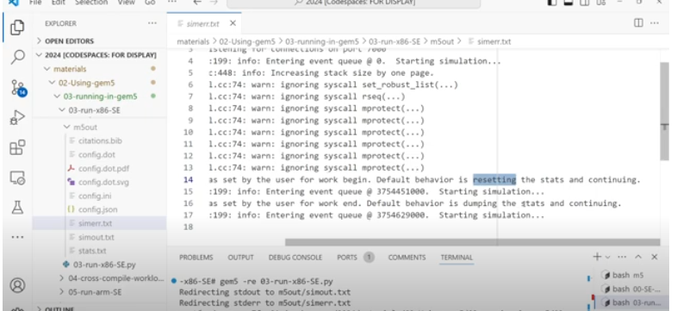
6.15 Example 03-run-x86-SE
https://www.youtube.com/watch?v=pGp_41V0xf4&list=PL_hVbFs_loVR_8ntTTmmG6YEq3Po_4snu&index=6
Example 03-run-x86-SE (26:22-26:23/1:10:12)
We can see the simerr.txt have messages:
1. workbegin_handler()
2. workend_handler()

Slide 59
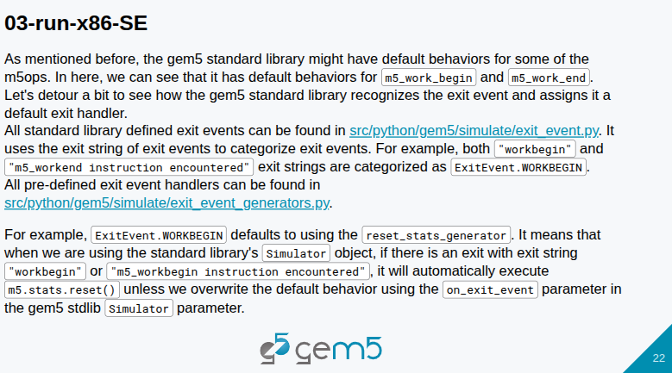
6.15 Example 03-run-x86-SE
https://www.youtube.com/watch?v=pGp_41V0xf4&list=PL_hVbFs_loVR_8ntTTmmG6YEq3Po_4snu&index=6
Example 03-run-x86-SE (26:24-26:30/1:10:12)
Gem5 standard library handle the m5_work_begin()/m5_work_end().

Slide 60
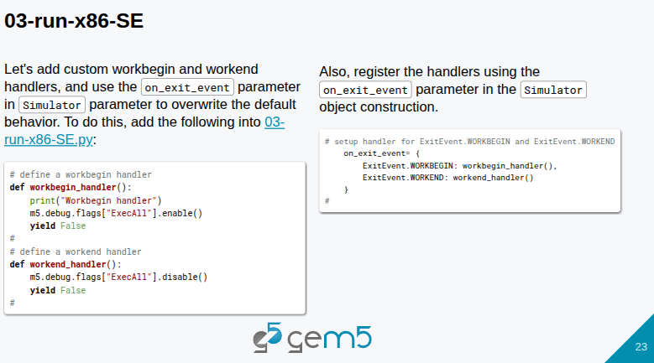
6.15 Example 03-run-x86-SE
https://www.youtube.com/watch?v=pGp_41V0xf4&list=PL_hVbFs_loVR_8ntTTmmG6YEq3Po_4snu&index=6
Example 03-run-x86-SE (26:31-27:00/1:10:12)

Slide 61
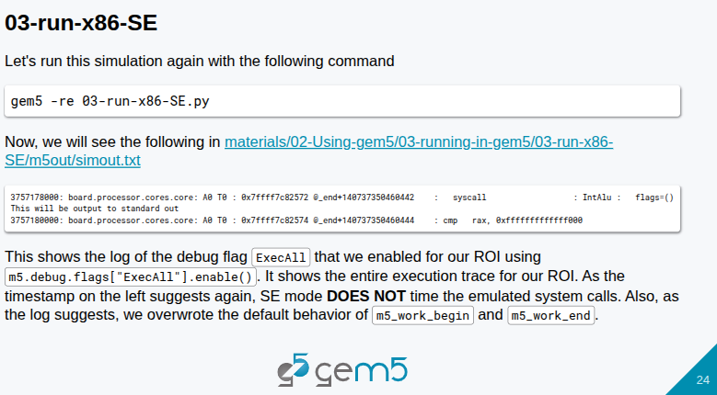
6.15 Example 03-run-x86-SE
https://www.youtube.com/watch?v=pGp_41V0xf4&list=PL_hVbFs_loVR_8ntTTmmG6YEq3Po_4snu&index=6
Example 03-run-x86-SE (27:01-28:30/1:10:12)

Slide 62
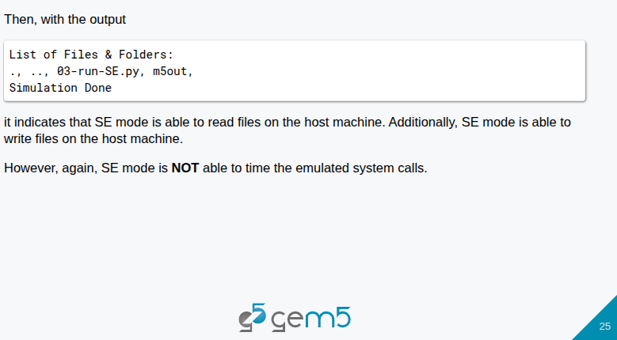
6.15 Example 03-run-x86-SE
https://www.youtube.com/watch?v=pGp_41V0xf4&list=PL_hVbFs_loVR_8ntTTmmG6YEq3Po_4snu&index=6
Example 03-run-x86-SE (28:31-29:00/1:10:12)

Slide 63
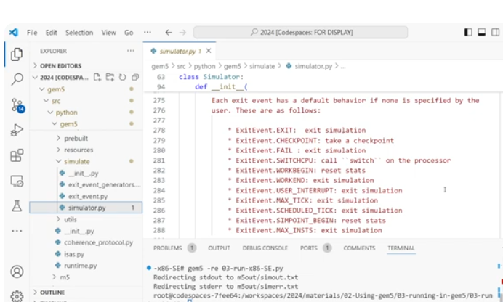
6.15 Example 03-run-x86-SE
https://www.youtube.com/watch?v=pGp_41V0xf4&list=PL_hVbFs_loVR_8ntTTmmG6YEq3Po_4snu&index=6
Example 03-run-x86-SE (29:01-31:00/1:10:12)
Now, the simulator overwrite the standard library with event handler: workbegin_handler()/workend_handler()

Slide 64
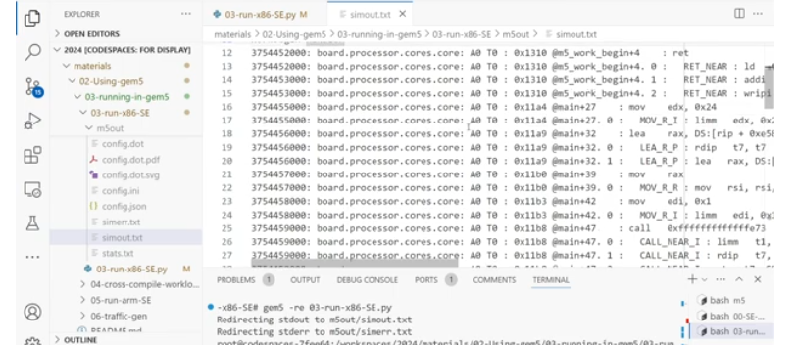
6.15 Example 03-run-x86-SE
https://www.youtube.com/watch?v=pGp_41V0xf4&list=PL_hVbFs_loVR_8ntTTmmG6YEq3Po_4snu&index=6
Example 03-run-x86-SE (31:01-31:38/1:10:12)
Now, we can see the simulator with all the annotate messages.

Slide 65
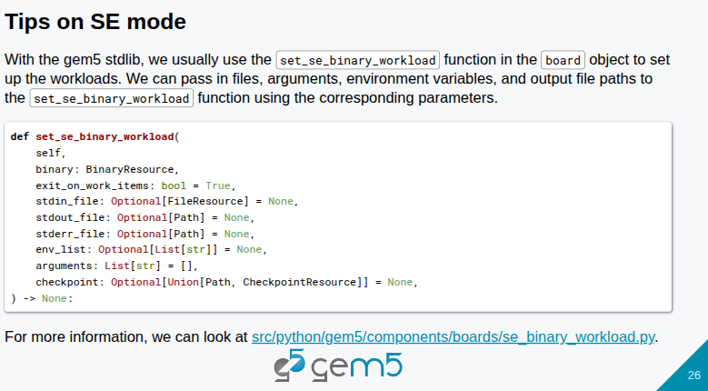
6.15 Example 03-run-x86-SE
https://www.youtube.com/watch?v=pGp_41V0xf4&list=PL_hVbFs_loVR_8ntTTmmG6YEq3Po_4snu&index=6
Example 03-run-x86-SE (31:39-32:15/1:10:12)
We can set the binary workload with function.

Slide 66
6.16 Cross-Compiler

Slide 67
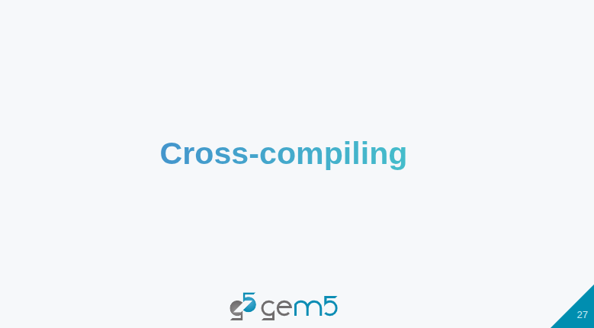
6.16 Cross-Compiler
https://www.youtube.com/watch?v=pGp_41V0xf4&list=PL_hVbFs_loVR_8ntTTmmG6YEq3Po_4snu&index=6
Cross-Compiler (32:16-32:20/1:10:12)
Now, we talk about cross-compilation.

Slide 68
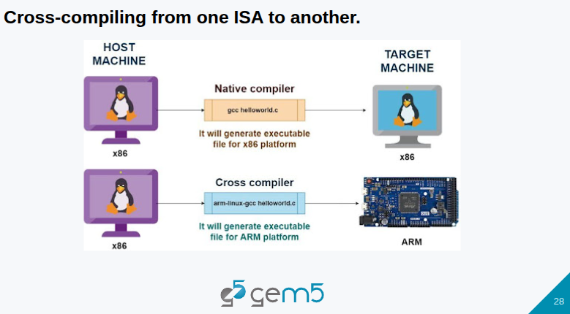
6.16 Cross-Compiler
https://www.youtube.com/watch?v=pGp_41V0xf4&list=PL_hVbFs_loVR_8ntTTmmG6YEq3Po_4snu&index=6
Cross-Compiler (32:21-32:30/1:10:12)
We use cross-compiler to compile ISA for different host.
1. If we compile the code by Native compiler (e.g., gcc hellowcorld.c), the generated binary code is run on target machine (x86 machine).
2. If we use cross compile (e.g., arm-linux-gcc helloworld.c) to generate binary code, the binary code will be run on ARM board.

Slide 69
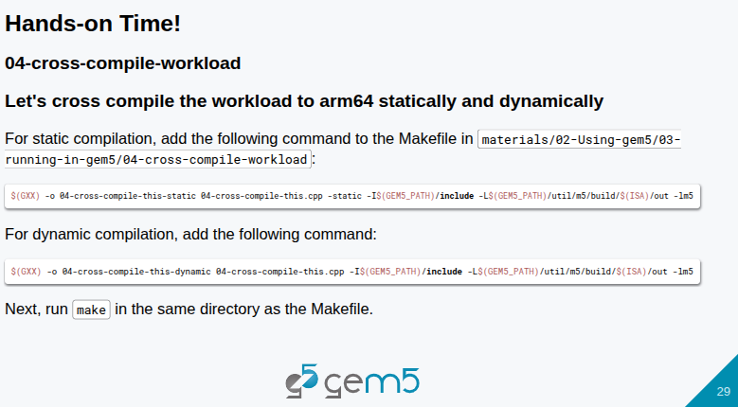
6.16 Cross-Compiler
https://www.youtube.com/watch?v=pGp_41V0xf4&list=PL_hVbFs_loVR_8ntTTmmG6YEq3Po_4snu&index=6
Cross-Compiler (32:31-32:40/1:10:12)
Just like we just compiled for the workload for arm64.

Slide 70
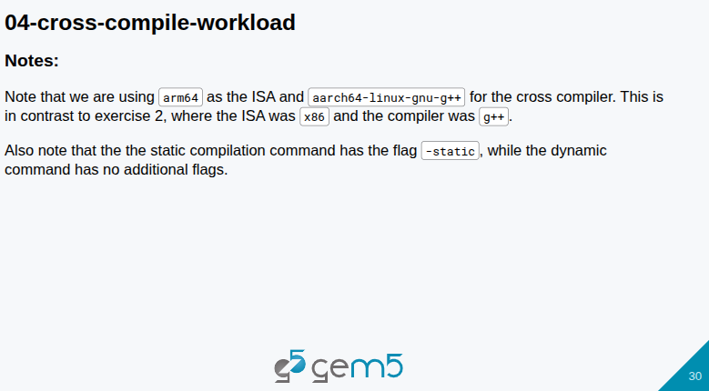
6.16 Cross-Compiler
https://www.youtube.com/watch?v=pGp_41V0xf4&list=PL_hVbFs_loVR_8ntTTmmG6YEq3Po_4snu&index=6
Cross-Compiler (32:41-33:27/1:10:12)
We have
1. ISA (Instruction Set Architecture): arm64
2. GCC compiler: aarch64-linux-gnu-g++
3. compiler option: static or dynamic

Slide 71
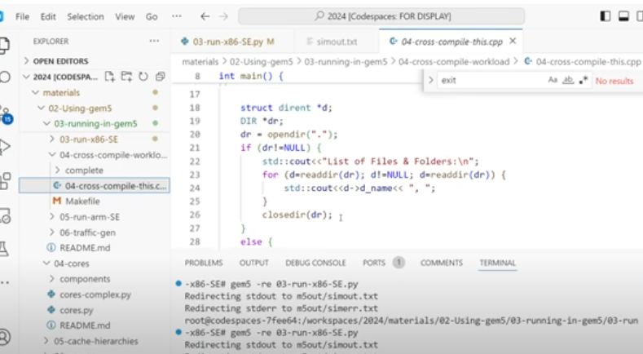
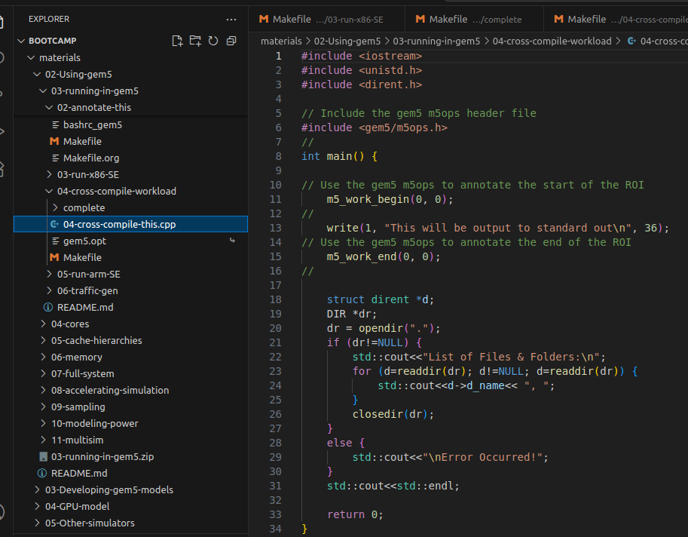
6.16 Cross-Compiler
https://www.youtube.com/watch?v=pGp_41V0xf4&list=PL_hVbFs_loVR_8ntTTmmG6YEq3Po_4snu&index=6
Cross-Compiler (33:28-33:29/1:10:12)
Source code: 04-cross-compile-this.cpp

Slide 72


6.16 Cross-Compiler
https://www.youtube.com/watch?v=pGp_41V0xf4&list=PL_hVbFs_loVR_8ntTTmmG6YEq3Po_4snu&index=6
Cross-Compiler (33:29-33:30/1:10:12)
We need to put code in between m5_work_begin() and m5_work_end () as below.

Slide 73


6.16 Cross-Compiler
https://www.youtube.com/watch?v=pGp_41V0xf4&list=PL_hVbFs_loVR_8ntTTmmG6YEq3Po_4snu&index=6
Cross-Compiler (33:31-36:36/1:10:12)
In the Makefile, we can compile into static or dynamic binary. The only difference is “-static” or “”.

Slide 74

6.16 Cross-Compiler
https://www.youtube.com/watch?v=pGp_41V0xf4&list=PL_hVbFs_loVR_8ntTTmmG6YEq3Po_4snu&index=6
Cross-Compiler (36:37-36:38/1:10:12)
Below is the Makefile which used to compile the binary code on
1. Compile with option -static: generate binary include library
2. Compile without option -static: generate binary with run time dynamic link library.

Slide 75

6.16 Cross-Compiler
https://www.youtube.com/watch?v=pGp_41V0xf4&list=PL_hVbFs_loVR_8ntTTmmG6YEq3Po_4snu&index=6
Cross-Compiler (33:38-33:39/1:10:12)
1. Set GEM5_PATH: Point to compiled Gem5 binary location.
2. Set ISA (Instruction Set Architecture): arm64
3. Set Cross-compiler GCC: aarch64-linux-gnu-g++

Slide 76

6.16 Cross-Compiler
https://www.youtube.com/watch?v=pGp_41V0xf4&list=PL_hVbFs_loVR_8ntTTmmG6YEq3Po_4snu&index=6
Cross-Compiler (33:39-39:00/1:10:12)
> make
It will make both the static and dynamic.

Slide 77

6.16 Cross-Compiler
https://www.youtube.com/watch?v=pGp_41V0xf4&list=PL_hVbFs_loVR_8ntTTmmG6YEq3Po_4snu&index=6
Cross-Compiler (39:01-39:02/1:10:12)
Compile the workload (Python file) with Makefile (compile cpp file)
> gem5 -re --outdir=static 05-run-arm-SE.py --workload-type=static

Slide 78

6.16 Cross-Compiler
https://www.youtube.com/watch?v=pGp_41V0xf4&list=PL_hVbFs_loVR_8ntTTmmG6YEq3Po_4snu&index=6
Cross-Compiler (39:03-39:04/1:10:12)
Error output
> dynamic/simout.txt
c

Slide 79

6.16 Cross-Compiler
https://www.youtube.com/watch?v=pGp_41V0xf4&list=PL_hVbFs_loVR_8ntTTmmG6YEq3Po_4snu&index=6
Cross-Compiler (39:05-39:06/1:10:12)
We can check static folder and dynamic folder.

Slide 80


6.16 Cross-Compiler
https://www.youtube.com/watch?v=pGp_41V0xf4&list=PL_hVbFs_loVR_8ntTTmmG6YEq3Po_4snu&index=6
Cross-Compiler (39:07-44:31/1:10:12)
In the 05-run-arm-SE.py, we need to check the gem5 argument is dynamic and set the dynamic library path for gem5 in the run time.

Slide 81

6.16 Cross-Compiler
https://www.youtube.com/watch?v=pGp_41V0xf4&list=PL_hVbFs_loVR_8ntTTmmG6YEq3Po_4snu&index=6
Cross-Compiler (34:32-44:51/1:10:12)
The SE mode does not implement a lot of functions, such as, file system, IO device interrupts, table missed page table walk, context switches, multiple threads.

Slide 82

6.16 Cross-Compiler
https://www.youtube.com/watch?v=pGp_41V0xf4&list=PL_hVbFs_loVR_8ntTTmmG6YEq3Po_4snu&index=6
Cross-Compiler (44:52-44:53/1:10:12)
What is difference between SE (System Emulation) and FS (Full System)mode?

Slide 83
6.17 Traffic Generator

Slide 84

6.17 Traffic Generator
https://www.youtube.com/watch?v=pGp_41V0xf4&list=PL_hVbFs_loVR_8ntTTmmG6YEq3Po_4snu&index=6
Traffic Generator (44:54-45:02/1:10:12)
Now, we are in Traffic Generator.

Slide 85

6.17 Traffic Generator
https://www.youtube.com/watch?v=pGp_41V0xf4&list=PL_hVbFs_loVR_8ntTTmmG6YEq3Po_4snu&index=6
Traffic Generator (45:03-45:43/1:10:12)
Synthetic Traffic Generator is a technique for driven memory subsystem without requiring the simulation of processor models and running workload programs.
When we talk about the synthetic traffic generation, we want to think about two things.
1. It can be used for measuring maximum theoretical bandwidth and testing correctness of cache coherency protocol.
2. But it cannot be used for measuring the execution time of a workload even if we have the memory trace.
So we can see a few patterns with synthetic traffic generation, such as, sequential (linear), stride, and random.
Now, we are going to take a look at how traffic generation works in Gem5.

Slide 86

6.17 Traffic Generator
https://www.youtube.com/watch?v=pGp_41V0xf4&list=PL_hVbFs_loVR_8ntTTmmG6YEq3Po_4snu&index=6
Traffic Generator (45:44-45:53/1:10:12)
We have seen the standard library in the previous discussion.
Standard library has a collection of components for generating synthetic traffic. All these components inherit from abstract generator which is found in the file path (src/python/gem5/components/processors).

Slide 87

6.17 Traffic Generator
https://www.youtube.com/watch?v=pGp_41V0xf4&list=PL_hVbFs_loVR_8ntTTmmG6YEq3Po_4snu&index=6
Traffic Generator (45:54-46:53/1:10:12)
In the folder:
gem5/src/python/gem5/components/processors
We see a lot of python files: such as, abstract_*.py, linear_generator_*.py, random_generator_*.py, stride_generator_*.py, traffic_generator_*.py.
We will talk more about the abstract core, linear generator, random generator, stride generator, and traffic generator.
We want to see linear generator and random generator simulate a memory subsystem with the code example.
We prepare a subsystem with a cache hierarchy, such as, a private L1 cache, a shared L2 cache, and one channel of DDR3 memory.

Slide 88

6.17 Traffic Generator
https://www.youtube.com/watch?v=pGp_41V0xf4&list=PL_hVbFs_loVR_8ntTTmmG6YEq3Po_4snu&index=6
Traffic Generator (46:54-47:18/1:10:12)
Linear Generator and Random Generator. We have different set of parameters for linear generator and random generator

Slide 89


6.17 Traffic Generator
https://www.youtube.com/watch?v=pGp_41V0xf4&list=PL_hVbFs_loVR_8ntTTmmG6YEq3Po_4snu&index=6
Traffic Generator (47:19-47:20/1:10:12)
In the gem5/src/python/components/processors/linear_generator.py, we have a set of parameters that help us customize how we want our synthetic traffic generator to work.

Slide 90

6.17 Traffic Generator
https://www.youtube.com/watch?v=pGp_41V0xf4&list=PL_hVbFs_loVR_8ntTTmmG6YEq3Po_4snu&index=6
Traffic Generator (47:21-48:04/1:10:12)
In the linear and random generator, we have parameters.
Few of important ones to look at are number cores, min address and max address , and block size,
The min and max address are what memory we want to access. The block size is like a step size to access the memory. We will see other parameters later on.

Slide 91

6.17 Traffic Generator
https://www.youtube.com/watch?v=pGp_41V0xf4&list=PL_hVbFs_loVR_8ntTTmmG6YEq3Po_4snu&index=6
Traffic Generator (48:05-48:59/1:10:12)
We have talked linear and random generator. We want to look at how they access memory.
Below is the example. Here, we have min address 0, max address 4, with a block size of 1.
Linear means sequential. The memory access pattern is 0, 1, 2, 3 with increase size 1 (block size = 1) .
Random is access randomly. Below, we start at 1 and then 3, then 3, then 0.

Slide 92

6.17 Traffic Generator
https://www.youtube.com/watch?v=pGp_41V0xf4&list=PL_hVbFs_loVR_8ntTTmmG6YEq3Po_4snu&index=6
Traffic Generator (49:00-49:19/1:10:12)
Open file
> materials/02-Using-gem5/03-running-in-gem5/06-traffic-gem/simple-traffic-generators.py

Slide 93

6.17 Traffic Generator
https://www.youtube.com/watch?v=pGp_41V0xf4&list=PL_hVbFs_loVR_8ntTTmmG6YEq3Po_4snu&index=6
Traffic Generator (49:20-50:23/1:10:12)
Below, we import the Gem5, Cache Hierarchy, DDR3 memory, LinearGenerator and RandomGenerator Library.

Slide 94

6.17 Traffic Generator
https://www.youtube.com/watch?v=pGp_41V0xf4&list=PL_hVbFs_loVR_8ntTTmmG6YEq3Po_4snu&index=6
Traffic Generator (50:24-50:30/1:10:12)
Here, we
1. Setup cache hierarchy, DDR3 memory, generator with LinearGenerator() with number of codes = 1 and rate = 1GB/s.
2. Setup mother board with clock, generator, DDR 3memory, cache hierarchy.

Slide 95


6.17 Traffic Generator
https://www.youtube.com/watch?v=pGp_41V0xf4&list=PL_hVbFs_loVR_8ntTTmmG6YEq3Po_4snu&index=6
Traffic Generator (50:31-50:50/1:10:12)
Below, we
1. put the LinearGenerator(num_cores=1, rate=”1GB/s”)
2. Note: I remove the root = Root () since the Root is singleton in gem5.opt

Slide 96

6.17 Traffic Generator
https://www.youtube.com/watch?v=pGp_41V0xf4&list=PL_hVbFs_loVR_8ntTTmmG6YEq3Po_4snu&index=6
Traffic Generator (50:51-50:58/1:10:12)
We completed the code.

Slide 97


6.17 Traffic Generator
https://www.youtube.com/watch?v=pGp_41V0xf4&list=PL_hVbFs_loVR_8ntTTmmG6YEq3Po_4snu&index=6
Traffic Generator (50:54-51:45/1:10:12)
Now, we want to run with gem5.
1. > cd <path>/06-traffic-gen
2. > ln -s <path>/gem5.opt .
3. > ./gem5.opt --debug-flags=TrafficGen --debug-end=1000000 simple-traffic-generators.py

Slide 98

6.17 Traffic Generator
https://www.youtube.com/watch?v=pGp_41V0xf4&list=PL_hVbFs_loVR_8ntTTmmG6YEq3Po_4snu&index=6
Traffic Generator (51:46-52:00/1:10:12)
We look at the output.

Slide 99

6.17 Traffic Generator
https://www.youtube.com/watch?v=pGp_41V0xf4&list=PL_hVbFs_loVR_8ntTTmmG6YEq3Po_4snu&index=6
Traffic Generator (52:01-52:50/1:10:12)
When we look at result output, we see a lot of “r to address …” message. This message means traffic generator is simulating a read request to access memory address 0, 0x40, 0x80, etc.
Because we run a linear generator, we can see the memory address is increased in hex 40.

Slide 100

6.17 Traffic Generator
https://www.youtube.com/watch?v=pGp_41V0xf4&list=PL_hVbFs_loVR_8ntTTmmG6YEq3Po_4snu&index=6
Traffic Generator (52:51-53:10/1:10:12)
If we run with Random Generator, we can see the address pattern is random.
There is no order of memory address.

Slide 101

6.17 Traffic Generator
https://www.youtube.com/watch?v=pGp_41V0xf4&list=PL_hVbFs_loVR_8ntTTmmG6YEq3Po_4snu&index=6
Traffic Generator (53:11-53:42/1:10:12)
We see the linear generator result. We will see random generator later on.
Linear generator and random generator are same except the order of access memory.
They all inherited from abstract generator class.

Slide 102

6.17 Traffic Generator
https://www.youtube.com/watch?v=pGp_41V0xf4&list=PL_hVbFs_loVR_8ntTTmmG6YEq3Po_4snu&index=6
Traffic Generator (53:43-54:44/1:10:12)
1. Gem5 library gem5/src/python/gem5/components/processors: abstract_generator.py defines class AbstractGenerator (AbstractProcessor). We passed in a list of AbstractoGeneratorCores(). The LinearGenerator() and RandomGenerator() inherit the based class AbstractGenerator().

Slide 103

6.17 Traffic Generator
https://www.youtube.com/watch?v=pGp_41V0xf4&list=PL_hVbFs_loVR_8ntTTmmG6YEq3Po_4snu&index=6
Traffic Generator (54:45-55:11/1:10:12)
Class AbstractGenerator() is the base class of class LinearGenerator () and class RandomGenerator ()

Slide 104

6.17 Traffic Generator
https://www.youtube.com/watch?v=pGp_41V0xf4&list=PL_hVbFs_loVR_8ntTTmmG6YEq3Po_4snu&index=6
Traffic Generator (55:12-55:40/1:10:12)
Gem5 has a lot of tools in gem5 standard library.
We can inherit AbstractGenerator() to create the new generator.
In the HybridGenerator example, we see the both LinearGenerator and RandomGenerator.

Slide 105

6.17 Traffic Generator
https://www.youtube.com/watch?v=pGp_41V0xf4&list=PL_hVbFs_loVR_8ntTTmmG6YEq3Po_4snu&index=6
Traffic Generator (55:41-56:25/1:10:12)
The class LinearGeneratorCores () only simulate linear traffic.
When we have multiple LinearGeneratorCores(), if we have same min address and max address, when we run the simulation, the memory will be accessed the same addresses at the same time.
If we want to simulate in different chunk of memory addresses, we need to split the memory into several chunk and configure each LinearGeneratorCores () to simulate the access to one of the chunks.

Slide 106

6.17 Traffic Generator
https://www.youtube.com/watch?v=pGp_41V0xf4&list=PL_hVbFs_loVR_8ntTTmmG6YEq3Po_4snu&index=6
Traffic Generator (56:26-56:47/1:10:12)
Below is the diagram of how LinearGeneratorCores() access the different memory address inside the memory address range. The accesses are happening in parallel.
So, each linear generator core is doing their accesses in parallel.

Slide 107

6.17 Traffic Generator
https://www.youtube.com/watch?v=pGp_41V0xf4&list=PL_hVbFs_loVR_8ntTTmmG6YEq3Po_4snu&index=6
Traffic Generator (56:48-56:58/1:10:12)
When we create a HybridGenerator, we have to get chunk of memory by the LinearGeneratorCore.
We use the partition_range() function to get the min_addr and max_addr and partition them into num_partition equal length pieces.
The partition_rnage () in
> gem5/src/python/gem5/components/processors/abstract_generator.py.

Slide 108

6.17 Traffic Generator
https://www.youtube.com/watch?v=pGp_41V0xf4&list=PL_hVbFs_loVR_8ntTTmmG6YEq3Po_4snu&index=6
Traffic Generator (56:59-57:00/1:10:12)
The partition_rnage () in
> gem5/src/python/gem5/components/processors/abstract_generator.py.

Slide 109

6.17 Traffic Generator
https://www.youtube.com/watch?v=pGp_41V0xf4&list=PL_hVbFs_loVR_8ntTTmmG6YEq3Po_4snu&index=6
Traffic Generator (57:01-57:23/1:10:12)
In the RandomGeneratorCores, the pattern is random, we do not have min_addr, max_addr, and partition_range.

Slide 110

6.17 Traffic Generator
https://www.youtube.com/watch?v=pGp_41V0xf4&list=PL_hVbFs_loVR_8ntTTmmG6YEq3Po_4snu&index=6
Traffic Generator (57:24-57:41/1:10:12)
Below diagram shows the HybridGenerator(). Here, we mix the LinearGeneratorCores (with min_addr, max_addr, and partition_range) and RandomGeneratorCores (without min, max, and range).

Slide 111

6.17 Traffic Generator
https://www.youtube.com/watch?v=pGp_41V0xf4&list=PL_hVbFs_loVR_8ntTTmmG6YEq3Po_4snu&index=6
Traffic Generator (57:42-57:53/1:10:12)
Now, we are in Traffic Generator.

Slide 112

6.17 Traffic Generator
https://www.youtube.com/watch?v=pGp_41V0xf4&list=PL_hVbFs_loVR_8ntTTmmG6YEq3Po_4snu&index=6
Traffic Generator (44:54-45:53/1:10:12)
Now, we are in Traffic Generator.

Slide 113

6.17 Traffic Generator
https://www.youtube.com/watch?v=pGp_41V0xf4&list=PL_hVbFs_loVR_8ntTTmmG6YEq3Po_4snu&index=6
Traffic Generator (44:54-45:53/1:10:12)
Now, we are in Traffic Generator.

Slide 114

6.17 Traffic Generator
https://www.youtube.com/watch?v=pGp_41V0xf4&list=PL_hVbFs_loVR_8ntTTmmG6YEq3Po_4snu&index=6
Traffic Generator (44:54-45:53/1:10:12)
Now, we are in Traffic Generator.

Slide 115

6.17 Traffic Generator
https://www.youtube.com/watch?v=pGp_41V0xf4&list=PL_hVbFs_loVR_8ntTTmmG6YEq3Po_4snu&index=6
Traffic Generator (44:54-45:53/1:10:12)
Now, we are in Traffic Generator.

Slide 116

6.17 Traffic Generator
https://www.youtube.com/watch?v=pGp_41V0xf4&list=PL_hVbFs_loVR_8ntTTmmG6YEq3Po_4snu&index=6
Traffic Generator (44:54-45:53/1:10:12)
Now, we are in Traffic Generator.

Slide 117

6.17 Traffic Generator
https://www.youtube.com/watch?v=pGp_41V0xf4&list=PL_hVbFs_loVR_8ntTTmmG6YEq3Po_4snu&index=6
Traffic Generator (44:54-45:53/1:10:12)
Now, we are in Traffic Generator.

Slide 118

6.17 Traffic Generator
https://www.youtube.com/watch?v=pGp_41V0xf4&list=PL_hVbFs_loVR_8ntTTmmG6YEq3Po_4snu&index=6
Traffic Generator (44:54-45:53/1:10:12)
Now, we are in Traffic Generator.

Slide 119

6.17 Traffic Generator
https://www.youtube.com/watch?v=pGp_41V0xf4&list=PL_hVbFs_loVR_8ntTTmmG6YEq3Po_4snu&index=6
Traffic Generator (44:54-45:53/1:10:12)
Now, we are in Traffic Generator.

Slide 120

6.17 Traffic Generator
https://www.youtube.com/watch?v=pGp_41V0xf4&list=PL_hVbFs_loVR_8ntTTmmG6YEq3Po_4snu&index=6
Traffic Generator (44:54-45:53/1:10:12)
Now, we are in Traffic Generator.

Slide 121

6.17 Traffic Generator
https://www.youtube.com/watch?v=pGp_41V0xf4&list=PL_hVbFs_loVR_8ntTTmmG6YEq3Po_4snu&index=6
Traffic Generator (44:54-45:53/1:10:12)
Now, we are in Traffic Generator.

Slide 122

6.17 Traffic Generator
https://www.youtube.com/watch?v=pGp_41V0xf4&list=PL_hVbFs_loVR_8ntTTmmG6YEq3Po_4snu&index=6
Traffic Generator (44:54-45:53/1:10:12)
Now, we are in Traffic Generator.

Slide 123

6.17 Traffic Generator
https://www.youtube.com/watch?v=pGp_41V0xf4&list=PL_hVbFs_loVR_8ntTTmmG6YEq3Po_4snu&index=6
Traffic Generator (44:54-45:53/1:10:12)
Now, we are in Traffic Generator.

Slide 124

6.17 Traffic Generator
https://www.youtube.com/watch?v=pGp_41V0xf4&list=PL_hVbFs_loVR_8ntTTmmG6YEq3Po_4snu&index=6
Traffic Generator (44:54-45:53/1:10:12)
Now, we are in Traffic Generator.

Slide 125

6.17 Traffic Generator
https://www.youtube.com/watch?v=pGp_41V0xf4&list=PL_hVbFs_loVR_8ntTTmmG6YEq3Po_4snu&index=6
Traffic Generator (44:54-45:53/1:10:12)
Now, we are in Traffic Generator.

Slide 126

6.17 Traffic Generator
https://www.youtube.com/watch?v=pGp_41V0xf4&list=PL_hVbFs_loVR_8ntTTmmG6YEq3Po_4snu&index=6
Traffic Generator (44:54-45:53/1:10:12)
Now, we are in Traffic Generator.

Slide 127

6.17 Traffic Generator
https://www.youtube.com/watch?v=pGp_41V0xf4&list=PL_hVbFs_loVR_8ntTTmmG6YEq3Po_4snu&index=6
Traffic Generator (44:54-45:53/1:10:12)
Now, we are in Traffic Generator.

Slide 128

6.17 Traffic Generator
https://www.youtube.com/watch?v=pGp_41V0xf4&list=PL_hVbFs_loVR_8ntTTmmG6YEq3Po_4snu&index=6
Traffic Generator (44:54-45:53/1:10:12)
Now, we are in Traffic Generator.

Slide 129
End

