Slide 1

11 Accelerate Gem5 Simulation
Peter H. Chen

Slide 2
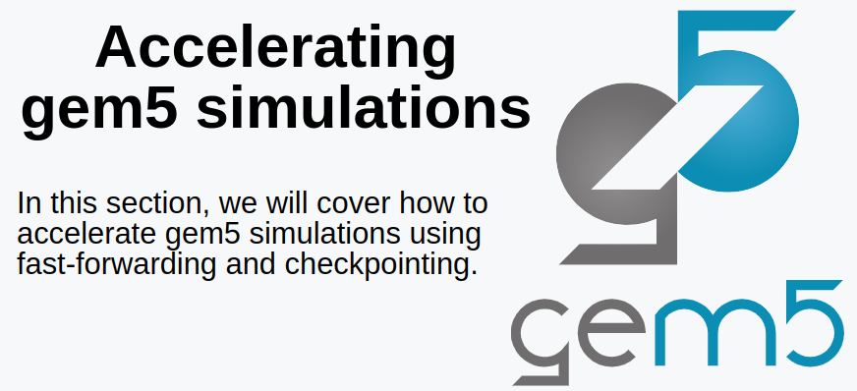
11 Accelerate Gem5 Simulation
https://www.youtube.com/watch?v=NgIHyaiZkIQ&list=PL_hVbFs_loVR_8ntTTmmG6YEq3Po_4snu&index=11
Accelerate Gem5 Simulation (0:00-0:09/20:39)
We talk Accelerate Gem5 Simulation using KVM to fast forwarding and checkpoint.

Slide 3
10.1 Topics

Slide 4
10.1 Topics
https://www.youtube.com/watch?v=NgIHyaiZkIQ&list=PL_hVbFs_loVR_8ntTTmmG6YEq3Po_4snu&index=11
Topics (0:10-0:11/20:39)
Topics:
1. How to get fast ROI (Region of Interest)?
  1.1 Fast forward with KVM (Kernel Virtual Machine)
  1.2 Restore a checkpoint
2. Address m5ops Annotation
3. Use m5_work_begin() and m5_work_end() to make the ROI (Region if Interest)
4. use KVM (Kernel Virtual Machine) fast forward for ROI.
5. Checkpoint of Gem5.
6. Summary of KVM and Checkpoint.

Slide 5
10.2 Why Accelerate Gem5 Simulation?

Slide 6
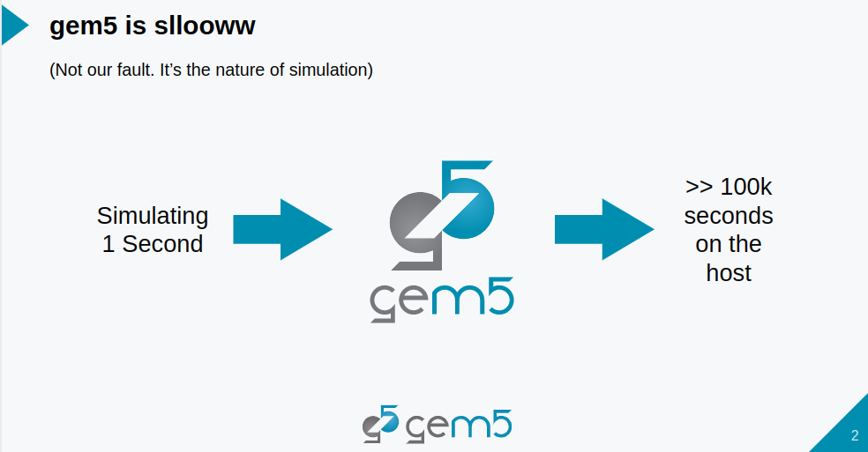
10.2 Why Accelerate Gem5 Simulation?
https://www.youtube.com/watch?v=NgIHyaiZkIQ&list=PL_hVbFs_loVR_8ntTTmmG6YEq3Po_4snu&index=11
Why Accelerate Gem5 Simulation? (0:11-0:18/20:39)
Because Gem5 simulation is very slow, we need to speed up Gem5 Simulation with KVM to fast forwarding and also checkpoint.

Slide 7
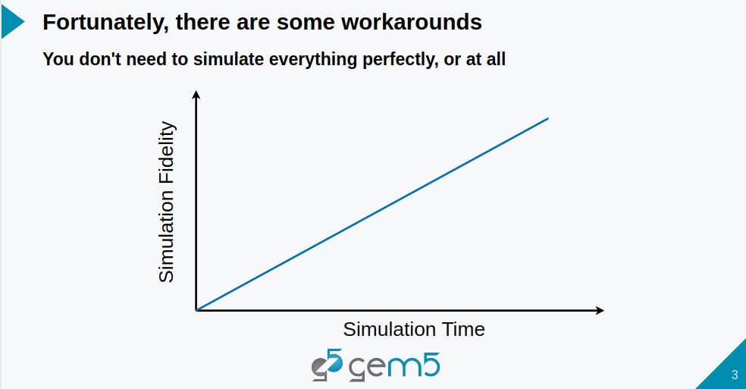
10.2 Why Accelerate Gem5 Simulation?
https://www.youtube.com/watch?v=NgIHyaiZkIQ&list=PL_hVbFs_loVR_8ntTTmmG6YEq3Po_4snu&index=11
Why Accelerate Gem5 Simulation? (0:19-0:26/20:39)
Fortunately, we have some work around.
We do not need to simulate everything perfectly.

Slide 8
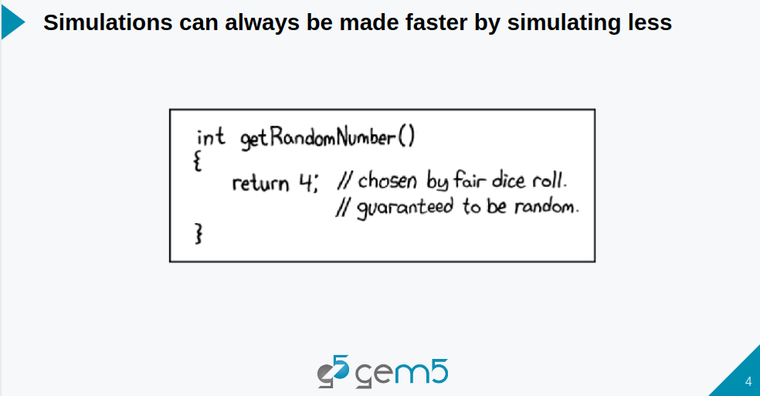
10.2 Why Accelerate Gem5 Simulation?
https://www.youtube.com/watch?v=NgIHyaiZkIQ&list=PL_hVbFs_loVR_8ntTTmmG6YEq3Po_4snu&index=11
Why Accelerate Gem5 Simulation? (0:27-0:31/20:39)
Simulation can always be made faster by simulating less.

Slide 9
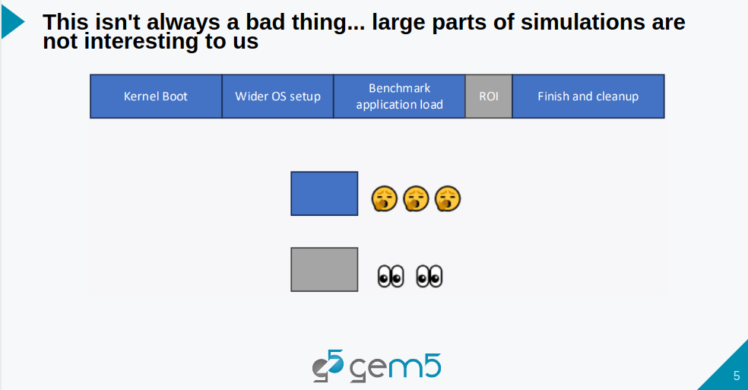
10.2 Why Accelerate Gem5 Simulation?
https://www.youtube.com/watch?v=NgIHyaiZkIQ&list=PL_hVbFs_loVR_8ntTTmmG6YEq3Po_4snu&index=11
Why Accelerate Gem5 Simulation? (0:32-0:52/20:39)
We are not interested in most part of simulations, such as, Kernel Boot, Wider OS Setup, the benchmark application is initialized, or after the ROI, at then end, finishing and cleaning up. We don’t care this.
We only interest the ROI (Region of Interest) area.

Slide 10
10.3 ROI (Region of Interest)

Slide 11
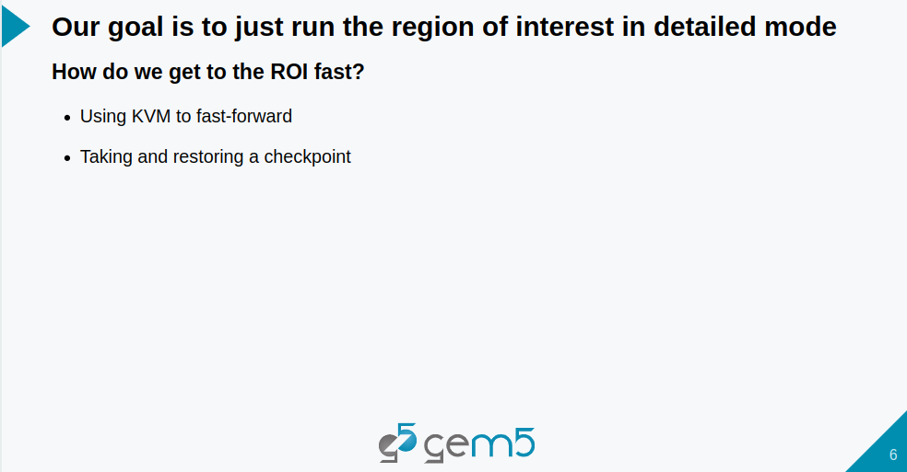
10.3 ROI (Region of Interest)
https://www.youtube.com/watch?v=NgIHyaiZkIQ&list=PL_hVbFs_loVR_8ntTTmmG6YEq3Po_4snu&index=11
ROI (Region of Interest) (0:53-1:08/20:39)
Our goal is is ROI (Region of Interest).
We can use KVM (Kernel-Based Virtual Machine) for fast forward or we can take and restore a checkpoint.

Slide 12
10.4 KVM

Slide 13
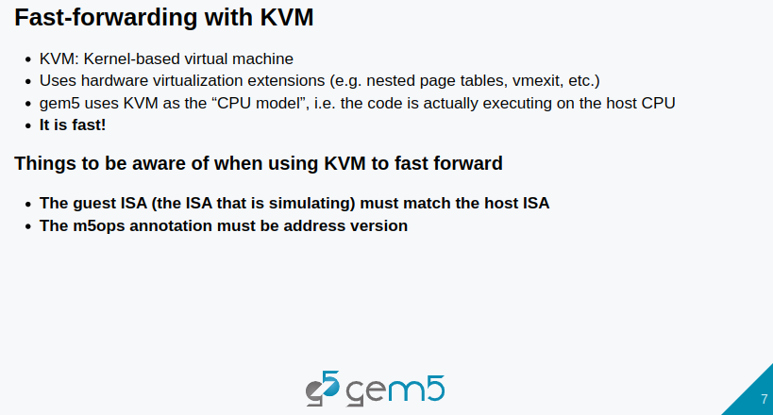
10.4 KVM
https://www.youtube.com/watch?v=NgIHyaiZkIQ&list=PL_hVbFs_loVR_8ntTTmmG6YEq3Po_4snu&index=11
KVM (1:09-1:45/20:39)
KVM is a Kernel-based virtual machine.
KVM used the hardware virtualization extension and Gem5 used KVM as the CPU model to fast forward the simulation and KVM is fast.
Note that when we use KVM to fast forward, the guest ISA much match the host ISA.
The m5ops annotation must be in address version.

Slide 14
10.5 Address Version m5ops Annotation

Slide 15
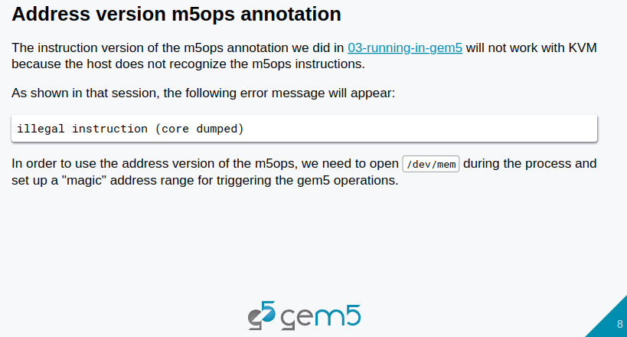
10.5 Address Version m5ops Annotation
https://www.youtube.com/watch?v=NgIHyaiZkIQ&list=PL_hVbFs_loVR_8ntTTmmG6YEq3Po_4snu&index=11
Address Version m5ops Annotation (1:46-2:33/20:39)
We have example to analyze the address version of m5ops.
Below, we have instruction version of the m5ops annotation. Below, we cannot run KVM (Kernel-Based Virtual Machine) because the host does not recognize the m5ops instructions.
In order to use the address version of the m5ops, we need to open the /dev/mem file during the process and setup a magic address range for checking the gem5 operations.

Slide 16
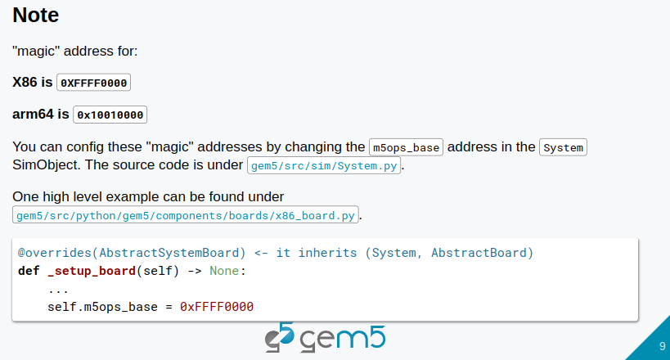
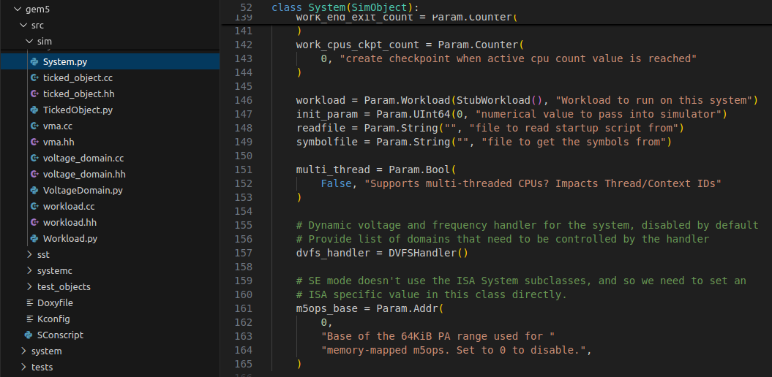
10.5 Address Version m5ops Annotation
https://www.youtube.com/watch?v=NgIHyaiZkIQ&list=PL_hVbFs_loVR_8ntTTmmG6YEq3Po_4snu&index=11
Address Version m5ops Annotation (2:34-3:10/20:39)
Note that there is a magic address for X86 is 0XFFFF0000 and AMD is 0x10010000.
We can configure the magic address by changing the m5ops_base address in the system SimObject.
The source of that can be found under gem5/src/sim/System.py.

Slide 17
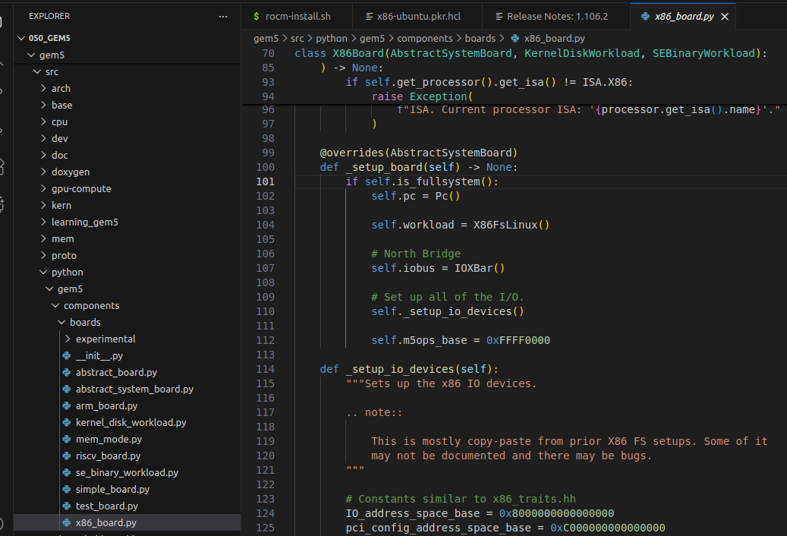
10.5 Address Version m5ops Annotation
https://www.youtube.com/watch?v=NgIHyaiZkIQ&list=PL_hVbFs_loVR_8ntTTmmG6YEq3Po_4snu&index=11
Address Version m5ops Annotation (3:11-3:37/20:39)
One high level example, can be found in gem5/src/python/gem5/components/boards/x86_board.py in the standard library.
This is for you to check out if you are interested for the magic address setup in the standard library.

Slide 18
10.6 01-annotate-this

Slide 19
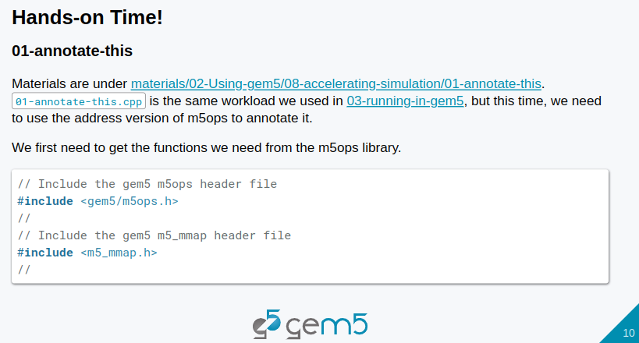
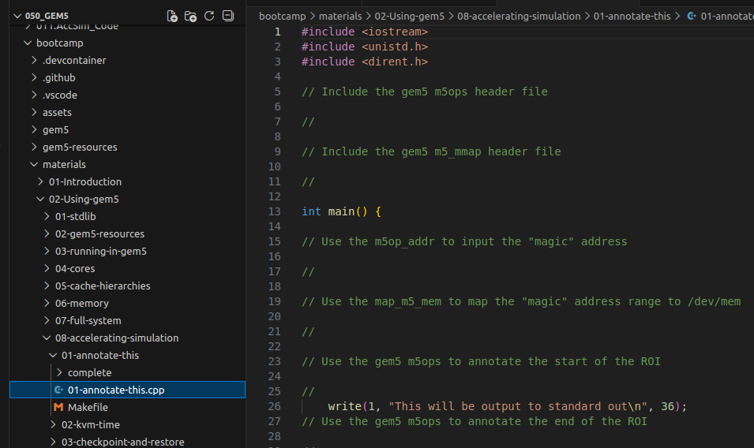
10.6 01-annotate-this
https://www.youtube.com/watch?v=NgIHyaiZkIQ&list=PL_hVbFs_loVR_8ntTTmmG6YEq3Po_4snu&index=11
01-annotate-this (3:38-3:48/20:39)
Below, we have annotate this example in the
> code ./materials/02-Using-gem5/08-accelerating-simulation/01-annotate-this/01-annotate-this.cpp
This example is same workload as we used in 03-running-in-gem5.
We need to include <gem5/m5ops.h> header file
If we want to do the address version of m5_ops, we need to include <m5_mmap.h> for function to open dev/mem file.

Slide 20
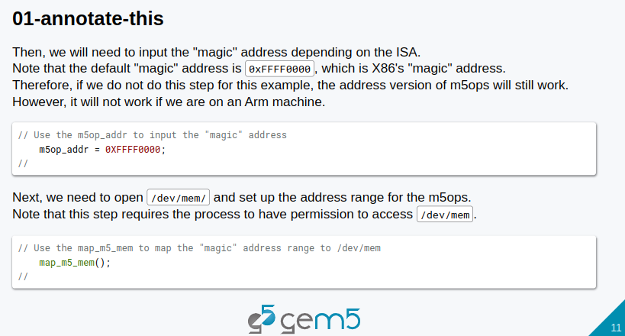
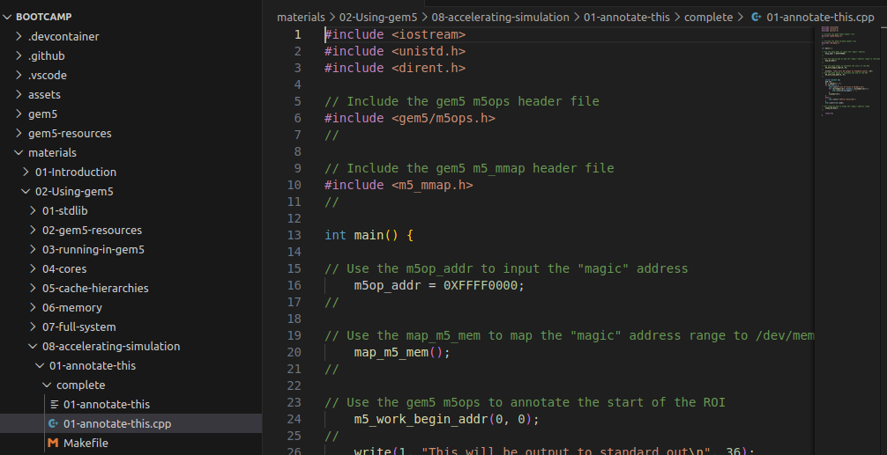
10.6 01-annotate-this
https://www.youtube.com/watch?v=NgIHyaiZkIQ&list=PL_hVbFs_loVR_8ntTTmmG6YEq3Po_4snu&index=11
01-annotate-this (3:49-4:25/20:39)
1. We also need to change the address of m5ops. We use m5op_addr to store the magic address.
2. We use map_m5_mem() function to open /dev/mem to map our magic address range into the m5 memory address m5ops.

Slide 21
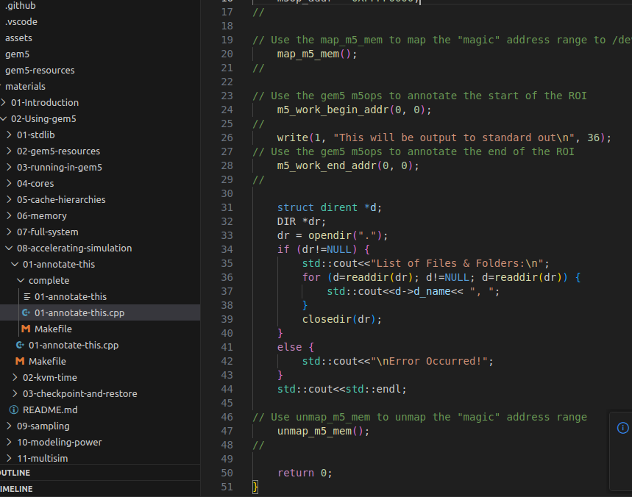
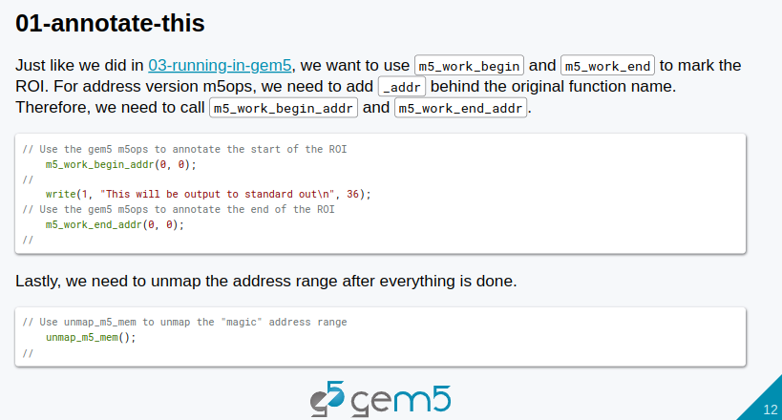
10.6 01-annotate-this
https://www.youtube.com/watch?v=NgIHyaiZkIQ&list=PL_hVbFs_loVR_8ntTTmmG6YEq3Po_4snu&index=11
01-annotate-this (4:26-4:49/20:39)
1. In the 03-running-in-gem5, we use m5_work_begin to trigger the ROI (Region Of Interest) of m5ops. In address mode, we need to add to use _addr () behind the m5_work_begin(), i.e., m5_work_begin_addr(), to trigger the address version of m5ops.
2. We also need to use m5_work_end_addr() for the end of m5ops address version.
3. At the end, in the we can unmap this address range by calling the unmap_m5_mem().

Slide 22
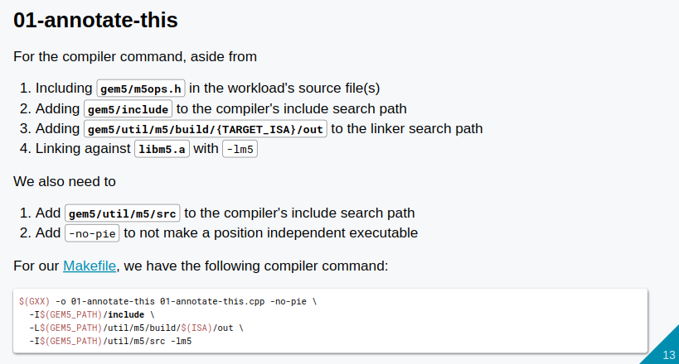
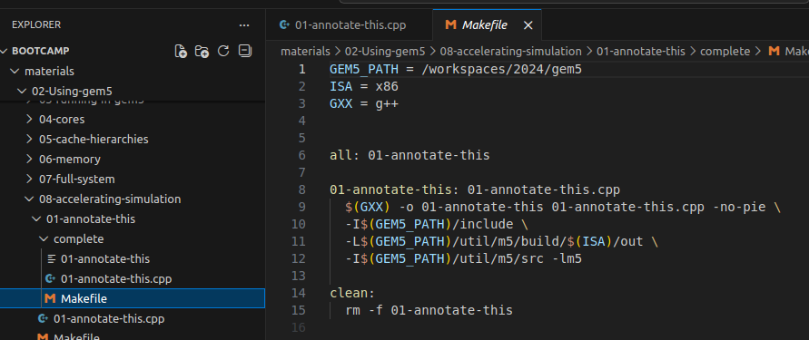
10.6 01-annotate-this
https://www.youtube.com/watch?v=NgIHyaiZkIQ&list=PL_hVbFs_loVR_8ntTTmmG6YEq3Po_4snu&index=11
01-annotate-this (4:50-5:27/20:39)
Below is the compiler command,
1. in addition to the m5ops, compiler search path, linker search path, link libm5,
2. we need to add m5 source search path and also add “-no-pie”not to make a position independent executable.
3. For Makefile, it looks like below.

Slide 23
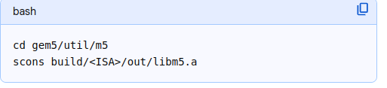
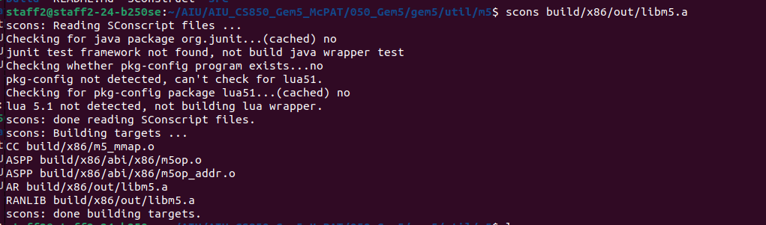
10.6 01-annotate-this
https://www.youtube.com/watch?v=NgIHyaiZkIQ&list=PL_hVbFs_loVR_8ntTTmmG6YEq3Po_4snu&index=11
01-annotate-this (5:28-5:29/20:39)
Build gem5 libm5
> cd util/m5
> scons build/x86/out/libm5.a
> cd <gem5-path>/util/m5/build/x86/out
> ls
>> libm5.a

Slide 24
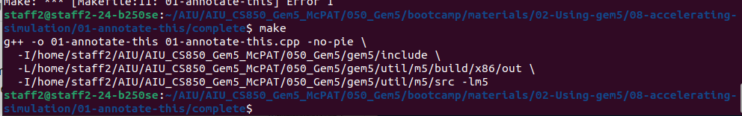
10.6 01-annotate-this
https://www.youtube.com/watch?v=NgIHyaiZkIQ&list=PL_hVbFs_loVR_8ntTTmmG6YEq3Po_4snu&index=11
01-annotate-this (5:30-5:31/20:39)
> cd <bootcamp-path>//bootcamp/materials/02-Using-gem5/08-accelerating-simulation/01-annotate-this/complete
> ln -s <gem5-path>/build/ALL/gem5.opt .
> ls
>> ...gem5.opt Makefile
> make

Slide 25
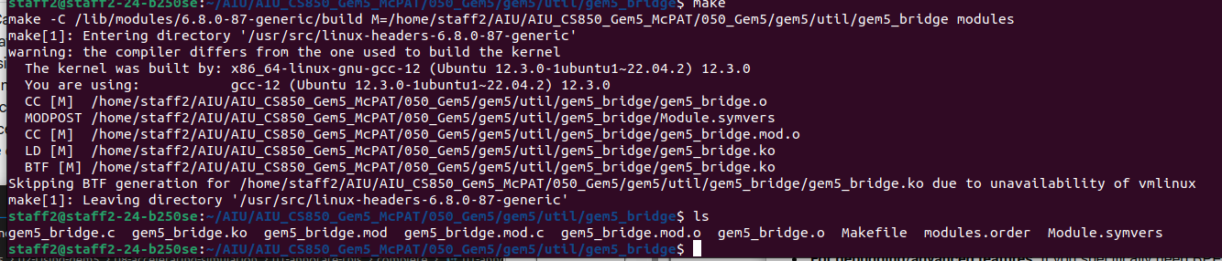
10.6 01-annotate-this
https://www.youtube.com/watch?v=NgIHyaiZkIQ&list=PL_hVbFs_loVR_8ntTTmmG6YEq3Po_4snu&index=11
01-annotate-this (5:32-5:33/20:39)
Run 01-annotate-this
> make
> ./01-annotate-this
I have below error.
> cd <gem5-path>/util/gem5_bridge
The gem5_bridge is provided by gem5 and my kernel is compiled with gcc_12
> sudo apt update
> sudo apt install gcc-12
> make
> gem5_bridge.ko is generated
> sudo insmod gem5_brdige.ko # put the gem5_bridge to /dev/ folder. I have error in device insertion.

Slide 26
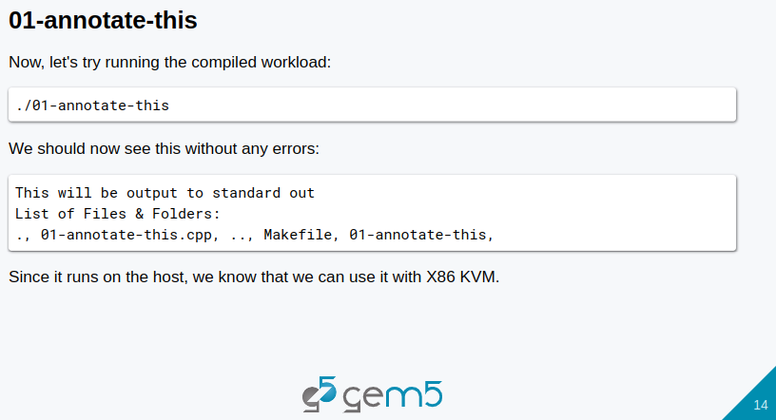
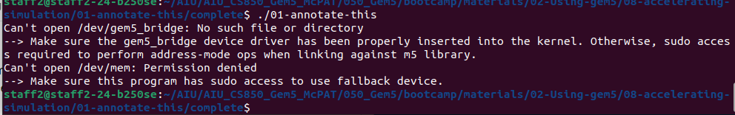
10.6 01-annotate-this
https://www.youtube.com/watch?v=NgIHyaiZkIQ&list=PL_hVbFs_loVR_8ntTTmmG6YEq3Po_4snu&index=11
01-annotate-this (5:34-6:33/20:39)
Run 01-annotate-this
> make
> ./01-annotate-this
In the video, The speaker did not get any illegal instruction error.
However, I have below error due to I did not insert the device module (gem5_bridge.ko)

Slide 27
End

