Slide 1

2.1 Get Started: Slides
Peter H. Chen

Slide 2
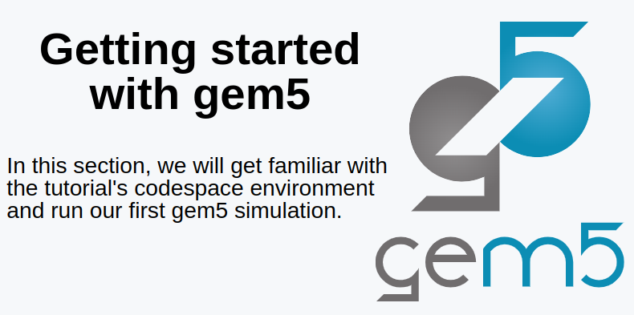
2.1 Get Started: Slides
https://gem5bootcamp.github.io/2024/#01-Introduction/02-getting-started
Get Started: Slides

Slide 3
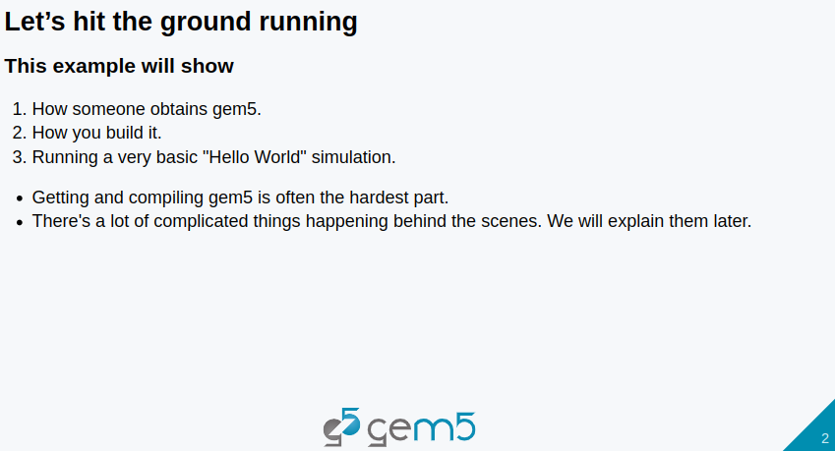
2.1 Get Started: Slides
https://gem5bootcamp.github.io/2024/#01-Introduction/02-getting-started
Get Started: Slides

Slide 4
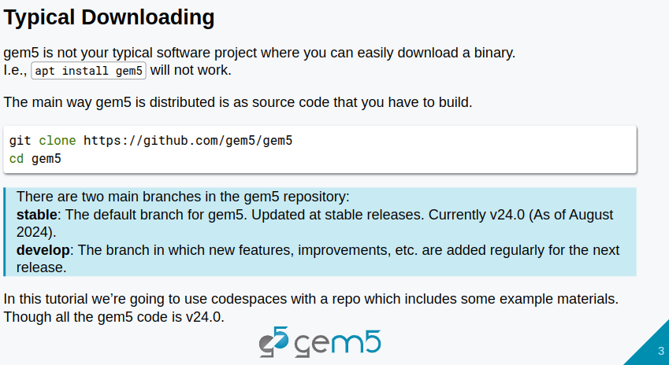
2.1 Get Started: Slides
https://gem5bootcamp.github.io/2024/#01-Introduction/02-getting-started
Get Started: Slides

Slide 5
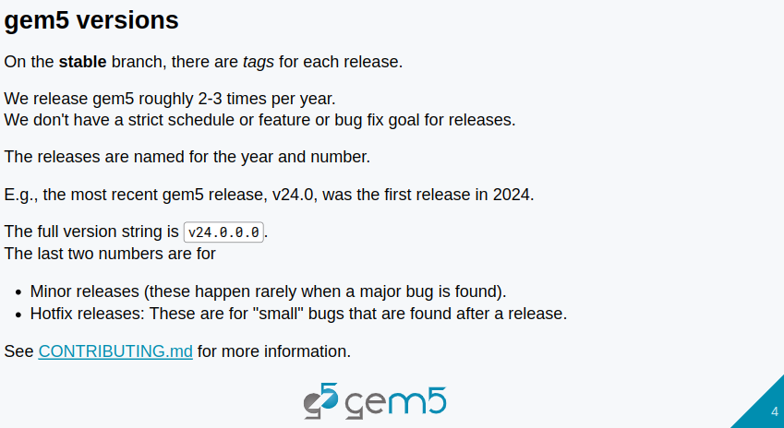
2.1 Get Started: Slides
https://gem5bootcamp.github.io/2024/#01-Introduction/02-getting-started
Get Started: Slides

Slide 6
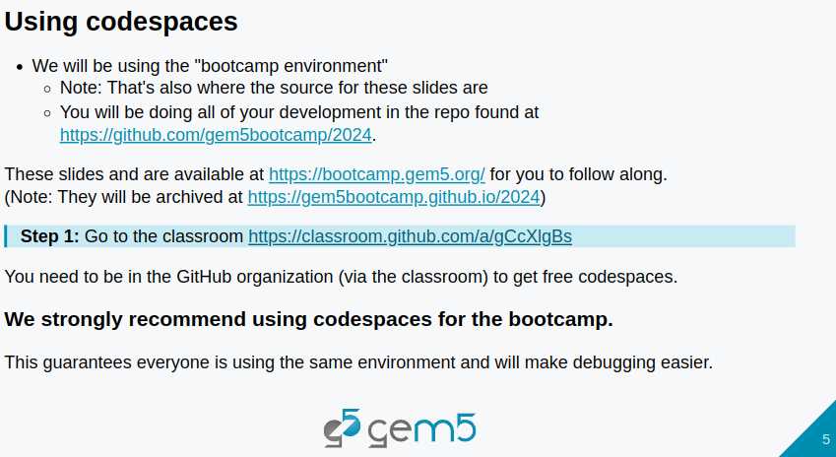
2.1 Get Started: Slides
https://gem5bootcamp.github.io/2024/#01-Introduction/02-getting-started
Get Started: Slides

Slide 7
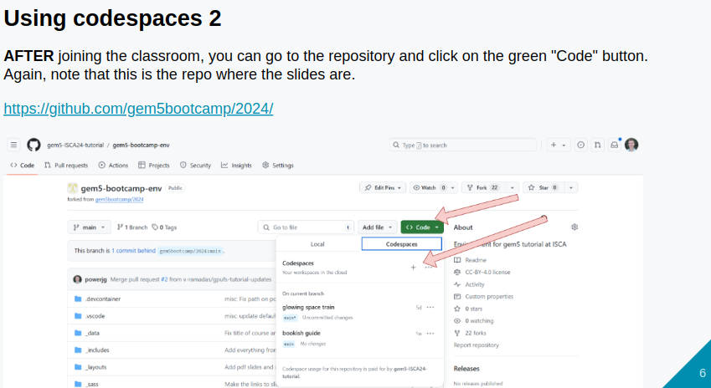
2.1 Get Started: Slides
https://gem5bootcamp.github.io/2024/#01-Introduction/02-getting-started
Get Started: Slides

Slide 8
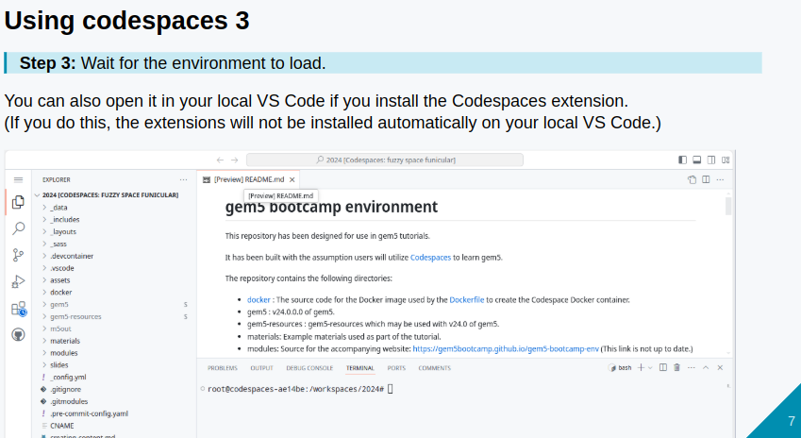
2.1 Get Started: Slides
https://gem5bootcamp.github.io/2024/#01-Introduction/02-getting-started
Get Started: Slides

Slide 9
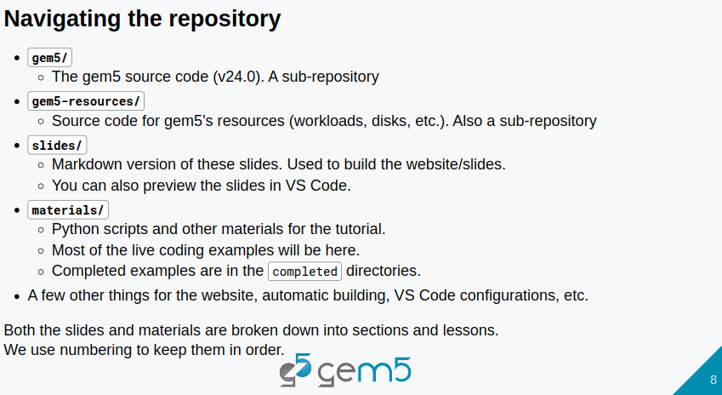
2.1 Get Started: Slides
https://gem5bootcamp.github.io/2024/#01-Introduction/02-getting-started
Get Started: Slides

Slide 10
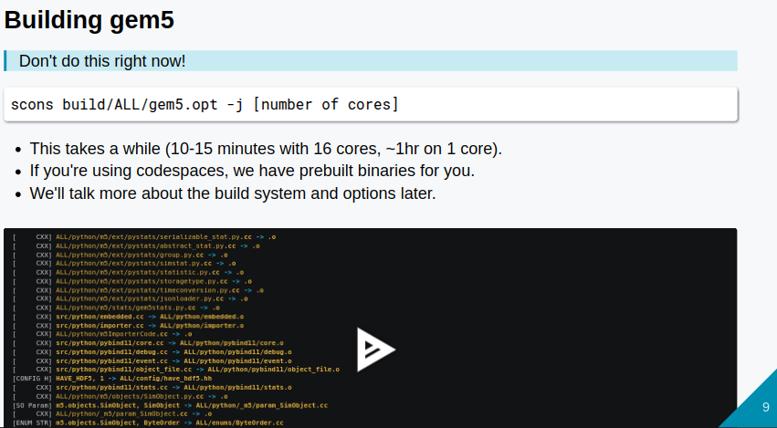
2.1 Get Started: Slides
https://gem5bootcamp.github.io/2024/#01-Introduction/02-getting-started
Get Started: Slides

Slide 11
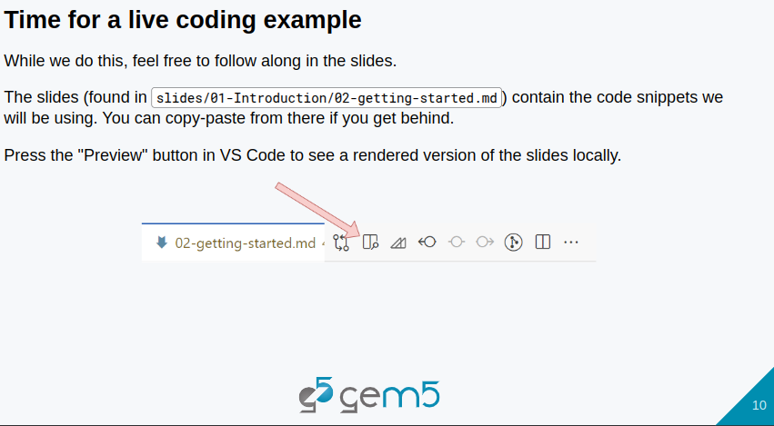
2.1 Get Started: Slides
https://gem5bootcamp.github.io/2024/#01-Introduction/02-getting-started
Get Started: Slides

Slide 12
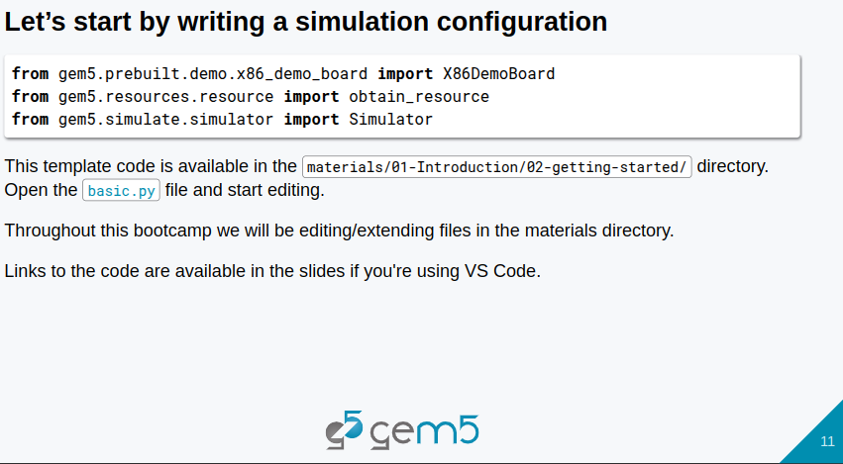
2.1 Get Started: Slides
https://gem5bootcamp.github.io/2024/#01-Introduction/02-getting-started
Get Started: Slides

Slide 13
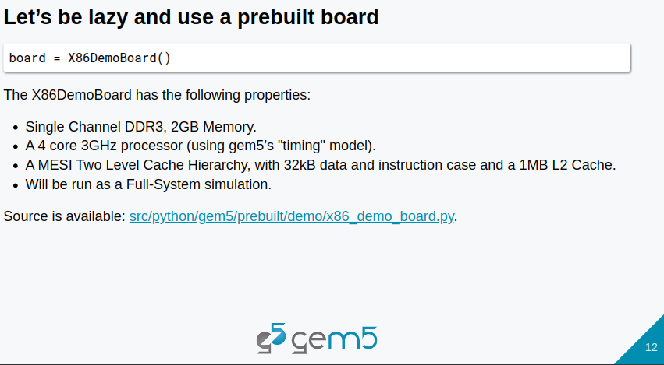
2.1 Get Started: Slides
https://gem5bootcamp.github.io/2024/#01-Introduction/02-getting-started
Get Started: Slides

Slide 14
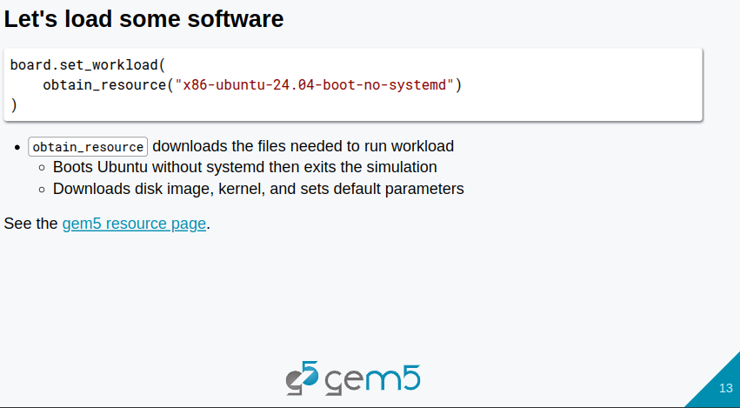
2.1 Get Started: Slides
https://gem5bootcamp.github.io/2024/#01-Introduction/02-getting-started
Get Started: Slides

Slide 15
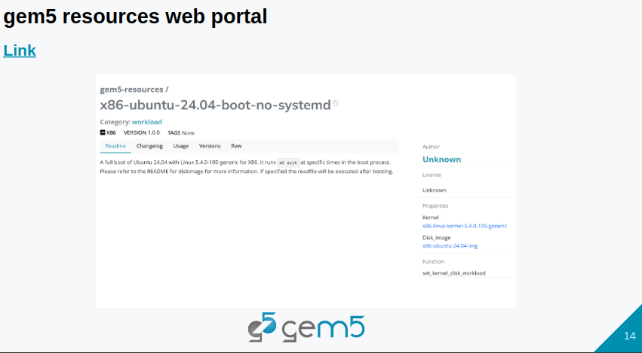
2.1 Get Started: Slides
https://gem5bootcamp.github.io/2024/#01-Introduction/02-getting-started
Get Started: Slides

Slide 16
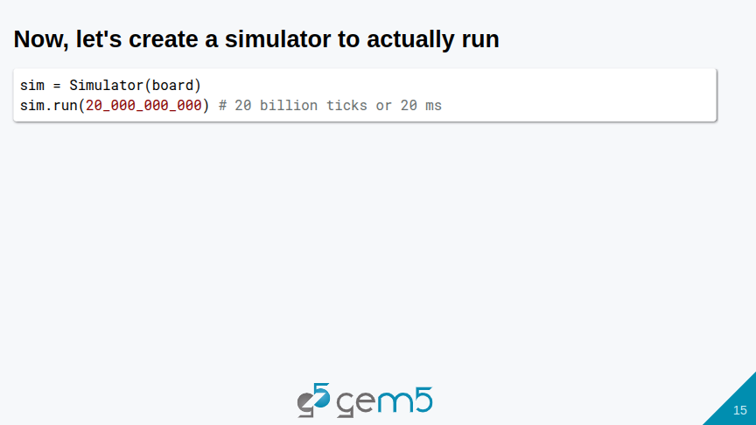
2.1 Get Started: Slides
https://gem5bootcamp.github.io/2024/#01-Introduction/02-getting-started
Get Started: Slides

Slide 17
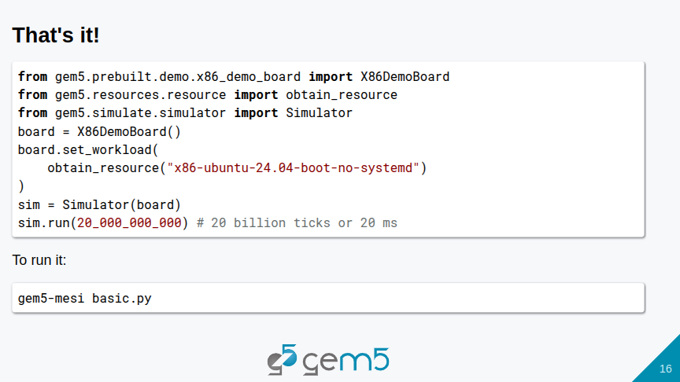
2.1 Get Started: Slides
https://gem5bootcamp.github.io/2024/#01-Introduction/02-getting-started
Get Started: Slides

Slide 18
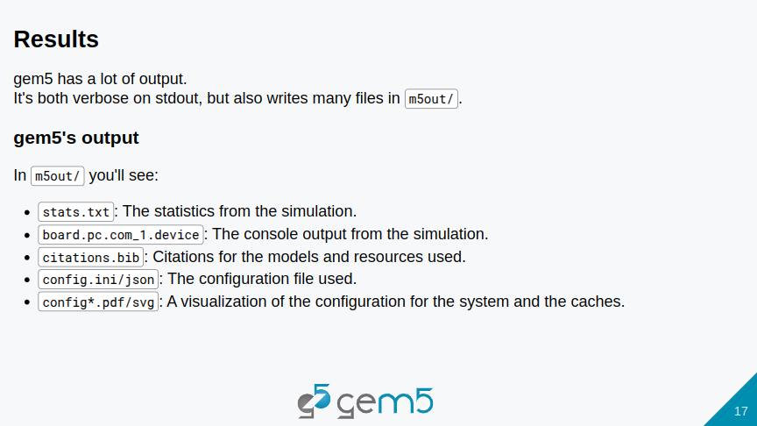
2.1 Get Started: Slides
https://gem5bootcamp.github.io/2024/#01-Introduction/02-getting-started
Get Started: Slides

Slide 19
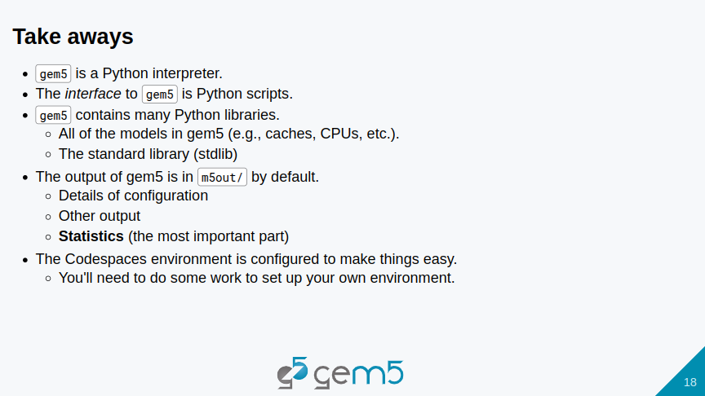
2.1 Get Started: Slides
https://gem5bootcamp.github.io/2024/#01-Introduction/02-getting-started
Get Started: Slides

Slide 20
End

