Slide 1

25.1 GPU: Slides
Peter H. Chen

Slide 2
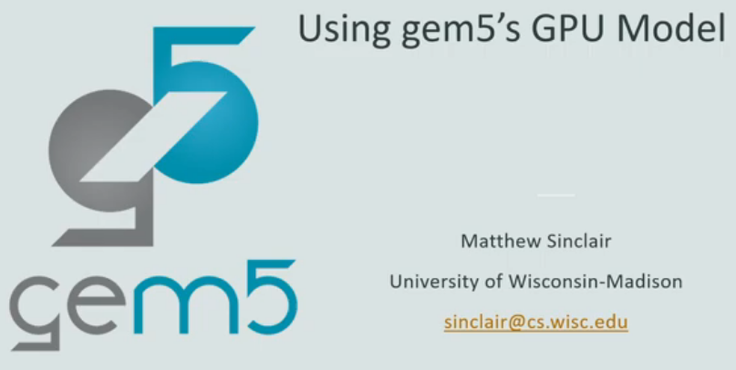
25.1 GPU: Slides
https://gem5bootcamp.github.io/2024/#04-GPU-model/01-GPU-model
GPU: Slides

Slide 3
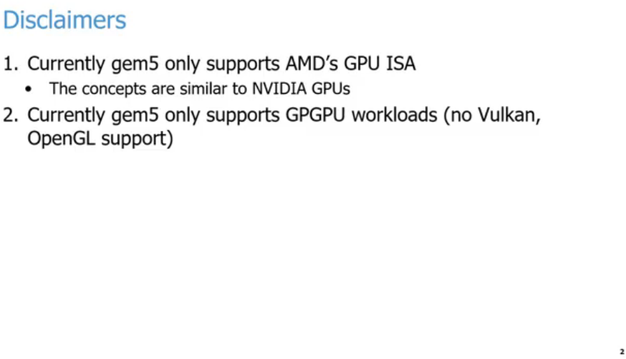
25.1 GPU: Slides
https://gem5bootcamp.github.io/2024/#04-GPU-model/01-GPU-model
GPU: Slides

Slide 4
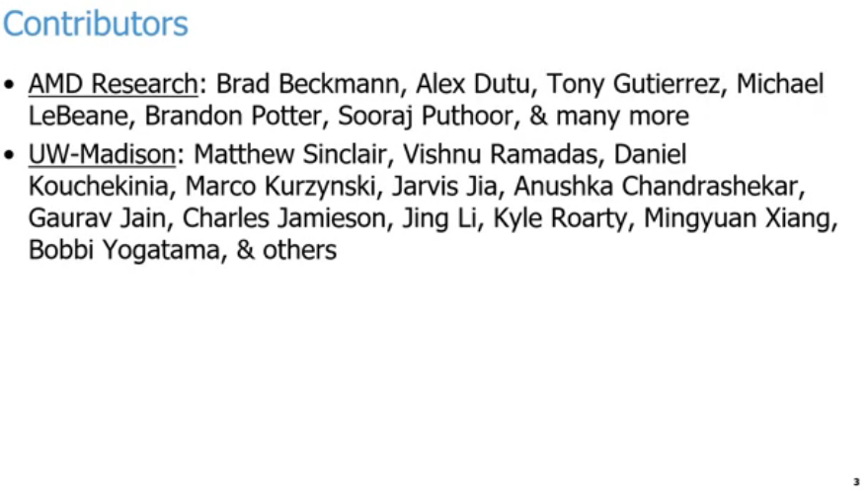
25.1 GPU: Slides
https://gem5bootcamp.github.io/2024/#04-GPU-model/01-GPU-model
GPU: Slides

Slide 5
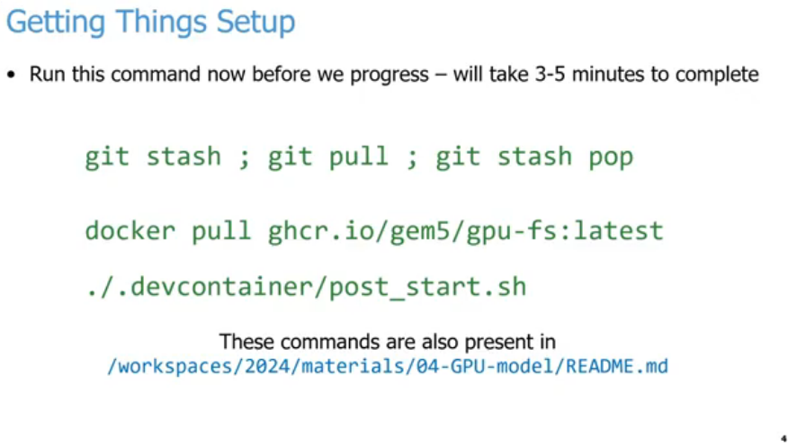
25.1 GPU: Slides
https://gem5bootcamp.github.io/2024/#04-GPU-model/01-GPU-model
GPU: Slides

Slide 6
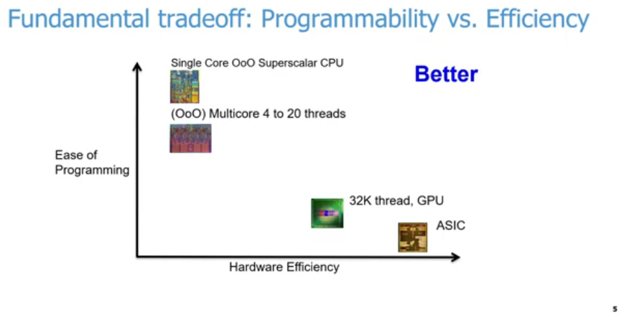
25.1 GPU: Slides
https://gem5bootcamp.github.io/2024/#04-GPU-model/01-GPU-model
GPU: Slides
1
3
4
2

Slide 7
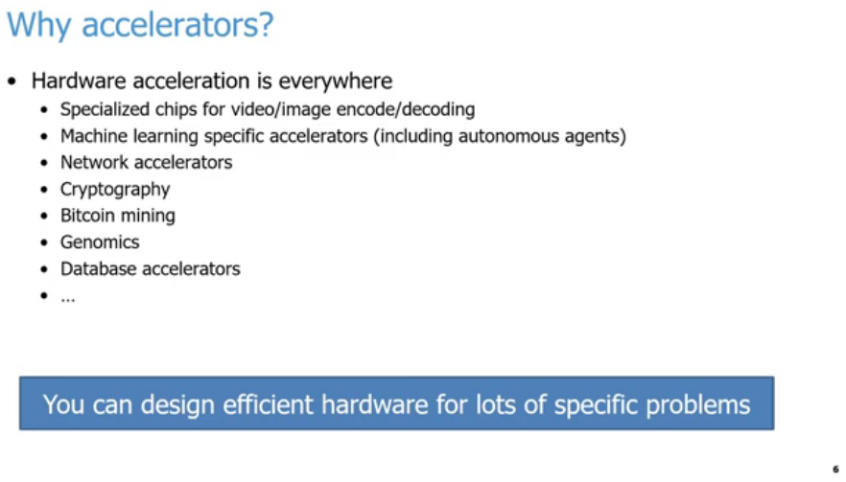
25.1 GPU: Slides
https://gem5bootcamp.github.io/2024/#04-GPU-model/01-GPU-model
GPU: Slides

Slide 8
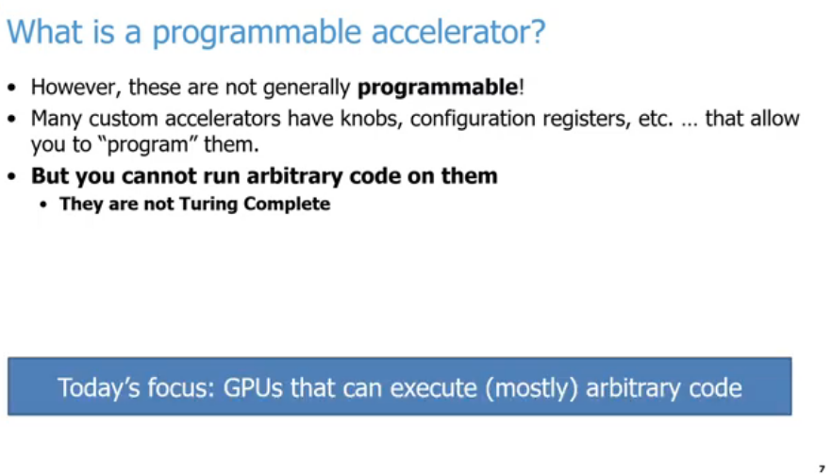
25.1 GPU: Slides
https://gem5bootcamp.github.io/2024/#04-GPU-model/01-GPU-model
GPU: Slides

Slide 9
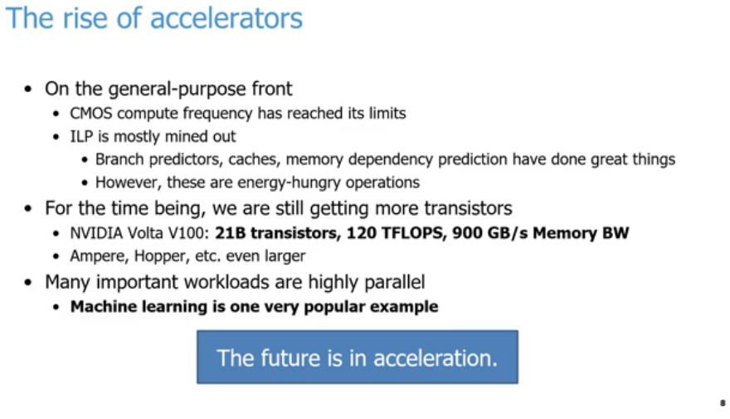
25.1 GPU: Slides
https://gem5bootcamp.github.io/2024/#04-GPU-model/01-GPU-model
GPU: Slides
1
2
3
4
5

Slide 10
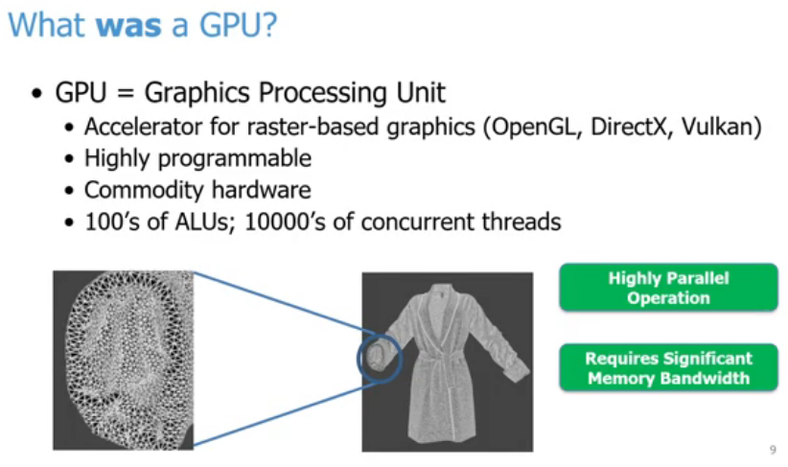
25.1 GPU: Slides
https://gem5bootcamp.github.io/2024/#04-GPU-model/01-GPU-model
GPU: Slides

Slide 11
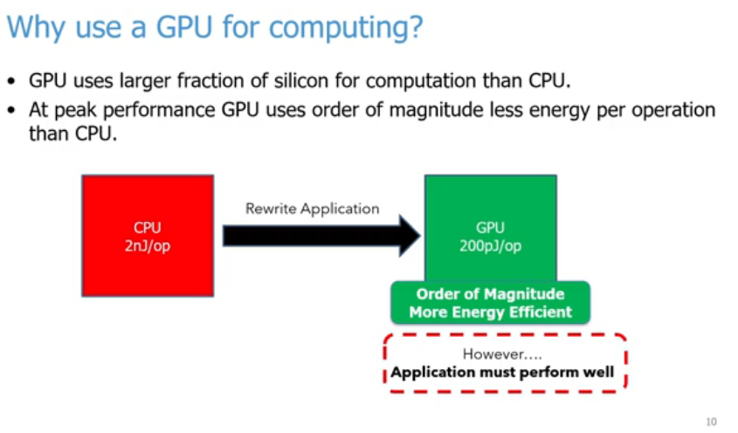
25.1 GPU: Slides
https://gem5bootcamp.github.io/2024/#04-GPU-model/01-GPU-model
GPU: Slides

Slide 12
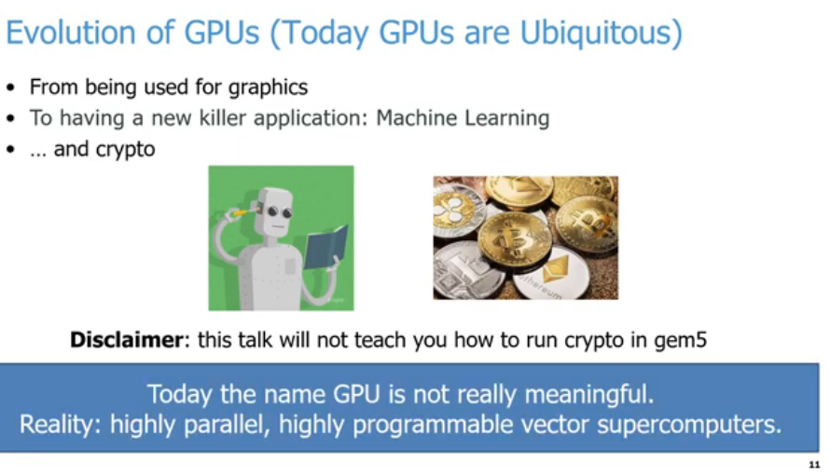
25.1 GPU: Slides
https://gem5bootcamp.github.io/2024/#04-GPU-model/01-GPU-model
GPU: Slides

Slide 13
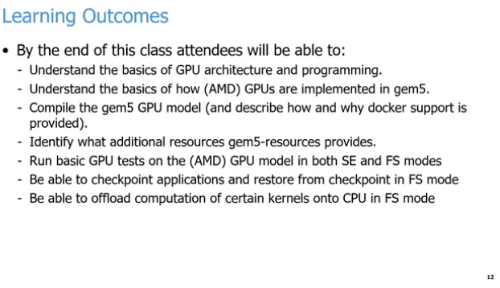
25.1 GPU: Slides
https://gem5bootcamp.github.io/2024/#04-GPU-model/01-GPU-model
GPU: Slides

Slide 14
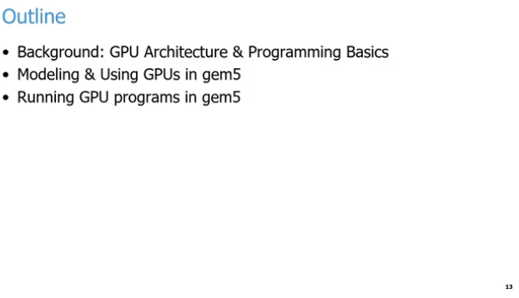
25.1 GPU: Slides
https://gem5bootcamp.github.io/2024/#04-GPU-model/01-GPU-model
GPU: Slides

Slide 15
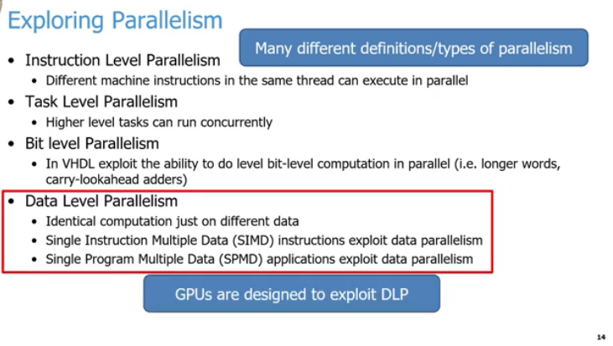
25.1 GPU: Slides
https://gem5bootcamp.github.io/2024/#04-GPU-model/01-GPU-model
GPU: Slides
5
1
2
3
4
6

Slide 16
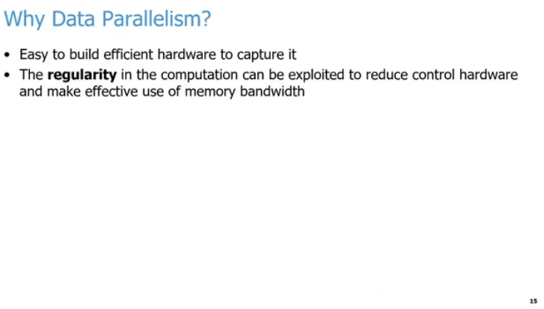
25.1 GPU: Slides
https://gem5bootcamp.github.io/2024/#04-GPU-model/01-GPU-model
GPU: Slides

Slide 17
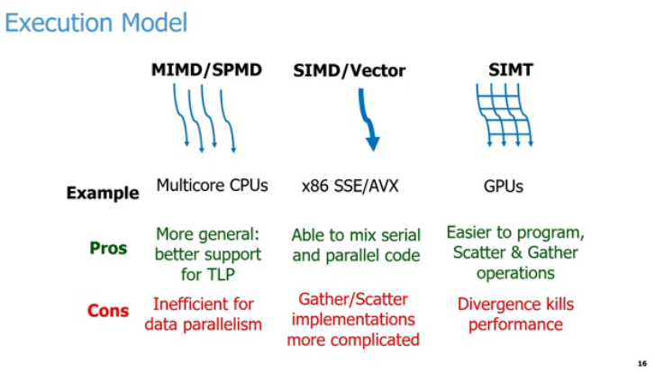
25.1 GPU: Slides
https://gem5bootcamp.github.io/2024/#04-GPU-model/01-GPU-model
GPU: Slides

Slide 18
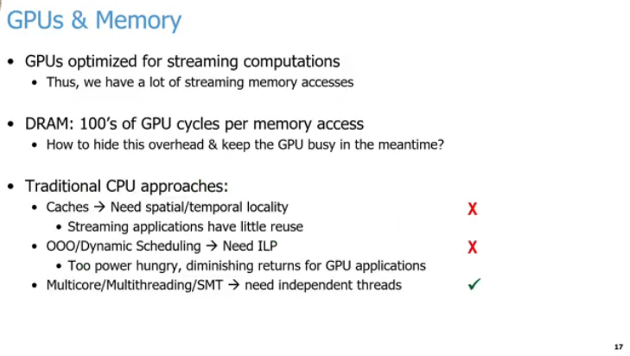
25.1 GPU: Slides
https://gem5bootcamp.github.io/2024/#04-GPU-model/01-GPU-model
GPU: Slides
1
2
3
a
b
c

Slide 19
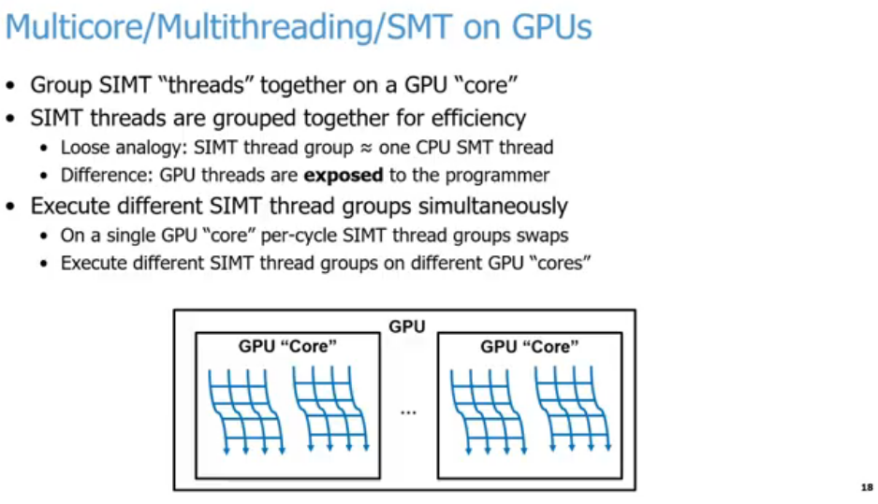
25.1 GPU: Slides
https://gem5bootcamp.github.io/2024/#04-GPU-model/01-GPU-model
GPU: Slides
1
2
3

Slide 20
End

