Slide 1

22 Model Port (02)
Peter H. Chen

Slide 2

22 Model Port (02)
https://www.youtube.com/watch?v=IAPlbIZg518&list=PL_hVbFs_loVR_8ntTTmmG6YEq3Po_4snu&index=22
Model Port (02) (0:00-0:20/1:36:50)
Last time, we discussed a little bit about Ports.

Slide 3
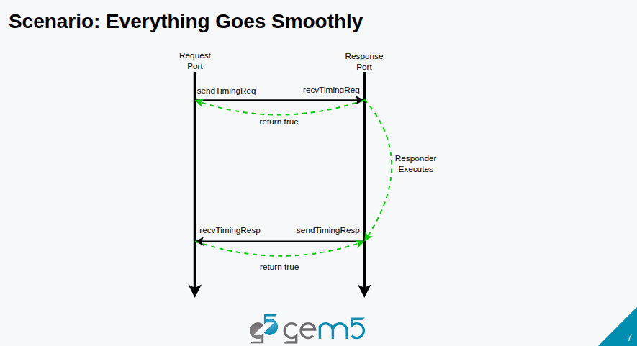
22 Model Port (02)
https://www.youtube.com/watch?v=IAPlbIZg518&list=PL_hVbFs_loVR_8ntTTmmG6YEq3Po_4snu&index=22
Model Port (02) (0:21-0:30/1:36:50)
We have below request, execution, and response diagram.
Gem5 has two types of ports: request port and response port.

Slide 4
22 Model Port (02)
https://www.youtube.com/watch?v=IAPlbIZg518&list=PL_hVbFs_loVR_8ntTTmmG6YEq3Po_4snu&index=22
Model Port (02) (0:31-1:40/1:36:50)
In Gem5, the concept of connected peers: Request port is connected to response port are always operated as connected peers.
The types of Ports are different. Usually, the SimObject has ports. We send the from the request port. The request and response ports are connected together. The signal propagates back from request to response port within the bandwidth.

Slide 5
22 Model Port (02)
https://www.youtube.com/watch?v=IAPlbIZg518&list=PL_hVbFs_loVR_8ntTTmmG6YEq3Po_4snu&index=22
Model Port (02) (1:41-2:20/1:36:50)
If cache is busy and cache is missing the status of handling registers. We get a miss and return False. Time continue to move on.
In some time, if cache is ready and port will return true. It is the responsibility of responder object to send the response back.
We call this is the timing response on the response port or receiving timing response on the request port.

Slide 6
22 Model Port (02)
https://www.youtube.com/watch?v=IAPlbIZg518&list=PL_hVbFs_loVR_8ntTTmmG6YEq3Po_4snu&index=22
Model Port (02) (2:21-2:55/1:36:50)
So, request ports send requests, receive responses. Response ports receive requests, send responses.
We will see in the code, the only functions that relate to receiving are pure virtual functions.
This means that response sending is very straightforward. We get the peer and ask peer to receive.

Slide 7
22.0 Topics

Slide 8
22.0 Topics
https://www.youtube.com/watch?v=IAPlbIZg518&list=PL_hVbFs_loVR_8ntTTmmG6YEq3Po_4snu&index=22
Model Port (02) (2:56-3:00/1:36:50)
1.

Slide 9
22.1 InspectorGadget

Slide 10
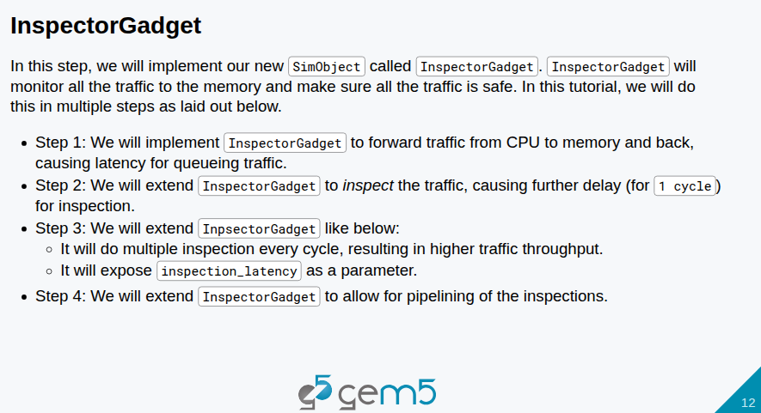
22.1 InspectorGadget
https://www.youtube.com/watch?v=IAPlbIZg518&list=PL_hVbFs_loVR_8ntTTmmG6YEq3Po_4snu&index=22
InspectorGadget (3:01-3:20/1:36:50)
1. Here, we implement InspectorGadget() in SimObject class.
2. InspectorGadget() will monitor all the traffic to the memory and make sure traffic is safe.
3. We will do this monitor in four steps.

Slide 11
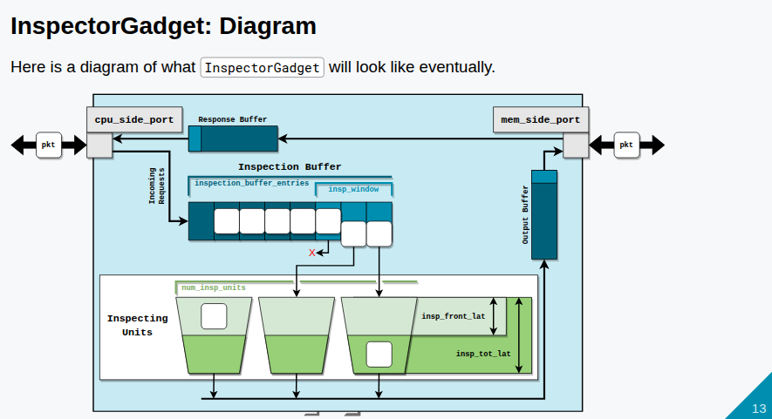
22.1 InspectorGadget
https://www.youtube.com/watch?v=IAPlbIZg518&list=PL_hVbFs_loVR_8ntTTmmG6YEq3Po_4snu&index=22
InspectorGadget (3:31-4:30/1:36:50)
Below is the diagram of high level view of InspectorGadget().
First step: At the left of the diagram, we have cpu_side_port. This is the model of the port on CPU side, a response port on CPU side. We have the buffer called Inspection Buffer. At the first step, we do not discuss the details of modeling any inspection.
Below describes how the protocol:
1. Create the inspection buffer.
2. Send inspection buffer through the memory side port to the memory.
3. Make a request
4. Get the responses
5. Forward the responses back.

Slide 12
22.1 InspectorGadget
https://www.youtube.com/watch?v=IAPlbIZg518&list=PL_hVbFs_loVR_8ntTTmmG6YEq3Po_4snu&index=22
InspectorGadget (4:31-4:45/1:36:50)
It seems to be easy, however, we have 73 slides to describe the protocol.
Because we cannot have infinite size of buffer in the hardware, we need to parameterize the size of memory buffers.

Slide 13
22.2 Step 1: Buffering Traffic

Slide 14
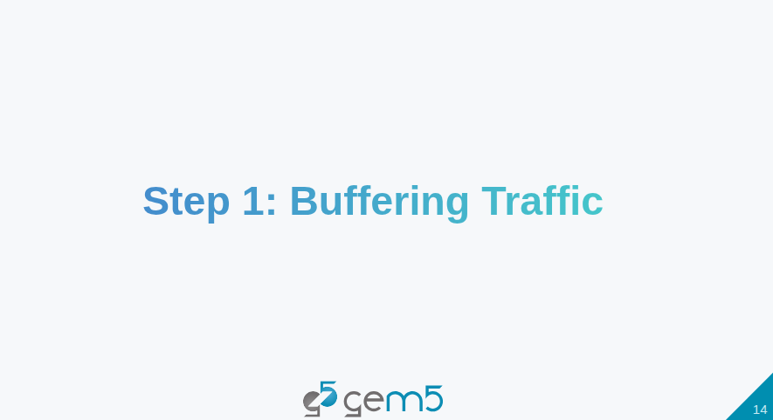
22.2 Step 1: Buffering Traffic
https://www.youtube.com/watch?v=IAPlbIZg518&list=PL_hVbFs_loVR_8ntTTmmG6YEq3Po_4snu&index=22
Step 1: Buffering Traffic (4:46-4:50/1:36:50)

Slide 15
22.3 ClockedObject

Slide 16
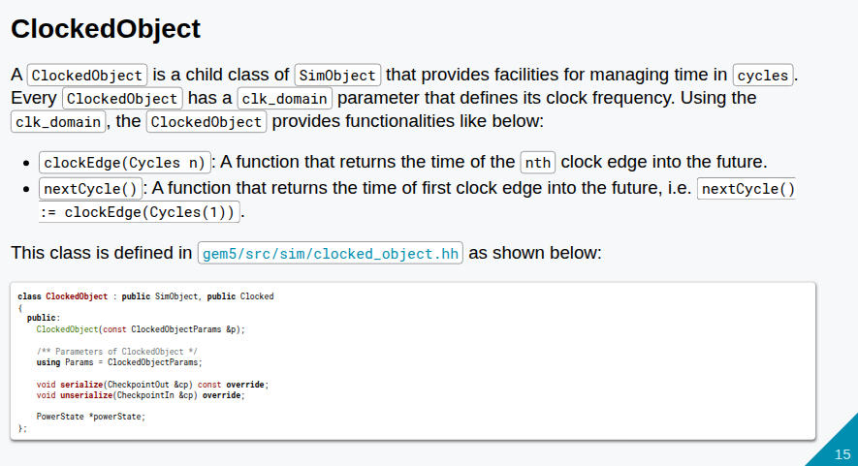
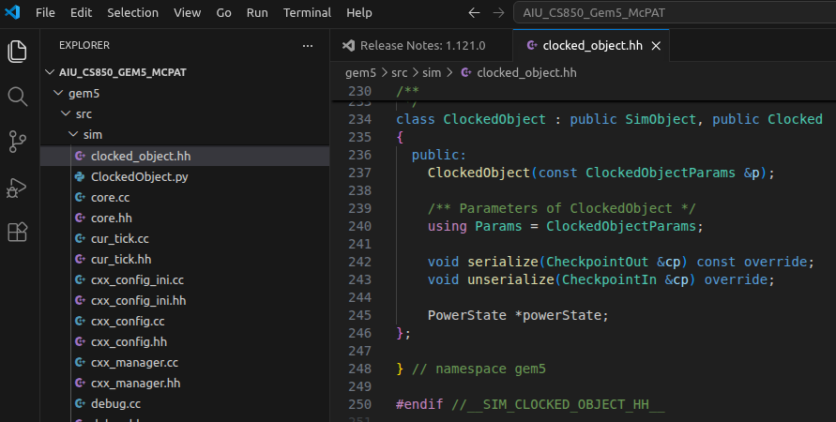
22.3 ClockedObject
https://www.youtube.com/watch?v=IAPlbIZg518&list=PL_hVbFs_loVR_8ntTTmmG6YEq3Po_4snu&index=22
ClockedObject (4:51-5:30/1:36:50)
> gem5/src/sim/clocked_object.hh
1. Before we write the code, we check the ClockedObject first.
2. The clocked_object.hh defines Clocked class and ClockedObject class.
3. The ClockedObject class inherited SimObject and Clocked class.
4. The ClockedObject will let us see the time in the concept of cycles, not tick.

Slide 17
22.3 ClockedObject
https://www.youtube.com/watch?v=IAPlbIZg518&list=PL_hVbFs_loVR_8ntTTmmG6YEq3Po_4snu&index=22
ClockedObject (5:31-5:40/1:36:50)
> gem5/src/sim/clocked_object.hh
5. The ClockedObject class has the function clockEdge(Cycle n) which returns tick of nth clock edge in the future.
6. The ClockedObject class also has nextCycle () function that return the first clock edge in the future, i.e., clockEdge(Cycle(1))
7. ClockedObject class gives you the time of next cycle in tick. It give you the time ticks and convert cycle to clock.

Slide 18
22.3 ClockedObject
https://www.youtube.com/watch?v=IAPlbIZg518&list=PL_hVbFs_loVR_8ntTTmmG6YEq3Po_4snu&index=22
ClockedObject (5:41-5:50/1:36:50)
> gem5/src/sim/clocked_object.hh
8. The ClockedObject has parameter (ClockedObjectParams) of Clock Domain. The clock frequency, rising, etc. are defined inside the parameters.
9. In C++, we cannot see the parameters. We only can see the next cycle, clock period, etc, We can get the all these in ticks.

Slide 19
22.4 InspectorGadget: Add File

Slide 20
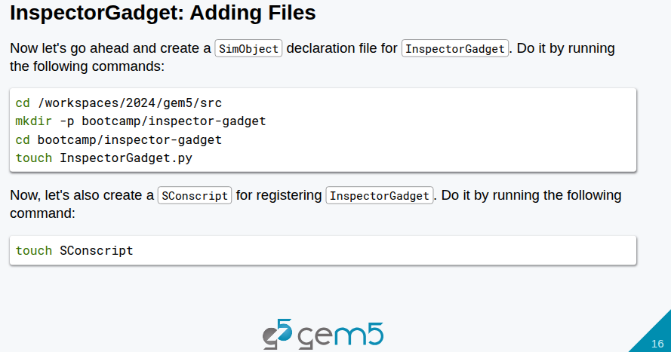
22.4 InspectorGadget: Add File
https://www.youtube.com/watch?v=IAPlbIZg518&list=PL_hVbFs_loVR_8ntTTmmG6YEq3Po_4snu&index=22
InspectorGadget: Add File (5:51-6:00/1:36:50)
> ~materials/03-Developing-gem5-models/04-ports/step-1/src/bootcamp/inspector-gadget/
Q: What is difference of ClockedObject and InspectorGadget?
Ans: In gem5,
1. ClockedObject is a Fundamental base class that governs simulation timing and clock domains.
2. “Inspector Gadget" is not a standard gem5 architectural class; it typically refers to specific debugging or tracing utilities within gem5, rather than a base object class.

Slide 21
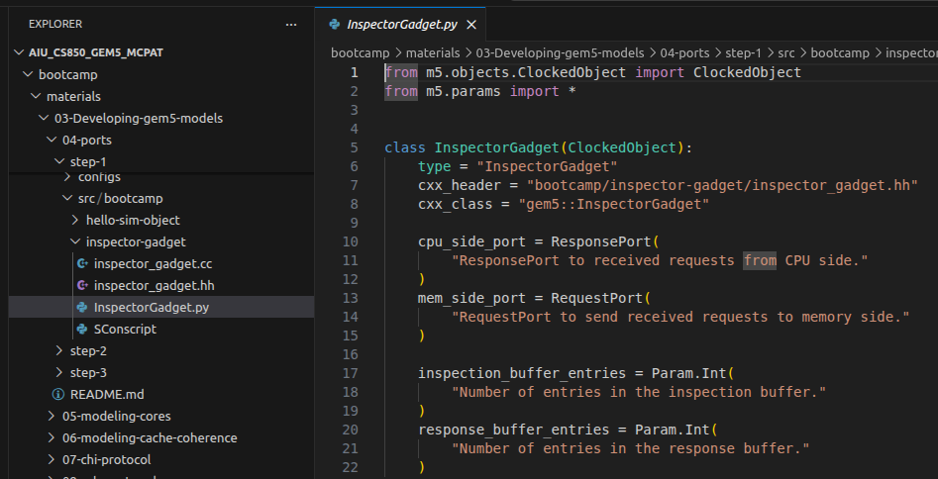
22.4 InspectorGadget: Add File
https://www.youtube.com/watch?v=IAPlbIZg518&list=PL_hVbFs_loVR_8ntTTmmG6YEq3Po_4snu&index=22
InspectorGadget: Add File (6:01-6:40/1:36:50)
> ~materials/03-Developing-gem5-models/04-ports/step-1/src/bootcamp/inspector-gadget/
> cd workspace/src
> mkdir bootcamp/inspector-gadget
> cd bootcamp/inspector-gadget
> touch InspectorGadget.py # Create SimObject declaration file
> touch SConscript # Scons builder

Slide 22
22.4 InspectorGadget: Add File
https://www.youtube.com/watch?v=IAPlbIZg518&list=PL_hVbFs_loVR_8ntTTmmG6YEq3Po_4snu&index=22
InspectorGadget: Add File (6:41-8:40/1:36:50)
> ~materials/03-Developing-gem5-models/04-ports/step-1/src/bootcamp/inspector-gadget/
Q: What is the relationship between the ClockedObject and SimObject?
Ans: In the gem5 simulator, ClockedObject is a direct subclass of SimObject that provides timing and clock management for hardware components.
A ClockedObject is a SimObject. The Clocked Object extends the class SimObject with one or more parameter. The ne parameter that we care about is clock domain.
Below, we create:
1. a directory called inspector-gadget under the bootcamp.
2. Under the inspector-gadget folder, we create the file
  2.1 InspectorGadget.py,
  2.2 inspector_gadget.hh
  2.3 inspector_gadget.cc

Slide 23
22.5 InspectorGadget.py

Slide 24
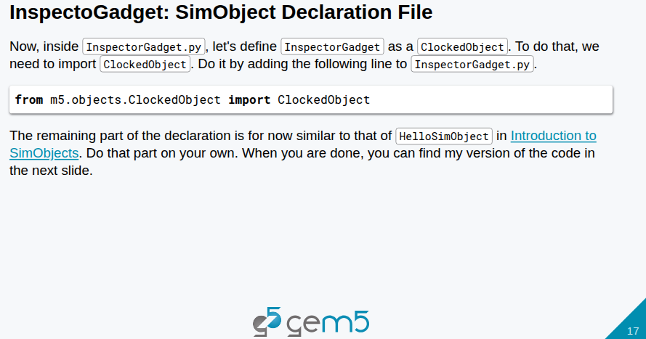
22.5 InspectorGadget.py
https://www.youtube.com/watch?v=IAPlbIZg518&list=PL_hVbFs_loVR_8ntTTmmG6YEq3Po_4snu&index=22
InspectorGadget.py (8:41-9:30/1:36:50)
> ~materials/03-Developing-gem5-models/04-ports/step-1/src/bootcamp/inspector-gadget/
Copy below line into our inspector-gadget/InspectorGadget.py
> from m5.objects.ClockedObject import ClockedObject

Slide 25
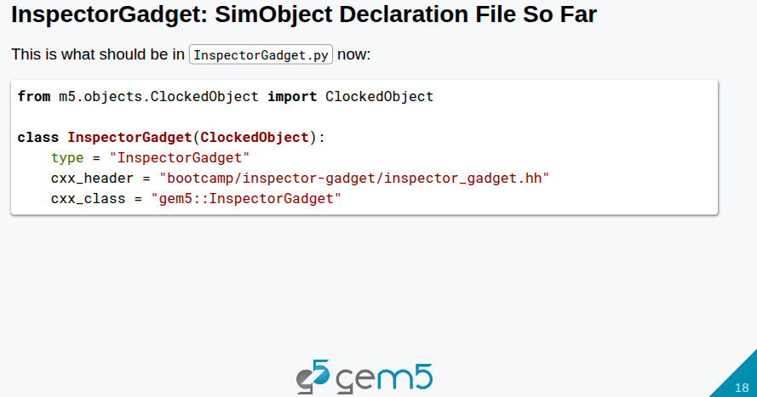
22.5 InspectorGadget.py
https://www.youtube.com/watch?v=IAPlbIZg518&list=PL_hVbFs_loVR_8ntTTmmG6YEq3Po_4snu&index=22
InspectorGadget.py (9:31-10:30/1:36:50)
> ~materials/03-Developing-gem5-models/04-ports/step-1/src/bootcamp/inspector-gadget/
Copy below line into our inspector-gadget/InspectorGadget.py
> class InspectorGadget(ClockedObject):
> type = "InspectorGadget"
> cxx_header = "bootcamp/inspector-gadget/inspector_gadget.hh"
> cxx_class = "gem5::InspectorGadget"

Slide 26
22.5 InspectorGadget.py
https://www.youtube.com/watch?v=IAPlbIZg518&list=PL_hVbFs_loVR_8ntTTmmG6YEq3Po_4snu&index=22
InspectorGadget.py (9:31-10:00/1:36:50)
> ~materials/03-Developing-gem5-models/04-ports/step-1/src/bootcamp/inspector-gadget/
Copy below line into our inspector-gadget/InspectorGadget.py
> class InspectorGadget(ClockedObject):
> type = "InspectorGadget"
> cxx_header = "bootcamp/inspector-gadget/inspector_gadget.hh"
> cxx_class = "gem5::InspectorGadget"
These codes are same as “Hello Object” and SimObject.
Those keywords are from Hello Object. For the type, we use the same name as the name of class in Python. For CXX_header, we use C++ path and header file, and for CXX_class, we use name of C++ class.

Slide 27
22.5 InspectorGadget.py
https://www.youtube.com/watch?v=IAPlbIZg518&list=PL_hVbFs_loVR_8ntTTmmG6YEq3Po_4snu&index=22
InspectorGadget.py (10:01-10:30/1:36:50)
> ~materials/03-Developing-gem5-models/04-ports/step-1/src/bootcamp/inspector-gadget/
Copy below line into our inspector-gadget/InspectorGadget.py
> from m5.objects.ClockedObject import ClockedObject
> class InspectorGadget(ClockedObject):
> type = "InspectorGadget"
> cxx_header = "bootcamp/inspector-gadget/inspector_gadget.hh"
> cxx_class = "gem5::InspectorGadget"
So far, nothing difference from SimObject, except the import ClockedObject

Slide 28
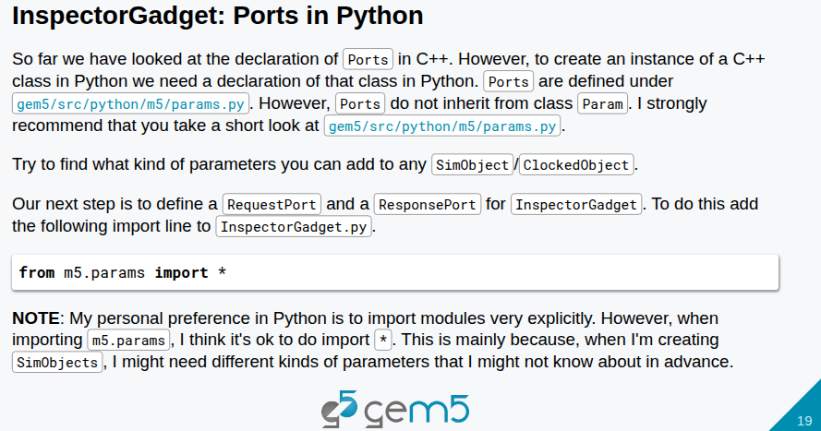
22.5 InspectorGadget.py
https://www.youtube.com/watch?v=IAPlbIZg518&list=PL_hVbFs_loVR_8ntTTmmG6YEq3Po_4snu&index=22
InspectorGadget.py (10:31-11:50/1:36:50)
> ~materials/03-Developing-gem5-models/04-ports/step-1/src/bootcamp/inspector-gadget/
Next step is to tell Gem5 that this SimObject has ports (ClockedObject) with parameters.
> from m5.objects.ClockedObject import ClockedObject
> from m5.params import *
> class InspectorGadget(ClockedObject):
> type = "InspectorGadget"
> cxx_header = "bootcamp/inspector-gadget/inspector_gadget.hh"
> cxx_class = "gem5::InspectorGadget"

Slide 29
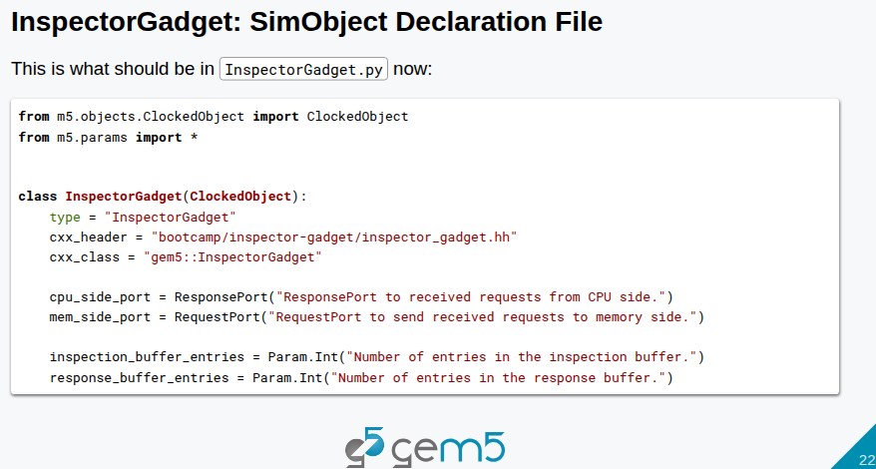
22.5 InspectorGadget.py
https://www.youtube.com/watch?v=IAPlbIZg518&list=PL_hVbFs_loVR_8ntTTmmG6YEq3Po_4snu&index=22
InspectorGadget.py (10:31-12:10/1:36:50)
> ~materials/03-Developing-gem5-models/04-ports/step-1/src/bootcamp/inspector-gadget/
Next step is to define the ports in Python level for C++ to access.
> from m5.objects.ClockedObject import ClockedObject
> from m5.params import *
> class InspectorGadget(ClockedObject):
> type = "InspectorGadget"
> cxx_header = "bootcamp/inspector-gadget/inspector_gadget.hh"
> cxx_class = "gem5::InspectorGadget"
> cpu_side_port = ResponsePort("ResponsePort to received requests from CPU side.")
> mem_side_port = RequestPort("RequestPort to send received requests to memory side.")
We define the CPU side Port and memory side port under the gem5.params.
CPU side port is a response port and we give it the description.
Memory side port is the request port and we give it the description as well.

Slide 30
22.5 InspectorGadget.py
https://www.youtube.com/watch?v=IAPlbIZg518&list=PL_hVbFs_loVR_8ntTTmmG6YEq3Po_4snu&index=22
InspectorGadget.py (12:11-13:10/1:36:50)
> ~materials/03-Developing-gem5-models/04-ports/step-1/src/bootcamp/inspector-gadget/
Next step is to define two buffers: one is inspection buffer and one is response buffer. We will add size for these buffers.
> from m5.objects.ClockedObject import ClockedObject
> from m5.params import *
> class InspectorGadget(ClockedObject):
> type = "InspectorGadget"
> cxx_header = "bootcamp/inspector-gadget/inspector_gadget.hh"
> cxx_class = "gem5::InspectorGadget"
> cpu_side_port = ResponsePort("ResponsePort to received requests from CPU side.")
> mem_side_port = RequestPort("RequestPort to send received requests to memory side.")
> inspection_buffer_entries = Param.Int("Number of entries in the inspection buffer.")
> response_buffer_entries = Param.Int("Number of entries in the response buffer.")
For example, we have buffer in FIFO structure. The FIFO buffer has a certain number of entries. We add the description of number of entries in the inspection buffer and response buffer,

Slide 31
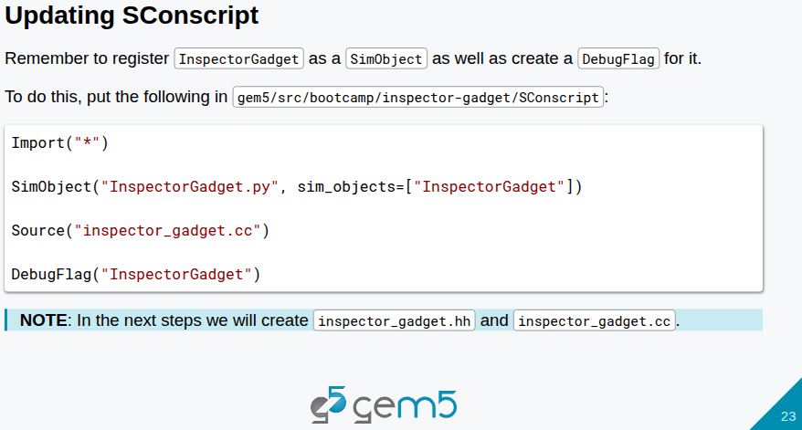
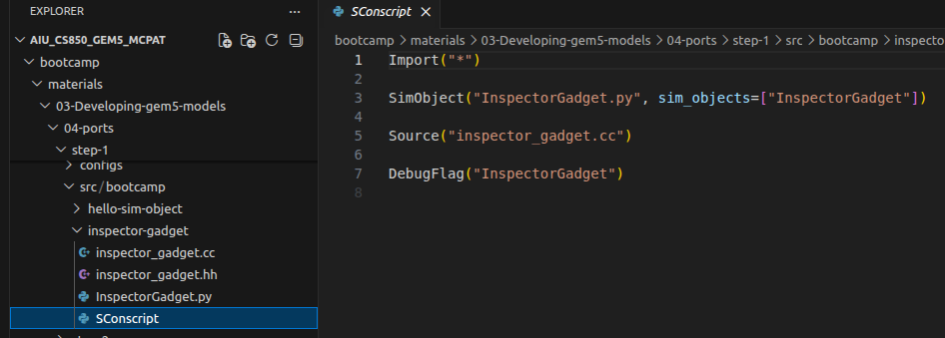
22.5 InspectorGadget.py
https://www.youtube.com/watch?v=IAPlbIZg518&list=PL_hVbFs_loVR_8ntTTmmG6YEq3Po_4snu&index=22
InspectorGadget.py (13:11-14:10/1:36:50)
> ~materials/03-Developing-gem5-models/04-ports/step-1/src/bootcamp/inspector-gadget/
We have done the Python.
Now, we copy below into SConscript file.
1. > Import("*")
2. > SimObject("InspectorGadget.py", sim_objects=["InspectorGadget"])
3. > Source("inspector_gadget.cc")
4. > DebugFlag("InspectorGadget")
Line # 1: “Import (*)” is same as SimObject.
Line #2: We give SimObject Python file: InspectorGadget.py and SimObject name "InspectorGadget"
Line #3: C++ Source file: inspector_gadget.cc
Line #4: Define the Debug Flag name: InspectorGadget

Slide 32
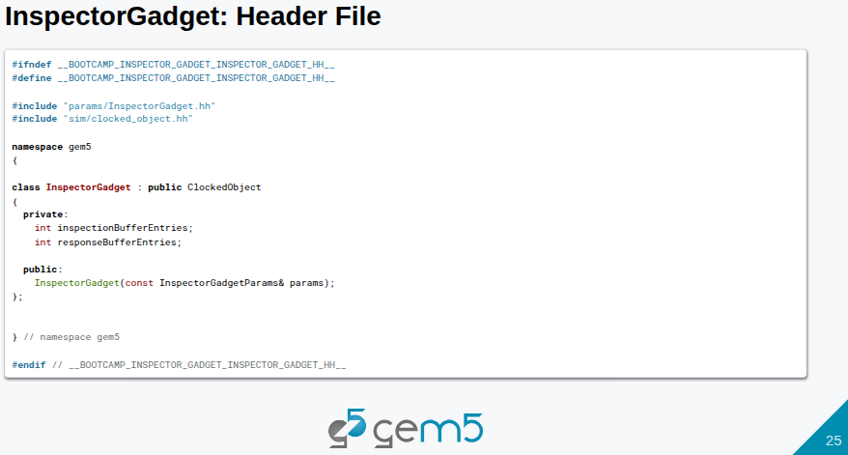
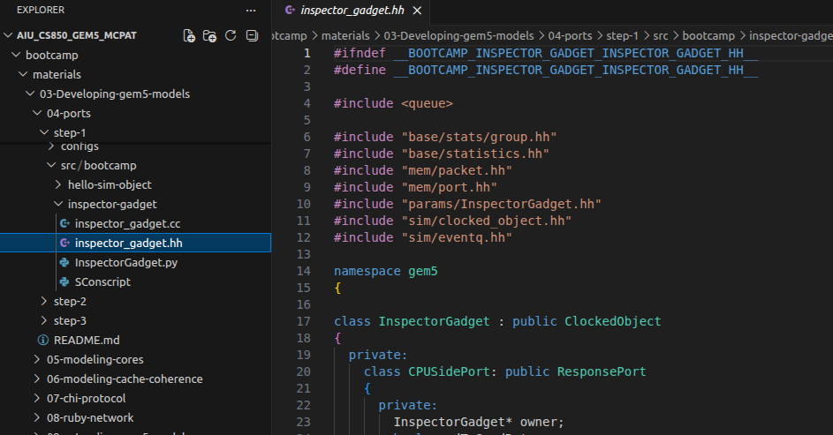
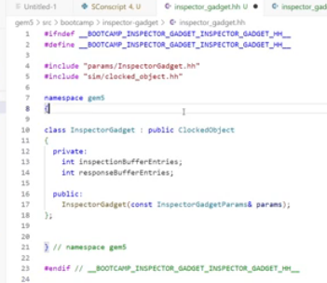
22.5 InspectorGadget.py
https://www.youtube.com/watch?v=IAPlbIZg518&list=PL_hVbFs_loVR_8ntTTmmG6YEq3Po_4snu&index=22
InspectorGadget.py (14:11-14:20/1:36:50)
> ~materials/03-Developing-gem5-models/04-ports/step-1/src/bootcamp/inspector-gadget/
Now, we create header file InspectorGadget.hh and copy below slide (page 25) to InspectorGadget.hh.

Slide 33
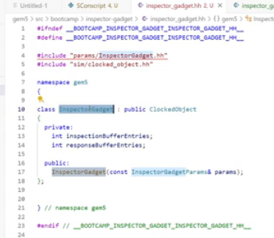
22.5 InspectorGadget.py
https://www.youtube.com/watch?v=IAPlbIZg518&list=PL_hVbFs_loVR_8ntTTmmG6YEq3Po_4snu&index=22
InspectorGadget.py (14:21-15:30/1:36:50)
> ~materials/03-Developing-gem5-models/04-ports/step-1/src/bootcamp/inspector-gadget/
The ClockedObject is a SimObject.
The InspectorGadget is a ClockedObject.

Slide 34
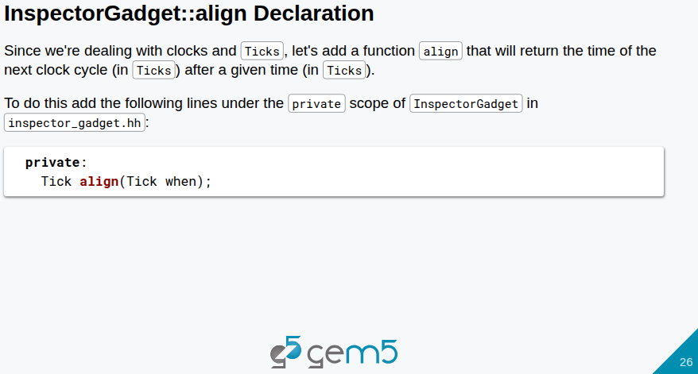
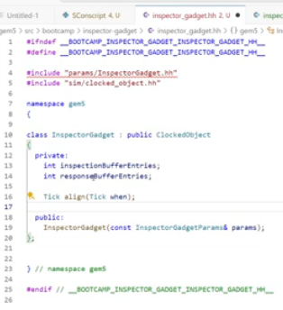
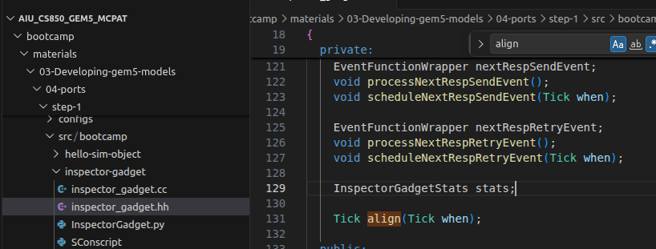
22.5 InspectorGadget.py
https://www.youtube.com/watch?v=IAPlbIZg518&list=PL_hVbFs_loVR_8ntTTmmG6YEq3Po_4snu&index=22
InspectorGadget.py (14:31-15:40/1:36:50)
> ~materials/03-Developing-gem5-models/04-ports/step-1/src/bootcamp/inspector-gadget/
Now, we want to add the align function for tick.
We copy slide page 26,
> private:
> Tick align (Tick when);
Into InspectorGadget.py.

Slide 35
22.5 InspectorGadget.py
https://www.youtube.com/watch?v=IAPlbIZg518&list=PL_hVbFs_loVR_8ntTTmmG6YEq3Po_4snu&index=22
InspectorGadget.py (15:41-16:00/1:36:50)
> ~materials/03-Developing-gem5-models/04-ports/step-1/src/ bootcamp/inspector-gadget
The function Align take the input Tick and return another tick.
The return tick aligns the input tick to a clock cycle time of some object.
The input tick is something happens at a time that is not aligned with an edge of a clock cycle.
We are going to respond to input tick at an edge of a clock cycle in the future.

Slide 36
22.5 InspectorGadget.py
https://www.youtube.com/watch?v=IAPlbIZg518&list=PL_hVbFs_loVR_8ntTTmmG6YEq3Po_4snu&index=22
InspectorGadget.py (16:01-16:30/1:36:50)
> ~materials/03-Developing-gem5-models/04-ports/step-1/src/ bootcamp/inspector-gadget
Inside the ClockedObject, we have access to our clock.
So, we can align everything with that.
If we try to do some events on the falling edge, some of them in rising edge.

Slide 37
22.5 InspectorGadget.py
https://www.youtube.com/watch?v=IAPlbIZg518&list=PL_hVbFs_loVR_8ntTTmmG6YEq3Po_4snu&index=22
InspectorGadget.py (16:31-16:50/1:36:50)
> ~materials/03-Developing-gem5-models/04-ports/step-1/src/ bootcamp/inspector-gadget
The SimObject that is connected to the request port to the response port. The request ports maybe not the same clock domain.
We can call Align function with current time (current tick) “when”. This time “when” may not be aligned the clock edge of our SimObject.

Slide 38
22.5 InspectorGadget.py
https://www.youtube.com/watch?v=IAPlbIZg518&list=PL_hVbFs_loVR_8ntTTmmG6YEq3Po_4snu&index=22
InspectorGadget.py (16:51-17:20/1:36:50)
> ~materials/03-Developing-gem5-models/04-ports/step-1/src/ bootcamp/inspector-gadget
For example, InspectorGadget CPU is running at 2 GHz. The L3 cache is running at 3 GHz. The L3 Cache is going to call functions like receive timing request at steps of 333 ticks.
We can only see ar 500 ticks. We have to those ticks with CPU clock.

Slide 39
22.6 Define align()

Slide 40
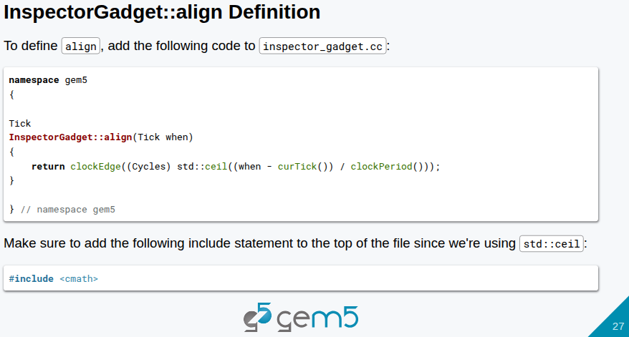
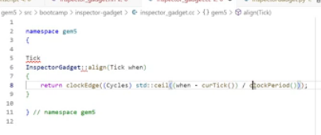
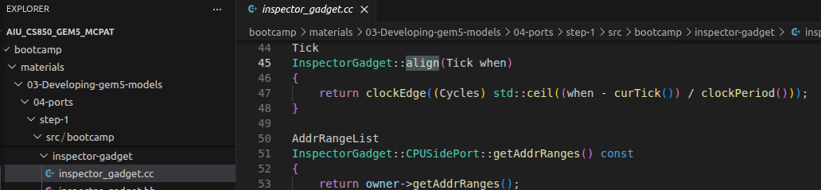
22.6 Define align()
https://www.youtube.com/watch?v=IAPlbIZg518&list=PL_hVbFs_loVR_8ntTTmmG6YEq3Po_4snu&index=22
Define align () (17:21-18:40/1:36:50)
> ~materials/03-Developing-gem5-models/04-ports/step-1/src/ bootcamp/inspector-gadget
We create another file inspector_gadget.cc
The clock edge takes cycle parameter “when”, unsigned integer Cycles.
Then, return the tick of clock cycle that is many cycles into the future.

Slide 41
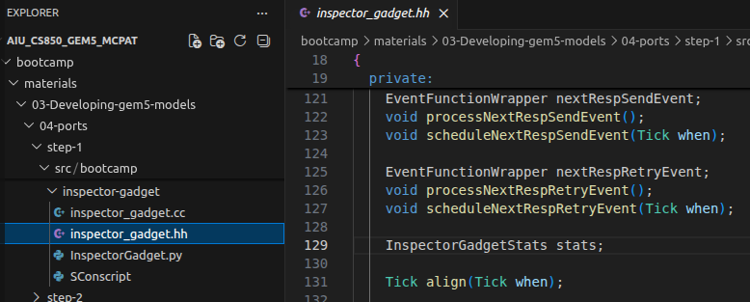
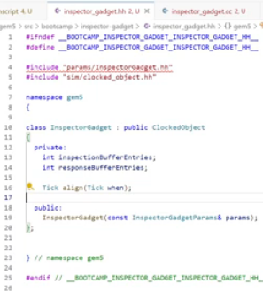
22.6 Define align()
https://www.youtube.com/watch?v=IAPlbIZg518&list=PL_hVbFs_loVR_8ntTTmmG6YEq3Po_4snu&index=22
Define align () (18:41-20:20/1:36:50)
> ~materials/03-Developing-gem5-models/04-ports/step-1/src/ bootcamp/inspector-gadget
inspector_gadget.hh declares
> Tick align(Tick when)
inspector_gadget.cc defines
> Tick InspectorGadget::align (Tick when) { … }

Slide 42
22.7 Include Port and Packet

Slide 43
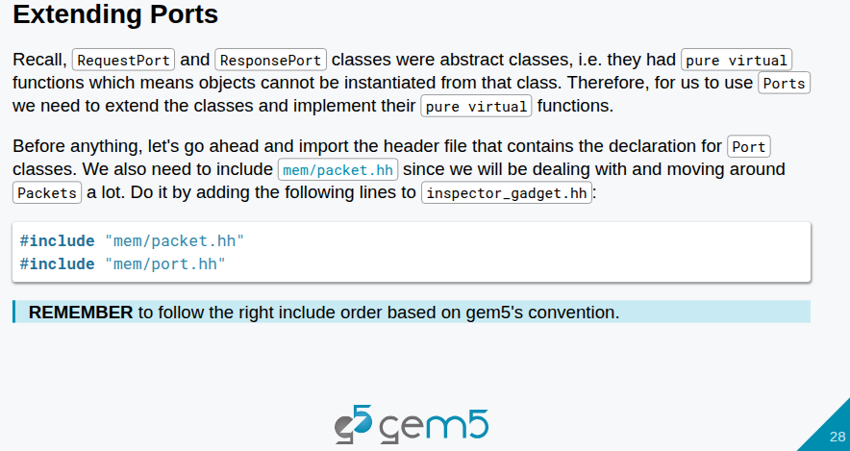
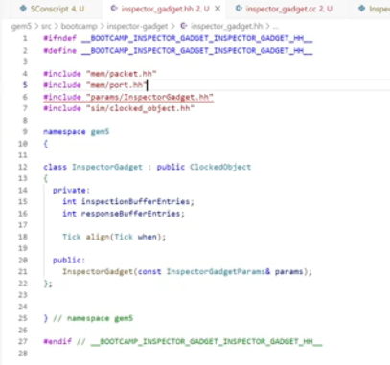
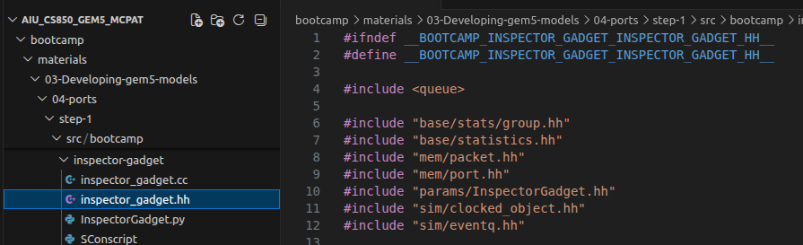
22.7 Include Port and Packet
https://www.youtube.com/watch?v=IAPlbIZg518&list=PL_hVbFs_loVR_8ntTTmmG6YEq3Po_4snu&index=22
Include Port and Packet (20:21-22:20/1:36:50)
> ~materials/03-Developing-gem5-models/04-ports/step-1/src/ bootcamp/inspector-gadget
inspector_gadget.hh declares
> Port () and Packet()
inspector_gadget.cc defines
> Port() and Packet
In inspect_gadget.hh, we need to include “mem/packet.hh” and “mem/port.hh”

Slide 44
22.8 Extend Response Port and Packet

Slide 45
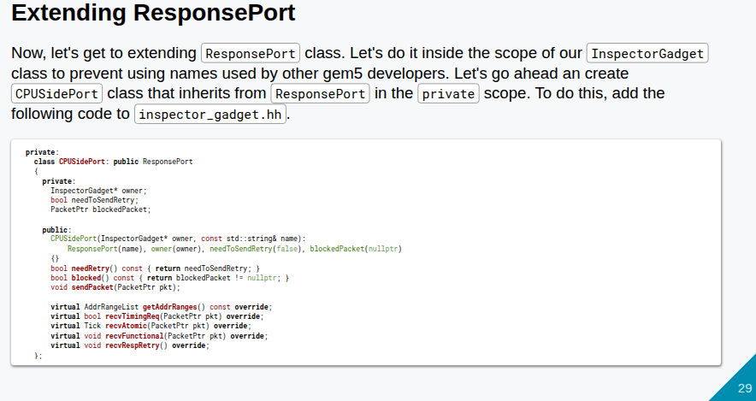
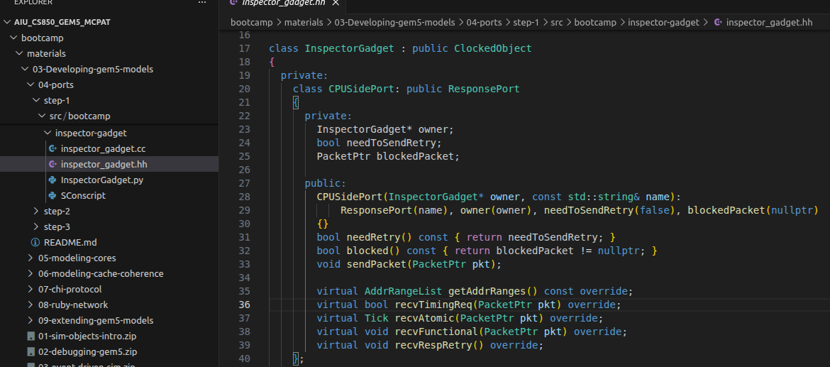
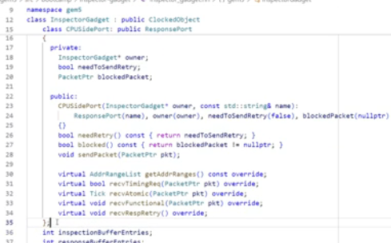
22.8 Extend Response Port and Packet
https://www.youtube.com/watch?v=IAPlbIZg518&list=PL_hVbFs_loVR_8ntTTmmG6YEq3Po_4snu&index=22
Extend Response Port and Packet (22:21-27:00/1:36:50)
> ~materials/03-Developing-gem5-models/ 04-ports/step-1/src/ bootcamp/inspector-gadget
In inspector_gadget.hh, we copy slide 29. Those codes define private variables, CPUSidePort class, extend ResponsePort and define virtual functions.
> class InspectorGadget : public ClockedObject {
> private:
> class CPUSidePort: public ResponsePort {
> private:
> PacketPtr blockedPacket
> ...
> public:
> CPUSidePort (...) {}
> ...
> virtual AddrRangeList getAddrRanges() const override;
> ...
> };

Slide 46
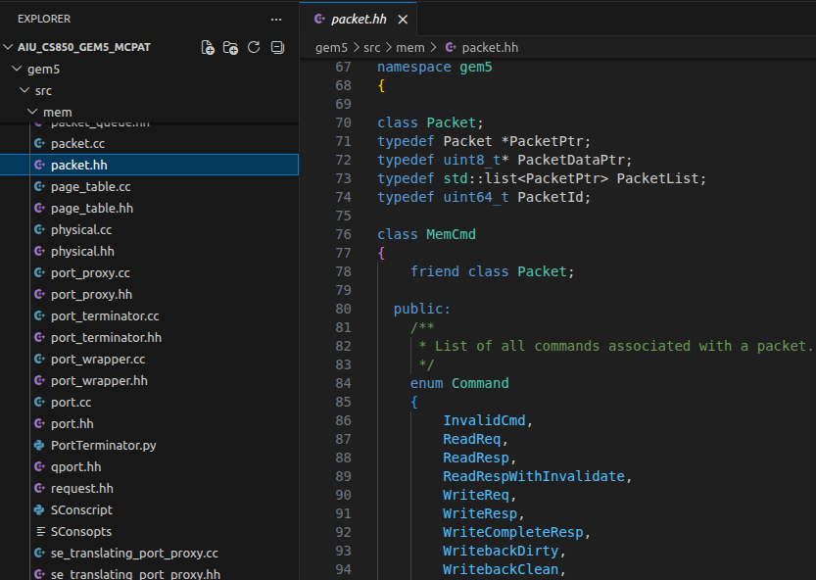
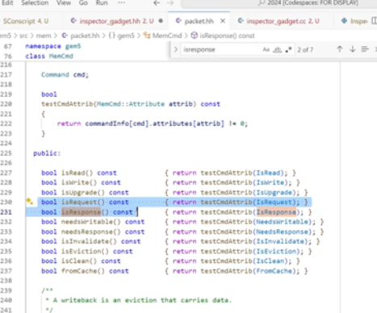
22.8 Extend Response Port and Packet
https://www.youtube.com/watch?v=IAPlbIZg518&list=PL_hVbFs_loVR_8ntTTmmG6YEq3Po_4snu&index=22
Extend Response Port and Packet (27:01-28:20/1:36:50)
> ~gem5/src/mem/packet.hh
We can go to packet.hh to see all the detail definition of packet information of
> PacketPtr blockedPacket

Slide 47
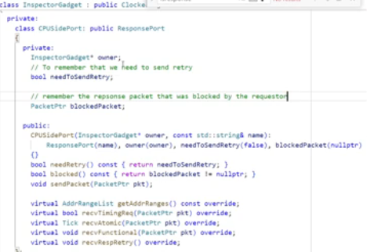
22.8 Extend Response Port and Packet
https://www.youtube.com/watch?v=IAPlbIZg518&list=PL_hVbFs_loVR_8ntTTmmG6YEq3Po_4snu&index=22
Extend Response Port and Packet (28:21-29:00/1:36:50)
> ~materials/03-Developing-gem5-models/ 04-ports/step-1/src/ bootcamp/inspector-gadget
Now, we understand the internal information of PacketPtr blockedPacket.
In the gem5, a blockedPacket is a standard software design pattern (typically a PacketPtr) used to temporarily store a memory request when a downstream component (like a memory controller or cache) is busy and unable to accept the packet.

Slide 48
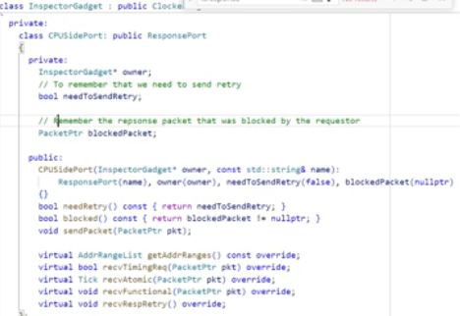
22.8 Extend Response Port and Packet
https://www.youtube.com/watch?v=IAPlbIZg518&list=PL_hVbFs_loVR_8ntTTmmG6YEq3Po_4snu&index=22
Extend Response Port and Packet (29:01-31:00/1:36:50)
> ~materials/03-Developing-gem5-models/ 04-ports/step-1/src/ bootcamp/inspector-gadget
It is the responsibility of CPU port to track the blocked Packet.
When the responser send a retry, the requestor tracks the request that was blocked.
> // To remember that we need to send retry
> bool needToSendRetry;
> // Remember the response packet that was blocked by the requestor.
> PacketPtr blockedPacket;

Slide 49
22.9 Extend Request Port and Packet

Slide 50
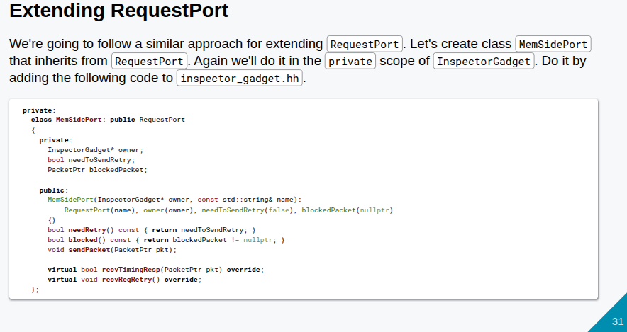
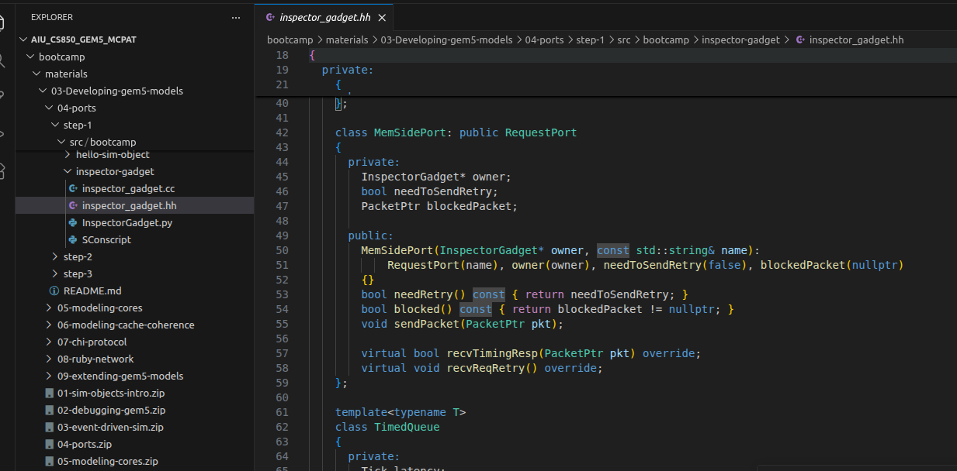
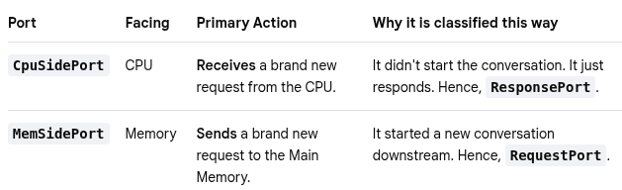
22.9 Extend Request Port and Packet
https://www.youtube.com/watch?v=IAPlbIZg518&list=PL_hVbFs_loVR_8ntTTmmG6YEq3Po_4snu&index=22
Extend Response Port and Packet (31:01-31:02/1:36:50)
> ~materials/03-Developing-gem5-models/ 04-ports/step-1/src/ bootcamp/inspector-gadget
In gem5, the Request Port (RequestPort) is placed on the CPU side.
It is used to forward request packets initiated by the CPU to the rest of the memory system.
Conversely, the response interface on the receiving end (e.g., a memory controller) is called the Response Port (ResponsePort) or the Memory-side port.

Slide 51
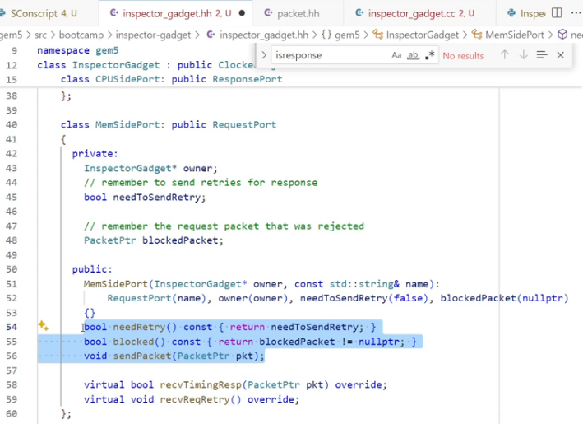
22.9 Extend Request Port and Packet
https://www.youtube.com/watch?v=IAPlbIZg518&list=PL_hVbFs_loVR_8ntTTmmG6YEq3Po_4snu&index=22
Extend Response Port and Packet (31:02-34:30/1:36:50)
> ~materials/03-Developing-gem5-models/ 04-ports/step-1/src/ bootcamp/inspector-gadget
In the inspector_gadget.hh, copy the page 31 int the
> MemSidePort: public RequestPort
These request the memory information.
> // Remember to send retries for response
> bool needToSendRetry;
> // Remember the request packet that was rejected
> PacketPtr blockedPacket

Slide 52
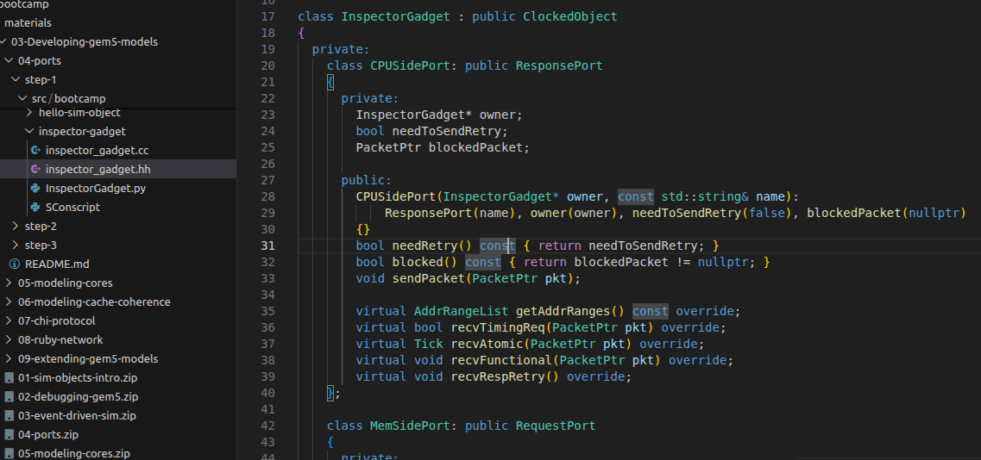
22.9 Extend Request Port and Packet
https://www.youtube.com/watch?v=IAPlbIZg518&list=PL_hVbFs_loVR_8ntTTmmG6YEq3Po_4snu&index=22
Extend Response Port and Packet (34:31-34:40/1:36:50)
> ~materials/03-Developing-gem5-models/ 04-ports/step-1/src/ bootcamp/inspector-gadget
Now, we have two classes:
1. class CPUSidePort and
2. class MemSidePort.
1
2

Slide 53
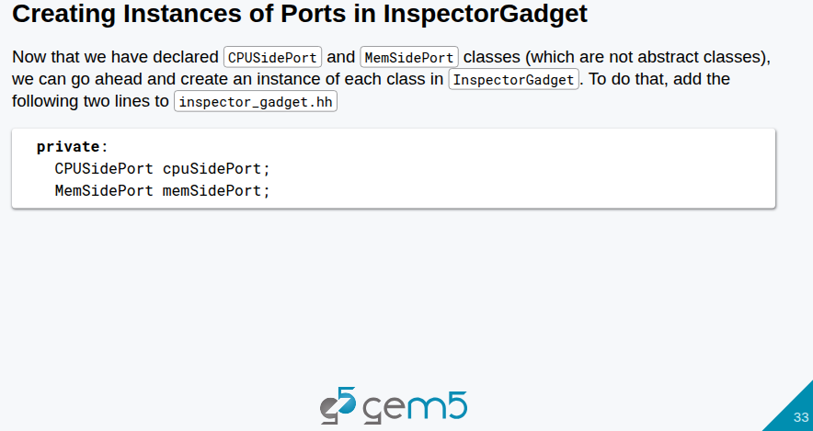
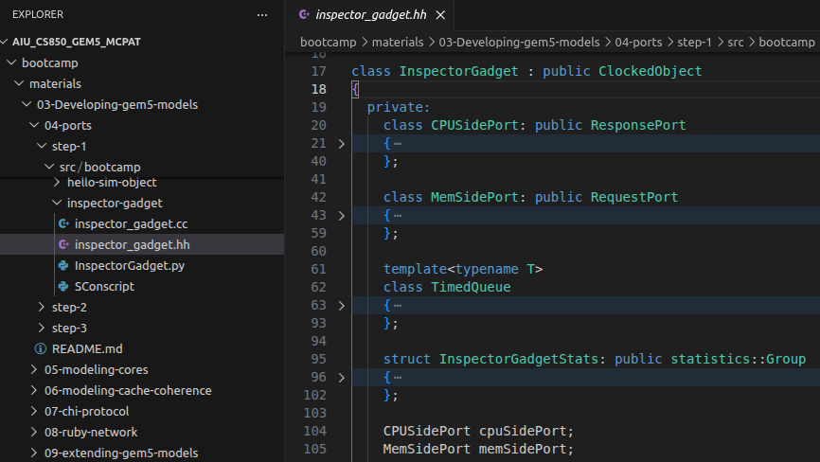
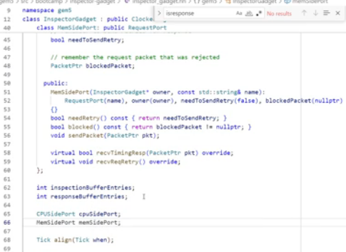
22.9 Extend Request Port and Packet
https://www.youtube.com/watch?v=IAPlbIZg518&list=PL_hVbFs_loVR_8ntTTmmG6YEq3Po_4snu&index=22
Extend Response Port and Packet (34:41-35:50/1:36:50)
> ~materials/03-Developing-gem5-models/ 04-ports/step-1/src/ bootcamp/inspector-gadget
We create two instances for CPU side port and Memory side port. We copy codes from slide 33:
> CPUSidePort cpuSidePort;
> MemSidePort memSidePort;
We create two private instances (one for CPU side Port and another one for Memory side port) under class InspectorGadget : public Clocked Object
We will see how the Python connect these two ports through the SimObject, one for CPU side. The other one for memory side.

Slide 54
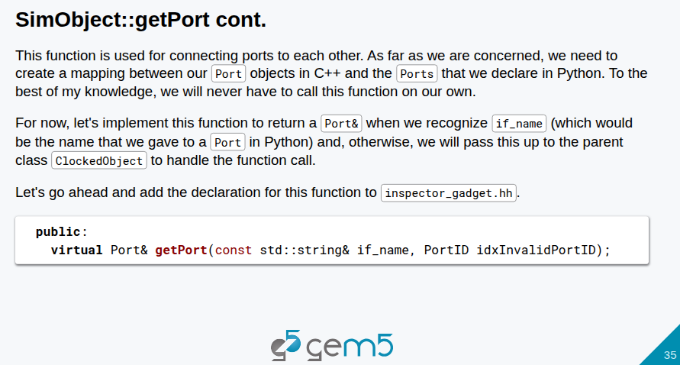
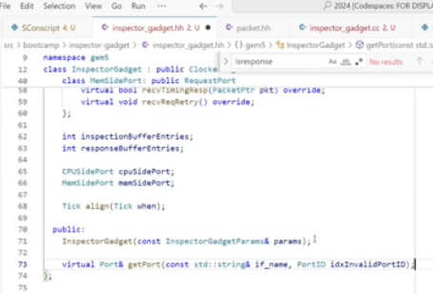
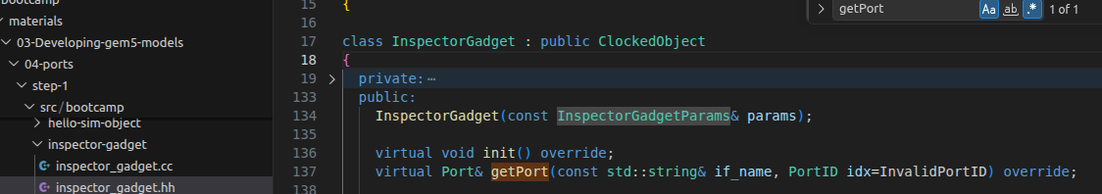
22.9 Extend Request Port and Packet
https://www.youtube.com/watch?v=IAPlbIZg518&list=PL_hVbFs_loVR_8ntTTmmG6YEq3Po_4snu&index=22
Extend Response Port and Packet (35:51-36:40/1:36:50)
> ~materials/03-Developing-gem5-models/ 04-ports/step-1/src/ bootcamp/inspector-gadget
We add virtual function getPort () from slide 35.
We never call getPort(). Gem5 call for us to connect ports in Python and in C++.

Slide 55
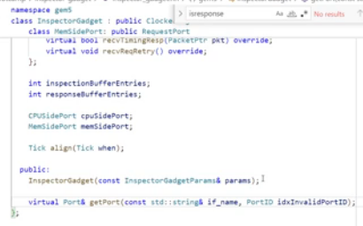
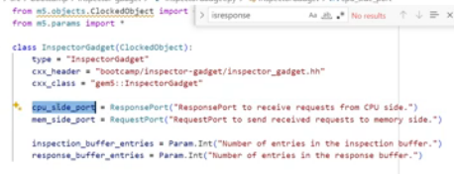
22.9 Extend Request Port and Packet
https://www.youtube.com/watch?v=IAPlbIZg518&list=PL_hVbFs_loVR_8ntTTmmG6YEq3Po_4snu&index=22
Extend Response Port and Packet (36:41-37:10/1:36:50)
> ~materials/03-Developing-gem5-models/ 04-ports/step-1/src/ bootcamp/inspector-gadget
Q1. What is the parameters pass into the class InspectorGadget()?
Ans: Pass in cpuSidePort or memSidePort?
Q2. Why gem5 define InspectorGadget in both Python and C++?
Ans: gem5 uses a dual-definition system for objects like InspectorGadget to separate the simulation configuration and parameters (defined in Python) from the actual hardware behavior and logic (defined in C++).
a. InspectorGadget.py: Defines the object as a SimObject. This allows gem5’s Python configuration scripts to instantiate the object, define its parameters (like latency or memory size), and connect it to other system components.
b. inspector_gadget.hh & .cc: Contains the actual C++ class implementation. This defines what the component does during the simulation execution, such as processing packets, reading hardware state, or triggering events.

Slide 56
22.9 Extend Request Port and Packet
https://www.youtube.com/watch?v=IAPlbIZg518&list=PL_hVbFs_loVR_8ntTTmmG6YEq3Po_4snu&index=22
Extend Response Port and Packet (37:11-38:40/1:36:50)
> ~materials/03-Developing-gem5-models/ 04-ports/step-1/src/ bootcamp/inspector-gadget
Inside the getPort(), all we have to do is create the pairing cpuSidePort and memSidePort.
Both ports are private and internal to C++ only.

Slide 57
22.10 Define Class InspectorGadget

Slide 58
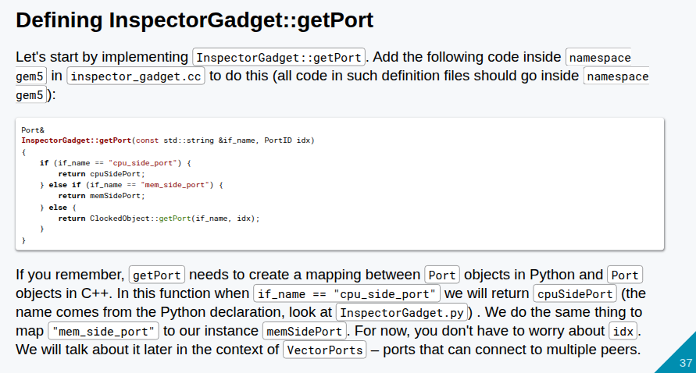


22.10 Define Class InspectorGadget
https://www.youtube.com/watch?v=IAPlbIZg518&list=PL_hVbFs_loVR_8ntTTmmG6YEq3Po_4snu&index=22
Define Class InspectorGadget (38:41-40:00/1:36:50)
> ~materials/03-Developing-gem5-models/ 04-ports/step-1/src/ bootcamp/inspector-gadget
Now, we define class InspectorGadget.
The getPort() map between Python and C++.
Copy code from slide 37 into inspector_gadget.cc.
For now, forget about the Port ID (or index). Port ID (index) is used for multiple peers. We don’t see how the Port ID work right now.

Slide 59
22.11 Define Function for CPU Side Port

Slide 60


22.11 Define Function for CPU Side Port
https://www.youtube.com/watch?v=IAPlbIZg518&list=PL_hVbFs_loVR_8ntTTmmG6YEq3Po_4snu&index=22
Define Function for CPU Side Port (40:01-40:30/1:36:50)
> ~materials/03-Developing-gem5-models/ 04-ports/step-1/src/ bootcamp/inspector-gadget
Slide 38 declares atomic functional and receive functional for CPU side port.

Slide 61



22.11 Define Function for CPU Side Port
https://www.youtube.com/watch?v=IAPlbIZg518&list=PL_hVbFs_loVR_8ntTTmmG6YEq3Po_4snu&index=22
Define Function for CPU Side Port (40:31-41:50/1:36:50)
> ~materials/03-Developing-gem5-models/ 04-ports/step-1/src/ bootcamp/inspector-gadget
Page 39 defines atomic and receive functional for CPU side port into inspector_gadget.cc.
In CPU side port, they return recvAtomic (pkt) and recvFunctional (pkt)

Slide 62



22.11 Define Function for CPU Side Port
https://www.youtube.com/watch?v=IAPlbIZg518&list=PL_hVbFs_loVR_8ntTTmmG6YEq3Po_4snu&index=22
Define Function for CPU Side Port (41:51-42:50/1:36:50)
> ~materials/03-Developing-gem5-models/ 04-ports/step-1/src/ bootcamp/inspector-gadget
Page 40 defines getAddrRanges() for CPU side port into inspector_gadget.cc.
In CPU side port, it return getAddrRanges()

Slide 63


22.11 Define Function for CPU Side Port
https://www.youtube.com/watch?v=IAPlbIZg518&list=PL_hVbFs_loVR_8ntTTmmG6YEq3Po_4snu&index=22
Define Function for CPU Side Port (42:51-43:30/1:36:50)
> ~materials/03-Developing-gem5-models/ 04-ports/step-1/src/ bootcamp/inspector-gadget
Q. Why do we define getAddrRanges () in CPU side Port and not Memory side port?
Ans: In gem5, getAddrRanges() is defined in the CPU-side port (the responder/slave port) because address routing in gem5 flows downstream from the request generator (CPU) to the ultimate data responder (Memory).

Slide 64



22.11 Define Function for CPU Side Port
https://www.youtube.com/watch?v=IAPlbIZg518&list=PL_hVbFs_loVR_8ntTTmmG6YEq3Po_4snu&index=22
Define Function for CPU Side Port (42:51-44:40/1:36:50)
> ~materials/03-Developing-gem5-models/ 04-ports/step-1/src/ bootcamp/inspector-gadget
In gem5/src/mem/port.hh, we can see getAddrRanges() is declared in class RequestPort { }.
1. Get a address range of connected responder port.
2. return address range list of its peer. This is the routing for forward. We have multiple request ports and figure out where to forward the request. We forward the request ports and the responsible port of peer give us the the address range.

Slide 65
22.11 Define Function for CPU Side Port
https://www.youtube.com/watch?v=IAPlbIZg518&list=PL_hVbFs_loVR_8ntTTmmG6YEq3Po_4snu&index=22
Define Function for CPU Side Port (44:51-46:10/1:36:50)
> ~materials/03-Developing-gem5-models/ 04-ports/step-1/src/ bootcamp/inspector-gadget
The getAddrRanges() is a crossbar function. It ask for all of its ports to give them the address ranges.
It ask all of its requests ports to give it their address ranges and it will create an internal map. The ma knows this address should go to this port that port or go to the other port.
If we have multiple request ports, we will have an internal map.
In our case, we only have one port. We do not need a map.

Slide 66




22.11 Define Function for CPU Side Port
https://www.youtube.com/watch?v=IAPlbIZg518&list=PL_hVbFs_loVR_8ntTTmmG6YEq3Po_4snu&index=22
Define Function for CPU Side Port (44:51-47:50/1:36:50)
> ~materials/03-Developing-gem5-models/ 04-ports/step-1/src/ bootcamp/inspector-gadget
1. Previously, we have declare the getAddrRanges() in private class CPUSidePort() inside the class InspectorGadget.
2. Now, we declare the getAddrRanges() inside the class InspectorGadget {}. Copy slide slide 42 to under public of class InspectorGadget getAddrRanges() declaration.
3. These four functions are declared for InspectorGadget.
1
2

Slide 67


22.11 Define Function for CPU Side Port
https://www.youtube.com/watch?v=IAPlbIZg518&list=PL_hVbFs_loVR_8ntTTmmG6YEq3Po_4snu&index=22
Define Function for CPU Side Port (47:51-48:30/1:36:50)
> ~materials/03-Developing-gem5-models/ 04-ports/step-1/src/ bootcamp/inspector-gadget
In the inspector_gadget.cc, we have recvTimingReq()
If recvTimingReq() is true, then we return true, else we set needToSendRetry = True and return false.

Slide 68


22.11 Define Function for CPU Side Port
https://www.youtube.com/watch?v=IAPlbIZg518&list=PL_hVbFs_loVR_8ntTTmmG6YEq3Po_4snu&index=22
Define Function for CPU Side Port (48:31-49:30/1:36:50)
> ~materials/03-Developing-gem5-models/ 04-ports/step-1/src/ bootcamp/inspector-gadget
In the inspector_gadget.cc, now, we look at recvFunctional ()

Slide 69
22.12 TimeQueue

Slide 70

22.12 TimeQueue
https://www.youtube.com/watch?v=IAPlbIZg518&list=PL_hVbFs_loVR_8ntTTmmG6YEq3Po_4snu&index=22
TimeQueue(49:01-50:00/1:36:50)
The InspectorGadget does not buffer the traffic. To buffer the traffic, we use FIFO (First In First Out) for inspectionBuffer and responseBuffer.

Slide 71



22.12 TimeQueue
https://www.youtube.com/watch?v=IAPlbIZg518&list=PL_hVbFs_loVR_8ntTTmmG6YEq3Po_4snu&index=22
TimeQueue(50:01-52:50/1:36:50)
> ~materials/03-Developing-gem5-models/ 04-ports/step-1/src/ bootcamp/inspector-gadget
We declare the TimingQueue in the private scope of class InspectorGadget.
We have two queue. Any time we request, we push into the timing queue.
Below, we have push() function to push the items and insert time for items into queue. Pop() function to remove the item and time from the queue.
There are front(), empty(), buffer size, hasReady() to return true or false for current time.
The firstReadyTime() return the time for the first items in the timing queue.

Slide 72


22.12 TimeQueue
https://www.youtube.com/watch?v=IAPlbIZg518&list=PL_hVbFs_loVR_8ntTTmmG6YEq3Po_4snu&index=22
TimeQueue(52:51-54:00/1:36:50)
> ~materials/03-Developing-gem5-models/ 04-ports/step-1/src/ bootcamp/inspector-gadget
In inspector_gadget.hh, we need to
> #include <queue>
Now, we can insert the items in the time queue.

Slide 73
22.13 inspectionBuffer

Slide 74



22.13 inspectionBuffer
https://www.youtube.com/watch?v=IAPlbIZg518&list=PL_hVbFs_loVR_8ntTTmmG6YEq3Po_4snu&index=22
inspectionBuffer (54:01-55:40/1:36:50)
> ~materials/03-Developing-gem5-models/ 04-ports/step-1/src/ bootcamp/inspector-gadget
In inspector_gadget.hh, we copy page 54 to private in class InspectorGadget.
> private:
> inspectionBufferEntries;
> # Memory/directory response
> TimeQueue<PacketPtr> inspectionBuffer;
> inspectionBufferEntries;
> # send response to CPU/Sequencer
> TimeQueue<PacketPtr> responseBuffer;

Slide 75
22.14 Four Functional

Slide 76



22.14 Four Functional
https://www.youtube.com/watch?v=IAPlbIZg518&list=PL_hVbFs_loVR_8ntTTmmG6YEq3Po_4snu&index=22
Four Functional (55:41-56:40/1:36:50)
> ~materials/03-Developing-gem5-models/ 04-ports/step-1/src/ bootcamp/inspector-gadget
1. getAddrRanges():

Slide 77
End

