Slide 1

16 SimObjects (Part 1)
Peter H. Chen

Slide 2

16 SimObjects (Part 1)
https://www.youtube.com/watch?v=4eHSdpX-hYU&list=PL_hVbFs_loVR_8ntTTmmG6YEq3Po_4snu&index=16
Introduction to Introduction to Introduction to Introduction to Introduction to Introduction to Introduction to Introduction to Introduction to Introduction to Introduction to Introduction to SimObjects (Part 1) (0:00-4:58/35:10)
We talk about the deepest level of Gem5 and develop Gem5 application.
Before we start, we have some commands for git operations:
> git stash # You can jump to another branch
> git fetch # Download commit files from remote repository into local repository.
> git pull origin main # Update your current local branch with the latest changes
> git stash pop # Drop the most recent stash
We will talk the breadth, not depth of Gem5.n How to write the SimObjects in Gem5 in C++ and Python.

Slide 3
16.0 Topics

Slide 4
16.0 Topics
https://www.youtube.com/watch?v=4eHSdpX-hYU&list=PL_hVbFs_loVR_8ntTTmmG6YEq3Po_4snu&index=16
Topic (4:49-4:50/35:10)
1. Build Gem5
2. Introduction to SimObjects
3. Step 1: Simple SimObject

Slide 5
16.1 Build Gem5

Slide 6
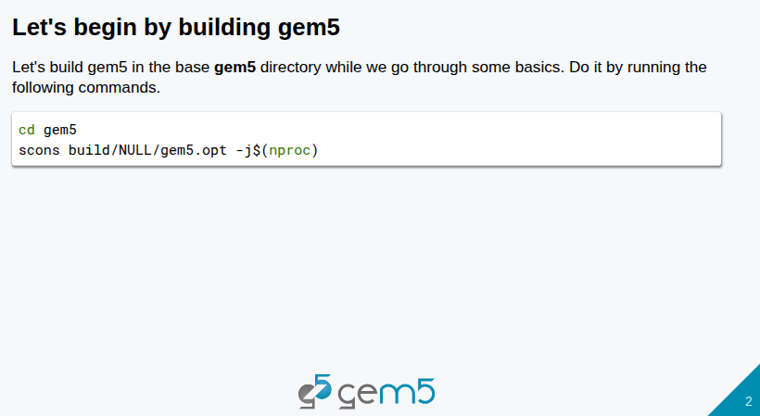
16.1 Build Gem5
https://www.youtube.com/watch?v=4eHSdpX-hYU&list=PL_hVbFs_loVR_8ntTTmmG6YEq3Po_4snu&index=16
Build Gem5 (4:51-5:05/35:10)
Below, we start building the Gem5.
> cd gem5
> scons build/NULL/gem5.opt -j$(nproc)

Slide 7
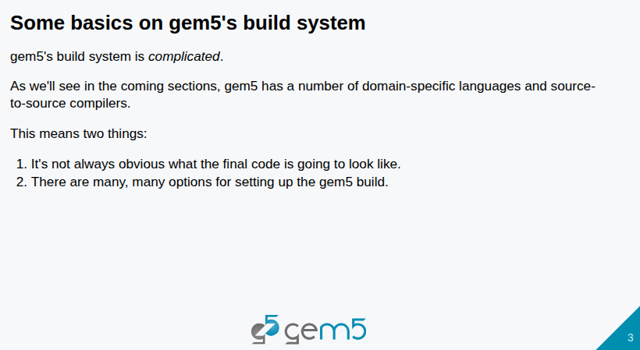
16.1 Build Gem5
https://www.youtube.com/watch?v=4eHSdpX-hYU&list=PL_hVbFs_loVR_8ntTTmmG6YEq3Po_4snu&index=16
Build Gem5 (4:51-5:20/35:10)
1. Gem5 contains three domain languages, 1. Python/C++, 2. SLICC (Specification Language Including Cache Coherence), 3. ISA (Instruction Set Architecture) Description Language.
2. Gem5 contains a lot of codes, such aa, ISA and Coherence Protocol. Gem5 has its own built system, such as scons (Software Construction).
3. Below
> scons --help
Will see how scons produce the ISA for X86, ARM, etc. Cache Coherence protocol, compiler optimizations for the binary.

Slide 8
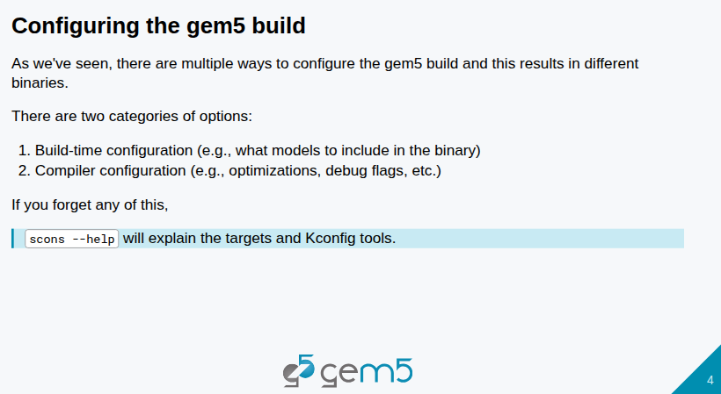
16.1 Build Gem5
https://www.youtube.com/watch?v=4eHSdpX-hYU&list=PL_hVbFs_loVR_8ntTTmmG6YEq3Po_4snu&index=16
Build Gem5 (5:21-6:20/35:10)
Scons commands includes two categories:
1. Build-time configuration: If you want X86 ISA, cache coherency protocol, or what model to include in the binary, etc.
2. Compiler configuration: What type of compiler configuration, such as, optimization, debug flags, etc.

Slide 9
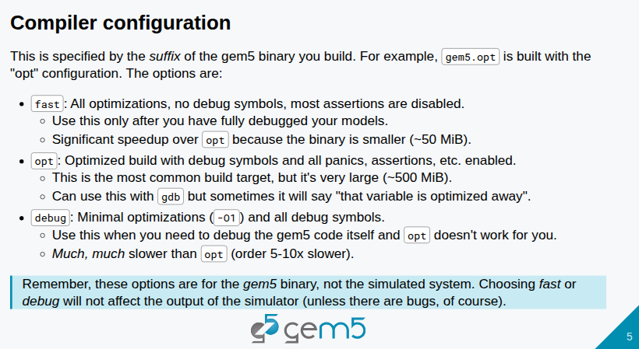
16.1 Build Gem5
https://www.youtube.com/watch?v=4eHSdpX-hYU&list=PL_hVbFs_loVR_8ntTTmmG6YEq3Po_4snu&index=16
Build Gem5 (6:21-7:20/35:10)
There are three possible optimization level, such as, debugs, fast, and opt.
1. We will use opt.
2. Fast has all the optimization, no debugging system. When we use gem5, we will put debug prints for ourself. Debug is not necessary for use SimObject. Fast mode does not have debugging. Fast will ignore the debugging.
3. Debugging is the minimal level of optimization -01 and has all the debug symbols. You can debug your code.
Opt has the best simulation performance. When I am in development, I usually use debugger first and them jump to fast mode. We do not need to use opt simulator.

Slide 10
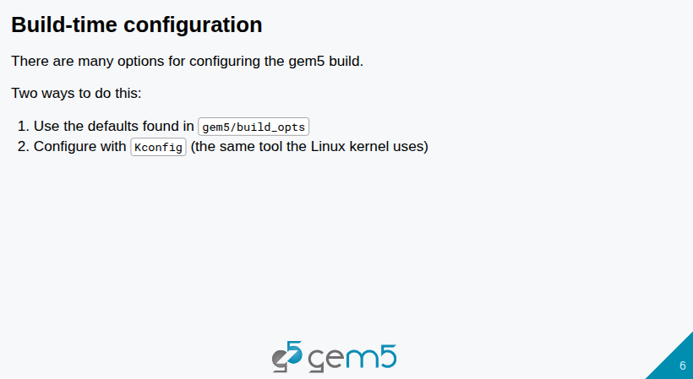
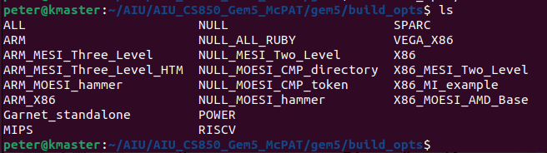
16.1 Build Gem5
https://www.youtube.com/watch?v=4eHSdpX-hYU&list=PL_hVbFs_loVR_8ntTTmmG6YEq3Po_4snu&index=16
Build Gem5 (7:21-8:10/35:10)
1. There are some defaults in the gem5 directory. Below, we go to gem5 build option directory (gem5/build_opts). There are the options, such as, ALL, NULL, SPARC, ARM, X86, etc.
2. gem5 has the Kconfig to build all the gem5 options.

Slide 11
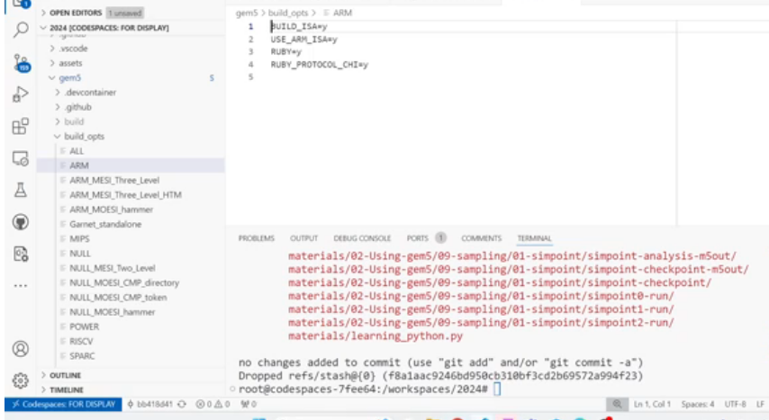
16.1 Build Gem5
https://www.youtube.com/watch?v=4eHSdpX-hYU&list=PL_hVbFs_loVR_8ntTTmmG6YEq3Po_4snu&index=16
Build Gem5 (8:11-9:10/35:10)
We will build with
1. ARM ISA
2. Use Ruby Cache and use RUBY_PROTOCOL_CHI
3. We will not use SLICC. The SLICC is used to define the state machine. Since we do not define the state machine, we will not create any Ruby Cache Coherency.
What is Cache Coherence?
In a shared-memory multiprocessor system, the cache coherence problem arises when multiple CPUs cache the same data.
If one CPU modifies its local copy, the other CPUs' copies become stale (invalid), leading to potential data corruption and incorrect program execution if not managed.
A system is considered cache coherent if:
a. Writes are propagated: Changes made to a shared data item in one cache are eventually seen by all other caches.
b. Writes are serialized: Writes to the same memory location are observed in the same order by all processors.

Slide 12
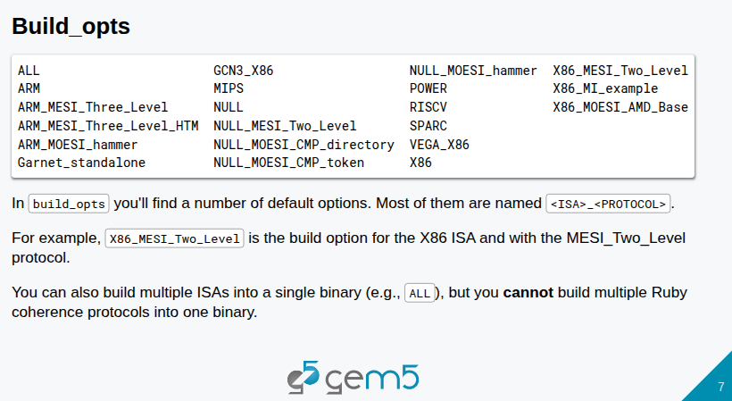
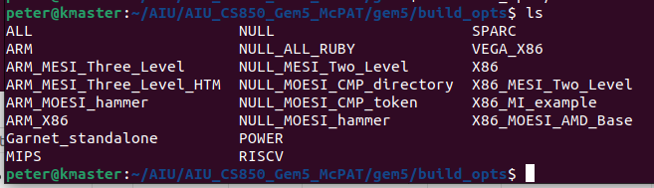
16.1 Build Gem5
https://www.youtube.com/watch?v=4eHSdpX-hYU&list=PL_hVbFs_loVR_8ntTTmmG6YEq3Po_4snu&index=16
Build Gem5 (9:11-9:30/35:10)
In the below gem5/build_opts directory, we can see there is VEGA_X86. VEGA_X86 is AMD model which has the GPU model built in. The cache coherence is required for the CPU/CPU connection. This AMD model VEGA_X86 is used for GPU/CPU Simulation.

Slide 13
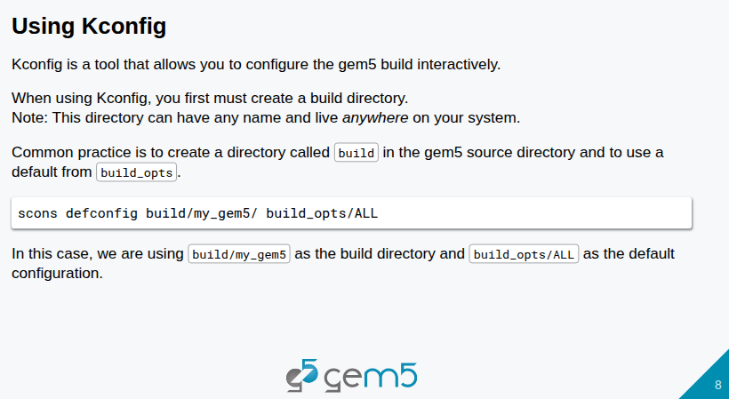
16.1 Build Gem5
https://www.youtube.com/watch?v=4eHSdpX-hYU&list=PL_hVbFs_loVR_8ntTTmmG6YEq3Po_4snu&index=16
Build Gem5 (9:31-10:10/35:10)
Below, we use Kconfig to configure gem5 building. Gem5 already includes both scons and kconfig.
1. We need to make a directory and build gem5 in that directory.
2. We can build gem5 in build/my_gem5 directory with gem5 build options ALL defined in build_opts/ALL
> scons defconfig build/my_gem5/ build_opts/ALL

Slide 14
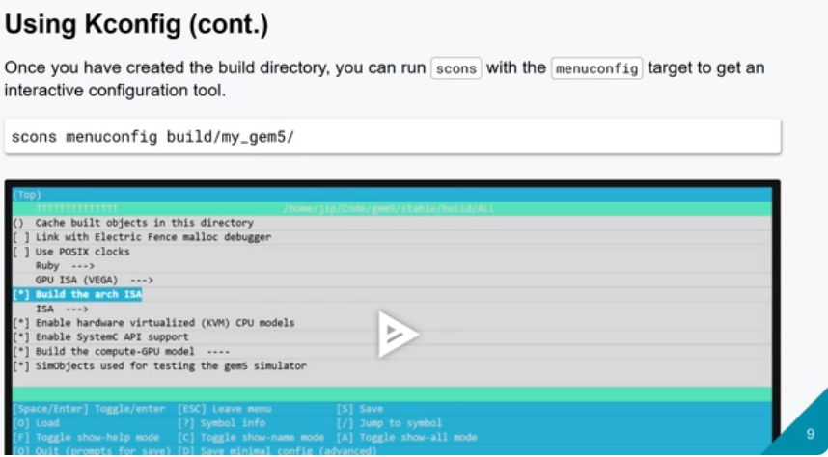
16.1 Build Gem5
https://www.youtube.com/watch?v=4eHSdpX-hYU&list=PL_hVbFs_loVR_8ntTTmmG6YEq3Po_4snu&index=16
Build Gem5 (10:11-11:15/35:10)
Below, we use Kconfig to configure gem5 building. Gem5 already includes both scons and kconfig.
> scons menuconfig build/my_gem5

Slide 15
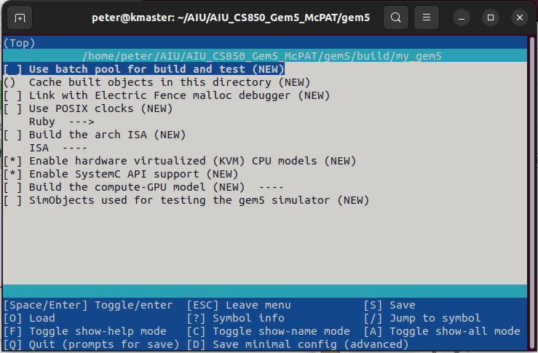
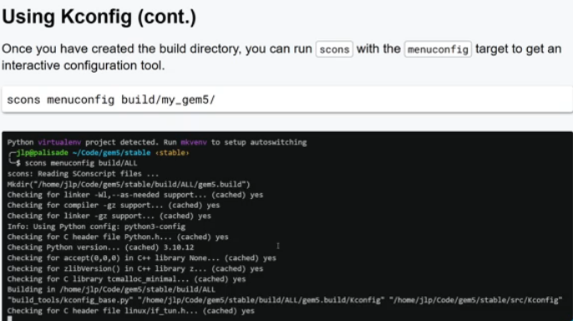
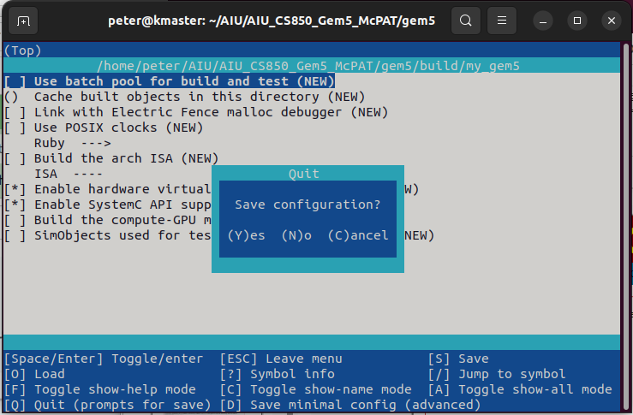
16.1 Build Gem5
https://www.youtube.com/watch?v=4eHSdpX-hYU&list=PL_hVbFs_loVR_8ntTTmmG6YEq3Po_4snu&index=16
Build Gem5 (10:16-10:20/35:10)
Below, we use Kconfig to configure gem5 building. Gem5 already includes both scons and kconfig.
> scons menuconfig build/my_gem5 # scons menuconfig build/X86

Slide 16
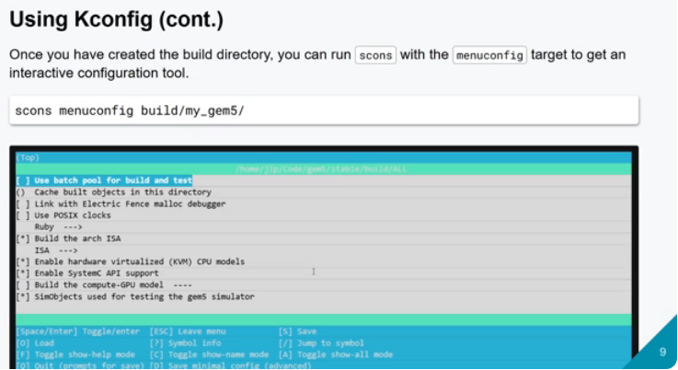
16.1 Build Gem5
https://www.youtube.com/watch?v=4eHSdpX-hYU&list=PL_hVbFs_loVR_8ntTTmmG6YEq3Po_4snu&index=16
Build Gem5 (10:21-10:25/35:10)
Below, we run run with scons and menuconfig and build/ALL.
> scons menuconfig build/ALL

Slide 17
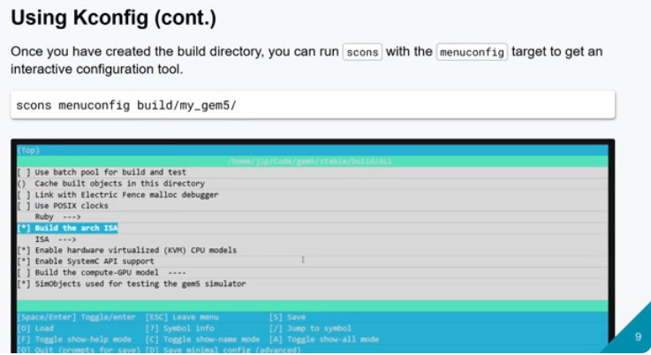
16.1 Build Gem5
https://www.youtube.com/watch?v=4eHSdpX-hYU&list=PL_hVbFs_loVR_8ntTTmmG6YEq3Po_4snu&index=16
Build Gem5 (10:21-10:25/35:10)
We can move cursor to Build the arch ISA.

Slide 18
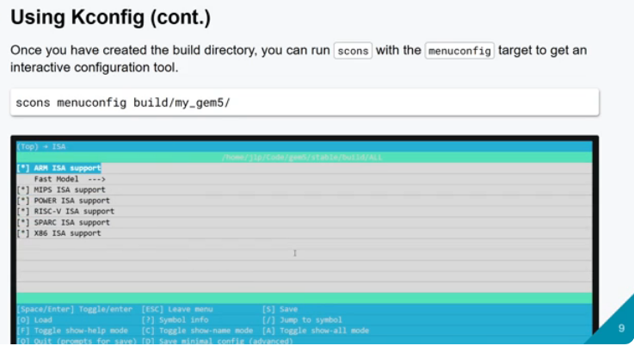
16.1 Build Gem5
https://www.youtube.com/watch?v=4eHSdpX-hYU&list=PL_hVbFs_loVR_8ntTTmmG6YEq3Po_4snu&index=16
Build Gem5 (10:26-10:27/35:10)
We go through the options that we have.

Slide 19
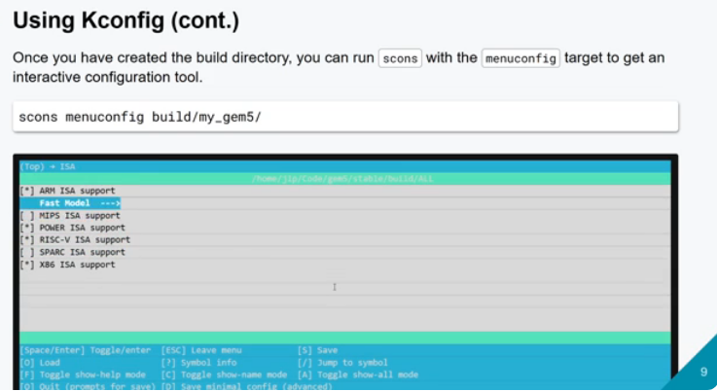
16.1 Build Gem5
https://www.youtube.com/watch?v=4eHSdpX-hYU&list=PL_hVbFs_loVR_8ntTTmmG6YEq3Po_4snu&index=16
Build Gem5 (10:28-10:30/35:10)
Below, we turn off MIPS ISA and SPARC ISA.
We only turn on ARM ISA, POWER ISA, RISC-V ISA, and X86 ISA.

Slide 20
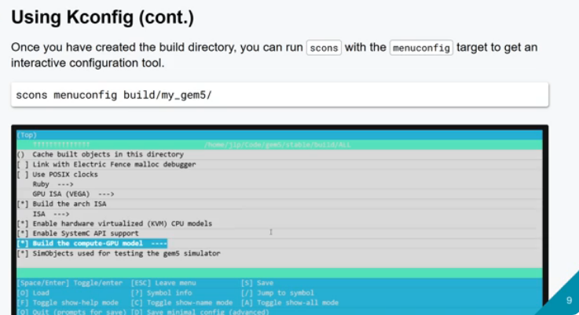
16.1 Build Gem5
https://www.youtube.com/watch?v=4eHSdpX-hYU&list=PL_hVbFs_loVR_8ntTTmmG6YEq3Po_4snu&index=16
Build Gem5 (10:31-11:05/35:10)
We enable some ISA options: Enable hardware virtualization (KVM) models, system C API support, Build the GPU model. SimObjects used for testing Gem5 simulator, etc.

Slide 21
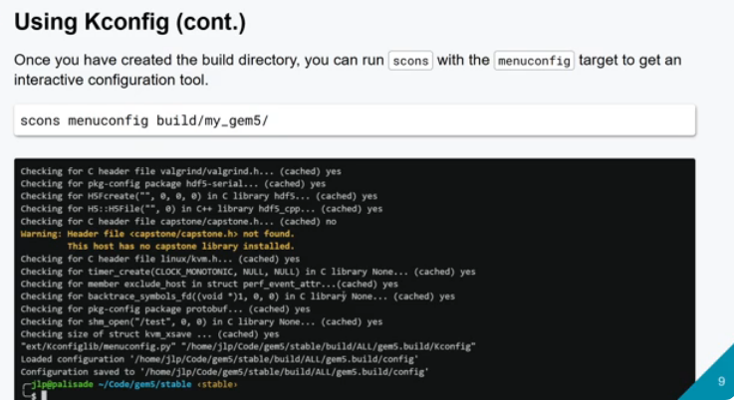
16.1 Build Gem5
https://www.youtube.com/watch?v=4eHSdpX-hYU&list=PL_hVbFs_loVR_8ntTTmmG6YEq3Po_4snu&index=16
Build Gem5 (11:06-11:15/35:10)
We start to run the scons with menuconfig.
The beginning data is taken out of JSON file.

Slide 22
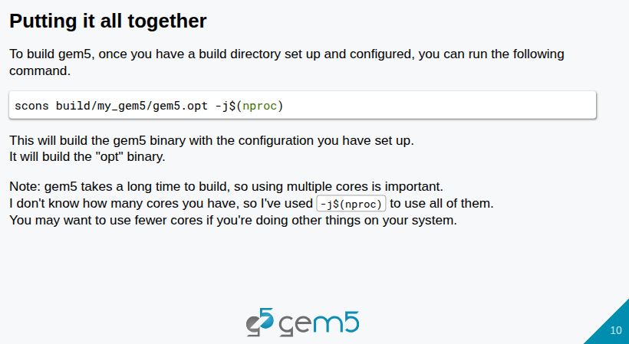
16.1 Build Gem5
https://www.youtube.com/watch?v=4eHSdpX-hYU&list=PL_hVbFs_loVR_8ntTTmmG6YEq3Po_4snu&index=16
Build Gem5 (11:16-11:30/35:10)
Now, we have run all the commands to configured data from the menuconfig.
We can use scons and configured data to build gem5.
> scons build/my_gem5/gem5.opt -j($nproc) # e.g., scons build/ALL/gem5.opt -j(8)

Slide 23
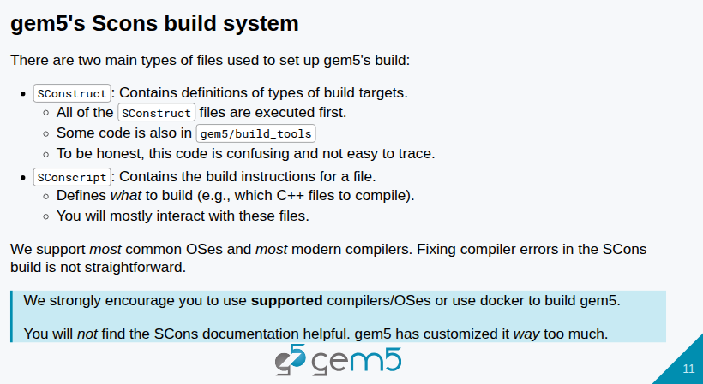
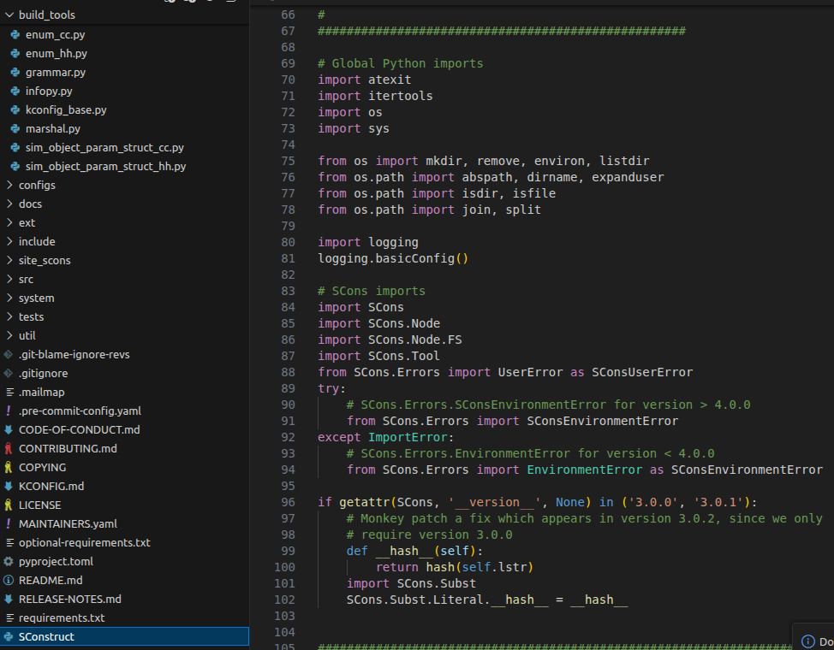

16.1 Build Gem5
https://www.youtube.com/watch?v=4eHSdpX-hYU&list=PL_hVbFs_loVR_8ntTTmmG6YEq3Po_4snu&index=16
Build Gem5 (11:31-11:40/35:10)
Under the gem5, there is “SConstruct” Python file without Python extension “.py”.
All the SConstruct files are executed first.

Slide 24
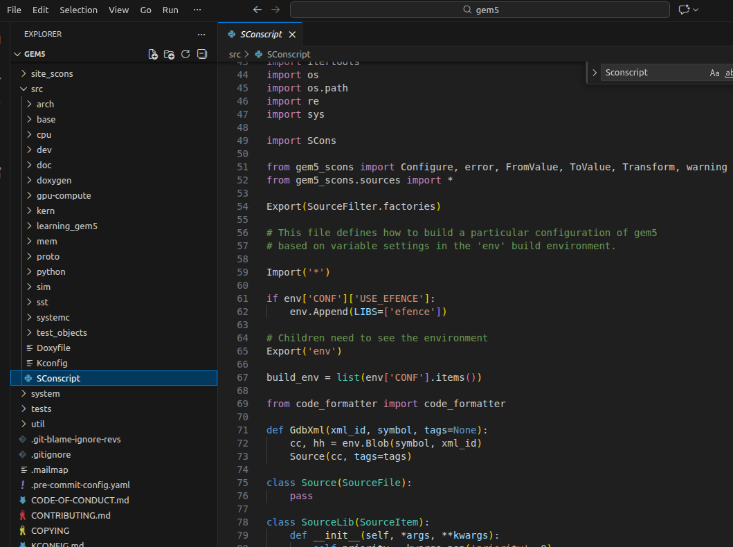
16.1 Build Gem5
https://www.youtube.com/watch?v=4eHSdpX-hYU&list=PL_hVbFs_loVR_8ntTTmmG6YEq3Po_4snu&index=16
Build Gem5 (11:41-11:50/35:10)
Under the gem5/[src, src/[arch, base, cpu, dev, gpu-compute, mem, kern, proto, python, sim, sst, systemc, test_objects, util], there is “SConscript” Python file without Python extension “.py”.
SConscript defines what to build.

Slide 25
16.2 Introduction to SimObjects

Slide 26
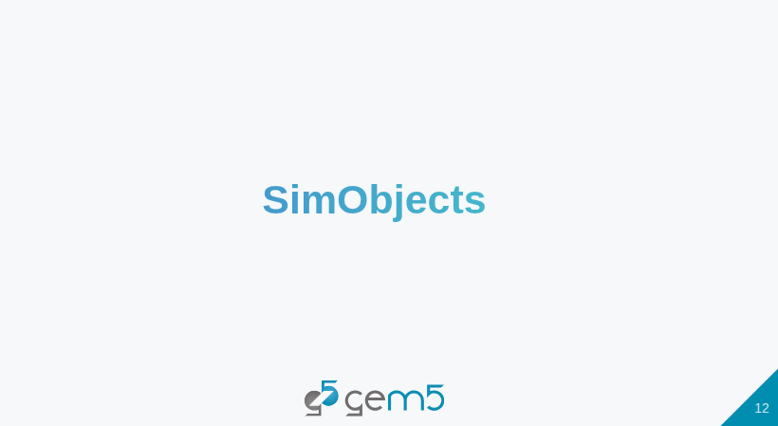
16.2 Introduction to SimObjects
https://www.youtube.com/watch?v=4eHSdpX-hYU&list=PL_hVbFs_loVR_8ntTTmmG6YEq3Po_4snu&index=16
Introduction to SimObjects (11:51-12:00/35:10)
Let’s get into SimObjects.

Slide 27
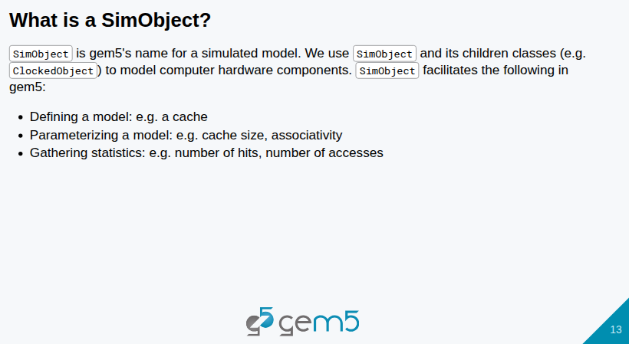
16.2 Introduction to SimObjects
https://www.youtube.com/watch?v=4eHSdpX-hYU&list=PL_hVbFs_loVR_8ntTTmmG6YEq3Po_4snu&index=16
Introduction to SimObjects (12:01-13:10/35:10)
SimObjects is the models of real world phenomena.
In computer hardware architecture, we use SimObjects to simulate computer hardware.
We want to make clear for some concepts:
1. A SimObject defines a model, for example, cache is a model.
2. A SimObject is a parameterized model. The functionality of a cache is described by a SimObjects. We can parameterized the functionality of cache SimObject. The parameter can be cache size. We can modify the cache functionality.
3. SimObject can also collect statistics. The statistics we see in the stats.txt are all come from SimObjects. The SimObjects collect the statistics throughout our simulation. For example, number of hits and number of accesses are collected by the SimObjects.

Slide 28
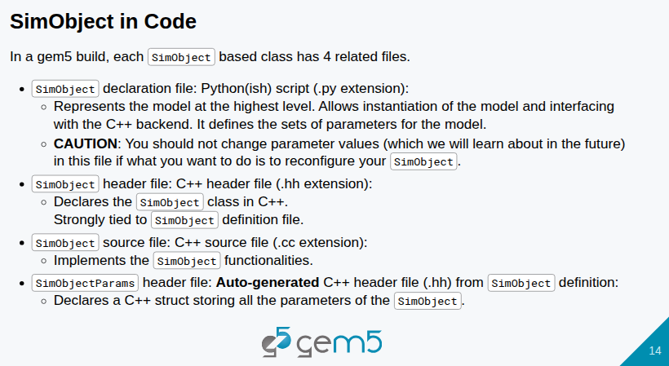
16.2 Introduction to SimObjects
https://www.youtube.com/watch?v=4eHSdpX-hYU&list=PL_hVbFs_loVR_8ntTTmmG6YEq3Po_4snu&index=16
Introduction to SimObjects (13:11-15:10/35:10)
Now, we look at Gem5 SimObjects Code. We have four files in the SimObjects.
1. Python declaration file: Declare Python Model.
2. C++ header file (*.hh): Declare C++ Class for SimObject.
3. C++ code: Implement C++ Class member function for SimObject.
4. SimObjectParams header file: Auto generated C++ header file (*.hh) from SimObject definition.

Slide 29
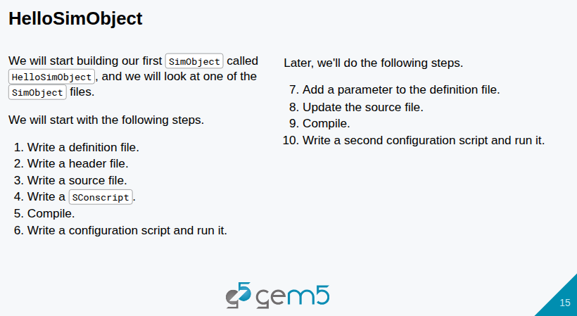
16.2 Introduction to SimObjects
https://www.youtube.com/watch?v=4eHSdpX-hYU&list=PL_hVbFs_loVR_8ntTTmmG6YEq3Po_4snu&index=16
Introduction to SimObjects (15:11-15:35/35:10)
In the below HelloSimObject example, we build our first SimObject and look at one of the SimObject file.
This example does not simulate the hardware. This example just say hello and print the message “Simulation finishes”. We will see the complicated process.
We will add a parameter to the example and say hello multiple times. We will familiar with Gem5 with this example.
We will start with the following steps:
1. Write definition file
2. Write header file
3. Write source file
4. Write SConscript
5. Compile
6. Write configuration script and run
7. Add parameter to definition file
8. Update source file
9. Compile
10. Write second configuration script and run.

Slide 30
16.3 Step 1: Simple SimObject

Slide 31
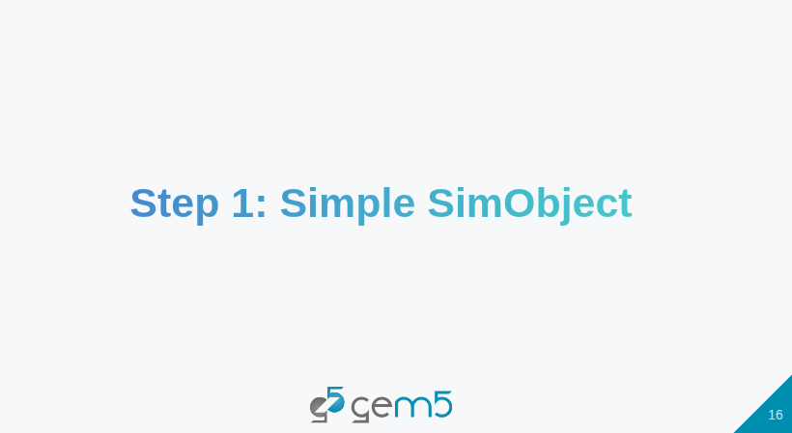
16.3 Step 1: Simple SimObject
https://www.youtube.com/watch?v=4eHSdpX-hYU&list=PL_hVbFs_loVR_8ntTTmmG6YEq3Po_4snu&index=16
Step 1: Simple SimObject (15:35-15:40/35:10)
We start with a Simple SimObject

Slide 32
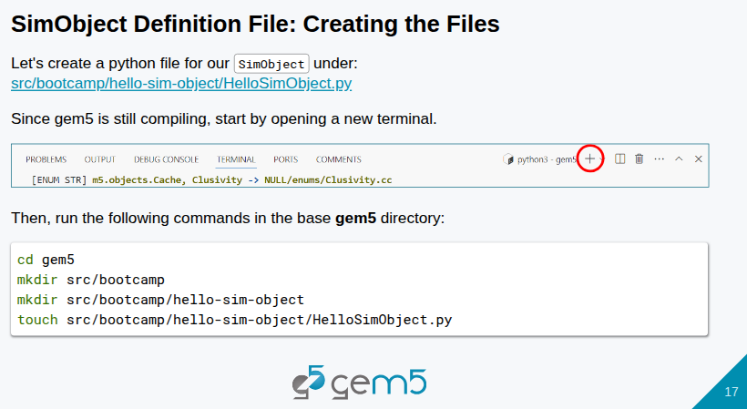
16.3 Step 1: Simple SimObject
https://www.youtube.com/watch?v=4eHSdpX-hYU&list=PL_hVbFs_loVR_8ntTTmmG6YEq3Po_4snu&index=16
Step 1: Simple SimObject (15:41-18:00/35:10)
> code ./src/bootcamp/hello-sim-object/HelloSimObject.py # Correction as below:
> code ~/materials/03-Devloping-gem5-models/01-sim-objects-intro/step-1/src/bootcamp/hello-sim-object/HelloSimObject.py
We create directory hello-sim-object and file HelloSimObject.py.

Slide 33
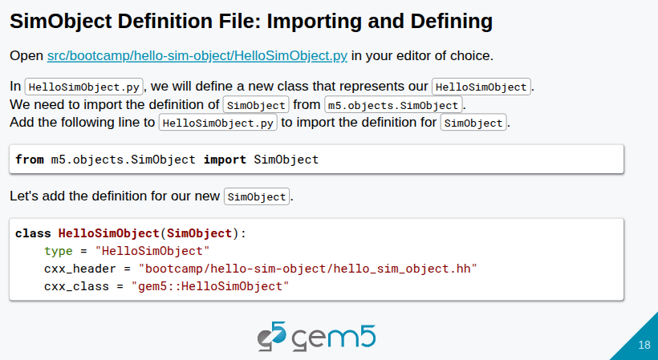
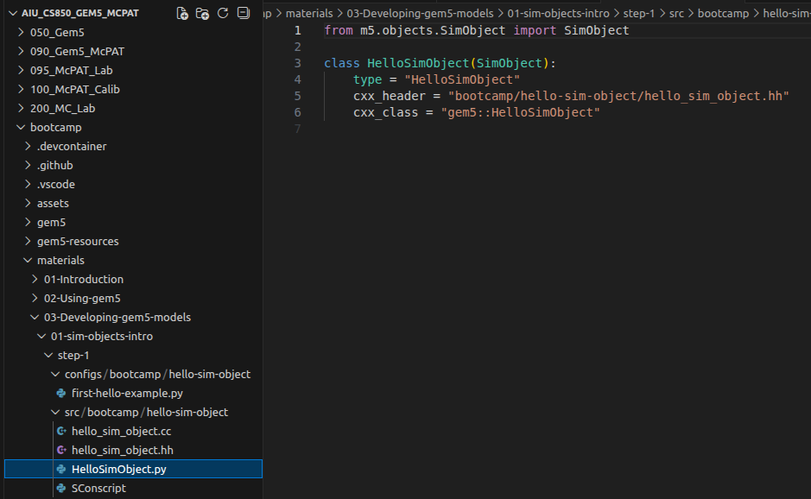
16.3 Step 1: Simple SimObject
https://www.youtube.com/watch?v=4eHSdpX-hYU&list=PL_hVbFs_loVR_8ntTTmmG6YEq3Po_4snu&index=16
Step 1: Simple SimObject (18:01-19:00/35:10)
> code ./src/bootcamp/hello-sim-object/HelloSimObject.py # Correction as below:
> code ~/materials/03-Devloping-gem5-models/01-sim-objects-intro/step-1/src/bootcamp/hello-sim-object/HelloSimObject.py
In below HelloSimObject.py, we
1. from m5.objects.SimObject import SimObject
2. Define class HelloSimObject (SimObject)

Slide 34
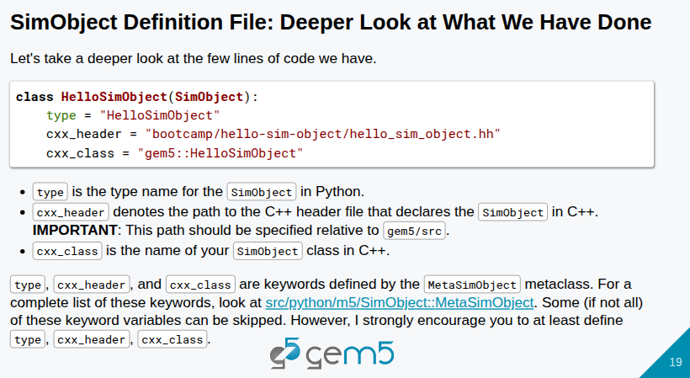
16.3 Step 1: Simple SimObject
https://www.youtube.com/watch?v=4eHSdpX-hYU&list=PL_hVbFs_loVR_8ntTTmmG6YEq3Po_4snu&index=16
Step 1: Simple SimObject (19:01-21:10/35:10)
> code ./src/bootcamp/hello-sim-object/HelloSimObject.py # Correction as below:
> code ~/materials/03-Devloping-gem5-models/01-sim-objects-intro/step-1/src/bootcamp/hello-sim-object/HelloSimObject.py
In the class HelloSimObject (SimObject): We specify three keywords, type, cxx_header, and cxx_class.
1. type: The type of SimObject in Python. The type is the name of SimObject (Class name of SimObject).
2. cxx_header: C++ header, bootcamp/hello-sim-object/hello_sim_object.hh
3. cxx_class: C++ object name, gem5::HelloSimObject.

Slide 35
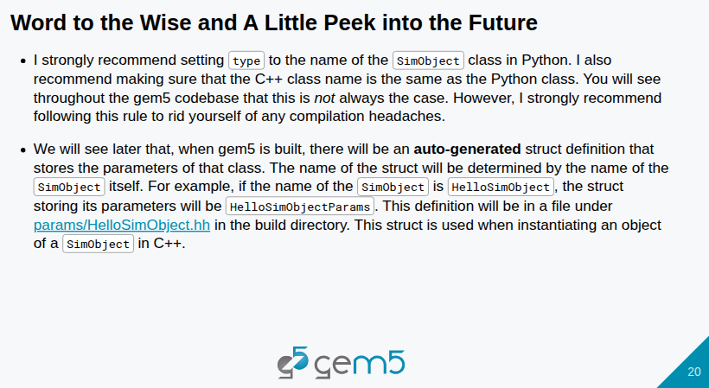
16.3 Step 1: Simple SimObject
https://www.youtube.com/watch?v=4eHSdpX-hYU&list=PL_hVbFs_loVR_8ntTTmmG6YEq3Po_4snu&index=16
Step 1: Simple SimObject (21:11-22:10/35:10)
> code ./src/bootcamp/hello-sim-object/HelloSimObject.py # Correction as below:
> code ~/materials/03-Devloping-gem5-models/01-sim-objects-intro/step-1/src/bootcamp/hello-sim-object/HelloSimObject.py
1. both Class name in Python and C++ are the same: SimObject
2. auto-generator struct definition that stores the parameters of that class. Struct name is determined by SimObject. For example, it SimObject is HelloSimObject, then the struct stor the parameter is HelloSimObjectParams.
3. The definition is stored in params/HelloSimObject.hh. This struct is used when instantiate a C++ SimObject.

Slide 36
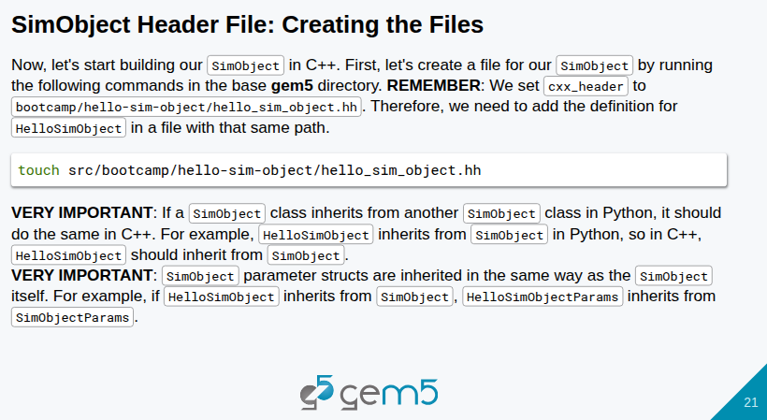
16.3 Step 1: Simple SimObject
https://www.youtube.com/watch?v=4eHSdpX-hYU&list=PL_hVbFs_loVR_8ntTTmmG6YEq3Po_4snu&index=16
Step 1: Simple SimObject (22:11-23:06/35:10)
> code ./src/bootcamp/hello-sim-object/hello_sim_object.hh # Correction as below:
> code ~/materials/03-Devloping-gem5-models/01-sim-objects-intro/step-1/src/bootcamp/hello-sim-object/hello_sim_object.hh
Now, we build the SimObject in C++. Since HelloSimObject is inherited from SimObject, the parameter od HelloSimObject is same as SimObject. The auto-generated for structure/parameters of HelloSimObject is also same as SimObject.

Slide 37
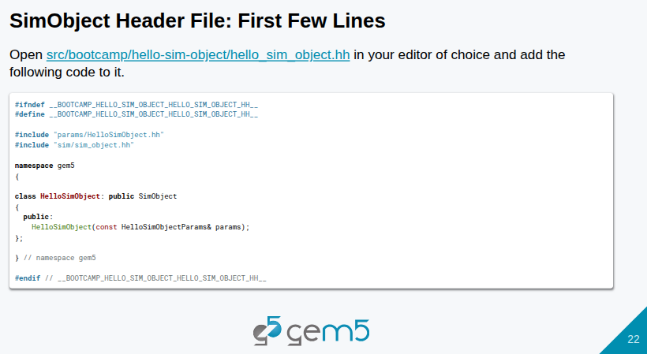
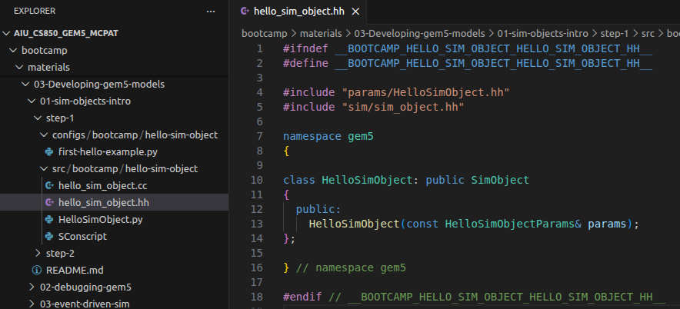
16.3 Step 1: Simple SimObject
https://www.youtube.com/watch?v=4eHSdpX-hYU&list=PL_hVbFs_loVR_8ntTTmmG6YEq3Po_4snu&index=16
Step 1: Simple SimObject (23:07-25:30/35:10)
> code ./src/bootcamp/hello-sim-object/hello_sim_object.hh # Correction as below:
> code ~/materials/03-Devloping-gem5-models/01-sim-objects-intro/step-1/src/bootcamp/hello-sim-object/hello_sim_object.hh
Below, we have the hello_sim_object.hh header file. We can see HelloSimObject is inherited from SimObject.
1. The first two lines are #ifndef and #define. This is to prevent the infinite include and definition. We need to use Gem5 naming convention.
2. We include auto-generated header files, params/HelloSimObject.hh and sim/sim_object.hh
1
2

Slide 38
16.3 Step 1: Simple SimObject
https://www.youtube.com/watch?v=4eHSdpX-hYU&list=PL_hVbFs_loVR_8ntTTmmG6YEq3Po_4snu&index=16
Step 1: Simple SimObject (25:31-26:30/35:10)
> code ./src/bootcamp/hello-sim-object/HelloSimObject.py # Correction as below:
> code ~/materials/03-Devloping-gem5-models/01-sim-objects-intro/step-1/src/bootcamp/hello-sim-object/hello_sim_object.hh
3. Then, we have namespace gem5 in C++ with gem5 convention.
4. we define C++ Class HelloSimObject and inherit SimObject from C++ Class library. In Gem5, we have both inheritance C++ and Python. SimObject in C++ and Python.
3
4

Slide 39
16.3 Step 1: Simple SimObject
https://www.youtube.com/watch?v=4eHSdpX-hYU&list=PL_hVbFs_loVR_8ntTTmmG6YEq3Po_4snu&index=16
Step 1: Simple SimObject (26:31-26:50/35:10)
> code src/bootcamp/hello-sim-object/hello_sim_object.hh # Correction as below:
> code ~/materials/03-Devloping-gem5-models/01-sim-objects-intro/step-1/src/bootcamp/hello-sim-object/hello_sim_object.hh
5. Then, we define the public constructor HelloSimObject () for class HelloSimObject {}. Later on, We can create the SimObject with the constructor.
6. The parameter params is constant structure reference with parameter class HelloSimObjectParam.
5
6

Slide 40
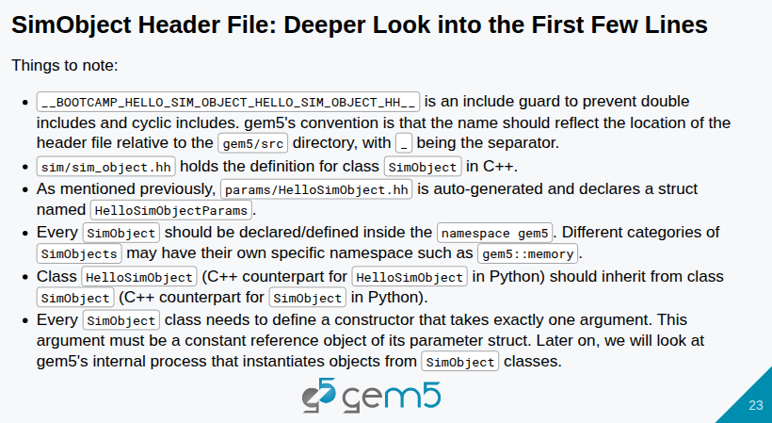
16.3 Step 1: Simple SimObject
https://www.youtube.com/watch?v=4eHSdpX-hYU&list=PL_hVbFs_loVR_8ntTTmmG6YEq3Po_4snu&index=16
Step 1: Simple SimObject (27:51-28:05/35:10)
> code src/bootcamp/hello-sim-object/hello_sim_object.hh # Correction as below:
> code ~/materials/03-Devloping-gem5-models/01-sim-objects-intro/step-1/src/bootcamp/hello-sim-object/hello_sim_object.hh
Some notes as below.

Slide 41
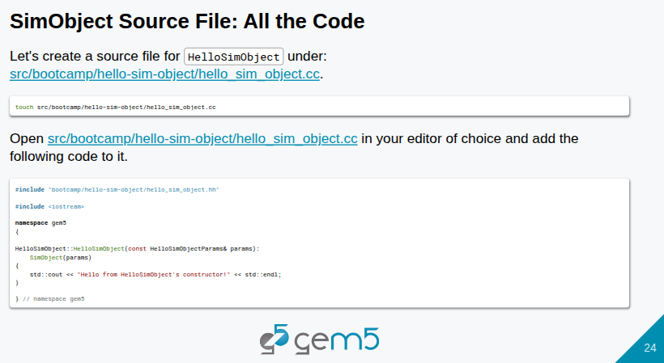
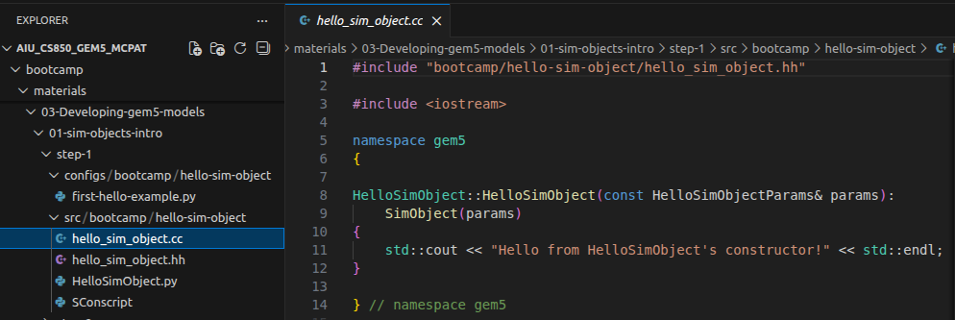
16.3 Step 1: Simple SimObject
https://www.youtube.com/watch?v=4eHSdpX-hYU&list=PL_hVbFs_loVR_8ntTTmmG6YEq3Po_4snu&index=16
Step 1: Simple SimObject (28:06-28:40/35:10)
> code src/bootcamp/hello-sim-object/hello_sim_object.cc # Correction as below:
> code ~/materials/03-Devloping-gem5-models/01-sim-objects-intro/step-1/src/bootcamp/hello-sim-object/hello_sim_object.cc
For Gem5 Convention, we include
1. the header file for SimObject first.
2. Then, C++, and
3. Then Gem5.
1
2
3

Slide 42
16.3 Step 1: Simple SimObject
https://www.youtube.com/watch?v=4eHSdpX-hYU&list=PL_hVbFs_loVR_8ntTTmmG6YEq3Po_4snu&index=16
Step 1: Simple SimObject (28:41-29:15/35:10)
> code src/bootcamp/hello-sim-object/hello_sim_object.cc # Correction as below:
> code ~/materials/03-Devloping-gem5-models/01-sim-objects-intro/step-1/src/bootcamp/hello-sim-object/hello_sim_object.cc
4. We define the HelloSimObject constructor. We have class name HelloSimObject, “::”, and then constructor HelloSimObject.
5. We passed in the parameter params with type “const HelloSimObjectParam”
6. We initialize the SimObject() with the parameters params.
5
4
6

Slide 43
16.3 Step 1: Simple SimObject
https://www.youtube.com/watch?v=4eHSdpX-hYU&list=PL_hVbFs_loVR_8ntTTmmG6YEq3Po_4snu&index=16
Step 1: Simple SimObject (29:16-29:50/35:10)
> code src/bootcamp/hello-sim-object/hello_sim_object.cc # Correction as below:
> code ~/materials/03-Devloping-gem5-models/01-sim-objects-intro/step-1/src/bootcamp/hello-sim-object/hello_sim_object.cc
In the constructor, we
7. Use iostream function cout to print the message.
8. Print the message “Hello from the HelloSimObject constructor”.
In simulation, we never print the message for better performance.
7
8

Slide 44
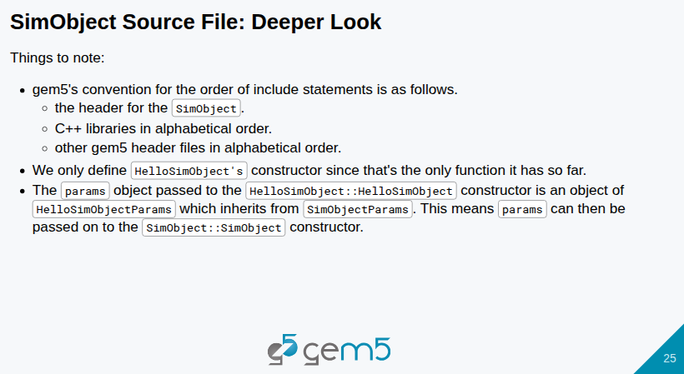
16.3 Step 1: Simple SimObject
https://www.youtube.com/watch?v=4eHSdpX-hYU&list=PL_hVbFs_loVR_8ntTTmmG6YEq3Po_4snu&index=16
Step 1: Simple SimObject (30:01-30:05/35:10)
> code hhsrc/bootcamp/hello-sim-object/HelloSimObject.py # Correction as below:
> code ~/materials/03-Devloping-gem5-models/01-sim-objects-intro/step-1/src/bootcamp/hello-sim-object/hello_sim_object.cc
Note:
1. Gem5 convention: SimObject header, C++ Library, Gem5 header file.
2. Constructor function Example: HelloSimObject
3. Parameter Params Object inherit from SimObjectParams. Parameter Params Object passed into SimObject constructor function.

Slide 45
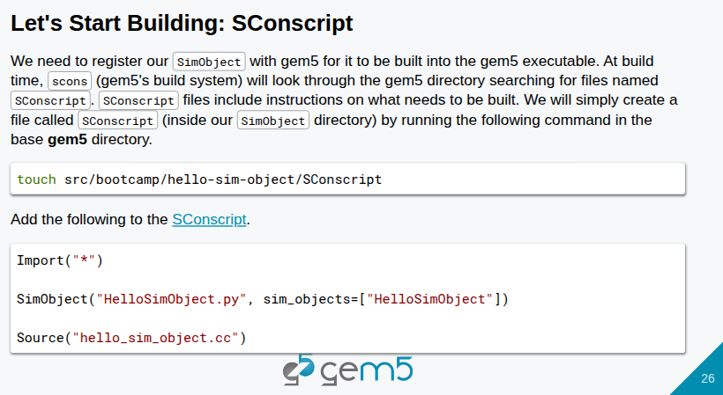
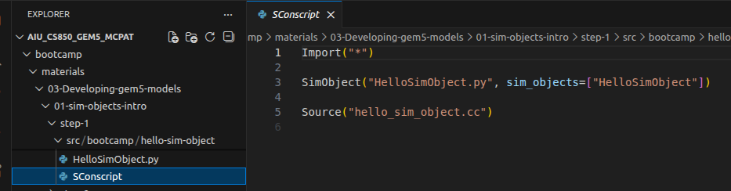
16.3 Step 1: Simple SimObject
https://www.youtube.com/watch?v=4eHSdpX-hYU&list=PL_hVbFs_loVR_8ntTTmmG6YEq3Po_4snu&index=16
Step 1: Simple SimObject (30:01-31:00/35:10)
> code src/bootcamp/hello-sim-object/SConscript # Correction as below:
> code ~/materials/03-Devloping-gem5-models/01-sim-objects-intro/step-1/src/bootcamp/hello-sim-object/SConscript
We register the SimObject with Gem5 executable with SConscript as below:
1. Create the SConscript in the same directory hello-sim-object.
2. scons search for SConscript for registration.

Slide 46
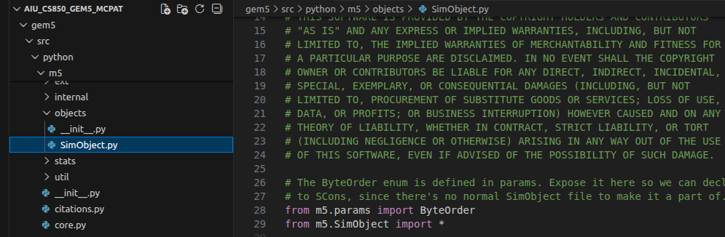
16.3 Step 1: Simple SimObject
https://www.youtube.com/watch?v=4eHSdpX-hYU&list=PL_hVbFs_loVR_8ntTTmmG6YEq3Po_4snu&index=16
Step 1: Simple SimObject (31:01-32:30/35:10)
> code src/bootcamp/hello-sim-object/SConscript # Correction as below:
> code ~/materials/03-Devloping-gem5-models/01-sim-objects-intro/step-1/src/bootcamp/hello-sim-object/SConscript
The SConscript
1. The SimObject.py defined all the m5 SimObject. SimObject.py is located at
> gem5/src/python/m5/objects/SimObject.py
2. The SConscript import all gem5 libraries and defined all the application (HelloSimObject.py) located under our application folder hello-sim-object. We can define multiple SimObject in this folder.
3. After, we defined SConscript, we can compile it with “scons build”.

Slide 47
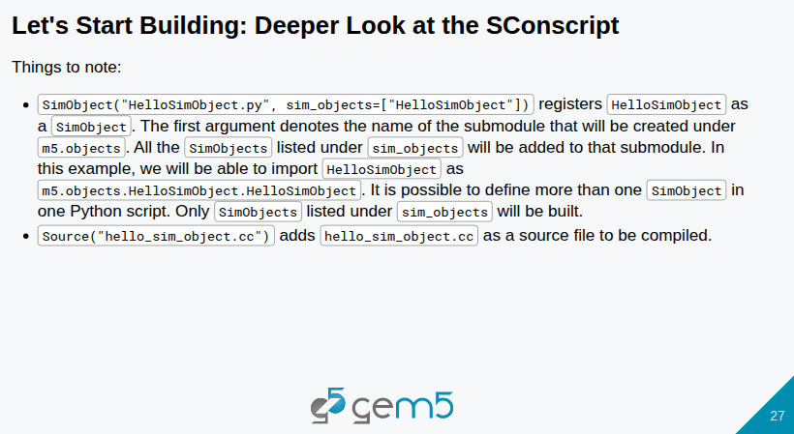
16.3 Step 1: Simple SimObject
https://www.youtube.com/watch?v=4eHSdpX-hYU&list=PL_hVbFs_loVR_8ntTTmmG6YEq3Po_4snu&index=16
Step 1: Simple SimObject (32:31-32:40/35:10)
> code src/bootcamp/hello-sim-object/SConscript # Correction as below:
> code ~/materials/03-Devloping-gem5-models/01-sim-objects-intro/step-1/src/bootcamp/hello-sim-object/SConscript
Note:
1. SimObject (“HelloSimObject.py”, sim_objects=[“HelloSimObject”) register the HelloSimObject as a SimObject.
2. source (“hello_sim_object.cc” add hello_sim_object.cc as source file for comiliation.

Slide 48
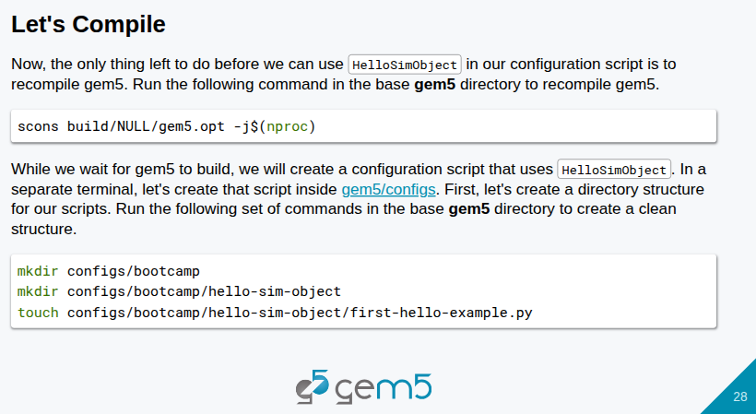
16.3 Step 1: Simple SimObject
https://www.youtube.com/watch?v=4eHSdpX-hYU&list=PL_hVbFs_loVR_8ntTTmmG6YEq3Po_4snu&index=16
Step 1: Simple SimObject (32:41-33:00/35:10)
> code src/bootcamp/hello-sim-object/SConscript # Correction as below:
> code ~/materials/03-Devloping-gem5-models/01-sim-objects-intro/step-1/src/bootcamp/hello-sim-object/SConscript
Let’s compile:

Slide 49
16.3 Step 1: Simple SimObject
https://www.youtube.com/watch?v=4eHSdpX-hYU&list=PL_hVbFs_loVR_8ntTTmmG6YEq3Po_4snu&index=16
Step 1: Simple SimObject (31:01-32:40/35:10)
> code src/bootcamp/hello-sim-object/SConscript # Correction as below:
> code ~/materials/03-Devloping-gem5-models/01-sim-objects-intro/step-1/src/bootcamp/hello-sim-object/SConscript
The SConscript
1. The SimObject.py defined all the m5 SimObject. SimObject.py is located at
> gem5/src/python/m5/objects/SimObject.py
2. The SConscript import all gem5 libraries and defined all the application (HelloSimObject.py) located under our application folder hello-sim-object. We can define multiple SimObject in this folder.
3. After, we defined SConscript, we can compile it with “scons build”.

Slide 50
End

