Slide 1

5 Resource
Peter H. Chen

Slide 2
5.0 Resource
https://www.youtube.com/watch?v=pCJSuYHv9WE&list=PL_hVbFs_loVR_8ntTTmmG6YEq3Po_4snu&index=5
Topics (0:00-0:01/23:39)
1.

Slide 3
5.1 Gem5 Resource

Slide 4

5.1 Gem5 Resource
https://www.youtube.com/watch?v=pCJSuYHv9WE&list=PL_hVbFs_loVR_8ntTTmmG6YEq3Po_4snu&index=5
Gem5 Resource (0:02-0:29/23:39)
We talk about Gem5 resource.

Slide 5
5.2 What are Gem5 Resources

Slide 6
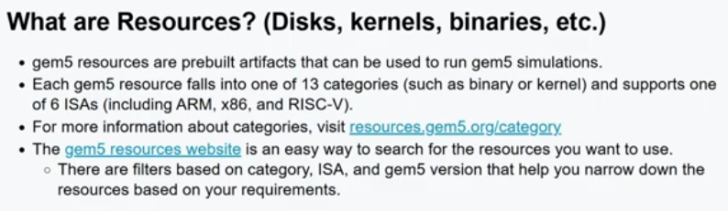
5.2 What are Gem5 Resources
https://www.youtube.com/watch?v=pCJSuYHv9WE&list=PL_hVbFs_loVR_8ntTTmmG6YEq3Po_4snu&index=5
What are Gem5 Resources (0:30-0:47/23:39)
Gem5 resources are prebuilt simulator. Currenlty, Gem5 resources are separated into 15 categories.
1. Types of resources: Kernels (pre-built Kernels for ARM, X86, RISC-V). Disk images (Pre-built disk images containing OS, such as, Ubuntu), binaries: Standalone applications.
2. Gem5 resources also separated by 6 ISA (ARM, X86, RISC-V, etc)
https://resources.gem5.org/category

Slide 7
5.3 Gem5 Resource Category

Slide 8
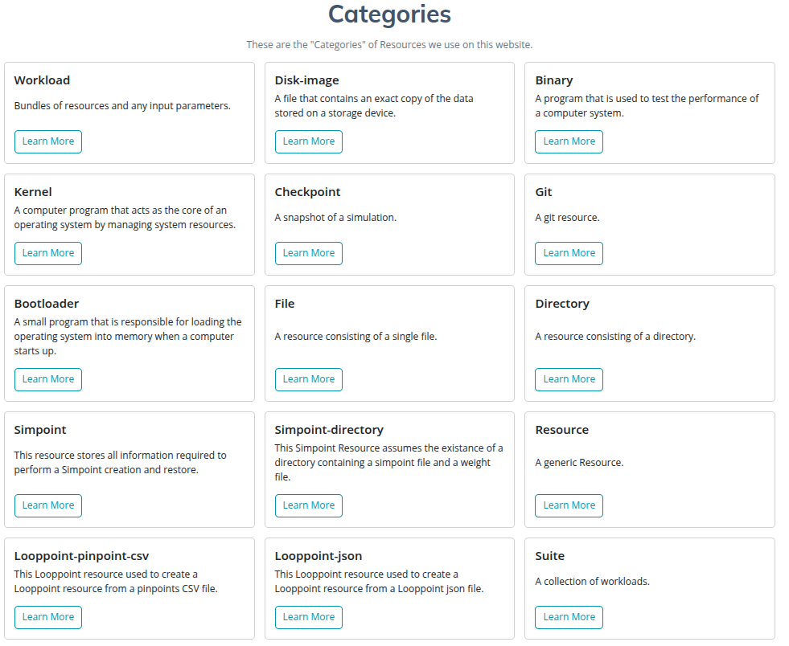
5.3 Gem5 Resource Category
https://www.youtube.com/watch?v=pCJSuYHv9WE&list=PL_hVbFs_loVR_8ntTTmmG6YEq3Po_4snu&index=5
Gem5 Resource Category (0:48-1:10/23:39)
Below are Gem5 15 prebuilt resource Category.
1. We have workloads which are a bundle of one or more resources which with preset parameters that you can directly run. An example of it would be like booting a full system Ubuntu.
https://resources.gem5.org/category

Slide 9
5.3 Gem5 Resource Category
https://www.youtube.com/watch?v=pCJSuYHv9WE&list=PL_hVbFs_loVR_8ntTTmmG6YEq3Po_4snu&index=5
Gem5 Resource Category (1:11-1:23/23:39)
2. We have a preset kernel, disk image
3. We have binaries which are pre-compiled programs which we can directly run.
4. We have checkpoints and Simpoints for snapshot of our simulation and resume that at a later point and time.
https://resources.gem5.org/category

Slide 10
5.3 Gem5 Resource Category
https://www.youtube.com/watch?v=pCJSuYHv9WE&list=PL_hVbFs_loVR_8ntTTmmG6YEq3Po_4snu&index=5
Gem5 Resource Category (1:24-1:45/23:39)
5. We have boot loaders.
6. We have a simple file resource if we a file in a simulation.
So, those are the resource types we have in gem 5.
https://resources.gem5.org/category

Slide 11
5.4 Gem5 Resource: Started

Slide 12
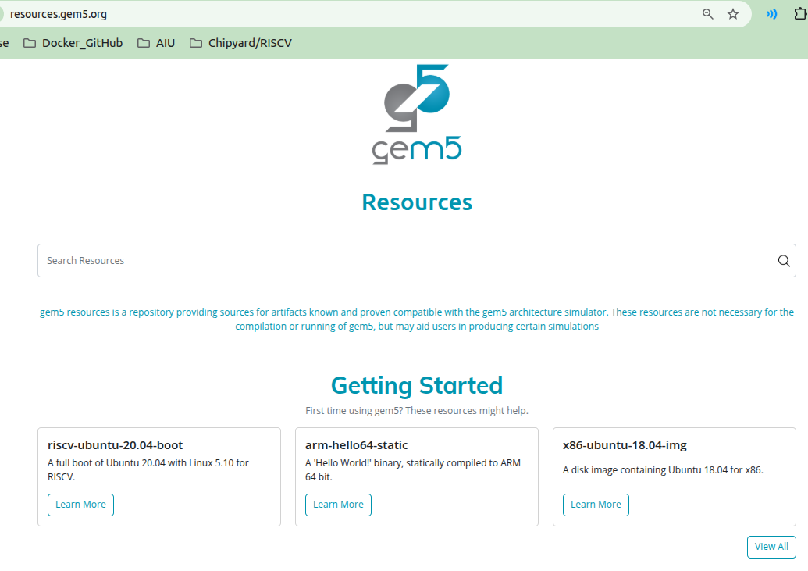
5.4 Gem5 Resource: Started
https://www.youtube.com/watch?v=pCJSuYHv9WE&list=PL_hVbFs_loVR_8ntTTmmG6YEq3Po_4snu&index=5
Gem5 Resource: Started (1:46-1:53/23:39)
Here, we start the Gem5 resources.
https://resources.gem5.org/

Slide 13
5.5 Ubuntu boot

Slide 14
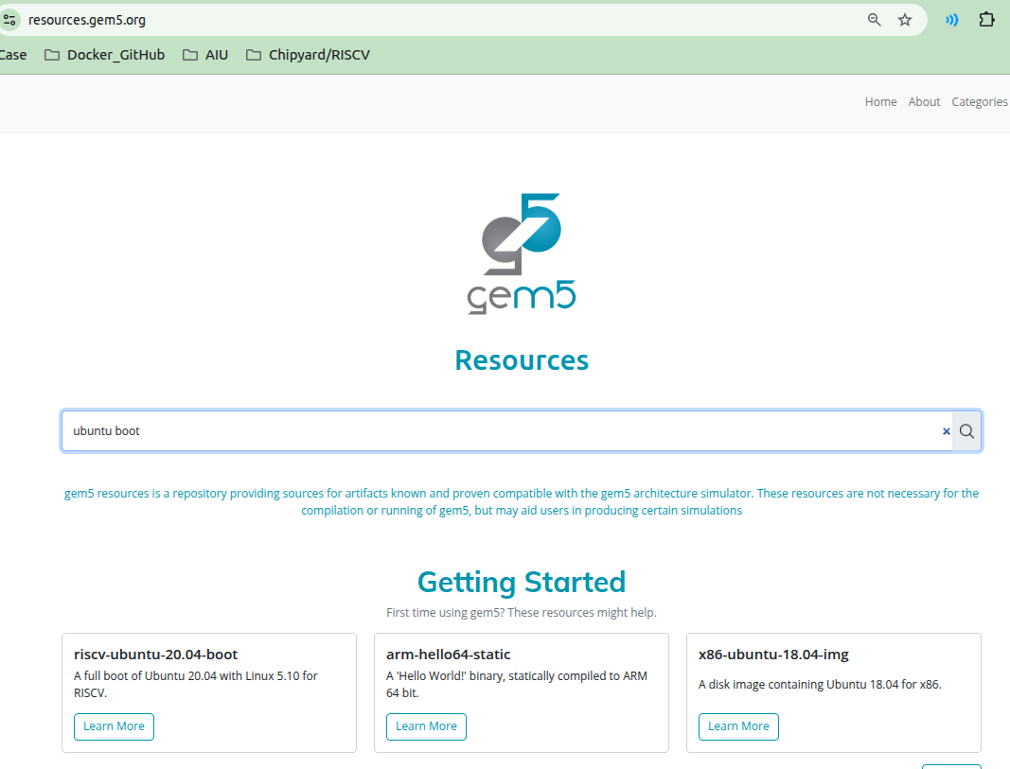
5.5 Ubuntu boot
https://www.youtube.com/watch?v=pCJSuYHv9WE&list=PL_hVbFs_loVR_8ntTTmmG6YEq3Po_4snu&index=5
Ubuntu Boot (1:54-2:00/23:39)
We can search “Ubuntu boot workload” by typing “ubuntu boot”.
https://resources.gem5.org/

Slide 15
5.6 RISCV Ubuntu boot

Slide 16
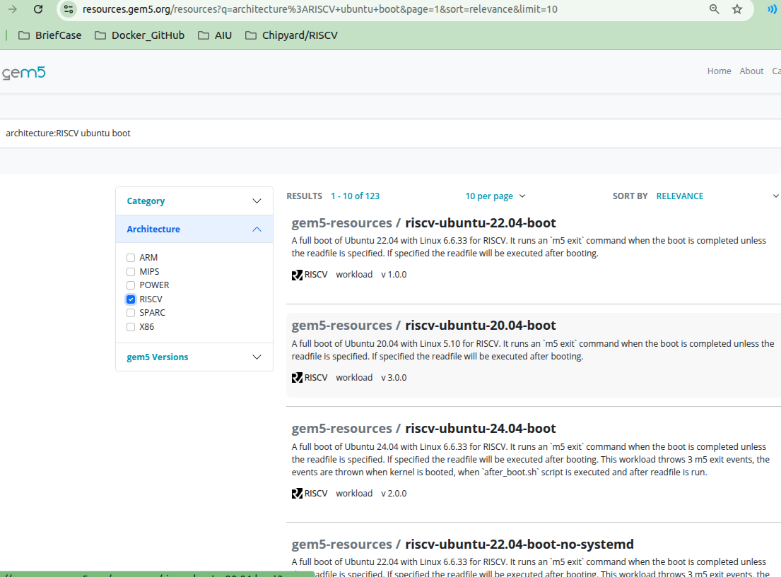
5.6 RISCV Ubuntu boot
https://www.youtube.com/watch?v=pCJSuYHv9WE&list=PL_hVbFs_loVR_8ntTTmmG6YEq3Po_4snu&index=5
RISCV Ubuntu Boot (2:01-2:03/23:39)
1. Below, we a list of Ubuntu boot workload.
2. If we want the RISC-V, we can select Architecture > RISCV for RISCV filter selection.
https://resources.gem5.org/

Slide 17
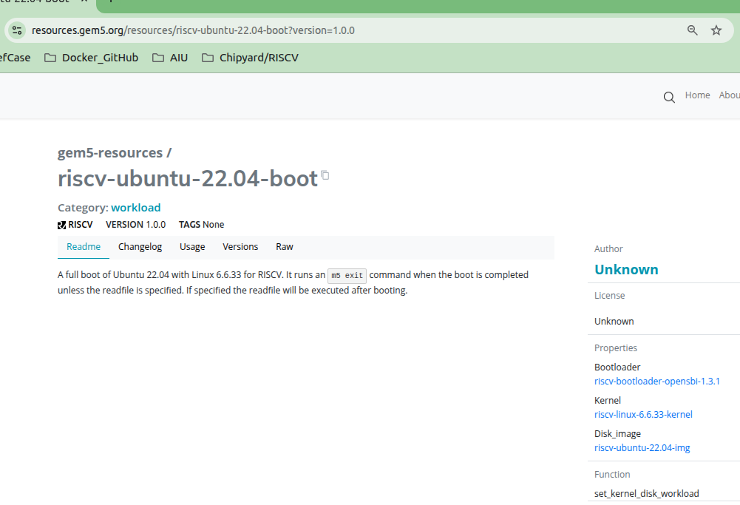
5.6 RISCV Ubuntu boot
https://www.youtube.com/watch?v=pCJSuYHv9WE&list=PL_hVbFs_loVR_8ntTTmmG6YEq3Po_4snu&index=5
RISCV Ubuntu Boot (2:04-2:19/23:39)
Below, we have RISCV boot workload.
On the right below, we can select “Disk Image”
https://resources.gem5.org/

Slide 18
5.7 RISCV Ubuntu Disk Image

Slide 19
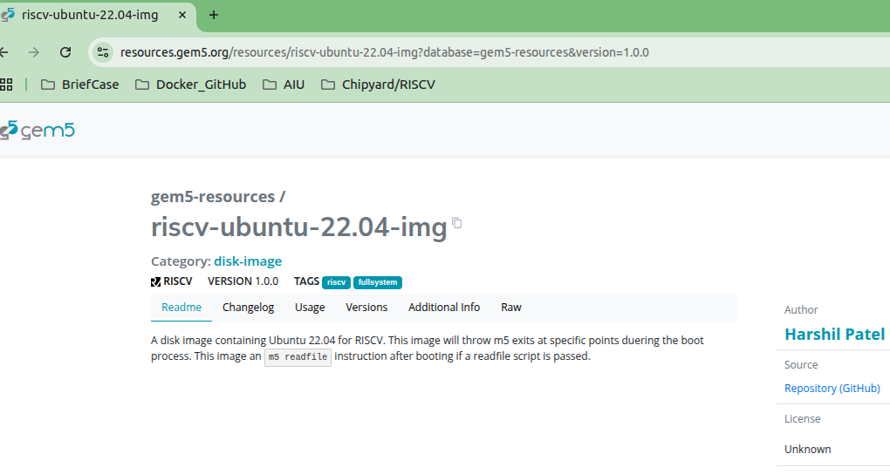
5.7 RISCV Ubuntu Disk Image
https://www.youtube.com/watch?v=pCJSuYHv9WE&list=PL_hVbFs_loVR_8ntTTmmG6YEq3Po_4snu&index=5
RISCV Ubuntu Disk Image (2:20-2:30/23:39)
Below, we have the disk image for RISCV Ubuntu 22.04.
https://resources.gem5.org/

Slide 20
5.8 RISCV Resource

Slide 21
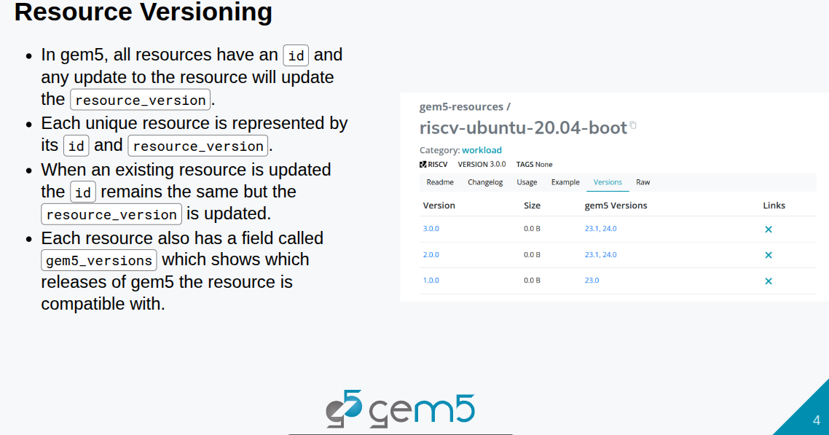
5.8 RISCV Resource
https://www.youtube.com/watch?v=pCJSuYHv9WE&list=PL_hVbFs_loVR_8ntTTmmG6YEq3Po_4snu&index=5
RISCV Resource (2:31-3:47/23:39)
We can use either RISCV Ubuntu Boot resource or Disk Image resource to run the simulation.
1. Each resource has unique ID and resource version.
2. Each resource release is compatible with particular version of Gem5 version.
https://resources.gem5.org/

Slide 22
5.9 Gem5 Resource for Simulation

Slide 23
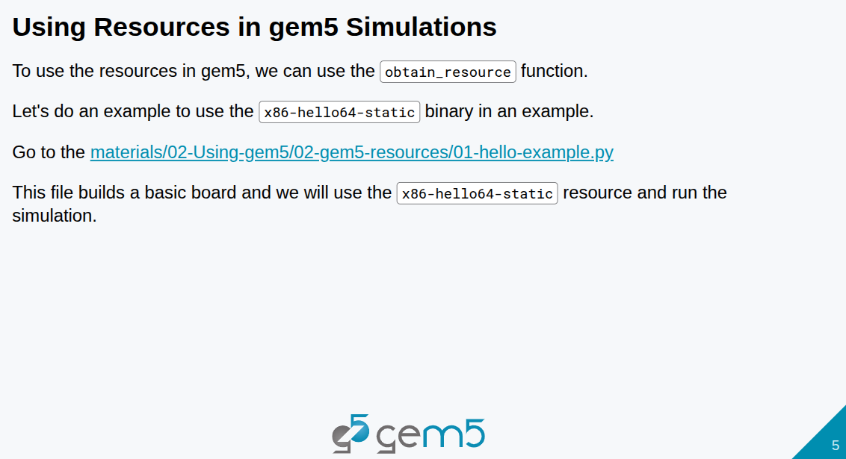
5.9 Gem5 Resource for Simulation
https://www.youtube.com/watch?v=pCJSuYHv9WE&list=PL_hVbFs_loVR_8ntTTmmG6YEq3Po_4snu&index=5
Gem5 Resource for Simulation (3:48-4:10/23:39)
We can use obtain_resource function to get the simulator.

Slide 24
5.10 Hello Example: Set Resource Binary

Slide 25
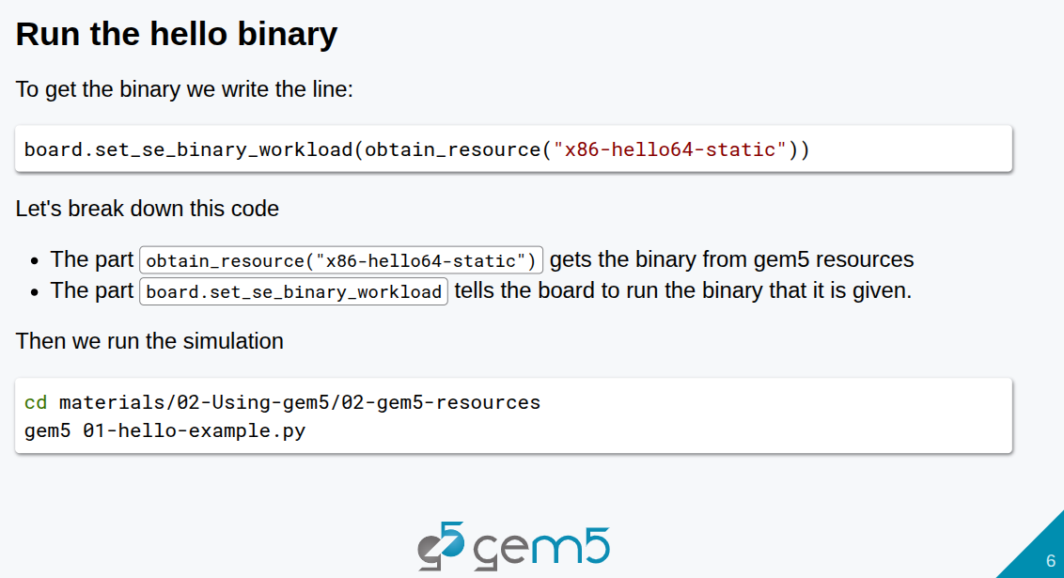
5.10 Hello Example: Set Resource Binary
https://www.youtube.com/watch?v=pCJSuYHv9WE&list=PL_hVbFs_loVR_8ntTTmmG6YEq3Po_4snu&index=5
Hello Example: Set Resource Binary (4:11-4:30/23:39)
In the materials/02-gem5-resources/complete/01-hello-example.py.
We use obtain_resource() to get the binary “x86-hello64-static”

Slide 26
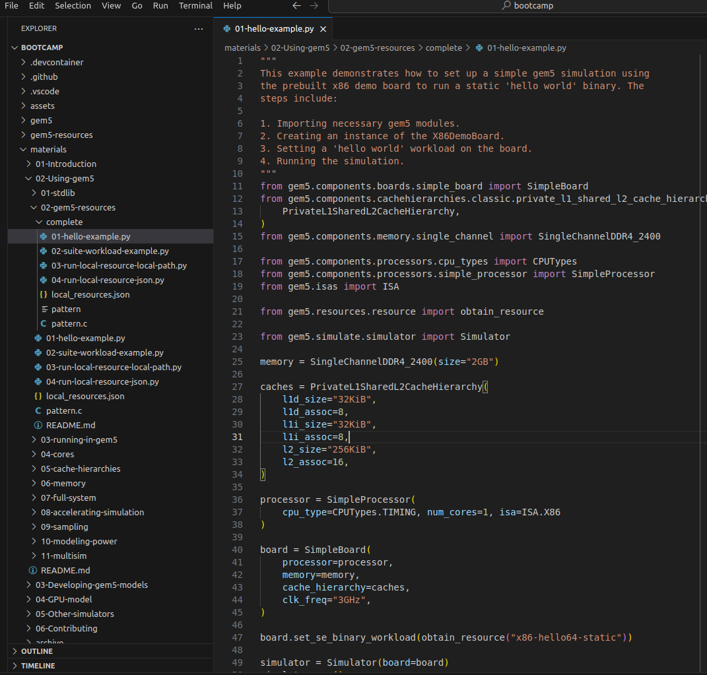
5.10 Hello Example: Set Resource Binary
https://www.youtube.com/watch?v=pCJSuYHv9WE&list=PL_hVbFs_loVR_8ntTTmmG6YEq3Po_4snu&index=5
Hello Example: Set Resource Binary (4:31-5:20/23:39)
In the materials/02-gem5-resources/complete/01-hello-example.py.
Here, we use obtain_resource (“x86-hello64-static”) to add the binary.

Slide 27
5.11 Run Hello Example

Slide 28
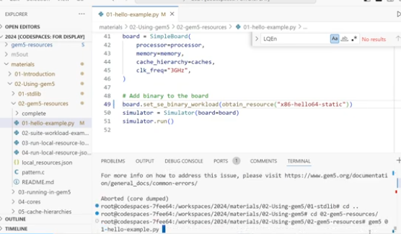
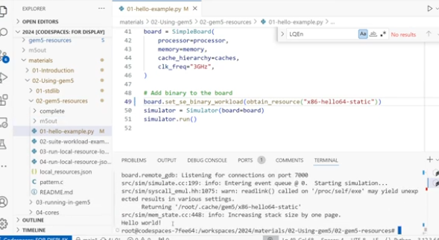
5.11 Run Hello Example
https://www.youtube.com/watch?v=pCJSuYHv9WE&list=PL_hVbFs_loVR_8ntTTmmG6YEq3Po_4snu&index=5
Run Hello Example (5:21-5:46/23:39)
We run the 01-hello-example.py
materials/02-gem5-resources/complete> gem5 01-hello-example.py
>> Hello world!

Slide 29
5.12 Workload

Slide 30
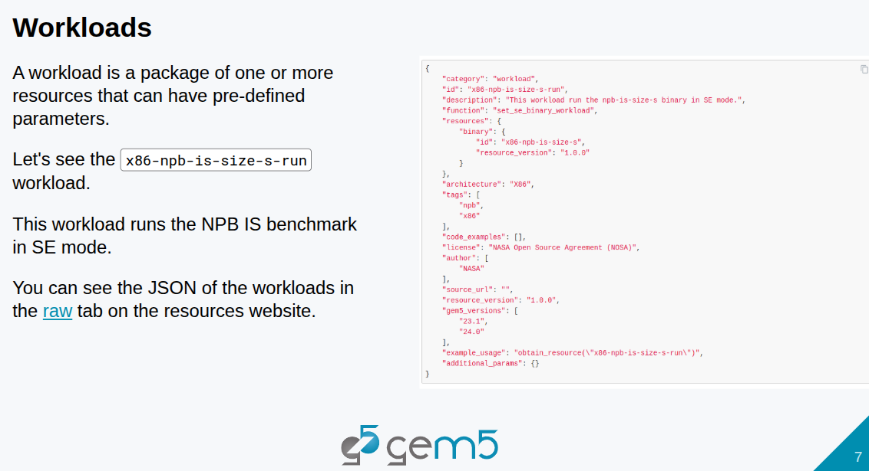
5.12 Workload
https://www.youtube.com/watch?v=pCJSuYHv9WE&list=PL_hVbFs_loVR_8ntTTmmG6YEq3Po_4snu&index=5
Workload (5:47-6:00/23:39)
Now, we look at workload. Workload let us run proper program.
Workload can be characterized as containing one or more resources with a preset predefined parameters.
Below, we have workload “x86-npb-is-size-s-run” which is standard benchmark test for a parallel supercomputer. It is an integer sort (IS) workload from NPB (NASA Parallel Benchmark) suite, compiled and run on X86-based system (SE, Standard Environment binary mode) using predefined “Size S” dataset.

Slide 31
5.12 Workload
https://www.youtube.com/watch?v=pCJSuYHv9WE&list=PL_hVbFs_loVR_8ntTTmmG6YEq3Po_4snu&index=5
Workload (6:01-7:00/23:39)
In the JSON file, it specify what ID (x86-npb-is-size-s) and resource version (1.0.0)

Slide 32
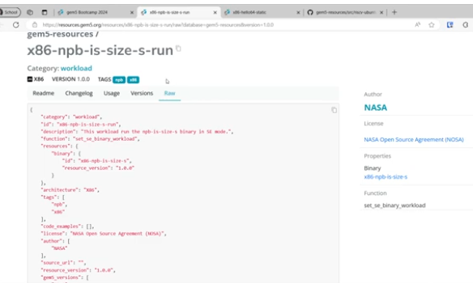
5.12 Workload
https://www.youtube.com/watch?v=pCJSuYHv9WE&list=PL_hVbFs_loVR_8ntTTmmG6YEq3Po_4snu&index=5
Workload (7:01-7:05/23:39)
In Category workload, we can see more configuration.

Slide 33
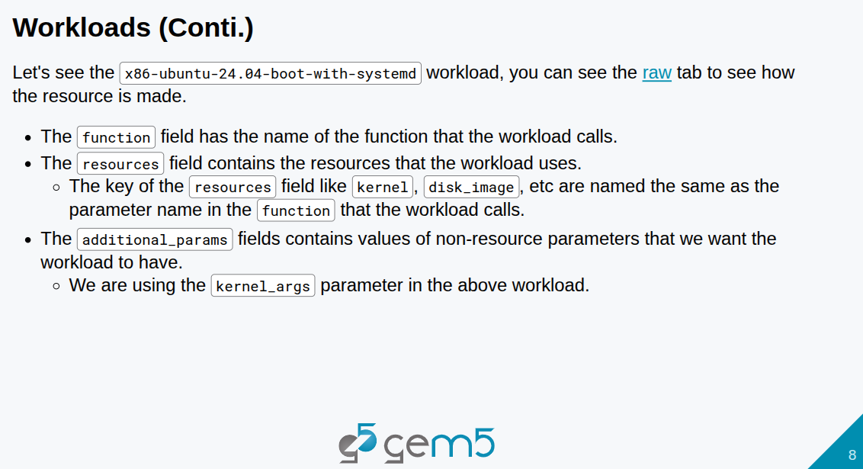
5.12 Workload
https://www.youtube.com/watch?v=pCJSuYHv9WE&list=PL_hVbFs_loVR_8ntTTmmG6YEq3Po_4snu&index=5
Workload (7:06-7:14/23:39)
In Category workload, we can see full system workload. We have x86 ubuntu 24.04 boot with system d.

Slide 34
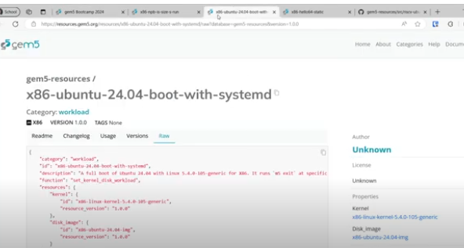
5.12 Workload
https://www.youtube.com/watch?v=pCJSuYHv9WE&list=PL_hVbFs_loVR_8ntTTmmG6YEq3Po_4snu&index=5
Workload (7:15-7:26/23:39)
This will boot ubuntu 24.04 for our full system simulation.

Slide 35
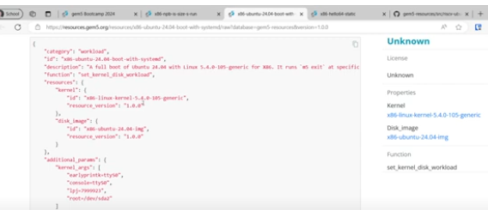
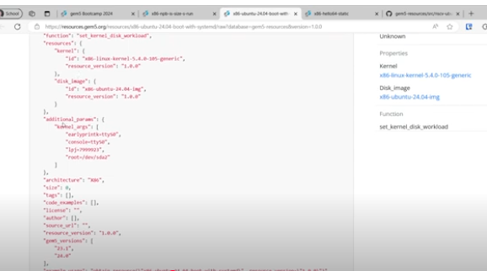
5.12 Workload
https://www.youtube.com/watch?v=pCJSuYHv9WE&list=PL_hVbFs_loVR_8ntTTmmG6YEq3Po_4snu&index=5
Workload (7:27-7:53/23:39)
Here, we are using the Linux 5.4.0.105 generic kernel and an X86 Ubuntu 24.4.
We run different function that is a set kernel dis workload function.
We also have additional parameters in the field.

Slide 36
5.13 Suite

Slide 37
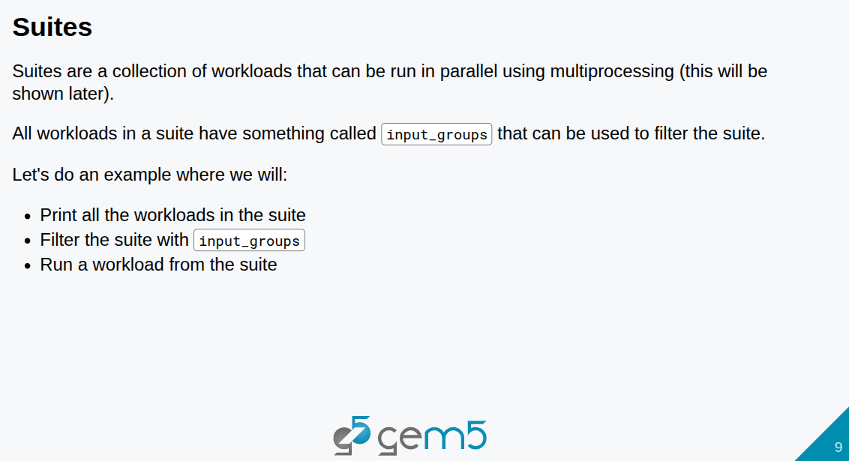
5.13 Suite
https://www.youtube.com/watch?v=pCJSuYHv9WE&list=PL_hVbFs_loVR_8ntTTmmG6YEq3Po_4snu&index=5
Suite (7:54-8:59/23:39)
Suites are a collection of workloads that can be run in parallel using multiprocessing.
For example, npb (NASA Parallel Benchmark) suite has all different benchmarks of workloads.
With npb suite, we can run different workloads.
In a suite, we have something called input_groups that can be used to filter the suite to select the desired workload in the suite.

Slide 38
5.14 Suite Example

Slide 39
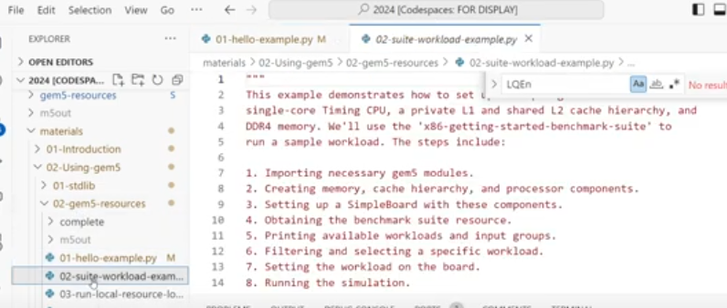
5.14 Suite Example
https://www.youtube.com/watch?v=pCJSuYHv9WE&list=PL_hVbFs_loVR_8ntTTmmG6YEq3Po_4snu&index=5
Suite Example (9:00-10:00/23:39)
In the materials/02-using-hem5/02-gem5-resources/02-suite-workload.py

Slide 40
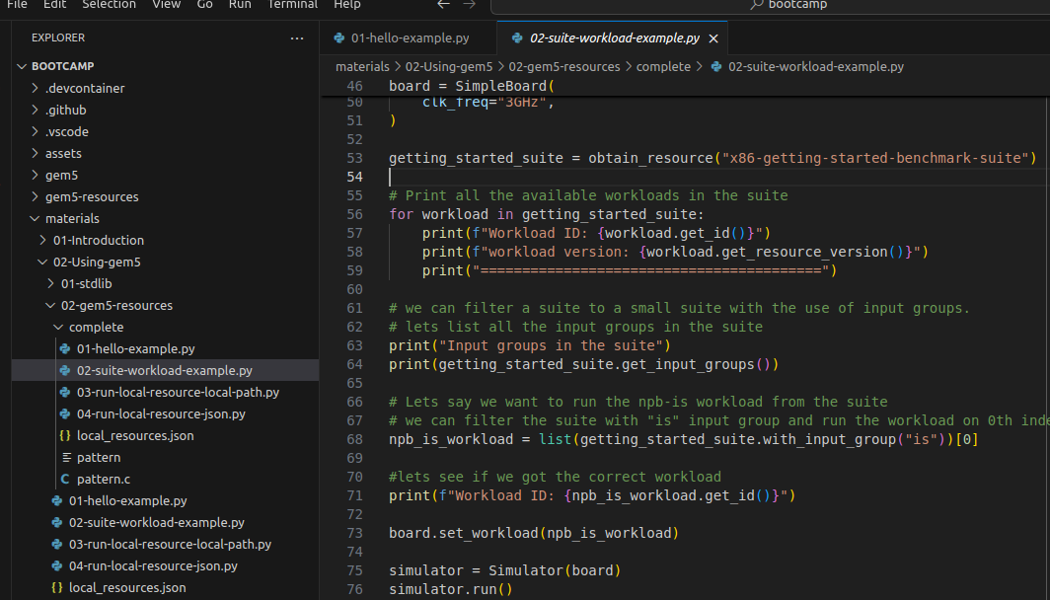
5.14 Suite Example
https://www.youtube.com/watch?v=pCJSuYHv9WE&list=PL_hVbFs_loVR_8ntTTmmG6YEq3Po_4snu&index=5
Suite Example (10:00-11:35/23:39)
In the materials/02-using-hem5/02-gem5-resources/complete/02-suite-workload.py
1. We print all the available workloads in the suite.
> getting_started_suite =obtain_resource (“x86-getting-started-benchmark”)
2. loop for all the workloads
> for workload in getting_started_suite:
> print workload ID
> print workload version

Slide 41
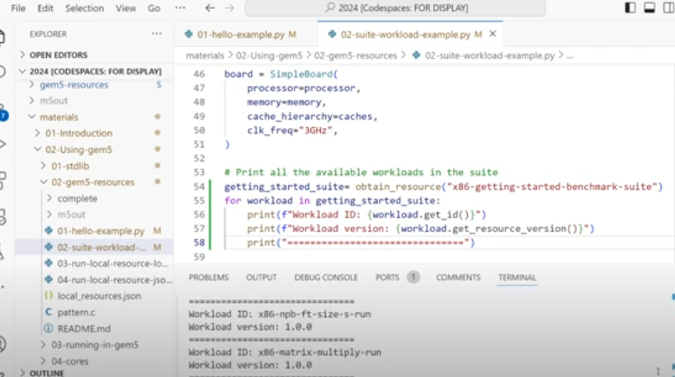
5.14 Suite Example
https://www.youtube.com/watch?v=pCJSuYHv9WE&list=PL_hVbFs_loVR_8ntTTmmG6YEq3Po_4snu&index=5
Suite Example (11:36-11:56/23:39)
We run it. Here, we can see all the workloads we have in this suite.

Slide 42
5.14 Suite Example
https://www.youtube.com/watch?v=pCJSuYHv9WE&list=PL_hVbFs_loVR_8ntTTmmG6YEq3Po_4snu&index=5
Suite Example (11:57-12:32/23:39)
Now, we print all the input_groups
> print getting_started_suite.get_input_groups()

Slide 43
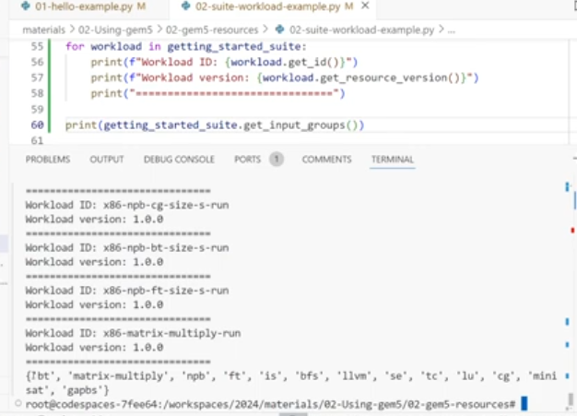
5.14 Suite Example
https://www.youtube.com/watch?v=pCJSuYHv9WE&list=PL_hVbFs_loVR_8ntTTmmG6YEq3Po_4snu&index=5
Suite Example (12:33-12:41/23:39)
Here, we can see the input groups for this suite.
Each workloads are provided by the input group.

Slide 44
5.14 Suite Example
https://www.youtube.com/watch?v=pCJSuYHv9WE&list=PL_hVbFs_loVR_8ntTTmmG6YEq3Po_4snu&index=5
Suite Example (11:42-14:36/23:39)
1. Now, we want to use npb is (NASA Parallel Benchmark integer sort for integer list in memory) workload for the benchmark.
> npb_is_workload = list (getting_started_suite.with_input_group (“is”))[0]
2. Print the workload ID of benchmark
3. set workload board
4. get the simulator
5. run simulator

Slide 45
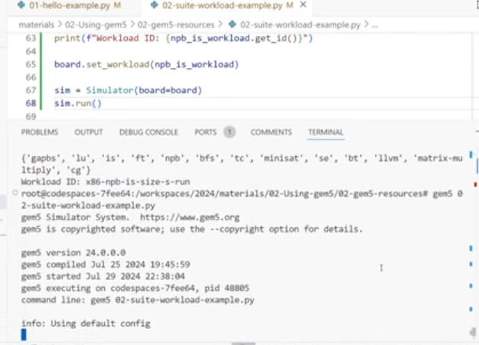
5.14 Suite Example
https://www.youtube.com/watch?v=pCJSuYHv9WE&list=PL_hVbFs_loVR_8ntTTmmG6YEq3Po_4snu&index=5
Suite Example (14:37-14:45/23:39)
Run the npb is workload for benchmark.

Slide 46
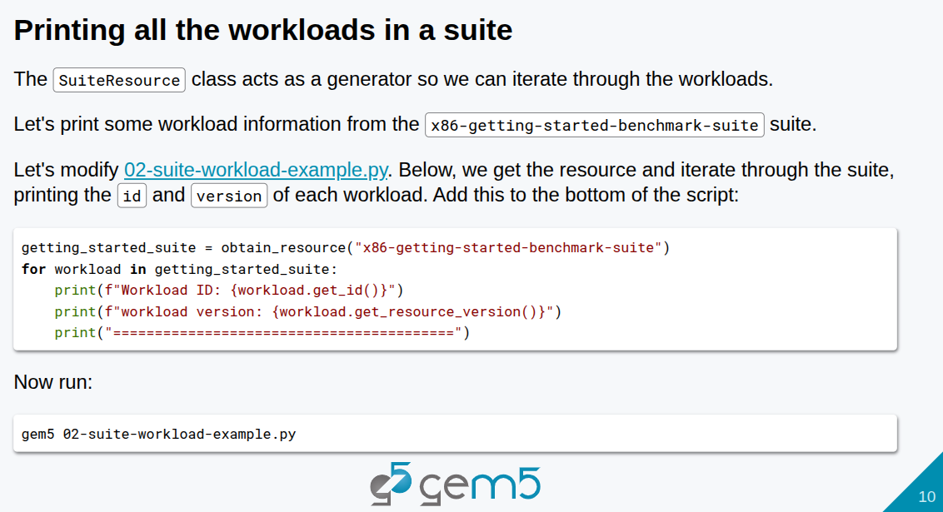
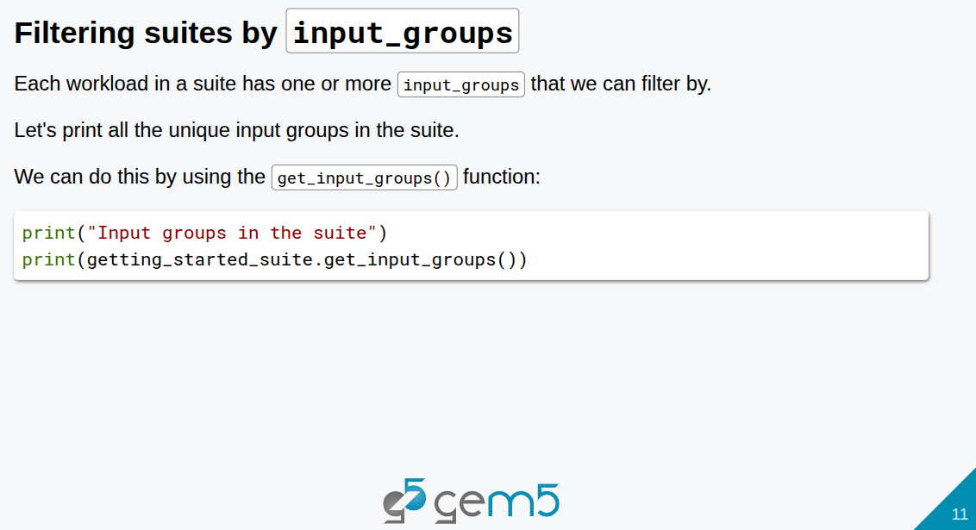
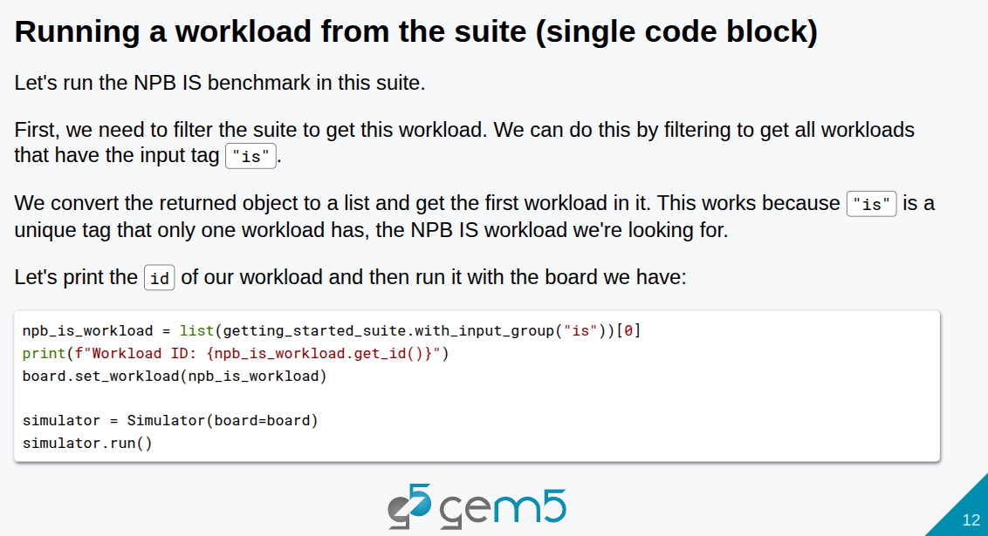
5.14 Suite Example
https://www.youtube.com/watch?v=pCJSuYHv9WE&list=PL_hVbFs_loVR_8ntTTmmG6YEq3Po_4snu&index=5
Suite Example (14:46-14:50/23:39)
Below are all the explanations of print workload, get input groups, and run a workload of the suite.

Slide 47
5.15 Local Resource

Slide 48
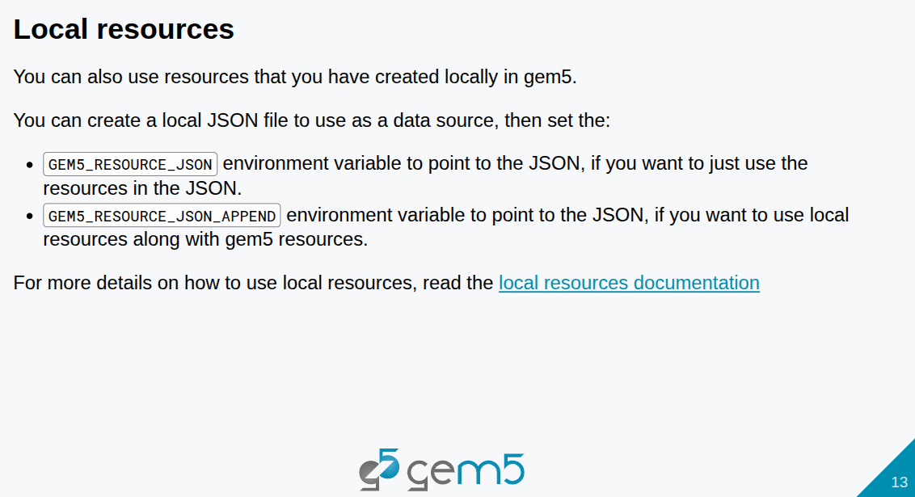
5.15 Local Resource
https://www.youtube.com/watch?v=pCJSuYHv9WE&list=PL_hVbFs_loVR_8ntTTmmG6YEq3Po_4snu&index=5
Local Resource (14:51-16:30/23:39)
Now, we want to talk about the Local Resource. In Gem5, we can create the local resource by JSON file. We can use the environment variable:
1. GEM5_RESOURCE_JSON to point to the JSON file for the local resource data.
2. GEM5_RESOURCE_JSON_APPEND for another JSON file for another local resource data
https://www.gem5.org/documentation/gem5-stdlib/using-local-resources

Slide 49
5.16 Why Use Local Resource

Slide 50
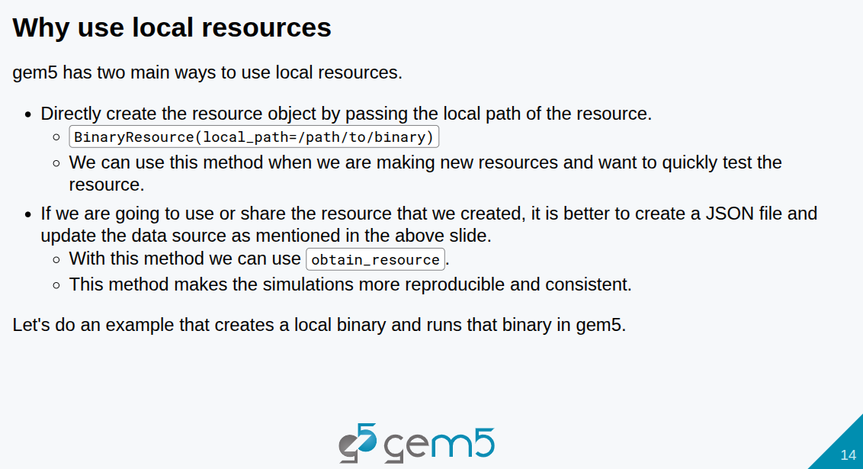
5.16 Why Use Local Resource
https://www.youtube.com/watch?v=pCJSuYHv9WE&list=PL_hVbFs_loVR_8ntTTmmG6YEq3Po_4snu&index=5
Why Use Local Resource (16:31-17:29/23:39)
Why do we need the local resource?
We can use local resource method:
1. If we work on some resource and we update it and keep it.
2. If we create some resource and want to share with others.
We can create a binary and use obtain_resource to to update the resource we created.

Slide 51
5.17 Create Local Binary Resource

Slide 52
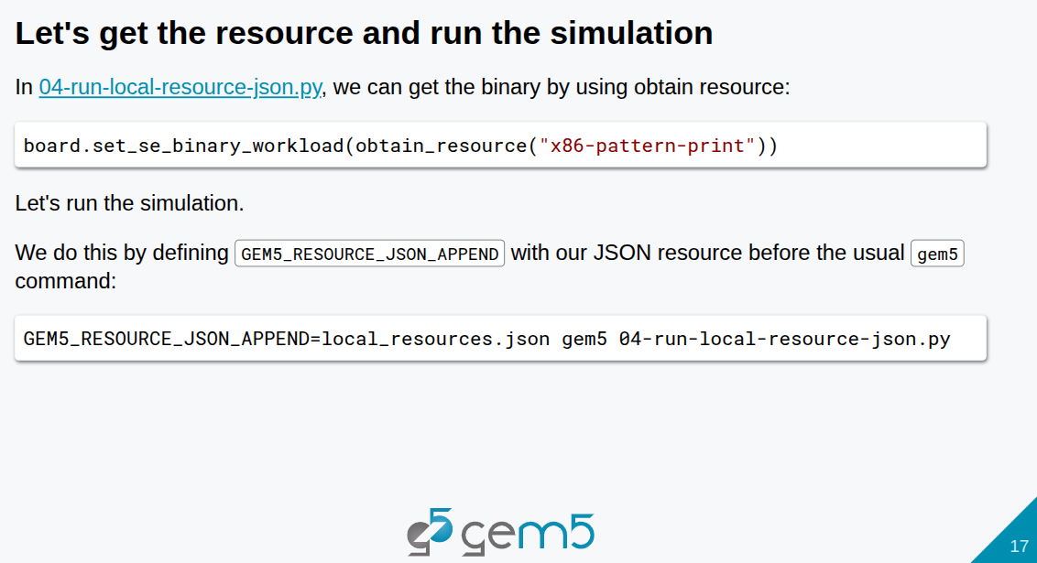
5.17 Create Local Binary Resource
https://www.youtube.com/watch?v=pCJSuYHv9WE&list=PL_hVbFs_loVR_8ntTTmmG6YEq3Po_4snu&index=5
Create Local Binary Resource (17:30-18:30/23:39)
Below, we create our local binary resource:
1. Use obtain_resource () to obtain the resource we create.
2. Create a binary by board.set_se_binary_workload()

Slide 53
End

