Slide 1

6.1 Run Gem5: Slides
Peter H. Chen

Slide 2

5.1 Run Gem5: Slides
https://gem5bootcamp.github.io/2024/#02-Using-gem5/03-running-in-gem5
Run Gem5: Slides

Slide 3
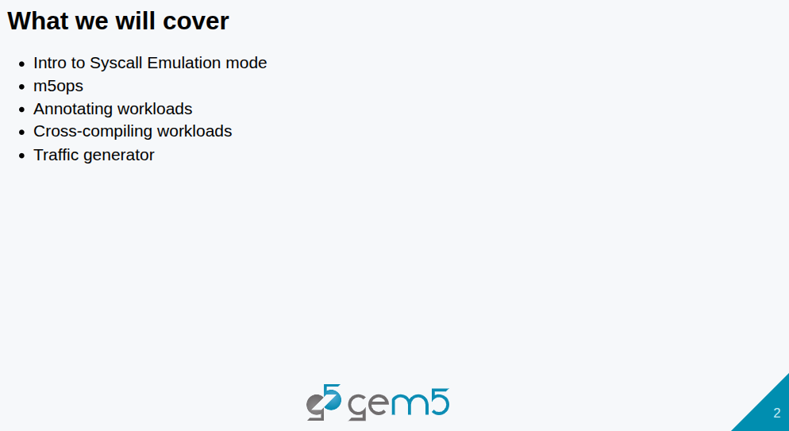
5.1 Run Gem5: Slides
https://gem5bootcamp.github.io/2024/#02-Using-gem5/03-running-in-gem5
Run Gem5: Slides

Slide 4
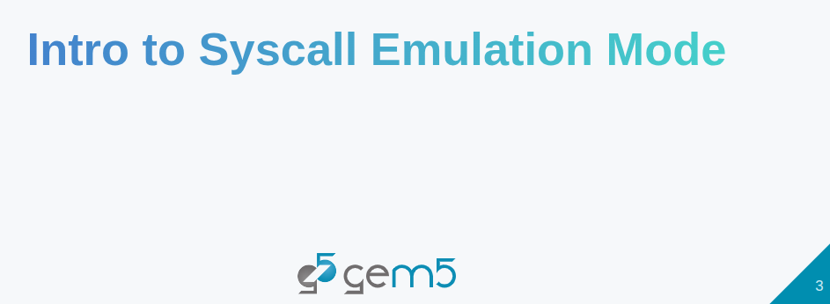
5.1 Run Gem5: Slides
https://gem5bootcamp.github.io/2024/#02-Using-gem5/03-running-in-gem5
Run Gem5: Slides

Slide 5
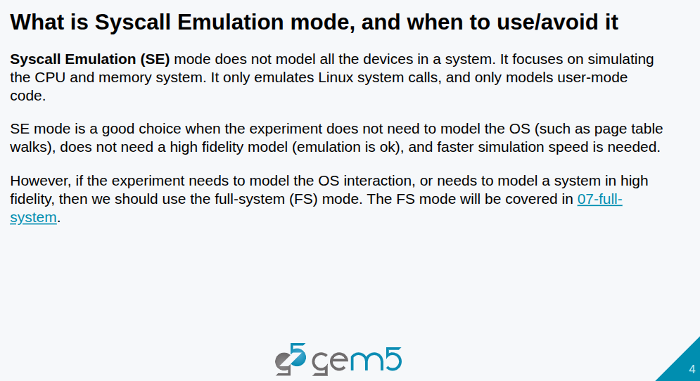
5.1 Run Gem5: Slides
https://gem5bootcamp.github.io/2024/#02-Using-gem5/03-running-in-gem5
Run Gem5: Slides

Slide 6
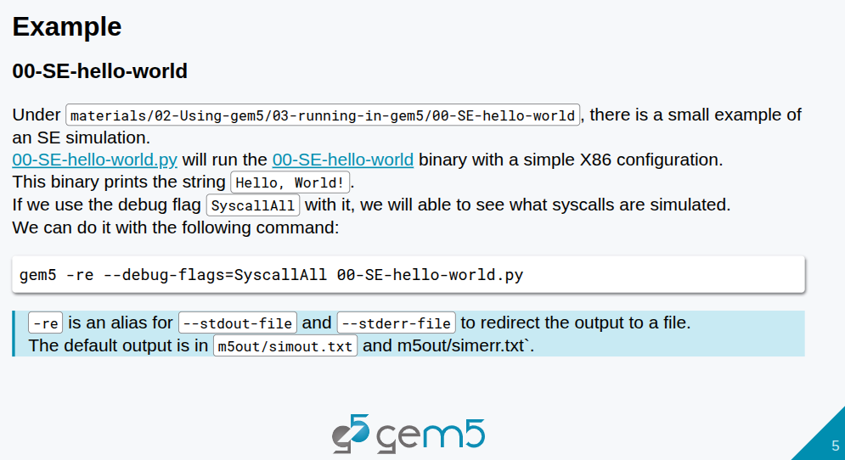
5.1 Run Gem5: Slides
https://gem5bootcamp.github.io/2024/#02-Using-gem5/03-running-in-gem5
Run Gem5: Slides

Slide 7
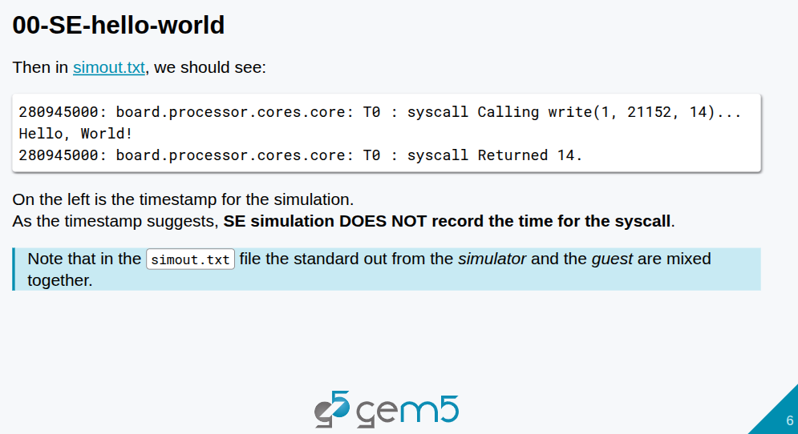
5.1 Run Gem5: Slides
https://gem5bootcamp.github.io/2024/#02-Using-gem5/03-running-in-gem5
Run Gem5: Slides

Slide 8

5.1 Run Gem5: Slides
https://gem5bootcamp.github.io/2024/#02-Using-gem5/03-running-in-gem5
Run Gem5: Slides

Slide 9
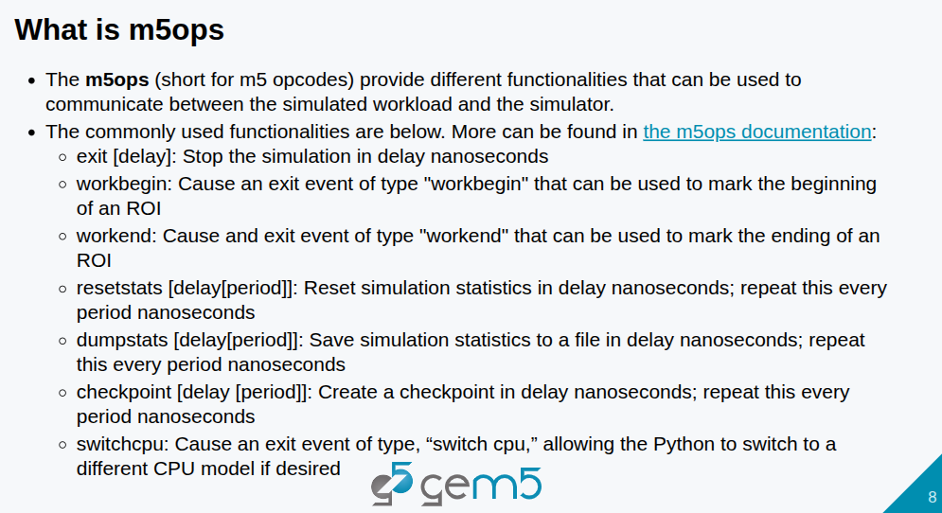
5.1 Run Gem5: Slides
https://gem5bootcamp.github.io/2024/#02-Using-gem5/03-running-in-gem5
Run Gem5: Slides

Slide 10
5.1 Run Gem5: Slides
https://gem5bootcamp.github.io/2024/#02-Using-gem5/03-running-in-gem5
Run Gem5: Slides

Slide 11
End

